Slide 1
Language Identification with Contextual Translation
Alex Shah

Slide 2
Initially:
English/Spanish only
But expandable

Slide 3
2 Main Components

Slide 4
Identify the Input Language
“Hola” → Es
“Hello” → En

Slide 5
Translate the input to the opposite language
“Hola” → Es → “Hello” (En)
“Hello” → En → “Hola” (Es)

Slide 6
Goals
Use latest and greatest models and methods
Doesn’t require training every detection/translation direction
Doesn’t require huge amount of training to add languages
Combine two networks in one product

Slide 7
Dataset
Europarl: A dataset in 21 languages comprised of European Parliament proceedings
Hand translated
En_Es dataset:
187 MB
1,965,734 sentences
51,575,748 words

Slide 8
Text Classifier
Use Convolutional Network (CNN) with a few specialized tweaks
Example: different languages use different accents/characters, this can tell us which language it is
Easiest part to get good accuracy
As little as 10 epochs of training could identify 140 char input sequences with 90%+ accuracy

Slide 9
Translation
A quickly evolving field
Accuracy and BLEU scores are an arms race
BLEU Score: automated metric to determine accuracy of translation compared to human translation
Contextual Translation
Take into account surrounding characters/words to translate more closely to a human translation
Gender agreement
Tenses
Advanced grammar structures

Slide 10
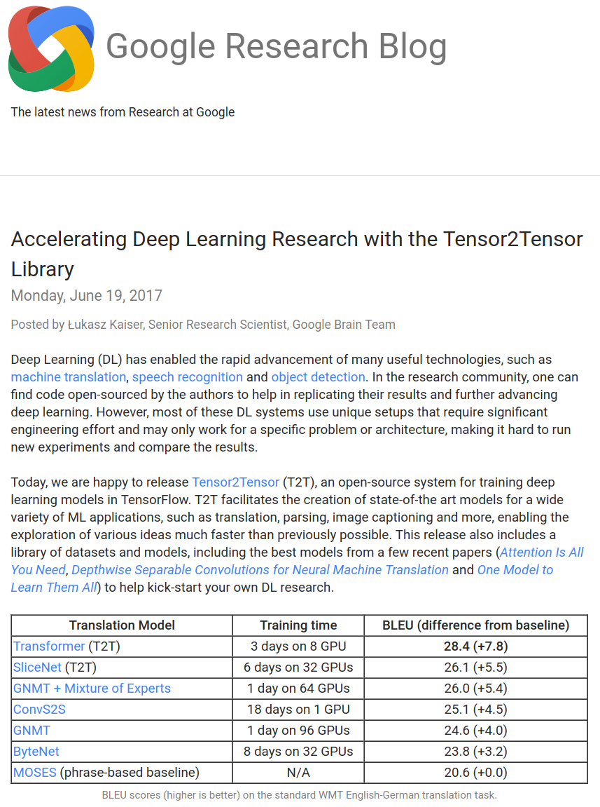
Google’s latest: Tensor2Tensor

Slide 11
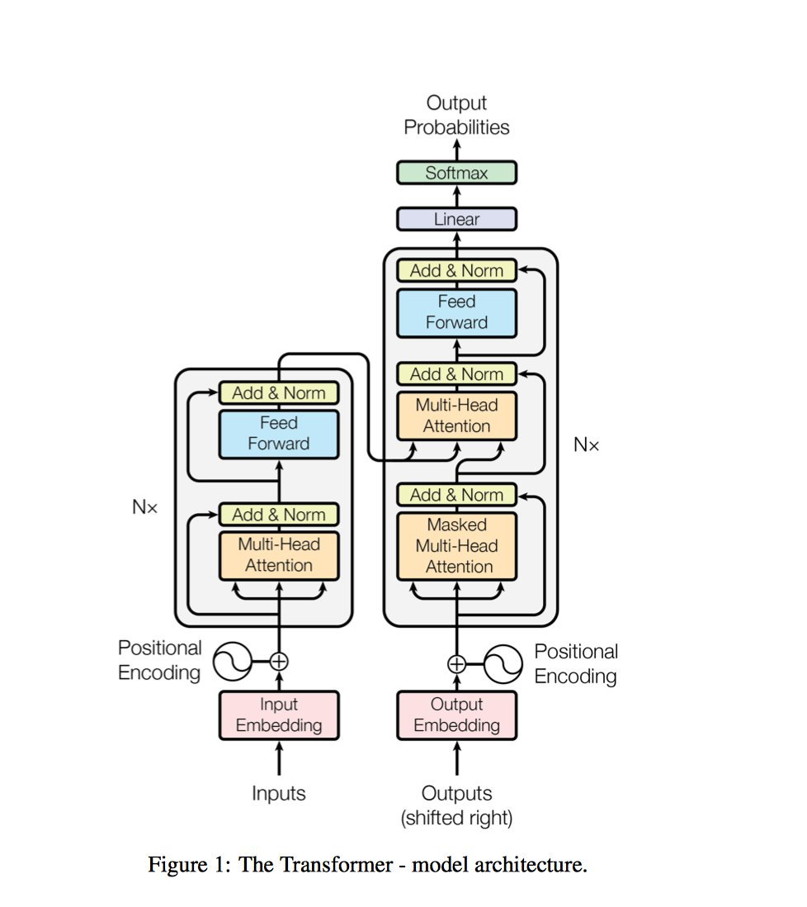
T2T
Transformer

Slide 12
Transformer model (Tensor2Tensor)
Pros:
Highest BLEU score to date
Training time/GPU requirements low in comparison to other methods
Cons:
Highly complex: You need a hands off approach to implement it
Use T2T as a library of models, can’t build from scratch

Slide 13
Efficiency
Training a new language in the classifier is easy
The classifier trains for all languages at once
CNN classifier is already highly accurate with little training time/power
Training a new language in the translation net is efficient
Adding a new language does not require retraining other languages.
All languages are trained into representations
Do not need to train every language pair, nor every direction
Translation treated like a feature set, just need to learn the features of the new language

Slide 14
Overview
Use latest and greatest models and methods
Specialized CNN → high accuracy, quick
Transformer (tensor2tensor) → highest BLEU score
Doesn’t require training every detection/translation direction
Doesn’t require huge amount of training to add languages
Combine two networks in one product
Classifier
Machine Translation
→ DIY Google Translate

Slide 15
Sources
https://research.googleblog.com/2017/06/accelerating-deep-learning-research.html
https://github.com/tensorflow/tensor2tensor
https://github.com/tensorflow/nmt
https://github.com/google/seq2seq
http://www.statmt.org/europarl/
https://nlp.stanford.edu/projects/nmt/
http://www.nltk.org/
https://research.googleblog.com/2017/07/building-your-own-neural-machine.html
I. Goodfellow, et.al, Deep Learning.

