Slide 1

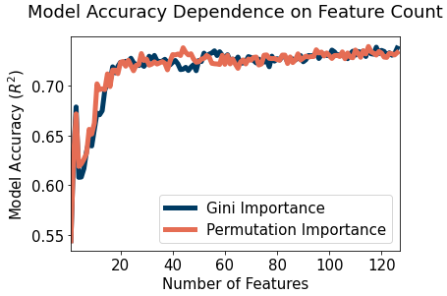

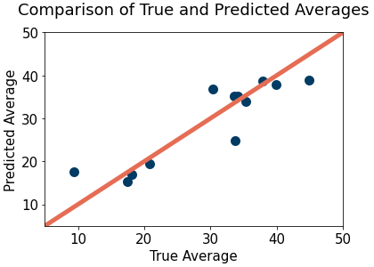


PREDICTING PLAYER PERFORMANCE IN CRICKET
QUT Science VRES 2022 Showcase
Alex Kenna
Supervisors: Prof. Chris Drovandi (QUT), Dr. Kate Saunders (QUT), Thomas Body (Cricket Australia), Charles Evans (QLD Cricket)
Introduction
Selection for international cricket is largely based on the perceived potential of a player using metrics not backed by empirical evidence. A consistent method for team selection is required. To achieve this, we developed a model to predict batter performance in One Day International cricket based on domestic performances. The model is intended to supplement the traditional metrics currently used.
Results
Discussion
Key takeaways of the results:
The model accuracy plateaus after the ~20 most important features.
The model accurately predicts whether a player has a low or high batting average. Most points are close to the diagonal, suggesting high accuracy.
Feature reduction and hyperparameter tuning provide significant increases to model performance. Using both, a player's predicted average is typically within 3.63 runs of their true average
͏Traditional metrics such as batting average are important in determining player performance.
Method
Random Forest model was developed from a summary of player domestic and international performances. Clustering and Recursive Feature Elimination were used to determine the most important domestic metrics. Random Search and Grid Search were used to optimise the model’s hyperparameters.
STEPS
Data cleaning and summarisation.
Feature selection.
Hyperparameter tuning.
Model Testing
Model accuracy using n most important features (Gini and Permutation importance).
Comparison of true and predicted batter averages.
Conclusion and Future Work
Using the developed model, we have been able to:
Accurately predict player One Day International batting averages (11% increase compared to traditional metrics).
Determine the most important features of a batter’s domestic career.
Future work includes:
Extension to include women’s formats.
Removal of specialist bowlers from the dataset.
Further testing as new data becomes available.
Model Performance
 | MAE | RMSE | R²
Base Model | 4.55 | 5.77 | 0.68
Feature Reduced Model | 4.00 | 5.07 | 0.75
Tuned Model | 4.02 | 5.27 | 0.74
Reduced + Tuned Model | 3.68 | 4.72 | 0.79
Domestic Metrics
Batting Position
Team Highest Scorer %
Start Rate
Team Run Contribution
Average Ball Count
Match Count
Batting Average
High Score
Four Rate
50 Rate
Data
Initial dataset of 1,112,051,876 datapoints was reduced to 546,035,948 after cleaning (handling missing data, outliers, etc.).
Cleaned dataset reduced to 8,060 datapoint summary of 62 eligible players.
Model comparison using Mean Absolute Error, Root Mean Squared Error, and Coefficient of Determination (R²).
References
Pedregosa, F., Varoquaux, G., Gramfort, A., Michel, V., Thirion, B., Grisel, O., ... Duchesnay, E. (2011). Scikit-learn: Machine Learning in Python. Journal of Machine Learning Research, 2825-2830.
Queensland University of Technology Department of Mathematics
qut.edu.au
Sample of most important domestic metrics (ordered).
Notes:
Predicting Player Performance in Cricket
Effective player selection is critical for team performance in cricket. This is especially true at the international level, where the best players are selected to represent their nation, largely based on their perceived potential. However, without an accurate method for predicting the performance of batters, selections are often made based on traditional metrics deemed important with little empirical evidence, such as domestic batting averages. This project aims to develop a method for predicting batter performance at the international level based on their domestic careers. In doing so, we will identify and quantify the most important metrics for determining international success. This is achieved through the derivation of a Random Forest model that uses domestic data to predict the batting average of a player in One Day International cricket. The model is fitted based on a subset of domestic metrics determined to be most important through feature selection techniques including recursive feature elimination and clustering. This enables the development of a model that is explainable, efficient, and accurate. Experimentally, the results support the idea that player performance is largely determined by the traditional metrics currently used for player selection. They also provide insight into lesser-known metrics, such as which domestic formats produce better international batsmen and how a batter’s contribution to their team translates to international performance. These results allow us to identify the features of a batter’s domestic career that have the most significant influence on international performance. This has practical implications in team selection, talent identification and player comparison.

