Slide 1

Numerical integration
in the restricted three-body problem
Building a tool for studying motion in the Earth–Moon system
“Start in Science” Olympiad
MIPT, 2026
Alexander Klyuchnikov
Supervisor
V. A. Babintsev, Associate Professor, Dept. of General Physics, MIPT

Slide 2
Introduction
The three-body problem
CR3BP
Rotating frame
A classical problem
of celestial mechanics.
No analytical solution
exists
Two massive bodies
move on circular orbits.
The third body has negligible mass
The Earth and Moon are stationary.
Coriolis and centrifugal
accelerations appear
The circular restricted three-body problem is the basic model for studying dynamics in the Earth–Moon system
1 / 16

Slide 3
Relevance and existing tools
The CR3BP is the basic model of Earth–Moon dynamics. No analytical solution exists
Tool | CR3BP | 3D | Thrust | Jacobi | Web
GMAT (NASA) | ● | ● | ● | − | −
STK (Ansys/AGI) | − | ● | ● | − | −
Universe Sandbox | − | ● | ● | − | −
PhET Simulations | − | − | − | − | ●
Desmos | − | − | − | − | ●
“Orbit. Challenge” | − | ● | − | − | ●
rocketlauncher.space | ● | ● | ● | ● | ●
I looked for an existing simulator and found none
2 / 16

Slide 4
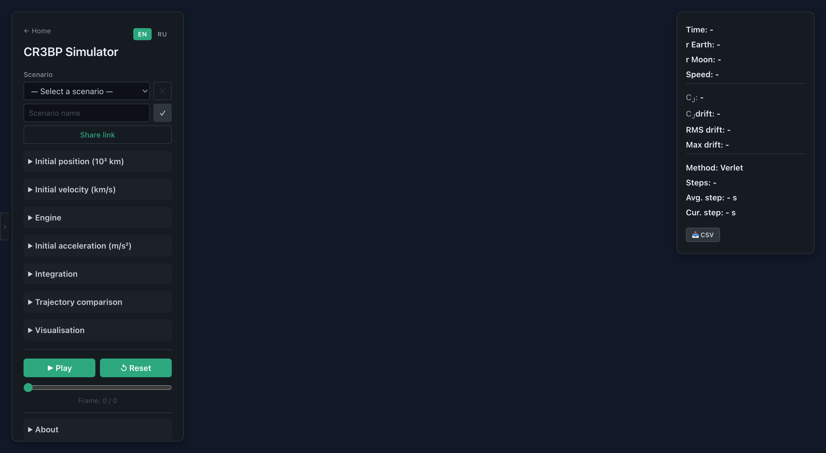

https://rocketlauncher.space
● 3D visualisation of the Earth–Moon system
● Three integrators with Jacobi-based accuracy control
● Engine with a configurable thrust window
● Lagrange points L1–L5
3 / 16

Slide 5
Aim and objectives
Building an educational web simulator for trajectories in the Earth–Moon system
1
Study the theoretical foundations of the CR3BP
4
Implement the Verlet method and compare its accuracy with Euler
2
Derive the equations of motion in a rotating frame
5
Find the Lagrange points L1–L5 numerically
3
Implement trajectory computation using the Euler method
6
Create an interactive 3D web simulator
4 / 16

Slide 6
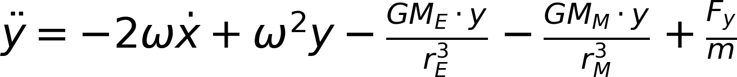
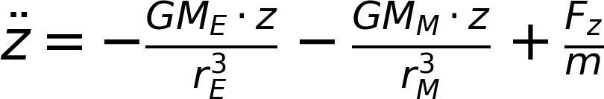
Mathematical model
Equations of motion in the rotating frame:
G
Mₑ, Mₘ
dₑ, dₘ
rₑ, rₘ
ω
m = M - 𝛌t
grav. constant
body masses
from the barycentre
to the centres of mass
angular velocity
fuel mass
2ωẏ and −2ωẋ — the Coriolis acceleration. It depends on velocity
+ thrust model: F = const within the window [t_on, t_off]
5 / 16

Slide 7
Scope of applicability
01
02
03
Circular orbit
Negligible spacecraft mass
No Sun
The Moon's orbit is treated as circular
(actual eccentricity = 0.055)
The spacecraft's mass is negligible
compared with the Earth and the Moon
The attraction of the Sun and other
bodies is not taken into account
The model is valid for qualitative study
of the dynamics and for educational use
Real missions are designed with
full ephemeris models
6 / 16

Slide 8
Three integrators
The Euler method
Verlet with explicit Coriolis handling
Verlet with iterative velocity correction
Simple, order O(h)
Does not conserve energy
Symplectic, O(h²) in theory
But Coriolis spoils it
Degrades to O(h) in the CR3BP
3 iterations per step refine v
Restores order O(h²)
O(h)
O(h) in the CR3BP
O(h²)
The Coriolis acceleration 2ω × v depends on velocity → Verlet with explicit Coriolis handling loses its order → iteration restores O(h²)
7 / 16

Slide 9
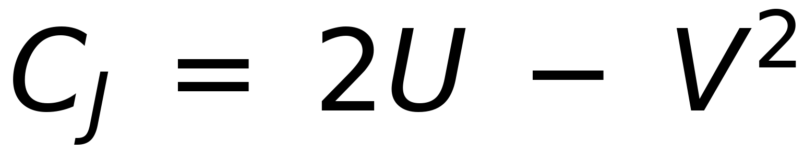
The Jacobi integral
The only conserved quantity in the CR3BP
< 0.001%
< 0.01%
< 0.1%
> 0.1%
Excellent
Good
Acceptable
Poor
8 / 16

Slide 10
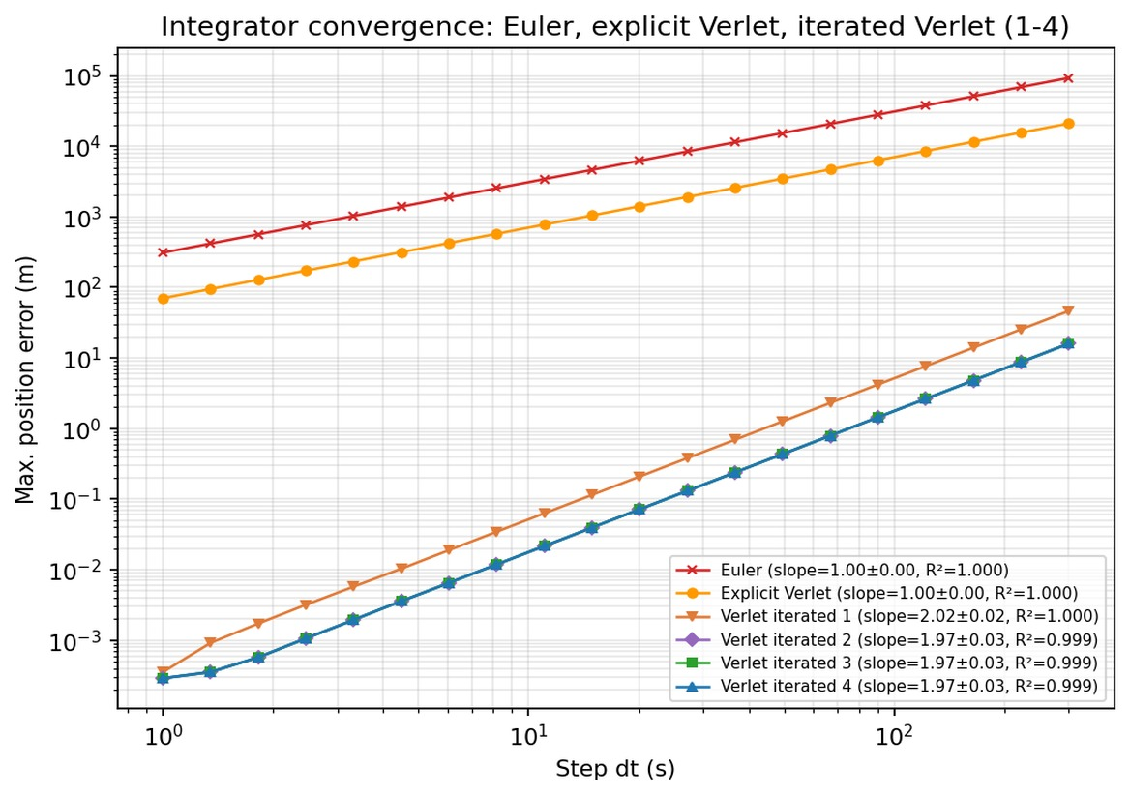


Log-log convergence
Euler
Explicit Verlet
Iterative Verlet
dt = 30 s | R² = 0.999
Euler: 8,400 m
Explicit Verlet: 1,900 m
Iterative Verlet: 0.13 m
64,600× more accurate in position
9 / 16

Slide 11
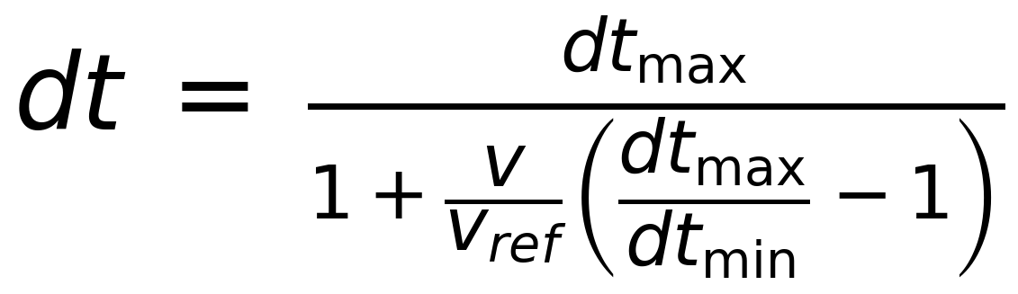
Adaptive step
Near a body 1/r grows → a smaller step is needed
Far from the bodies
Transition zone
Near a body
→
→
dt = dt_{max}
Forces are small, the step is at its maximum
dt decreases
in proportion to v
dt ≈ dt_{min}
Forces are large, the step is at its minimum
10 / 16

Slide 12
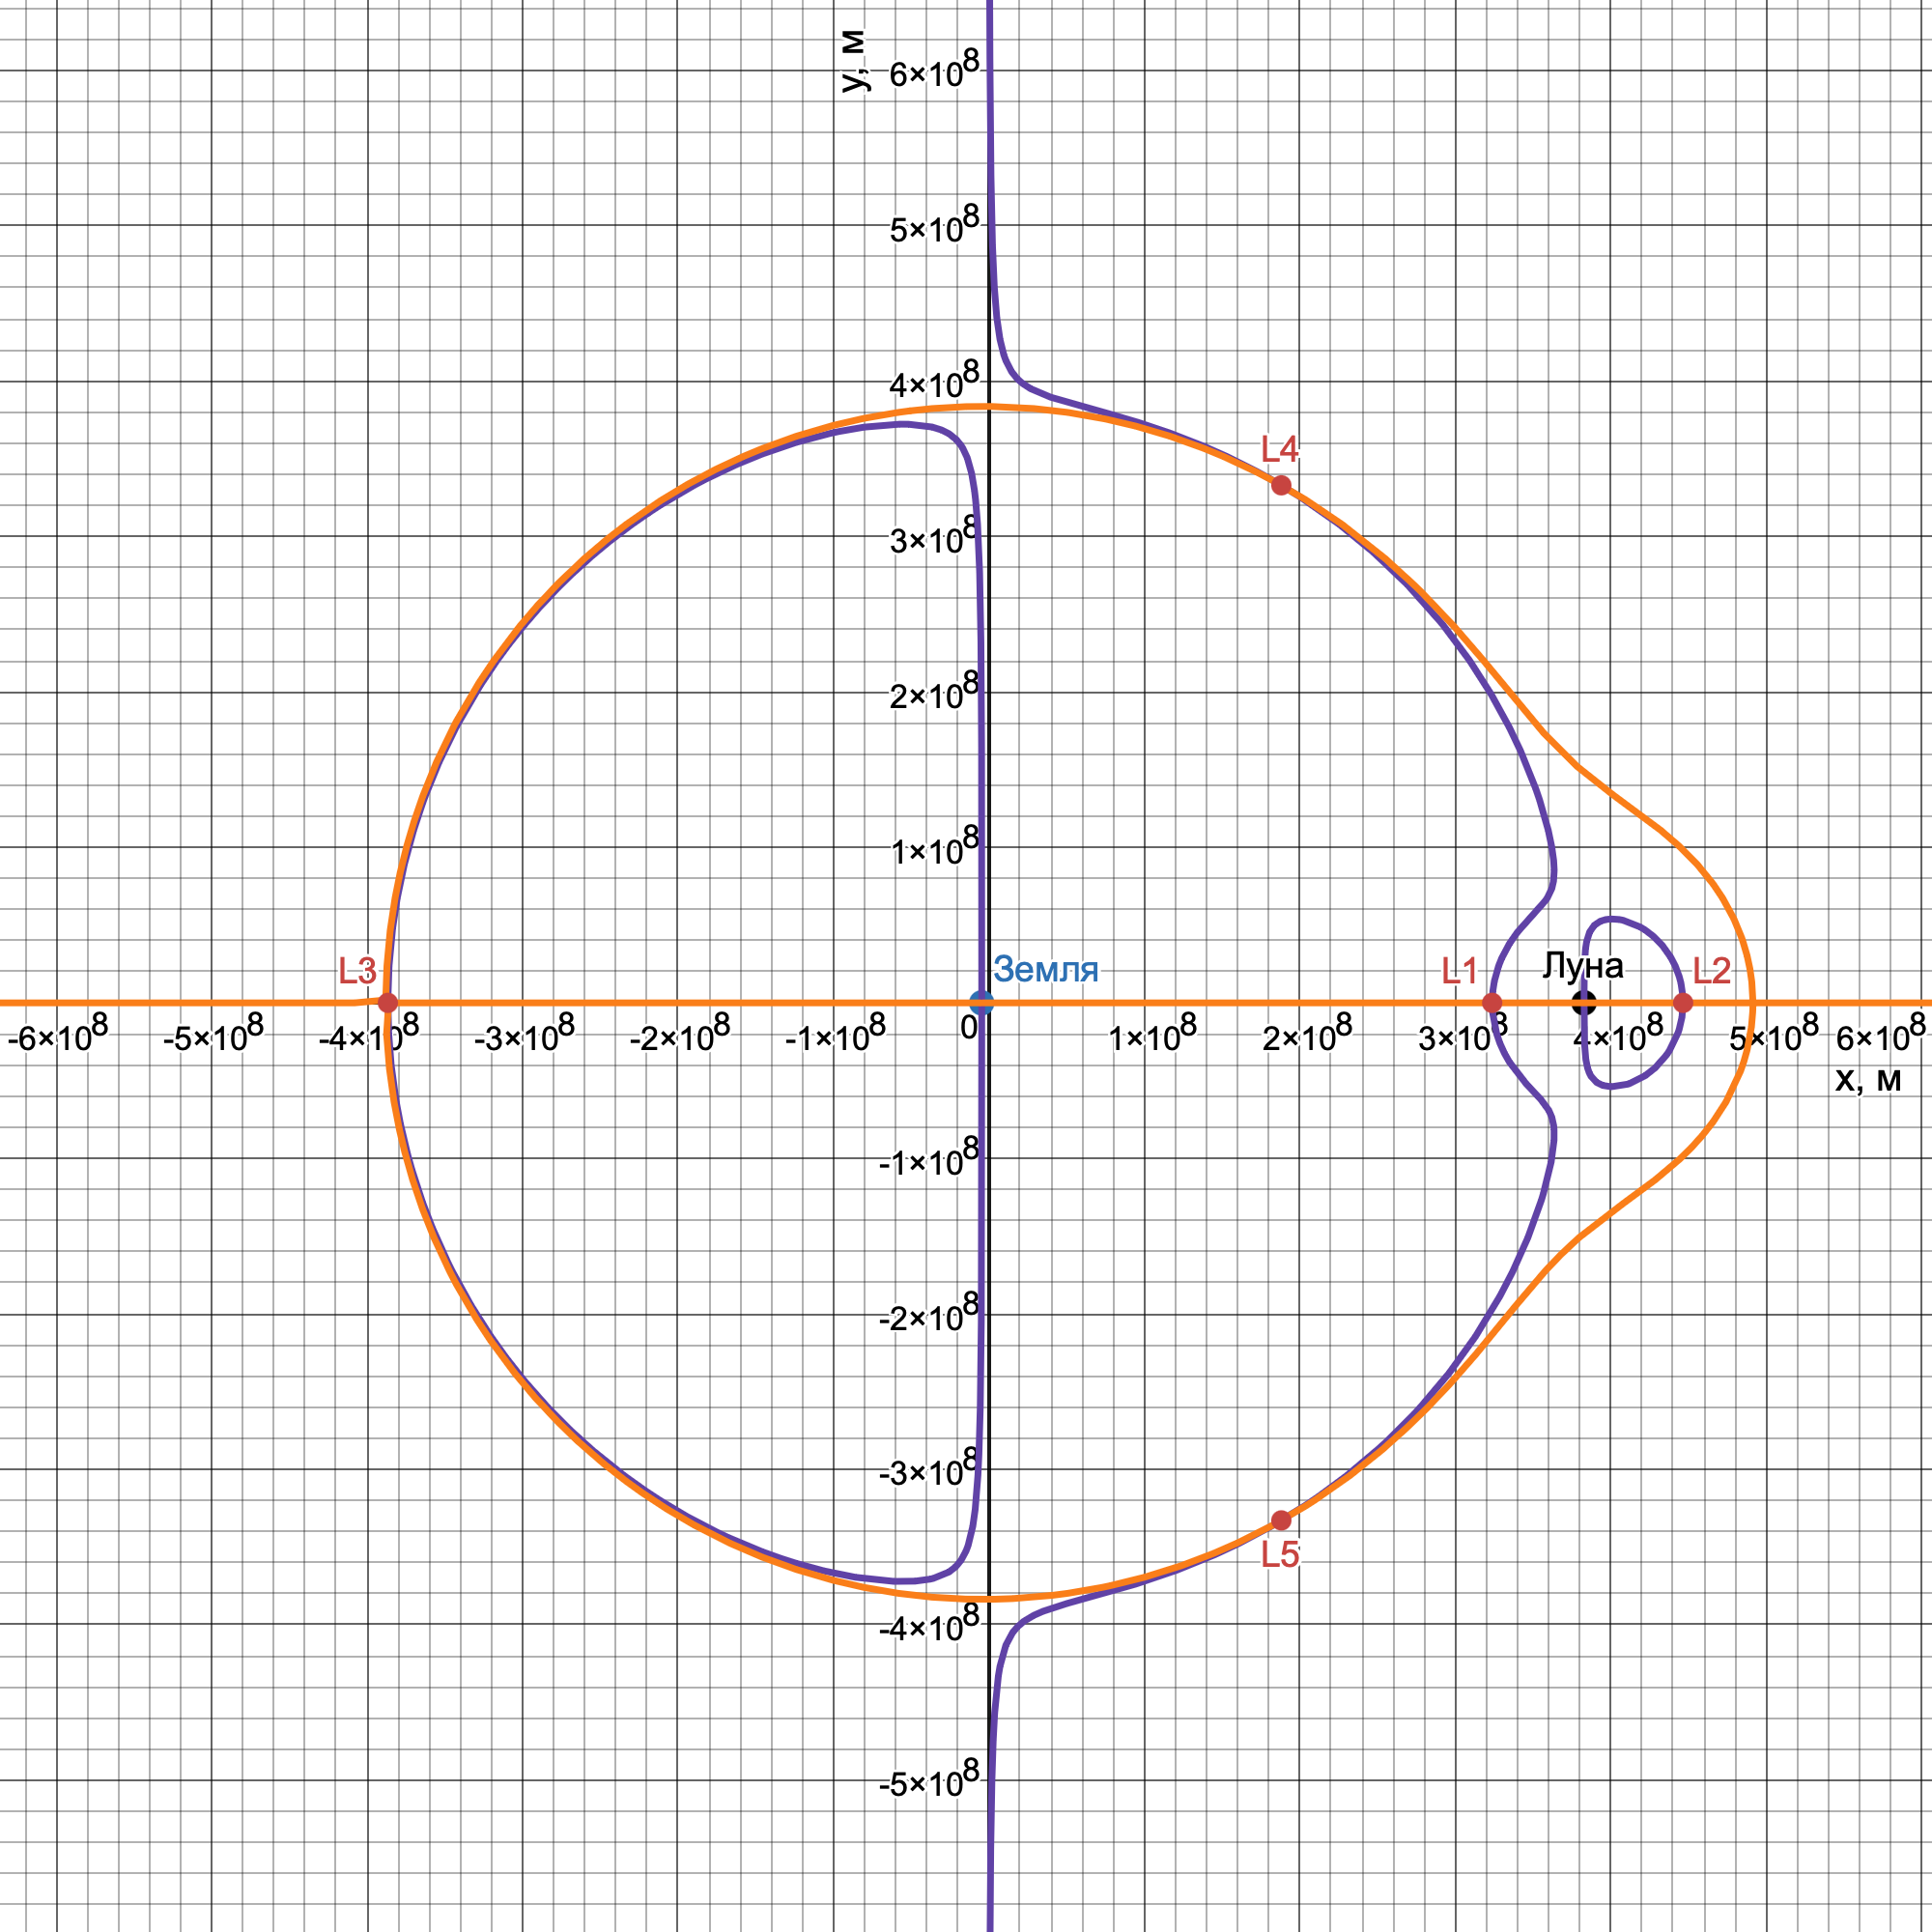
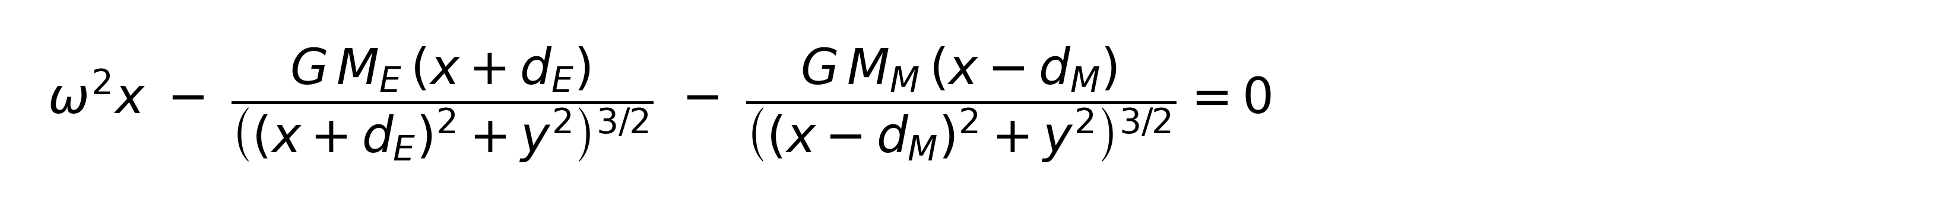
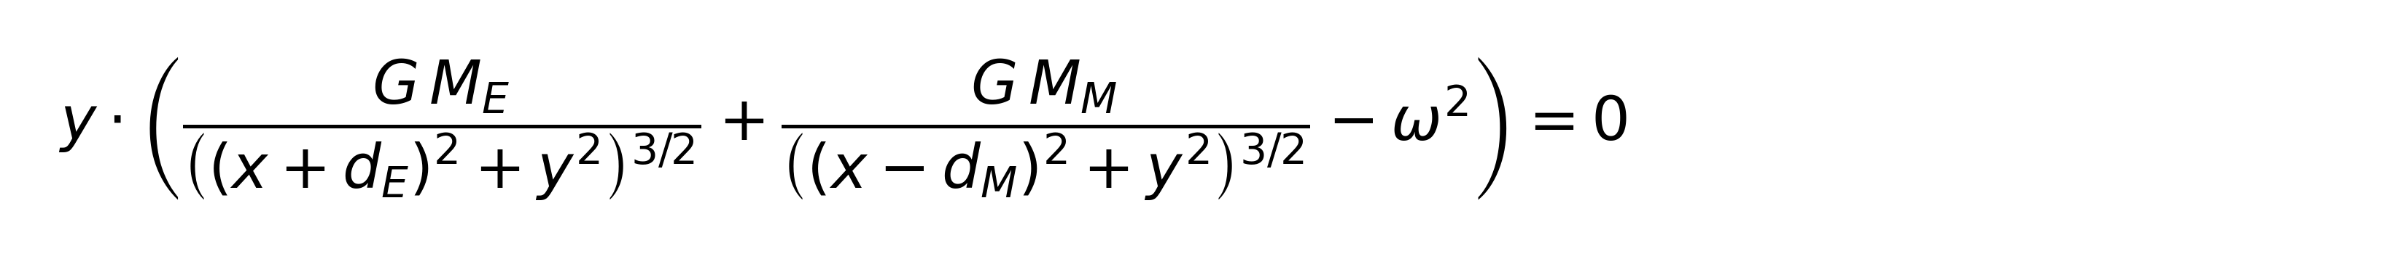
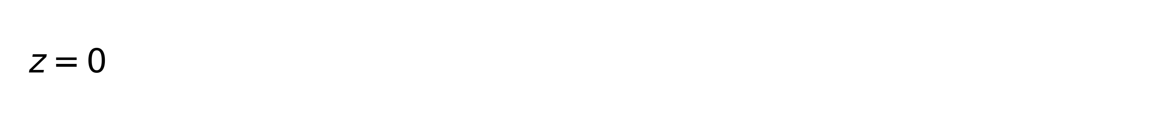
Locating the Lagrange points: Desmos
Graphical analysis of the total acceleration in Desmos
From graph to algorithm
The graphical investigation led to formalising the bisection method for locating the Lagrange points automatically
11 / 16

Slide 13
Lagrange points L1–L5
5 equilibrium points of the Earth–Moon system
Point | x, km | y, km | Method | Resid. accel., m/s²
L1 | 323 696 | 0 | Bisection | < 10⁻¹⁸
L2 | 446 531 | 0 | Bisection | < 10⁻¹⁸
L3 | −386 651 | 0 | Bisection | < 10⁻¹⁸
L4 | 188 081 | 332 925 | Newton | < 10⁻¹⁸
L5 | 188 081 | −332 925 | Newton | < 10⁻¹⁸
Desmos graph → sign change → bisection → accuracy < 10⁻¹⁸ m/s²
Analytical approximations (Hill sphere) give a relative error of 0.4–0.8% — the numerical solution is more accurate
12 / 16

Slide 14
Personal contribution
Physics
Derivation of the CR3BP equations of motion in a rotating frame
Validation
Implementation of the Jacobi integral as an accuracy-checking tool
Num. methods
3 integrators; discovering the degradation of Verlet and implementing the variant with iterative velocity correction
Experiments
A series of 7 computational experiments for quantitative verification
Algorithms
Locating the Lagrange points L1–L5: bisection + Newton's method
Development
3D web simulator + scripts for finding initial conditions
13 / 16

Slide 15
Directions for development
Elliptical orbit
Solar gravity
Radiation pressure
Accounting for the Moon's eccentricity
Extension to the four-body problem
Accounting for solar radiation pressure
Station keeping
Laboratory exercises
Holding the spacecraft near a halo orbit
A set of assignments built on the simulator
14 / 16

Slide 16
Conclusions
✓
The theoretical foundations of the CR3BP were studied and the equations of motion derived
✓
3 integrators were implemented. Verlet with iterative velocity correction is 64,600× more accurate than Euler
✓
The Lagrange points L1–L5 were found numerically (resid. accel. < 10⁻¹⁸)
✓
The model was verified by a series of 7 numerical experiments
✓
An educational 3D web simulator was built and published online
15 / 16

Slide 17

Thank you for your attention
MIPT · Start in Science · 2026 · Alexander Klyuchnikov
16 / 16

Slide 18
Appendix
Supplementary material for answering questions

Slide 19
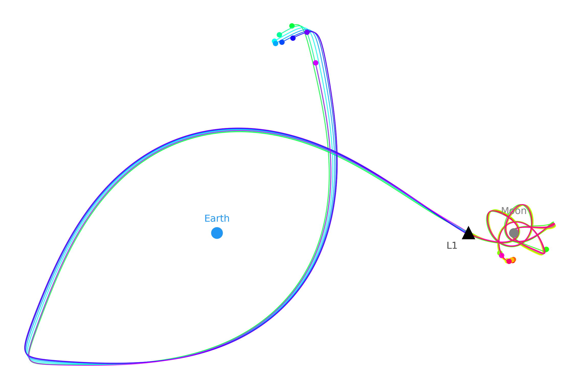
Chaos at L1
Δv₀
10 m/s
Lyapunov exponent λ
0.64 day⁻¹
Predictability horizon
~2 days
Directions / time
16 / 30 days

Slide 20
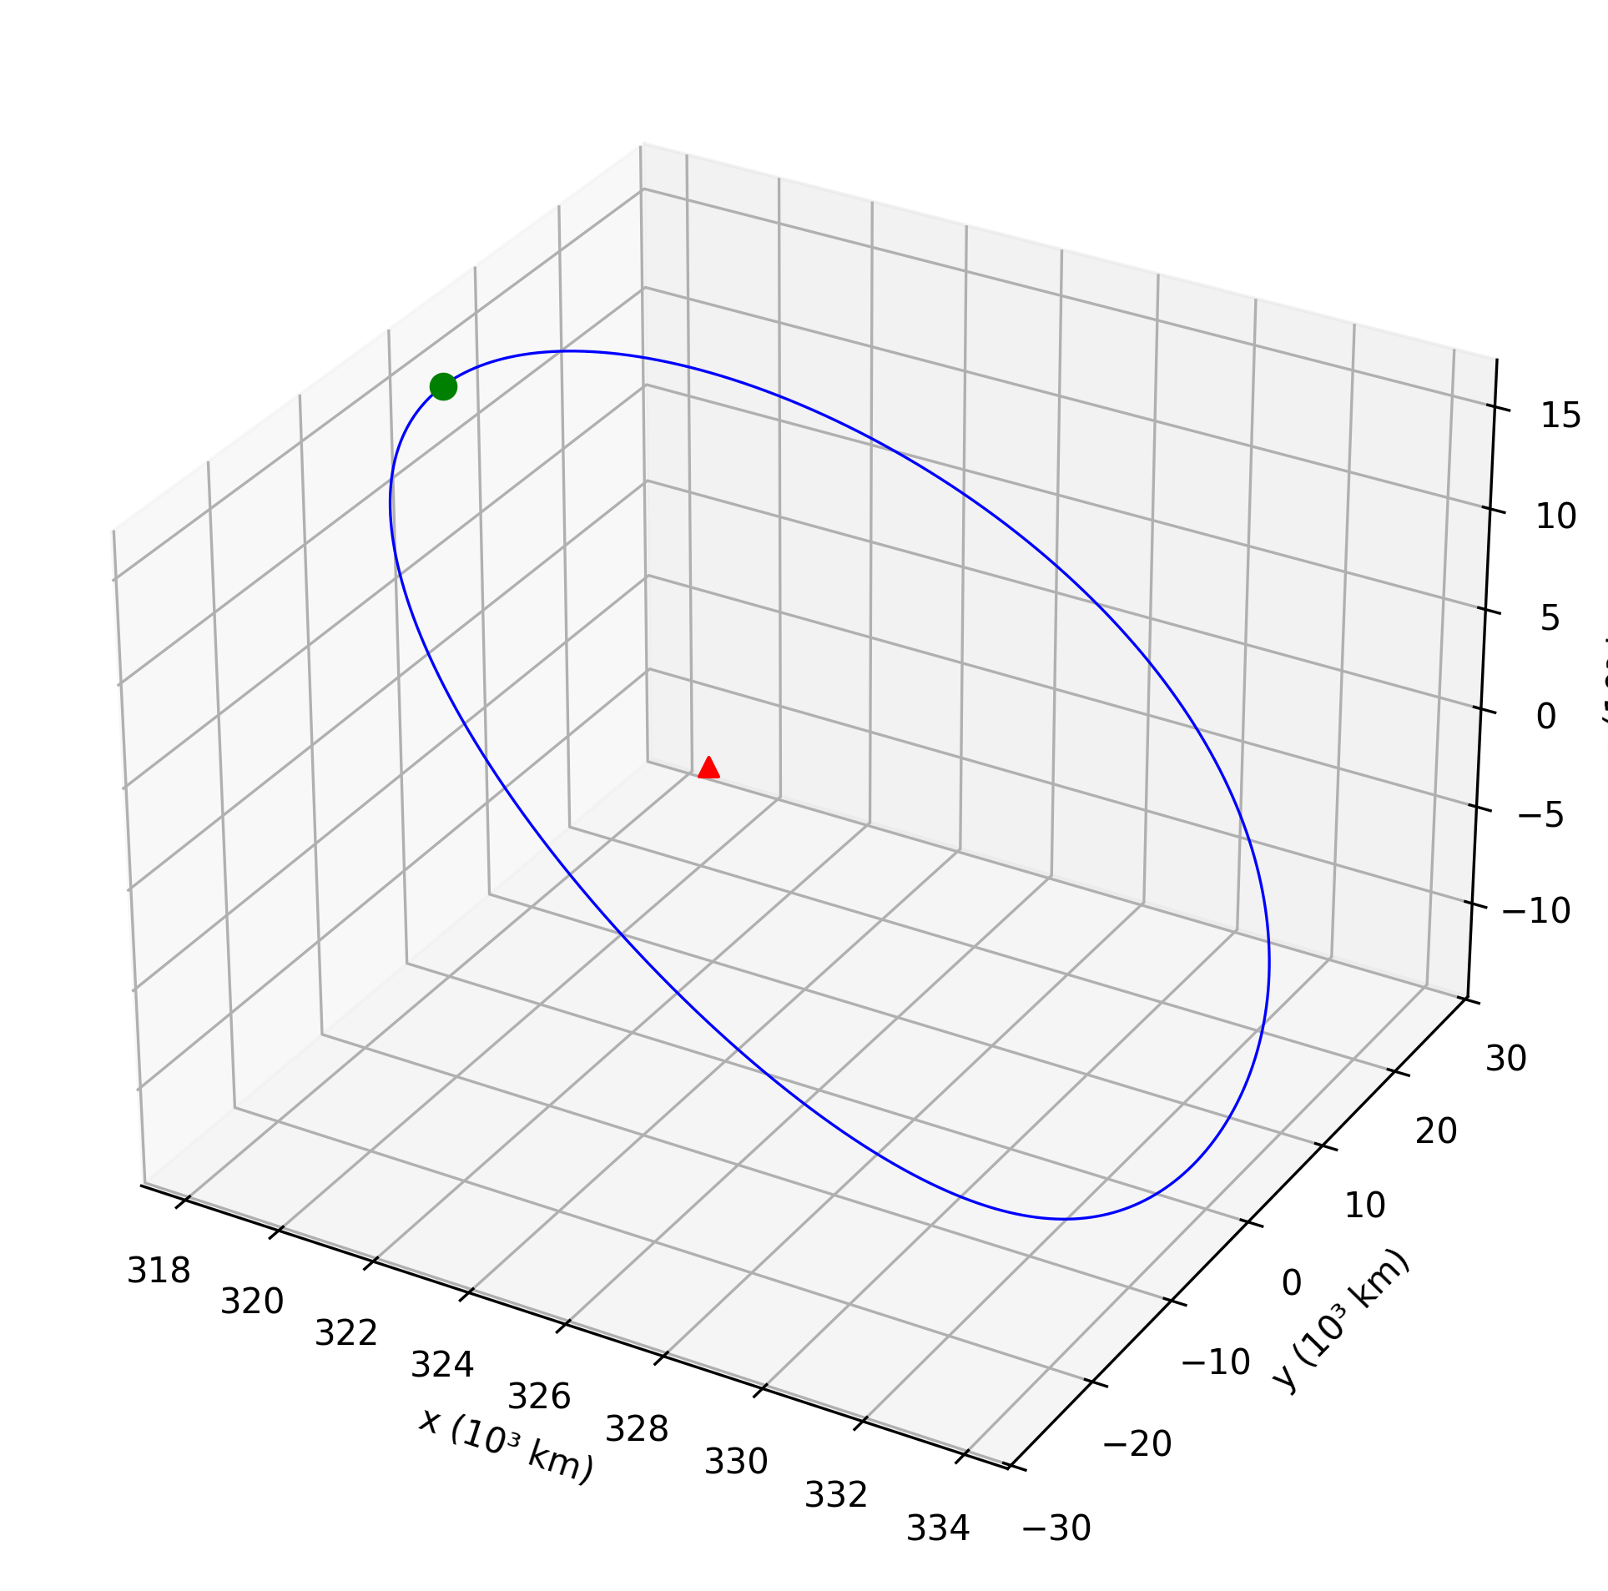
Halo orbit at L1
Amplitude Az
15,000 km
Period
293 h (12.2 days)
Closure error
3.6 km
Jacobi drift
3.8 × 10⁻¹¹

Slide 21
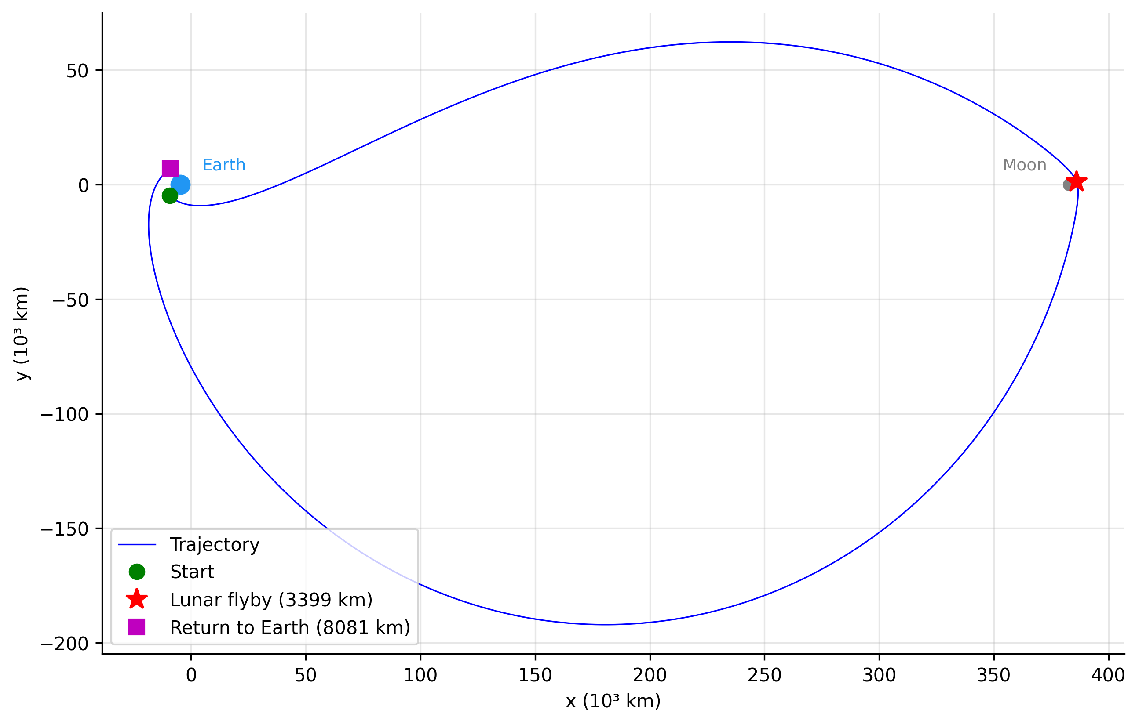
Free return
Lunar flyby
3,399 km
Return to Earth
8,081 km
Flight time
168 h
+1 m/s → Δr Moon
+89 km

Slide 22
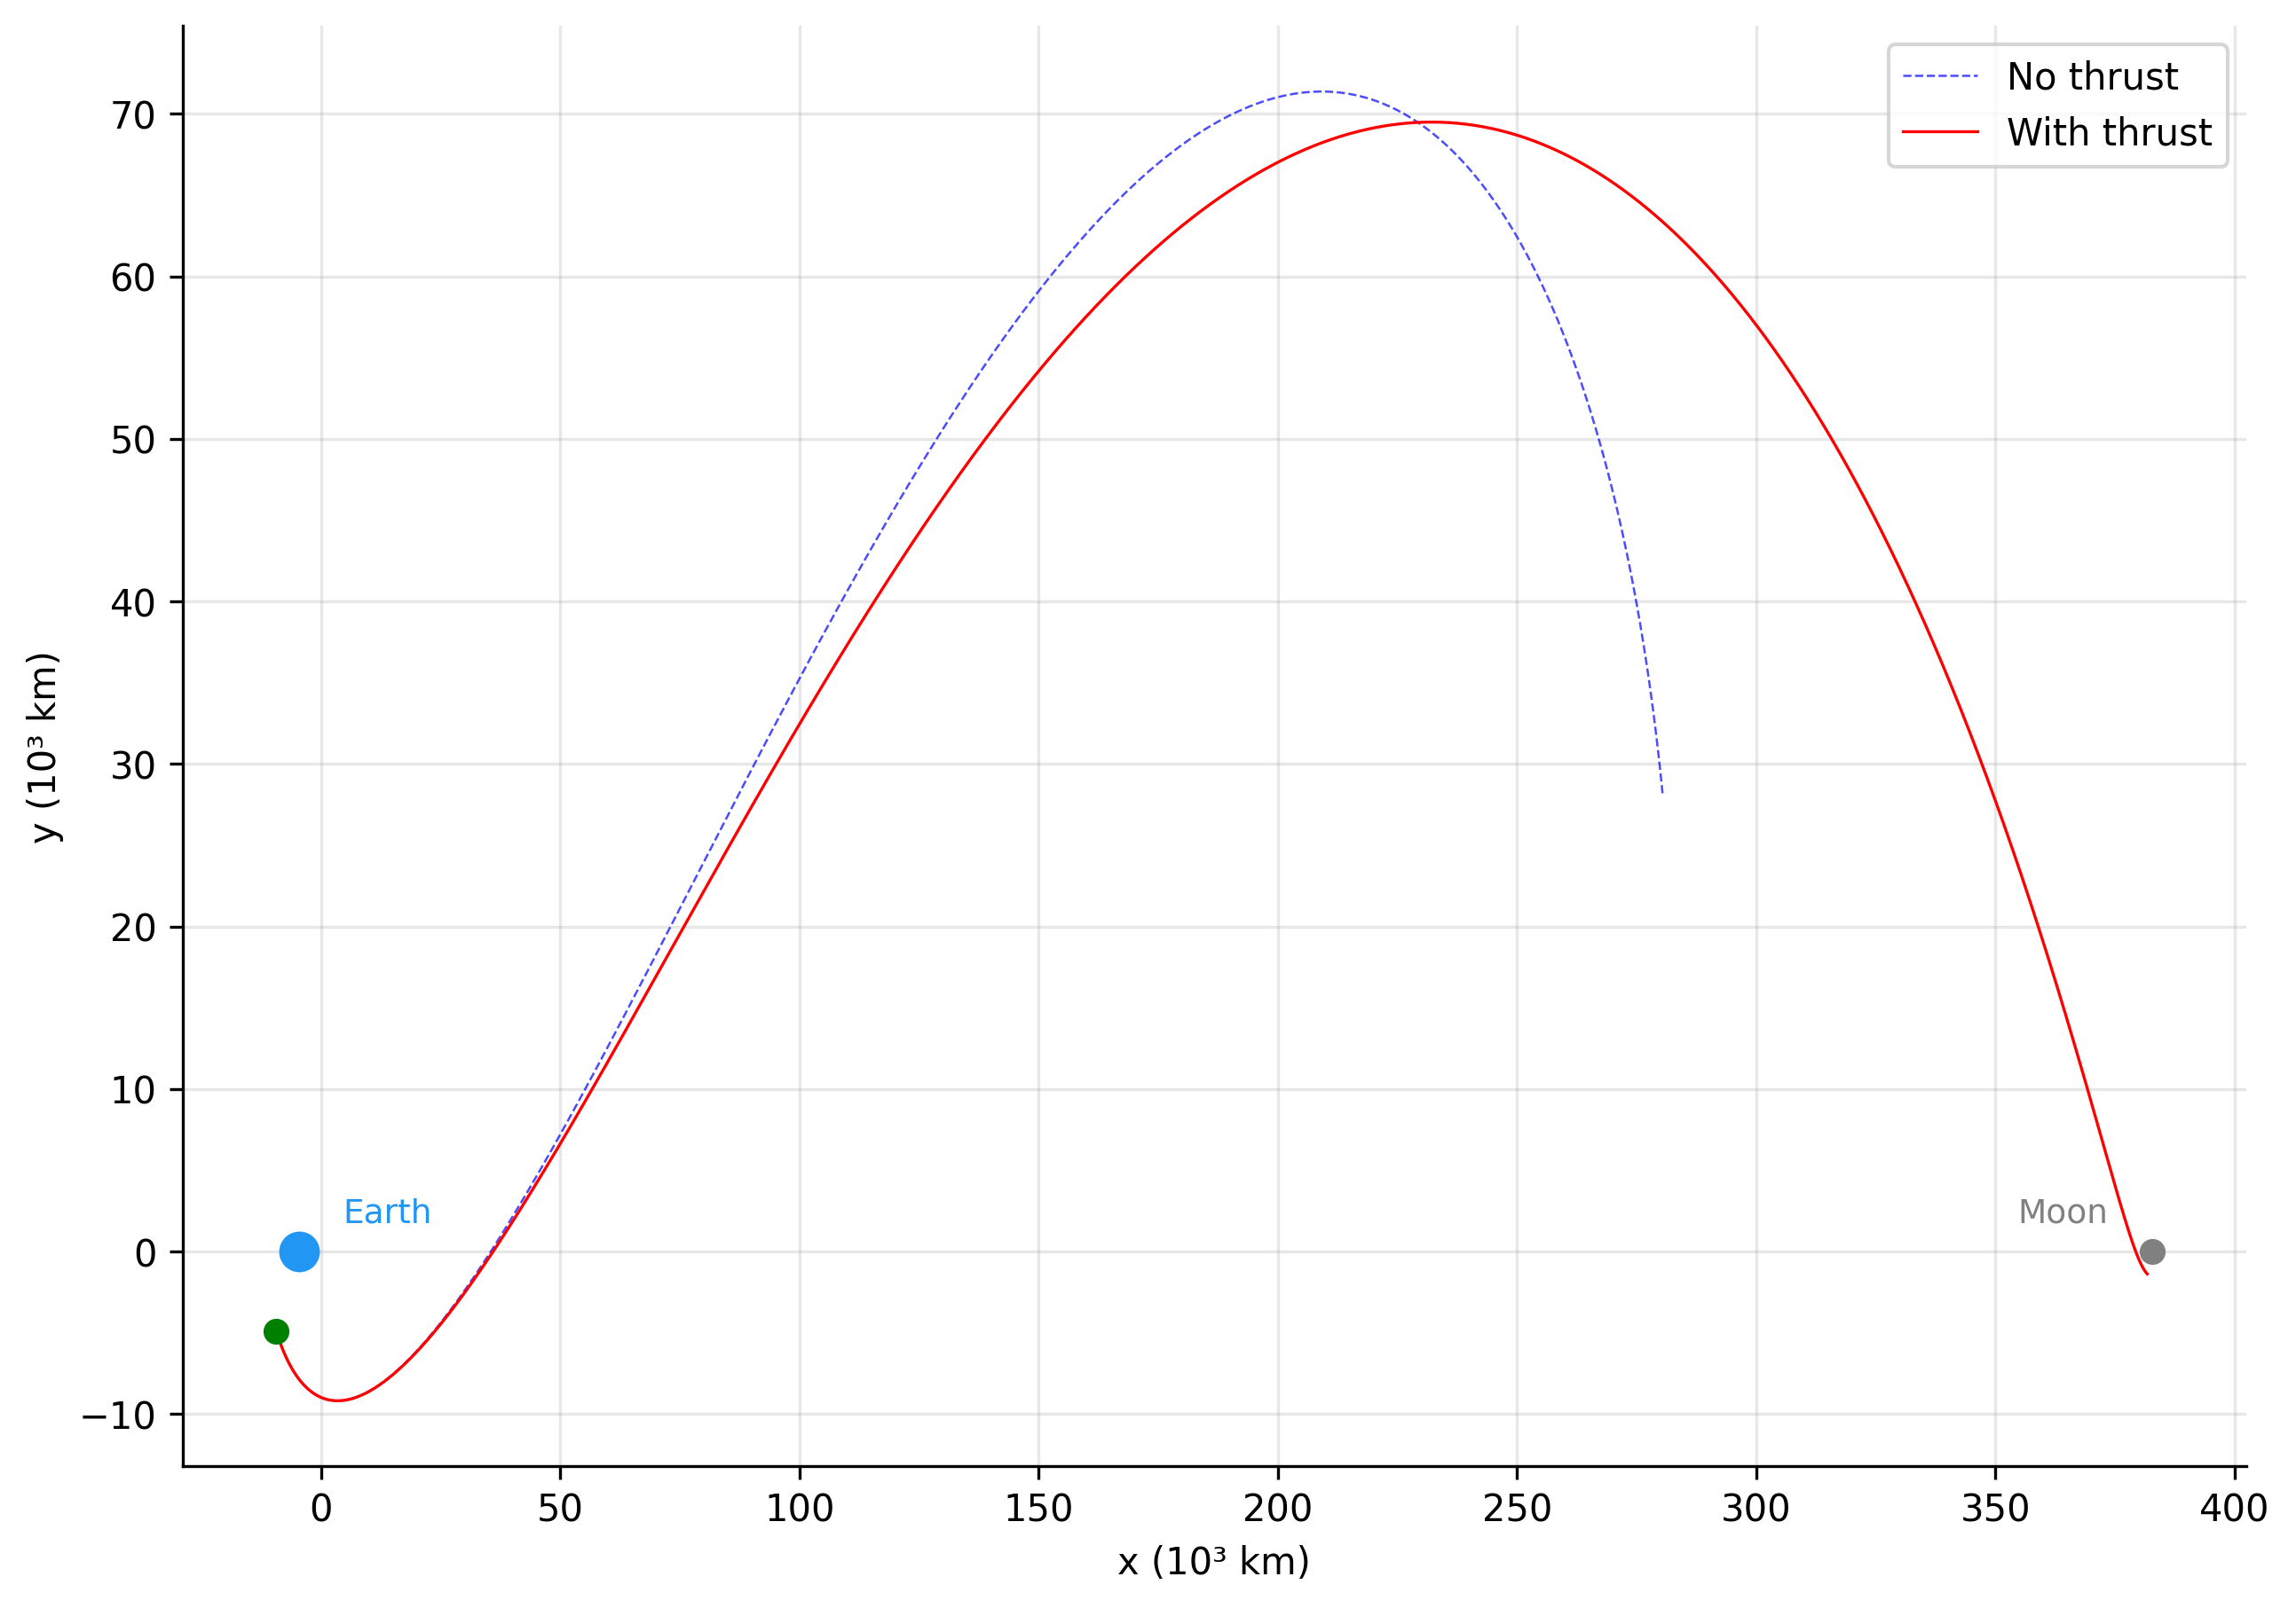
Powered transfer
Thrust / duration
5 N / 3 h
Δv
108 m/s
Lunar flyby
2,494 km
Fuel
18 kg (3.6%)

Slide 23
Integrator comparison
Jacobi integral drift, halo orbit at L1, dt = 30 s, T = 720 h
Integrator | Mode | Max. drift
Euler | fixed | 2.2 × 10⁻⁶
Verlet half-step | fixed | 1.1 × 10⁻⁶
Verlet iterated | fixed | 3.8 × 10⁻¹¹
58 000×
64 600×
by Jacobi drift
by position error

Slide 24
A ready-made tool for laboratory work
The simulator is ready for classroom use — no installation, runs in the browser
01
02
03
04
Halo orbits
Free return
Chaos and Lyapunov
Thrust optimisation
Parametric study:
period, closure error, Jacobi drift
Sensitivity to initial
conditions, lunar flyby
Predictability horizon,
divergence of trajectories
Choosing the engine
firing window for a manoeuvre
Browser access · No installation · 7 ready-made experiments · Open source

Slide 25
Technical stack
3D simulator
Experiments
Deployment
Tools
JavaScript · Three.js
HTML · CSS
~1,500 lines
Python · NumPy
SciPy (RK45 for validation)
Matplotlib · 7 scripts
VPS Beget.com
1 vCPU · 1 GB RAM
NVMe SSD · 210 ₽/month
Git · GitHub
Desmos (exploring L1–L5)
Python ~2,500 lines
All code written from scratch · Three.js + Python + NumPy · VPS at 210 ₽/month

Slide 26
References
[1]
V. V. Beletsky — Essays on the Motion of Celestial Bodies
[2]
G. N. Duboshin — Celestial Mechanics: Principal Problems and Methods
[3]
D. E. Okhotsimsky, Yu. G. Sikharulidze — Fundamentals of Space Flight Mechanics
[4]
A. A. Tselousova — Numerical-Analytical Methods for Constructing Trajectories in the Three- and Four-Body Problems
[5]
Dmitri Rozmanov, Peter G Kusalik - «Robust rotational-velocity-Verlet integration methods»

Slide 27
Project timeline
Sep 2025
Mar 2026
1
2
3
4
5
6
7
8
9
CR3BP theory
2D Python
3D Three.js
Verlet
Lagrange
Adaptive step
Trajectories
Num. experiments
Publication
7 months: from theory to publication on the web

Slide 28
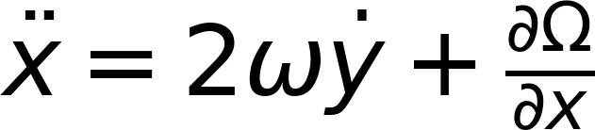
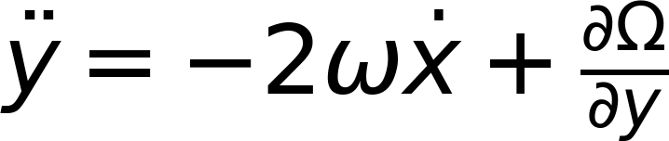
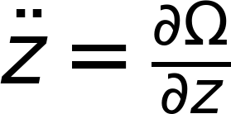
Derivation of the equations of motion
The equations of motion expressed via the effective potential:
Ω
ω
rₑ, rₘ
dₑ, dₘ
G
Mₑ, Mₘ
eff. potential
angular velocity
to the centres of mass
from the barycentre
grav. constant
body masses
2ωẏ and −2ωẋ — the Coriolis terms; they are not part of Ω

