Slide 1


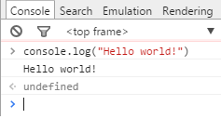
Lab work #1 1/2
Get practice the Web Console First Using:
Open any browser
Press F12
In console command line write:
console.log("Hello world!")
Press Enter to execute
Get the result:

Slide 2
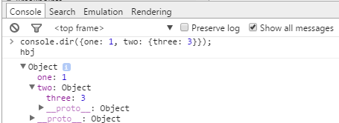
Lab work #1 2/2
console.dir({one: 1, two: {three: 3}});
Notes:
In JavaScript there are:
[] – array
{} – hash table
More about this terms you will be see later.

Slide 3
Lab work #2
Please create the web page:
Ask to input two numbers with a prompt dialog window
Do the converting as it necessary
Ask to input an arithmetic operator
Output the calculated result in the web console
Please validate code with online validator end errors
Notes:
Describe all elements

Slide 4
Lab work #3
Create program for the following algorithm
Input balls from 0 to 100.
Output the received assessment according to the rules:
А 100-95
B 85-94
C 75-84
D 65-74
E 60-64
FX 0-59

Slide 5
Lab work #4
Prompt the user to input the marks of 5 subjects of a student. Display if he has passed in each subject if mark is above 60 else use break for
Build a numerical calculator. Ask user for two inputs (numbers). Ask user for what function to perform:
1. Addition,
2. Subtraction,
3. Multiplication
4. Division.
Display the result accordingly. And loop the code while user prompts – “That’s all”

Slide 6
Lab work #5
Write code to create an array of 5 Cars
Car has following properties:
FirmName (string)
ModelName (string)
EngineDisplacement (float)
All parameters to prompt by user
Output all Cars that has Engine Displacement > 2.0

Slide 7
Lab work #6
Demonstration:
Please create function without arguments, that alerts the number of arguments and there names
Please call this function several times with a different values amount.
Notes:
function func() {
for(i=0; i<arguments.length; i++) {
alert(" arguments["+i+"] = "+arguments[i])
}
}
func('a','b',true)
// arguments[0] = a
// arguments[1] = b
// arguments[2] = true

