Slide 1
Valuation Flex Capacity E-Boilers per Flex Market
Tom Lemmens

Slide 2
Aim
Determine value of e-Boiler as flex asset on three flex markets:
R1 – frequency control
Passive imbalance
R2 – reserve capacity (contracted vs voluntary)

Slide 3
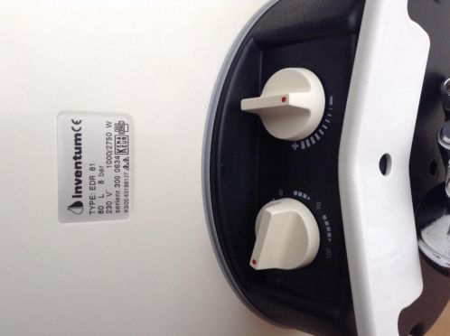
EDR 81
Volume: 80 L
2 Heating elements:
1000 W (standard)
1750 W (connected to timer = turbo stand, max 2 hours)
Temperature range: 68 – 88 C
Cost: 950 EUR
On time per day: 0-4 hours/day (at 1 kW)
Heat loss: 43 W
Heating time (10C to 60 C): 4h39m (1000W) or 1h41m (turbo)

Slide 4
Simulation
Physical model due to absence of measurement data.
Parameters:
4000 households/boilers
Daily water usage (research Unilever in UK)
Shower head flow rate
Shower Duration
Shower water temp
# people in house hold
# showers per day

Slide 5
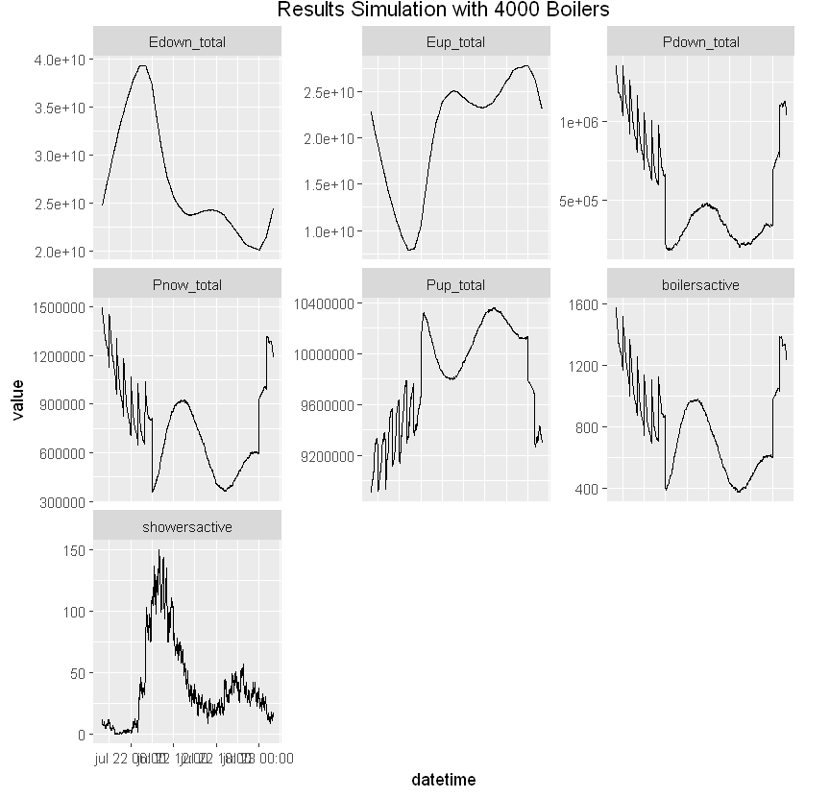
Simulation - Results

Slide 6
Simulation - Conclusions
Average hours on per day = 4,8 (19 PTU) @ 1 kW, or 1.75 (7 PTU) @ 2.75 kW
Yearly energy usage = 1750 kWh
Yearly energy costs:
Consumer costs (22 ct/Kwh) = 386 EUR
Commodity costs - normal tariff
APX price = 37,66 EUR/MWh
Yearly = 65 EUR
Commodity costs - night tariff
APX for first 19 PTU’s (23h – 3h45) = 31,22 EUR/MWh
Yearly = 54 EUR (-16%)
The customer is likely to start using more power outside of the night tariff hours, this should be taking into consideration in the proposition.

Slide 7
Valuation Per Market

Slide 8
Primary Reserve (R1/ PCR/ FCR)
Aim: Stabalize frequency distruptions in the linked European grid. The Netherlands is obliged to supply 96 MW of primary reserve.
Rules:
Bids have a minimum capacity of 1 MW (up & down)
Accuracy of frequency measurements Δf < 10 mHz
No steering is required if Δf < 10 mHz
Activation speed: assets is able to be at full capacity within 30 s.
Full activation frequency is ± 200 mHz, below this frequency the capacity scales down linearly, e.g. at ± 100 mHz the asset should operate at 50% of total capacity.
Production is measured every 4-10 s in MW.
Exceptions for limited assets:
Δf > 200 mHz: full capacity>30 min, after which < 2 hours fully available
Allert state: Δf ± 100 mHz > 5 min, or Δf > 50 mHz for > 15 min, must supply full capacity for > 30 min.
Standard frequency range: Δf < 50 mHz, always available

Slide 9
R1
Peeeks has won tender from TenneT to supply 100 kW R1 capacity with poule of assets.
The challenge:
Must supply 100 kW ramp up AND down.
Hence, a stable baseline is desired to meet 100 kW as efficient as possible.
Difficult because of peak usage of warm water in morning and afternoon. Factor 3 was found in the simulation between mean Pdown (545 kW) and min Pdown (180 kW).
30 min rule: if large imbalance, then asset should be able to ramp up/down full capacity for 30 min
Advantage: Households do not have to be in Eneco’s portfolio

Slide 10
R1 – Lower Limit
How many boilers needed for 100 kW PCR
4,8 hours on time per day
1 kW capacity
Factor between mean and min capacity of 3
15 boilers needed for 1 kW baseline capacity
1500 boilers for 100 kW baseline capacity
Earnings per boiler:
3000 EUR/MW/week paid by TenneT for contracted PCR
300 EUR/week for 100 kW
300 EUR / 1500 boilers = 0,20 EUR/week/boiler

Slide 11
R1 – Upper Limit
How many boilers needed for 100 kW PCR
4,8 hours on time per day
1 kW capacity
5 boilers needed for 1 kW baseline capacity
500 boilers for 100 kW baseline capacity
Earnings per boiler:
3000 EUR/MW/week paid by TenneT for contracted PCR
300 EUR/week for 100 kW
300 EUR / 500 boilers = 0,60 EUR/week/boiler

Slide 12
R1 - Results
Earnings per boiler: 10-30 EUR/year
Between 500 and 1500 boilers needed to deliver 1 kW of R1 capacity to TenneT with EDR-81 boiler.
The most important source of uncertainty is the stability of the baseline a group of boilers can produce.
Technically very challenging market due to high responsive that is required.

Slide 13
Passive Imbalance
Approach:
Income determined by spread between APX and imbalance price for ramping down.
Upper limit: only use power in 19 most profitable PTU every day.
Lower limit: poor man’s forecast – determine most profitable PTU’s in year one (train), and test in year two (test).
Data used:
Period: 2014/06 – 2016/05
Train: 2014/06 – 2015/05
Test: 2015/06 – 2016/05
Imbalance price (afnemen), APX price
Difficult to offer on large scale to customers outside Eneco’s portfolio.

Slide 14
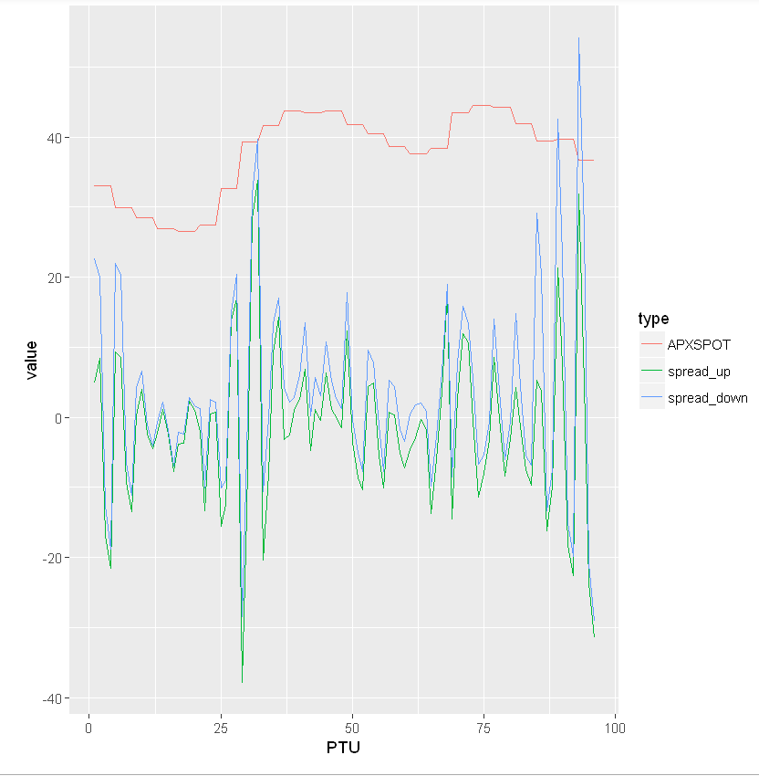
Market trends
Clear seasonality in APX-imbalance spread. This can be used in development of baseline steering application.

Slide 15
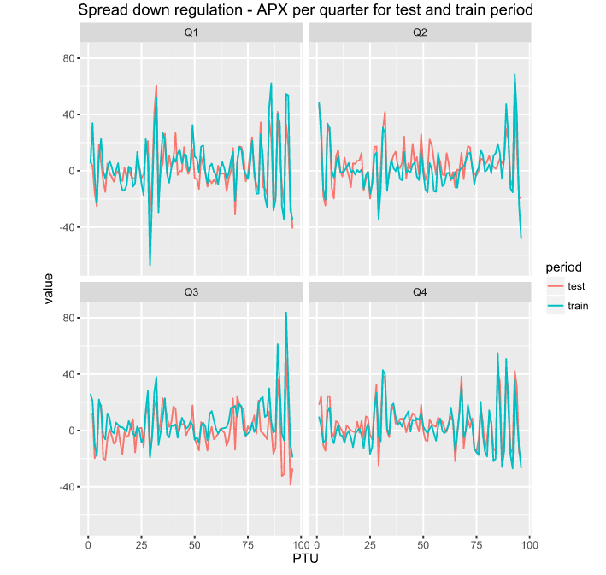
Passive imbalance – lower limit
Trends observed similar for train and test period. Method will suffice as simple forecast.

Slide 16
Passive imbalance - results
Lower limit:
Average spread = -12,67 EUR/MWh
Earning per boiler = 23,89 EUR/year
Upper limit:
Average spread = -50,17 EUR/MWh
Earning per boiler = 94,60 EUR/year
Profitability to large extend dependent on selecting the most profitable PTU’s, i.e. having a good imbalance price forecast.
Technically less demanding than R1.

Slide 17
R2
Advantage over passive imbalance, is the absence of downward risk .
R2 offer consists of:
Capacity, price, ramp rate per PTU
Rules & regulations:
Up 75 minutes before delivery able to adjust bid
Able to bid ramp up and down capacity separately
Voluntary vs contracted
The contracted capacity always needs to be offered (can play with price).
Contracted capacity requires back-up in case of planned and unplanned unavailability (spinning back-up).
If fail to comply with bid, voluntary; TenneT gives warning, contracted; financial penalty.
Contracted capacity fee approx 18k EUR/quarter
Hence: In this analysis only voluntary capacity is considered
Callrate
Depends on: price, asset’s ramp rate, imbalance volume

Slide 18
Simulation
Capacity used 2750 W (less risk averse than for passive imbalance).
Burning time per day: 1.75 hours or 7 PTU
Taking into account the amount of minutes of actual ramping down.
Assumptions:
Price taker: do no influence price/volume.
Volume is offered at APX price

Slide 19
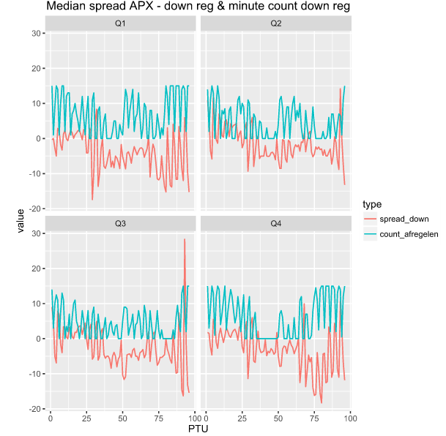
Market Trends
A clear correlation is observed between the median price spread and the median number of minutes of ramping down per PTU.

Slide 20
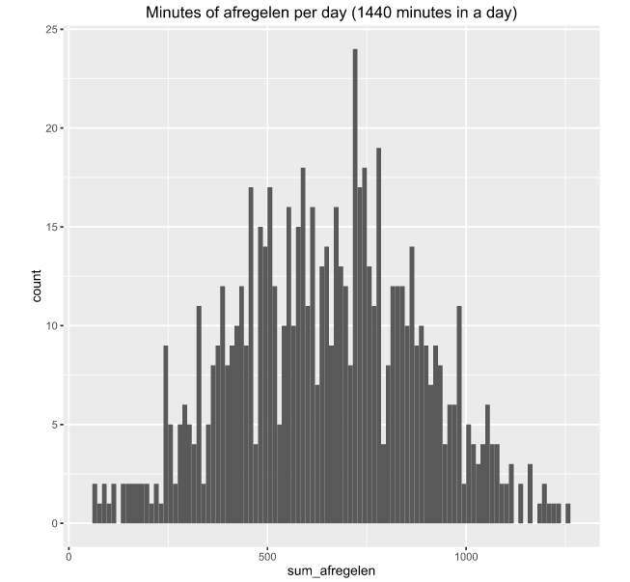
Market Trends
In 99.3% of the days there is more than 1.75 hours of ramping down per day.

Slide 21
R2 – Upper Limit
Method:
Boilers supply down ramping capacity on most profitable 1.75 hours of every day.
Call rate of the boilers is 1.
No ramp rate; pool of boilers can switch on/off instantaneously
Results:
The upper limit of the income on the R2 market per boiler is 255 EUR/year, this is with respect to buying all the power needed on the APX market the same hours.

Slide 22
R2 – Lower Limit
Method:
- To determine the lower limit of income on the R2 market the call rate is varied to study the impact on the income. Also, instead selecting the most profitable PTU, in this case the PTU in which regulating capacity is offered are selected randomly.
- If for a day not called enough afregel capacity is called to get the 1.75 burning hours, then the remaining burning hours are sold against the mean Afneem spread for that day.
Power is offered at APX price on the R2 market, so no negative prices possible.
Results:
The lower limit of expected income on the R2 market is 45 EUR/boiler/year.
See next slide for fig income vs callrate.

Slide 23
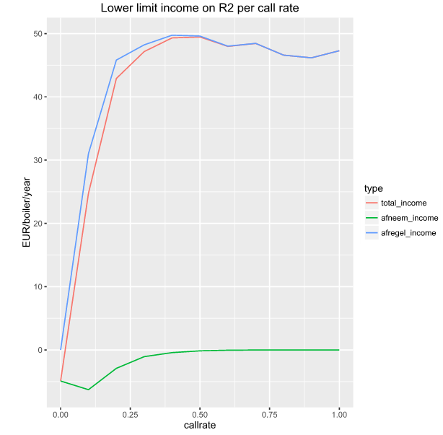
Observed impact small due to random selection of PTU, i.e. if not enough minutes in one PTU a random other PTU is selected until no more minutes available.
Impact will be larger for smarter R2-bidding strategy.

Slide 24
Conclusions

Slide 25
Conclusions & Recommandations
Expected income R1 per boiler: 10-30 EUR/year
Expected income passive imbalance per boiler: 24-94 EUR/year
Expected income voluntary R2 market per boiler: 45-255 EUR/year
Steering on passive imbalance is technically less demanding than R1.
It is recommended to start using the flex from the boilers on the passive imbalance market, and later explore possibilities for R2.

Slide 26


