Slide 1
DMS-545 CRDS Affected Datasets Tool and System DEMO
Todd Miller
2016-05-23

Slide 2
Requirement DMS-545
“A tool shall be provided that will list where differences exist for recommended reference files between two rules and list of data sets.”

Slide 3
crds.bestrefs program
crds.bestefs mode
context-to-context comparison
Inputs
Two CRDS contexts from CRDS cache
Dataset parameters from archive web service
Output list of affected datasets

Slide 4
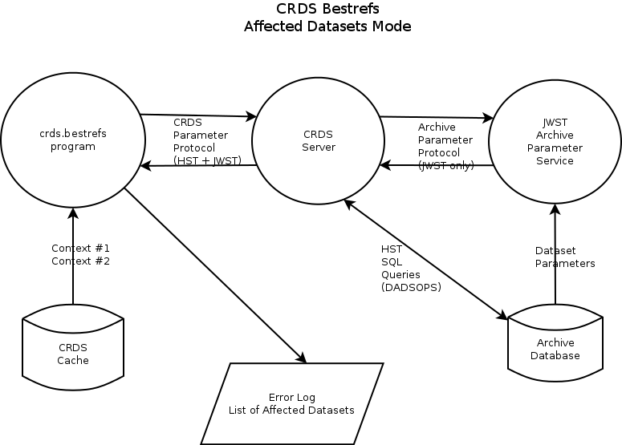

Slide 5
Running crds.bestrefs
Anybody can run crds.bestrefs in “affected datasets mode”
Basic mode runs on arbitrary old and new contexts
% setenv CRDS_SERVER_URL https://jwst-crds-b6it.stsci.edu
% setenv CRDS_PATH /grp/crds/aux/jwst/build6_cache
% python -m crds.bestrefs --old-context jwst_0183.pmap --new-context jwst_0190.pmap --affected-datasets

Slide 6
crds.bestrefs output
CRDS : INFO Mapping differences from 'jwst_0183.pmap' --> 'jwst_0190.pmap' affect:
{'miri': ['readnoise', 'dark', 'flat', 'lastframe', 'area', 'reset', 'photom']}
CRDS : INFO Checking all dates due to header changes or file deletions.
CRDS : INFO Computing bestrefs for db datasets for dict_keys(['miri'])
CRDS : INFO Dumping dataset parameters for 'miri' from CRDS server at 'https://jwst-crds-b6it.stsci.edu' since '1900-01-01 00:00:00'
CRDS : INFO Downloaded 335 dataset ids for 'miri' since '1900-01-01 00:00:00’
CRDS : ERROR instrument='MIRI' type='FLAT' data='JW80600039001_02102_00001.MIRIFULONG:JW80600039001_02102_00001.MIRIFULONG' :: New: No match found => 'N/A'.
…
CRDS : ERROR instrument='MIRI' type='FLAT' data='JW99001001001_02102_00001.MIRIMAGE:JW99001001001_02102_00001.MIRIMAGE' :: Old: No match found => 'N/A'.
CRDS : INFO Updated exposure counts:
{'MIRI': {'area': 77, 'flat': 90, 'photom': 110}}
CRDS : INFO Affected products = 110
jw80600009001_02101_00001.mirimage
…
jw99001001001_02101_00004.mirimage
jw99002002001_02101_00001.mirimage

Slide 7
crds.bestrefs output (cont)
CRDS : INFO ==================== unique error classes ====================
CRDS : INFO 8 total errors like:: instrument='MIRI' type='FLAT' data='JW80600009001_02101_00001.MIRIMAGE:JW80600009001_02101_00001.MIRIMAGE' :: New: No match found => 'N/A'.
CRDS : INFO 26 total errors like:: instrument='MIRI' type='FLAT' data='JW80600009001_02101_00001.MIRIMAGE:JW80600009001_02101_00001.MIRIMAGE' :: Old: No match found => 'N/A'.
CRDS : INFO Unique error types: 2
CRDS : INFO ==================== ==================== ====================
CRDS : INFO STARTED 2016-05-23 15:10:31.07
CRDS : INFO STOPPED 2016-05-23 15:11:39.53
CRDS : INFO ELAPSED 0:01:08.46
CRDS : INFO 0 total-bytes at 0.0 total-bytes-per-second
CRDS : INFO 0 total-files at 0.0 total-files-per-second
CRDS : INFO 335 datasets at 4.9 datasets-per-second
CRDS : INFO 34 errors
CRDS : INFO 0 warnings
CRDS : INFO 18 infos

Slide 8
Affected Datasets System
Automatically runs crds.bestrefs basic tool
Permanently Stores Results
Client/Server interface for fetching results
E-mails results

Slide 9
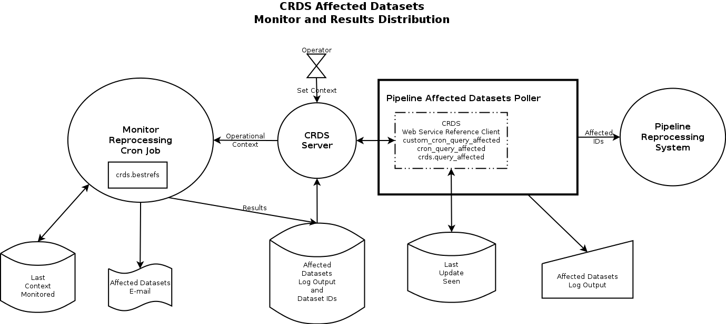

Slide 10
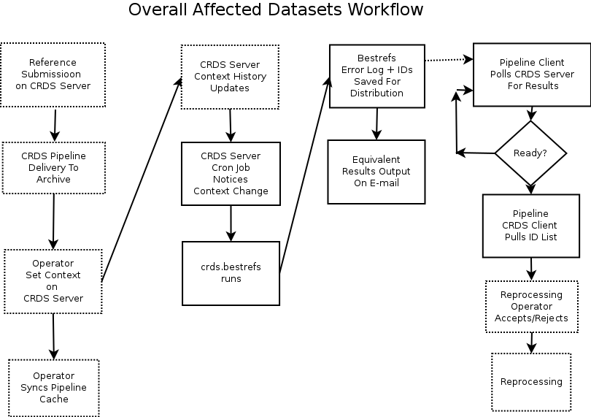

Slide 11
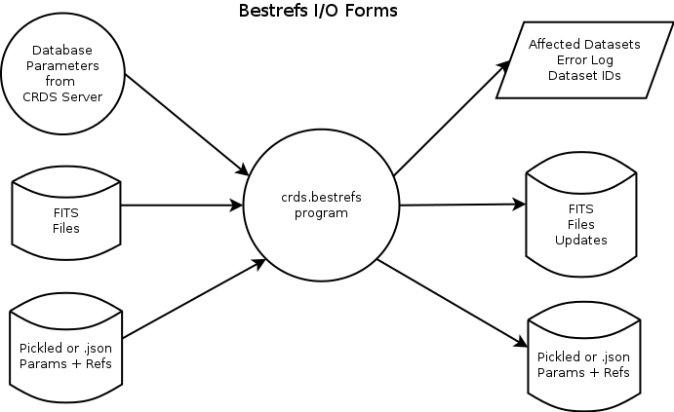

Slide 12
query_affected_datasets
CRDS Client Script
Run in/near pipeline’s reprocessing environment
Queries CRDS Server for Stored Results
Requires connection to CRDS server
Stores state in *a* CRDS cache
Outputs list of affected IDs to stdout
Outputs log to stderr
Remembers last context processed/queried
Queries limited to context transitions in history
Requires one time inititialization

Slide 13
query_affected_datasets Initialization
setenv CRDS_SERVER_URL https://jwst-crds-b6it.stsci.edu
setenv CRDS_PATH $HOME/crds_cache_affected
Fake Init
query_affected_datasets –list
List out context history with QAD indices
B6 only has two stored transitions, last two
query_affected_datasets –x 40 –y 41
Initialize query state as first of two B6 transitions
41 (jwst_0183.pmap) is assumed to be current default
Real Init / Reset
query_affected_datasets –reset
Sets last seen context recorded in cache to end of history
Since already at end, requires a new context to demo!

Slide 14
query_affected_datasets single context update
query_affected_datasets --quiet

