Slide 1
DMS-545 CRDS Affected Datasets Tool and System DEMO
Todd Miller
2016-05-23

Slide 2
Requirement DMS-545
“A tool shall be provided that will list where differences exist for recommended reference files between two rules and list of data sets.”

Slide 3
Basic Program

Slide 4
crds.bestrefs program
One of many crds.bestefs modes
context-to-context comparison
Inputs
Two CRDS contexts from CRDS cache
Dataset parameters from archive web service
Output
list of affected datasets
error log

Slide 5
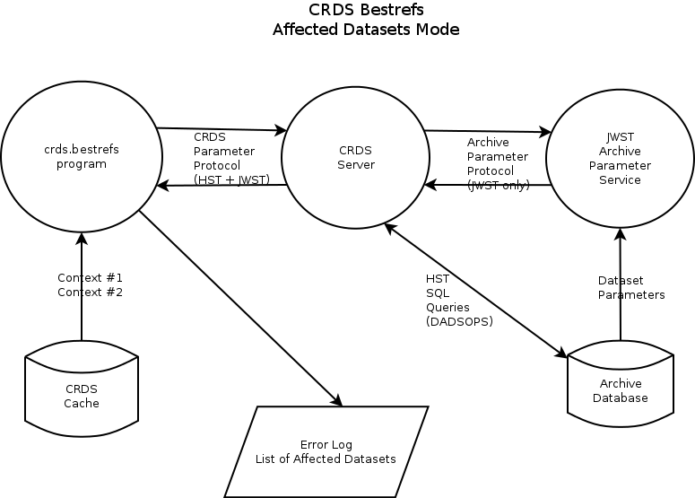

Slide 6
Running crds.bestrefs
Anybody can run crds.bestrefs in “affected datasets mode”
Basic mode runs on arbitrary old and new contexts
% setenv CRDS_SERVER_URL https://jwst-crds-b6it.stsci.edu
% setenv CRDS_PATH /grp/crds/aux/jwst/build6_cache
% python -m crds.bestrefs --old-context jwst_0183.pmap --new-context jwst_0190.pmap --affected-datasets

Slide 7
crds.bestrefs output
CRDS : INFO Mapping differences from 'jwst_0183.pmap' --> 'jwst_0190.pmap' affect:
{'miri': ['readnoise', 'dark', 'flat', 'lastframe', 'area', 'reset', 'photom']}
CRDS : INFO Checking all dates due to header changes or file deletions.
CRDS : INFO Computing bestrefs for db datasets for dict_keys(['miri'])
CRDS : INFO Dumping dataset parameters for 'miri' from CRDS server at 'https://jwst-crds-b6it.stsci.edu' since '1900-01-01 00:00:00'
CRDS : INFO Downloaded 335 dataset ids for 'miri' since '1900-01-01 00:00:00’
CRDS : ERROR instrument='MIRI' type='FLAT' data='JW80600039001_02102_00001.MIRIFULONG:JW80600039001_02102_00001.MIRIFULONG' :: New: No match found => 'N/A'.
…
CRDS : ERROR instrument='MIRI' type='FLAT' data='JW99001001001_02102_00001.MIRIMAGE:JW99001001001_02102_00001.MIRIMAGE' :: Old: No match found => 'N/A'.
CRDS : INFO Updated exposure counts:
{'MIRI': {'area': 77, 'flat': 90, 'photom': 110}}
CRDS : INFO Affected products = 110
jw80600009001_02101_00001.mirimage
…
jw99001001001_02101_00004.mirimage
jw99002002001_02101_00001.mirimage

Slide 8
crds.bestrefs output (cont)
CRDS : INFO ==================== unique error classes ====================
CRDS : INFO 8 total errors like:: instrument='MIRI' type='FLAT' data='JW80600009001_02101_00001.MIRIMAGE:JW80600009001_02101_00001.MIRIMAGE' :: New: No match found => 'N/A'.
CRDS : INFO 26 total errors like:: instrument='MIRI' type='FLAT' data='JW80600009001_02101_00001.MIRIMAGE:JW80600009001_02101_00001.MIRIMAGE' :: Old: No match found => 'N/A'.
CRDS : INFO Unique error types: 2
CRDS : INFO ==================== ==================== ====================
CRDS : INFO STARTED 2016-05-23 15:10:31.07
CRDS : INFO STOPPED 2016-05-23 15:11:39.53
CRDS : INFO ELAPSED 0:01:08.46
CRDS : INFO 0 total-bytes at 0.0 total-bytes-per-second
CRDS : INFO 0 total-files at 0.0 total-files-per-second
CRDS : INFO 335 datasets at 4.9 datasets-per-second
CRDS : INFO 34 errors
CRDS : INFO 0 warnings
CRDS : INFO 18 infos

Slide 9
Client/Server System

Slide 10
Affected Datasets System
Automatically runs crds.bestrefs basic tool
Permanently Stores Results
Client/Server interface for fetching results
E-mails results

Slide 11
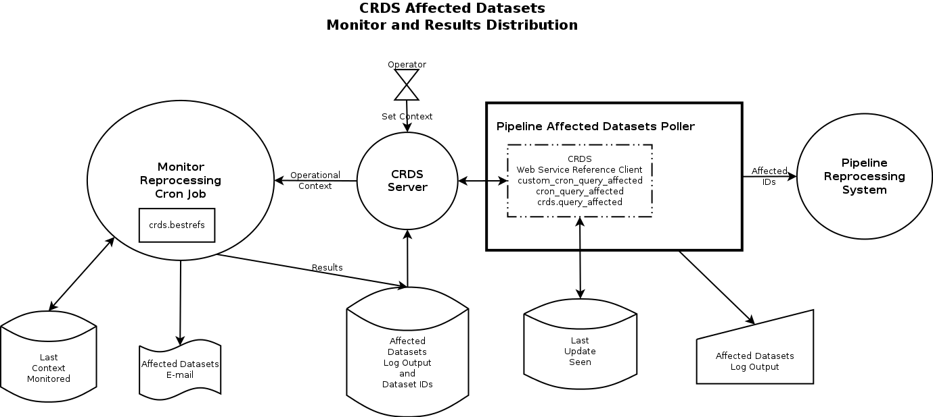

Slide 12
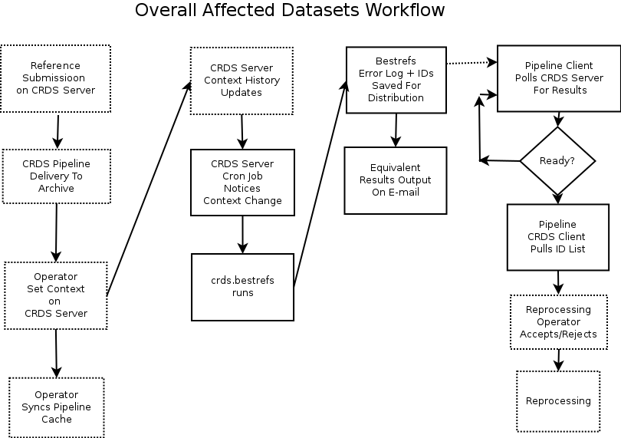

Slide 13
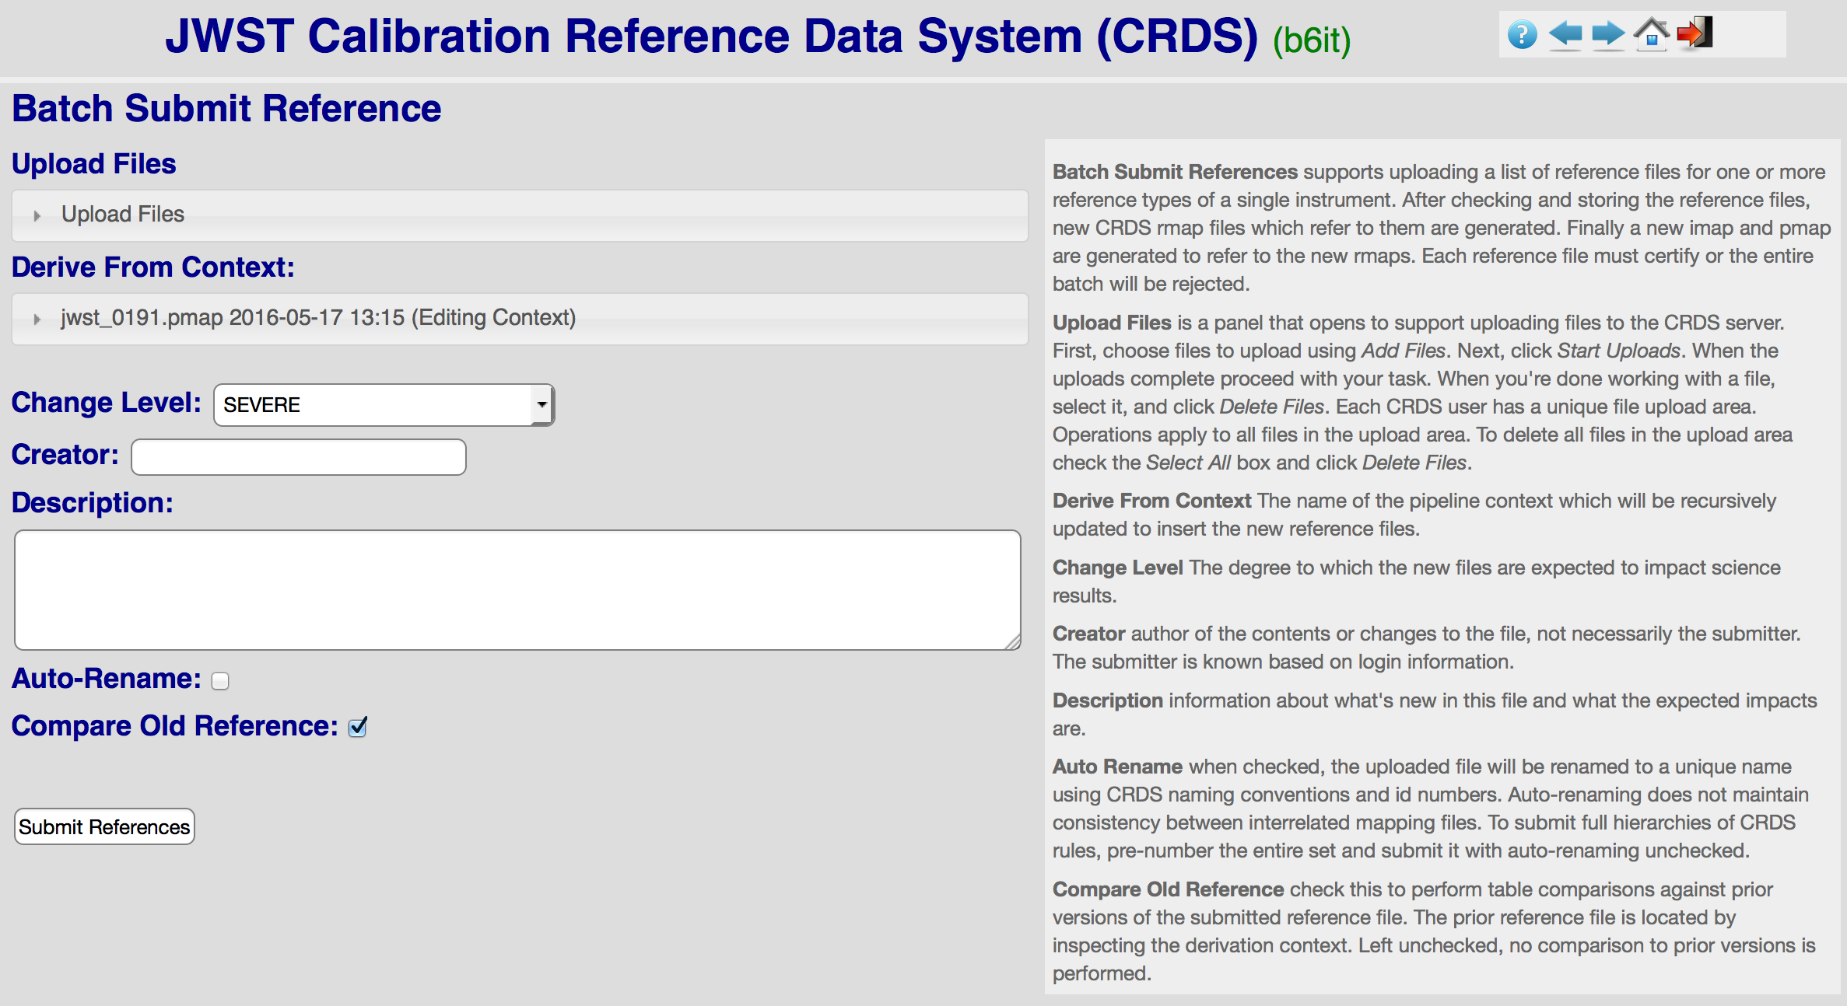
ReDCaT Submits References

Slide 14
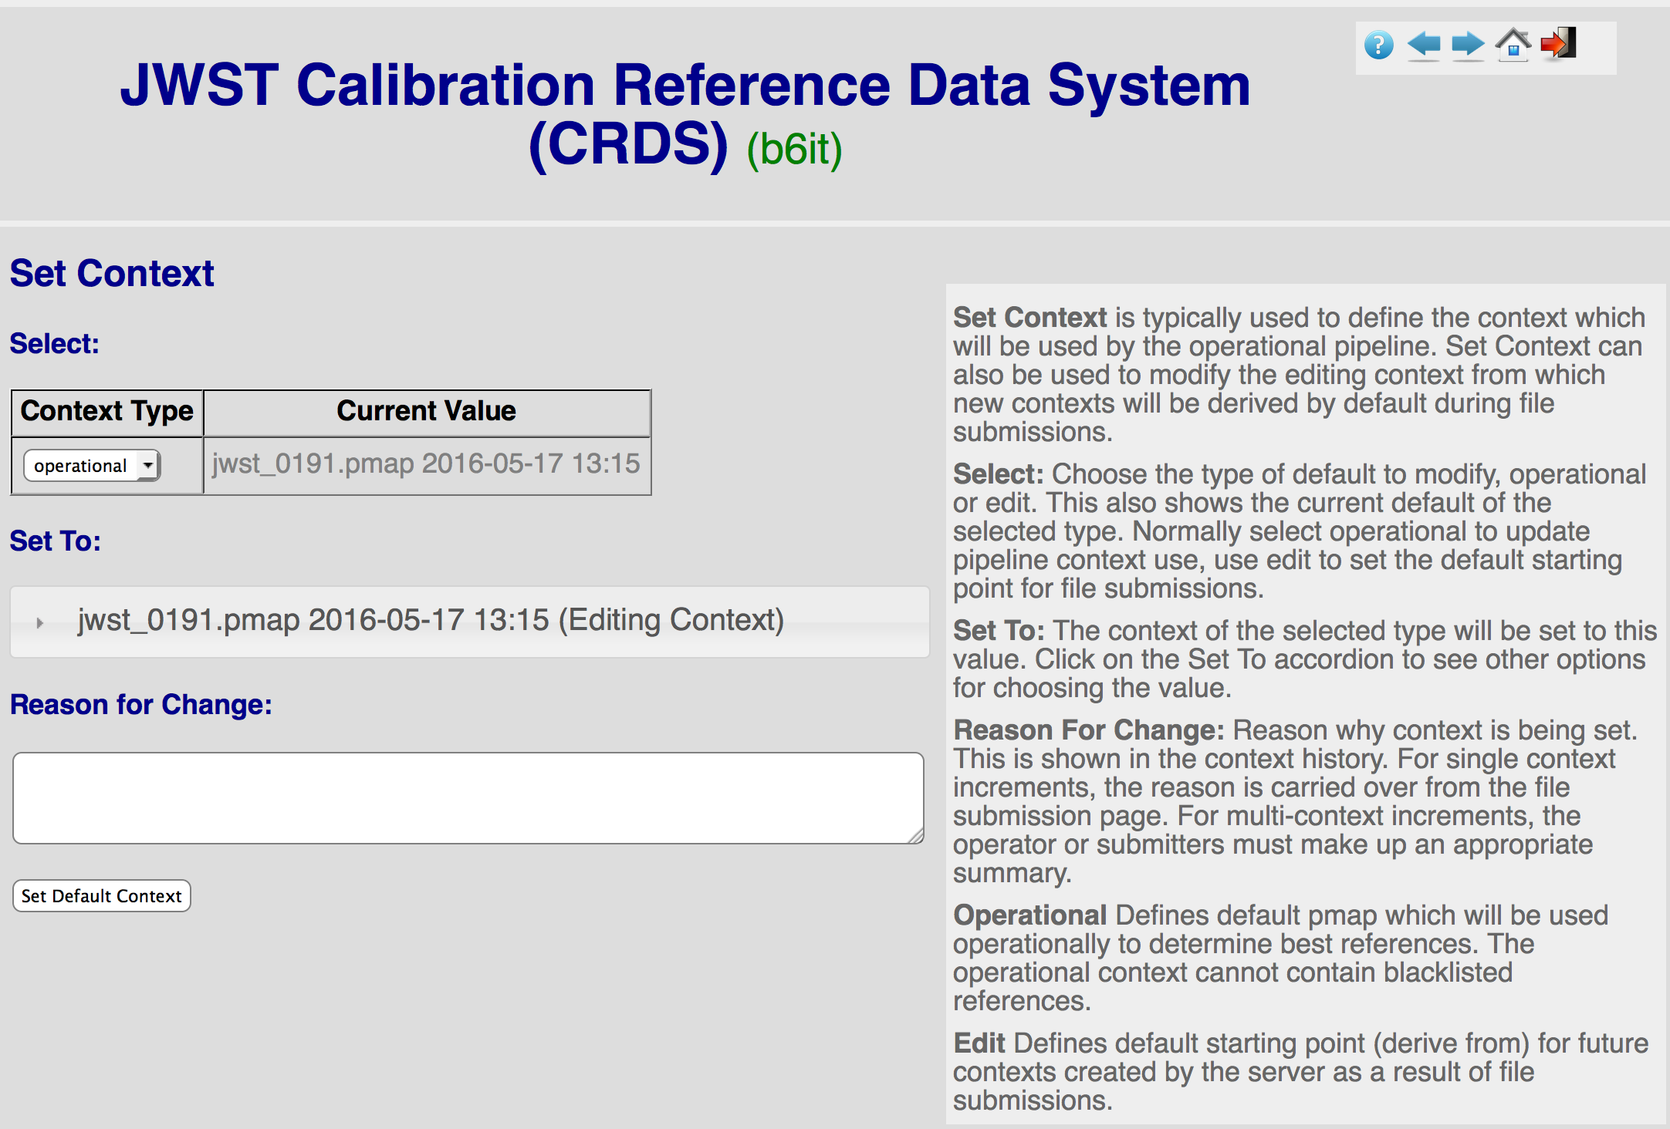
Operator Sets Default Context

Slide 15
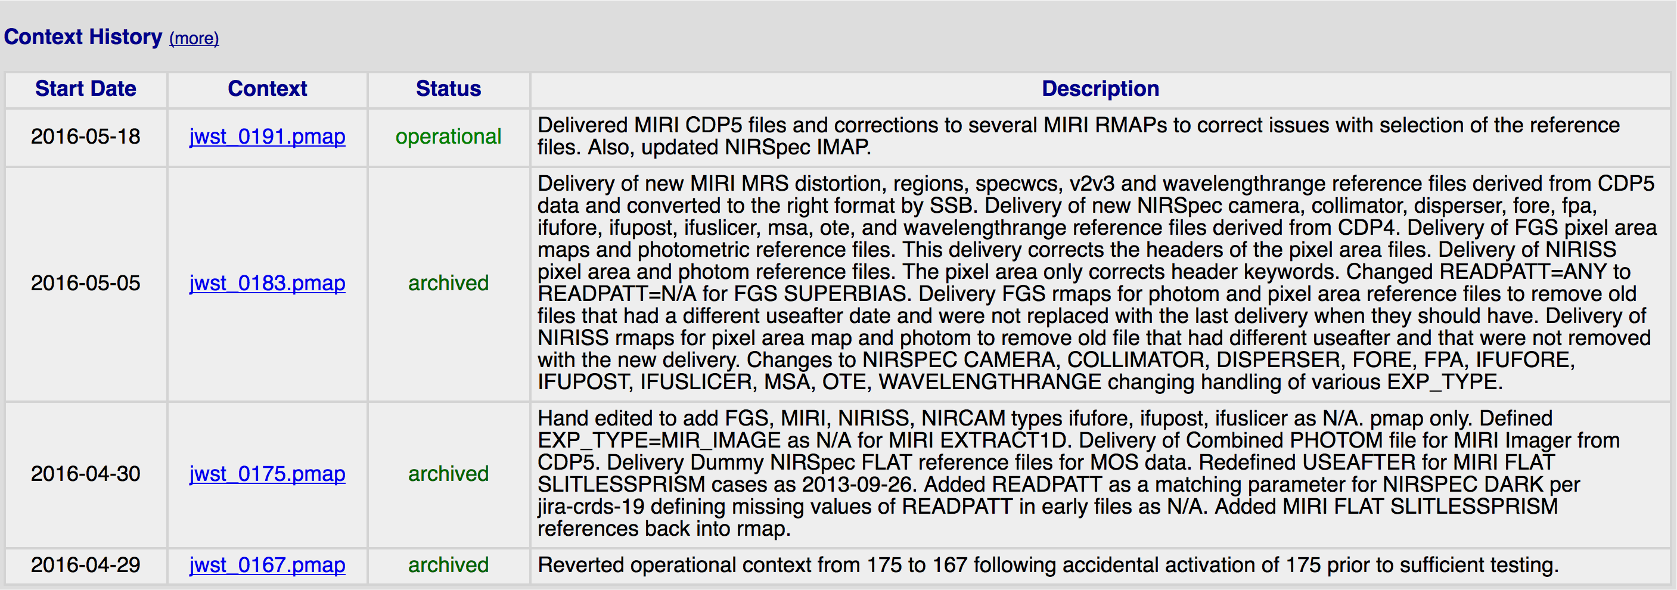
Context History Updates
Context history defines which official queries are possible

Slide 16
Pipeline Affected Datasets Queries

Slide 17
query_affected_datasets
CRDS Client Script / Poller
Run in/near pipeline’s reprocessing environment
Queries CRDS Server for Stored Results
Requires connection to CRDS server
Outputs list of affected IDs to stdout
Outputs log to stderr
Stateful:
Remembers last context processed/queried
stores state in CRDS cache config area or file
Queries limited to context transitions in history
Requires one time initialization

Slide 18
query_affected_datasets Initialization
setenv CRDS_SERVER_URL https://jwst-crds-b6it.stsci.edu
setenv CRDS_PATH $HOME/crds_cache_affected
Fake Init
query_affected_datasets –list
List out context history with QAD indices
B6 only has two stored transitions, last two
query_affected_datasets –x 40 –y 41
Initialize query state as first of two B6 transitions
41 (jwst_0183.pmap) is assumed to be current default
Real Init
query_affected_datasets –reset
Sets “last seen” to end of history
Since already at end, requires a new context to demo!

Slide 19
query_affected_datasets single context update
% query_affected_datasets –quiet
CRDS : INFO Fetching effects for (41, '2016-05-18 09:40:19', 'jwst_0191.pmap', 'Delivered MIRI CDP5 files and corrections to several MIRI RMAPs to correct issues with selection of the reference files. Also, updated NIRSpec IMAP.')
CRDS : ERROR CRDS server-side errors for 41 2016-05-21-11:40:11_0183_0191
jw80600009001_02101_00001.mirimage
jw80600016001_02101_00001.mirifulong
jw80600018001_02101_00001.mirifulong
jw80600018001_02101_00002.mirifulong
jw80600018001_02101_00003.mirifulong
jw80600020001_02101_00001.mirifulong
jw80600039001_02102_00001.mirifulong
jw80600039001_02102_00002.mirifulong
jw80600050001_02102_00001.mirifulong

