Slide 1
Rocky
Mountain
Ski Genie
Alex Doran, Eric Rudat, Will Vardell

Slide 2
Project Goal
Provide weather conditions for nearby mountains.
Give wax recommendations based on a given mountain’s conditions.

Slide 3
Methodologies
Waterfall approach
Appropriate for project size
Better for group members schedules
Pair programming
Useful for group members that don’t know certain coding aspects

Slide 4

VCS: Github
❄ ❄ ❄ ❄
Pros:
Suited our needs completely
Easy to use interface aesthetically pleasing
Cons:
Never used before, difficult to get used to
Commands aren’t intuitive

Slide 5
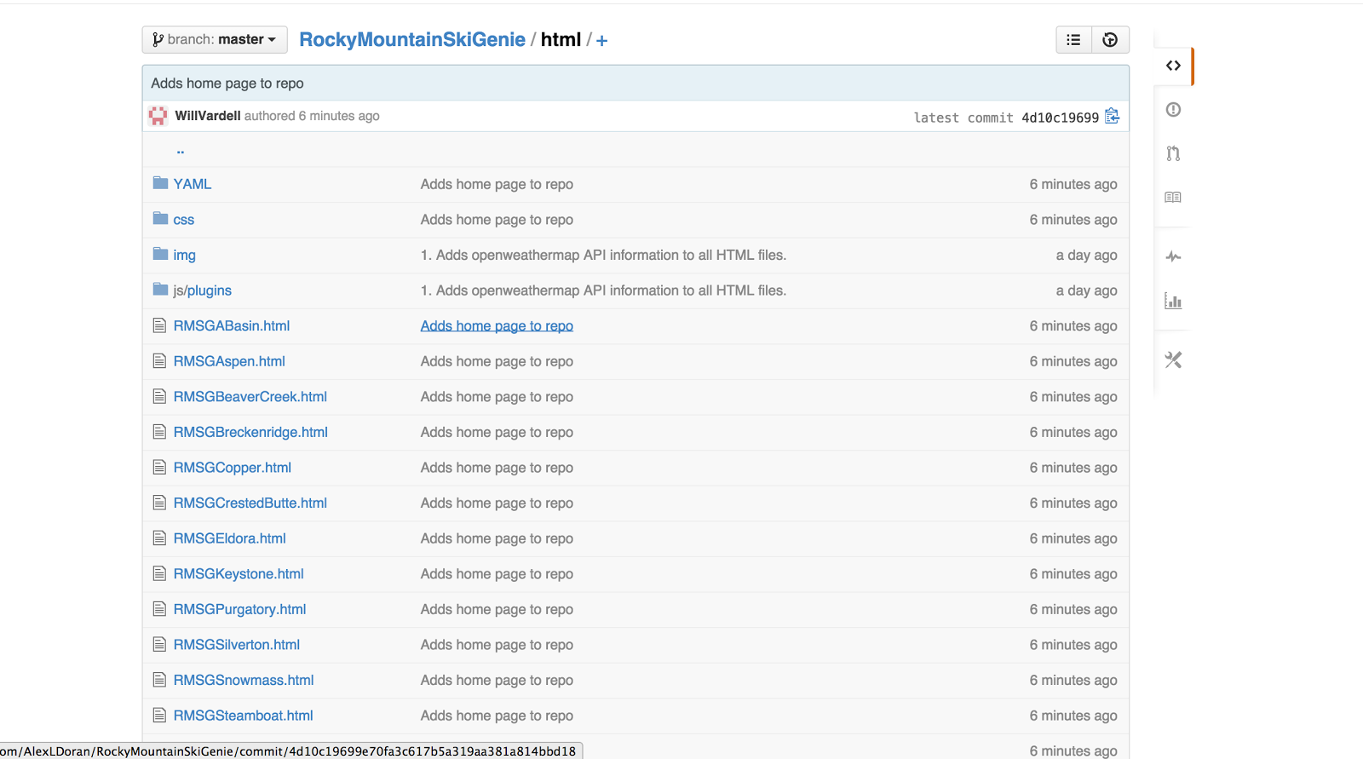

Slide 6
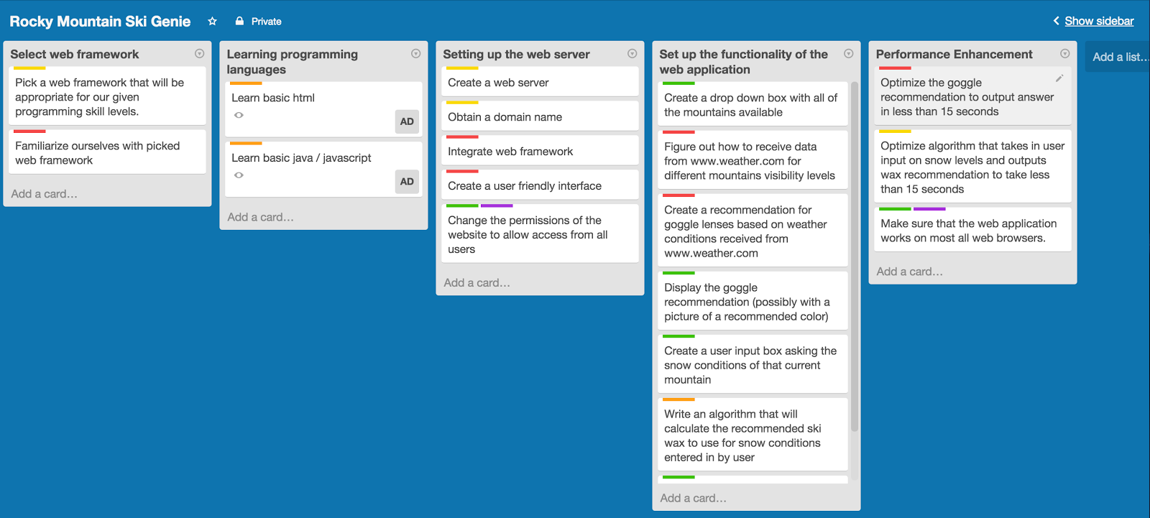
Tracker: Trello
❄ ❄
Pros:
Extremely intuitive
Visual layout was nice
Easy to collaborate
Cons:
Very unnecessary for a project of this size

Slide 7
Testing: User Testing
❄ ❄ ❄ ❄ ❄
With our project being quite simple, all of our testing was able to be done by users interacting with the interface.
Pros:
Easily done
Cons:
User tests don’t point exactly where errors are

Slide 8


IDEs: Emacs, Genie,
Sublime
❄ ❄ ❄ ❄ ❄
Pros:
Different IDE’s make different types of coding simpler
Emacs was useful for quick HTML/CSS editing
Genie/Sublime were useful for Ajax/JSON
Cons:
None

Slide 9

Framework: YAML
❄ ❄ ❄
Pros:
Free to use
Provided intuitive grid system for our project
Easy to change to change to tailor to RMSG
Cons:
Very steep learning curve

Slide 10

Deployment Environment: DigitalOcean
❄ ❄ ❄ ❄ ❄
Pros:
extremely fast deployment
it only took roughly 60 seconds to deploy our SSD to the cloud server
works well with apache2 web servers
Cons:
Again, like most tools, it had a steep learning curve

Slide 11

Data Management:
OpenWeatherMap
❄ ❄ ❄ ❄ ❄
We didn’t use a traditional database, like MySQL, for our project. We were, instead, able to use OpenWeatherMap’s data services to retrieve all the weather information needed.
Pros:
We were able REST API calls for data retrieval, instead of having to set up and link and database.
Cons:
OpenWeatherMap.org’s precision in the location of mountains was difficult to work with.

Slide 12
Challenges
Unfamiliar with chosen development languages
Difficult to find time to meet up with schedules
Inexperienced with some of the tools used

Slide 13
Demo

