Slide 1
Lunchtime Programming Sessions
Automating the boring stuff with Python

Slide 2
Agenda
What is Python?
What can I expect to gain from the course.
What does the course cover.
Is this course right for you.
Q&A

Slide 3

What is Python?
(What is computer programming?)
Notes:
When someone thinks of computer programming this sought of thing comes to mind:
http://hackertyper.com/
Python is a programming language. Virtually all software you have used was built using a programming language like python. The key word is language. It is a way to communicate with a computer. To give it instructions to do something. I could speak to it. But it makes more sense to write it down.
There is a program on my computer called a python interpreter. It interprets what I am telling it to do and gives that to the computer in a language it understands.

Slide 4
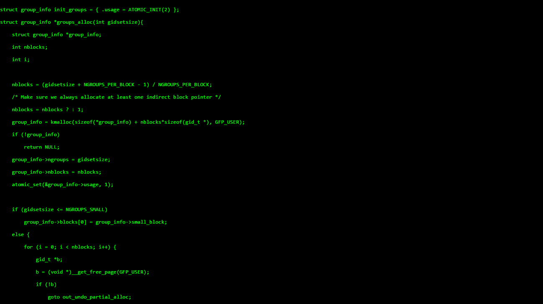
What is Python?
(What is computer programming?)
Notes:
When someone thinks of computer programming this sought of thing comes to mind:
http://hackertyper.com/
Python is a programming language. Virtually all software you have used was built using a programming language like python. The key word is language. It is a way to communicate with a computer. To give it instructions to do something. I could speak to it. But it makes more sense to write it down.
There is a program on my computer called a python interpreter. It interprets what I am telling it to do and gives that to the computer in a language it understands.

Slide 5
What is Python?
(What is computer programming?)
Notes:
When someone thinks of computer programming this sought of thing comes to mind:
http://hackertyper.com/
Python is a programming language. Virtually all software you have used was built using a programming language like python. The key word is language. It is a way to communicate with a computer. To give it instructions to do something. I could speak to it. But it makes more sense to write it down.
There is a program on my computer called a python interpreter. It interprets what I am telling it to do and gives that to the computer in a language it understands.

Slide 6
What is Python?
(What is computer programming?)
Sum all the numbers from 1 up to 100
Notes:
Lets get concrete with an example.

Slide 7
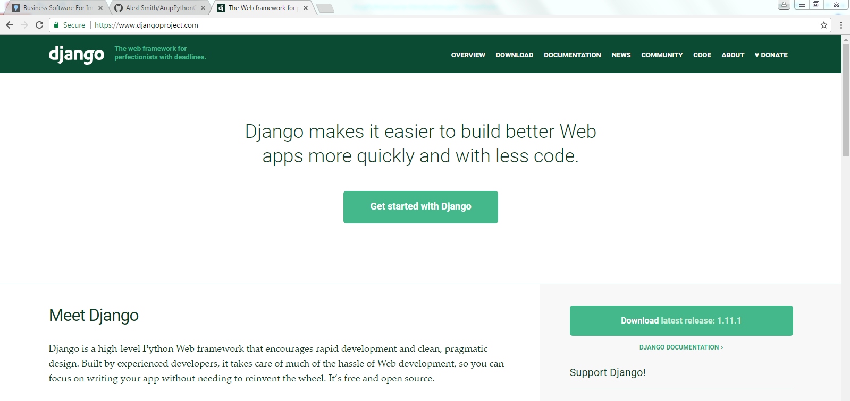
What can you do with python
Notes:
You can make a website

Slide 8
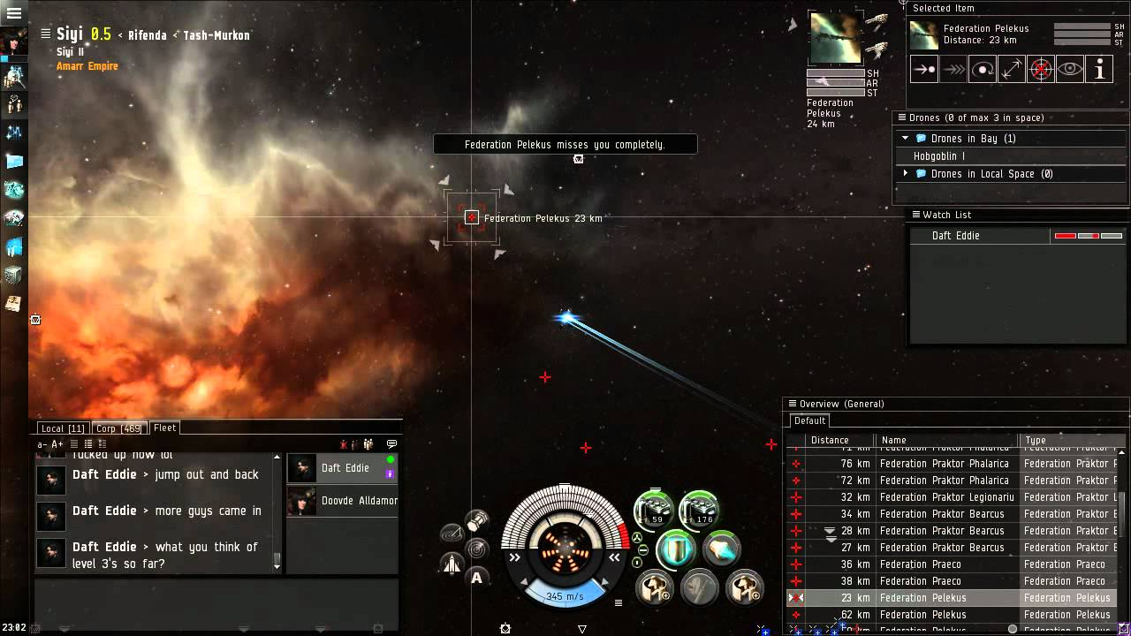
What can you do with python
Notes:
You can make a video game

Slide 9
What can you do with python
Notes:
You can perform engineering simulations

Slide 10
What can you expect to gain from this course
Rename, move, copy thousands of files
Inspect & manipulate numerous rows in spreadsheets and the like
Write scripts to do engineering calculations
Downloading files or scraping text from a website
Copy the data from PDFs and format for other programs
Resize and compress images
Interact with existing programming environments (Dynamo, Grasshopper, ArcGIS)

Slide 11
What does this course cover
Session 0 | Pre-Work. Do this at home
Session 1 | Python Basic
Session 2
Session 3
Session 4 | Solve some typical problems
Session 5 | Group project
Session 6 | How to work as a group and best practice
Session 7 | Group project
Session 8 | Group project

Slide 12
Is this course right for you
This course is for anyone who wants to learn!
Notes:
This course is for everyone who wants to learn. But remember learning programming is like learning a new spoken language. It takes hard work and dedication to become fluent.

Slide 13
The next steps
Get yourself into a group of 8-12 people
Then get in touch with me
Courses start on the first week of July

Slide 14
Questions?

