Slide 1
晶圓24*24 探針尺寸3 | soft attention + LSTM | Model-PR3 W_{z} = W_{a} ( =W_{r} = W_{h}) U_{z} = U_{a} ( = U_{r} = U_{h})
 |  | 預載入12*12晶圓訓練模型的參數
time |  | 434446 (120.7 hrs)
episode |  | 34957
總移動步數 | Avg: 158.05 SD: 11.39 | Avg: 335.93 SD: 32.79
探針獎勵 | Avg: 3.90 | Avg: -3.8811
晶圓探測次數 | Avg: 1.47 SD: 0.73 | Avg: 2.8608 SD: 1.62

Slide 5
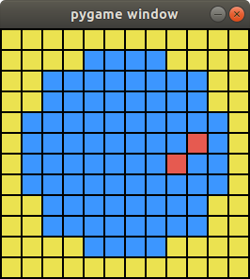
晶圓12*12 探針尺寸2 |  | Model-PR1 | Model-PR2 |  | Model-PR3 |  | soft attention
 |  | W_{h} = W_{a} U_{h} = U_{a} | W_{r} = W_{a} (=W_{h}) U_{r} = U_{a} (=U_{h}) |  | W_{z} = W_{a} ( =W_{r} = W_{h}) U_{z} = U_{a} ( = U_{r} = U_{h})
 | time | 44.6 hrs (160525) | 47.9 hrs (172512) | 71.36 hrs (256904) | 46.5hrs (167561) | 69.03 hrs (248492)
 | episode | 30679 | 30679 | 64565 | 30679 | 64565
 | step | Avg: 98.59 SD: 9.8 | Avg: 95.96 SD: 13.83 | Avg: 77.85 SD: 9.72 | Avg: 92.13 SD: 10.41 | Avg: 70.05 SD: 7.63 | Avg: 61.6 SD: 5.817
 | reward | Avg: -0.2127 SD: 1.27 | Avg: -0.0089 SD: 0.822 | Avg: 0.845 SD: 0.44 | Avg: 0.1996 SD: 0.55 | Avg:1.0762 SD: 0.3627 | Avg: 1.5183 SD: 0.1576

Slide 6
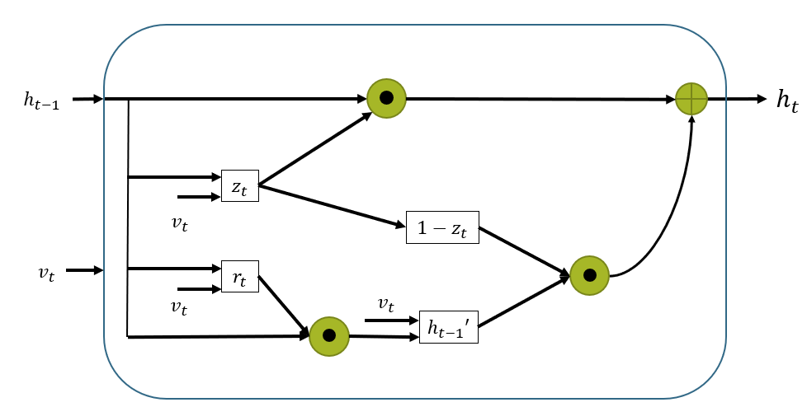
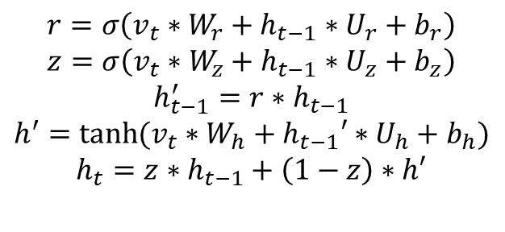
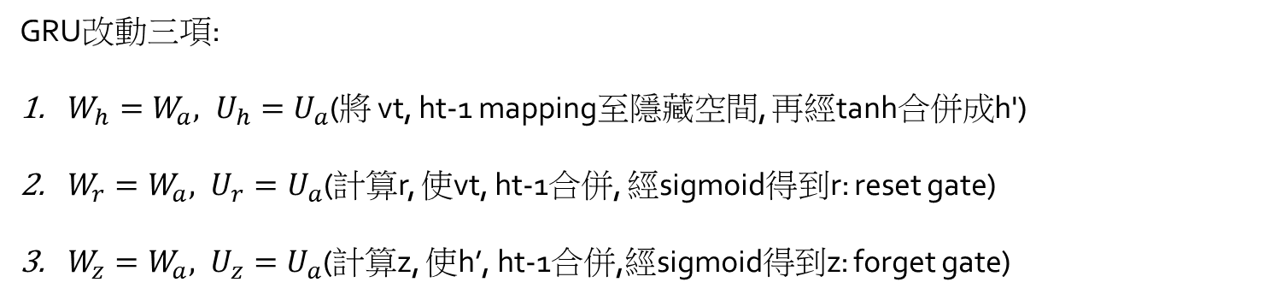
3.W_{z}, U_{z}
1.W_{h}, U_{h}
2.W_{r}, U_{r}
<number>

Slide 7
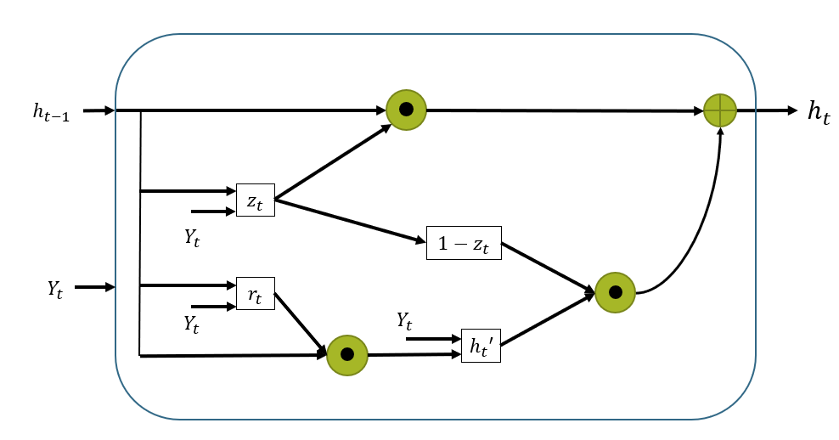
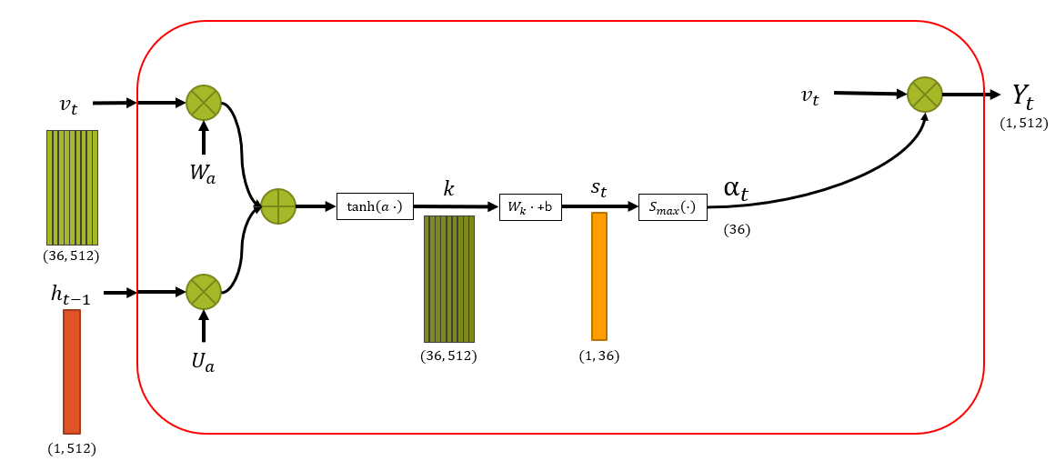
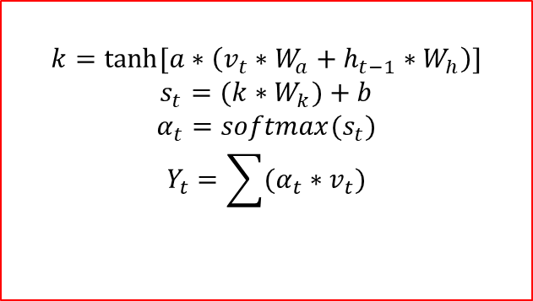
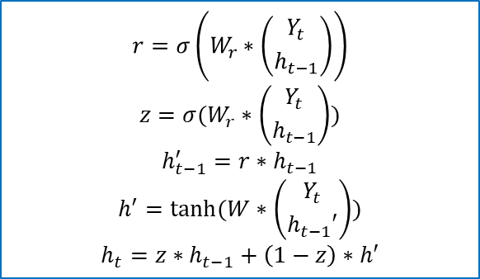
Soft attention + GRU (串聯式)
改動三項:
1.tanhx -> tanh(ax)
2.α_{t}=g_{t}* α_{t}+(1-g_{t})* α_{t-1}
3. α_{t}= (α_{t})^{r} / Σ (α_{t})^{r}
<number>

Slide 8
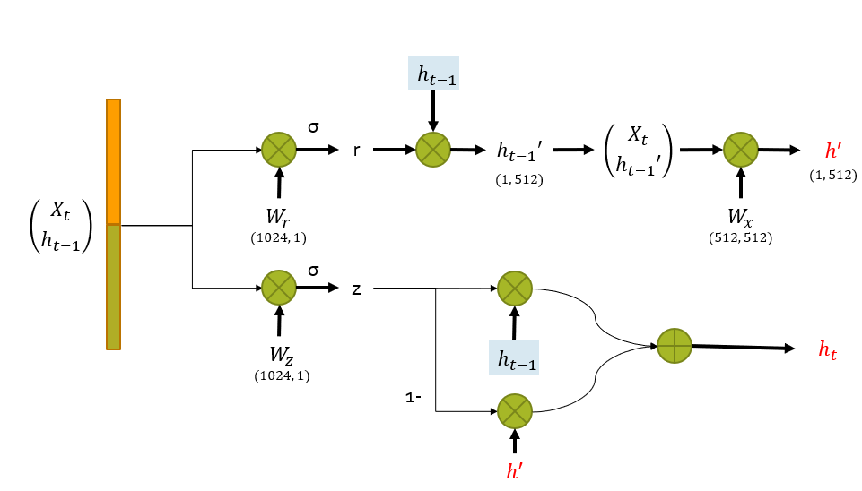
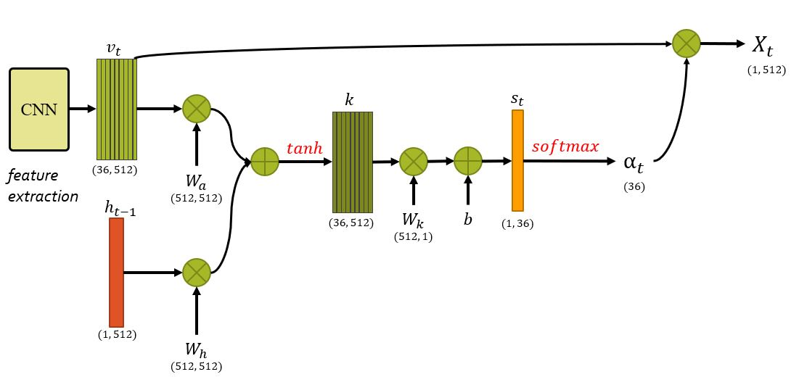
Soft attention + GRU (串聯式)
<number>

Slide 9
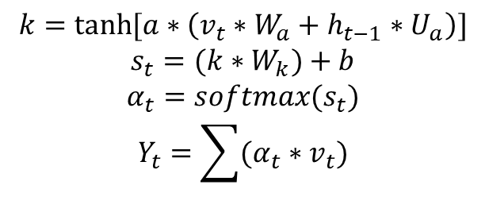
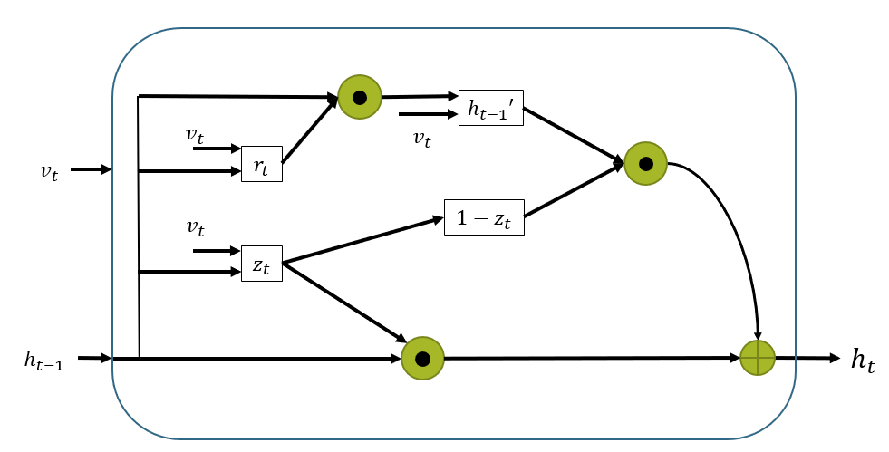
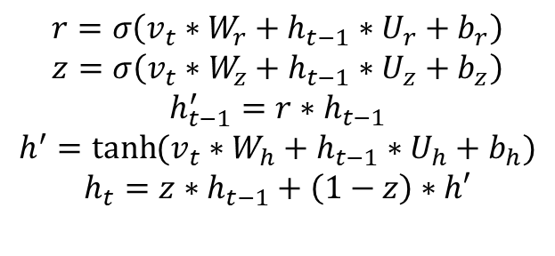
Soft attention + GRU (並聯式)
<number>

Slide 10
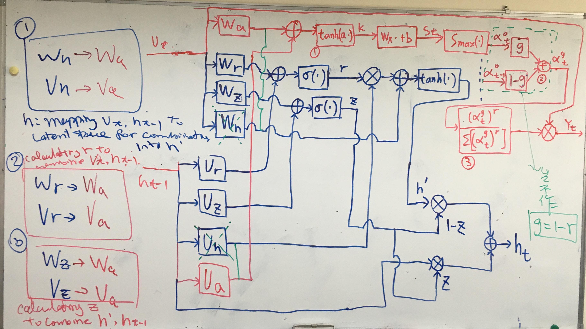
<number>

Slide 11


















$v_{t}$
$v_{t}$
$Y_{t}$
$\left(1,512\right)$
$W_{a}$
$α_{t}$
$k$
$s_{t}$
$tanh\left(a∙\right)$
+b
$S_{max}\left(∙\right)$
$\left(36\right)$
$\left(36,512\right)$
$h_{t−1}$
$U_{a}$
$\left(36,512\right)$
$\left(1,36\right)$
$\left(1,512\right)$

Slide 12










$h_{t−1}′$
$v_{t}$
$v_{t}$
$v_{t}$
$r_{t}$
$v_{t}$
${1−z}_{t}$
$z_{t}$
$h_{t−1}$
$h_{t}$

Slide 13
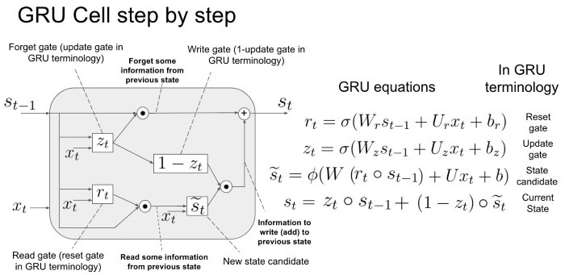
<number>

Slide 14
















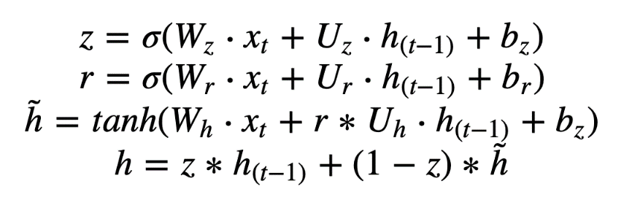









$Y_{t}$
$\left(1,512\right)$
$v_{t}$
$W_{r}$
CNN
σ
$k$
$s_{t}$
r
$tanh$
$softmax$
r
$α_{t}$
feature
extraction
$\left(36,512\right)$
$\left(36\right)$
$h_{t−1}$
$U_{r}$
1-r
$\left(36,512\right)$
$b$
$\left(1,36\right)$
$W_{z}$
$U_{z}$
z
$\left(1,512\right)$
σ
$h_{t}$
$h_{t−1}$
$U_{h}$
1-z
$W_{h}$
$tanh$
h’
<number>

