Slide 1
5G DDoS Game Formulation
Zhan-Lun Chang
2020/10/14

Slide 2

System Architecture
One base station and thus one MEC operator which has virtual machines (VMs).
A finite number of users and attackers
One service provider (SP)

Slide 3
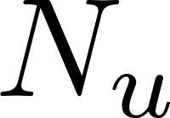

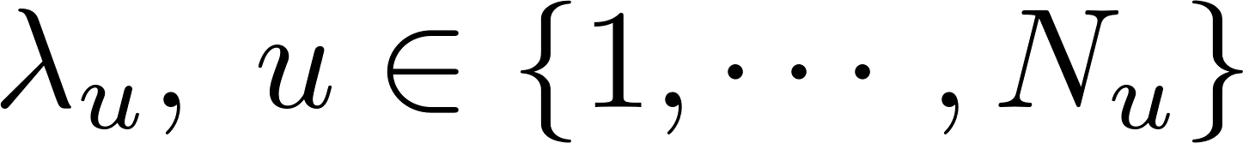
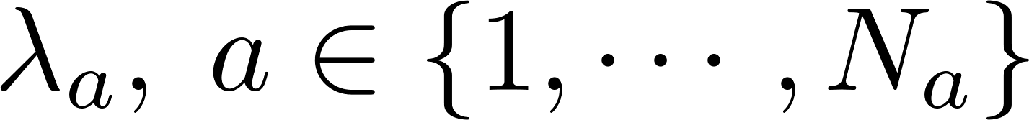
Nomal Users and Malicious users (attackers)
Attackers are not players in current formulation.
Since attackers are not players, we assume that the attack is executed by issuing requests to connect with the base station.
Number of users = , number of attackers =
Each attacker and normal user has different task arrival rate.
Arrival rate of users=
Arrival rate of attackers =
The attack traffic and normal users traffic are now assumed to be evenly distributed among all VMs owned by the MEC operator.

Slide 4
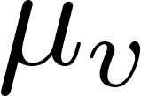
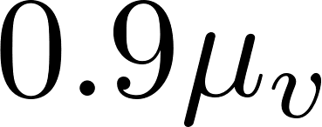
Virtual Machine
Homogeneous and thus the price of each VM is the same.
Each VM provides the same service rate
The service rate can be divided. This corresponds to the way the resources devoted to the IDS is often represented by CPU utilization (percentage). For example, if 10% CPU utilization is used by the IDS, the service rate is reduced to .
The CPU utilization used by IDS is the percentage by which all VMs devote their resources to the IDS.

Slide 5
IDS
Pricing plan (AWS Shield advanced):
Addition to computing resources such as AWS EC2, ELB, Cloudfront
Fixed monthly fee + Fixed unit price per usage fee (per GB)
In this stage, we assume once the packets are analyzed by the IDS, the malicious traffic is discerned and dropped. That is, we consider 100% accuracy.

Slide 6
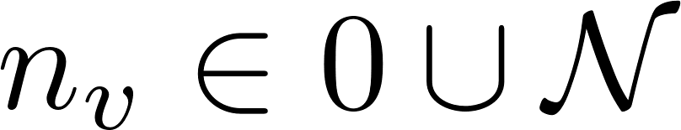
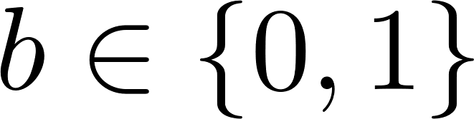
Solution Concept: NBS (1)
Players: the MEC operator and the service provider
Bargaining decision:
The number of VMs that the service provider would like to buy from MEC operator
If the service provider would like to buy the authentication of IDS (the service provider can decide how many resources is dedicated to the IDS)
Disagreement point:
For the MEC operator: 0
For the service provider: When the task is served by the cloud

Slide 7
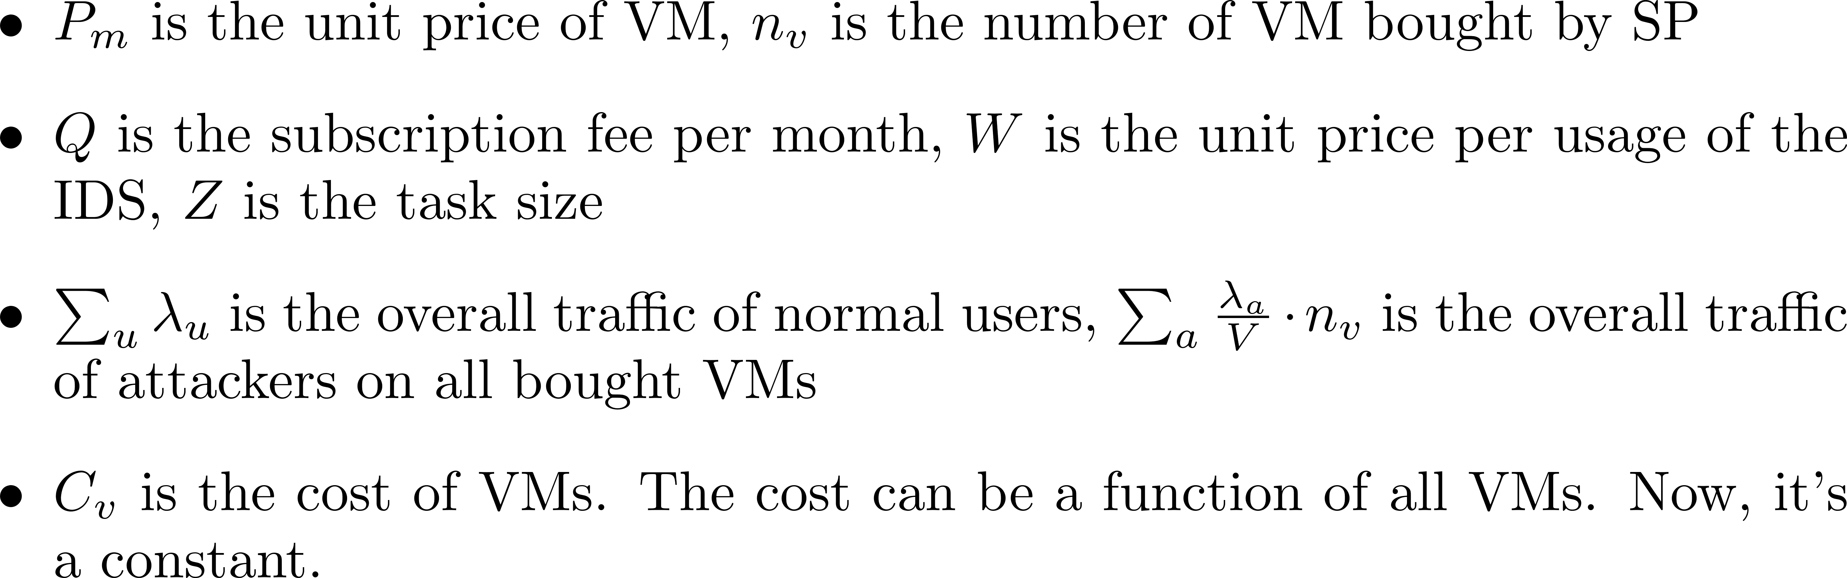
Solution Concept: NBS (2)
Utility of the MEC operator

Slide 8
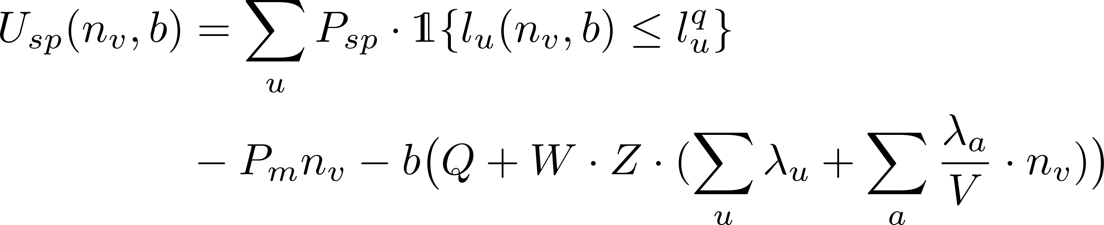
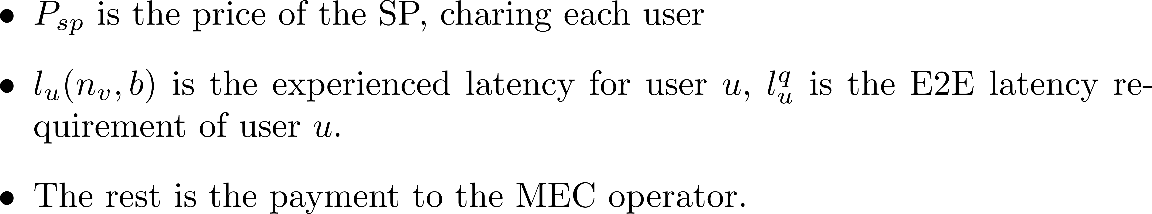
Solution Concept: NBS (3)
Utility of the service provider

Slide 9
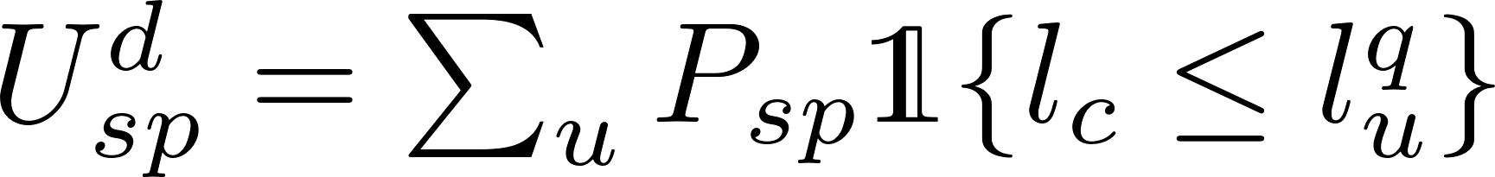
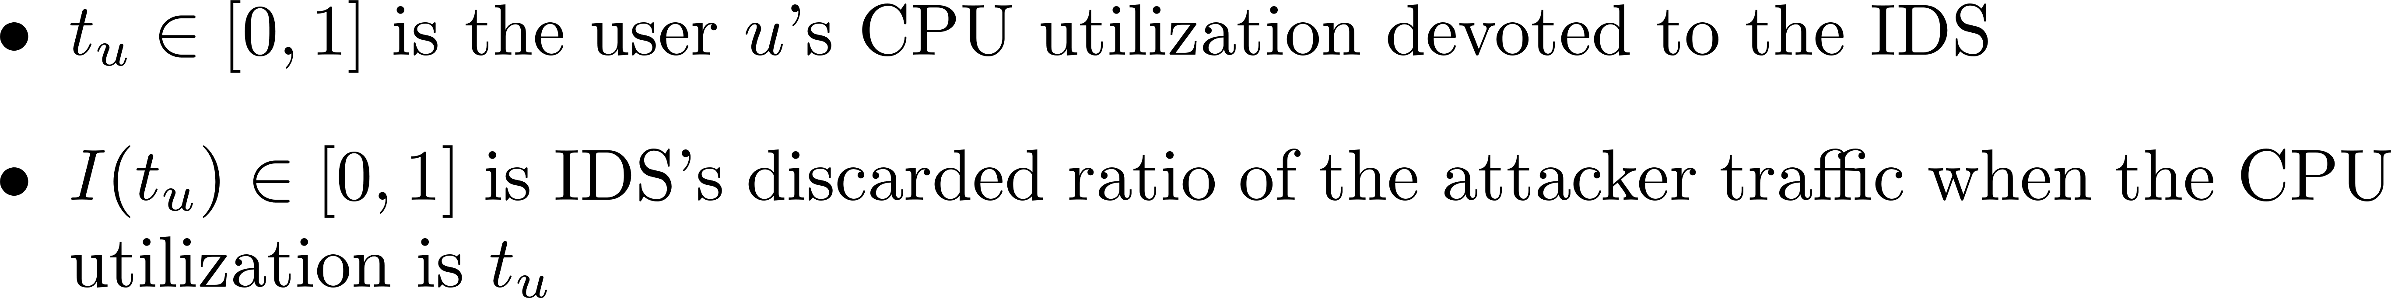
Solution Concept: NBS (4)
Disagreement utility for servicce provider
Model computation delay at the VM as M/M/1 queue

Slide 10
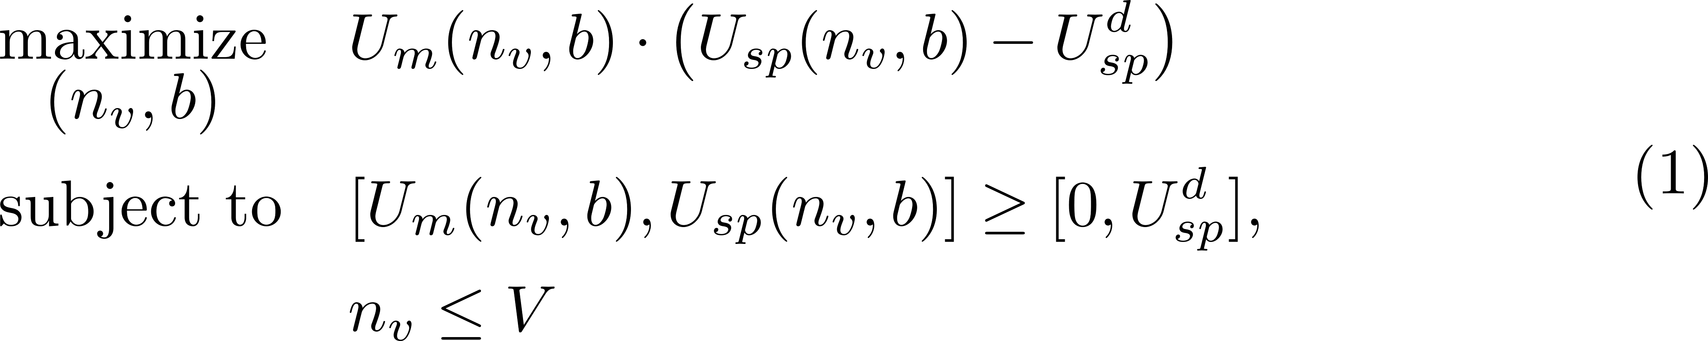
Solution Concept: NBS (5)

