Slide 1
5G DDoS Game Formulation
Zhan-Lun Chang

Slide 2


System Architecture
One base station and thus one MEC operator which has virtual machines (VMs).
Homogeneous and thus the price of each VM is the same.
Each VM provides the same service rate
A finite number of users and attackers
One service provider (SP)

Slide 3


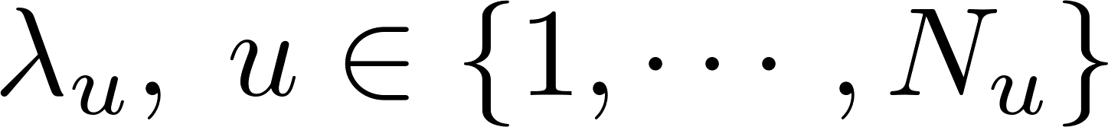
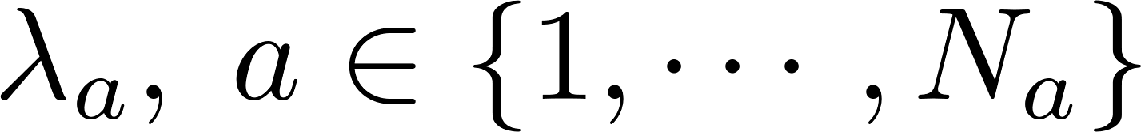
Nomal users and malicious users (attackers)
Attackers are not players in current formulation.
Since attackers are not players, we assume that the attack is executed by issuing requests to connect with the base station.
Number of users = , number of attackers =
Each attacker and normal user has different task arrival rate.
Arrival rate of users=
Arrival rate of attackers =

Slide 4
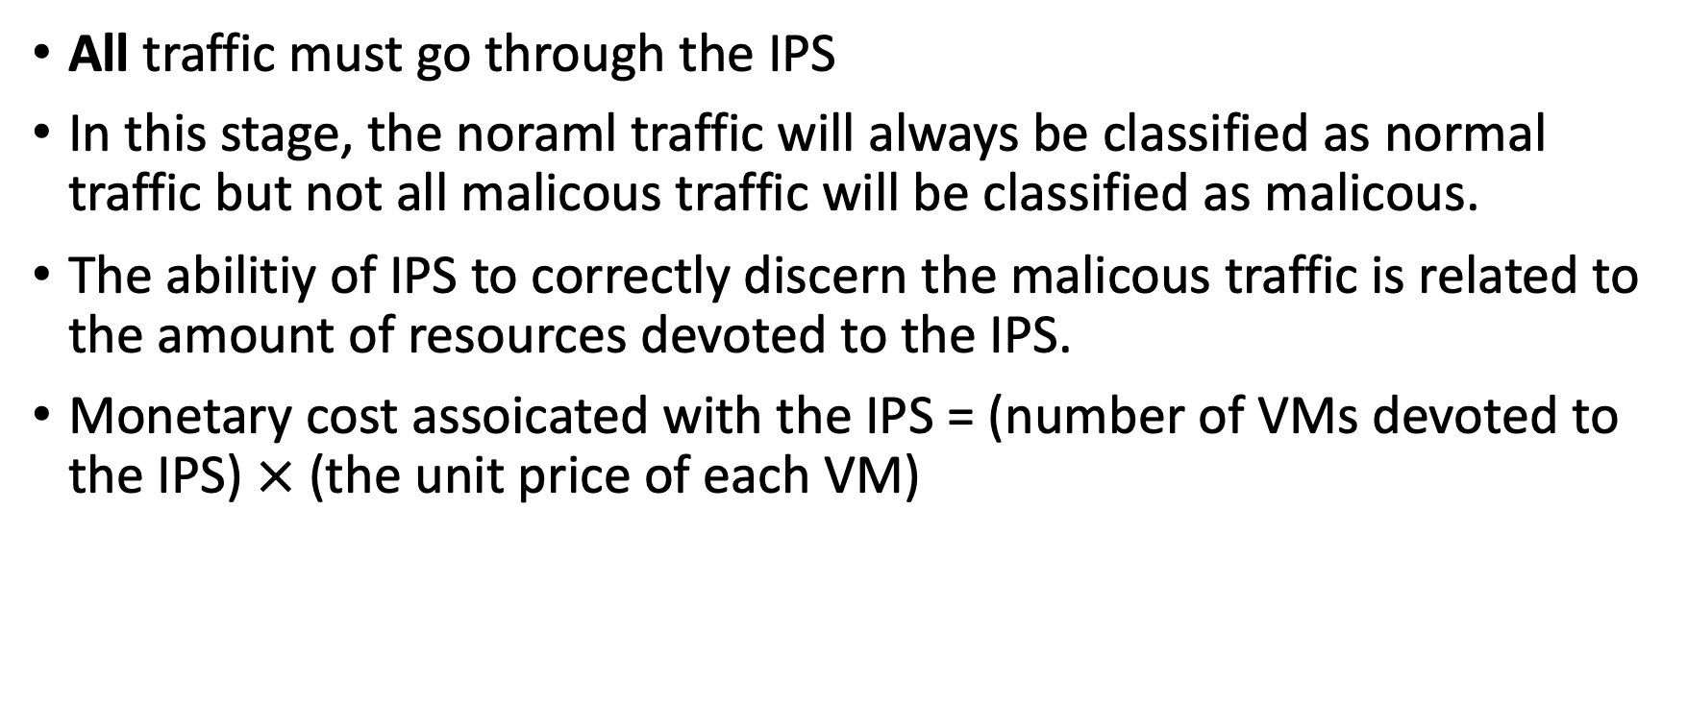
IPS (Intrusion Prevention System)
All traffic must go through the IPS
In this stage, the noraml traffic will always be classified as normal traffic but not all malicous traffic will be classified as malicous.
The abilitiy of IPS to correctly discern the malicous traffic is related to the amount of resources devoted to the IPS.
Monetary cost assoicated with the IPS = (number of VMs devoted to the IPS) $×$ (the unit price of each VM)

Slide 5
IPS Flow Diagram
Malicious traffic
IPS (run in many VMs)
Normal traffic
Traffic out of IPS
All VMs bought by service provider
VM
VM
VM
VM
VM
VM
VM
VM

Slide 6
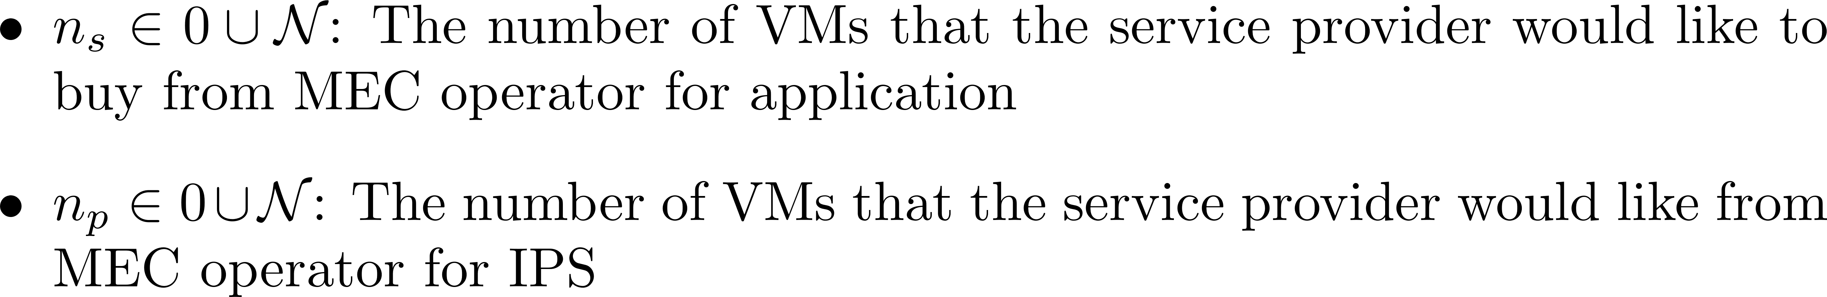
Solution Concept: NBS
Players: the MEC operator and the service provider (SP)
Bargaining decision variables:
Disagreement point:
For the MEC operator: 0
For the service provider: When the all tasks are served by the cloud

Slide 7
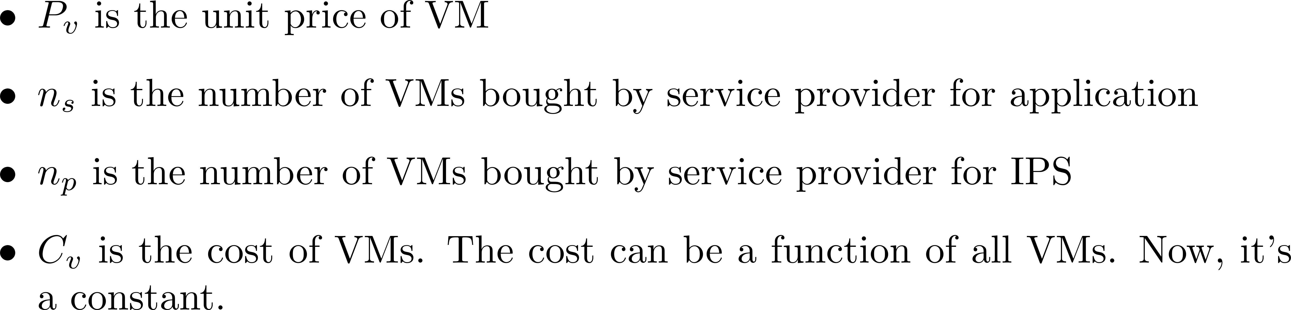
Solution Concept: NBS
Utility of the MEC operator

Slide 8
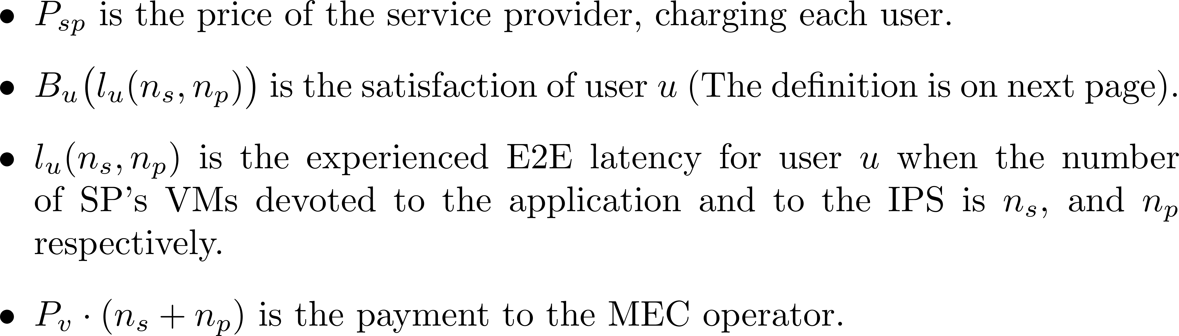
Solution Concept: NBS
Utility of the service provider

Slide 9
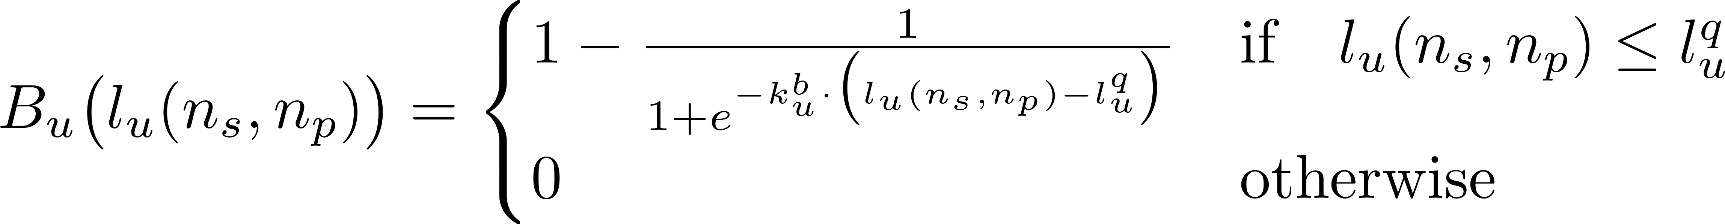
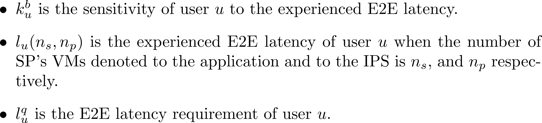
Solution Concept: NBS
Satisfaction of Users
Notes:
two benefits: No need for further assumptions on the E2E latency requirements. The utility of the service provider is continuous function in order to apply NBS.

Slide 10
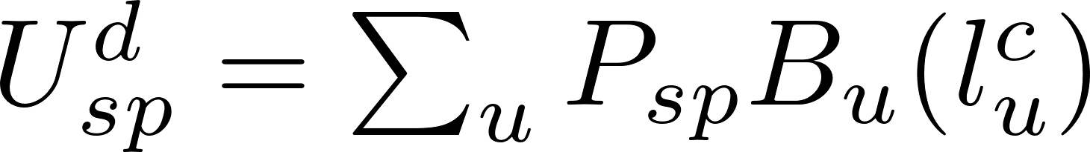
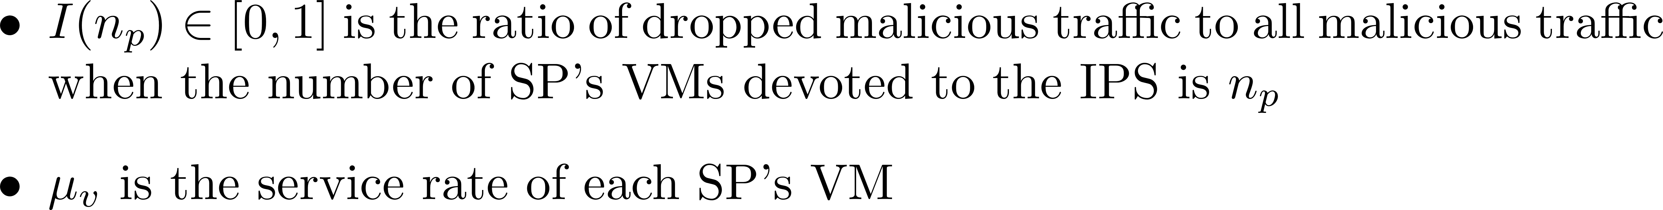
Solution Concept: NBS
Disagreement utility for servicce provider
Model computation delay at the service provider as M/M/1 queue

Slide 11
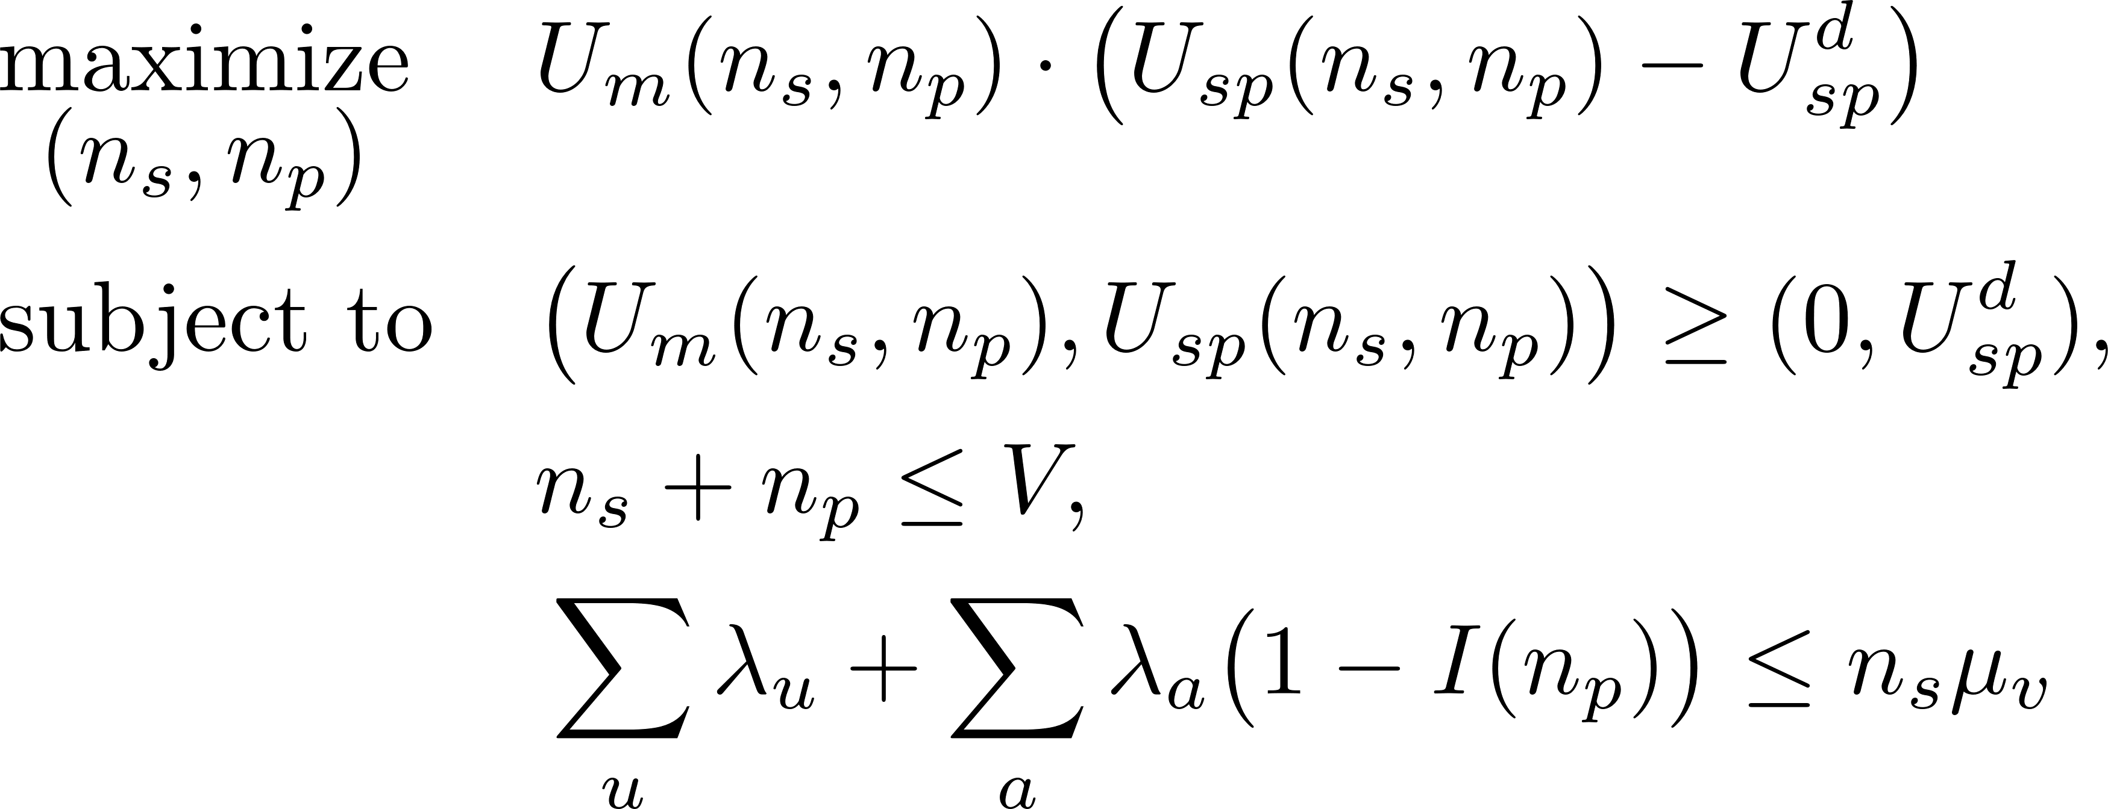
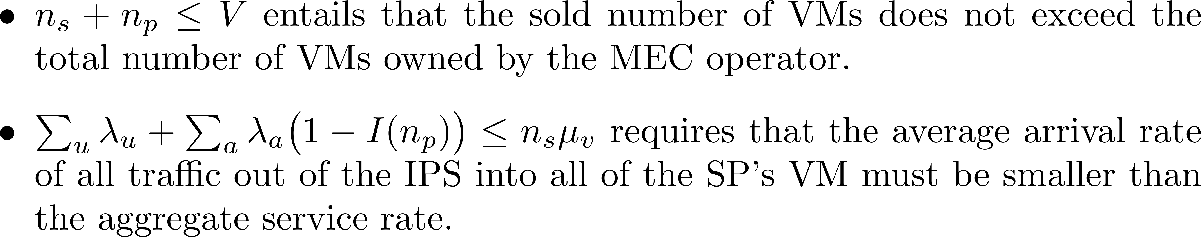
Solution Concept: NBS

Slide 12
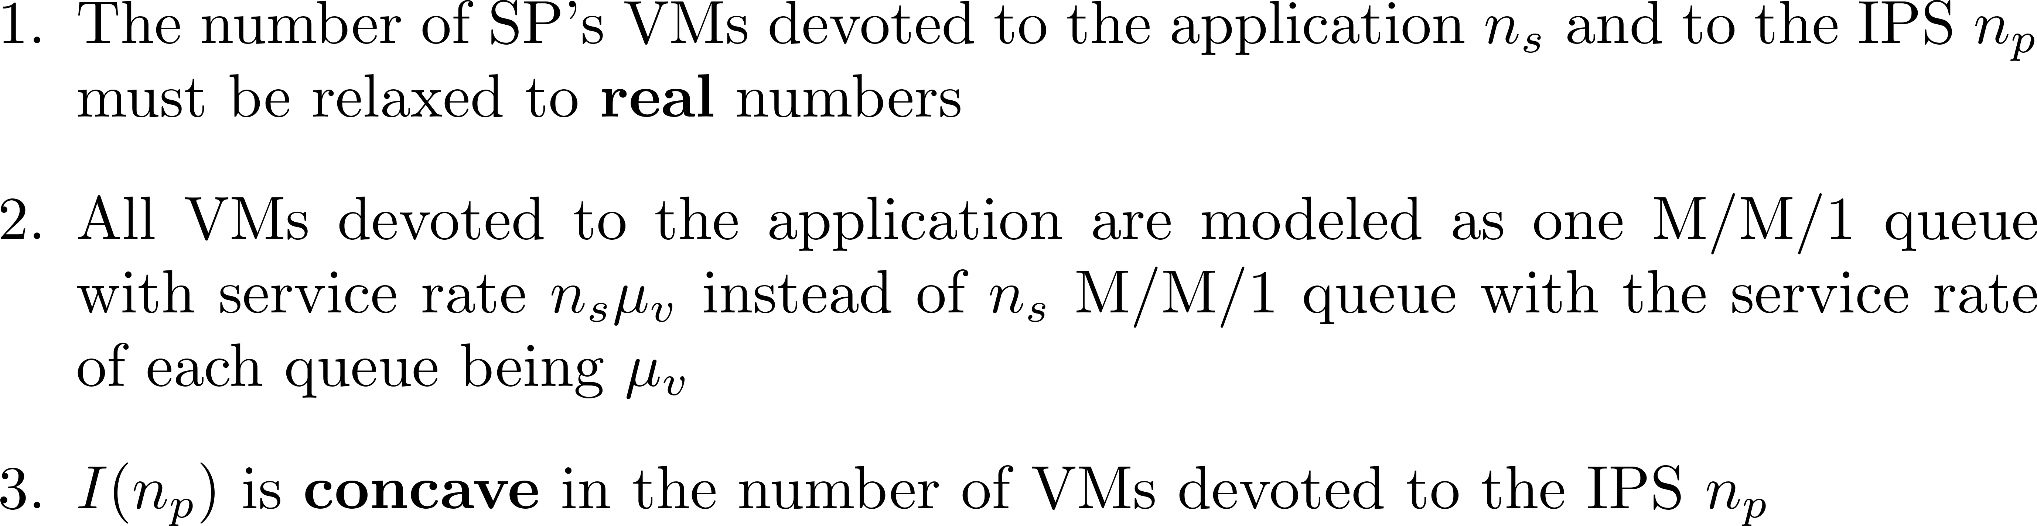
Solution Concept: NBS
In order to apply the NBS, the feasible region of the defined optimization problem must be convex and compact, the following conditions are needed in the current setting.

