Slide 1
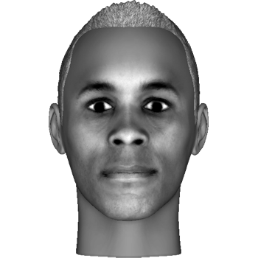
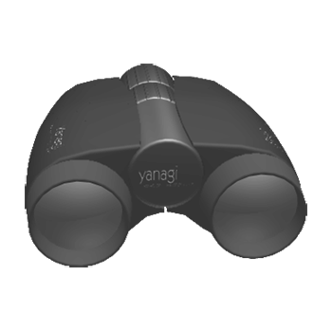


Welcome to the experiment!
We will present you with sequences of images. Each image will be a particular face, object, letter or meaningless symbol, like these:
Some will be presented in front view and some in side view; some will be shown briefly and some for longer periods.
Press the index finger button to proceed

Slide 2
At the beginning of each sequence, we will show you two specific “target” images that you will need to be on the lookout for.
Your task will be to attentively look at each image for as long as it’s on the screen, and press the index finger button whenever you see a target image.
Please respond as quickly and as accurately as possible whenever you see a target image in any view (front or side) shown for short or long duration.
Press the index finger button to proceed or the middle finger button to return to the previous slide

Slide 3
Each block contains 4 sequences and will last about 6 minutes. You will be able to rest between every two blocks.
Please do your best to remain focused and alert during the experiment, and keep your eyes fixed on the center of the screen.
We will start with a few practice trials, and you will have a chance to ask more questions before starting the main experiment.
Good luck!
Press the index finger button to proceed or the middle finger button to return to the previous slide

