Slide 1
Participants rely on task-structured preferences for decision making in large state spaces
Lepauvre, Alex
Post doctoral researcher at Faculty of Psychology
Dysco lab meeting
27-05-2026

Slide 2

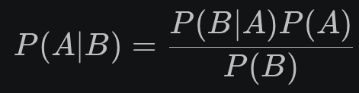
Bayesian account of planning
Internal model
Prediction
Under bayesian accounts of perception and sensorimotor control, sensory evidence is integrated with priors
When sensory evidence is noisy, prior should dominate behaviour
When sensory evidence is strong, it should dominate behaviour
A similar idea can be applied to planning
Evidence is the ouput forward planning
Priors are participants belief about which action is best in the current situation
Sensory
Input
Environment

Slide 3
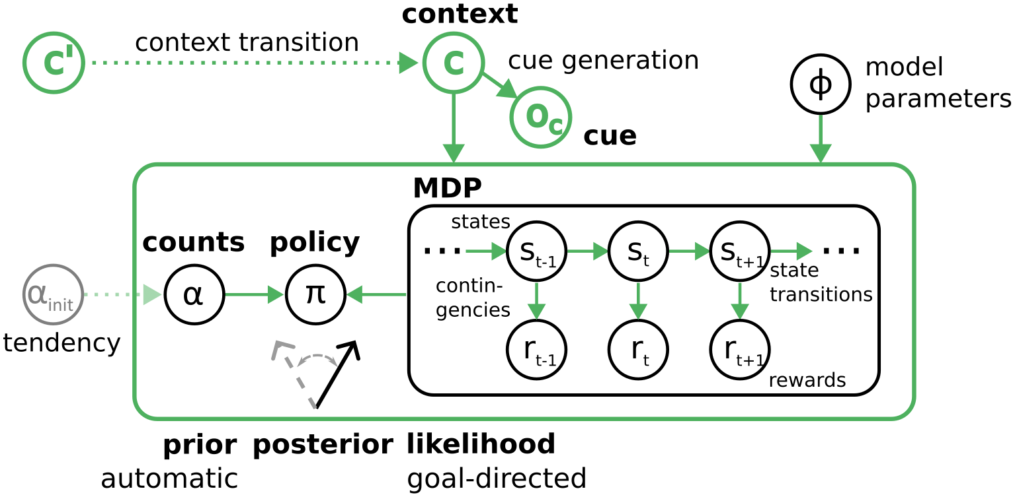
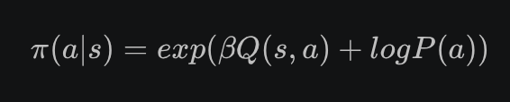
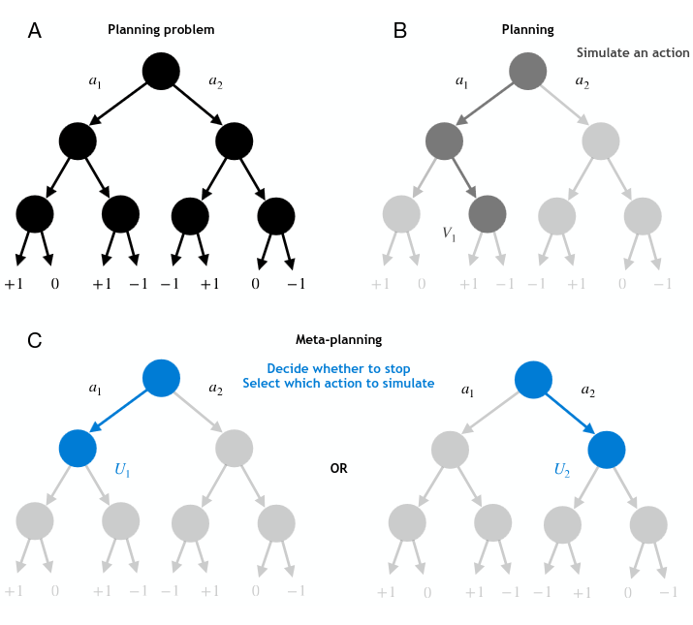
Existing bayesian accounts of planning
(1)
Several frameworks have already investigated forms of this idea
Planning as inference (Botvinick and Toussaint, 2012¹)
Bayesian accounts of habitual vs. Goal directed control (Schwöbel et al., 2021²)
Computational rationality and policy compression (Li and Gershman, 2021³)
Priors conditioned decision tree search depths frameworks (Kuperwajs and Ma, 2021⁴)
Prior is generally assumed to be a recency bias of some kind
(2)
(3)
Sources: (1) https://doi.org/10.1016/j.tics.2012.08.006
(2) https://doi.org/10.1371/journal.pcbi.1012228
(3) https://doi.org/10.1016/bs.plm.2021.02.004
(4) https://doi.org/10.31234/osf.io/qtk9j_v2
Sources: (1) https://doi.org/10.1371/journal.pcbi.1012228
(2) https://doi.org/10.1371/journal.pcbi.1012057
(3) https://doi.org/10.31234/osf.io/qtk9j_v2

Slide 4
Biases in large structured state spaces
(1)
A state independent prior might not be useful depending on the task
Hypothesis: participants priors might reflect the structure of the task
Participants have simple heuristics associated with distinct factors of a task:
  „Accept when reward is high“ or „Reject when cost is high“
Factor specific preferences can be combined to obtain state-specific preferences
The stronger the preference, the less the need for planning
(2)
(3)

Slide 5
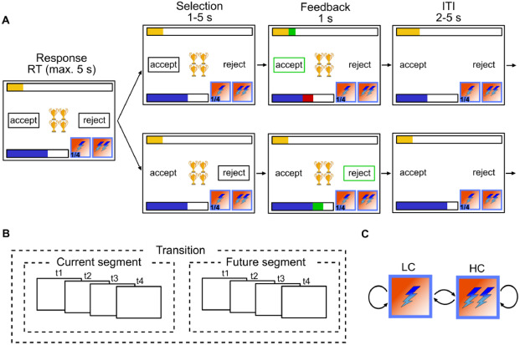
Experimental task: sequential decision making with distinct states
Participants are presented with an offer which accepting comes at a cost
Offers=[1, 2, 3, 4]
Current cost=[1, 2]
Future cost=[1, 2]
Energy=[0:6]
Optimal behaviour requires considering the impact of current action on future reward

Slide 6
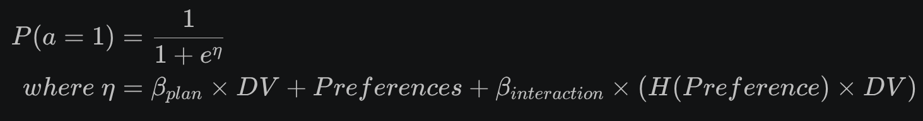
Modelling participants preferences

Slide 7

Modelling participants preferences
Planning

Slide 8

Modelling participants preferences
Planning
 | Offer = 1 | Offer = 2 | Offer = 3 | Offer = 4 | Cost = 1
Trial 1 | 1 | 0 | 0 | 0 | 1
Trial 2 | 0 | 0 | 1 | 0 | 0
... | ... | ... | ... | ... | ...

Slide 9


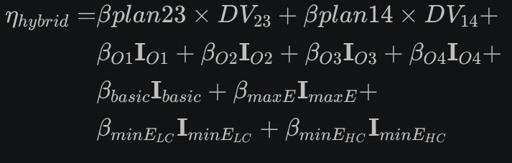
Model to compare against
The preference model is pitted against 3 different models
Pure planning model:
Response Frequency model:
Contextual model:

Slide 10
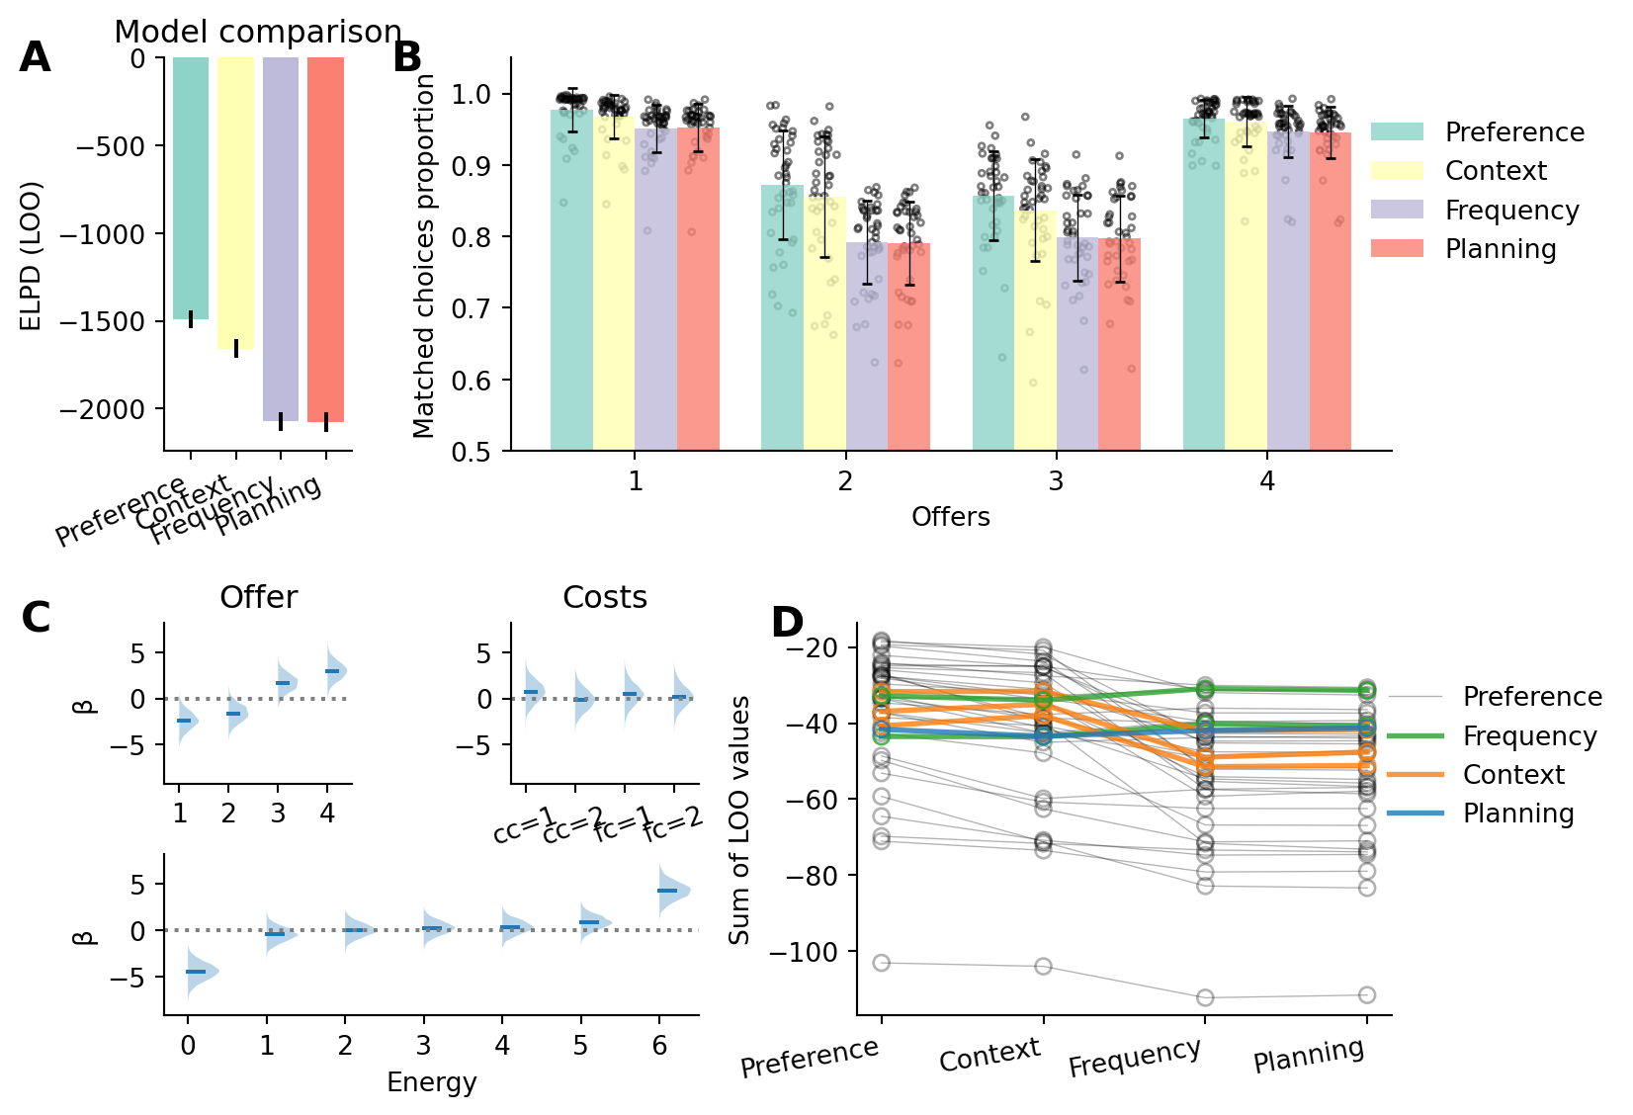
Results: participants show preferences reflecting the structure of the task
The preference model fits the data the best
Participants do show task-structured preferences

Slide 11
Results: participants show preferences reflecting the structure of the task
The preference model fits the data the best
Participants do show task-structured preferences
Participants preferences indicate systematic deviation from optimality
Overly conservative in low offers
Slightly liberal in low costs
Strongly biased when energy is very high or very low

Slide 12
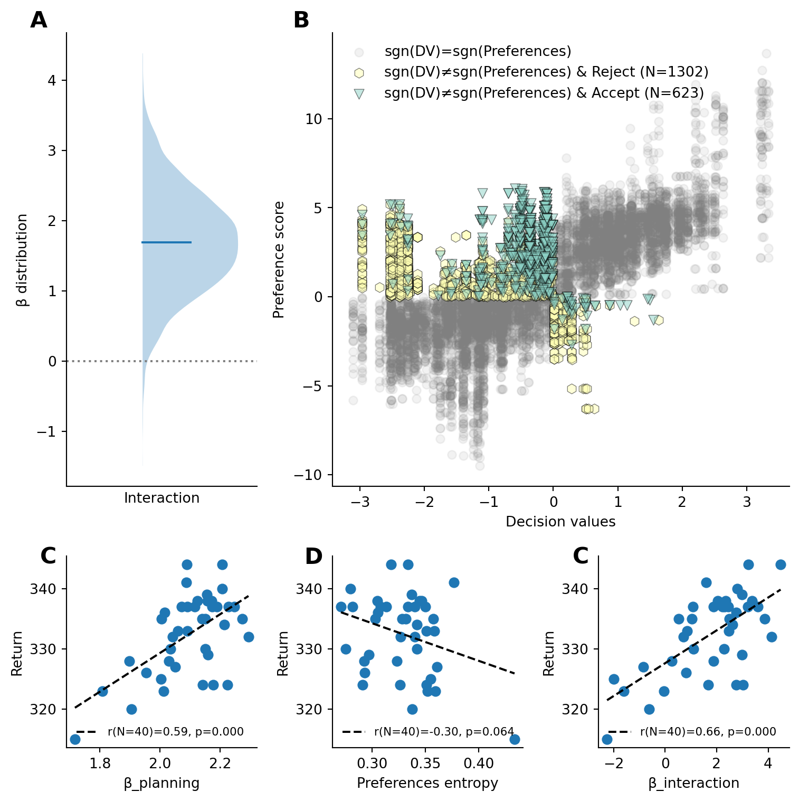
Results: participants choice is most impacted by the ratio of planning and preferences strength
There is a significant interaction between planning and preferences entropy
When decision values are weak, participants choices reflect their preferences
When preferences are weak, participants choices reflect planning

Slide 13
Results: participants choice is most impacted by the ratio of planning and preferences strength
There is a significant interaction between planning and preferences entropy
When decision values are weak, participants choices reflect their preferences
When preferences are weak, participants choices reflect planning

Slide 14
Results: participants choice is most impacted by the ratio of planning and preferences strength
There is a significant interaction between planning and preferences entropy
When decision values are weak, participants choices reflect their preferences
When preferences are weak, participants choices reflect planning

Slide 15
Results: fitted parameters correlates with performances
Planning
Preferences
Participants with stronger planning weights perform better in the task
Participants relying more on planning are expected to have higher returns
Participants with stronger preferences perform slightly worst in the task
Participants relying more on planning are expected to have higher returns
The stronger the interaction the higher the performances
Interaction

Slide 16
Results: the interaction between preferences and planning is reflected in participants reaction times
Earlier evidence suggest that planning is easier when the difference in value between action is high
The larger the |DV| the faster the RT
Our results suggest that the stronger the preferences, the less participants rely on planning
We would expect a positive correlation between preferences and the conflict (-|DV|) → The stronger the preferences, the less planning, hence the less RT should depend on DV

Slide 17
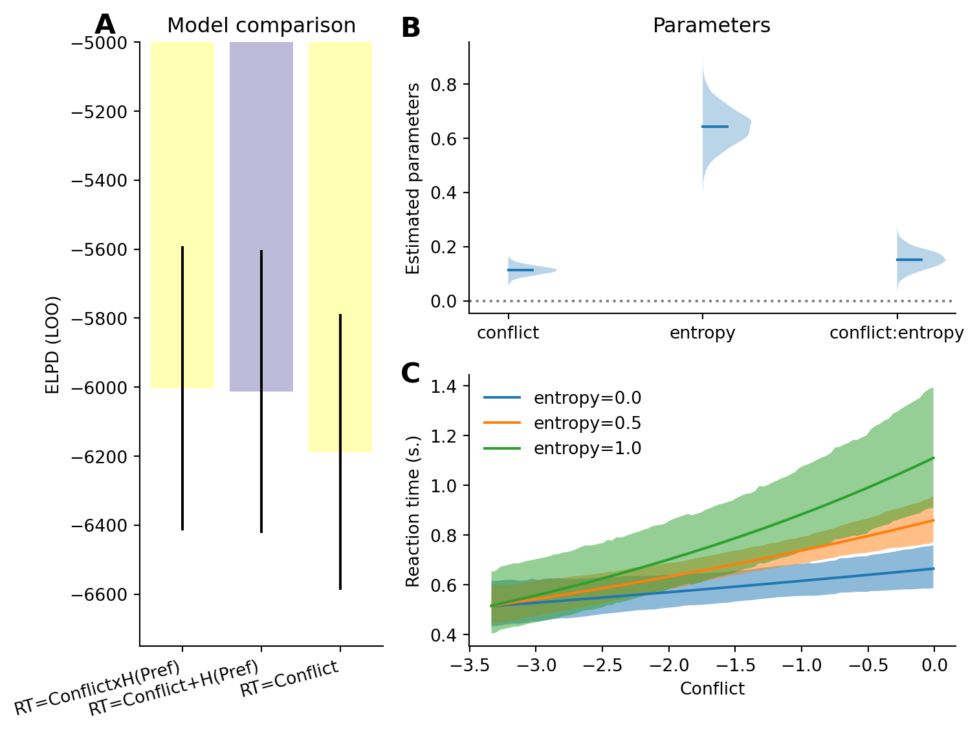
Results: the interaction between preferences and planning is reflected in participants reaction times
The facilitatory effect of increased conflict is most pronounced when preferences are weak (i.e. strong entropy)

Slide 18
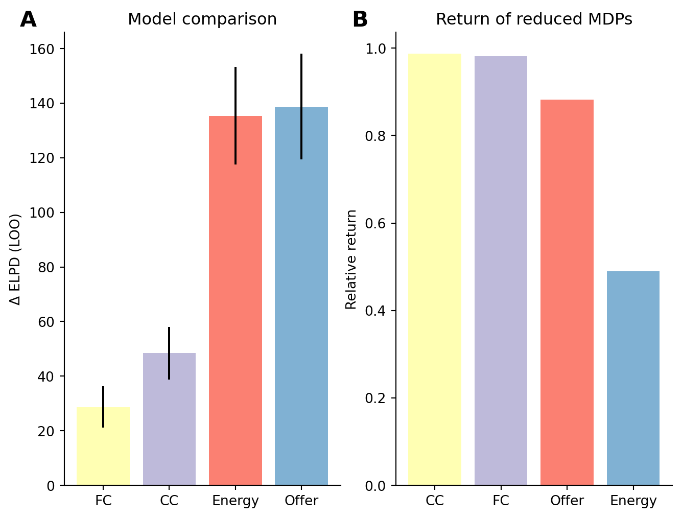
Results: participants preferences weightings reflect the value of task factors
Different factors have different impact in terms of reward
Ignoring certain factor of the task should lead to larger loss than other
An agent with limited resources should attend more to those features that have a stronger impact on return
Could it be what participants preferences weights reflect?
Computed the value of each features and compared it to participants preferences

Slide 19
Summary of the results
In tasks with large state space, participants priors reflect the structure of the task
Preference model fits the datat the best
Parameters from the preference model is predictive of participants performances
Preferences are predictive of participants reaction time
Participants planning is to some extent contingent on preferences
Interaction between preferences entropy and planning on choice responses
The facilitatory effect of conflict is conditioned on preferences
Preferences weights reflect the value of task factors

Slide 20
Interpretation of the results
In tasks with large state space, participants priors reflect the structure of the task
Participants have a factorized representation of the task on which their priors are mapped
When clear information about task structure is available, participants might abstract context from task factors
Participants planning is to some extent contingent on preferences
Preferences’ strength is readily available
Participants sample future outcomes to determine the value of each action
Depending on both, participants either follow preferences, sampled value, or continues sampling

Slide 25
Interpretation of the results
In tasks with large state space, participants priors reflect the structure of the task
Participants have a factorized representation of the task on which their priors are mapped
When clear information about task structure is available, participants might abstract context from task factors
Participants planning is to some extent contingent on preferences
Preferences’ strength is readily available
Participants sample future outcomes to determine the value of each action
Depending on both, participants either follow preferences, sampled value, or continues sampling

Slide 26
Interpretation of the results
In tasks with large state space, participants priors reflect the structure of the task
Participants have a factorized representation of the task on which their priors are mapped
When clear information about task structure is available, participants might abstract context from task factors
Participants planning is to some extent contingent on preferences
Preferences’ strength is readily available
Participants sample future outcomes to determine the value of each action
Depending on both, participants either follow preferences, sampled value, or continues sampling

