Slide 1
Variational Laplace for dummies
20 January 2025

Slide 2
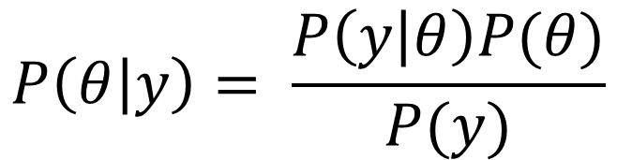
Variational Laplace: approximating model evidence
The method of variational Laplace enables to approximate the posterior and marginal likelihood
Marginal likelihood can be compared between models to relate their evidence
Variational Free energy can be used to accumulate evidence for a particular model
Bayes Theorem
$$P\left(θ | y\right)= \frac{P\left(y | θ\right)P(θ)}{P(y)}$$
Variational Laplace

Slide 3
Variational Laplace: approximating model evidence
The variational approximation of the marginal likelihood has been derived for generalized linear model:
Connectivity analysis (PPI, DCM)
Univariate GLM
Multivariate GLM (MANOVA, pattern component modelling, vRSA)
Bayes Theorem
$$P\left(θ | y\right)= \frac{P\left(y | θ\right)P(θ)}{P(y)}$$
Variational Laplace

Slide 4
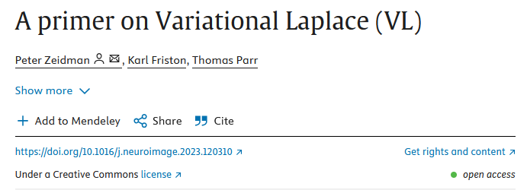
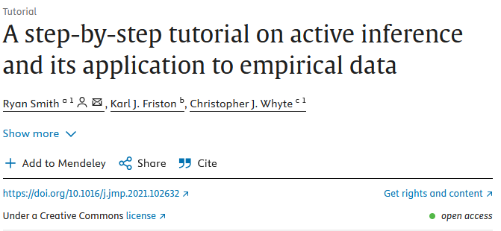

The math behind variational Laplace are a bit daunting for students with “weak” mathematical background
Some excellent resources are available to understand the mathematical backbone of variational Laplace
These resources are challenging to approach for readers who do not have a strong background in mathematics (such as myself)

Slide 5



Variational Laplace for dummies: understanding and applying variational Laplace
I started documenting my own journey to understanding variational Laplace
I recently started to organize the notes I took along the way using Jupyter book with python
Jupyter book enables to compile textbook-like websites based on Jupyter notebook

Slide 6
Where we are at
A first draft of the book was written, covering:
Introduction to basic concepts of probabilities and statistics and the Bayes theorem
Detailed explanation of Variational Laplace for the simplest case of the linear model
I combine three strategies to maximize accessibility: Wordy Explanations, Mathematical Formulas, Python Code Translation
The draft is currently under review by Jan

Slide 7
Where we are heading
The book will be extended to cover:
Multivariate GLM (MANOVA, variational RSA)
Hierarchical univariate linear models
Hierarchical multivariate linear models
Our publishing model:
We aim to keep the online book open access
We hope it will become community driven, where various users contribute based on their interests and expertise
For paper version, considering print on demand services where benefits are shared with nonprofit organization

Slide 8
Where we could use some help
Are we overlooking resources
To our knowledge, there exist no textbook meant to explain variational Laplace for novices
Any contribution is welcome…
We are currently making great progress and are confident that we will achieve our goal
An extra pair of (expert) eyes to revise the content are always welcome
Advice on distributing our resource
It would be ideal for the book to reach its target audience. How can we facilitate it?
Are there any thematic omission in what we have described so far:
The content is tailored to what is most useful to us, but other aspects might be relevant

