Slide 1
AST10401 Introduction to Electrical Engineering
0. Introduction

Slide 2
Teacher
Kwan Ho Yuet, Vincent
Email: hykwan@cityu.edu.hk
Tel: 3442-8763
Office: AC2 6432
Consultation: 2:00pm to 3:00pm every Friday

Slide 3
Teaching Schedule
Lectures
Almost 2 hours: 17:00 – 18:50, Friday, at LI(AC2) – 2505
Tutorial/LAB sessions (on Friday, almost 1 hour)
Totally 4 sessions.
Please go to your assigned session.

Slide 4
What is Electrical Engineering?
A study of electricity, electromagnetism and electronics.
EE can be viewed as the study of controlling electron flow to serve our purposes (e.g. power generation, control a robot, telecommunications, computations etc.)

Slide 5
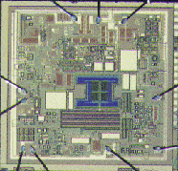




Major Areas of Electrical Engineering
Power Systems
Micro Electronics
Electrical Engineering
Control Systems
Telecommunication
System
Computer Systems

Slide 6
What we care in this course?
To provide students the basic concepts and analytical techniques for analyzing electric circuits
This course is a foundation course of EE, it supports you to study different areas in EE in your future!

Slide 7
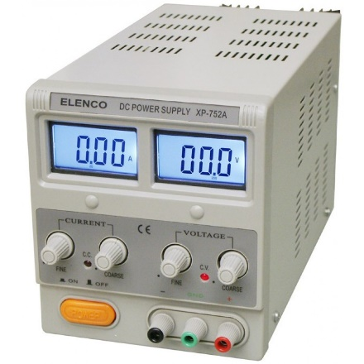
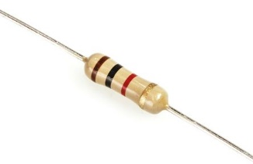
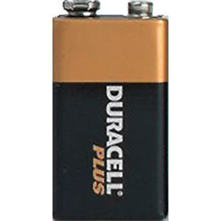
Contents
Week 1: Basic Concept and Laws in Electrical Engineering
Electrical quantities and units, Electrical Sources, Power, Energy, resistors, Ohm’s Law
Week 2: Electric Circuit
Kirchhoff’s Voltage and Current Laws, Equivalent resistance
Electrical Sources
resistor

Slide 8
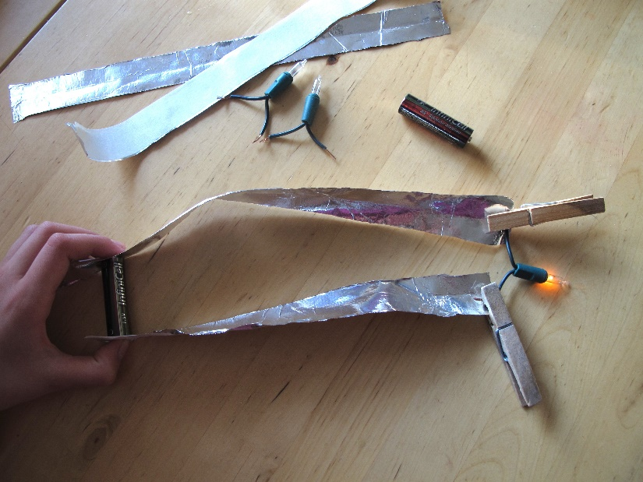
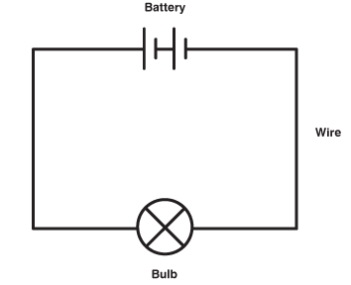
Contents
Week 3: Circuit Analysis I
Nodal Analysis, Mesh Analysis
Week 4: Circuit Analysis II
Linearity, Superposition, Thévenin Equivalent Circuit
Week 5: Circuit Analysis III
Norton Equivalent Circuit, Maximum Power Transfer Theorem
Actual Circuit
The corresponding circuit diagram

Slide 9
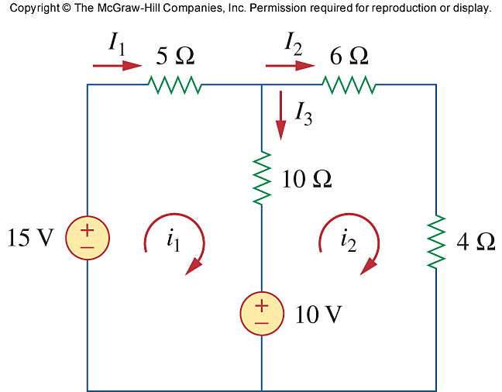
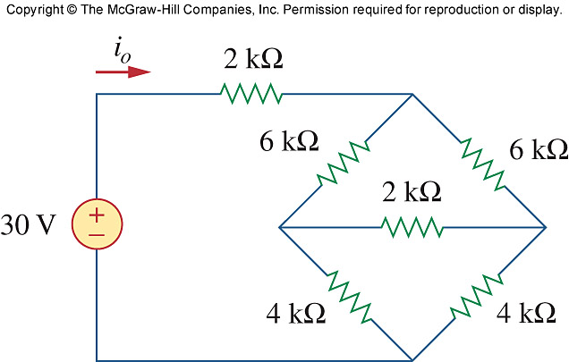
Contents
You will know how to analyze circuits like

Slide 10
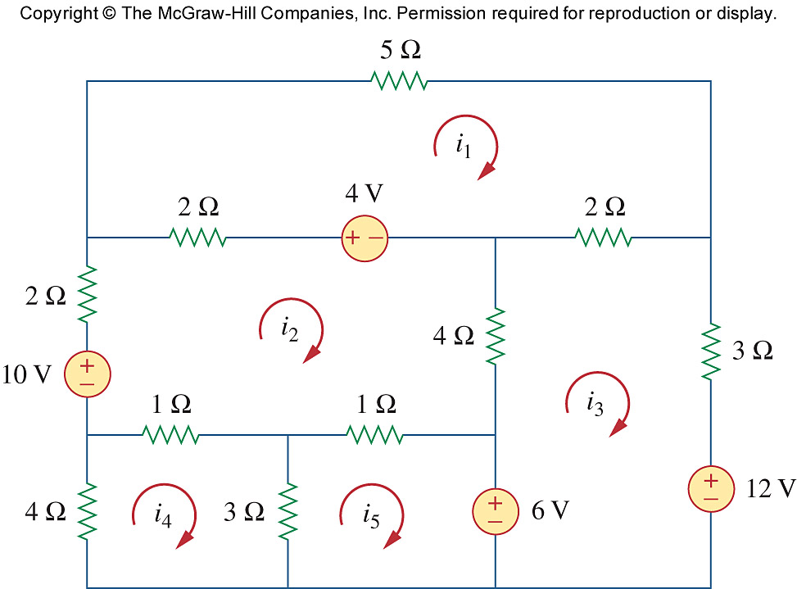
Contents
You will know how to analyze a circuit like

Slide 11
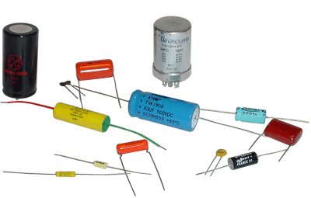
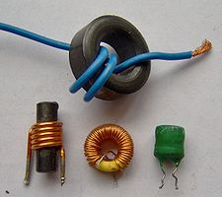
Contents
Week 6: Capacitors and Inductors
Inductance, Capacitance, Equivalent Inductance and Capacitance
Week 7: First Order Circuits
Natural Responses of
RC and LR circuits
Week 8: First Order Circuits
Step Responses of RC and LR circuits
Capacitors
Inductors
R₁
v_{s}
R₂
+
–
R₃
C
First Order Circuit

Slide 12
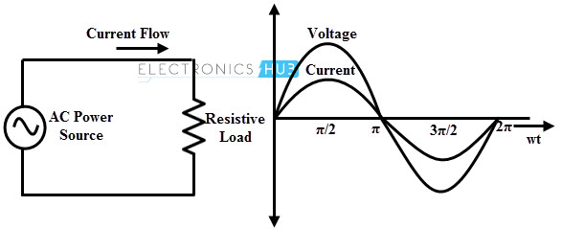
Contents
Week 9: Second Order Circuits
Natural Responses of RLC circuits
Week 10: Second Order Circuits
Step Responses of RLC circuits, Sinusoidal functions, Frequency, Phase, Phasor representation of voltage and current, Impedance
Week 11: AC circuits
AC circuit analysis, Power Factor Correction
Week 12-13: AC circuits
Three phase circuits

Slide 13
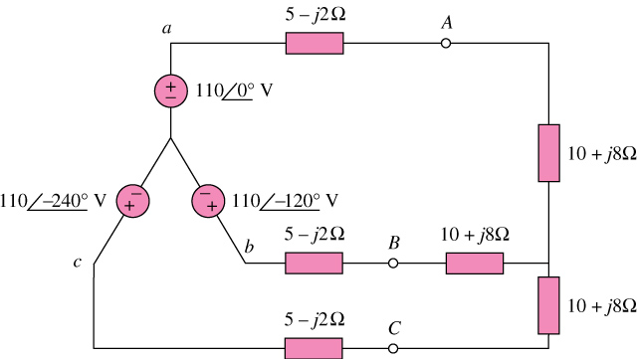
Contents
You will know how to analyze a 3-phrase circuit:

Slide 14
Course Intended Learning Outcomes
Apply standard methods for the analysis, design, and simulation of passive, linear electric circuits, and measurement of their properties.
Analyse the behaviour of energy storage elements in a circuit.
Perform transient and ac steady state circuit analysis.
Determine the power supplied and distributed in three-phase systems, and perform power factor corrections.
Produce functional and efficient, passive circuits for various applications.

Slide 15
Assessing Scheme
Examination (60%)
Coursework (40%)
Midterm (10%)
Assignments (20%) (2 sets, 10% each)
Lab Reports and Tutorial Exercise (10%, 10/12% each)
Final mark in the course
A student’s final mark in the course will be the aggregate of the results from all assessment tasks according to the weighting specified above.

Slide 16
Assignments and Tutorials
For tutorials, you are required to submit only what have been discussed in a tutorial session.
For each assignment, there are two sections: Sections A and B.
Section A is a “warm-up” part. With relevant steps and answers, full marks of each question will be granted. (Just check your effort)
Section B is a “formal” part. Detailed steps and answers are required and checked.
You have to show a reasonable number of steps and correct answer for getting full marks.

Slide 17
Assignment and Tutorial Submissions
For Tutorials/Lab:
Each tutorial/lab report submission should be done within one week after each tutorial session.
Electronic Submissions via CANVAS are required.
For Assignments:
The deadline of each assignment is specified on the front page of the assignment.
Both Electronic Submissions via CANVAS and Hardcopy Submissions are required.
A standard cover page must be included for each hardcopy submission.
Any submissions without the cover page will not be handled.

Slide 18
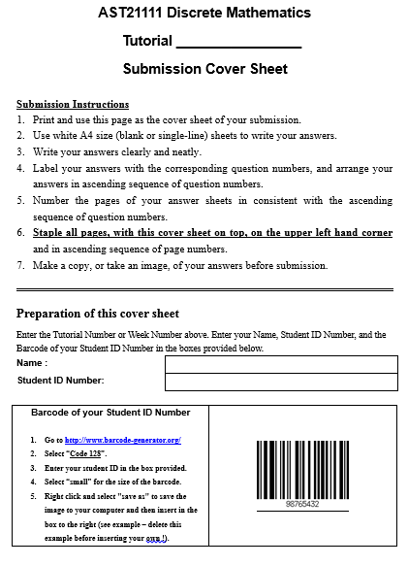
Assignment and Tutorial Submissions
AST10401 Introduction to EE
The Standard Cover page

Slide 19
Late Submission of Assessment Work
No late submission is allowed unless you have a valid reason.

Slide 20
Test and Exam
The time allowed of the test is about 1 hour. The test will be conducted in around Week 9.
The exact date and location of the test will be announced later.
The examination is closed book and an approved calculator is allowed.

Slide 21
Assessment-Related Policies
Students are expected to present their own work. Academic dishonesty is regarded as a serious offence in CCCU. Any related offence can lead to disciplinary action with a penalty including expulsion from CCCU and debarment from re-admission. For details, you may refer to CCCU’s Rules on Academic Honesty in your student handbook.
If you are not able to attend an examination or test due to extenuating circumstances such as illness, hospitalization, accident, family problems or other unforeseeable serious personal or emotional circumstances, you need to inform the AST general office. Please refer to the Academic Regulations on Illness or other Circumstances Affecting Assessment for details: http://www6.cityu.edu.hk/arro/content.asp?cid=171.

Slide 22
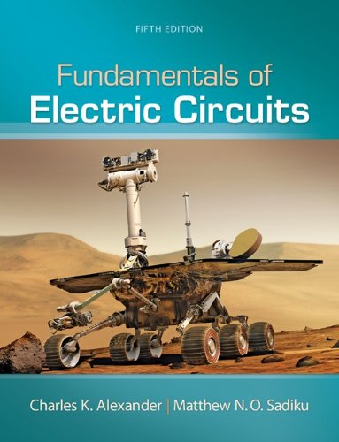
Textbook
Fundamentals of Electric Circuits (5th edition, international edition) by Alexander and Sadiku

Slide 23
Course Outline
All the above contents are extracted from the course outline which can be downloaded from CANVAS.
For more details, please check the course outline by yourself.

