Slide 1
AST10401 Introduction to Electrical Engineering
1. Basic Concepts and Laws in Electrical Engineering

Slide 2
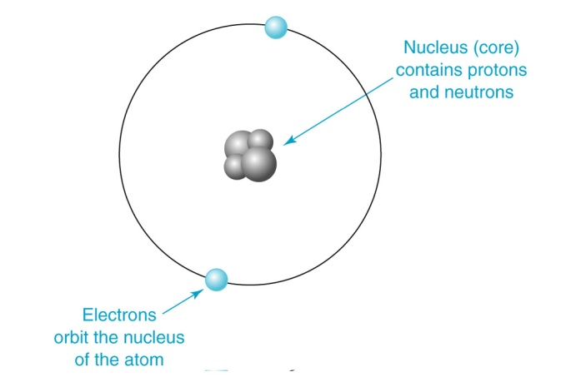
Charge(電荷)
All matter is made of atoms.
Each atom is made of electron(s), proton(s) and neutron(s).
Both proton and electron carry charges.
Charge is a fundamental electric quantity which is measured in Coulombs (C).
The Atomic Model of an atom

Slide 3
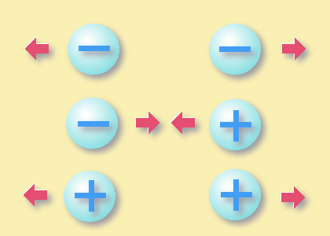
Charge
Each proton carries the amount of +ve charge q₀ = +1.602×10⁻¹⁹ C.
Each electron carries the amount of –ve charge -q₀ = -1.602×10⁻¹⁹ C.
Like charges repel each other.
Opposite charges attract each other.
Charges found in nature are usually integral multiples of q₀. (i.e. +/- q_{0,} +/- 2q_{0 ,} +/- 3q₀)

Slide 4
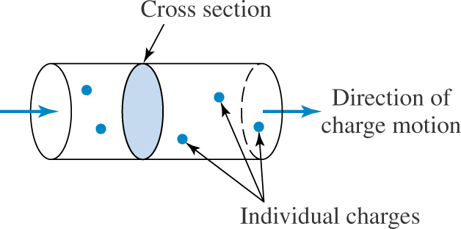
Electric Current(電流)
Electric Current (i)
The amount of positive charges passing through a given cross section of
a substance in one second is called Electric Current.
The unit of Current :
1 Ampere (A) = 1 Coulomb/second
dq charge that flow through a given cross-sectional area in dt units of time.

Slide 5
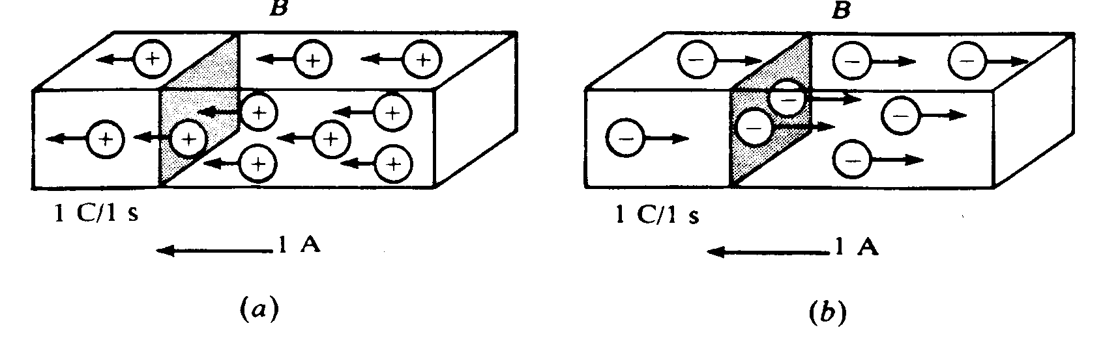
Electric Current
The direction of current is defined as the flow direction of +ve charges.
L
R
1C +ve charges flow from Right to Left per second, so there is 1A current flows from Right to Left.

Slide 6
Electric Current
The direction of current can also be defined as the opposite direction of -ve charges flow.
L
R
1C -ve charges flow from Left to Right per second, so there is 1A current
flows from Right to Left.

Slide 7
Electric Current
Positive charges
Negative charges
L
=
R
1C +ve charges flow from R to L per second
= 1C -ve charges flow from L to R per second
= 1A current flows from Right to Left.

Slide 8

Electric Current
Example
A conductor has a constant current of 5 A. How many electrons pass a cross section of the conductor in one minute?
L
R
5A
Solution
Total no. of charges pass in 1 min in 5 A current = (5 C/s) (60) = 300 C/min
Total no. of electrons pass in 1 min is given by

Slide 9
Electric Potential Energy
In electrical engineering, moving charges in a substance involves some work or electric potential energy (電勢能) transferred(gain/loss).
We simply call electric potential energy as “energy” in this course.
The work or energy is measured in joules(J).

Slide 10
Voltage(電壓)
The unit of energy is Joules (J)
Voltage at Point a (V_{a})
The energy transferred (gain/loss) of a unit +ve charge (+1C) moving from a reference point to point a in an electric element.
The unit of voltage is Volt(V).
The voltage at a reference point is defined as 0V.
V_{a}
b
a
Consider a 1C +ve charge moves from a reference point (0V) to point a,
if it gains 2J energy, then V_{a} = +2V.
If it losses 2J energy, then V_{a} = -2V.
A reference point defined as 0V
1C
10

Slide 11
Voltage Difference
Potential/Voltage Difference between points a and b in an electric element, V_{ab} is defined as
V_{ab} is also called as Voltage Across point a and point b in an element.
It is found that V_{ab} is related to energy transferred:
ΔW_{ba} is the energy transfer of charges q moving from b to a.
V_{ab}
V_{b}
V_{a}
b
a
q

Slide 12
Voltage Difference
Find the energy transferred of +2C moving from b to a via the element below.
Given q = +2C, V_{a} = 10V and V_{b} = 5V,
V_{ab} = V_{a} – V_{b} = 10 – 5 = 5V,
As V_{ab} = ΔW_{ba} / q , so ΔW_{ba} = 5 (+2) = +10J.
That means when +2C charge moves from b to a, the charge gains 10J.
(+ve means a gain)
ΔW_{ba}
+2C
b
a
5V
10V
a reference point with 0V

Slide 13
Voltage Difference
Find the energy transferred of +2C moving from b to a via the element below.
Given q = +2C, V_{a} = 5V and V_{b} = 10V,
V_{ab} = 5 – 10 = -5V,
As V_{ab} = ΔW_{ba} / q , so ΔW_{ba} = -5 (+2) = -10J.
That means when +2C charge moves from b to a, the charge losses 10J.
(-ve means a loss)
ΔW_{ba}
+2C
b
a
10V
5V
a reference point with 0V

Slide 14
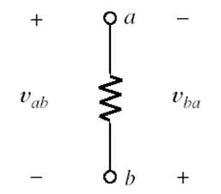

Voltage Difference
Given that there is a voltage across an element, the terminal with a higher voltage is marked with a + sign and the terminal with a lower voltage is marked with a - sign

Slide 15
Power(功率)
When a charge passes through an electric element, energy transferred takes place between the charge and element.
Power (p) of an element:
The energy transferred of the element per second in watts (W). Mathematically:
where v is the voltage across the element and i is the current.
The change of energy content of the element in one second

Slide 16
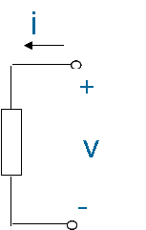
Power(功率)
charge losses energy
+2C
10V
5V
Power (p) of an element: the energy transferred of the element per second
Case 1: (the current entering point has a higher voltage then leaving point)
+ve charges loss power
2) the power absorbed by the element
3) The power of the element increases
4) The element’s power is defined as +ve:
p = +|v||i|
a
a current / a charge flows from a to b
b
+ve sign represents power absorption of an element

Slide 17
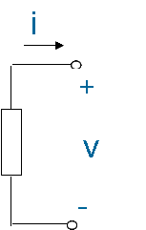
Power(功率)
charge gains energy
+2C
b
a
5V
10V
Power (p) of an element: the energy transferred of the element per second
Case 2: (the current entering point has a lower voltage)
+ve charges gain power
2) the power supplied by the element
3) the power of the element decreases
4) the element’s power is defined as -ve:
p = -|v||i|
a
a current / a charge flows from b to a
b
-ve sign represents power supplying of an element

Slide 18
Power
p = +|v||i|
p = -|v||i|
i
i
+
v
_
a
Voltage at the current entering point > voltage at the current leaving point
+
v
_
a
Voltage at the current entering point < voltage at the current leaving point
b
b
Power Absorbing Element with +ve power
Power Supplying Element with –ve power

Slide 19
Power Sum
In an electric circuit, Total Power supplied = Total Power absorbed
According to the previous definitions, at any time we have:
Sum of all power in a circuit must be zero.

Slide 20
Power Sum
Example:
Now V₁ = V_{ab} = 1.5V
Power of the light bulb = +|V₁|x|I| = +|1.5|x|2| = +3W
Power of the battery = -|V_{ab}|x|I| = -|1.5|x|2| = -3W
I = 2A
a
The light bub
absorbs power
+
+
The battery
supplies power
v_{ab}
+
v₁
1.5 V
_
_
_
I
b

Slide 21
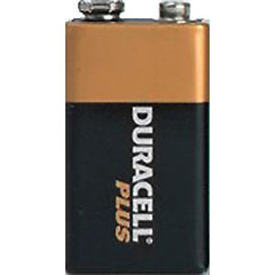
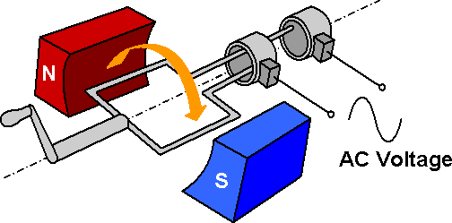
Electrical Sources
An electrical source is a device that is capable of converting non-electric energy to electric energy.
e.g.:
A battery: Chemical Energy to Electric Energy
An electric generator: Mechanical Energy to Electric Energy

Slide 22
Electrical Sources
There are 4 types of source in electrical engineering.
Independent Voltage Sources
Dependent Voltage Sources
Independent Current Sources
Dependent Current Sources

Slide 23
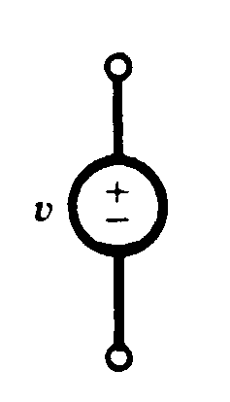
Independent Voltage Sources
Independent Voltage Source:
A circuit element that maintains a certain voltage across its terminals, regardless of the current flowing inside.
Device symbols:
Voltage is known, but its current is determined by the electrical elements that are connected to the source.
A battery is considered as an independent voltage source.

Slide 24
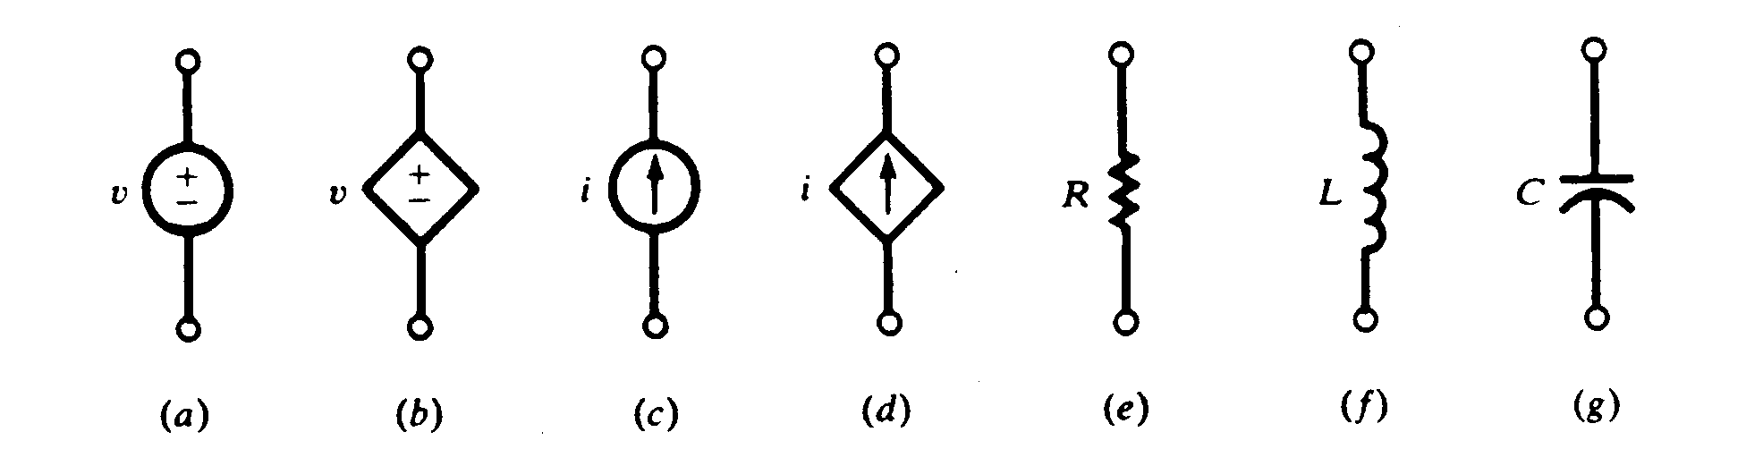
Dependent Voltage Sources
The voltage of a source depends on a voltage or current somewhere else in the circuit.
Device symbols:
v =μ v_{x}
v =ρ i_{x}
depends on other voltage V_{x}
depends on other
current i_{x}
Voltage-Controlled
Voltage Source (VCVS)
Current-Controlled
Voltage Source (CCVS)

Slide 25
Independent Current Sources
Independent Current Source:
A circuit element that maintains a certain current through its terminals, regardless of the voltage across those terminals.
Device symbols:
Current is known, but its voltage is determined by the electrical elements that are connected to the source.

Slide 26
Dependent Current Sources
The current of a source depends on a voltage or current somewhere else in the circuit.
Device symbols:
i =α v_{x}
i =α i_{x}
depends on other voltage V_{x}
depends on other voltage i_{x}
Voltage-Controlled
Current Source (VCCS)
Current-Controlled
Current Source (CCCS)

Slide 27
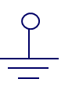
Ground
Ground: represents a specific reference node.
Usually assign 0V to ground
The ground symbol:

Slide 28
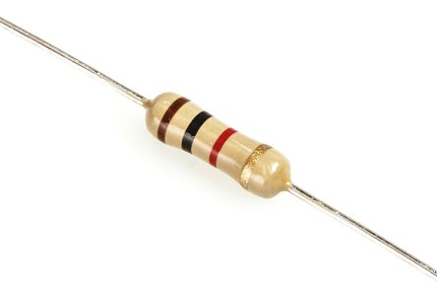
Resistors
Resistor:
A 2-termainal power absorbing device that its current and voltage across the 2 terminals are determined by Ohm’s law.
Device symbols:

Slide 29
Ohm’s Law
Ohm’s law
The voltage across a resistor is directly proportional to the current
flowing through the resistor.
The mathematical expression for Ohm’s Law is as follows:
where R is a constant and called resistance, measured in Ohm(Ω).
V_{a}
R
V_{b}
b
A resistor is a power absorbing device.
a
+
-
I
current from a to b

Slide 30
Ohm’s Law
V_{a}
R
V_{b}
a
b
+
-
I
current from a to b
The i-v characteristic curve of a resistor
I
V

Slide 31
Ohm’s Law
Given that V_{a} = 10V, V_{b} = 5V and I = 1A, Find R
V_{ab} = V_{a} – V_{b} = 10 – 5 = 5V
By Ohm’s law: R = V_{ab} / I = 5Ω
I
R
V_{a}
V_{b}
+
V_{ab}
-

Slide 32
Ohm’s Law
The power absorbed by a resistor:
I
R
V_{a}
V_{b}
+
V_{ab}
-

