Slide 1
AST10401 Introduction to Electrical Engineering
L02 Electric Circuits

Slide 2
Electric Circuits
An electric circuit is a connection of electric elements with wires and those electric elements are usually connected to form loop(s).
A loop is a closed path. (i.e. a journey starts and ends at the same point.)
+
R₂
R₃
V
_
R₁
a conductive wire with zero resistance
an electric circuit

Slide 3
Circuit Terminologies

Slide 4
Branches
A branch is an element in a circuit. (e.g. a voltage source or a resistor)
R₃
R₂
R₃
+
R₂
+
_
V
_
V
R₁
R₁
4 branches in this circuit

Slide 5
Nodes
A node in a circuit is a point that joins branches together.
+
R₁
R₂
V
_

Slide 6
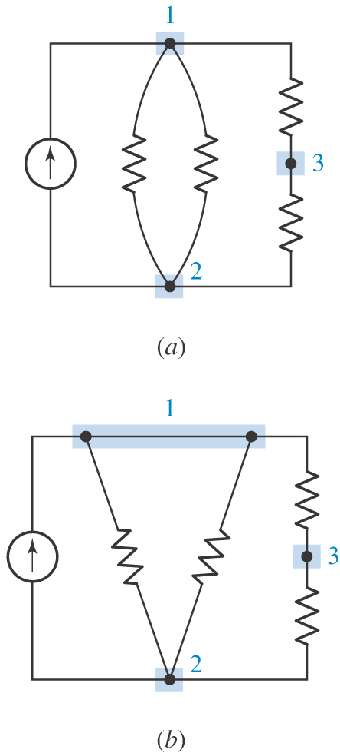
Nodes and Branches
If nodes are joined together by wire(s) only, those nodes are considered as the same node.
A circuit containing 3 nodes

Slide 7
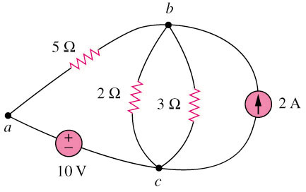
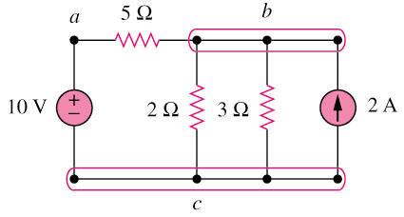
Nodes and Branches
Example
How many branches and nodes are there?
original circuit
equivalent circuit
5 Branches and 3 nodes

Slide 8
Laws in Circuit Theory

Slide 9
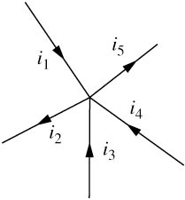
Kirchhoff’s Current Law
KCL helps form a current relationship.
Kirchhoff’s Current Law (KCL):
The algebraic sum of currents at a node is zero.
Define:
A current entering a node has +ve sign.
A current leaving a node has –ve sign.
signs of numbers are taken into account
Mathematically,
-ve
+ve
sum of “in” = sum of “out”

Slide 10
KCL
you can make an assumption on the flow direction of an unknown current initially.
Example: Find i₀ and i₄
i_{s} = 5A, i₁ = 2A, i₂ = 3A, i₃ = 1.5A
-ve
+ve
a
i₀
i₁
i₂
2A
3A
b
i_{s}
+
V_{s}
i₃
i₄
_
1.5A
i_{s}
i₄ flows in the opposite way to the early assumption.
5A
c

Slide 11
Kirchhoff’s Voltage Law
Kirchhoff’s Voltage Law (KVL):
The algebraic sum of all voltage/potential differences around a loop in a circuit is zero.
Summing clock-wisely or anti-clock-wisely is the same.
Mathematically,
By the conservation of energy
KVL helps form a voltage relationship.

Slide 12
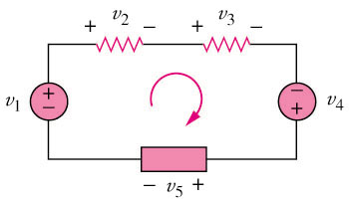
KVL
move from a to b:
a voltage drop by v, so +v
b
a
The way to sum:
1) Start at any node in the loop, move clock-wisely (a → b → c → d → e →a).
2) Summing the potential difference of each element in the loop gives 0.
3) When we enter an element and leave it with a voltage drop, the potential difference of that element is +ve.
4) When we enter an element and leave it with a voltage gain, the potential difference of that element is -ve.
c
+ v -
a
b
move from b to a:
a voltage gain by v, so -v
e
d

Slide 13
KVL
move from a to b:
a voltage drop by v, so +v
+ v -
a
b
move from b to a:
a voltage gain by v, so -v
Example
Start at a and sum clock-wisely (a → b → c → d → e → a)
By KVL, we have:
(V₂) + (V₃) + (-V₄) + (V₅) + (-V₁) = 0
So V₂ + V₃ +V₅ = V₁ + V₄
b
a
c
-
+
e
d

Slide 14
KVL
Example:
Find v₂ given that v_{s} = 12V, v₁ = 6V, v₃ = 1V
a
b
c
(a → b → c → d → a)
+ v₁ –
+ v₂ –
+
v₃
–
+
V_{s}
_
d

Slide 15
Combining resistors

Slide 16
Resistors in Series
For N resistors connected in series (N resistors connected as a chain), we have
R₁
R₂
R₃
R_{n}
R_{N}
∙ ∙ ∙
∙ ∙ ∙
All resistors connected in series are having the same current.
R_{eq}

Slide 17
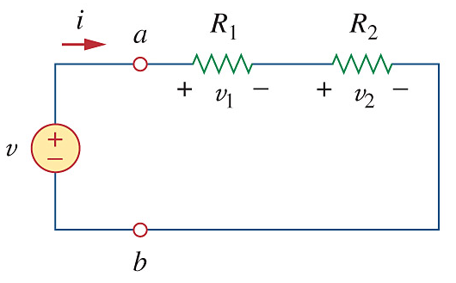
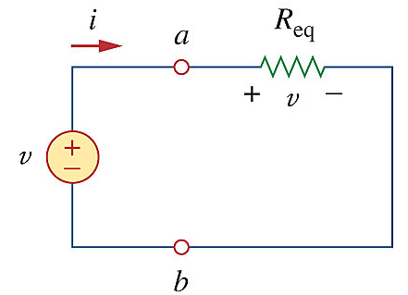
Voltage Divider
R₁ and R₂ are in series
R_{eq} = R₁ + R₂
i = v / R_{eq}
By Ohm’s law,
v₁ = i R₁ and v₂ = i R₂
If R₁ is larger than R₂, V₁ will get a larger share of V.
equivalent circuit

Slide 18
Voltage Divider
The previous result can be extended. If we have N resistors connected in series, voltage across R_{a} would be:
R₁
R₂
R₃
R_{a}
R_{N}
∙ ∙ ∙
∙ ∙ ∙
+ V1 -
+ V2 -
+ Va -
+ VN -
+
V
_

Slide 19
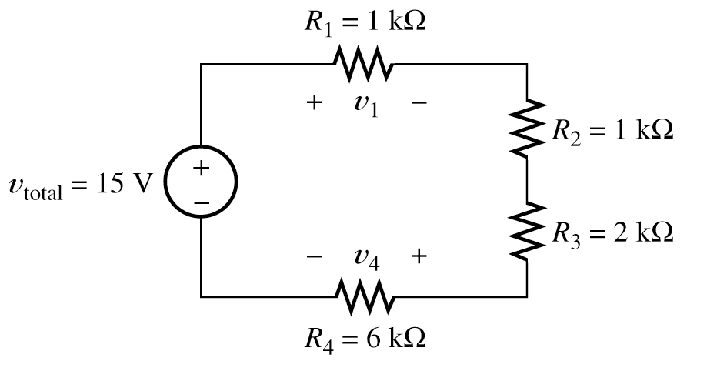
Voltage Divider
Example

Slide 20
Resistors in Parallel
For N resistors connected in parallel (they are connected together by two nodes only), we have
R₁
R₃
R_{N}
R_{eq}
R₂
All resistors connected in parallel are having the same voltage.

Slide 21
Current Divider
As R₁ and R₂ are in parallel, voltage drops are the same.
i
a
+
v
–
i₁
i₂
R₁
R₂
i
i
+
Vx
–
i
R_{eq}
i
If R1 is very large, i2 gets a large share of i.
Equivalent circuit

Slide 22
Current Divider
The previous result can be extended. If N resistors are connected in parallel, current flow in R_{a} would be:
R₁
R₂
R₃
R_{a}
R_{N}
i
i_{a}
i
where
R_{eq}
i

Slide 23
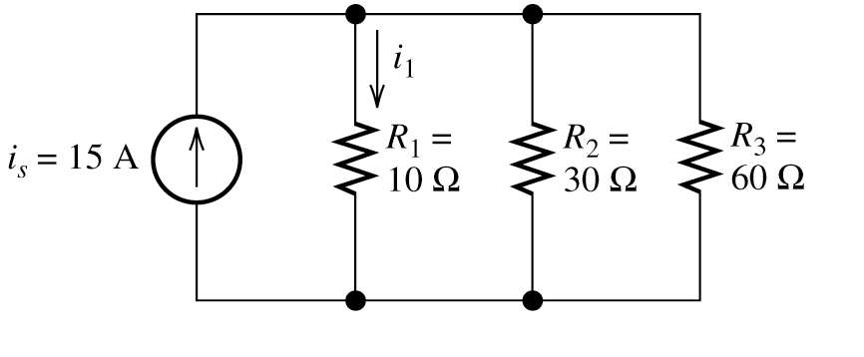
Current Divider
Example: Find i₁

Slide 24
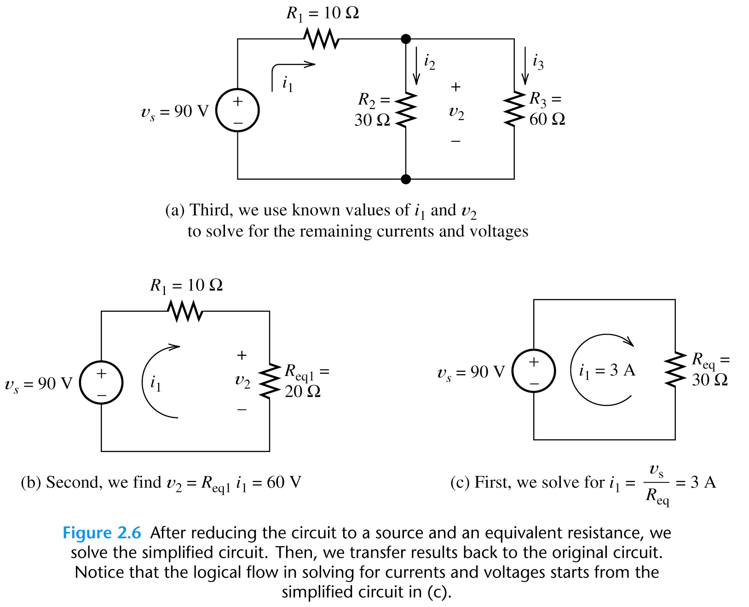
Find i1, i2 and i3
Example
R_{eq1}

Slide 25
Find i2 and i3
Now we know i₁ = 3A,
As a voltage divider,
By Ohm’s law:
Voltage across R₂ = Voltage across R_{eq}

