Slide 1
AST10401 Introduction to Electrical Engineering
03. Circuit Analysis I

Slide 2
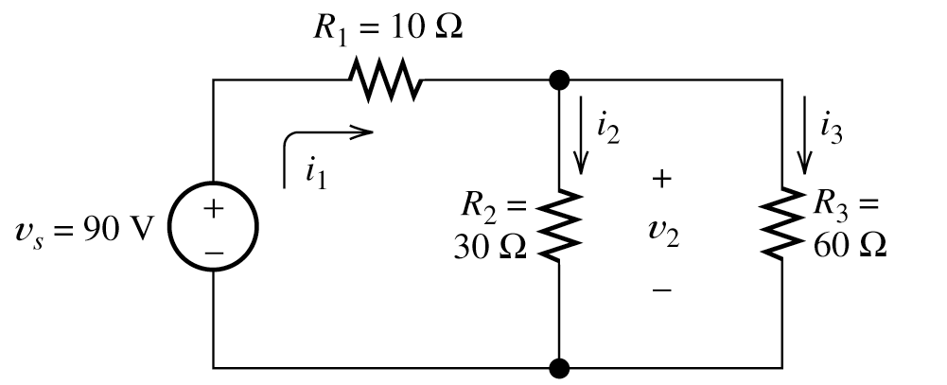
Motivation
Analyzing a circuit means to know the currents and voltages of each electrical elements in the circuit.
We know how to analyze an electric circuit with resistors connected in series or parallel by techniques like reducing to equivalent resistance, voltage and current divider etc.
Seems quite easy!

Slide 3
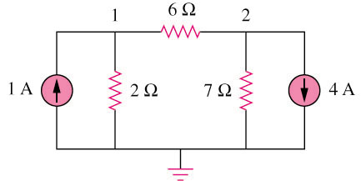
Motivation
Those techniques cannot be applied directly if we have the following circuit:
As not easy to reduce to equivalent resistors in this circuit.
What can we do?

Slide 4
Nodal Analysis
Things we need to know in analyzing a resistive circuit are only:
Kirchhoff’s Current Laws (KCL)
Kirchhoff’s Voltage Laws (KVL)
Ohm’s Law
How can we apply these laws systematically to determine the answers?
Nodal Analysis gives us the way!

Slide 5
Nodal Analysis
Nodal Analysis provides a general procedure for analyzing a circuit using node voltages as the circuit variables.
Once the voltages are found, the corresponding currents can be obtained by Ohm’s law.

Slide 6
Nodal Analysis
Step 1: Identify nodes and select a node as the reference node and set it to 0V.
Usually choose the lowest node as a reference node
0V

Slide 7
Nodal Analysis
Step 2: Assign voltages symbols V₁, V₂, … , V_{n-1} to the remaining n - 1 nodes. The voltages are referenced with respect to the reference node.
V1
V2
0V

Slide 8
Nodal Analysis
Step 3: Assign or guess the direction of current flows at each branch and label the currents:
1A
V1
V2
4A
I1
I3
I2
0V

Slide 9
Nodal Analysis
Step 4: Label the voltage polarities for all resistors
1A
V1
+
-
V2
4A
+
I1
+
I2
I3
-
-
0V

Slide 10
Nodal Analysis
Step 5: Apply KCL to each of the n - 1 nodes
Node 1
Node 2
V1
+
-
V2
At node 1, by KCL:
1 + (-I1) + (-I2) = 0
1 = I1 + I2
At node 2, by KCL:
(I1) + (-I3) + (-4) = 0
I1 = 4 + I3
+
I1
+
I2
I3
-
-
0V

Slide 11
Nodal Analysis
Step 6: Use Ohm’s law to express each resistor current in terms of node voltages.
By Ohm’s law
V1 – V2 = I1 (6)
V1 – 0 = I2 (2)
V2 – 0 = I3 (7)
V1
+
-
V2
+
I1
+
I2
I3
-
-
By Ohm’s law
V1 – V2 = I1 (6) means I1 = (V1 – V2) / 6
V1 = I2 (2) means I2 = V1 / 2
V2 = I3 (7) means I3 = V2 / 7
0V

Slide 12
Nodal Analysis
Step 7: Substitute the currents in terms of the unknown node voltages to KCL equations and solve the equation set.
By Ohm’s law
V1 – V2 = I1 (6) means I1 = (V1 – V2) / 6
V1 = I2 (2) means I2 = V1 / 2
V2 = I3 (7) means I3 = V2 / 7
By KCL:
I1 + I2 = 1
I1 = 4 + I3
Voltages are negative!

Slide 13
Nodal Analysis
Step 8: Check the current directions and voltage polarities and correct them accordingly (resistor: current flows from high potential node to low potential)
-2V
+
-
-14V
I1
+
+
I2
I3
-
-
0V

Slide 14
Nodal Analysis
Finally we have
-2V
+
-
-14V
-
I1
-
I2
I3
+
+
0V

Slide 15
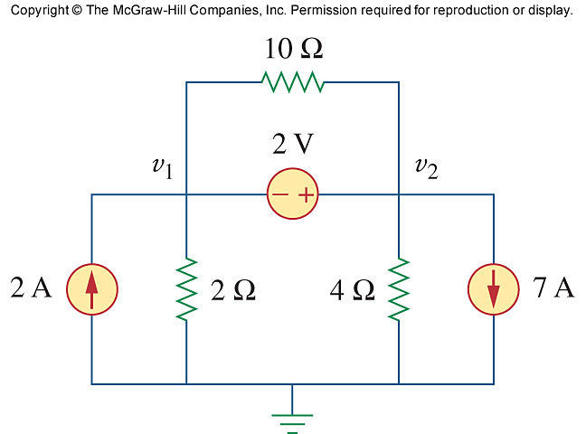
Nodal Analysis with Voltage sources
A dependent or independent voltage source connecting two nodes (not the ground node) together with any elements connected between these two nodes forms a supernode.
The consequence is that we can care less current when we apply Nodal Analysis.
+
-
i4
+
+
i2
i3
i1
-
-

Slide 16
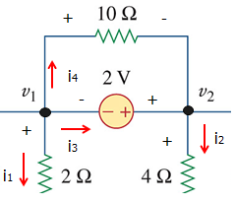
Nodal Analysis with Voltage sources
With a supernode, we don’t need to care about currents inside the supernode.
You only need to care about entering and leaving currents to/from the supernode. Hence care less currents in the circuit.
2A
7A
2A
Supernode
7A
i1
i2

Slide 17
Nodal Analysis with Voltage sources
Consider nodes 1 and 2 as a supernode, apply Nodal analysis:
+
-
i4
2A
Supernode
7A
+
+
i2
i1
i2
i3
i1
we have
2 = i1 + i2 + 7
-
-
Now express currents in terms of node voltages, (i₁ = (V1 – 0) / 2 and i₂= (V2 – 0)/ 4)
we have
2 = V1 / 2 + V2 / 4 + 7 → V2 = -20 - 2V1

Slide 18
Nodal Analysis with Voltage sources
We have
V2 – V1 = 2
together with V2 = -20 - 2V1, we have 2 simultaneous equations. Solve them we get
V1 = -7.33V and V2 = -5.33V
By identifying supernodes in a circuit, we can reduce the number of unknown currents involved!

Slide 19
Mesh Analysis
Mesh analysis provides another general procedure for analyzing a circuit using mesh currents as circuit variables.
Nodal analysis applies KCL to find unknown node voltages in a circuit, while mesh analysis applies KVL to find unknown currents.
A mesh is a circuit loop which does not contain any other circuit loops inside.

Slide 20
Mesh Analysis
Example
+
R₂
R₃
+
R₂
R₃
V
_
R₁
V
_
R₁
3 Meshes
Not a Mesh

Slide 21
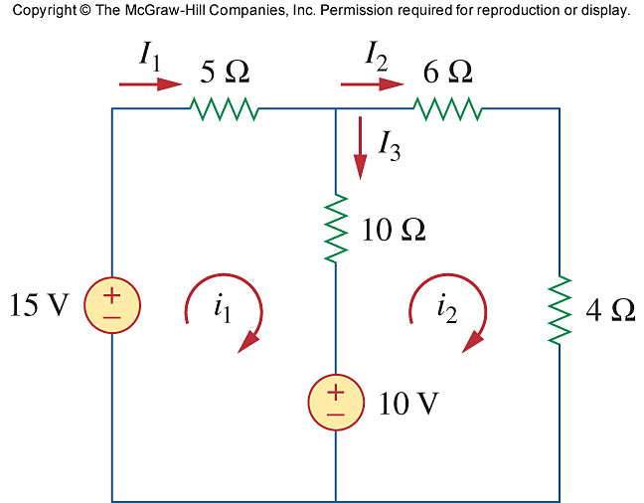
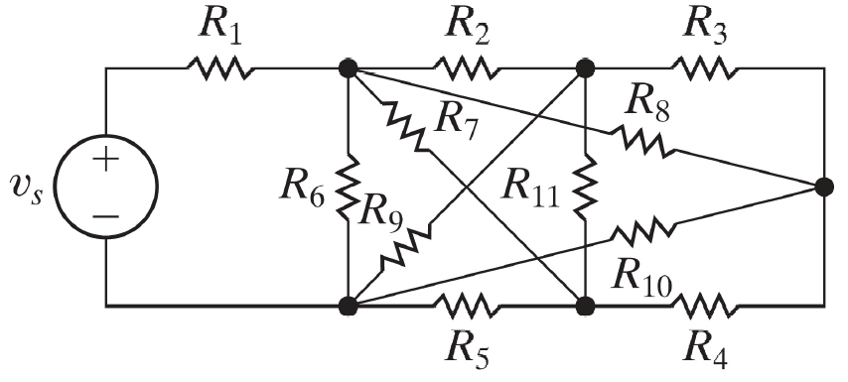
Mesh Analysis
Mesh analysis only applies to a planar circuit!
A planar circuit is one that can be drawn in a plane with no branches crossing one another.
a planar circuit
non-planar circuit

Slide 22
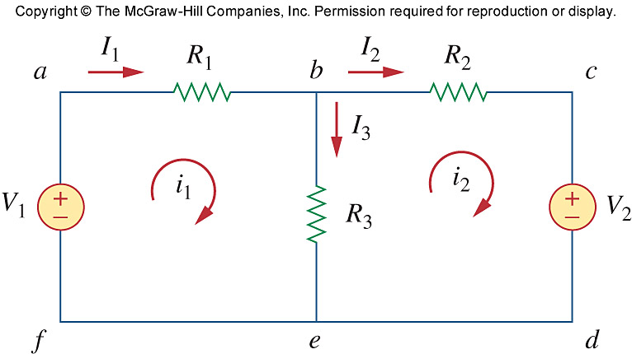
Mesh Analysis
Definition:
A mesh current is an imaginary current flowing in a mesh and it flows through all elements in that mesh. They are used as circuit variables in mesh analysis.
Assume a mesh current i₁ flows through R₁, R₃ and V₁ clockwisely
assume a mesh current i₂ flows through R₂, V₂ and R₃ clockwisely

Slide 23
Mesh Analysis
Based on the definition,
R₁, R₃ and V₁ “experience” the same mesh current i₁ flowing around.
R₂, V₂ and R₃ “experience” the same mesh current i₂ flowing around.
R₃ “experiences” two mesh currents (i₁ and i₂) flowing in opposite direction.

Slide 24
Mesh Analysis
Note:
Mesh currents i₁ and i₂ running in meshes are just circuit variables.
I₁, I₂ and I₃ are actual branch currents experienced by elements (real, measurable).
A branch current can be written in terms of mesh currents:
I₁ = i₁ I₂ = i₂ I₃ = i₁ - i₂

Slide 25
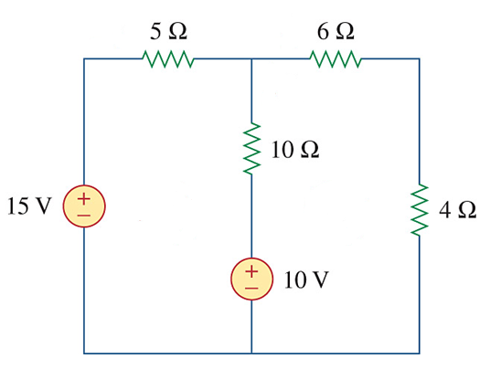
Mesh Analysis
Step 1: Assign mesh currents i₁, i₂, …, to the n meshes and branch current I₁, I₂, … , in each elements.
I1 = i1
I2 = i2
I3 = i1 - i2

Slide 26
Mesh Analysis
Step 2: Apply KVL to each of the n meshes. Use Ohm’s law to express the voltages in terms of the mesh currents.
voltage drop due to i1
a
b
+
-
e
voltage gain due to i2
+
-
By KVL:
i1(5) + i1(10) - i2(10) + 10 - 15 = 0
i2(6) + i2(4) - 10 + i2(10) - i1(10) = 0
So
15 = i1(5) + (i1 - i2)(10) + 10
10 = i2(6) + i2(4) – (i1 - i2)(10)
+
-
+
-
+
c
voltage drop due to i2
-
voltage gain due to i1
d

Slide 27
Mesh Analysis
Step 3: Solve the simultaneous equations
1 = 3 i1 - 2 i2
1 = 2 i2 – i1
i1 = 1A
i2 = 1A
But
I1 = i1
I2 = i2
I3 = i1 - i2
so
I1 = i1 = 1A
I2 = i2 = 1A
I3 = i1 - i2 = 0A

Slide 28
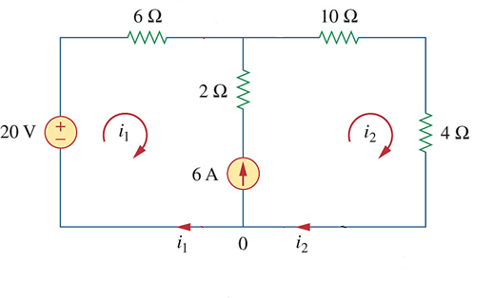
Mesh Analysis with current sources
When a current source exists in between 2 neighboring meshes, we can write less KVL equations by identifying a supermesh.

Slide 29
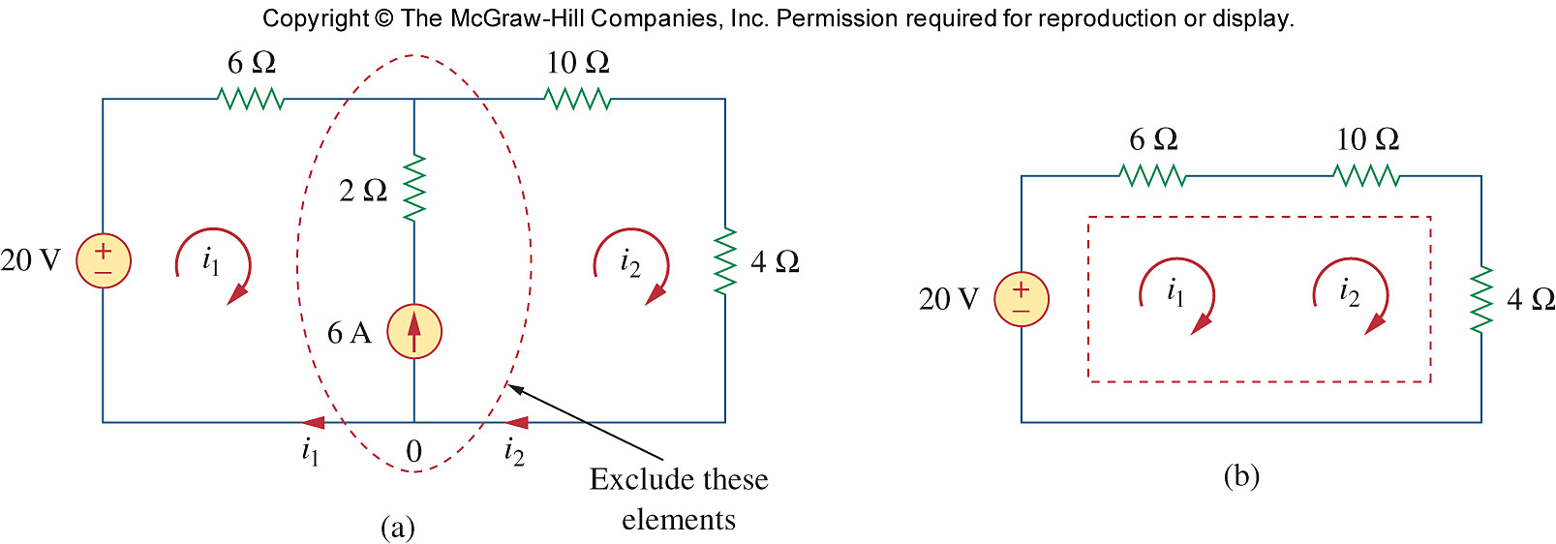
Mesh Analysis with current sources
By mentally removing the common branch with the current source, we form a larger mesh which is called supermesh.
All previously defined mesh currents are kept in the supermesh.

Slide 30
Mesh Analysis with current sources
The relationship between the mesh currents can be found by considering the common branch.
Consider node 0 in the green region,
by KCL at node 0
i1 + 6 = i2
The relationship of i1 and i2 is now known!

Slide 31
Mesh Analysis with current sources
Apply KVL for the supermesh, with the original mesh current i₁ and i₂
i1 (6) + i2 (10) + i2 (4) - 20 = 0
6 i1 + 14 i2 = 20
But we have i1 + 6 = i2 from the
“removed” source branch.
So
6 i1 + 14(i1 + 6) = 20
i1 = -3.2 A
i2 = 2.8 A
a
b
c
+
-
+
-
+
-
d

