Slide 1
AST10401 Introduction to Electrical Engineering
03. Circuit Analysis II

Slide 2
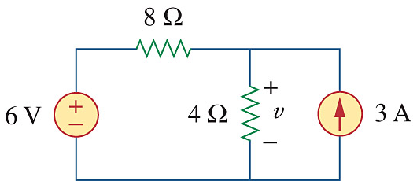
If you are given the following circuit, can you determine the voltage across 4Ω resistor simply by inspection?
Analyzing circuit by inspection?

Slide 3
Linearity
Linearity of an electric element is a special relationship between the voltage and current of the electric element.
The concept of linearity is a combination of Scaling Property and Additive Property.
Scaling Property: if a current of an electric element is multiplied by a constant, its corresponding voltage is multiplied by the same constant.
Additive Property: the voltage of an electric element due to a current sum equals the sum of voltages due to each current applied separately.

Slide 4
Scaling Property
Assume that we applied a current I to a resistor, we have voltage V across its terminals where V = IR, by Ohm’s law.
If we have a new current I’ = kI, where k is a constant, then we have a new voltage V’ developed and it is given by V’ = kV.
So a resistor has Scaling Property.
I
R
V = IR
+
V
-
I’ = kI
R
V’ = I’R = (kI)R = k(IR) = kV
+
V’
-

Slide 5
Additive Property
Given that two currents I₁ and I₂ , then V₁ = I₁R and V₂ = I₂R.
Applying I₃ = I₁ + I₂ to the resistor, we have
It shows a resistor has Additive Property, hence a resistor is a linear element.
I₁
I₂
R
R
+
V₁
-
+
V₂
-
V₃ = I₃R
= (I₁ + I₂)R = I₁R + I₂R
= V₁ + V₂
I₃
R
+
v₃
-
V₃ = Sum of the voltages due to I₁ and I₂

Slide 6
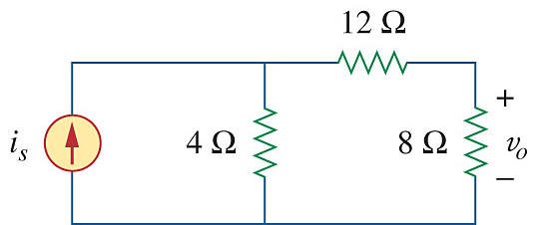
Linearity Property
If an electric circuit consists of only linear elements, linear dependent sources and independent sources, then the electric circuit is called a linear electric circuit.
If all sources are scaled by a constant k, all the currents and voltages will be scaled by the same k as well.
If i_{s} = 15A and v_{o} = 20V
If i_{s} = 30A (k=2), by the linear property of an electric circuit,
v_{o} = 20 x 2 = 40V

Slide 7
Superposition Principle
Superposition Principle
The current/voltage of an element in a Multiple Sources Linear Circuit can be determined by 2 steps:
1) First obtaining the current/voltage of that element due to each independent source working alone.
2) Summing up all those currents/voltages found in 1) to get the answer.
By Superposition, v = v1 + v2
where
v1 is the voltage across 4Ω due to the 6V working alone
v2 is the voltage across 4Ω due to the 3A working alone.

Slide 8
Superposition Principle
How to make one independent source works alone in a circuit?
By switching off all the rest of independent sources:
v
+
–
i
When setting voltage sources to zero they become short circuits (v = 0)
When setting current sources to zero they become open circuits (i = 0)

Slide 9
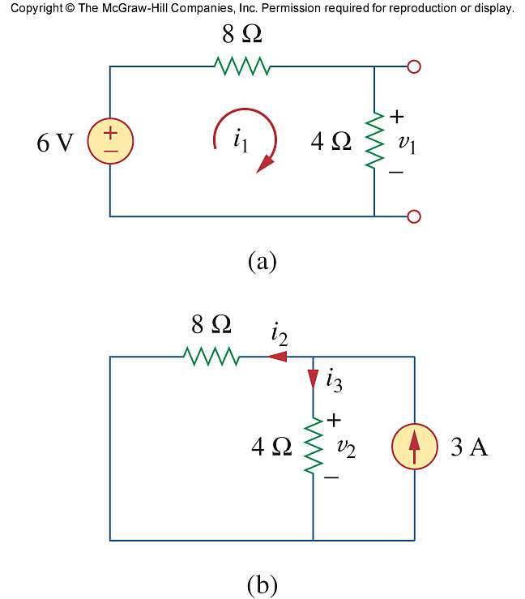
Superposition Principle
Example:
By Superposition, v = v1 + v2
where
v1 is the voltage across 4Ω due to the 6V voltage source working alone
v2 is the voltage across 4Ω due to the 3A current source working alone.

Slide 10
Superposition Principle
Find v₁ by the voltage divider rule:

Slide 11
Superposition Principle
Find v₂ by the current divider rule:

Slide 12
Superposition Principle
Adding the two results:

Slide 13
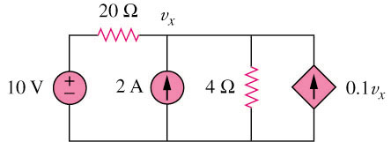
Superposition Principle
Example:
Find v_{x} in the circuit below.
Dependent source keep unchanged

Slide 14
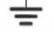
Superposition Principle
Dependent source keep unchanged
2A is discarded by open-circuit
10V is discarded by short-circuit
20 Ω
v₁
20 Ω
v₂
+
−
10 V
4 Ω
0.1v₁
2 A
4 Ω
0.1v₂
(a)
(b)

Slide 15
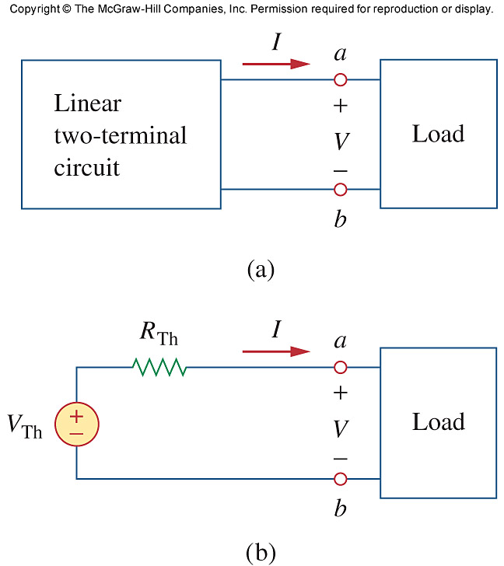
Thevenin’s Theorem
Thevenin’s Theorem
Any two terminal linear circuit can be replaced by an equivalent circuit which is a voltage source V_{Th} connects in series with a resistor R_{Th} .
How to find Thevenin voltage V_{Th} and Thevenin resistance R_{Th}?

Slide 16
Thevenin’s Theorem
Finding V_{Th} :
V_{Th} can obtained by calculating or measuring the voltage across the two terminals of the original linear circuit.
a
+
Vab
-
Vab = VTh
b

Slide 17
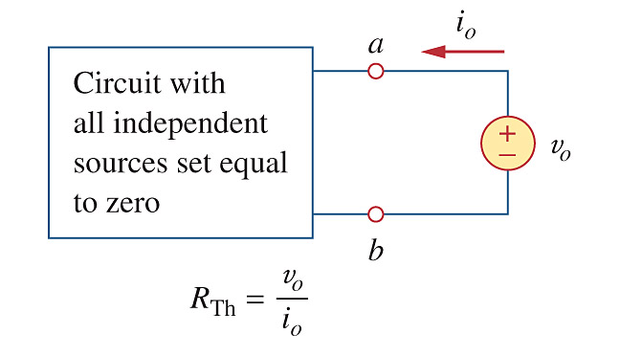
Thevenin’s Theorem
Finding R_{Th}:
1) Turning off all sources in the circuit
2) Applying a test voltage source v_{o} (known) across a and b.
3) Finding i_{o} drawn from v_{o}.
4) R_{Th} = v_{o} / i_{o}

Slide 18
Thevenin’s Theorem
If there is no dependent sources in the linear circuit,
then R_{Th} is the equivalent resistance “seen” from the terminals a-b when all the independent sources are turned off.
a
Rin is the equivalent resistance across a and b when all independent sources inside are turned off.
Rin
b
Rin = RTH

Slide 19
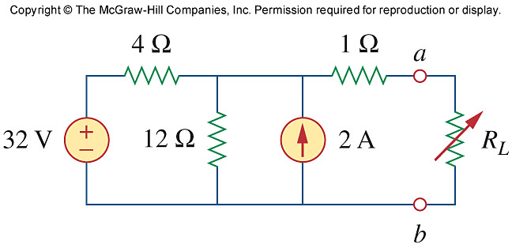
Thevenin’s Theorem
Example
Find the Thevenin equivalent of the circuit shown below to the left of the terminals a-b. Then find the current through R_{L} = 6Ω

Slide 20
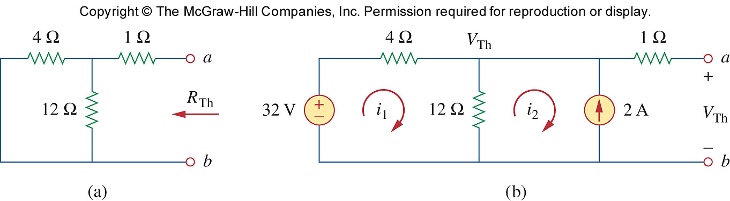
Thevenin’s Theorem
Find R_{Th} by turning off the 32V voltage source and 2A current source:
R_{TH} = (4 || 12) + 1 = 4 Ω

Slide 21
Thevenin’s Theorem
Find V_{Th}. We consider the circuit below.
Note that V_{c} = V_{a} (why?), so V_{Th} = V_{ab} = V_{cb}. Apply superposition:
c

Slide 22
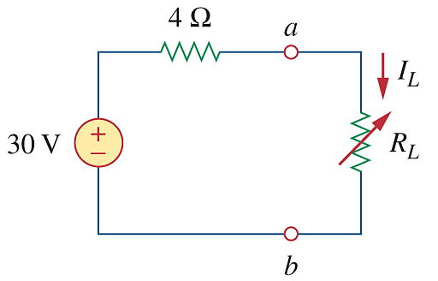
Thevenin’s Theorem
Find the current through R_{L} = 6Ω
IL
I_{L} = 30 / (4 + 6) = 3A

Slide 23
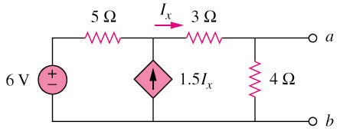
Thevenin’s Theorem
5 Ω
I_{x}
3 Ω
a
Example
Find the Thevenin equivalent of the circuit shown below to the left of the terminals a-b.
+
−
+
V_{Th}
−
6 V
4 Ω
1.5I_{x}
Find v_{Th}
o
b
I_{x}
3 Ω
a
i
+
−
5 Ω
1.5I_{x}
4 Ω
1 V
Find R_{Th}
b

Slide 24
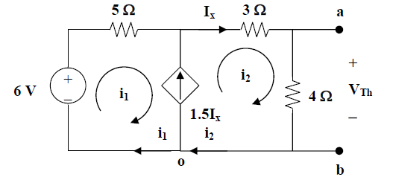
Thevenin’s Theorem
Ix = i2
1.5 Ix = i2 – i1
i1 = -0.5 i2 (1)
For the Supermesh:
5 i1 + 3 i2 + 4 i2 - 6 = 0
6 = 5 i1 + 7 i2 (2)
Solving (1) and (2), we have
i2 = 4/3 A
So VTh = 4 (4/3) = 5.33V
d
c

Slide 25
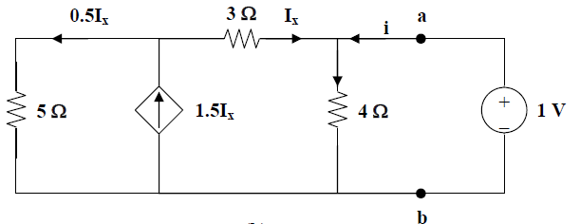
Thevenin’s Theorem
1.5I_{x} = I_{x} + 0.5I_{x}
Turn off the 6V and apply a test voltage 1V across a and b to find i:
c
+
+
-
I_{4Ω}
-

Slide 26
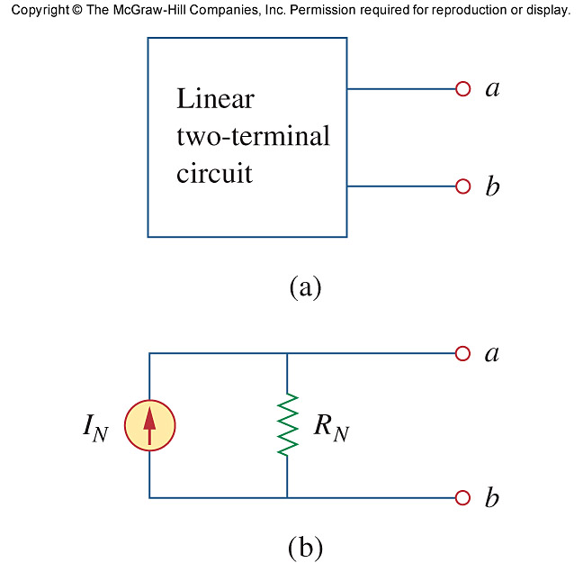
Norton’s Theorem
Norton’s Theorem
Any two terminal linear circuit can be replaced by an equivalent circuit
which is a current source I_{N} connects in parallel with a resistor R_{N} .
the Norton equivalent to the two-terminal linear circuit
How to find Norton current I_{N} and Norton resistance R_{N}?

Slide 27
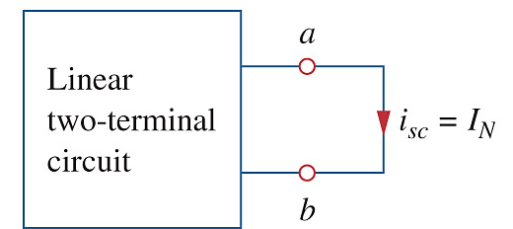
Norton’s Theorem
Finding I_{N}
The Norton current I_{N} is the short-circuit current at the terminal of the linear circuit.

Slide 28
Norton’s Theorem
Finding R_{N}
1) Turning off all sources in the circuit
2) Applying a test voltage source v_{o} (known) across a and b.
3) Finding i_{o} drawn from v_{o}.
4) R_{N} = v_{o} / i_{o}
Refer back to Thevenin theorem,
RN = RTh

Slide 29
Norton’s Theorem
If there is no dependent sources in the linear circuit,
then R_{N} is the equivalent resistance “seen” from the terminals a-b when all the independent sources are turned off.
a
Rin is the equivalent resistance across a and b when all independent sources inside are turned off.
Rin
b
Rin = RN = RTH

Slide 30
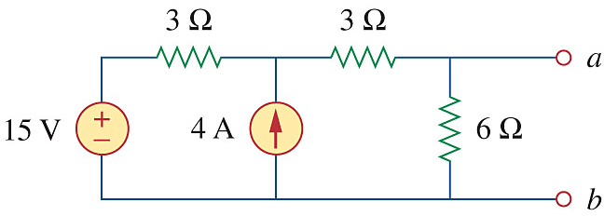
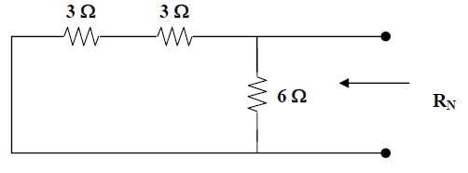
Norton’s Theorem
Example: Find the Norton equivalent of the following circuit at terminal a-b
RN = 6 || 6 = 3Ω

Slide 31
Norton’s Theorem
c
IN
0V
At node c, by KCL
(15 – Vc) /3 + 4 = IN (1)
Vc / 3 = IN (2)
Solve for IN in (1) and (2),
we have IN = 4.5 A
4.5 A
RN = 3Ω

Slide 32
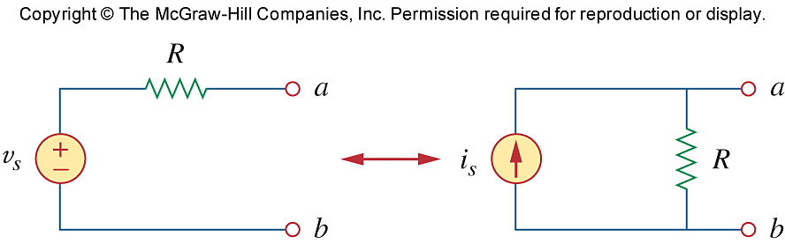
Source Transformation
Given the following voltage source and resistor pair (Thevenin equivalent), we can always find its Norton equivalent:
IN
RN
where
IN = vs /R (by shorting the a and b in the original configuration)
RN = R (by turning off vs and see from terminal a-b)

Slide 33
Source Transformation
Given the following current source and resistor pair (Norton equivalent), we can always find its Thevenin equivalent:
RTh
VTh
where
VTh = is x R (by measuring the voltage across a and b)
RTh = R (by turning off is and see from terminal a-b)

Slide 34
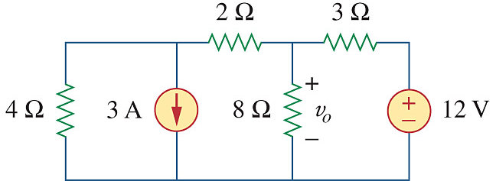
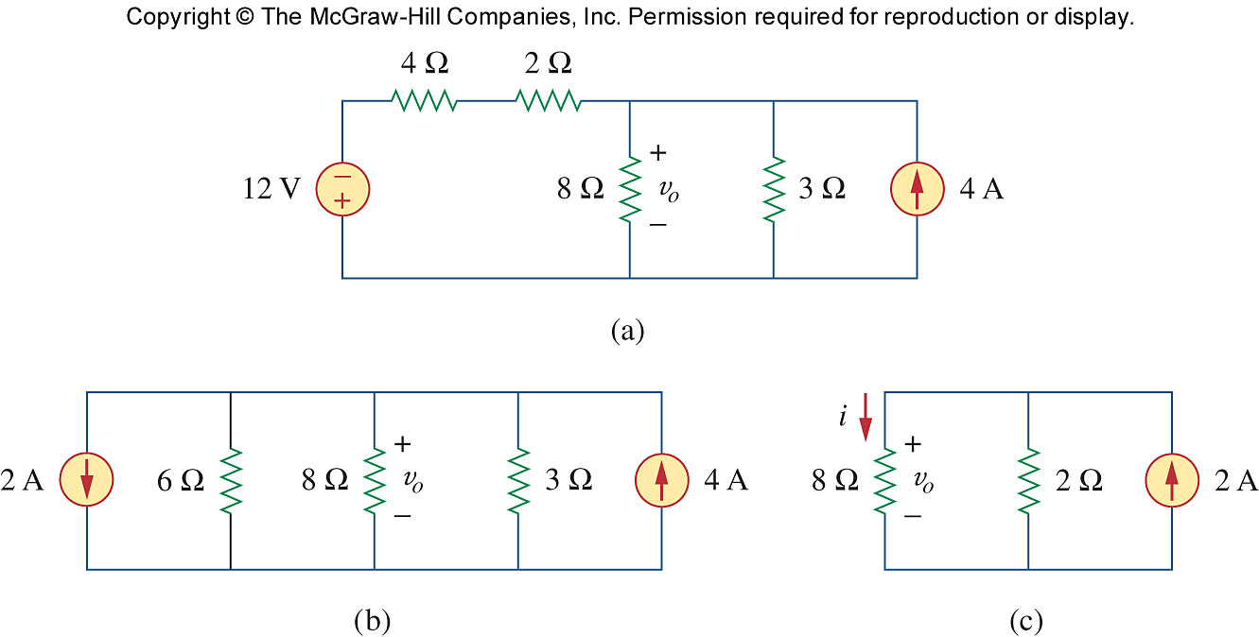
Source Transformation
Example: Find v_{o}
12 = 3 X 4

Slide 35
Source Transformation

Slide 36
Source Transformation
By current divider:
i = 2 (2/(2+8))
Vo = 8 i = 3.2V

Slide 37
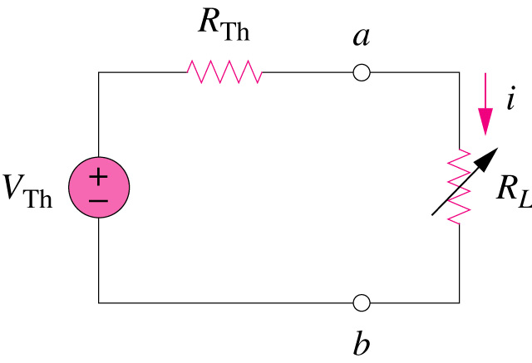
Maximum Power Transferred
Find R_{L} such that R_{L} receives maximum power transferred from the 2 terminal linear circuit.
?

Slide 38
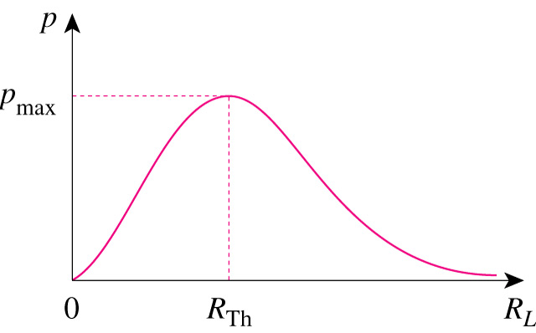
Maximum Power Transferred
If the entire circuit is replaced by its Thevenin equivalent excluding the load, the power delivered to the load is:
For maximum power dissipated in R_{L}, P_{max}, for a given R_{TH} and V_{TH},
any linear circuit
The power transfer profile with different R_{L}

Slide 39
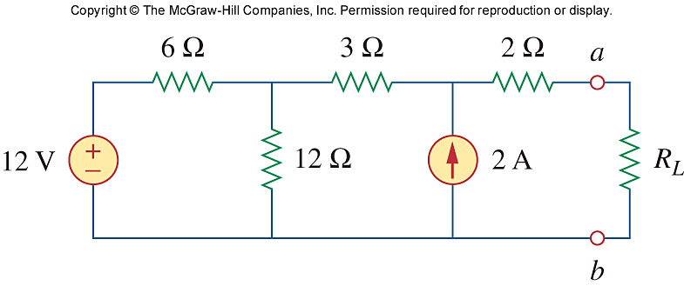
Maximum Power Transferred
Example:
Find R_{L} for maximum power transfer and the corresponding power

Slide 40
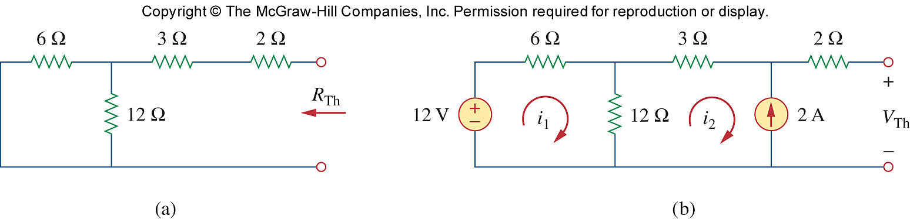
Maximum Power Transferred
First find the Thevenin equivalent across a and b:
RTh = (6 || 12) + (3 + 2) = 9Ω

Slide 41
Maximum Power Transferred
Find VTh:
6i1 + 12i1 - 12i2 - 12 = 0 (1)
i2 = -2A (2)
So i1 = -2/3 A
12 - i1(6) - i2 (3) = V_{Th}
12 - (-2/3)(6) - (-2)(3) = V_{Th}
VTh = 22 V
e
c
d
b

Slide 42
Maximum Power Transferred
To have a maximum power transfer, we should have R_{L} = R_{Th} = 9Ω
So

