Slide 1
AST10401 Introduction to Electrical Engineering
4. Capacitors and Inductors

Slide 2
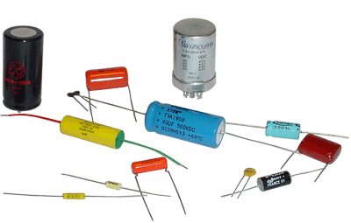
Capacitors
A capacitor is a device that consists of two metal plates separated by an insulator/dielectric (air, ceramic or mica).
A capacitor is an electrical element designed to store energy.
Electrical Symbol

Slide 3
Capacitors
Inside metal, only electrons are free to move as charge carriers.
When we apply a voltage source v across a capacitor, the source attracts electrons on the metal plate connected to the +ve terminal of the source and put them on the metal plate connected to the –ve terminal of the source.
When an electron leaves, it leave behind a +ve charge.
e⁻
an open circuit, no constant current flow at the end
v
+
–
+

Slide 4
Capacitors
When a voltage source v is applied long enough (at steady state), there are fixed amount of positive charges q developed on one plate and there are fixed amount of negative charges –q on the other.
We have charge separation across the plates and it is due to the voltage source.
+
–
q
v
+
–
+
–
–
+
–
+
–
-q

Slide 5
Capacitors
The amount of charge q stored in the capacitor is proportional to the applied voltage v:
C is a constant and known as the capacitance.
Capacitance is measured in farad (F), 1 Farad = 1 Coulomb / Volt
The capacitance C of a capacitor depends on its dimensions:
A
d
ε – relative permittivity
(dielectric constant)
Dielectric (or air)

Slide 6
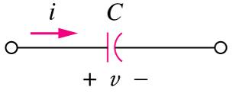
Capacitors
To obtain the current-voltage relationship of a capacitor, consider
and differentiate both side of , we have
The voltage-current relationship can be obtained by integrating both side
of the above relationship:
initial voltage
at t = t₀

Slide 7
Capacitors
The capacitor is an electric energy storing device.
The energy w stored in the capacitor is given by
Since there is an insulator between the two plates, you expected that there is no current flow at the end even you continuously apply a voltage source.
A capacitor is an open circuit at steady state (i.e. dv/dt = 0). Its voltage cannot change abruptly.

Slide 8
Capacitors
Example: Calculate the current through the capacitor C = 0.1μF with the voltage as shown: v(t) = 5(1 – e^{-t /10-6})

Slide 9
Capacitors

Slide 10
Capacitors in parallel
Capacitors in parallel has an equivalent capacitance which can be represented sum of all individual capacitance:
C₁
C₂
C₃
C_{n}
C_{N}
C_{eq}

Slide 11
Capacitors in series
Capacitors in series has an equivalent capacitance which can be represented by:
C₁
C₂
C₃
C_{n}
C_{N}
C_{eq}
∙ ∙ ∙
∙ ∙ ∙

Slide 12
Parallel and Series Capacitors
Example:
Determine the equivalent capacitance C_{eq} , C₁ = 2mF, C₂ = 2mF, C₃ = 1mF, C₄ = 1/3mF, C₅ = 1/3mF, C₆ = 1/3mF
C₁
C₄
C_{eq}
C₃
C₆
C₂
C₅

Slide 13
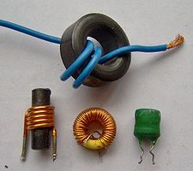
Inductors
An inductors is a coil of wire wound around a core.
The core can be air, an insulator or ferromagnetic material.
An inductor is an electrical element designed to store energy.
Electrical Symbol
core

Slide 14
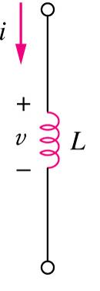
Inductors
Given a current passes through an inductor, the voltage across the inductor is directly proportional to the rate of change of the current:
Inductance L depends on the number of turns N, the length of the inductor l, the cross sectional area of the core A and the permeability of the core μ.
The inductance is measured in Henry (H).
where

Slide 15
Inductors
The current-voltage relationship of an inductor:
initial current
at t = t₀
The energy stored in an inductor:
An inductor is a short circuit in a steady state (i.e. di /dt = 0), its current cannot change abruptly.

Slide 16
Inductors in series
Inductors in series has an equivalent inductance which can be represented by sum of all individual inductance :
L₁
L₂
L₃
L_{n}
L_{N}
∙ ∙ ∙
∙ ∙ ∙
L_{eq}

Slide 17
Inductors in parallel
Inductors in parallel has an equivalent inductance which can be represented by:
L₁
L₂
L₃
L_{n}
L_{N}
L_{eq}

Slide 18
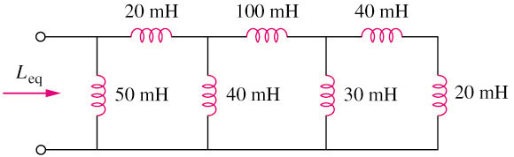
Inductors in parallel and series
Example :
Calculate the equivalent inductance for the inductive
network in the circuit shown below:
L_{eq} = 25mH

Slide 19
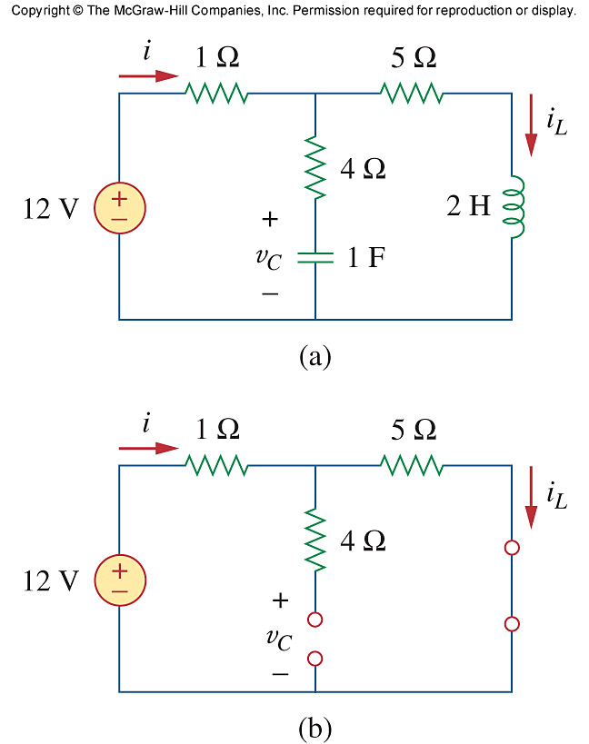
RLC circuits at steady state
Find V_{c} and i_{L} in the circuit at a steady state
Replace a capacitor by an open circuit
Replace an inductor by a short circuit

Slide 20
RLC circuits at steady state
No current through 4Ω, so 4Ω can be ignored.
v_{a}
So i = i_{L}
i = 12/(1+5) = 2A
i_{L} = 2A
No current through 4Ω, so Va = Vc
Va = 12(5/6) = 10V
Vc = Va = 10V
v_{c}
0V
Voltage across the capacitor is 10V

