Slide 1
AST10401 Introduction to Electrical Engineering
5. First Order Circuits

Slide 2
First order circuits
A First Order Circuit is a circuit that contains a single energy storing element (either a capacitor or an inductor) together with a number of sources and resistors.
R_{s}
R₁
R₁
R₂
v_{s}
R₂
C
v_{s}
+
–
+
–
L₁
L₂
1st order
Not 1st order

Slide 3
A first order circuit with switches
Assumption:
A first order circuit with a switch exists from a long time ago and the switch is activated (opened / closed) at t = 0 only.
R₁
v_{s}
R₂
+
–
R₃
C
The circuit exits for a long long time.
3

Slide 4
A first order circuit with switches
If the circuit exists for a long time and the switch is activated only at t = 0, the circuit would have Two DC steady states:
A DC steady state Just Before t = 0.
A DC steady state Long After t = 0.
A DC steady state means there is no change in both voltages and currents in that circuit.

Slide 5
Steady state Just Before t = 0
The circuit exists from a long time ago.
All voltages and currents settle down before t = 0.
Just Before t = 0 (denote as t = 0-), the circuit is in steady state.
R₁
R₁
v_{s}
R₂
v_{s}
R₂
+
–
+
–
R₃
R₃
C
C
t → - ∞ (a long long time ago)
t = 0- (the switch is not activated yet)

Slide 6
Steady state long after t = 0
The switch is closed at t = 0.
Long After t = 0 (t → ∞), all voltages and currents settle down again.
The circuit is in another steady state when t → ∞.
R₁
R₁
v_{s}
R₂
v_{s}
R₂
+
–
+
–
R₃
R₃
C
C
t = 0
t → ∞

Slide 7
A first order circuit with switches
We have two steady state circuits:
R₁
R₁
v_{s}
R₂
v_{s}
R₂
+
–
+
–
R₃
R₃
C
C
The circuit at t = 0-
The circuit at t → ∞
(just before t = 0)
(long after t = 0)

Slide 8
A first order circuit with switches
Each steady state has it own equivalent circuit.
R₁
R₁
v_{s}
R₂
v_{s}
R₂
+
–
+
–
R₃
R₃
C
C
The equivalent circuit at t = 0-
The equivalent circuit at t → ∞
(just before t = 0)
(long after t = 0)

Slide 9
Initial Conditions
The Initial Conditions of a capacitor :
Steady capacitor current or voltage just before t = 0 is
denoted as I_{c}(0–) and V_{c}(0–).
R₁
R₁
v_{s}
R₂
v_{s}
R₂
+
–
+
–
R₃
R₃
C
C
The equivalent circuit at t = 0-

Slide 10
Final Conditions
The Final Conditions of a capacitor :
Steady capacitor current or voltage long after t = 0 (t → ∞) is
denoted as I_{c}(∞) and V_{c}(∞).
R₁
R₁
v_{s}
R₂
v_{s}
R₂
+
–
+
–
R₃
R₃
C
C
The equivalent circuit at t → ∞

Slide 11
DC Steady-State
Example:
Find the initial and final current of the inductor when i_{s} = 10mA.
a
t = 0
i_{s}
b
i_{L}
L
R

Slide 12
DC Steady-State
In DC steady state, inductors act like short circuits, thus no current flows through R.
a
10mA
10mA
b
i_{L}
L
i_{L}
R
The circuit is in steady state at t = 0-

Slide 13
DC Steady-State
At t = 0, the inductor current cannot change instantaneously, the inductor keeps the same current flow at t = 0.
t = 0
a
i_{s}
b
R
L
i_{L}
R
L
i_{L}
By KCL

Slide 14
DC Steady-State
Energy stored in the inductor is released to resistor R but the amount of energy is finite.
So, eventually, all energy stored are released to resistor R. In that case, no energy remains in the inductor. Hence i_{L}(∞) = 0A at the end.
R
L
i_{L}
The circuit reaches another steady state when t → ∞

Slide 15
Step response of first order circuit

Slide 16
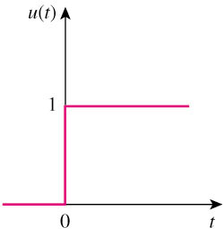
Unit-Step Function
The unit step function u(t) is 0 for t < 0 and 1 for t ≥ 0.

Slide 17
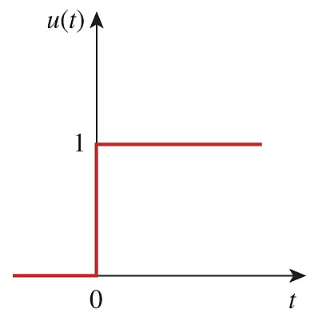
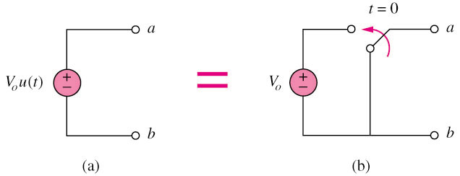
Unit-Step Function
An abrupt voltage change in a voltage source can be represented by a step function:
V₀ u(t)
V₀
a step voltage source

Slide 18
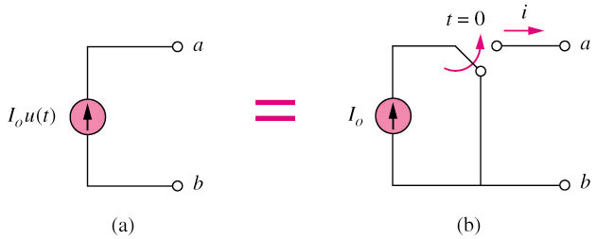
Unit-Step Function
An abrupt current change in a current source can be represented by a step function:
I₀ u(t)
I₀
a step current source

Slide 19
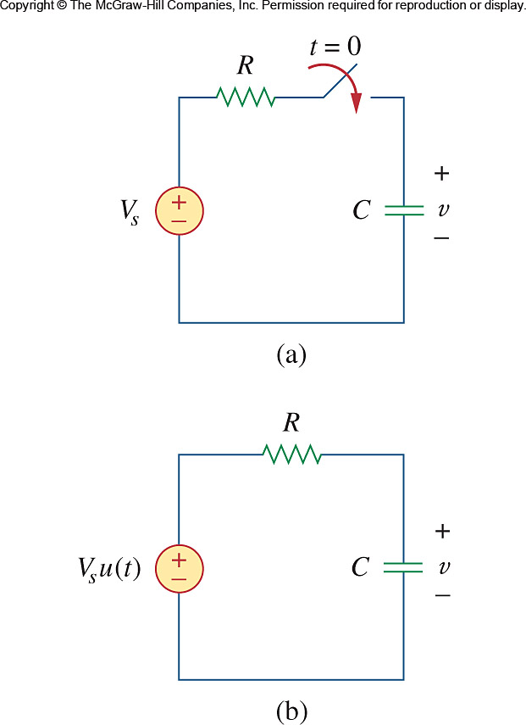
Step response of an RC circuit
Suppose before t = 0, the initial voltage of the capacitor is V_{o}.
We close the switch at t = 0, the capacitor will be charged up by the voltage source V_{s}. (This is called the Charging Process)
For t ≥ 0
V_{s}
Interested in knowing how v changes for t ≥ 0. (i.e. find v(t) for t ≥ 0)

Slide 20
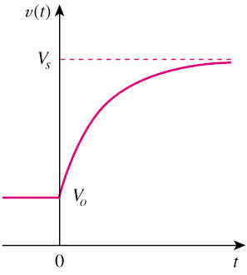
Step response of an RC circuit
The initial capacitor voltage at t = 0⁻ : v(0⁻) = V₀, So v(0) = v(0⁻) = V₀
The final capacitor voltage at t → ∞ : v(∞) = V_{s} (as a cap is an open circuit at steady state)
We expect a curve joining these two points.
We want to know how v changes with time.
Assume that V_{s} > V₀
V₀

Slide 21
Step response of an RC circuit
Determine how v changes for t ≥ 0. (i.e. find v(t) for t ≥ 0)
For t ≥ 0, apply KCL at a, we have
For t ≥ 0
a
V_{s}
Rearrange terms we have
0V
set that node as ground

Slide 22
Step response of an RC circuit
Integrate both side,
For t ≥ 0
V_{s}
Recall that the initial voltage V₀ on the capacitor
Thus

Slide 23
Step response of an RC circuit
For t ≥ 0
The time constant is
V_{s}
This is called the step response of an RC circuit which is caused by a sudden change of the circuit configuration at t = 0.

Slide 24
Step response of an RC circuit
The capacitor voltage v(t) is given by
final voltage
Assume that V_{s} > V₀
Final value at t → ∞
Initial value at t = 0
initial voltage

Slide 25
Step response of an RC circuit
Three steps to find the step response of an RC circuit (voltage across C):
Find the initial capacitor voltage v(0).
Find the final capacitor voltage v(∞):
Determine the time constant τ = RC.
Put them in to the expression:
V_{s}
τ can only be determined in “a standard form RC circuit”
A standard form RC circuit

Slide 26
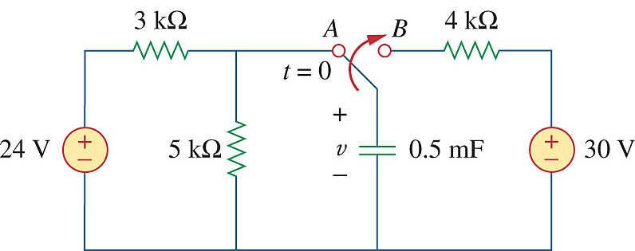
Step response of an RC circuit
Example: The switch has been in position A for a long time. At t = 0, the switch moves to B. Determine v(t) for t ≥ 0.
For t = 0-, the capacitor acts like an open circuit (v is the same as the voltage across 5k), so
But capacitor voltage cannot change instantly. Thus,

Slide 27
Step response of an RC circuit
For t ≥ 0, the switch is at position B, find the resistance experienced by the 0.5mF capacitor:
The time constant is
For t ≥ 0
Since the capacitor acts like an open circuit at steady state. So,
V_{s}
“A standard form RC circuit”

Slide 28
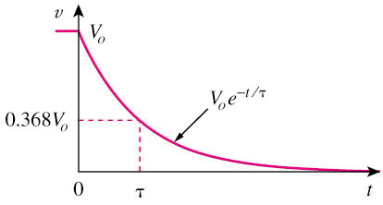
Natural response of RC circuit
When an RC circuit is connected no source after t = 0 (i.e. final cap. voltage v(∞) = 0), the step response of the RC circuit in this special case is given by
The voltage response of the RC circuit is an exponential decay of the initial voltage v(0).
The response is due to the initial energy stored in the cap.
It is also known Natural Response of an RC circuit.

Slide 29
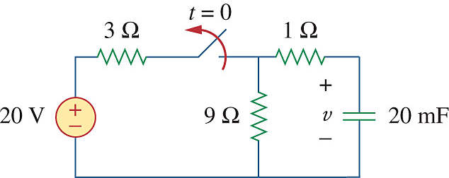
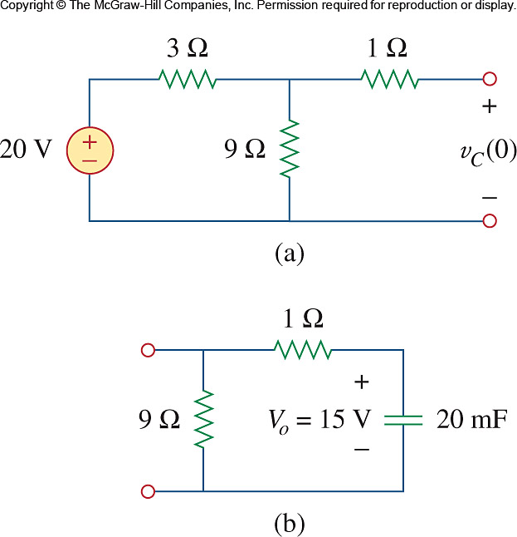
Natural response of RC circuit
Example
The switch has been closed for a long time and it is opened at t = 0, find v(t) for t ≥ 0
For t < 0, the capacitor is an open circuit
Voltage across a capacitor cannot change instantly, so
t = 0-
Cap. Voltage just before t = 0

Slide 30
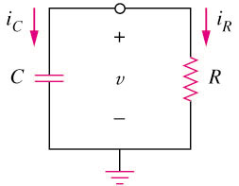
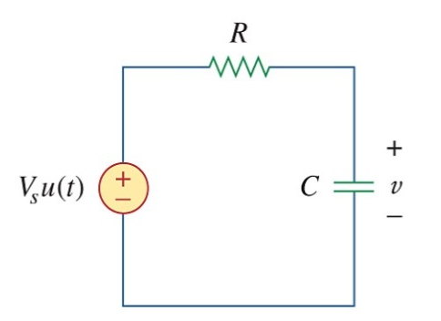
Natural response of RC circuit
For t ≥ 0, the circuit connects no source.
“a standard form RC circuit without a source (V_{s} = 0)”
R_{eq}
The time constant is
The voltage v(t) across the capacitor for t ≥ 0 is
V_{s}

Slide 31
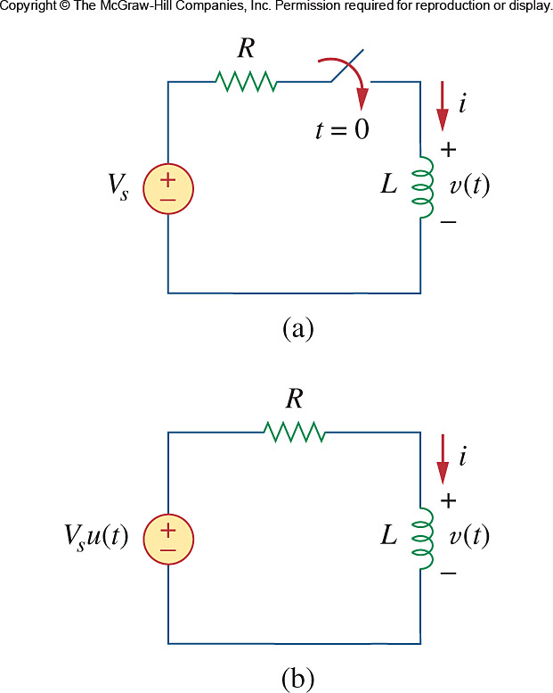
Step response of an RL circuit
Suppose before t = 0, the initial current of an inductor is I₀.
We close the switch at t = 0, the inductor is power supplied by the voltage source V_{s}.
For t ≥ 0
I₀
V_{s}
Interested in knowing how i changes for t ≥ 0. (i.e. find i(t) for t ≥ 0)

Slide 32
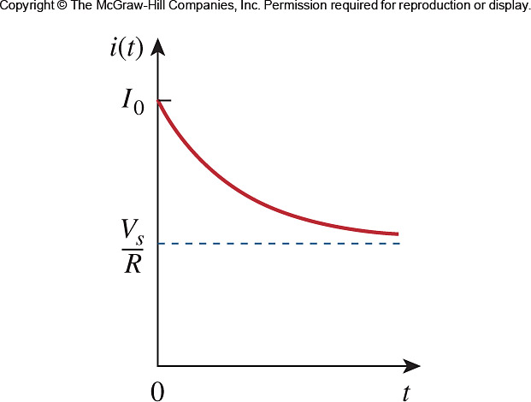
Step response of an RL circuit
The initial inductor current at t = 0⁻ : i(0⁻) = I_{o}, So i(0) = i(0⁻) = I_{o}
The final inductor current at t → ∞: i(∞) = V_{s}/R (as an inductor is an short wire at steady state)
Assume that I₀ > V_{s} /R
We expect a curve joining these two points.
We want to know how i changes with time

Slide 33
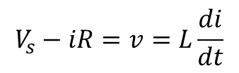
Step response of an RL circuit
Determine how i changes for t ≥ 0. (i.e. find i(t) for t ≥ 0)
For t ≥ 0, by KVL, we have
$$V_{s}−iR=v=L\frac{di}{dt}$$
0V
For t ≥ 0
i
V_{s}
0V

Slide 34
Step response of an RL circuit
Integrate both side, we have
For t ≥ 0
V_{s}
Recall that the initial current,

Slide 35
Step response of an RL circuit
For t ≥ 0
V_{s}
The time constant is
This is called the step response of an RL circuit which is caused by a sudden change of the circuit configuration at t = 0.

Slide 36
Step response of an RL circuit
The inductor current i(t) is given by
Initial current
final current
Final value at t → ∞
Initial value at t = 0
Assume that I₀ > V_{s} /R

Slide 37
Step response of an RL circuit
Three steps to find the step response of an RL circuit (current of L):
Find the initial inductor current i(0) at t = 0
Find the final inductor current i(∞)
Determine the time constant τ = L/R.
Put them in to the expression:
V_{s}
τ can only be determined in “A standard form RL circuit”
A standard form RL circuit

Slide 38
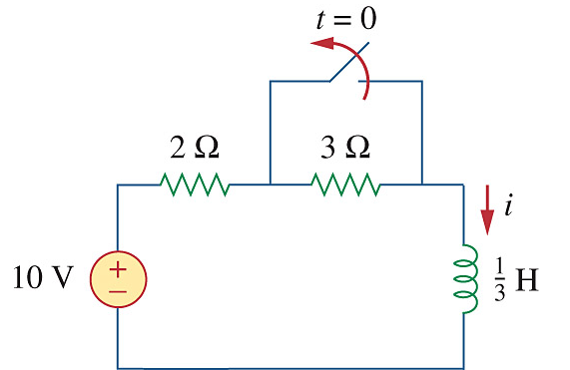
Step response of an RL circuit
Example: Find i(t) for t ≥ 0. Assume that the switch has been closed for a long time before t = 0.
When t = 0-, the current through the inductor (short circuit) is
When switch is opened for a long time, the current through the inductor (short circuit) is
The total resistance experienced by the inductor is
V_{s}
a standard form RL circuit

Slide 39
Step response of an RL circuit
The time constant is
Thus
V_{s}
a standard form RL circuit

Slide 40
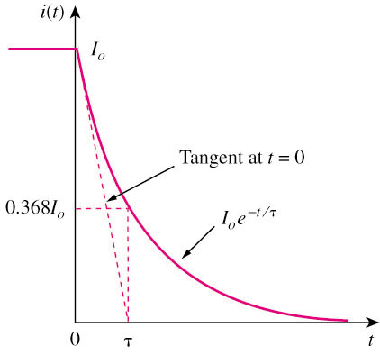
Natural response of RL circuit
When an RL circuit is connected no source after t = 0 (i.e. final inductor current i(∞) = 0), the step response of the RL circuit in this special case is given by
The current response of the RL circuit is an Exponential Decay of the initial inductor current i(0).
The response is due to the initial energy stored in the inductor.
It is also known Natural Response of an RL circuit.

Slide 41
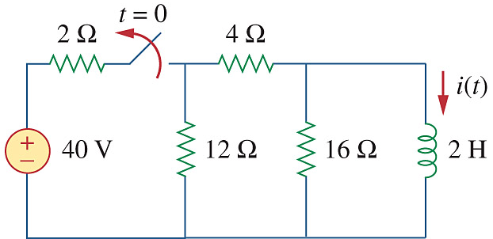
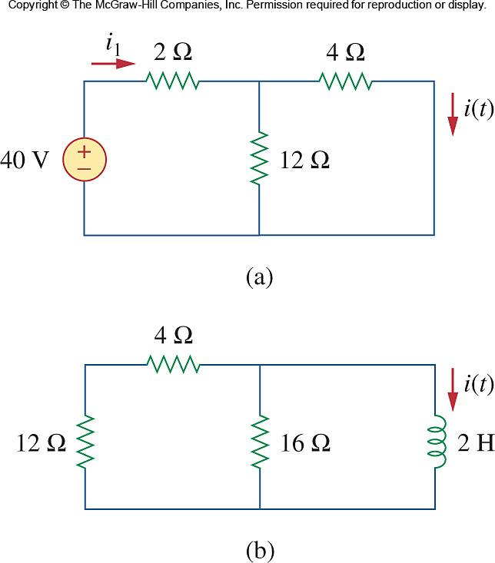
Natural response of RL circuit
The switch has been closed for a long time. At t = 0, the switch is opened. Calculate i(t) for t ≥ 0.
When t < 0 the switch is closed, the inductor is a short circuit.
By current divider,
t = 0-

Slide 42
Natural response of RL circuit
Since the current through an inductor cannot change immediately
When t ≥ 0, the circuit connects no source.
The equivalent resistance experienced by the inductor is
t ≥ 0
The time constant is
Thus

