Slide 1
AST10401 Introduction to Electrical Engineering
6. Second Order Circuits

Slide 2
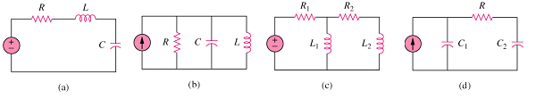
Second order circuits
A second-order circuit is a circuit that consists of exactly two energy storing elements together with power sources and resistors.
RLC Series
RLC Parallel
RL config.
RC config.

Slide 3
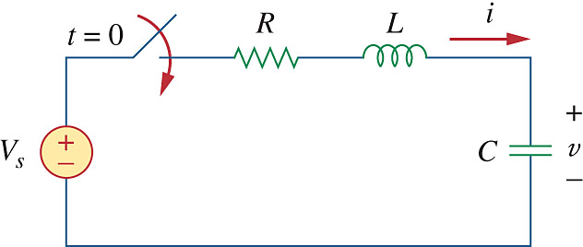
Step response of a series RLC circuit
The step response is the response of a RLC circuit when it is suddenly changed into a series RLC circuit with a source.
The switch is open when t < 0.
Assume the following initial conditions:
A Standard Form Series RLC circuit after t =0
How does v change after the sudden change in the circuit setting at t = 0?

Slide 4
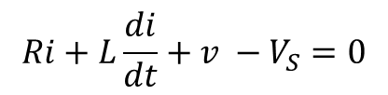
Step response of a series RLC circuit
Find v(t) in the series RLC circuit for t ≥ 0.
When t ≥ 0 the switch is closed. Applying KVL around the loop, we have
$$Ri+L\frac{di}{dt}+v −V_{S}=0$$
i
Note that
A Standard Form Series RLC circuit after t = 0
So

Slide 5
Step response of a series RLC circuit
(1)
This is a Second Order Differential Equation.
We let
R, L and C are found in the standard form series RLC circuit
The equation can be rewritten as
(2)
Solving (2) is equivalent to solving (1).

Slide 6
Step response of a series RLC circuit
The solution of (2) contains two parts:
Steady State response
Transient response
The Steady State response v_{ss}(t) is the Final Value of v(t), so

Slide 7
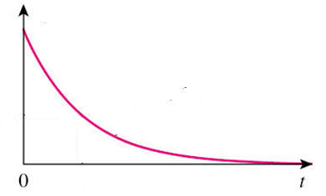
Step response of a series RLC circuit
With
There are 3 possible forms of the transient response v_{t}(t):
1. If α > ω₀ , over-damped case
v_{t}(t)
where

Slide 8
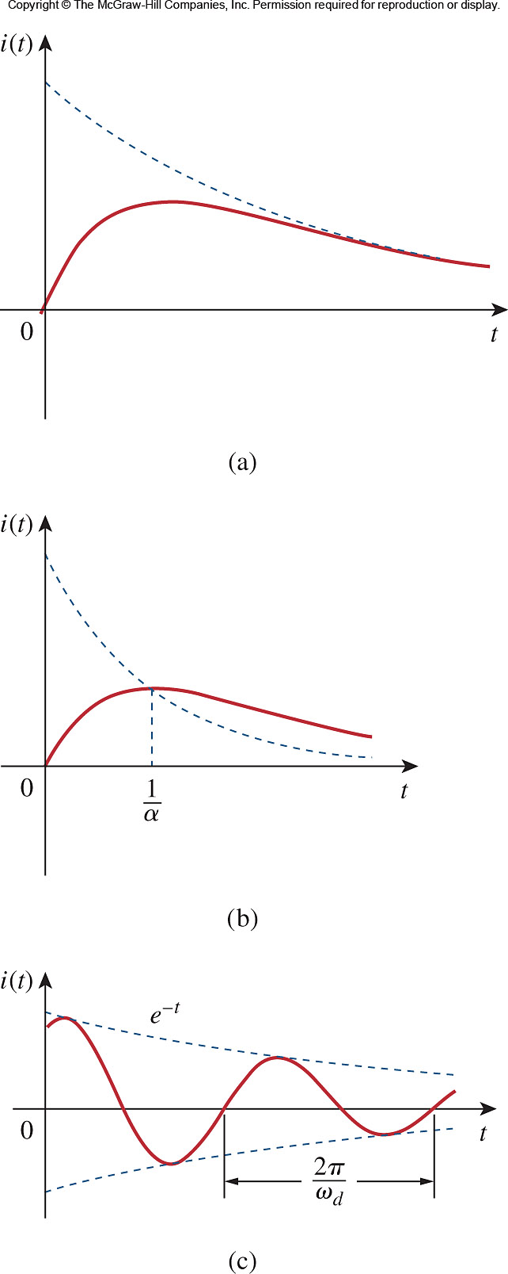
Step response of a series RLC circuit
v_{t}(t)
2. If α = ω₀ , critical damped case
3. If α < ω₀ , under-damped case
v_{t}(t)
where

Slide 9
Step response of a series RLC circuit
A standard form series RLC circuit after t = 0
The complete solution v(t) for t ≥ 0 would be either one of the three:
(α > ω₀ over-damped)
(α = ω₀ critically damped)
(α < ω₀ under-damped)
The values of A₁ and A₂ are obtained from the initial conditions:
v(0) and i(0) at t = 0.

Slide 10
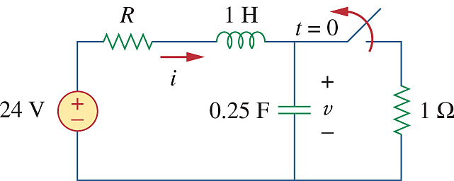
Step response of a series RLC circuit
Example: Find v(t) for t ≥ 0
For t < 0, the switch is closed for a long time.
The capacitor behaves like an open circuit and the inductor acts like a short circuit
5Ω

Slide 11
Step response of a series RLC circuit
For t ≥ 0, the switch is opened.
The circuit becomes a Standard Form Series RLC circuit.
5Ω
5Ω
1H
24V
0.25F

Slide 12
Step response of a series RLC circuit
Now α > ω₀ , over-damped case, the solution would be in the form:
5Ω
1H
Vss is the steady state response.
It is the final capacitor voltage.
24V
0.25F
Thus
Find A1 and A2 using initial conditions

Slide 13
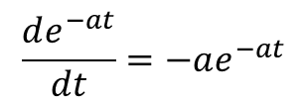
Step response of a series RLC circuit
Recall that at t ≥ 0, the inductor and capacitor have the same current (in series)
5Ω
5Ω
1H
Differentiate v(t) w.r.t t,
24V
0.25F
$$\frac{de^{−at}}{dt}=−ae^{−at}$$

Slide 14
Step response of a series RLC circuit
5Ω
Solve for A₁ and A₂, we have:
5Ω
1H
24V
0.25F

Slide 15
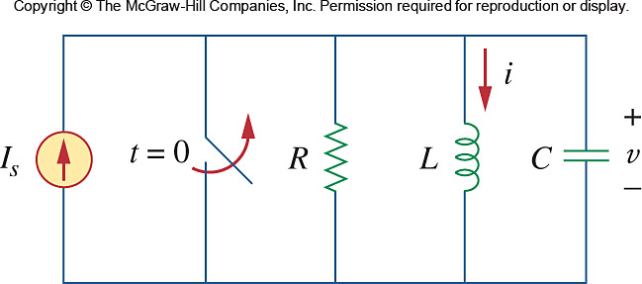
Step response of a parallel RLC circuit
The step response is the response of a RLC circuit when it is suddenly changed into a parallel RLC circuit with a source.
The switch is open when t < 0.
Assume the following initial conditions:
A Standard Form Parallel RLC circuit after t =0
How does i change after the sudden change in the circuit setting at t = 0?

Slide 16
Step response of a parallel RLC circuit
Find i(t) in the parallel RLC circuit for t ≥ 0.
When t ≥ 0 the switch is open. Applying KCL, we have
Note that
A Standard Form Parallel RLC circuit after t =0
So

Slide 17
Step response of a parallel RLC circuit
(1)
This is a Second Order Differential Equation
Let
R, L and C are found in the Standard Form Parallel RLC circuit.
The equation can be rewritten as
(2)
Solving (2) is equivalent to solving (1).

Slide 18
Step response of a parallel RLC circuit
The solution of (2) contains two parts:
Transient response
Steady State response
The steady-state response i_{ss}(t) is the final value of i(t), so

Slide 19
Step response of a parallel RLC circuit
With
There are 3 possible forms of the transient response v_{t}(t):
1. If α > ω₀ , over-damped case
i_{t}(t)
where

Slide 20
Step response of a parallel RLC circuit
i_{t}(t)
2. If α = ω₀ , critical damped case
A₁ = 0
3. If α < ω₀ , under-damped case
i_{t}(t)
where

Slide 21
Step response of a parallel RLC circuit
A Standard Form Parallel RLC circuit after t =0
The complete solution i(t) for t ≥ 0 would be either one of the three:
(α > ω₀ over-damped)
(α = ω₀ critically damped)
(α < ω₀ under-damped)
The values of A₁ and A₂ are obtained from the initial conditions:
i(0) and v(0) at t = 0.

Slide 22
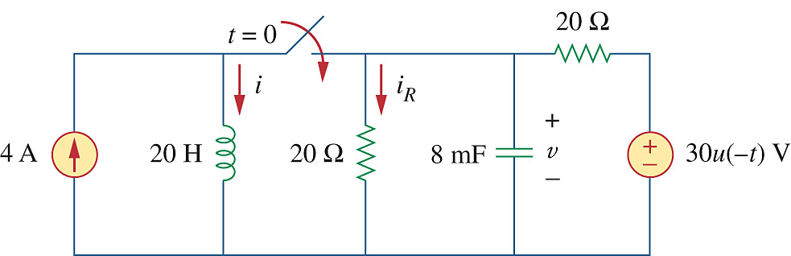
Step response of a parallel RLC circuit
Example: Find i(t) for t ≥ 0
For t = 0-, the switch is open.
Note that
30u(-t) = 30 for t < 0
30u(-t) = 0 for t ≥ 0.
For t < 0,
the capacitor acts like an open circuit so

Slide 23
Step response of a parallel RLC circuit
For t ≥ 0, the switch is closed and voltage source is off.
We have a Standard Form Parallel RLC circuit with a 4A current source.
20||20
4A
20H
8mF

Slide 24
Step response of a parallel RLC circuit
Now α > ω_{ο}, over-damped case, the solution would be in the form:
20||20
4A
20H
8mF
Is is the steady state response.
It is the final inductor current.
Thus

Slide 25
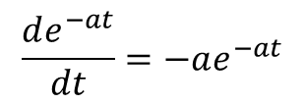
Step response of a parallel RLC circuit
Find A1 and A2 using initial conditions
Cap and Inductor are parallel
Recall that
20||20
4A
20H
8mF
Differentiate i(t) w.r.t t,
$$\frac{de^{−at}}{dt}=−ae^{−at}$$

Slide 26
Step response of a parallel RLC circuit
Thus
20||20
4A
20H
8mF

