Slide 1
AST10401 Introduction to Electrical Engineering
6. AC circuits
(Alternating Current circuits)

Slide 2
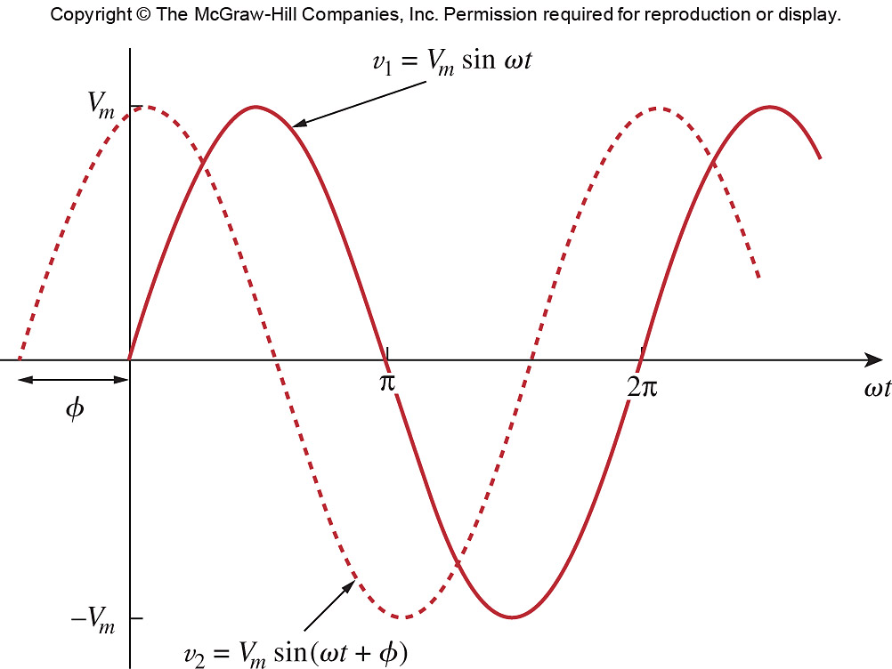
AC Sources
An AC source is a voltage or current source that generates a time varying voltage or current in the form of a sine or cosine function.
~
where
V_{m} = the amplitude of AC voltage
ω = the angular frequency in radians/s
Ф = the phase in degree or radians
+Ф means shifted to left by Ф,
-Ф means shifted to right by Ф.

Slide 3
DC vs AC Voltage
V(t)
V(t)
+
~
Vs
_
v(t) = V_{m} sin(ωt)
0V
0V
V(t)
V(t)
Vs
v(t) = V_{m} sin(ωt)
t
t
A DC source voltage gives a constant voltage.
An AC source voltage gives a sinusoidal voltages.

Slide 4
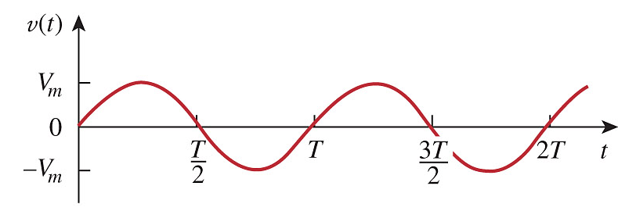
AC signals
AC voltages or AC currents
An AC voltage or current is periodic. It repeats a cycle for every T sec., where T is the period of the AC signal (i.e. time take to complete a cycle)
v(t) = V_{m} sin(ωt)
Angular frequency
Frequency in Hz
Frequency is the number of repeated cycles per second
Period

Slide 5
AC signals
Period T = 1/3 s
e.g.
V(t)
Frequency f = 1/(1/3) = 3Hz (3 cycles per sec)
Angular Freq. ω = 2πf = 2π(3)
1s
1
……
……
t
1/3 s
2/3 s
1s
-1
1 cycle
A basic unit of a sine function
v(t) = V_{m} sin( 2πf t + Ф) = sin( 2π(3)t )

Slide 6
Important Relationships
Recalled the following relationships

Slide 7
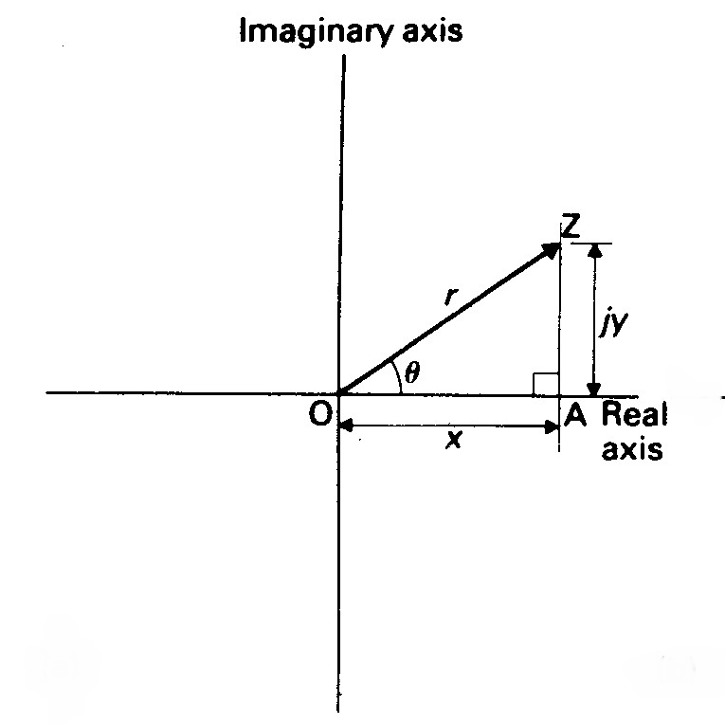




Phasors
A phasor is a Complex Number that represents the Amplitude and Phase of an AC signal.
A complex number can be represented in one of the following 2 forms:
Rectangular
Polar
$$z=x+jy$$
$$z=r cos⁡(φ)+j r sin(φ)$$
Shorthand:
$$z=r ∠ φ$$
where
$z=r\cos\left(φ\right)+j r sin\left(φ\right)=$ $r ∠ φ$

Slide 8

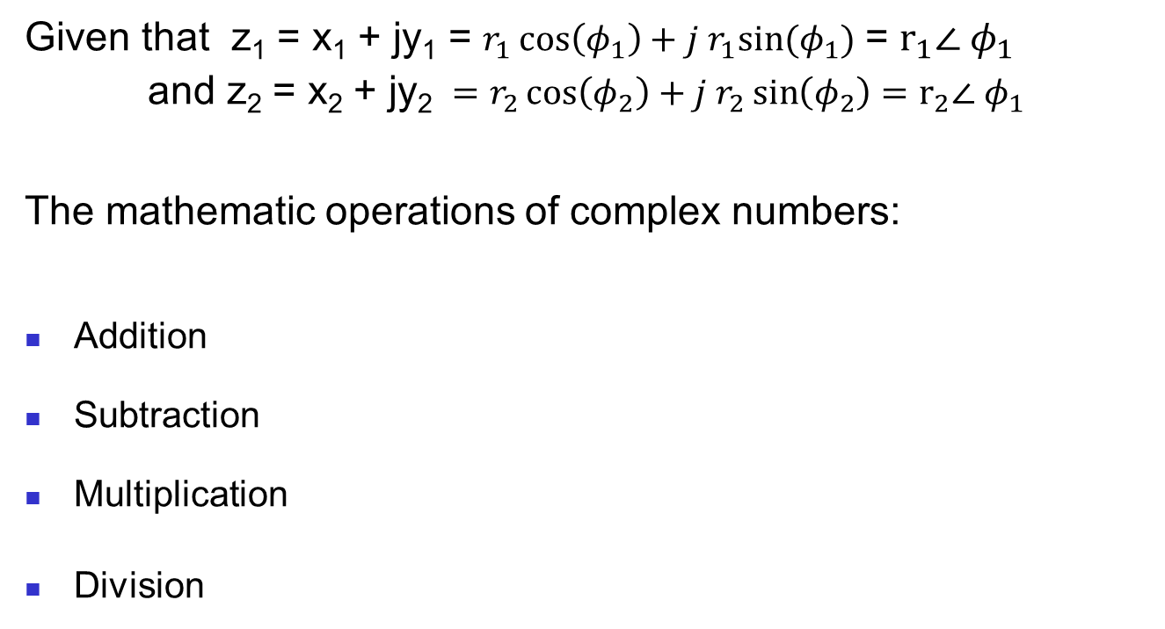
Phasors
$$z_{1}z_{2}=\left(r_{1}\cos\left(φ_{1}\right)+j{ r}_{1}sin⁡(φ_{1})\right)\left(r_{2}\cos\left(φ_{2}\right)+j{ r}_{2}sin⁡(φ_{2})\right)=r_{1}r_{2}\cos\left({ φ}_{1}+φ_{2}\right)+{j r}_{1}r_{2}\sin\left({ φ}_{1}+φ_{2}\right)$$
$z_{1}z_{2}=$ $\left(r_{1}∠ φ_{1}\right)\left(r_{2}∠ φ_{2}\right)=r_{1}r_{2}∠{ φ}_{1}+φ_{2}$
Given that z₁ = x₁ + jy₁ = $r_{1}\cos\left(φ_{1}\right)+j{ r}_{1}sin⁡(φ_{1})$ = $r_{1}∠ φ_{1}$
and z₂ = x₂ + jy₂ ${ =r_{2}\cos\left(φ_{2}\right)+j{ r}_{2}\sin\left(φ_{2}\right)=r}_{2}∠ φ_{1}$
The mathematic operations of complex numbers:
Addition
Subtraction
Multiplication
Division
$z_{1}z_{2}=$ $\left(r_{1}∠ φ_{1}\right)\left(r_{2}∠ φ_{2}\right)=r_{1}r_{2}∠{ φ}_{1}+φ_{2}$
$\frac{z_{1}}{z_{2}}=$ $\frac{r_{1}∠ φ_{1}}{r_{2}∠{ φ}_{1}}=\frac{r_{1}}{r_{2}}∠{ φ}_{1}−φ_{2}$

Slide 9






Phasors
$$z=r cos⁡(φ)+j r sin(φ)$$
$$Re\left\{x+jy\right\}=x$$
$$z=r ∠ φ$$
$$\left(r_{1}∠ φ_{1}\right)\left(r_{2}∠ φ_{2}\right)=r_{1}r_{2}∠{ φ}_{1}+φ_{2}$$
Given an AC signal ,
$$V_{m}\cos\left(ωt+φ\right)=Re\{{ V}_{m}\cos\left(ωt+φ\right)+j V_{m}\sin\left(ωt+φ\right) \}$$
$V_{m}\cos\left(ωt+φ\right)=Re\left\{{ V}_{m}∠\left(ωt+φ\right) \right\}=Re\left\{{ V}_{m}∠\left(φ+ωt\right) \right\}$ = $Re\left\{{ V}_{m}(1)∠\left(φ+ωt\right) \right\}$
$$V_{m}\cos\left(ωt+φ\right)=Re\{ \left({ V}_{m}∠ φ\right)\left(1 ∠ ωt\right) \}$$
Let V = ${ V}_{m}∠ φ$
$V_{m}\cos\left(ωt+φ\right)=Re\{ \left({ V}_{m}∠ φ\right)\left(1 ∠ ωt\right) \}$ = $Re\{ \text{V} \left(1 ∠ ωt\right) \}$
V is the Phasor Representation of the AC signal v(t).
V summarizes 2 important information of the AC signal v(t):
Both Amplitude and Phrase Angle of the AC signal v(t).

Slide 10

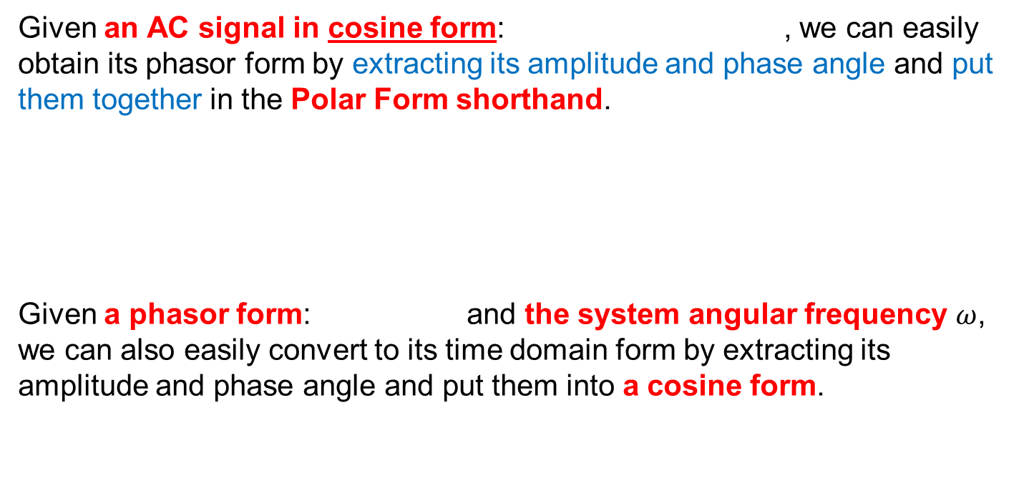


Phasors
Given an AC signal in cosine form: , we can easily obtain its phasor form by extracting its amplitude and phase angle and put them together in the Polar Form shorthand.
Given a phasor form: and the system angular frequency $ω$, we can also easily convert to its time domain form by extracting its amplitude and phase angle and put them into a cosine form.
V = ${ V}_{m}∠ φ$
Time domain form
Phasor domain form
V = ${ V}_{m}∠ φ$
V = ${ V}_{m}∠ φ$
Phasor domain form
Time domain form

Slide 11
Phasors
Example
Find the phasor forms of the following AC signals.
a) i(t) = 6cos(50t – 40º)
b) v(t) = – 4sin(30t + 50º)
Solution:
a) I
b) Since –sin(x) = cos(x + 90º);
v(t) = 4cos((30t + 50º) + 90º) = 4cos(30t + 140º)
Transform to phasor V

Slide 12
Adding AC Signals
Example: Find v_{s}(t) = v₁(t) + v₂(t)
Two cosine function with same ω.
Note that
Complicated Formulae!
So

Slide 13

Adding AC Signals in Phasors
Example: Find v_{s}(t) = v₁(t) + v₂(t)
$z=r\cos\left(φ\right)+j r sin\left(φ\right)=$ $r ∠ φ$
Rectangular to Polar

Slide 14
Comparing Signal and Phasor
The differences between v(t) and V:
v(t) is time-domain representation.
V is phasor-domain representation.
v(t) is always real, V is generally complex.
v(t) is changing with time, V is fixed.
Note:
Phasor analysis can only be applied when
a) the system frequency is a constant.
b) all AC sources are having the same frequency.

Slide 15
Impedance
When there is an AC voltage v(t) across an electrical device then there is an AC current i(t) passing through it.
The Impedance Z of an electrical device is defined as the ratio of the voltage phasor V to the current phasor I, measured in ohms Ω.
AC signals
Phasors
i(t)
I
v(t)
V
Z
where R = Re{Z} called the resistance and X = Im{Z} called the reactance.

Slide 16
Impedance – Resistors
Impedance of a Resistor:
Consider Ohm’s Law in phasor form:
Phasor form:
i_{R}(t)
+
v_{R}(t)
–
R
Im
IC
IR
VR
Ф
Re

Slide 17



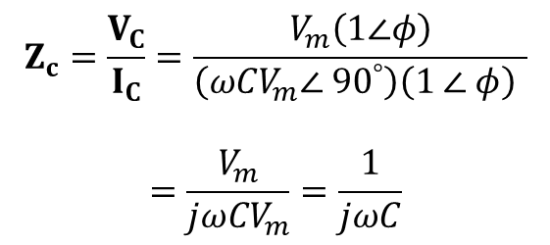



Impedance – Capacitor
$$\left(r_{1}∠ φ_{1}\right)\left(r_{2}∠ φ_{2}\right)=r_{1}r_{2}∠{ φ}_{1}+φ_{2}$$
$$X∠{90}^{∘}=\operatorname{Xcos}\left({90}^{∘}\right)+jXsin\left({90}^{∘}\right)=jX$$
Impedance of a Capacitor:
V_{m} , ω and Ф are fixed
Phasor form:
i_{C}(t)
+
v_{C}(t)
–
$$V_{C}=V_{m}∠φ=V_{m}\left(1∠φ\right)$$
C
$$I_{C}={ωCV}_{m}∠ {90}^{°}+φ$$
$$=\left({ωCV}_{m}\right)(1)∠ {90}^{°}+φ$$
$$=\left({ωCV}_{m}∠ {90}^{°}\right)\left(1 ∠ φ\right)$$
Im
IC
$$Z_{c}=\frac{V_{C}}{I_{C}}=\frac{V_{m}\left(1∠φ\right)}{\left({ωCV}_{m}∠ {90}^{°}\right)\left(1 ∠ φ\right) }$$
$$=\frac{V_{m}}{{jωCV}_{m}}=\frac{1}{jωC}$$
VC
Ф
Re

Slide 18
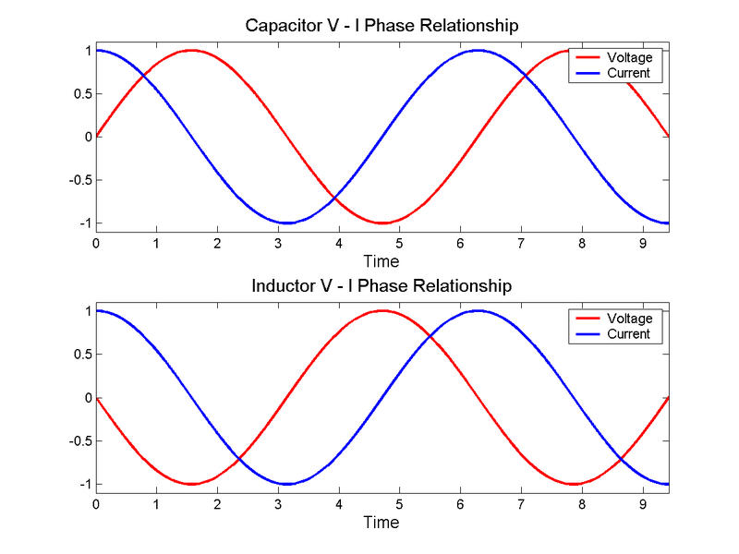
Impedance – Capacitor
Shift L by 90º
90º or t = π/2
V_{c}(t)
i_{c}(t)
i_{C}(t)
Current leads Voltage by 90º
+
v_{C}(t)
–
C

Slide 19

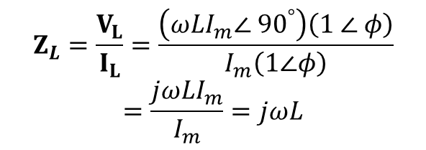



Impedance – Inductor
$$\left(r_{1}∠ φ_{1}\right)\left(r_{2}∠ φ_{2}\right)=r_{1}r_{2}∠{ φ}_{1}+φ_{2}$$
$$X∠{90}^{∘}=\operatorname{Xcos}\left({90}^{∘}\right)+jXsin\left({90}^{∘}\right)=jX$$
Impedance of an Inductor:
i_{L}(t)
I_{m} , ω and Ф are fixed
Phasor form:
$$I_{L}=I_{m}∠φ=I_{m}\left(1∠φ\right)$$
+
v_{L}(t)
–
L
$$V_{L}={ωLI}_{m}∠{ 90}^{°}+φ$$
$$=\left({ωLI}_{m}\right)\left(1\right)∠ {90}^{° }+φ$$
$$=\left({ωLI}_{m}∠ {90}^{°}\right)\left(1 ∠ φ\right)$$
Im
VL
$$Z_{L}=\frac{V_{L}}{I_{L}}=\frac{\left({ωLI}_{m}∠ {90}^{°}\right)\left(1 ∠ φ\right)}{I_{m}\left(1∠φ\right)}$$
$$=\frac{j{ωLI}_{m}}{I_{m}}=jωL$$
IL
Ф
Re

Slide 20
Impedance – Inductor
Shift L by 90º
90º or t = π/2
i_{L}(t)
V_{L}(t)
i_{L}(t)
+
v_{L}(t)
–
Voltage leads Current by 90º
L

Slide 21


Impedance
I
$$Z= \frac{V}{I}$$
V
Z
$$I= \frac{V}{Z}$$
Impedance of resistors, capacitors and inductors
+
R
–
+
C
–
+
L
–
A “larger” impedance tends to allow less AC current flow in an elements for a given AC voltage.

Slide 22
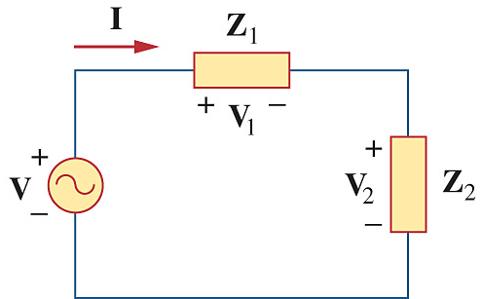
Phasor form of KVL
Let v₁(t), v₂(t), … , v_{n}(t) be the AC voltages of electrical components around a closed loop, as KVL holds for all time, we have
It is found that KVL also holds for phasors:
KVL in phasor version
-
v₃(t)
+
+ v₁(t) -
-
V₃
+
+ V₁ -
+
v₂(t)
-
+
V₂
-
Time Domain Circuit
Phasor Domain Circuit

Slide 23
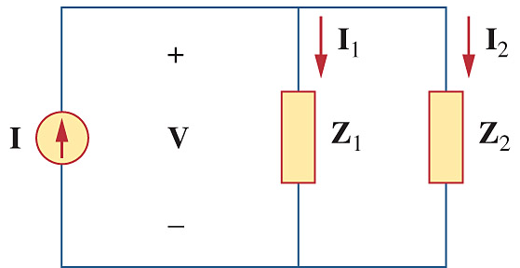
Phasor form of KCL
Let i₁(t), i₂(t), … , i_{n}(t) be the AC currents entering a node in a circuit, as KCL holds all the time, we have
It is found that KCL also holds for phasors:
KCL in phasor version
i₂(t)
i₃(t)
I₂
I₃
i₁(t)
I₁
Time Domain Circuit
Phasor Domain Circuit

Slide 24
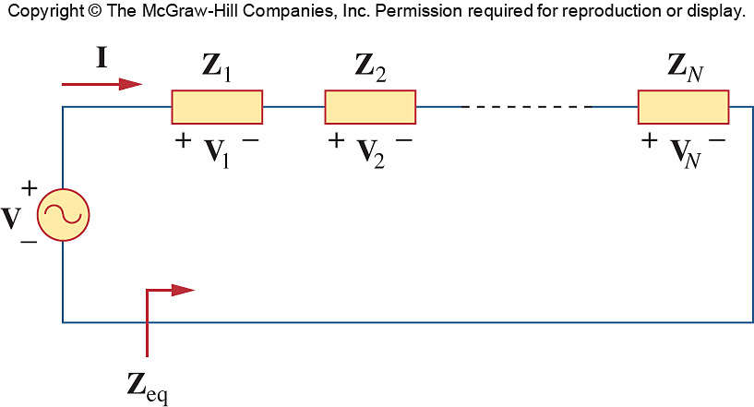


Combining Impedances
Consider the N-series connected impedances.
The same current I flows through the impedances, applying KVL around the loop gives:
$$V_{1}+V_{2}+…+V_{N}−V=0$$
I
$$\frac{V}{I}=Z$$
V
Z

Slide 25
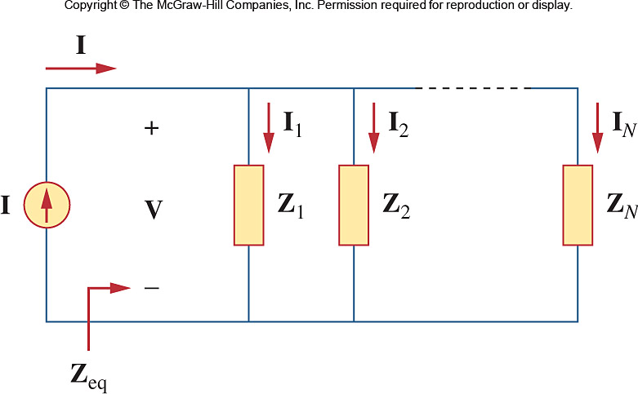
Combining Impedances
Consider the N-parallel connected impedances.
The same voltage V across the impedances, applying KCL at the top node gives:
I
$$\frac{V}{I}=Z$$
V
Z

Slide 26
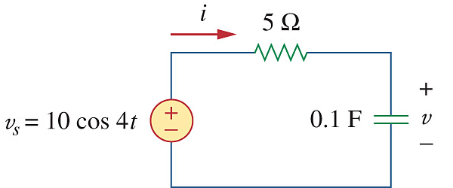

Combining Impedances
Find v(t) and i(t) in the circuit
I
$$\frac{V}{I}=Z$$
V
Z

Slide 27
Combining Impedances
The voltage across the capacitor is
Converting phasors I and V to their AC signals

