Slide 1
AST10401 Introduction to Electrical Engineering
8. AC power and Three-phase Circuits

Slide 2
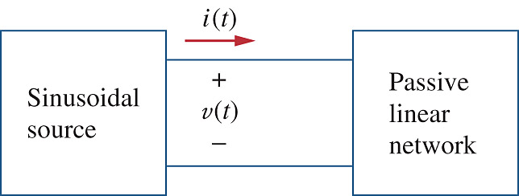
Instantaneous power
Suppose we have an AC circuit as follows:
A load
with
impedance
Z
The instantaneous power p(t) of a load with impedance Z is given by
Where

Slide 3
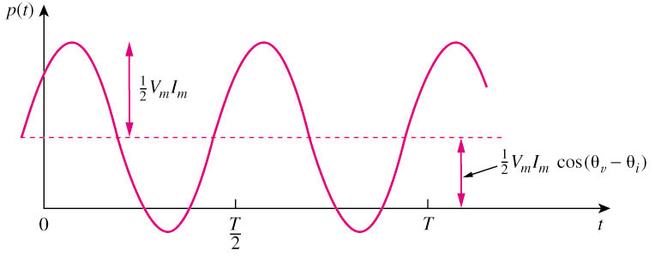
Instantaneous power
A
B
We apply the Product to Sum formula:
The instantaneous power p(t) of the load becomes
A Cosine function
(time-varying)
Constant

Slide 4
Average Power
Constant
A Cosine function
(time-varying)
Note that is a constant, so its Time Average value is
is a cosine function. The Time Average Value
of it is zero!
The Average Power P of the load with impedance Z is given by
The Average Power depends on the Phase Difference between voltage and current.

Slide 5
Impedance – Resistors
Impedance of a Resistor:
Consider Ohm’s Law in phasor form:
Phasor form:
i_{R}(t)
+
v_{R}(t)
–
R
Im
IC
IR
VR
Ф
Re

Slide 6


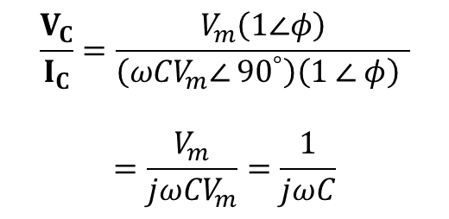


Impedance – Capacitor
$$X∠{90}^{∘}=\operatorname{Xcos}\left({90}^{∘}\right)+jXsin\left({90}^{∘}\right)=jX$$
Impedance of a Capacitor:
Phasor form:
i_{C}(t)
+
v_{C}(t)
–
$$V_{C}=V_{m}∠φ=V_{m}\left(1∠φ\right)$$
C
$$I_{C}={ωCV}_{m}∠ {90}^{°}+φ$$
$$=\left({ωCV}_{m}∠ {90}^{°}\right)\left(1 ∠ φ\right)$$
Im
$$\frac{V_{C}}{I_{C}}=\frac{V_{m}\left(1∠φ\right)}{\left({ωCV}_{m}∠ {90}^{°}\right)\left(1 ∠ φ\right) }$$
$$=\frac{V_{m}}{{jωCV}_{m}}=\frac{1}{jωC}$$
IC
VC
Ф
Re

Slide 7

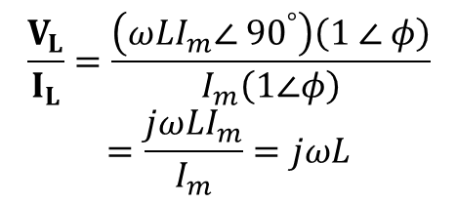


Impedance – Inductor
$$X∠{90}^{∘}=\operatorname{Xcos}\left({90}^{∘}\right)+jXsin\left({90}^{∘}\right)=jX$$
Impedance of an Inductor:
i_{L}(t)
Phasor form:
$$I_{L}=I_{m}∠φ=I_{m}\left(1∠φ\right)$$
+
v_{L}(t)
–
L
$$V_{L}={ωLI}_{m}∠{ 90}^{°}+φ$$
$$=\left({ωLI}_{m}∠ {90}^{°}\right)\left(1 ∠ φ\right)$$
Im
$$\frac{V_{L}}{I_{L}}=\frac{\left({ωLI}_{m}∠ {90}^{°}\right)\left(1 ∠ φ\right)}{I_{m}\left(1∠φ\right)}$$
$$=\frac{j{ωLI}_{m}}{I_{m}}=jωL$$
VL
IL
Ф
Re

Slide 8
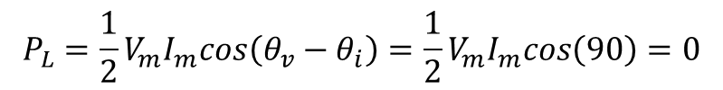
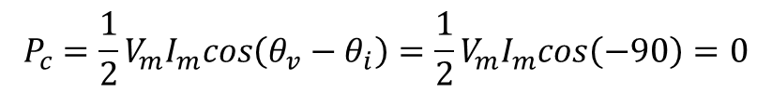
Average Power
A load
with
impedance
Z
If the load is a resistor,
On Average, a resistor always absorbs power.
If the load is a capacitor,
(Cap current leads Cap voltage by 90º)
$$P_{c}=\frac{1}{2}V_{m}I_{m}cos\left(θ_{v}−θ_{i}\right)=\frac{1}{2}V_{m}I_{m}cos\left(−90\right)=0$$
On Average, a capacitor and inductor DO NOT Absorb or Supply power.
If the load is an inductor,
(Inductor voltage leads inductor current by 90º)
$$P_{L}=\frac{1}{2}V_{m}I_{m}cos\left(θ_{v}−θ_{i}\right)=\frac{1}{2}V_{m}I_{m}cos\left(90\right)=0$$

Slide 9
Power Factor
The average power P of a general load with impedance Z is given by
Based on this expression, we define a number called the Power Factor of a load with impedance Z.
Power Factor (PF) of a load with impedance Z is the cosine of phase difference between voltage and current of the load.
If the load is a resistor, PF = 1
If the load is a capacitor or inductor, PF = 0

Slide 10
Three-phase Circuits

Slide 11
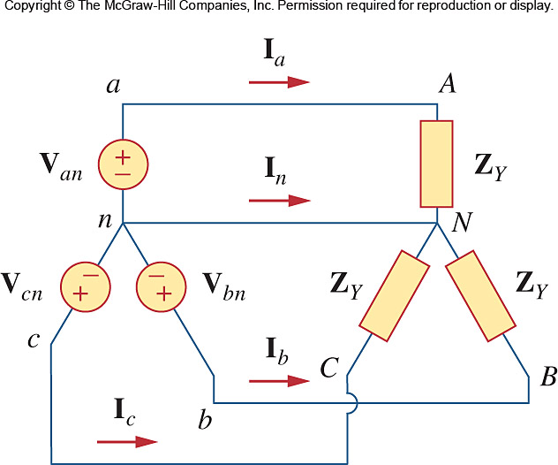
Three-phase Circuits
Phase difference between any 2 voltage sources is 120° .
A three-phase circuit is a circuit with three AC voltage sources having the same amplitude and frequency but out of phase with each other by 120° and each phase has a load.
Each Sub-circuit is called a Phase.
Three AC sources with 120° out
of phase
neutral wire

Slide 12
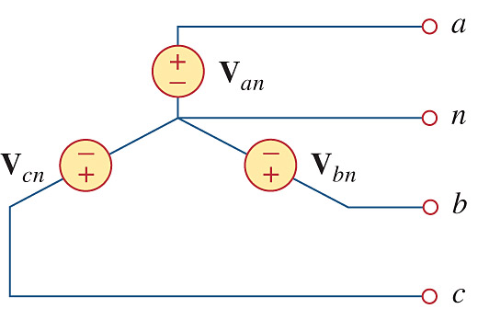
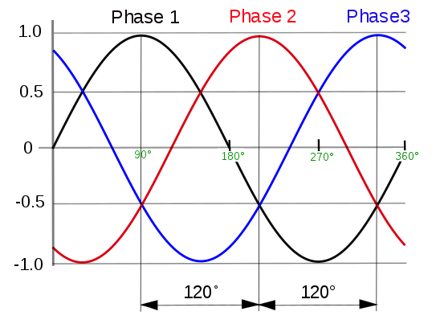
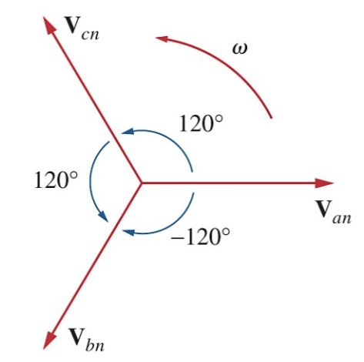
Three-phase Circuits
Same amplitude and frequency but out of phase with each other by 120°
Three-phase circuit sources
A common node

Slide 13
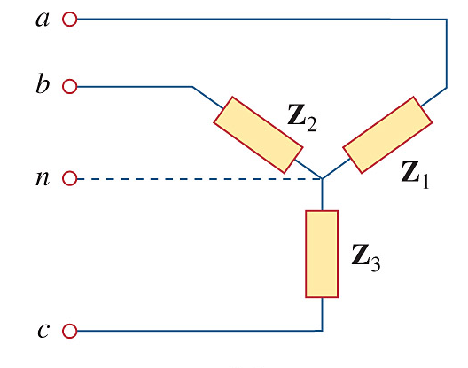
Three-phase Circuits
A common node
Three-phase circuit load

Slide 14
Three-phase Circuits
Three-phase circuit source
Three-phase circuit load
A balanced voltage source has three AC sources with equal amplitude but are out of phase with each other by 120°.
A balanced load is one in which the all 3 impedances are equal (i.e. Z₁ = Z₂ = Z₃).

Slide 15
Balanced Three-phase Circuits
A balanced three-phase circuit is a three-phase system with a balanced voltage source and a balanced load.
the neutral wire

Slide 16
Balanced Three-phase Circuits
Assume that
1st phase
2nd phase
3rd phase

Slide 17
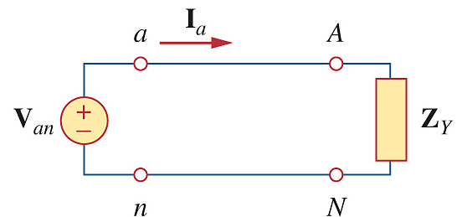
Balanced Three-phase Circuits
We can analyze a three-phase circuit on “per phase” basis:
I_{a}
V_{an}
b
I_{b}
B
V_{bn}
c
I_{c}
C
V_{cn}

Slide 18




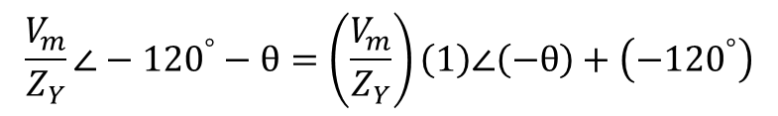


Balanced three-phase Circuits
$$\frac{V_{m}}{Z_{Y}}∠−{120}^{°}−θ=\left(\frac{V_{m}}{Z_{Y}}\right)\left(1\right)∠\left(−θ\right)+\left(−{120}^{°}\right)$$
Apply KCL at node N
$$I_{a}+I_{b}+I_{C}+I_{n}=0$$
$$\left(\frac{V_{m}}{Z_{Y}}∠−θ \right)+\left(\frac{V_{m}}{Z_{Y}}∠−{120}^{∘}−θ\right)+\left(\frac{V_{m}}{Z_{Y}}∠−{240}^{∘}−θ\right)+I_{n}=0$$
$$\left(\frac{V_{m}}{Z_{Y}}∠−θ \right)+\left(\left(\frac{V_{m}}{Z_{Y}}∠−θ\right)\left(1∠−{120}^{∘}\right)\right)+\left(\left(\frac{V_{m}}{Z_{Y}}∠−θ\right)\left(1∠−{240}^{∘}\right)\right)+I_{n}=0$$
$$\left(\frac{V_{m}}{Z_{Y}}∠−θ \right)\left(1+\left(1∠−{120}^{∘}\right)+\left(1∠−{240}^{∘}\right)\right)+I_{n}=0$$
$$\left(\frac{V_{m}}{Z_{Y}}∠−θ \right)\left(1+\cos\left(−{120}^{∘}\right)+jsin(−{120}^{∘})+\cos\left(−{240}^{∘}\right)+jsin(−{240}^{∘})\right)+I_{n}=0$$
$$\left(\frac{V_{m}}{Z_{Y}}∠−θ \right)\left(1+\left(−0.5\right)+j(−0.866)+(−0.5)+j(0.866)\right)+I_{n}=0$$
The neutral wire current I_{n} = 0
$$I_{n}=0$$
18

Slide 19
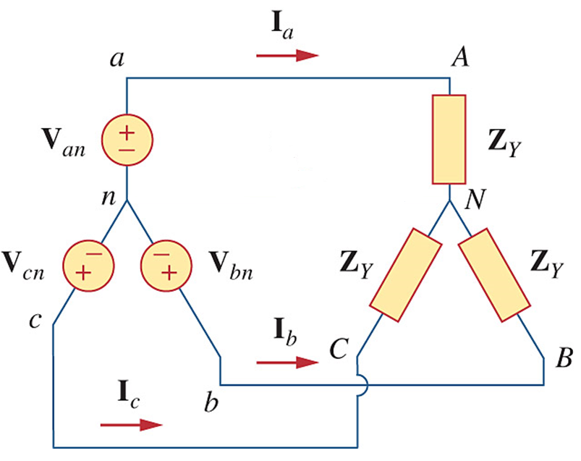
Balanced three-phase circuits
As there is no current in the neutral line for a balanced three-phase circuit, the neutral line is usually removed in a balanced three-phase circuit.

Slide 20
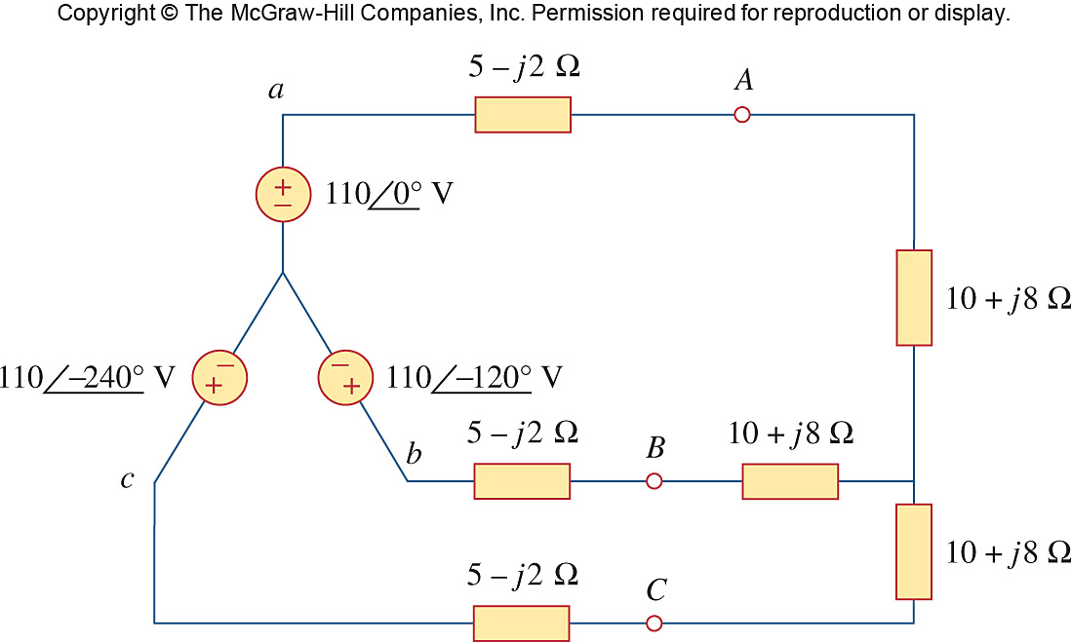
Balanced three-phase circuits
Example
Calculate the currents in the balanced three-phase circuit shown below:
Adopt “per-phase” approach

Slide 21
Power in a Balanced Circuit
Consider the Total Instantaneous Power of the loads p(t) in a balanced three-phase circuit.
where

Slide 22

Power in a Balanced Circuit
The instantaneous power is given by
By applying the trigonometry identity
The instantaneous power becomes
It is a constant which only depends on the phase different between voltage and current.

Slide 23
Advantages of Three-phase Circuits
The total instantaneous power of the loads in a balanced three-phase system is a constant.
b
I_{m}
V_{m}
In a single phase system, the instantaneous power of the load is time-varying.

Slide 24
Advantages of Three-phase Circuits
The amount of power cable required for a balanced three-phase circuit to connect to the loads is less than that required for an equivalent single-phase system.
Need only 3 power cables

Slide 25
Advantages of Three-phase Circuits
I_{a}
V_{an}
b
I_{b}
B
V_{bn}
c
I_{c}
C
V_{cn}
Needs 4 cables
The equivalent single-phase system totally needs 6 power cables!

