Slide 1
Problem Definition:
Given a directed graph G=(V, E, W), where each edge has a weight (length, cost),
Find a shortest path from s to v.
s—source
v—destination.

Slide 2
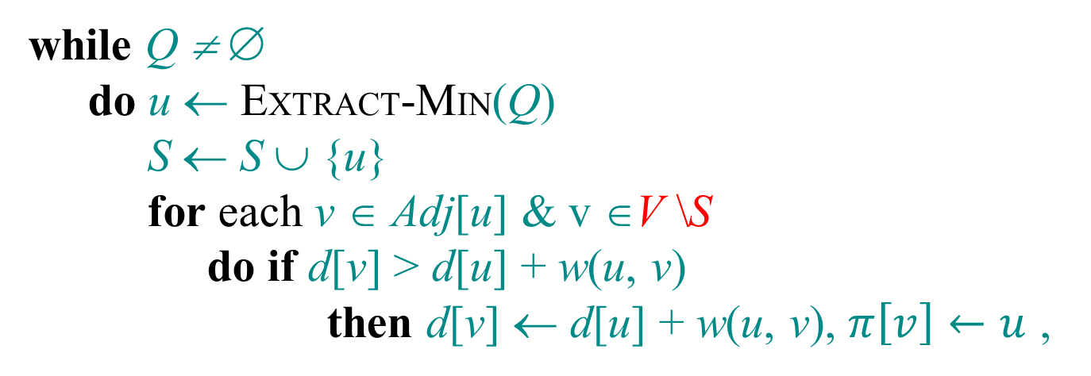
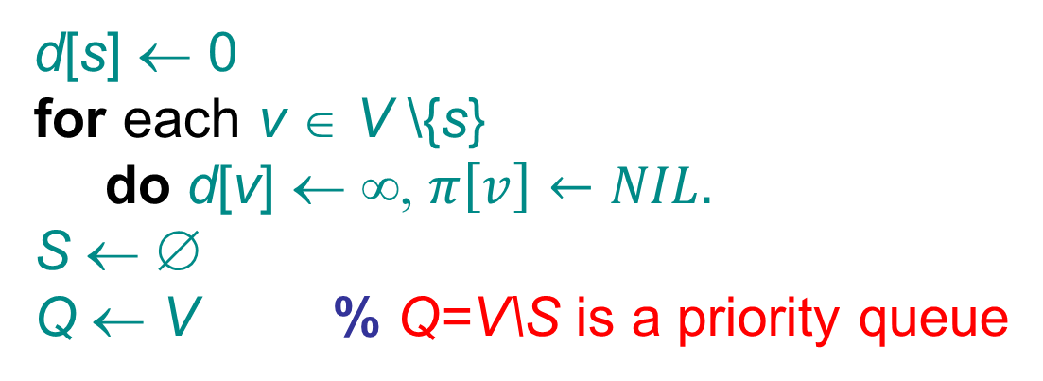
Dijkstra’s algorithm
d[s] ← 0
for each v ∈ V \{s}
do d[v] ← ∞, $π\left[v\right]←NIL.$
S ← ∅
Q ← V % Q=V\S is a priority queue
while Q ≠ ∅
do u ← EXTRACT-MIN(Q)
S ← S ∪ {u}
for each v ∈ Adj[u] & v ∈V \S
do if d[v] > d[u] + w(u, v)
then d[v] ← d[u] + w(u, v), $π\left[v\right]←u$ ,
relaxation step

Slide 3






Example of Dijkstra’s algorithm
7
11
“E” ← EXTRACT-MIN(Q):
2
B
D
10
A
8
0
1
4
7
9
3
C
E
Q:
A
B
C
2
C
D
E
3
5
d
0
7
3
11
5
$$π$$
$$NIL$$
$$C$$
$$A$$
$$C$$
$$C$$
S: { A, C, E }

Slide 4
The algorithm does not work if there are negative weight edges in the graph
 | s | v | u
t=0 | 0/Nil | Inf/Nil | Inf/Nil
t=1 |  | 1/s | 2/s
t=2 |  |  | 2/s
Dijkstra doesn’t work
u
-10
2
v
s
1
s→v is shorter than s → u, but it is longer than s → u → v.

Slide 5
Lecture 10: Shortest Paths with Negative weighted edges Bellman-Ford algorithm

Slide 6
Negative-weight cycles
Recall: If a graph G = (V, E) contains a negative-weight cycle, then some shortest paths may not exist.
…
Example:
< 0
u
v
Bellman-Ford algorithm: Finds all shortest-path lengths from a source s ∈ V to all v ∈ V or determines that a negative-weight cycle exists.

Slide 7
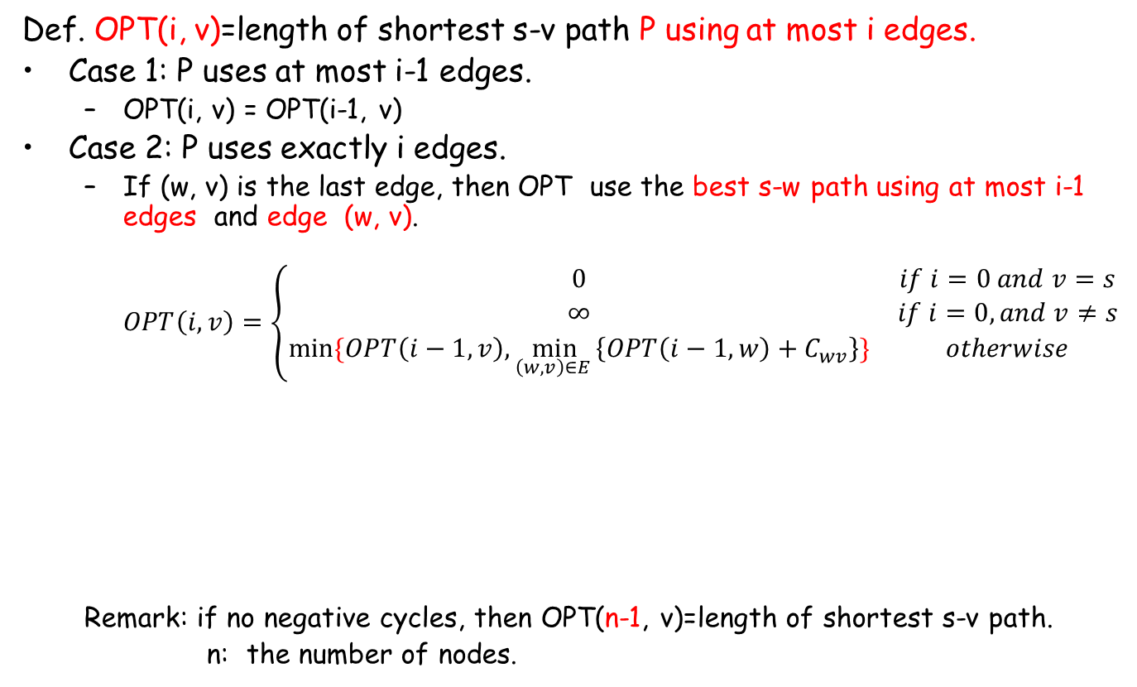
Shortest Paths: Dynamic Programming
Def. OPT(i, v)=length of shortest s-v path P using at most i edges.
Case 1: P uses at most i-1 edges.
OPT(i, v) = OPT(i-1, v)
Case 2: P uses exactly i edges.
If (w, v) is the last edge, then OPT use the best s-w path using at most i-1 edges and edge (w, v).
$$OPT\left(i,v\right)=\left\{\begin{matrix}0 & if i=0 and v=s \\ ∞ & if i=0, and v≠s \\ min⁡\{OPT\left(i−1, v\right),\min_{\left(w,v\right)∈E }\left\{OPT\left(i−1,w\right)+C_{wv}\right\}\} & otherwise\end{matrix}\right.$$
Remark: if no negative cycles, then OPT(n-1, v)=length of shortest s-v path.
n: the number of nodes.
s
w
v

Slide 8
Using this recursive equation, You can design a DP algorithm. Opt(v, i) is a subproblem (exercise).

Slide 9
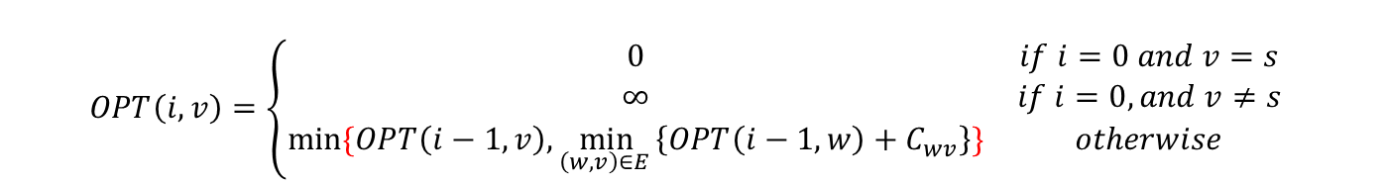
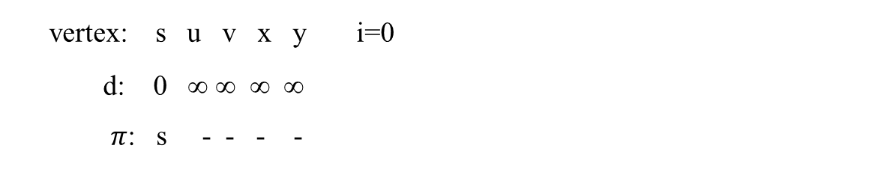
u
5
v
8
8
6
-2
-3
0
8
7
s
-4
2
7
8
8
9
x
y
(a)
$$OPT\left(i,v\right)=\left\{\begin{matrix}0 & if i=0 and v=s \\ ∞ & if i=0, and v≠s \\ min⁡\{OPT\left(i−1, v\right),\min_{\left(w,v\right)∈E }\left\{OPT\left(i−1,w\right)+C_{wv}\right\}\} & otherwise\end{matrix}\right.$$
vertex: s u v x y i=0
d: 0 ∞ ∞ ∞ ∞
$π$: s - - - -

Slide 10
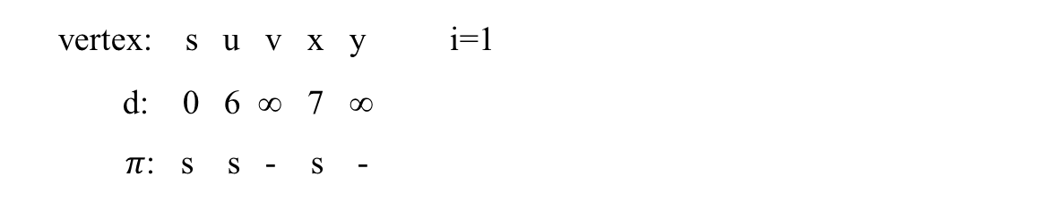
u
5
v
6
8
6
-2
-3
0
8
7
s
-4
2
7
7
8
9
x
y
(b)
$$OPT\left(i,v\right)=\left\{\begin{matrix}0 & if i=0 and v=s \\ ∞ & if i=0, and v≠s \\ min⁡\{OPT\left(i−1, v\right),\min_{\left(w,v\right)∈E }\left\{OPT\left(i−1,w\right)+C_{wv}\right\}\} & otherwise\end{matrix}\right.$$
vertex: s u v x y i=1
d: 0 6 ∞ 7 ∞
$π$: s s - s -

Slide 11
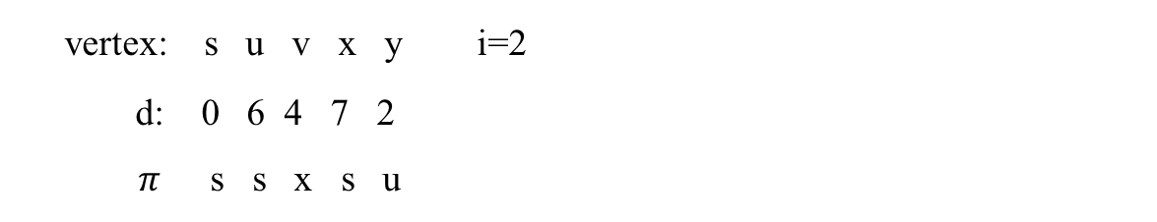
u
5
v
6
4
6
-2
-3
0
8
7
s
-4
2
7
7
2
9
x
y
(c)
$$OPT\left(i,v\right)=\left\{\begin{matrix}0 & if i=0 and v=s \\ ∞ & if i=0, and v≠s \\ min⁡\{OPT\left(i−1, v\right),\min_{\left(w,v\right)∈E }\left\{OPT\left(i−1,w\right)+C_{wv}\right\}\} & otherwise\end{matrix}\right.$$
vertex: s u v x y i=2
d: 0 6 4 7 2
$π$s s x s u

Slide 12
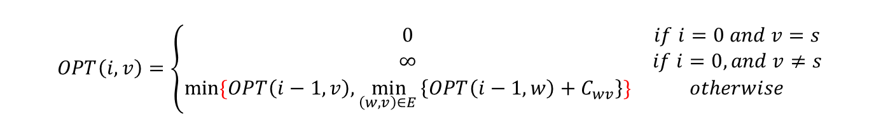
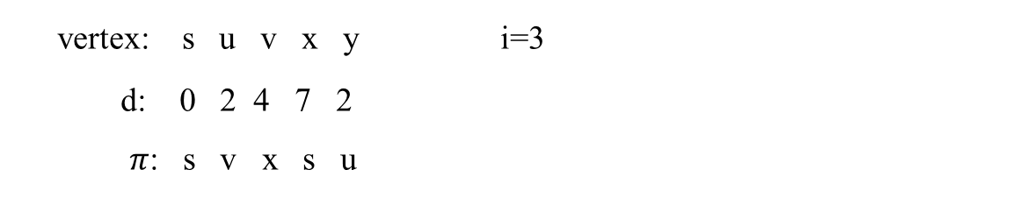
u
5
v
2
4
6
-2
-3
0
8
7
s
-4
2
7
7
2
9
x
y
(d)
$$OPT\left(i,v\right)=\left\{\begin{matrix}0 & if i=0 and v=s \\ ∞ & if i=0, and v≠s \\ min⁡\{OPT\left(i−1, v\right),\min_{\left(w,v\right)∈E }\left\{OPT\left(i−1,w\right)+C_{wv}\right\}\} & otherwise\end{matrix}\right.$$
vertex: s u v x y i=3
d: 0 2 4 7 2
$π$: s v x s u

Slide 13
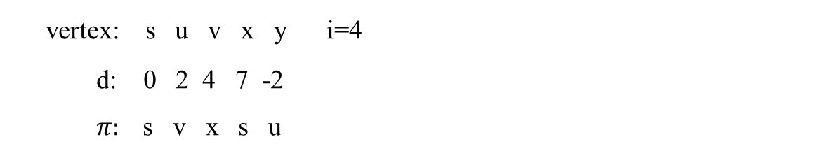
u
5
v
2
4
-2
6
-3
8
s
0
7
-4
2
7
x
7
-2
y
9
(e)
vertex: s u v x y i=4
d: 0 2 4 7 -2
$π:$s v x s u

Slide 14
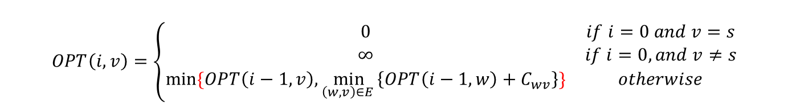
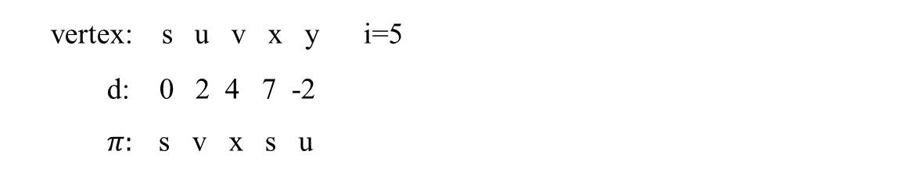
u
5
v
2
4
-2
6
-3
8
s
0
7
-4
2
7
x
7
-2
y
9
(e)
$$OPT\left(i,v\right)=\left\{\begin{matrix}0 & if i=0 and v=s \\ ∞ & if i=0, and v≠s \\ min⁡\{OPT\left(i−1, v\right),\min_{\left(w,v\right)∈E }\left\{OPT\left(i−1,w\right)+C_{wv}\right\}\} & otherwise\end{matrix}\right.$$
vertex: s u v x y i=5
d: 0 2 4 7 -2
$π:$s v x s u

Slide 15

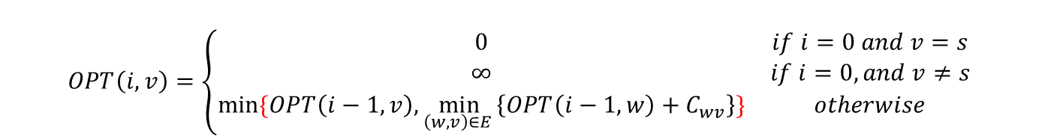
$$OPT\left(i,v\right)=\left\{\begin{matrix}0 & if i=0 and v=s \\ ∞ & if i=0, and v≠s \\ min⁡\{OPT\left(i−1, v\right),\min_{\left(w,v\right)∈E }\left\{OPT\left(i−1,w\right)+C_{wv}\right\}\} & otherwise\end{matrix}\right.$$
vertex: s u v x y
d: ∞ ∞ ∞ ∞ ∞ i=0
$π$: s - - - -
d: 0 6 ∞ 7 ∞ i=1
$π$: s s - s -
d: 0 6 4 7 2 i=2
$π:$ s s x s u
d: 0 2 4 7 2 i=3
$π$: s v x s u
d: 0 2 4 7 -2 i=4
$π$: s v x s u
d: 0 2 4 7 -2 i=5
$π$: s v x s u
So, no negative cycle.

Slide 16
Bellman-Ford algorithm is more efficient.

Slide 17
Bellman-Ford algorithm
d[s] ← 0
for each v ∈ V – {s}
do d[v] ← ∞
initialization
for i ← 1 to | V | – 1
do for each edge (u, v) ∈ E
do if d[v] > d[u] + w(u, v)
then d[v] ← d[u] + w(u, v)
relaxation step
for each edge (u, v) ∈ E
do if d[v] > d[u] + w(u, v)
then report that a negative-weight cycle exists
At the end, d[v] = δ(s, v). Time = O(|V| |E|).

Slide 18
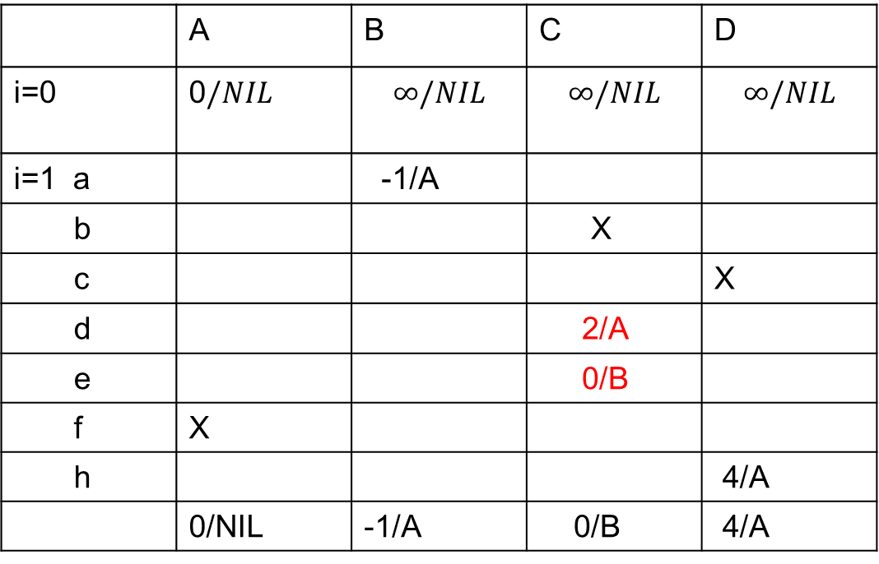
f
2
A
B
a
-1
e
2
d
h
1
4
C
c
5
 | A | B | C | D
i=0 | 0$/NIL$ | $$∞/NIL$$ | $$∞/NIL$$ | $$∞/NIL$$
i=1 a |  | -1/A
b |  |  | X
c |  |  |  | X
d |  |  | 2/A
e |  |  | 0/B
f | X
h |  |  |  | 4/A
 | 0/NIL | -1/A | 0/B | 4/A
b
-3
D

Slide 19
f
2
A
B
a
-1
e
2
d
h
1
4
C
c
 | A | B | C | D
i=1 | 0/NIL | -1/A | 0/B | 4/A
i=2 a |  | -1/A
b |  |  | X
c |  |  |  | X
d |  |  | X
e |  |  | X
f | X
h |  |  |  | X
 | 0/NIL | -1/A | 0/B | 4/A
5
b
-3
D
The result for i=2 is the same as i=1, so are i=3, 4.
Conclusion: no negative cycle.

Slide 20
Corollary: If negative-weight circuit exists in the given graph, in the n-th iteration, the cost of a shortest path from s to some node v will be further reduced.
Demonstrated by the following examples.

Slide 21
5
∞
∞
6
1
-2
0
8
7
∞
7
9
∞
∞
2
2
5
-8
∞
∞
An example with negative-weight cycle

Slide 22
5
6
∞
6
1
-2
0
8
7
∞
7
9
7
∞
2
2
5
-8
∞
∞
i=1

Slide 23
5
6
11
6
1
-2
0
8
7
∞
7
9
7
16
2
2
5
-8
9
∞
i=2

Slide 24
5
6
11
6
1
-2
0
8
7
12
7
9
7
16
2
2
5
-8
9
1
i=3

Slide 25
5
6
11
6
1
-2
0
8
7
12
7
9
6
16
2
2
5
-8
9
1
i=4

Slide 26
5
6
11
6
1
-2
0
8
7
12
7
9
6
15
2
2
5
-8
8
1
i=5

Slide 27
5
6
11
6
1
-2
0
8
7
12
7
9
6
15
2
2
5
-8
8
0
i=6

Slide 28
5
6
11
6
1
-2
0
8
7
12
7
9
5
15
2
2
5
-8
8
0
x
i=7

Slide 29
5
6
11
6
1
-2
0
8
7
12
7
9
5
15
2
2
5
-8
7
0
x
i=8

Slide 30
0-1 Knapsack Problem

Slide 31
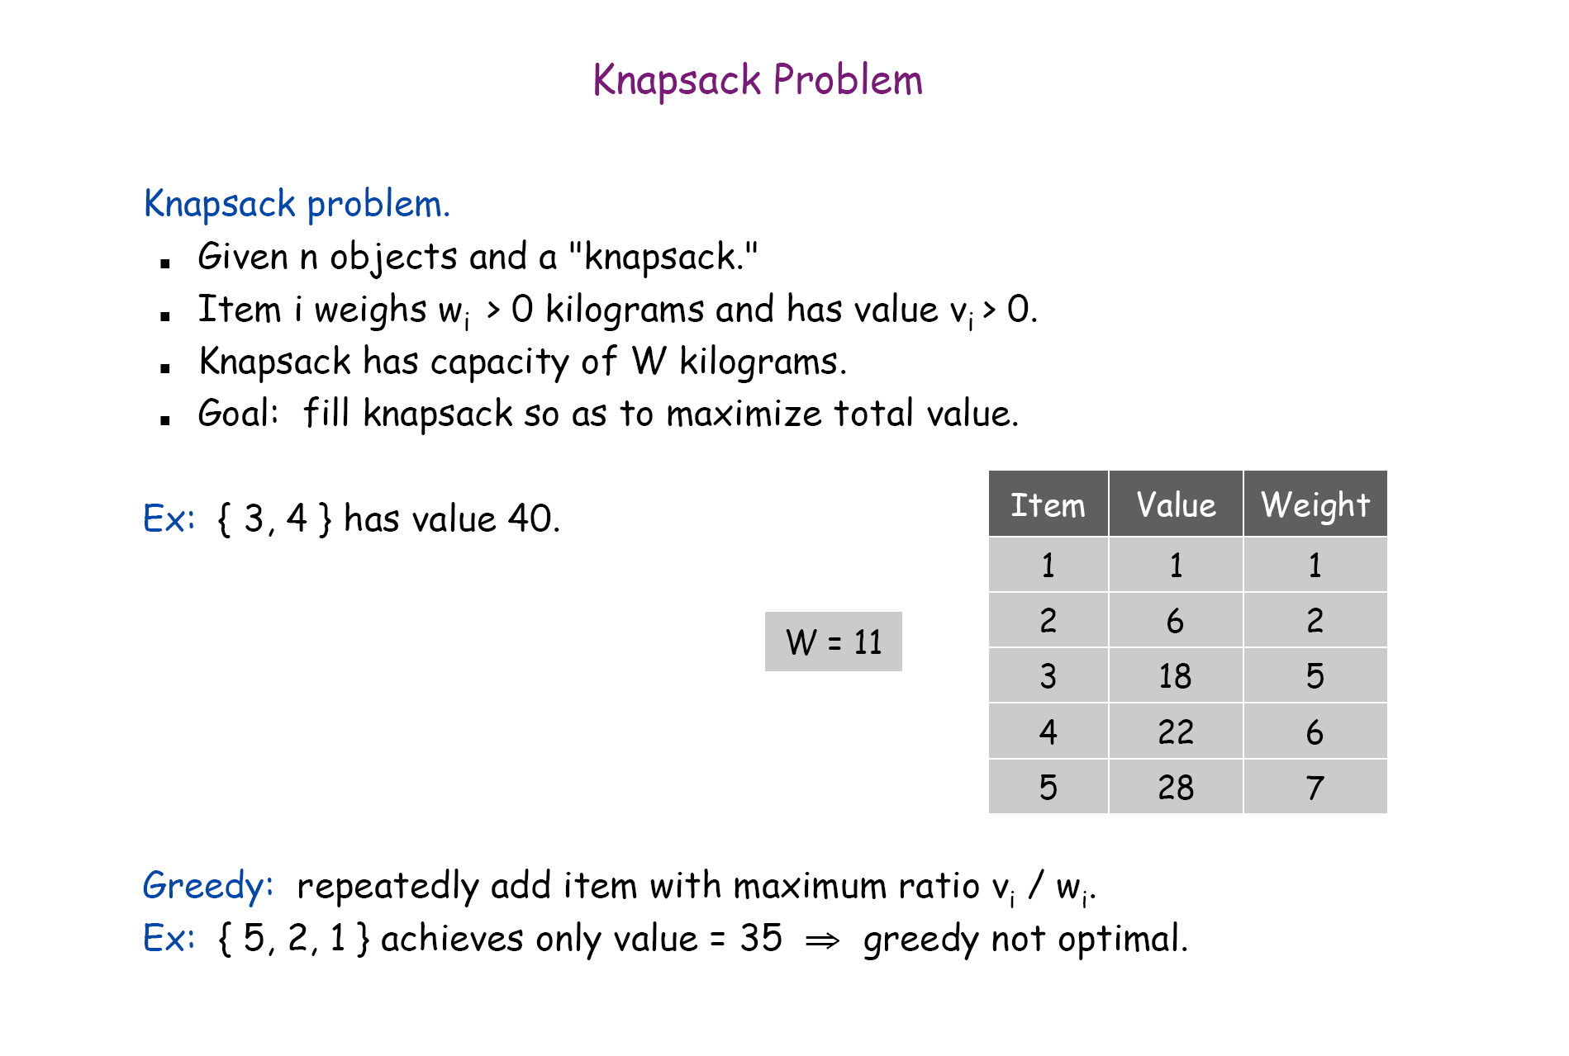
0-1 version

Slide 32
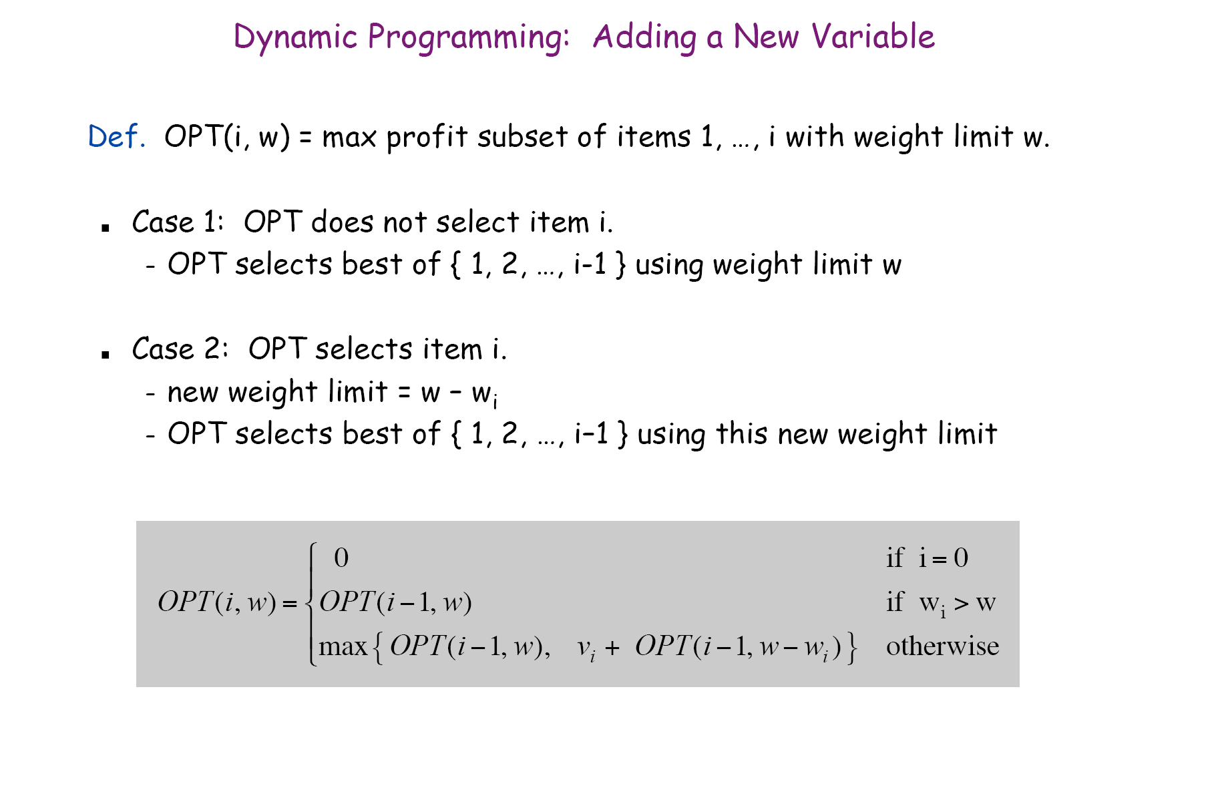

Slide 33
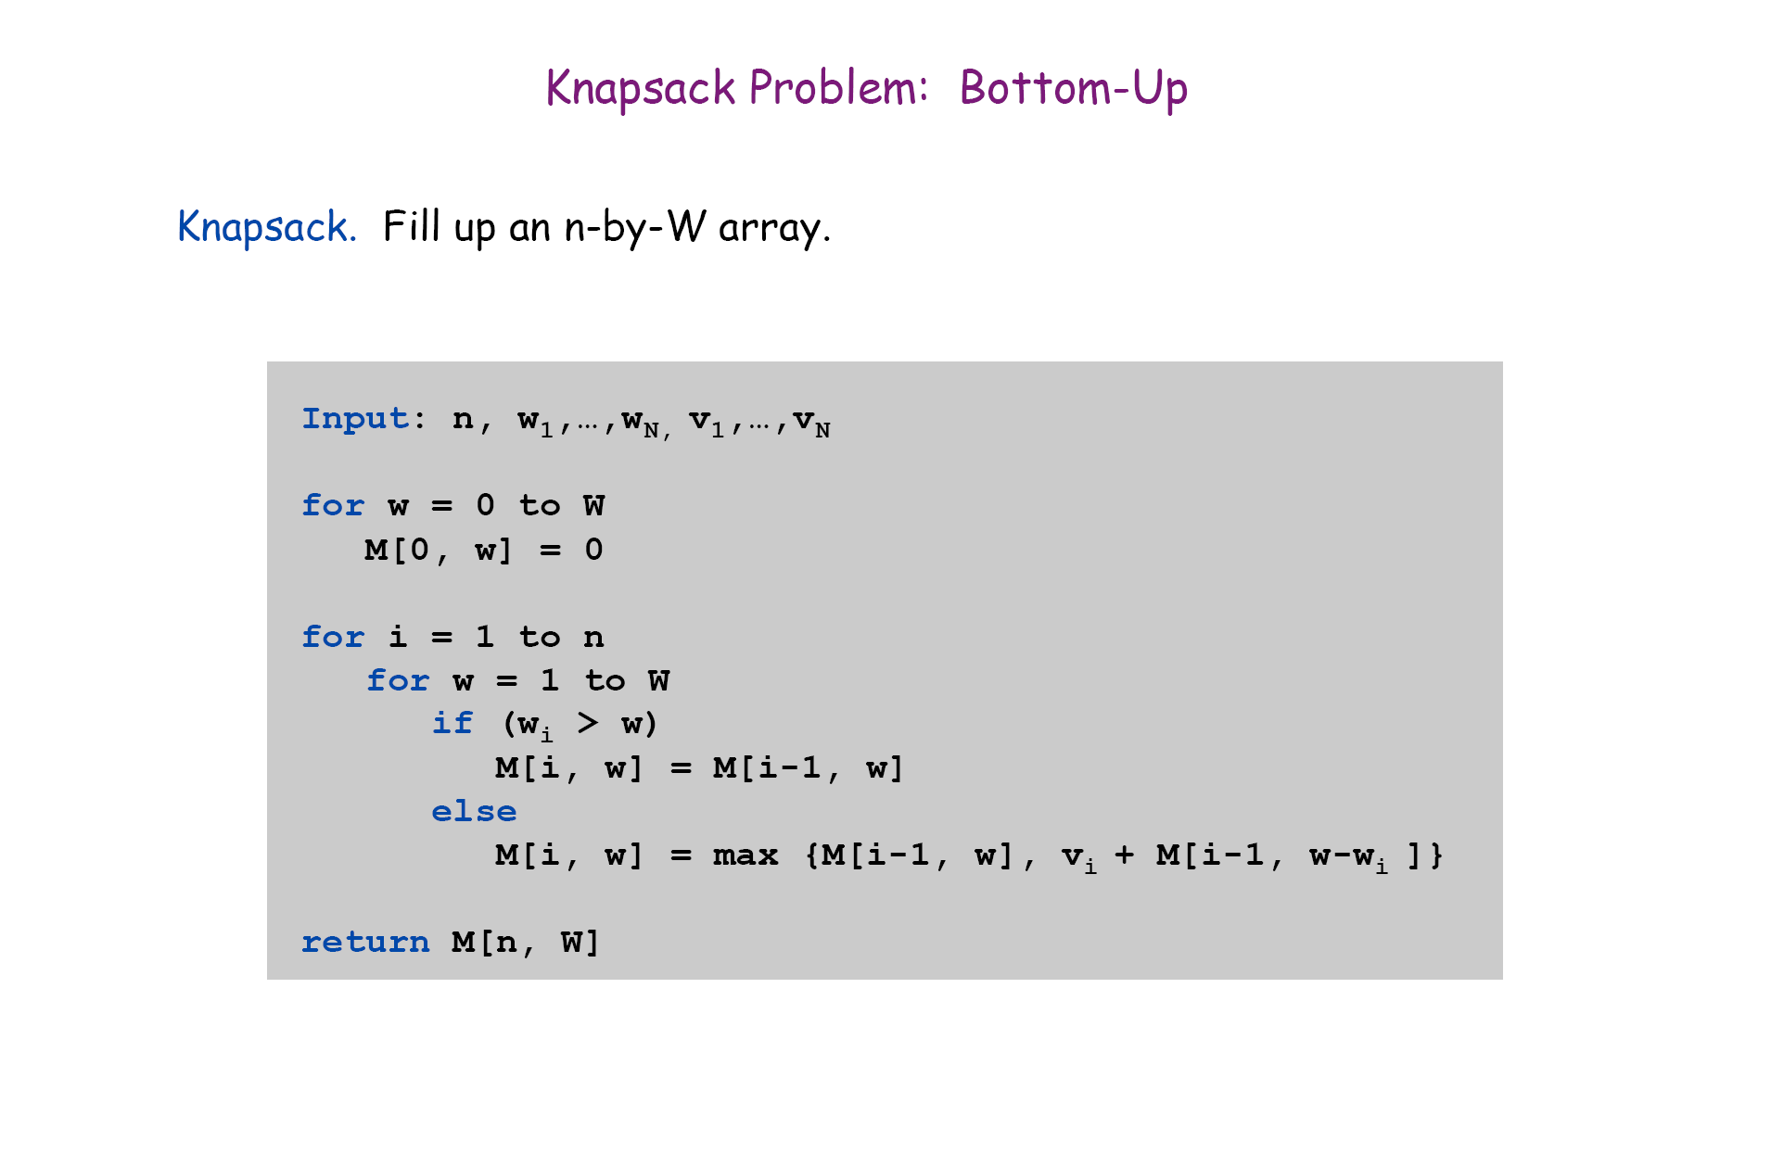

Slide 34
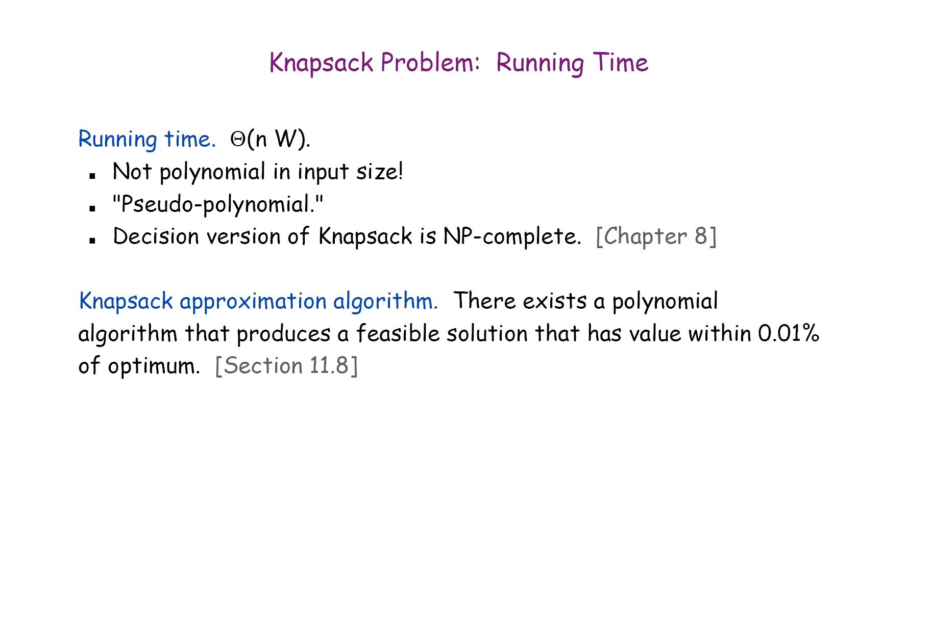

Slide 35
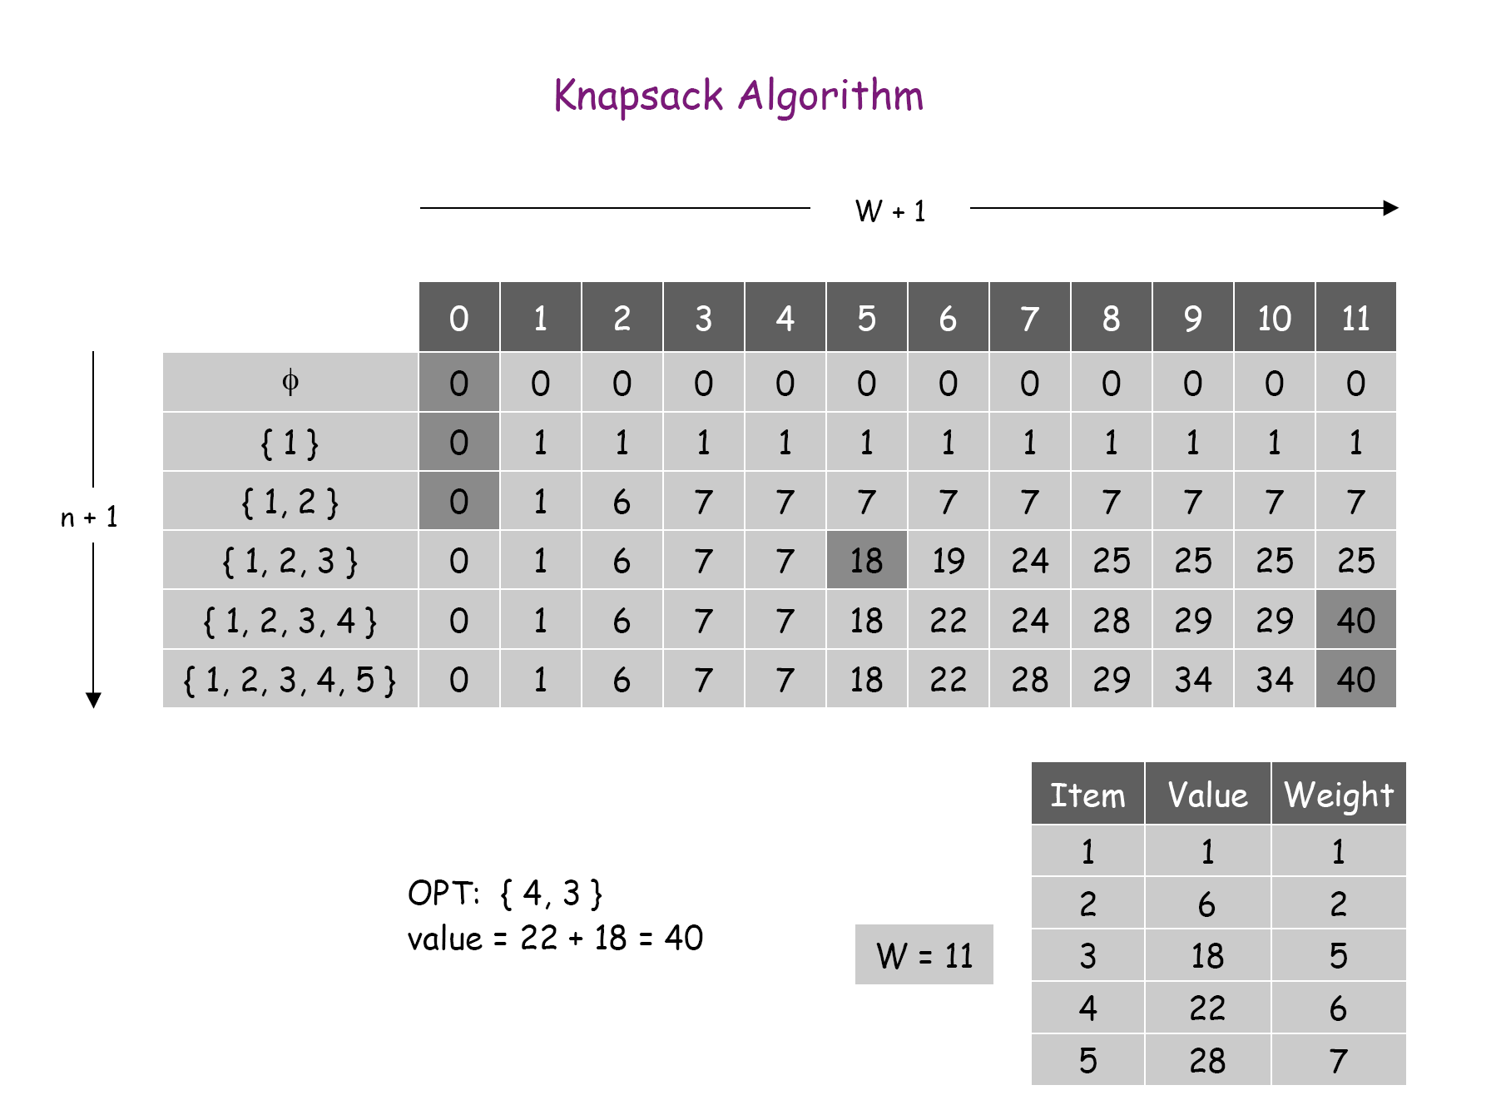
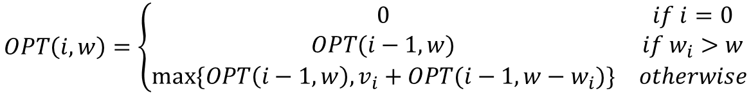
$$OPT\left(i,w\right)=\left\{\begin{matrix}0 & if i=0 \\ OPT(i−1,w) & if w_{i}>w \\ max⁡\{OPT\left(i−1,w\right), v_{i}+OPT(i−1, w−w_{i})\} & otherwise\end{matrix}\right.$$

Slide 36
Summary
Bellman-ford algorithm
Comparison with Dijkstra Algorithm.
Knapsack Problem.

