Slide 1
11. String Matching

Slide 2
The problem
Input: a text T (very long string) and
a pattern P (short string).
Output: the index in T where a copy of P begins.

Slide 3
Example
T:
b | a | c | b | a | b | a | b | a | b | a | c | a | a | b
P:
a | b | a | b | a | c | a

Slide 4
T
a | b | a | b | a | b | a | b | a | b | a | c | a | a | b
a | b | a | b | a | c | a
a | b | a | b | a | c | a
a | b | a | b | a | c | a
a | b | a | b | a | c | a
a | b | a | b | a | c | a
a | b | a | b | a | c | a
a | b | a | b | a | c | a
a | b | a | b | a | c | a
a | b | a | b | a | c | a

Slide 5
Brute force method
Basic idea:
1. i=1;
2. do
Start with T[i] and match P with
T[i],T[i+1], ... T[i+|P|-1]
| | |
P[1] P[2] P[|P|]
3. until a mismatch is found,
i=i+1 and goto 2 until i+|P|-1>|T|.

Slide 6
Analysis
Step 2 takes O(|P|) comparisons in the worst case.
Step 2 could be repeated O(|T|) times.
Total running time is O(|T||P|).

Slide 7
Notations and Terminologies
|P| and |T|: the lengths of P and T.
P[i]: the i-th letter of P.
Prefix of P: a substring of P starting with P[1].
P[1…i]: the prefix containing the first i letters of P.
Example: abcabbccaa.
prefix: a, ab, abc, abca, abcab, abcabb, ….

Slide 8
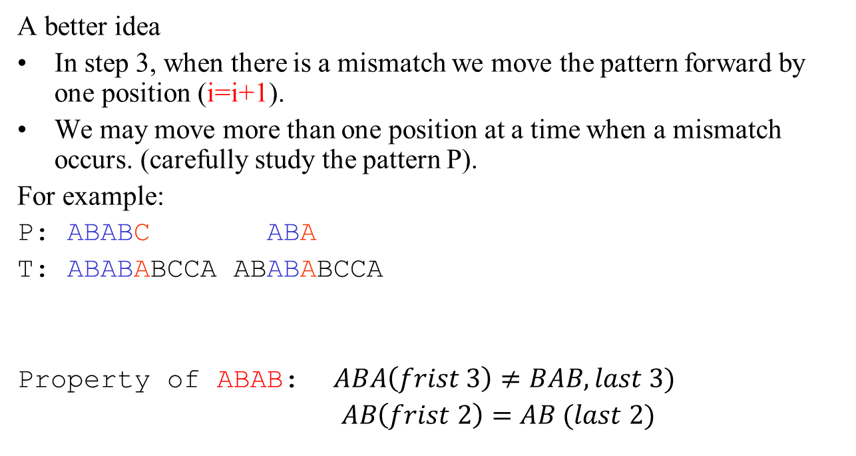
Knuth-Morris-Pratt (KMP) Method (linear time algorithm)
A better idea
In step 3, when there is a mismatch we move the pattern forward by one position (i=i+1).
We may move more than one position at a time when a mismatch occurs. (carefully study the pattern P).
For example:
P: ABABC ABA
T: ABABABCCA ABABABCCA
Property of ABAB: $ABA\left(frist 3\right)≠BAB,last 3)$
$AB\left(frist 2\right)=AB (last 2)$

Slide 9
Key: When mismatch occurs at P[i+1], we want to find the longest prefix of P[1..i] which is also a suffix of P[1..i].

Slide 10
Failure function
f(i) is the largest r with (r<i) such that
P[1] P[2] ...P[r] = P[i-r+1]P[i-r+2], ..., P[i].
Prefix of length r Suffix of P[1]P[2]…P[i] of length r

Slide 11
Example: P=abcabbabcabbaa
P[1] =a, f(1)=0;
P[1..2] =ab, f(2)=0;
P[1..3] =abc, f(3)=0;
P[1..4] =abca, f(4)=1;
P[1..5] =abcab, f(5)=2;
P[1..6] =abcabb, f(6)=0;
P[1..7] =abcabba, f(7)=1;
P[1..8] =abcabbab, f(8)=2;
P[1..9] =abcabbabc, f(9)=3;
P[1..10] =abcabbabca, f(10)=4;
P[1..11] =abcabbabcab, f(11)=5;
P[1..12] =abcabbabcabb, f(12)=6;
P[1..13] =abcabbabcabba, f(13)=7;
P[1..14] =abcabbabcabbaa, f(14)=1;

Slide 12
T
a | b | a | b | a | b | a | b | a | b | a | c | a | a | b
P
a | b | a | b | a | c | a
a | b | a | b | a | c | a
a | b | a | b | a | c | a
a | b | a | b | a | c | a
a | b | a | …
f(1)=0, f(2)=0, f(3)=1, f(4)=2, f(5)=3, f(6)=0, f(7)=1

Slide 13
The Scan Algorithm
i : indicates that T[i] is the next character in T to be compared (green arrow).
q: indicates that P[q+1] is the next character in P to be compared with T[i] (red arrow-1).
i=1 and q=0;
compare T[i] with P[q+1] case 1: T[i]==P[q+1] i=i+1;q=q+1; if q==|P| then print "P occurs at i-|P|”, and q=f(|P|). case 2: T[i]≠P[q+1] and q≠0 q=f(q); % the pattern shifts forward case 3: T[i]≠P[q+1] and q==0 i=i+1; % the pattern shifts one position forward
Repeat step2 until i==|T|.

Slide 14
Illustration: given a String ‘S’ and pattern ‘P’ as follows:
T
b | a | c | b | a | b | a | b | a | b | a | c | a | c | a
P
a | b | a | b | a | c | a
Let us execute the KMP algorithm to find whether ‘P’ occurs in ‘T’.
the failure function, f was computed previously and is as follows:
q | 1 | 2 | 3 | 4 | 5 | 6 | 7
f | 0 | 0 | 1 | 2 | 3 | 0 | 1

Slide 15
Initially: n = size of T = 15;
m = size of P = 7
Step 1: i = 1, q = 0
comparing P[0+1] with T[1]
T
b | a | c | b | a | b | a | b | a | b | a | c | a | a | b
P
a | b | a | b | a | c | a
P[1] does not match with T[1]. P will be shifted one position to the right.
Step 2: i = 2, q = 0
comparing P[1] with T[2]
T
b | a | c | b | a | b | a | b | a | b | a | c | a | a | b
P
a | b | a | b | a | c | a
P[1] matches T[2]. Since there is a match, P is not shifted.

Slide 16
Step 3: i = 3, q = 1
Comparing P[2] with T[3]
P[2] does not match with T[3]
T
b | a | c | b | a | b | a | b | a | b | a | c | a | a | b
P
a | b | a | b | a | c | a
Backtracking on p, comparing P[1] and T[3]
Step 4: i = 4, q = 0
comparing P[1] with T[4]
P[1] does not match with T[4]
T
b | a | c | b | a | b | a | b | a | b | a | c | a | a | b
P
a | b | a | b | a | c | a
Step 5: i = 5, q = 0
comparing P[1] with T[5]
P[1] matches with T[5]
T
b | a | c | b | a | b | a | b | a | b | a | c | a | a | b
p
a | b | a | b | a | c | a

Slide 17
Step 6: i = 6, q = 1
Comparing P[2] with T[6]
P[2] matches with T[6]
S
b | a | c | b | a | b | a | b | a | b | a | c | a | a | b
p
a | b | a | b | a | c | a
Step 7: i = 7, q = 2
Comparing P[3] with T[7]
P[3] matches with T[7]
S
b | a | c | b | a | b | a | b | a | b | a | c | a | a | b
p
a | b | a | b | a | c | a
Step 8: i = 8, q = 3
Comparing P[4] with T[8]
P[4] matches with T[8]
S
b | a | c | b | a | b | a | b | a | b | a | c | a | a | b
p
a | b | a | b | a | c | a

Slide 18
Step 9: i = 9, q = 4
Comparing P[5] with T[9]
P[5] matches with T[9]
T
b | a | c | b | a | b | a | b | a | b | a | c | a | a | b
P
a | b | a | b | a | c | a
Step 10: i = 10, q = 5
Comparing P[6] with T[10]
P[6] doesn’t match with T[10]
T
b | a | c | b | a | b | a | b | a | b | a | c | a | a | b
P
a | b | a | b | a | c | a
Mismatch. Backtracking on p, q=f(5)=3, comparing P[3+1] with T[10].
Step 11: i = 11, q = 4
Comparing P[5] with T[11]
P[5] matches with T[11]
b | a | c | b | a | b | a | b | a | b | a | c | a | a | b
T
P
a | b | a | b | a | c | a

Slide 19
Step 12: i = 12, q = 5
Comparing P[6] with T[12]
P[6] matches with T[12]
T
b | a | c | b | a | b | a | b | a | b | a | c | a | a | b
P
a | b | a | b | a | c | a
Step 13: i = 13, q = 6
Comparing P[7] with T[13]
P[7] matches with T[13]
T
b | a | c | b | a | b | a | b | a | b | a | c | a | a | b
P
a | b | a | b | a | c | a
Pattern ‘P’ has been found to completely occur in string ‘T’. The total number of shifts
that took place for the match to be found are: i – m = 13 – 7 = 6 shifts.

Slide 20
b | a | c | b | a | b | a | b | a | b | a | c | a | c | a
a | b | a | b | a | c | a
q | 1 | 2 | 3 | 4 | 5 | 6 | 7
f | 0 | 0 | 1 | 2 | 3 | 0 | 1
Solution:
P occurs at i=7 in T.
i T | 1 | 2 | 3 | 4 | 5 | 6 | 7 | 8 | 9 | 10 | 11 | 12 | 13 | 14 | 15
 | b | a | c | b | a | b | a | b | a | b | a | c | a | c | a
 | a
 |  | a | b
 |  |  | a | b | a | b | a | c
 |  |  |  |  | a | b | a | b | a | c
 |  |  |  |  |  |  | a | b | a | b | a | c | a

Slide 21
Running time complexity(hard)
The running time of the scan algorithm is O(|T|).
Proof:
After each comparison.
either i increases by 1 (i.e, the pointer moves one step forward)
or the pattern moves at least one postion forward.

Slide 22
Another version of scan algorithm (code)
n=|T|
m=|P|
q=0
for i=1 to n
{
while q>0 and P[q+1]≠T[i] do
{
q=f(q)
}
if P[q+1]==T[i] then
q=q+1
if q==m then
{
print "pattern occurs at i-m+1"
q=f(q)
}
}

Slide 23
Failure Function
a | b | c | a | b | c | a | b | c | a | a | c
a | b | c | a | b | c | a | b | c | a | a | c
f(7)=4, f(8)=f(7)+1

Slide 24
Failure Function
1 2 3 4 5 6 7 8 9 10 11
a | b | a | a | b | a | a | b | a | a | a | c
a | b | a | a | b | a | a | b | c | a | a | c
a | b | a | a | b | ? | ? | ? | ? | ? | ? | ?
f(7)=4, f(8)=f(7)+1=5, f(8)=f(9)+1=6, f(10)=f(9)+1=7
f(11): try to see if P[1..f(f(10))] is good!

Slide 25
Failure Function
Case 1: f(1) is always 0.
Case 2: if P[q]==P[f(q-1)+1] then f(q)=f(q-1)+1.
Example: p=abcabcc
abc
f(1)=0; f(2)=0; f(3)=0; f(4)=1; f(5)=2; f(6)=3; f(7)=0;
P[4]= P[f(4-1)+1], f(4)=f(4-1)+1=1.
P[5]= P[f(5-1)+1], f(5)=f(5-1)+1=1+1=2.
P[6]= P[f(6-1)+1]. F(6)=f(6-1)+1=2+1=3.

Slide 26
Case 3: if P[q]≠P[f(q-1)+1] and f(q-1)≠0 then consider P[q] ?= P[f(f(q-1))+1] (Do it recursively)
Case 4: if P[q] ≠ P[f(q-1)+1] and f(q-1)==0 then f[q]=0.
Example : abc abc abb
abc abc f(8)=5
abc f(5)=2
a f(2)=0
i: 1 2 3 4 5 6 7 8 9
f(i): 0 0 0 1 2 3 4 5 0

Slide 27
The algorithm (code) to compute failure function
1. m=|P|;
2. f(1)=0;
3. k=0;
4. for q=2 to |P| do
{
5. k=f(q-1);
6. if(k>0 and P[k+1]!=P[q])
{ k=f(k); goto 6; }
7. if(k>0 and P[k+1]==P[q])
{ f[q]=k+1; }
8. if(k==0)
{ if(P[k+1]==P[q] f[q]=1; else f[q]=0;}
}

Slide 28
Another version
1. m=|P|;
2. f(1)=0;
3. k=0;
4. for q=2 to |P| do
{
5. k=f(q-1);
6. while(k>0 and P[k+1]!=P[q]) do
{
7. k=f(k);
}
8. if(P[k+1]==P[q]) then k=k+1;
9. f[q]=k;
}

Slide 29
a | b | c | a | b | c | a | b | c | a | a | c
a | b | c | a | b | c | a | b | c | a | a | c
a | b | c | a | b | c | a | b | c | a | a | c
a | b | c | a | b | c | a | b | c | …
a | b | c | a | b | c | …
a | b | c | a | b | … | …
a | b | c | a | b | c | a | b | c | a | a | c
f(1)=0;
f(2)=0;
f(3)=0
f(4)=1;
f(5)=2;
f(6)=3;
f(7)=4;
f(8)=5;
f(9)=6;
f(10)=7;
f(11)=1
f(12)=0

Slide 30
Running time complexity (Fun Part, not required)
The running time of failure function construction algorithm is O(|P|). (The proof is similar to that for scan algorithm.)
Total running time complexity
The total complexity for failure function construction and scan algorithm is O(|P|+|T|).

Slide 31
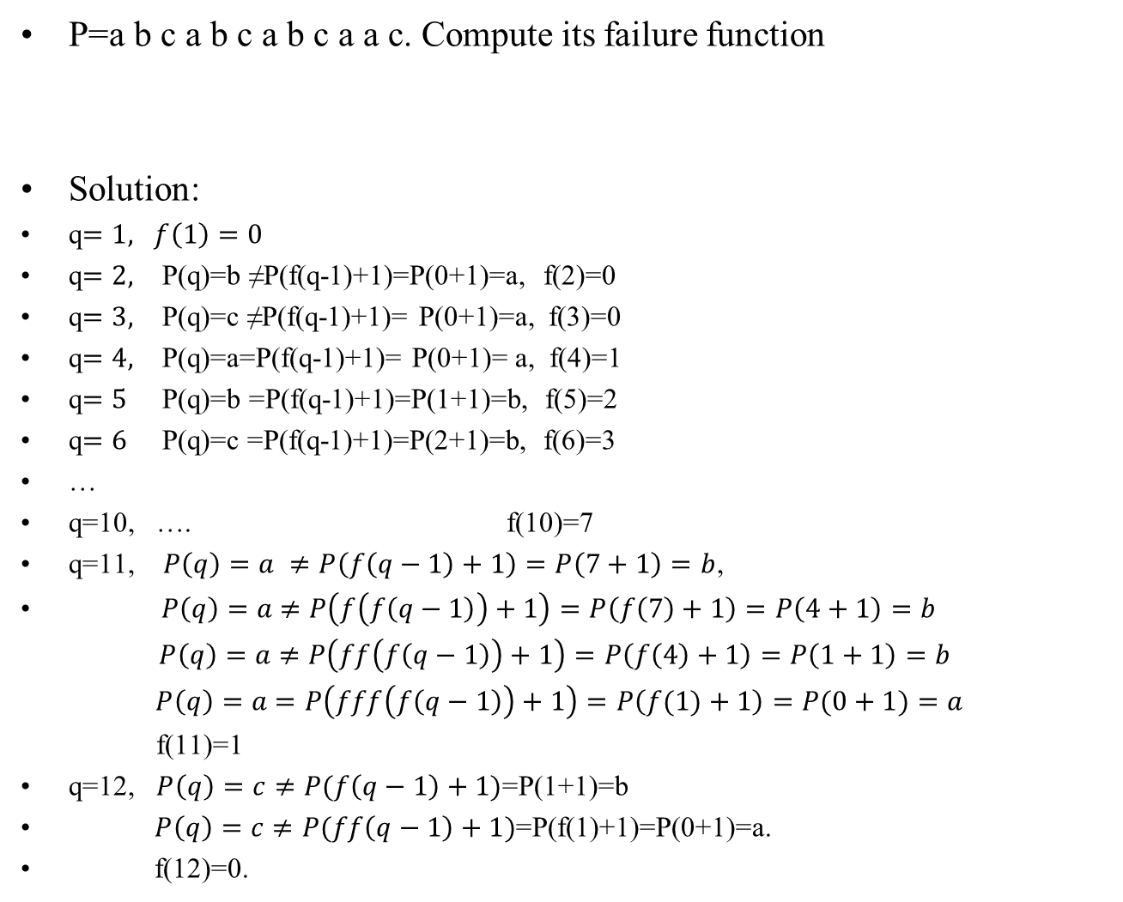
P=a b c a b c a b c a a c. Compute its failure function
Solution:
q$=1, f\left(1\right)=0$
q$=2,$ P(q)=b ≠P(f(q-1)+1)=P(0+1)=a, f(2)=0
q$=3,$ P(q)=c ≠P(f(q-1)+1)= P(0+1)=a, f(3)=0
q$=4,$ P(q)=a=P(f(q-1)+1)= P(0+1)= a, f(4)=1
q$=5$ P(q)=b =P(f(q-1)+1)=P(1+1)=b, f(5)=2
q$=6$ P(q)=c =P(f(q-1)+1)=P(2+1)=b, f(6)=3
…
q=10, …. f(10)=7
q=11, $P\left(q\right)=a ≠P\left(f\left(q−1\right)+1\right)=P\left(7+1\right)=b$,
$P\left(q\right)=a$ $≠P\left(f\left(f\left(q−1\right)\right)+1\right)=P\left(f\left(7\right)+1\right)=P\left(4+1\right)=b$
$P\left(q\right)=a$ $≠P\left(ff\left(f\left(q−1\right)\right)+1\right)=P\left(f\left(4\right)+1\right)=P\left(1+1\right)=b$
$P\left(q\right)=a$ $=P\left(fff\left(f\left(q−1\right)\right)+1\right)=P\left(f(1)+1\right)=P(0+1)=a$
f(11)=1
q=12, $P\left(q\right)=c≠P(f\left(q−1\right)+1)$=P(1+1)=b
$P\left(q\right)=c≠P(ff\left(q−1\right)+1)$=P(f(1)+1)=P(0+1)=a.
f(12)=0.
q | 1 | 2 | 3 | 4 | 5 | 6 | 7 | 8 | 9 | 10 | 11 | 12
 | a | b | c | a | b | c | a | b | c | a | a | c

Slide 32
Summary
String Matching Problem
KMP algorithm O(|P|+|T|)
Failure Function

Slide 33
Case 1: f(1) is always 0.
Case 2: if P[q]==P[f(q-1)+1] then f(q)=f(q-1)+1.
Case 3: if P[q]≠P[f(q-1)+1] and f(q-1)≠0 then consider P[q] ?= P[f(f(q-1))+1] (Do it recursively)
Case 4: if P[q] ≠ P[f(q-1)+1] and f(q-1)==0 then f[q]=0.

