Slide 1
CS3103 Operating System
Scheduling Policies

Slide 2
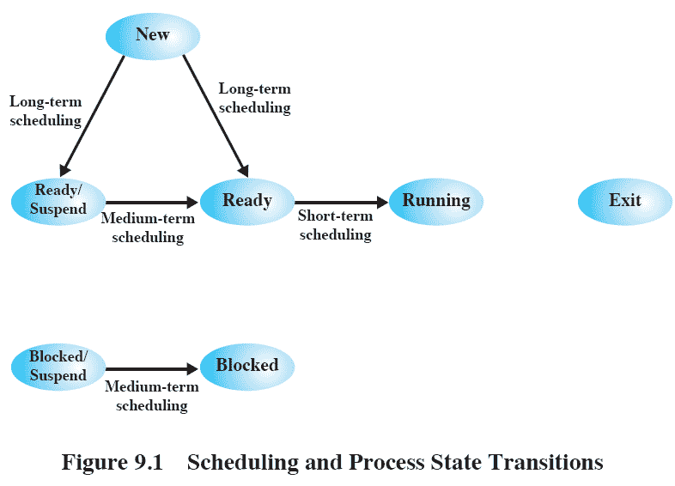
Background
Long-term scheduling: whether a new process is admitted.
Medium-term scheduling: whether a process is swapped in.
Short-term scheduling: which ready process to execute next.

Slide 3
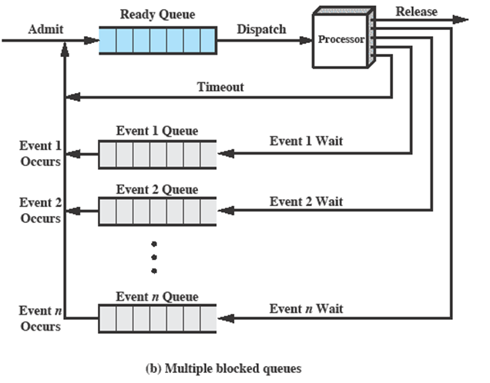
Background

Slide 4
Goal
In this assignment, you need implement a single-threaded program to simulate a scheduling dispatcher in a computer.
FCFS (First-Come-First-Serve)
RR (Round-Robin)
FB (Feedback)

Slide 5
Goal
The scheduling system should be able to
admit new processes to ready queues.
dispatch processes to CPU according to scheduling algorithms.
block the running process when it has to wait for an event like I/O completion or mutex signals and put them back to ready queues (unblock) when the corresponding event occurs.

Slide 6
Demo Code
demo.cpp
This file emulates the FCFS scheduling algorithm with disk I/O operations
Other scheduling algorithms (RR and FB) and mutexes are NOT supported in demo.cpp
Compilation
To compile the program demo.cpp
g++ demo.cpp -o demo
Run the demo
./demo demo_processes.txt demo_output.txt

Slide 7
Process Description
Process description
# process_id arrival_time service_number
service_type service_description
service_type service_description
Service type
C: CPU
D: Disk I/O
K: Keyboard input
L mtx: lock the mutex mtx
U mtx: unlock the mutex mtx

Slide 8
Process Description Example
A process description example
# 0 0 8
C 2
D 6
C 3
K 5
C 4
L mtx
C 5
U mtx

Slide 9
Input Sample in Demo
# 0 0 3
C 7
D 10
C 9
# 1 2 5
C 3
D 8
C 2
D 9
C 3
# 2 2 4
C 5
D 6
C 5
C 5
# 3 4 1
C 15

Slide 10
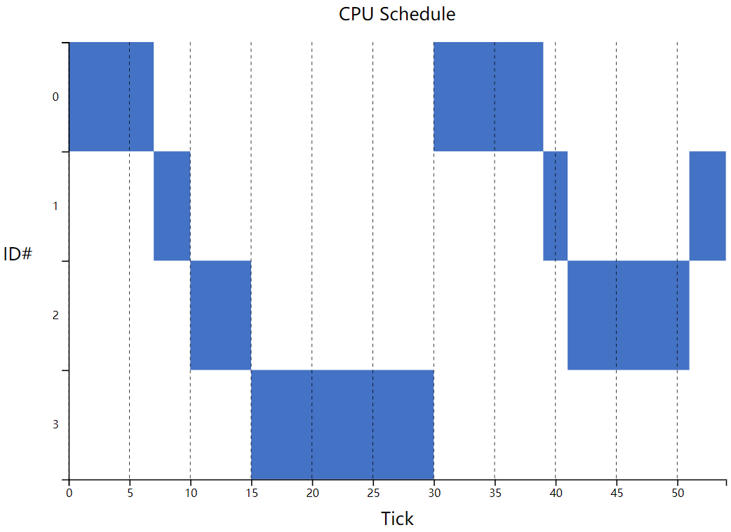
Output in Demo
process 0
0 7 30 39
process 1
7 10 39 41 51 54
process 2
10 15 41 51
process 3
15 30

Slide 11
Visualization of Output
Download the attachment vis_schedule.zip from Canvas
Open vis.html
Click the button on webpage to open file
Select your output text file for visualization

Slide 12
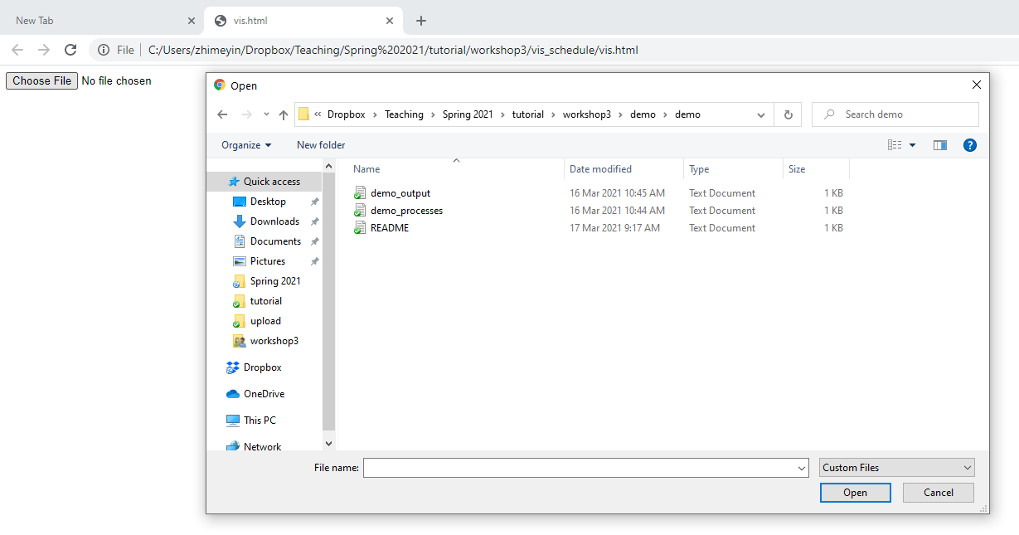
Visualization of Output
GUI interface for visualization

Slide 13
Visualization of Output
We have tested this visualization with typical browsers, e.g., Chrome, Edge, Safari, and Firefox.
If the vis.html file doesn’t work, please try it with one of the tested browsers.

Slide 14
Overall Workflow
Step 1: check new processes' arrival. If any, admit them.
Step 2: events handling (i.e. I/O completion, mutex signal). If any, move processes from block queues to ready queues.
Step 3: If no process on CPU, dispatch from ready queue. At the end of current tick, look ahead the service at next tick to determine what actions to take
process completion – release it;
event wait – block it;
mutex lock & unlock – it depends (assuming all mutex operations are valid).

Slide 15
Overall Workflow
Step 1: At the start of each tick, check new processes' arrival. If any, admit them.
Tick. A tick is an arbitrary unit for measuring internal system time. How many milliseconds a tick represents depends on the OS.
Our simulator
int fcfs(vector<process_t> processes, const char* output_path) {
// main loop
for(int cur_tick = 0; cur_tick < MAX_LOOP; cur_tick++) {
// scheduling details
}
}
Tick is increased by one in each iteration

Slide 16
Step 1: New processes arrival - P9 arrives
Same as the current tick
#9 100 3
Ready Queue
Dispatch
Release
9
3
2
1
Processor
Disk Queue
6
5
Keyboard Queue
7
4
Current Tick 100
Mutex Queue
8

Slide 17
Step 1: New processes arrival - P9 arrives
Ready Queue
Dispatch
Release
9
3
2
1
Processor
Disk Queue
6
5
Keyboard Queue
7
4
Current Tick 100
Mutex Queue
8

Slide 18
Overall Workflow
Step 1: check new processes' arrival. If any, admit them.
Step 2: events handling (i.e. I/O completion or mutex unlock). If any, move processes from block queues to ready queues.

Slide 19
Step 2: Unblock P6
Ready Queue
Dispatch
Release
9
3
2
1
Processor
Tick 97
D 3
Disk Queue
6
5
Keyboard Queue
7
4
Current Tick 100
Mutex Queue
8

Slide 20
Step 2: Unblock P6
Ready Queue
Dispatch
Release
9
3
2
1
Processor
Tick 97
D 3
Disk Queue
6
5
Disk I/O completes
Keyboard Queue
7
4
Current Tick 100
Mutex Queue
8

Slide 21
Step 2: Unblock P6
Ready Queue
Dispatch
Release
6
9
3
2
1
Processor
Disk Queue
5
Keyboard Queue
7
4
Mutex Queue
8

Slide 22
Overall Workflow
Step 1: check new processes' arrival. If any, admit them.
Step 2: events handling (i.e., I/O completion, mutex signal). If any, move processes from block queues to ready queues.
Step 3: If no process on CPU, dispatch from ready queue. At the end of current tick, look ahead the service at next tick to determine what actions to take.
check time quantum and processor execution time;
process completion – release it;
event wait – block it;
mutex lock & unlock – it depends (assuming all mutex operations are valid).

Slide 23
Step 3: dispatch P1 to CPU
Ready Queue
Dispatch
1
Release
6
9
3
2
1
Processor
Disk Queue
5
Keyboard Queue
7
4
MTX Queue
8

Slide 24
Step 3: check P1’s future description
Ready Queue
Dispatch
1
Release
6
9
3
2
1
Processor
Disk Queue
5
Keyboard Queue
7
4
MTX Queue
8

Slide 25
Step 3: case 0 – P1 is still running
Execution time not met
Ready Queue
Dispatch
1
Release
6
9
3
2
1
Processor
Disk Queue
Current duration 1 tick
Quantum 5 ticks
Time quantum has not expired
5
Keyboard Queue
7
4
MTX Queue
8

Slide 26
Step 3: look ahead
Ready Queue
Dispatch
Release
6
9
3
2
1
Processor
If current execution finishes,
examine future services
Disk Queue
D 10
5
Keyboard Queue
7
4
MTX Queue
8

Slide 27
Step 3: case 1 – P1 gets blocked by Disk operation
Ready Queue
Dispatch
Release
6
9
3
2
1
Processor
Disk Queue
D 10
5
Keyboard Queue
7
4
MTX Queue
8

Slide 28
Step 3: case 1 – P1 gets blocked by Disk operation
Ready Queue
Dispatch
Release
6
9
3
2
Processor
Disk Queue
D 10
5
1
Keyboard Queue
7
4
MTX Queue
8

Slide 29
Step 3: case 2 – P1 has mutex lock
Ready Queue
Dispatch
Release
6
9
3
2
1
Processor
Disk Queue
5
Keyboard Queue
7
4
MTX Queue
L mtx
8
Unsuccessful mutex lock

Slide 30
Step 3: case 2 – P1 has mutex lock
Ready Queue
Dispatch
Release
6
9
3
2
Processor
Disk Queue
5
Keyboard Queue
7
4
MTX Queue
L mtx
8
1
Unsuccessful mutex lock

Slide 31
Step 3: case 3 – P1 has mutex unlock
Ready Queue
Dispatch
Release
6
9
3
2
1
Processor
Disk Queue
5
Keyboard Queue
7
4
MTX Queue
U mtx
8
No action on P1

Slide 32
Step 3: case 3 – P1 has mutex unlock
Ready Queue
Dispatch
Release
6
9
3
2
1
Processor
Disk Queue
5
This will unblock P8 in the next tick
Keyboard Queue
7
4
MTX Queue
U mtx
8
No action on P1

Slide 33
Step 3: case 3 – P1 has mutex unlock
Ready Queue
Dispatch
Release
6
9
3
2
1
Processor
Disk Queue
5
Keyboard Queue
7
4
Zero time cost
MTX Queue
U mtx
8

Slide 34
Step 3: case 3 – P1 has mutex unlock
Ready Queue
Dispatch
Release
6
9
3
2
1
Processor
Disk Queue
5
Look at the next service
Keyboard Queue
7
4
MTX Queue
U mtx
C 10
8

Slide 35
Step 3: case 4 – P1 timeout
Ready Queue
Dispatch
Release
6
9
3
2
1
Processor
If running out of time quantum
Disk Queue
5
Keyboard Queue
7
4
MTX Queue
8

Slide 36
Step 3: case 4 – P1 timeout
Ready Queue
Dispatch
Release
1
6
9
3
2
Processor
Disk Queue
5
Keyboard Queue
7
4
MTX Queue
8

Slide 37
Notes
For simplification, this assignment assumes that handling interrupts and mutex operations require zero overhead.
The demo code only contains a queue for disk I/O in FCFS. You need to add a corresponding queue for keyboard operation, and one blocked queue for the mutex (To reduce your workload, we only have one mutex).

Slide 38
Notes
FCFS is non-preemptive, each process will execute till the its completion, unless blocked due to some events.
RR and FB are preemptive. A process will be moved from running to ready when it runs out of its time quantum.
To save your implementation time, feel free to reuse/modify the sample code in your submission.

