Slide 1
Lecture 3: Structured Query Language (SQL)
CS3402 Database Systems

Slide 2
Relational Query Languages
Query languages
Data Definition Language (DDL): standard commands for defining the different structures in a database. DDL statements create, modify, and remove database objects such as tables, indexes, and users. Common DDL statements are CREATE, ALTER, and DROP.
Data Manipulation Language (DML): standard commands for dealing with the manipulation of data present in database. Common DDL statements SELECT, INSERT, UPDATE, and DELETE.
Each statement in SQL ends with a semicolon (;)

Slide 3
CREATE SCHEMA Statement
A schema is a way to logically group objects in a single collection and provide a unique namespace for objects.
The CREATE SCHEMA statement is used to create a schema. A schema name cannot exceed 128 characters. Schema names must be unique within the database.
Syntax
CREATE SCHEMA schemaName AUTHORIZATION user-name
Example
CREATE SCHEMA COMPANY AUTHORIZATION ‘Jsmith’;

Slide 4
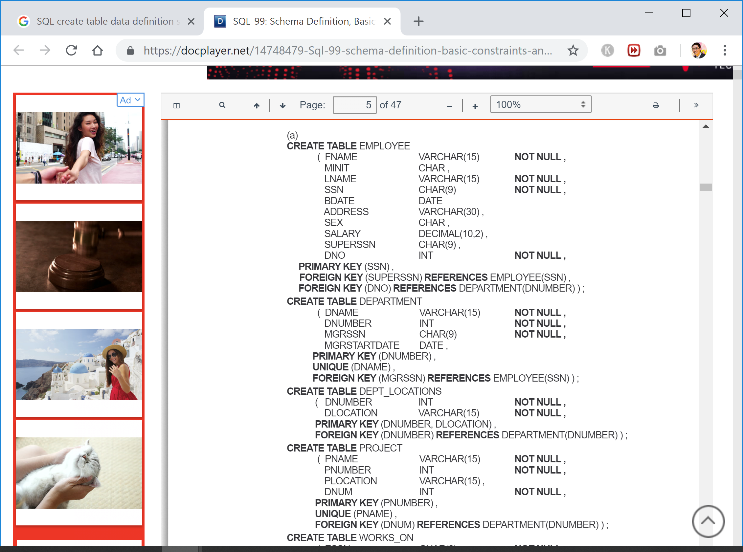
CREATE TABLE Statement (1/3)
A CREATE TABLE statement creates a table. Tables contain columns and constraints, rules to which data must conform. Table-level constraints specify a column or columns. Columns have a data type and can specify column constraints (column-level constraints).

Slide 5
CREATE TABLE Statement (2/3)

Slide 6
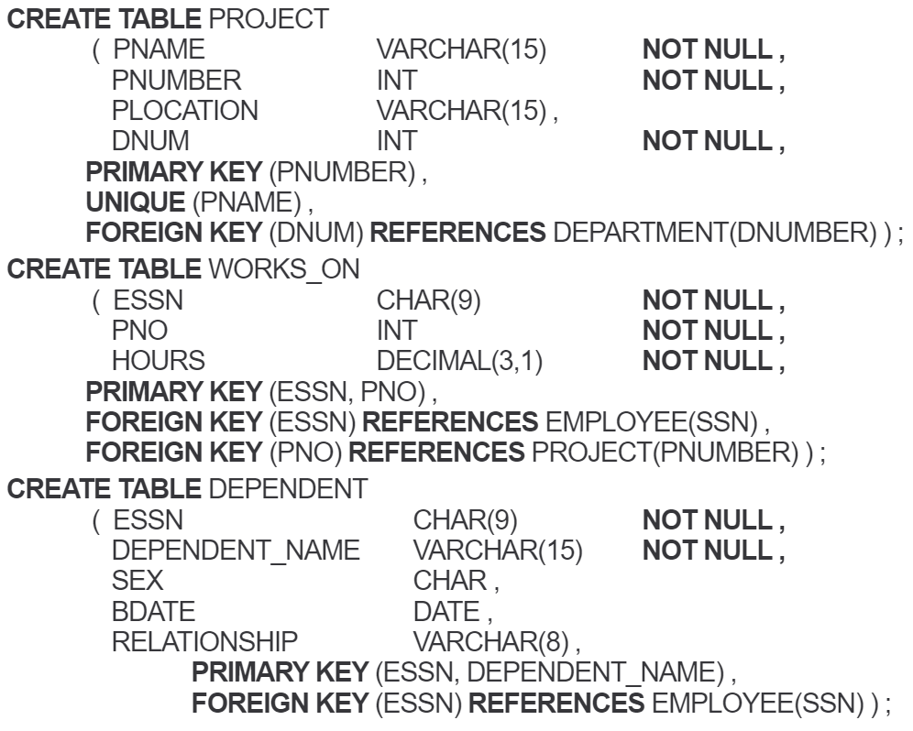
CREATE TABLE Statement (3/3)
Create 6 tables
EMPLOYEE
DEPARTMENT
DEPT_LOCATIONS
PROJECT
WORKS_ON
DEPENDENT

Slide 7
Table Manipulation
The ALTER TABLE statement allows you to:
Add a column to a table
Add a constraint to a table
Drop a column from a table
Drop an existing constraint from a table
Increase the width of a VARCHAR or VARCHAR FOR BIT DATA column
change the default value for a column
…
DROP TABLE statement removes the specified table.
The TRUNCATE TABLE statement allows you to quickly remove all content from the specified table and return it to its initial empty state.

Slide 8
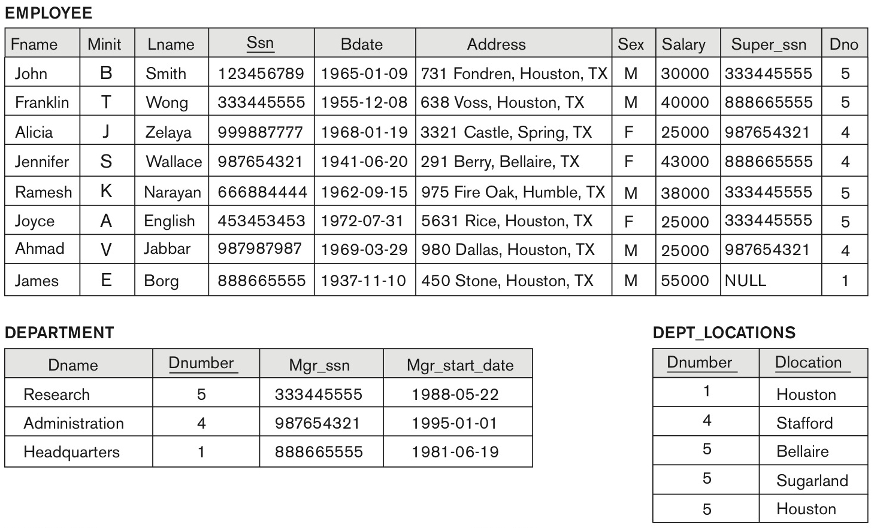
One Possible Database State for the COMPANY Relational Database Schema (1/2)

Slide 9
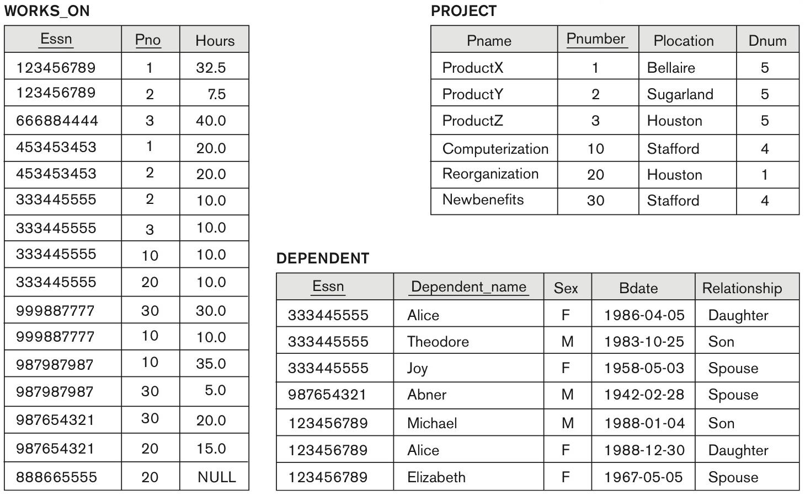
One Possible Database State for the COMPANY Relational Database Schema (2/2)

Slide 10
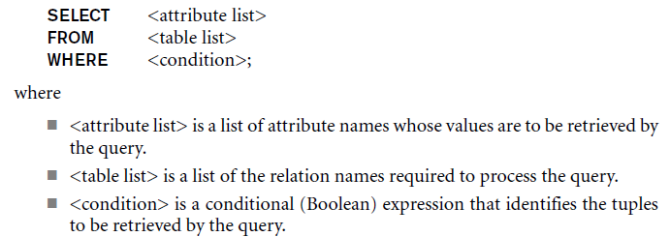
SELECT Statement (1/4)
The basic statement for retrieving information from a database

Slide 11
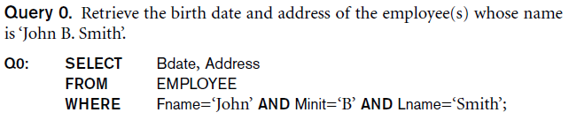
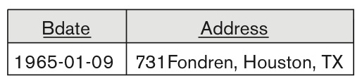
SELECT Statement (2/4)
Projection attributes
Selection conditions
Result:

Slide 12
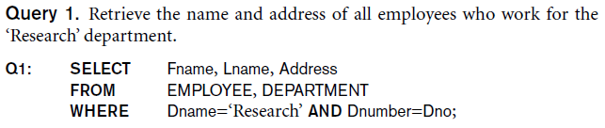
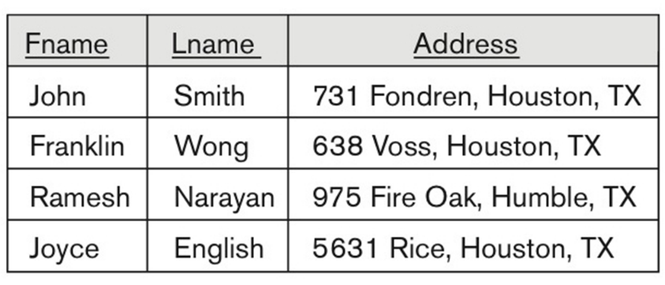
SELECT Statement (3/4)
Result:
Join conditions

Slide 13
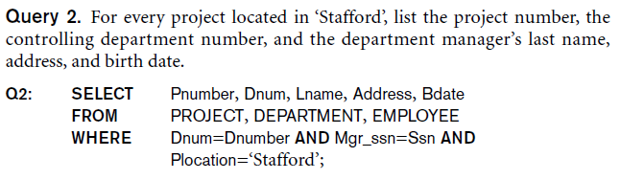
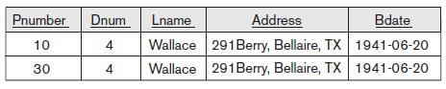
SELECT Statement (4/4)
Result:
Project joins Department
Department joins Employee

Slide 14

Ambiguous Attribute Names
Same name can be used for two (or more) attributes in different relations
As long as the attributes are in different relations
Must qualify the attribute name with the relation name to prevent ambiguity

Slide 15
Aliasing, Renaming and Tuple Variables (1/2)
Aliases or tuple variables
Declare alternative relation names E and S to refer to the EMPLOYEE relation twice in a query:
For each employee, retrieve the employee’s first and last name and the first and last name of his or her immediate supervisor.
SELECT E.Fname, E.Lname, S.Fname, S.Lname FROM EMPLOYEE AS E, EMPLOYEE AS S WHERE E.Super_ssn=S.Ssn;
Recommended practice to abbreviate names and to prefix same or similar attribute from multiple tables
Alias
One-level recursive query

Slide 16
Aliasing, Renaming and Tuple Variables (2/2)
The attribute names can also be renamed
EMPLOYEE AS E (Fn, Mi, Ln, Ssn, Bd, Addr, Sex, Sal, Sssn, Dno)
Note that the relation EMPLOYEE now has a variable name E which corresponds to a tuple variable
The “AS” may be dropped in most SQL implementations
EMPLOYEE E (Fn, Mi, Ln, Ssn, Bd, Addr, Sex, Sal, Sssn, Dno)

Slide 17
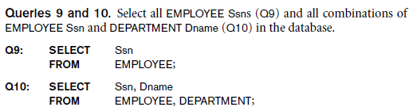
Unspecified WHERE Clause (1/2)
Missing WHERE clause
Indicates no condition on tuple selection (select ALL)
The resultant effect is a CROSS PRODUCT (JOIN n x m)
Result is all possible tuple combinations between the participating relations
8 rows in the result

Slide 18
Unspecified WHERE Clause (2/2)
……
CROSS PRODUCT
24 rows in the result

Slide 19
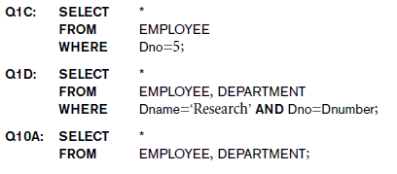
Use of the Asterisk for SELECT Clause (1/2)
Specify an asterisk *
Retrieve all the attribute values of the selected tuples

Slide 20
Use of the Asterisk for SELECT Clause (2/2)
……

Slide 21
Tables as Sets in SQL (1/3)
The ALL and DISTINCT keywords determine whether duplicates are eliminated from the result of the operation.
If you specify the DISTINCT keyword, then the result will have no duplicate rows.
If you specify the ALL keyword, then there may be duplicates in the result, depending on whether there were duplicates in the input.
DISTINCT is the default, so if you don't specify ALL or DISTINCT, the duplicates will be eliminated.
For example,
Retrieve the salary of every employee SELECT ALL Salary FROM EMPLOYEE;
Retrieve all distinct salary values SELECT DISTINCT Salary FROM EMPLOYEE;

Slide 22
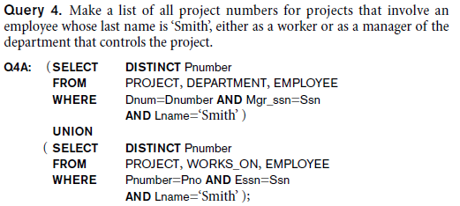
Tables as Sets in SQL (2/3)
You can combine SELECT statement using the set operators UNION, INTERSECT, and MINUS. All set operators have equal precedence.
Each SELECT statement within the operator must have the same number of fields in the result sets with similar data types.
UNION operator
The UNION operator is used to combine the result sets of 2 or more SELECT statements. It removes duplicate rows between the various SELECT statements.
UNION ALL operator
The UNION ALL operator is used to combine the result sets of 2 or more SELECT statements. It returns all rows from the query and it does not remove duplicate rows between the various SELECT statements.

Slide 23
Tables as Sets in SQL (3/3)
INTERSECT operator
The INTERSECT operator is used to return the results of 2 or more SELECT statements.It only returns the rows selected by all queries or data sets. In other words, if a record exists in one query and not in the other, it will be omitted from the INTERSECT results.
MINUS operator
The MINUS operator is used to return all rows in the first SELECT statement that are not returned by the second SELECT statement. Each SELECT statement will define a dataset. The MINUS operator will retrieve all records from the first dataset and then remove from the results all records from the second dataset.
Dataset 1
Dataset 2
Dataset 1
Dataset 2

Slide 24
LIKE Conditions
The LIKE condition allows wildcards to be used in the WHERE clause of a SELECT, INSERT, UPDATE, or DELETE statement. This allows you to perform pattern matching.
For example, we want to find all of the customers whose first_name begins with ‘P’. SELECT first_name FROM customers WHERE last_name LIKE ‘P%’;
Wildcar | Explanation
% | Allows you to match any string of any length (including zero length)
_ | Allows you to match on a single character

Slide 25
ORDER BY Clause (1/2)
The ORDER BY clause is used to sort the records in your result set. The ORDER BY clause can only be used in SELECT statements.
Syntax: ORDER BY expression [ ASC | DESC ]
expressions: The columns or calculations that you wish to retrieve.
ASC: Optional. It sorts the result set in ascending order by expression (default, if no modifier is provider).
DESC: Optional. It sorts the result set in descending order by expression.

Slide 26
ORDER BY Clause (2/2)
Example 1: List in alphabetic order all customers having a loan at Kowloon branch:
Example 2: List the entire borrow table in descending order of amount, and if several loans have the same amount, order them in ascending order by loan#:
SELECT DISTINCT cname FROM Borrow WHERE bname = “Kowloon” ORDER BY cname;
SELECT *
FROM Borrow
ORDER BY amount DESC, loan# ASC;

Slide 27
INSERT STATEMENT (1/2)
The INSERT statement is used to insert a single record or multiple records into a table.
Syntax:
Insert a single record using the VALUES keyword
Insert multiple records using a SELECT statement
INSERT INTO table (column1, column2, ... column_n) VALUES (expression1, expression2, ... expression_n);
INSERT INTO table (column1, column2, ... column_n)
SELECT expression1, expression2, ... expression_n
FROM source_table
[WHERE conditions];

Slide 28
INSERT STATEMENT (2/2)
Example:
Insert a single record using the VALUES keyword
Insert multiple records using a SELECT statement
INSERT INTO suppliers
(supplier_id, supplier_name)
VALUES
(5000, 'Apple');
INSERT INTO suppliers (supplier_id, supplier_name)
SELECT account_no, name
FROM customers
WHERE customer_id > 5000;

Slide 29
DELETE Statement
The DELETE statement is used to delete a single record or multiple records from a table.
Syntax:
table: The table that you wish to delete records from.
WHERE conditions: Optional. The conditions that must be met for the records to be deleted. If no conditions are provided, then all records from the table will be deleted.
Example: Delete all records from the employee table where the first_name is Bob
DELETE FROM table
[WHERE conditions];
DELETE FROM employee
WHERE first_name = ‘Bob’;

Slide 30
UPDATE Statement (1/2)
The UPDATE statement is used to update existing records in a table.
Syntax:
Example 1: Update the last_name to ‘Bob’ in the employee table where the employee_id is 123.
UPDATE table
SET column1 = expression1,
column2 = expression2,
...
column_n = expression_n
[WHERE conditions];
UPDATE employee
SET last_name = ‘Bob’
WHERE employee_id = 123;

Slide 31
UPDATE Statement (2/2)
Example 2: Increase the payment by 5% to all accounts; it is applied to each tuple exactly once.
Example 3: Increase the payment by 6% to all accounts with balance over $10000; all others receive 5% increase
UPDATE Deposit
SET balance = balance * 1.05;
UPDATE Deposit
SET balance = balance * 1.06 WHERE balance > 10000;
UPDATE Deposit
SET balance = balance * 1.05 WHERE balance <= 10000;

Slide 32
Nested Queries and Set Comparisons (1/6)
Nested queries
SELECT-FROM-WHERE blocks within WHERE clause of another query
For example, some queries require that existing values in the database be fetched and then used in a comparison condition
Comparison operator IN
Compares value v with a set (or multiset) of values V
Evaluate to TRUE if v is one of the elements in V

Slide 33
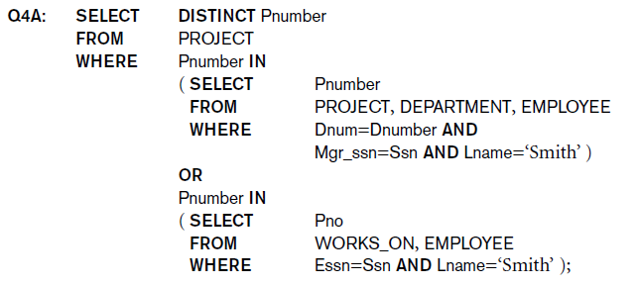
Nested Queries and Set Comparisons (2/6)
List all project numbers for project that involves an employee whose last name is ‘Smith’ as a manager of the department that controls the project.
List all project numbers for project that involves an employee whose last name is ‘Smith’ as a worker.

Slide 34
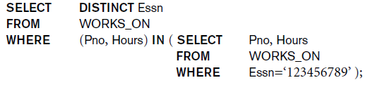
Nested Queries and Set Comparisons (3/6)
Place multiple values within parentheses for comparisons
For example, select the Essn of all employees who work the same (project, hours) as the employee Essn =“123456789”

Slide 35
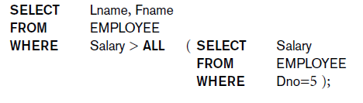
Nested Queries and Set Comparisons (4/6)
Use other comparison operators to compare a single value v
= ANY (or = SOME) operator returns TRUE if the value v is equal to some value in the set V and is hence equivalent to IN
= ALL returns TRUE if the value v is equal to all the values in the set V
Other operators that can be combined: >, >=, <, <=, and <>
Example 1: Find the last name and first name of the employees with salary higher than all the employees in the department with Dno=5

Slide 36
Nested Queries and Set Comparisons (5/6)
Example 2: Find names of all branches that have greater assets than some branch located in Central
or
SELECT bname
FROM Branch
WHERE assets > SOME (SELECT assets
FROM Branch
WHERE b-city = “Central”);
SELECT X.bname
FROM Branch X, Branch Y
WHERE X. assets > Y.assets AND Y.b-city= “Central”;

Slide 37
Nested Queries and Set Comparisons (6/6)
Example 3: Find all customers who have an account at some branch in which Jones has an account
or
SELECT DISTINCT T.cname
FROM Deposit T
WHERE T.cname != “Jones”
AND T.bname IN (SELECT S.bname
FROM Deposit S
WHERE S.cname = “Jones”);
A set of branch name with “Jones” as cname.
SELECT DISTINCT T.cname
FROM Deposit S, Deposit T
WHERE S.cname = “Jones” AND S.bname = T.bname
AND T.cname != S.cname;

Slide 38
Nested Queries and EXISTS Condition (1/3)
The EXISTS condition is used in combination with a nested query and is considered “to be met” if the nested query returns at least one row.
The NOT EXISTS condition is used in combination with a nested query and is considered “to be met” if the nested query returns empty result.
Example 1: Find all customers of Central branch who have an account there but no loan there
SELECT C.cname
FROM Customer C
WHERE EXISTS (SELECT *
FROM Deposit D
WHERE D.cname = C.cname
AND D.bname = “Central”)
AND NOT EXISTS
(SELECT *
FROM Borrow B
WHERE B.cname = C.cname
AND B.bname = “Central”);

Slide 39
Nested Queries and EXISTS Condition (2/3)
Example 2: Find branches having greater assets than all branches in N.T.
or
SELECT X.bname
FROM Branch X
WHERE NOT EXISTS (SELECT *
FROM Branch Y
WHERE Y.b-city = “N.T.”
AND Y.assets >= X.assets);
The branches in N.T. with assets greater than or equal to branch X
SELECT bname
FROM Branch
WHERE assets > ALL (SELECT assets
FROM Branch
WHERE b-city = “N.T.”);

Slide 40
Nested Queries and EXISTS Condition (3/3)
Example 3: Find all customers who have a deposit account at ALL branches located in Kowloon
SELECT DISTINCT S.cname
FROM Deposit S
WHERE NOT EXISTS ((SELECT bname
FROM Branch
WHERE b-city = “Kowloon”)
MINUS
(SELECT T.bname
FROM Deposit T
WHERE S.cname = T.cname));
Branches in “Kowloon”
No branches in “Kowloon” S does not has account
Branches where S has an account (cname)

Slide 41
Aggregate Functions (1/5)
Built-in aggregate functions
COUNT, SUM, MAX, MIN, and AVG
Used to summarize information from multiple tuples into a single tuple
Example 1: Find the sum of the salaries of all employees, the maximum salary, the minimum salary, and the average salary.
SELECT SUM(Salary), MAX(Salary), MIN(Salary), AVG(Salary)
FROM EMPLOYEE;
SUM(Salary) | MAX(Salary) | MIN(Salary) | AVG(Salary)
281000 | 55000 | 25000 | 35125

Slide 42
Aggregate Functions (2/5)
Example 2: Find the sum of the salaries of all employees of the ‘Research’ department, as well as the maximum salary, the minimum salary, and the average salary in this department.
SELECT SUM(Salary), MAX(Salary), MIN(Salary), AVG(Salary)
FROM EMPLOYEE, DEPARTMENT
WHERE Dno=Dnumber AND Dname=‘Research’;
SUM(Salary) | MAX(Salary) | MIN(Salary) | AVG(Salary)
133000 | 40000 | 25000 | 33250

Slide 43
Aggregate Functions (3/5)
Example 3: Retrieve the total number of employees in the company.
Example 4: Retrieve the number of employees in the ‘Research’ department.
COUNT(*) returns the number of rows
SELECT COUNT(*)
FROM EMPLOYEE;
COUNT(*)
8
SELECT COUNT(*)
FROM EMPLOYEE, DEPARTMENT
WHERE Dno=Dnumber AND Dname=‘Research’
COUNT(*)
4

Slide 44
Aggregate Functions (4/5)
Example 5: Count the number of distinct salary values in the database
SELECT COUNT(DISTINCT Salary)
FROM EMPLOYEE
COUNT(*)
6

Slide 45
Aggregate Functions (5/5)
Example 6: Retrieve the names of all employees who have two or more dependents
SELECT Lname, Fname
FROM EMPLOYEE
WHERE (SELECT COUNT(*) FROM DEPENDENT WHERE SSN=ESSN) >= 2
3
3
1
Lname | Fname
Smith | John
Wong | Franklin

Slide 46
GROUP BY Clause (1/4)
We can apply the aggregate functions to subgroups of tuples in a relation based on some attribute values. For example, find the average salary of employees in each department.
Grouping the tuples that have same value of some attribute(s), called the grouping attribute(s), and the aggregate function is applied to each subgroup independently.
SQL has the GROUP BY clause for this purpose
The GROUP BY clause specifies the grouping attributes, which should also appear in the SELECT clause, so that the value resulting from applying each function to a group of tuples appears along with the value of the grouping attributes.

Slide 47
GROUP BY Clause (2/4)
Example 1: For each department, retrieve the department number, the number of employees in the department, and their average salary.
The EMPLOYEE tuples are divided into groups , i.e., each group having the same value for the grouping attribute Dno.
SELECT Dno, COUNT(*), AVG(Salary)
FROM EMPLOYEE GROUP BY Dno

Slide 48
GROUP BY Clause (3/4)
The COUNT and AVG functions are applied to each group of tuples.
Note that the SELECT clause includes only the grouping attribute and the functions applied on each group of tuples.
33250
Dno | COUNT(*) | AVG (Salary)
5 | 4 | 33250
4 | 3 | 31000
1 | 1 | 55000
31000
55000
SELECT Dno, COUNT(*), AVG(Salary)
FROM EMPLOYEE GROUP BY Dno

Slide 49
GROUP BY Clause (4/4)
Example 2: For each project, retrieve the project number, the project name, and the number of employees who work on that project
SELECT Pnumber, Pname, COUNT(*)
FROM PROJECT, WORKS_ON
WHERE Pnumber=Pno GROUP BY Pnumber, Pname

Slide 50
HAVING Clause (1/4)
Retrieve the values of the aggregate functions only for groups that satisfying certain conditions
SQL provides the HAVING clause which is used in conjunction with the GROUP BY clause for this purpose.
HAVING clause specifies a condition on the group of tuples associated with each value of the grouping attributes; and only the groups that satisfy the condition are retrieved in the query result.

Slide 51
HAVING Clause (2/4)
Example 1: For each project on which more than two employees work, retrieve the project number, the project name, and the number of employees who work on the project.
The selection conditions in the WHERE clause limit the tuples to which functions are applied, and then the HAVING clause serves to choose groups.
SELECT Pnumber, Pname, COUNT (*)
FROM PROJECT, WORKS_ON
WHERE Pnumber=Pno
GROUP BY Pnumber, Pname
HAVING COUNT (*) > 2;

Slide 52
HAVING Clause (3/4)
Example 2: For each department that has more than five employees, retrieve the department number and the number of its employees who are marking more than $40,000.
This is incorrect because it will select only departments that have more than five employees who earn more than $40,000. This is because the WHERE clause is executed first to select individual tuples, and then the HAVING clause is applied later to select individual groups of tuples.
SELECT Dname, COUNT (*)
FROM DEPARTMENT, EMPLOYEE
WHERE Dnumber=Dno AND Salary>40000
GROUP BY Dname
HAVING COUNT (*) > 5;

Slide 53
HAVING Clause (4/4)
Example 2: For each department that has more than five employees, retrieve the department number and the number of its employees who are marking more than $40,000.
SELECT Dnumber, COUNT (*)
FROM DEPARTMENT, EMPLOYEE
WHERE Dnumber=Dno AND Salary>40000 AND Dno in (SELECT Dno FROM EMPLOYEE GROUP BY Dno HAVING COUNT(*) > 5)
GROUP BY Dnumber;

Slide 54
Views (Virtual Tables) (1/2)
A VIEW is a virtual table that does not physically exist.
A view contains rows and columns, just like a real table. The fields in a view are fields from one or more real tables in the database.
You can add SQL functions, WHERE, and JOIN statements to a view and present the data as if the data were coming from one single table.
A view always shows up-to-date data! The database engine recreates the data, using the view's SQL statement, every time a user queries a view.
When you update record(s) in a VIEW, it updates the records in the underlying tables that make up the View. However, most SQL-based DBMSs restrict that a modification is permitted through a view ONLY IF the view is defined in terms of ONE underlying table.

Slide 55
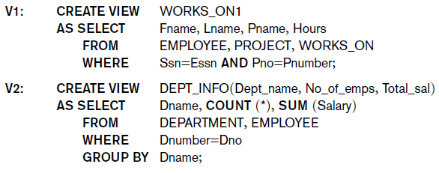
Views (Virtual Tables) (2/2)
CREATE VIEW statement
Once a View is defined, SQL queries can use the View relation in the FROM clause
DROP VIEW statement delete a view

Slide 56
NULL Values
Information can be very often incomplete in the real world
Unknown attributes are assigned a null value
One proposal to deal with NULL values is by using 3-valued logic
NOT
T | F
U | U
F | T
AND | T | U | F
T | T | U | F
U | U | U | F
F | F | F | F
OR | T | U | F
T | T | T | T
U | T | U | U
F | T | U | F

Slide 57
NULL Value Comparisons
Syntax: expression IS NULL
Expression: The value to test whether it is a null value
If expression is a NULL value, the condition evaluates to TRUE.
If expression is not a NULL value, the condition evaluates to FALSE.
Syntax: expression IS NOT NULL
Expression: The value to test whether it is a not null value
Condition | Value of a | Evaluation
a IS NULL | 10 | FALSE
a IS NOT NULL | 10 | TRUE
a IS NULL | NULL | TRUE
a IS NOT NULL | NULL | FALSE

Slide 58
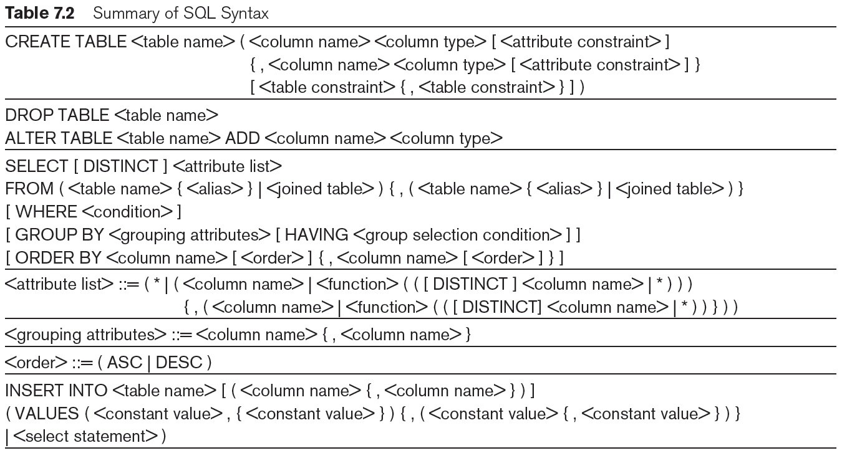
Summary of SQL Syntax (1/2)

Slide 59
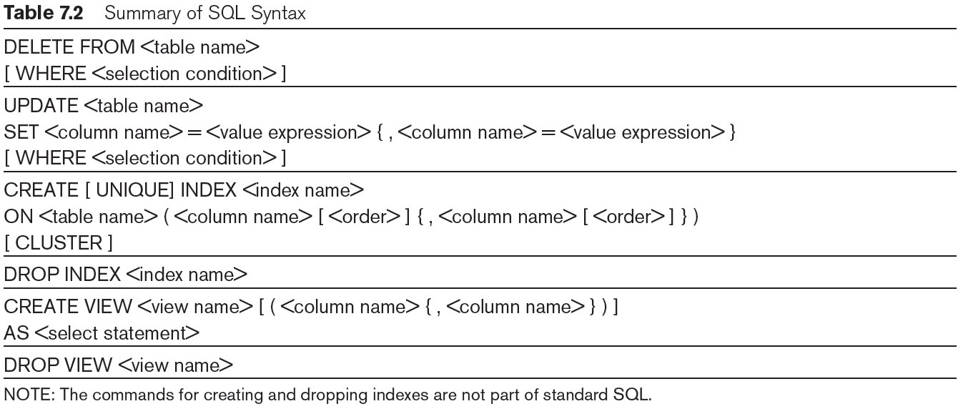
Summary of SQL Syntax (2/2)

