Slide 1
Lecture 5: Integrity Constraints
CS3402 Database Systems

Slide 2
Integrity Constraints
Constraints determine which values are permissible and which are not in the database (table)
Constraints are conditions that must hold on all valid relation states
A relational database schema S is a set of relation schemes S = {R₁, R₂, …, R_{n}} and a set of integrity constraints IC
Valid state vs. invalid state
Valid state: a state that satisfies all the constraints in the defined set of integrity constraints
Invalid state: A database state that does not obey all the integrity constraints

Slide 3
Three Main Types of Relational Integrity Constraints
Inherent or Implicit Constraints: characteristics of relations, e.g., no duplicate tuples
Schema-based or Explicit Constraints: Expressed in schemas by DDL (i.e., SQL)
Application-based or Semantic constraints: These are beyond the expressive power of the model (i.e., cannot be expressed in the schemas of the data model) and must be specified and enforced by the application programs

Slide 4
Schema-based Constraints
There are three main types of schema-based constraints that can be expressed in the relational model
Key constraints
Entity integrity constraints
Referential integrity constraints
Another schema-based constraint is the domain constraint
Every value in a tuple must be from the domain of its attribute (or it could be null, if allowed for that attribute)

Slide 5
Keys of Relations
A set of one or more attributes {A₁, A₂, …, A_{n}} is a key for a relation if:
The attributes functionally determine all other attributes of the relation
Relations are sets. It is impossible for two distinct tuples of R to agree on all A₁, A₂, …, A_{n}
No proper subset of {A₁, A₂, …, A_{n}} functionally determines all other attributes of R, i.e., a key must be minimal
A functional dependency (FD) on a relation R is a statement of the form: if two tuples of R agree on attributes {A₁, A₂, …, A_{n}} (i.e., the tuples have the same values in their respective components for each of these attributes), then they must also agree on another attribute, “B”, {A₁, A₂, …, A_{n}} → B

Slide 6
Keys of Relations: Example
Movies(title, year, length, type, studioName, starName): title, year, starName → length, type, studioName
Attributes {title, year, starName} form a key for the relation Movie
Suppose two tuples agree on these three attributes: title, year, starName
They must agree on the other attributes, length, type and studioName
No proper subset of {title, year, starName} functionally determines all other attributes
{title, year} does not determine starName since many movies have more than one star
{year, starName} is not a key because we could have a star in two movies in the same year

Slide 7
Key Constraints (1/3)
Superkey of R
A set of attributes that contains a key is called a superkey
It is a set of attributes superkey SK, e.g., {A₁, A₂} of R with the following conditions:
No two tuples in any valid relation state r(R) will have the same value for SK
For any distinct tuples t1 and t2 in r(R), t1[SK] ≠ t2[SK] (i.e., different SK)
Key of R
A “minimal” superkey
A key is a superkey K such that removal of any attribute from K results in a set of attributes that is not a superkey (does not possess the superkey uniqueness property)

Slide 8
Key Constraints (2/3)
Example: Consider the CAR relation schema
CAR(State, Reg#, SerialNo, Make, Model, Year)
CAR has two keys:
Key1 = {State, Reg#}
Key2 = {SerialNo}
Both are also superkeys of CAR
{SerialNo, Make} is a superkey but not a key
In general:
Any key is a superkey (but not vice versa)
Any set of attributes that includes a key is a superkey
A minimal superkey is also a key

Slide 9
Key Constraints (3/3)
If a relation has several candidate keys, one is chosen arbitrarily to be the primary key
The primary key attributes are underlined
Example: Consider the CAR relation schema:
CAR(State, Reg#, SerialNo, Make, Model, Year)
We chose SerialNo as the primary key
The primary key value is used to uniquely identify each tuple in a relation
General rule: Choose as primary key the smallest of the candidate keys (in terms of size)

Slide 10
Entity Integrity
The primary key attributes PK of each relation schema R cannot have null values in any tuple of R
Primary key values are used to identify the individual tuples
t[PK] ≠ null for any tuple t in R
If PK has several attributes, null is not allowed in any of these attributes
Note: Other attributes of R may be constrained to disallow null values, even though they are not members of the primary key

Slide 11
Referential Integrity
Key and entity integrity constraints are specified on individual relations
Referential integrity is a constraint involving two relations
To specify a relationship among tuples in two relations
The referencing relation and the referenced relation (R₁ → R₂)
Tuples in the referencing relation R₁ have attributes FK (called foreign key attributes) that reference the primary key attributes PK of the referenced relation R₂ if it satisfies:
The attributes in FK have the same domain(s) as the primary key attributes PK of R₂

Slide 12
Displaying a Relational Database Schema and its Constraints
Each relation schema can be displayed as a row of attribute names
The name of the relation is written above the attribute names
The primary key attribute (or attributes) will be underlined
A foreign key (referential integrity) constraints is displayed as a directed arc (arrow) from the foreign key attributes to the referenced table
Next slide shows the COMPANY relational schema diagram with referential integrity constraints

Slide 13
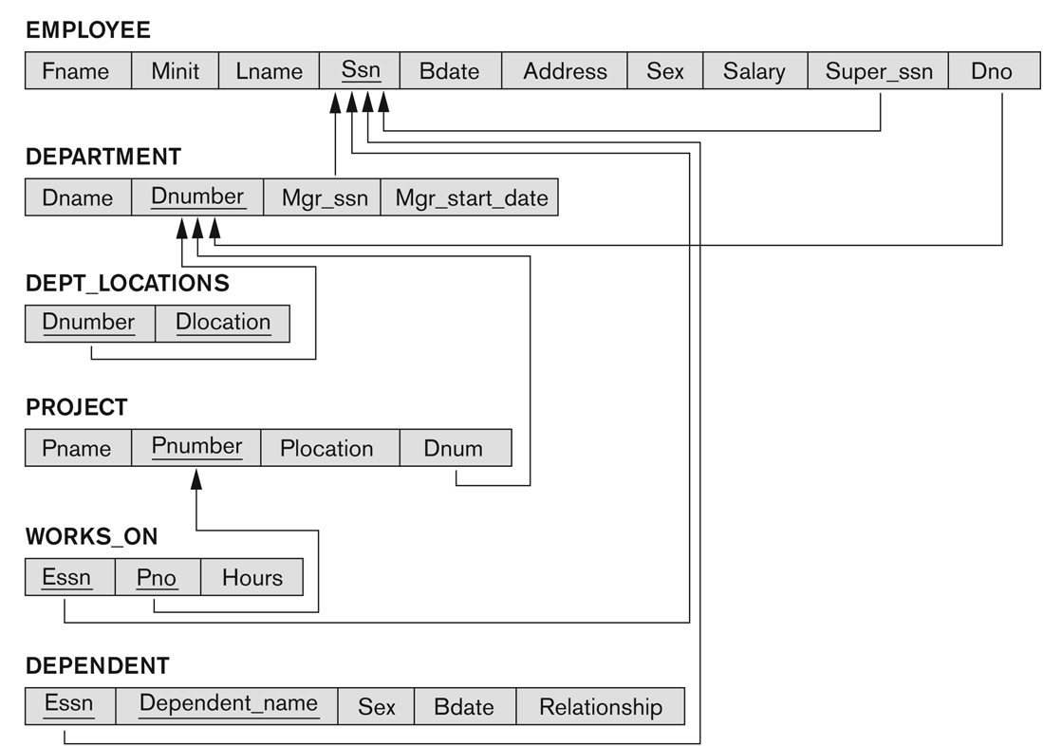
Referential Integrity Constraints for the COMPANY Relational Database Schema

Slide 14
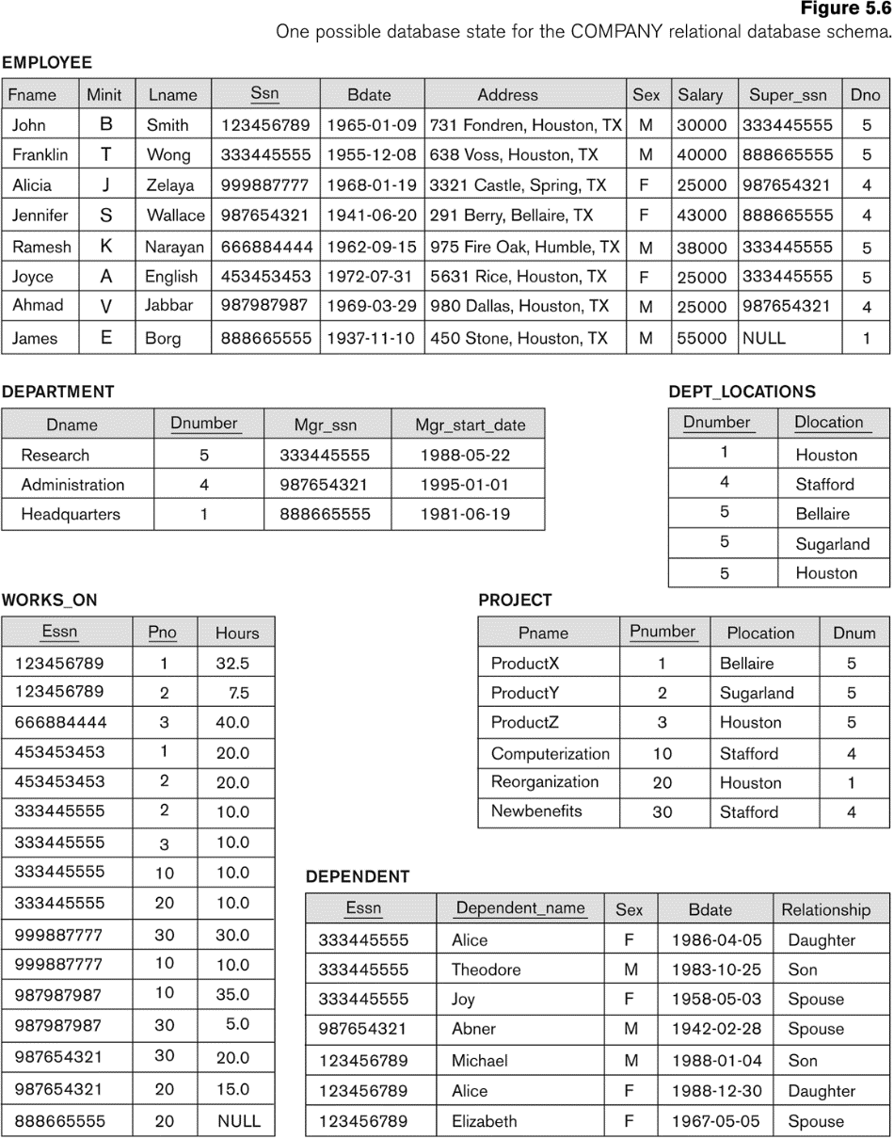
Populated Database State for COMPANY

Slide 15
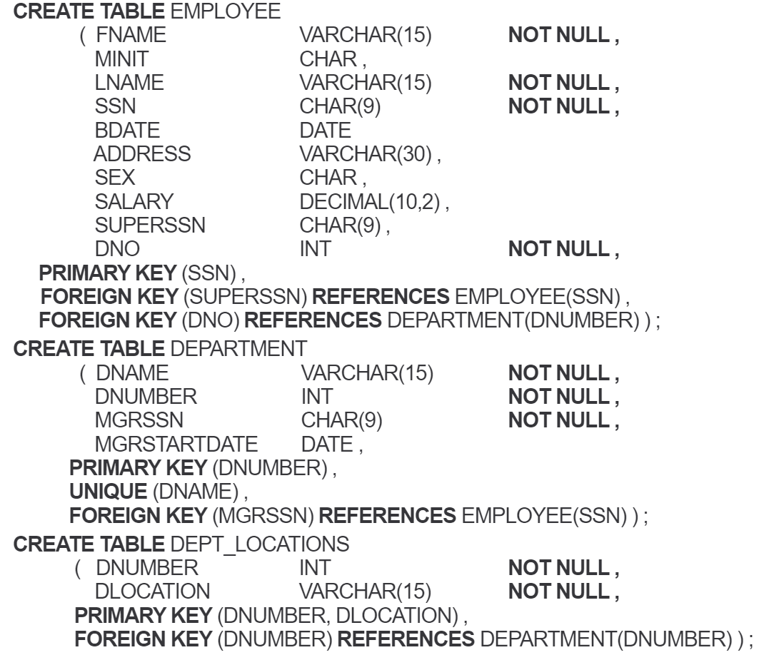
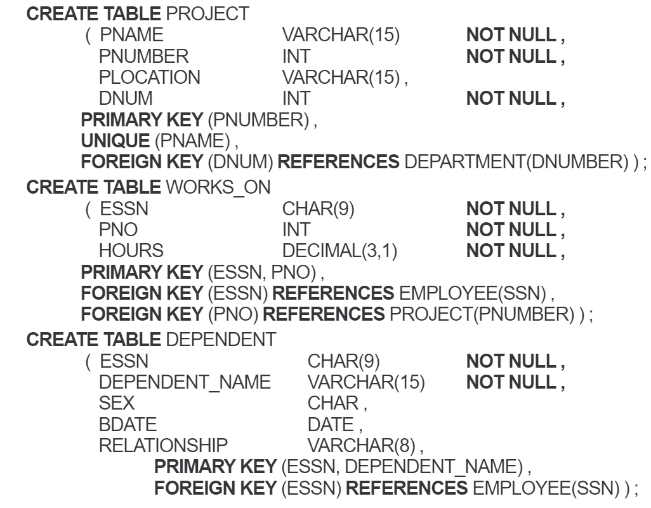
SQL CREATE TABLE Data Definition Statements for COMPANY

Slide 16
Referential Integrity
Referential integrity constraints typically arise from the relationships among the entities represented by the relation
For example, in the EMPLOYEE relation, the attribute Dno refers to DEPARTMENT for which an employee works. We designate Dno to be a foreign key of EMPLOYEE referencing the DEPARTMENT.
A value of Dno in any tuple t₁ of the EMPLOYEE relation must match a value of the primary key of DEPARTMENT, Dnumber, in the same tuple t₂ of the DEPARTMENT relation or the value of Dno can be NULL if the employee does not belong to a department or will be assigned to a department later.

Slide 17
Update Operations on Relations
Update operations
INSERT a tuple
DELETE a tuple
MODIFY a tuple
Integrity constraints should not be violated by the update operations
Update the department number of “Research” from “001” to “R001”
Several update operations may have to be grouped together
Updates may propagate to cause other updates automatically. This may be necessary to maintain integrity constraints

Slide 18
Possible Violations for Update Operations
DELETE may violate only referential integrity
If the primary key value of the tuple being deleted is referenced from other tuples in the database
INSERT may violate any of the constraints
Domain constraint: if one of the attribute values provided for the new tuple is not of the specified attribute domain
Key constraint: if the value of a key attribute in the new tuple already exists in another tuple in the relation
Referential integrity: if a foreign key value in the new tuple references a primary key value that does not exist in the referenced relation
Entity integrity: if the primary key value is null in the new tuple

Slide 19
Integrity Violation
In case of integrity violation, several actions can be taken:
Cancel the operation that causes the violation
Perform the operation but inform the user of the violation
Trigger additional updates so the violation is corrected
Execute a user-specified error-correction routine

Slide 20
Adding Constraints in SQL
CREATE TABLE TOY
( toy_id NUMBER(10), description VARCHAR(15) NOT NULL,
purchase_date DATE,
remaining_qnt NUMBER(6));
A unique constraint is a single field or combination of fields that uniquely defines a record.
CREATE TABLE TAB1
( col1 NUMBER(10) PRIMARY KEY, col2 NUMBER(4) NOT NULL,
col3 VARCHAR(5) REFERENCES zipcode(zip) ON DELETE CASCADE, col4 DATE,
col5 VARCHAR(20) UNIQUE,
col6 NUMBER(5) CHECK (col6 < 100));
A check constraint allows you to specify a condition on each row in a table.

Slide 21
Naming Constraints in SQL
CREATE TABLE TAB2
( col1 NUMBER(10),
col2 NUMBER(4) NOT NULL,
col3 VARCHAR(5),
col4 DATE,
col5 VARCHAR(20),
col6 NUMBER(5),
CONSTRAINT TAB1_PK PRIMARY KEY(col1),
CONSTRAINT TAB1_ZIPCODE_FK FOREIGN KEY(col3) REFERENCES ZIPCODE(zip) ON DELETE CASCADE,
CONSTRAINT TAB1_COL5_UK UNIQUE(col5),
CONSTRAINT TAB1_COL6_CK CHECK(col6 < 100));
A foreign key with cascade delete means that if a record in the parent table is deleted, then the corresponding records in the child table will automatically be deleted. This is called a cascade delete in Oracle.

Slide 22
Reference Constraints in SQL (1/2)
CREATE TABLE COUNTRY
(cntry_cd VARCHAR(3) NOT NULL,
cname VARCHAR2(32) NOT NULL,
ename VARCHAR2(32) NOT NULL,
curr_cd VARCHAR(3) NOT NULL,
upd_dt DATE DEFAULT SYSDATE NOT NULL ,
upd_uid VARCHAR2(16) NOT NULL);
CREATE TABLE EXCHANGE
(exchg_cd VARCHAR2(8) NOT NULL,
cname VARCHAR2(32) NOT NULL,
ename VARCHAR2(32) NOT NULL,
cntry_cd CHAR(3) NOT NULL);

Slide 23
Reference Constraints in SQL (2/2)
Add constraints to tables COUNTRY and EXCHANGE
ALTER TABLE COUNTRY ADD CONSTRAINT PK_country PRIMARY KEY(cntry_cd);
ALTER TABLE EXCHANGE ADD CONSTRAINT PK_exchange PRIMARY KEY(exchg_cd);
ALTER TABLE EXCHANGE ADD CONSTRAINT FK_exchg_cntry FOREIGN KEY(cntry_cd) REFERENCES COUNTRY(cntry_cd);

