Slide 1
Lecture 6: Functional Dependency & Normalization
CS3402 Database Systems

Slide 2
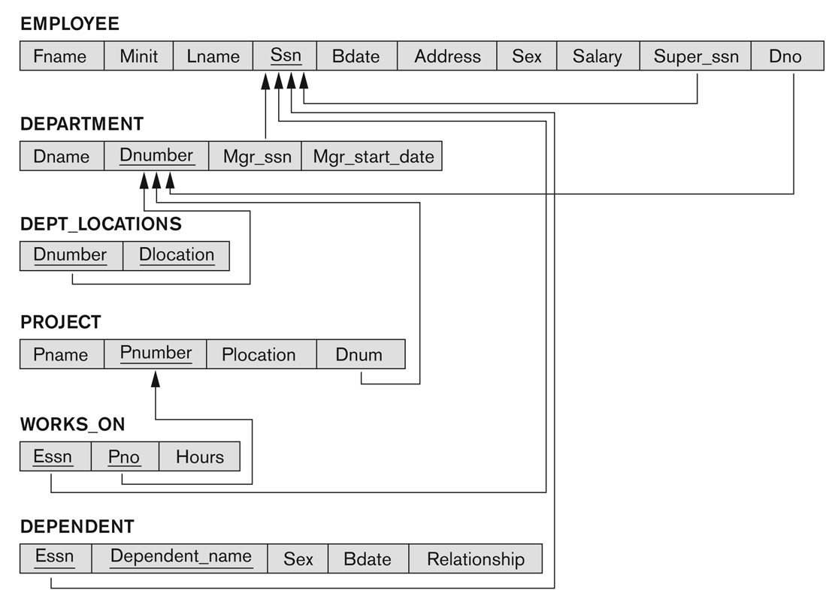
The COMPANY Relational Database Schema

Slide 3
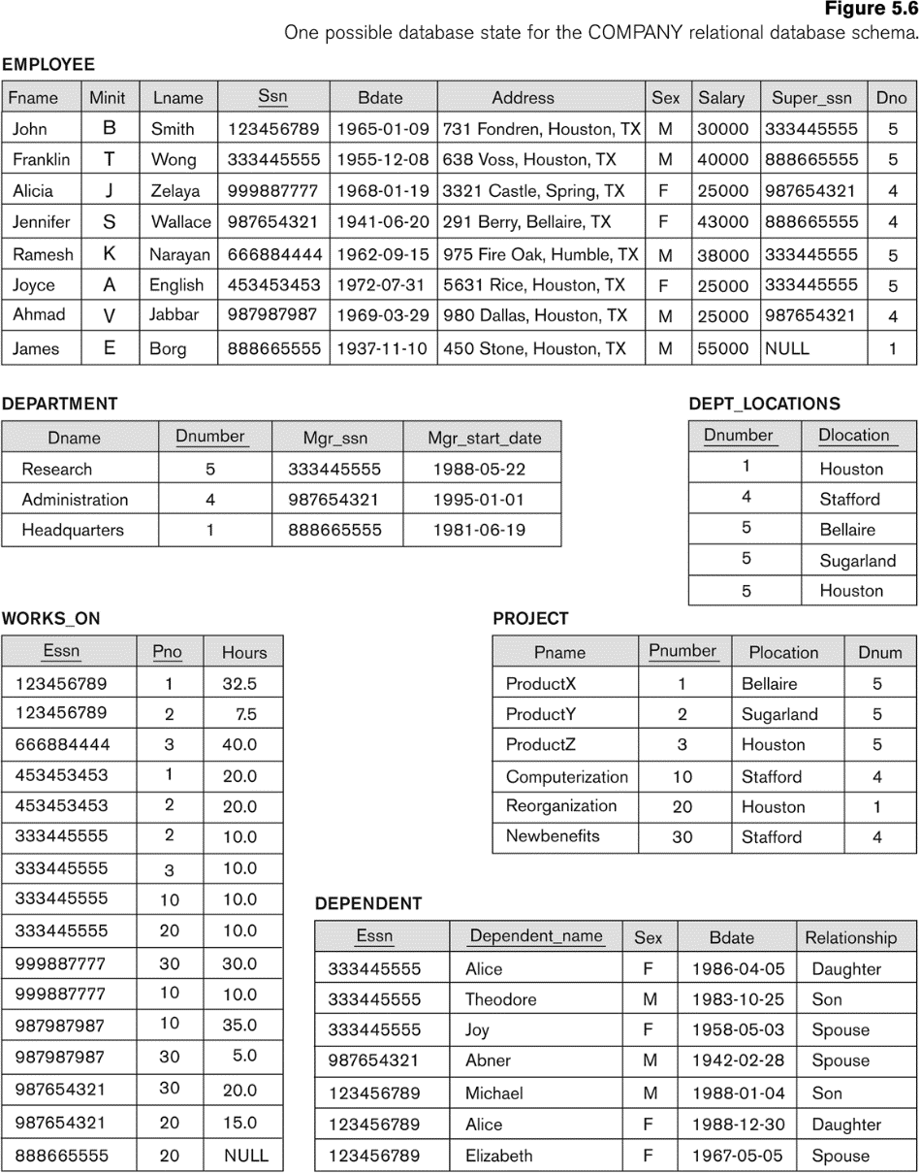
Populated Database State for COMPANY

Slide 4
Functional Dependency
Functional dependency is a constraint between two sets of attributes from the database
For example, deptno and dname in DEPARTMENT, if you know the department number, you know the department name
A functional dependency denoted by X → Y specifies a constraint on the possible tuples between two sets of attributes X and Y that are subsets of a relation R that can form a relation state r of R
The constraint is that, for any two tuples t₁ and t₂ in r that have t₁[X] = t₂[X], they must also have t₁[Y] = t₂[Y]
The values of the Y component of a tuple in r depend on, or are determined by the values of the X component
If you know his student ID, then I know his name (X → Y)

Slide 5
Functional Dependency: Formal Definition
Let R be a relation schema, and α ⊆ R, β ⊆ R (i.e., α and β are sets of R’s attributes).
We say α → β, if in any relation instance r(R), for all pairs of tuples t₁ and t₂ in r, we have (t₁[α] = t₂[α]) → (t₁[β] = t₂[β])

Slide 6
Functional Dependency: Example
Movies(title, year, length, type, studioName, starName): {title, year, starName} → {length, type, studioName}
Attributes {title, year, starName} form a key for the relation Movie
If two tuples agree on these three attributes, title, year, and starName, they must agree on the other attributes, length, type and studioName.
No proper subset of {title, year, starName} functionally determines all other attributes
{title, year} does not determine starName since many movies have more than one star
{year, starName} is not a key because we could have a star in two movies in the same year
Can it be {title, year, starName, length} → type? Yes

Slide 7
Functional Dependency: Candidate Key
Candidate key
If a constraint on R states X is a candidate key of R, then X → Y for any subset of attributes Y of R
A candidate key uniquely identifies a tuple
The values of all remaining attributes are determined
If X → Y in R, this does not say whether or not Y → X in R
{length, type, studioName} → {title, year, starName}? No
A functional dependency is property of the semantics or meaning of the attributes

Slide 8
Trivial Functional Dependency
Some functional dependencies are “trivial”, since they are always satisfied by all relations:
E.g., A → A, AB → A,
E.g., {Ename, Salary} → Ename
A functional dependency is trivial if and only if the right-hand side (the dependent) is a subset of the left-hand side (the determinant)
E.g., AB → A

Slide 9
Inference Rules for FDs (1/2)
Given a set of FDs F, we can infer additional FDs that hold whenever the FDs in F hold
Armstrong's inference rules:
IR1. (Reflexivity) If Y ⊆ X (i.e., Y is a subset of X), then X → Y
IR2. (Augmentation) If X → Y, then XZ → YZ (Note: XZ stands for X ∪ Z)
IR3. (Transitivity) If X → Y and Y → Z, then X → Z
IR1, IR2, IR3 form a sound and complete set of inference rules
Sound: These rules are true
Complete: All the other rules that are true can be deduced from these rules

Slide 10
Inference Rules for FDs (2/2)
Some additional inference rules that are useful:
Decomposition: If X → YZ, then X → Y and X → Z
Since X → YZ (given) and YZ → Y (reflexivity), X → Y (transitivity)
Since X → YZ (given) and YZ → Z (reflexivity), X → Z (transitivity)
Union: If X → Y and X → Z, then X → YZ
Pseudo transitivity: If X → Y and YW → Z, then XW → Z
Since YW → Z (given) and XW → YW (augmentation), XW → Z (transitivity)

Slide 11
Inference Rules for FDs: Example
Suppose we are given a schema R with attributes A, B, C, D, E, F and the FDs are:
A → BC
B → E
CD → EF
Show that FD: AD → F holds
Solution
A → BC (given)
A → C (decomposition from 1)
AD → CD (augmentation from 2)
CD → EF (given)
AD → EF (transitivity from 3 and 4)
AD → F (decomposition from 5) (proved)

Slide 12
Closure of a Set of FDs (1/2)
Given a set of FDs F, there are certain other FDs that are logically implied by F based on Armstrong’s inference rules (i.e., reflexivity, augmentation and transitivity).
The set of all FDs logically implied by F is the closure of F, denoted by F⁺.
(Reflexivity) If Y ⊆ X, then X → Y
Ssn → Ssn
{Ssn, Dmgr_ssn} → Ssn
{Ssn, Dmgr_ssn} → Dmgr_ssn

Slide 13
Closure of a Set of FDs (2/2)
(Augmentation) If X → Y, then XZ → YZ
Ssn → Ename (given)
{Ssn, Address} → {Ename, Address}
(Transitivity) If X → Y and Y → Z, then X → Z
Ssn → Dnumber (given)
Dnumber → {Dname, Dmgr_ssn} (given)
Ssn → {Dname, Dmgr_ssn}

Slide 14
Closure of a Set of FDs: Example
R = {A, B, C, D, E, F}
FDs in F:
A → B
A → C
CD → E
CD → F
B → D
Some members of F⁺:
A → D
A → BC
AD → E
CD → EF
…

Slide 15
Closure of Attribute Sets
The closure of X under F (denoted by X⁺) is the set of attributes that are functionally determined by X under F (X and X⁺ are a set of attributes):
X → Y in F⁺ ↔ Y ⊆ X⁺
If X⁺ consists of all attributes of R, X is a superkey for R. From the value of X, we can determine the values of the whole tuple.
For example, given Ssn, if Ssn → Ename, then Ename is part of Ssn⁺, i.e., Ssn⁺ = {Ssn, Ename, …}
If Ssn → Dmgr_ssn, then Dmgr_ssn is part of Ssn⁺, i.e., Ssn⁺ = {Ssn, Ename, Dmgr_ssn, …}

Slide 16
Closure of Attribute Sets: Algorithm
Input
R: a relation schema
F: a set of FDs
X ⊂ R: the set of attributes for computing the closure
Output
X⁺ is the closure of X with respect to F
X₀ = X
Repeat
X_{i+1} = X_{i} ∪ Z, where Z is the set of attributes such that Y → Z in F and Y ⊂ X_{i}
Until X_{i+1} = X_{i}
Return X_{i+1}

Slide 17
Closure of Attribute Sets: Example
Given a schema R={A, B, C, D, E, F}, F= {A → BC, B → E, E → CF, CD → EF}, and X={A}.
X₀={A}
A → BC
X₁={A, B, C}
B → E
X₂={A, B, C, E}
E → CF
X₃={A, B, C, E, F}
Output: X⁺={A, B, C, E, F}

Slide 18
Equivalence of Sets of FDs
A set of functional dependencies F is said to cover another set of functional dependency E if every FD in E is also in F⁺ (E is a subset of F⁺)
Two sets of FDs F and G are equivalent if
Every FD in F can be inferred from G, and
Every FD in G can be inferred from F
Hence, F and G are equivalent if F⁺ =G⁺
Example:
F: A → BC; {A → B, A → C (decomposition rule)}
G: A → B, A → C
F⁺ = G⁺

Slide 19
Relational Database Design
Logical/conceptual DB design
Schema
What relations (tables) are needed?
What their attributes should be?
What is a “bad” DB design?
Repetition of data/information
Potential inconsistency
Inability to represent certain information
Loss of data/information

Slide 20
Normalization (1/2)
Normalization was proposed by Codd in 1972 to take a relation schema through a series of tests to certify whether it satisfies a certain normal form
Analyzing the relation schema based on FD and primary keys to achieve
Minimizing redundancy
Minimizing the insertion, deletion and update anomalies

Slide 21
Normalization (2/2)
Normalization requires two properties
Non-additive or lossless join
Decomposition is reversible and no information is loss
No spurious tuples (tuples that should not exist) should be generated by doing a natural-join of any relations (extremely important)
Preservation of the functional dependencies
Ensure each functional dependency is represented in some individual relation (sometimes can be sacrificed)

Slide 22
Lossless Decomposition
S# | Status | City
S3 | 30 | Paris
S5 | 30 | Athens
Decomposition
Natural Join
S# | Status
S3 | 30
S5 | 30
S# | Status
S3 | 30
S5 | 30
Status | City | S#
30 | Paris | S3
30 | Paris | S5
30 | Athens | S3
30 | Athens | S5
Natural Join
S# | City
S3 | Paris
S5 | Athens
Status | City
30 | Paris
30 | Athens

Slide 23
First Normal Form with Primary Key (1/4)
First normal form (1NF)
Disallow multivalued attributes, composite attributes and their combination
Disallow multivalued attributes that are themselves composite
The domain of an attribute must be atomic (simple and indivisible) values
No repeating groups in a relation (no nested relations)
For example, each department can have a number of locations
1NF: DEPT_LOCATIONS(Dnumber, Dlocation)

Slide 24
First Normal Form with Primary Key (2/4)
(a) A relation schema that is not in 1NF. (b) Sample state of relation DEPARTMENT.
(c) 1NF version of the same relation with redundancy
Better solution: DEPARTMENT(Dname, Dnumber, Dmgr_ssn) and DEPT_LOCATIONS (Dnumber, Dlocation)

Slide 25

First Normal Form with Primary Key (3/4)
Normalizing nested relations into 1NF.
(a) Schema of the EMP_PROJ relation with a nested relation attribute PROJS. (b) Sample extension of the EMP_PROJ relation showing nested relations within each tuple.
(c) Decomposition of EMP_PROJ into relations EMP_PROJ1 and EMP_PROJ2 by propagating the primary key.

Slide 26
First Normal Form with Primary Key (4/4)
Example: FIRST(S#, Status, City, P#, Qty)
What’s the primary key?
R = {S#, P#, Qty, Status, City}
F = {{S#, P#} → Qty, S# → {Status, City}}
Possible Solution
Replace the original table by two sub-tables
SECOND(S#, Status, City)
SP(S#, P#, Qty)

Slide 27
Second Normal Form with Primary Key (1/3)
Full functional dependency
If removal of any attribute A from X means that the dependency does not hold any more
E.g., {Ssn, Pnumber} → Hours
Partial functional dependency
If some attributes A belonging to X can be removed from X and the dependency still holds
E.g., {Ssn, Pnumber} → Ename as Ssn → Ename

Slide 28
Second Normal Form with Primary Key (2/3)
A relation schema R is in 2NF if every non-prime attributes A in R is fully functional dependent on the primary key of R
An attribute of R is called prime attribute of R if it is a member of some candidate key of R. Otherwise it is non-prime.
For example,
Non-prime attributes: Hours, Ename, Pname, Plocation
Primary key: {Ssn, Pnumber}
If a relation schema is not in 2NF, it can be 2NF normalized into a number of 2NF relations in which non-prime attributes are associated only with the part of the primary key on which they are fully functional dependent

Slide 29
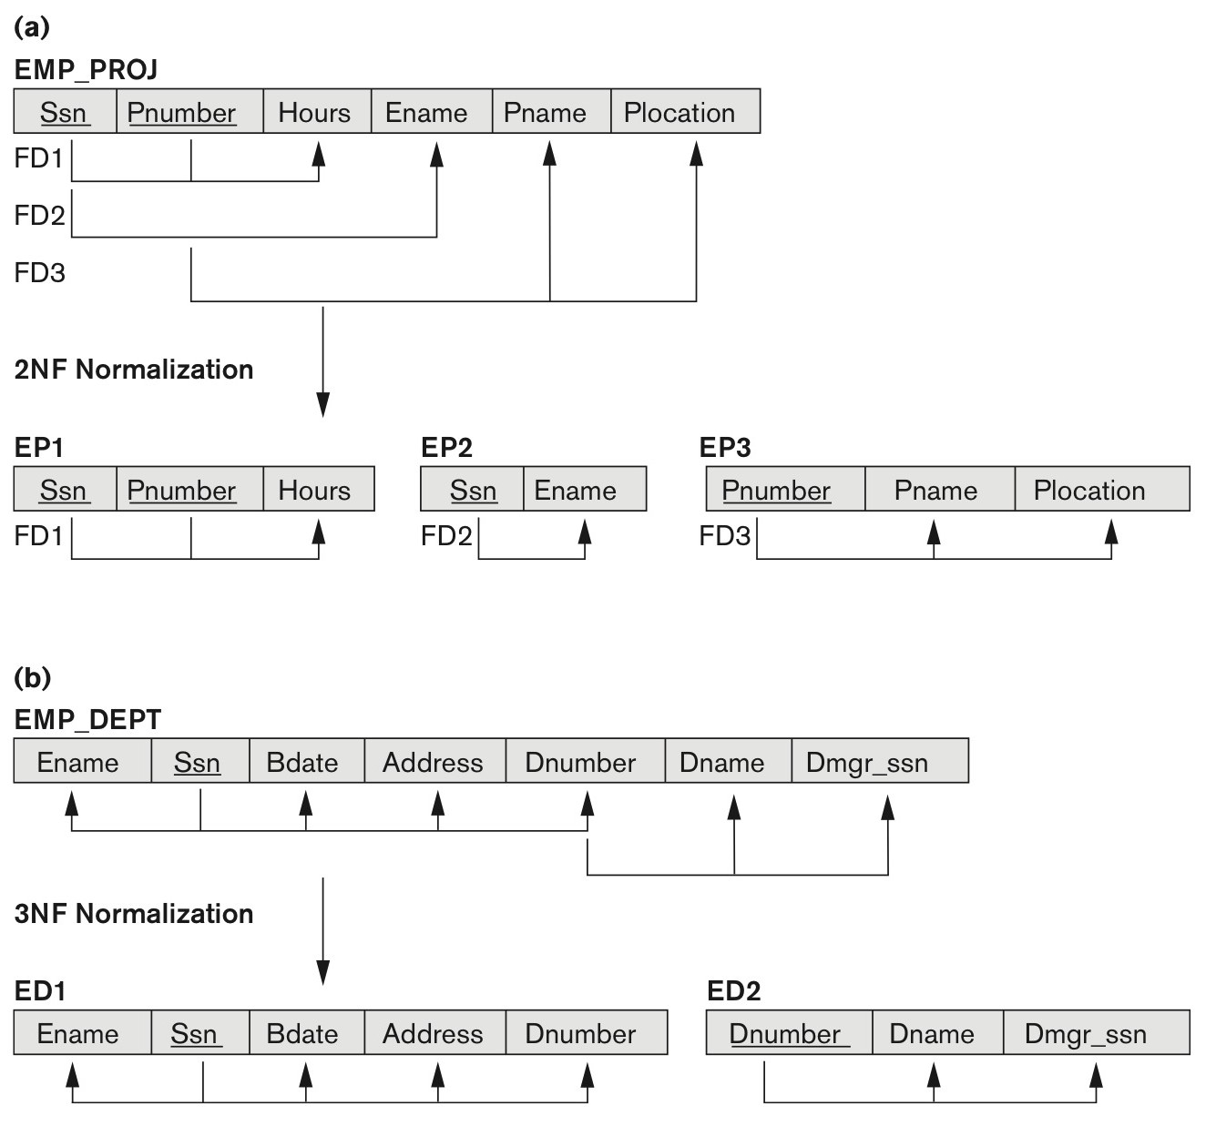
Second Normal Form with Primary Key (3/3)
The non-prime attribute Ename violates 2NF because of FD2 (i.e., is not fully functional dependent on the primary key)
Similarly, Pname and Plocation violate 2NF because of FD3
Solution: EP1(Ssn, Pnumber, Hours); EP2(Ssn, Ename), and EP3(Pnumber, Pname, Plocation)

Slide 30
Third Normal Form with Primary Key (1/2)
A relation schema R is in 3NF if whenever a non-trivial FD X → A holds in R, either (a) X is a Superkey of R or (b) A is a prime attribute of R.
3NF is based on the concept of transitive dependency
A functional dependency X → Y in a relation schema R is transitive dependency if there exists a set of attributes Z in R that is neither a candidate key nor a subset of any key of R, and both X → Z and Z → Y hold
X → Z → Y (Z is not a candidate key nor a subset of any key)
For example, dependency Ssn → Dmgr_ssn is transitive through Dnumber
Ssn → Dnumber and Dnumber → Dmgr_ssn, and Dnumber is neither a key itself nor a subset of the key
Ssn → Dnumber → Dmgr_ssn

Slide 31
Third Normal Form with Primary Key (2/2)
According to Codd’s original definition, a relation scheme R is in 3NF if it satisfies 2NF and no non-prime attribute of R is transitively dependent on the primary key
The Ssn → Dnumber, Dumber → {Dname, Dmgr_ssn} and Dnumber is neither a candidate key nor a subset of any key of EMP_DEPT, so EMP_DEPT violates 3NF
Solution: ED1(Ename, Ssn, Bdate, Address, Dnumber), ED2(Dnumber, Dname, Dmgr_ssn)

Slide 32
General Definitions of Normal Forms

Slide 33
Boyce-Codd Normal Form
BCNF was proposed as a simpler form of 3NF, but it was found to be stricter than 3NF
Every relation in BCNF is also in 3NF
BUT Relation in 3NF is not necessarily in BCNF
A relation schema R is in BCNF if whenever a non-trivial functional dependency X → A holds in R, then X is a superkey of R.
For example, the relation schema below is in 3NF (B is a prime attribute) but not in BCNF.

Slide 34
Algorithm for BCNF Decomposition
Let R be the initial table with FDs F and S={R}
Until all relation schemes in S are in BCNF
for each R in S
for each FD X → Y that violates BCNF for R
S = (S – {R}) ∪ (R-Y) ∪ (X,Y)
End until
When we find a table R with BCNF violation X → Y we:
Remove R from S
Add a table that has the same attributes as R except for Y
Add a second table that contains the attributes in X and Y

Slide 35
BCNF Decomposition: Example (1/2)
Let us consider the relation scheme R=(A,B,C,D,E) and the FDs: {A} → {B,E}, {C} → {D}
Candidate key: AC
Both functional dependencies violate BCNF because the LHS is not a candidate key
Pick {A} → {B,E}
We can also choose {C} → {D}, but different choices lead to different decompositions.
(A,B,C,D,E) generates R₁=(A,C,D) and R₂=(A,B,E)

Slide 36
BCNF Decomposition: Example
Let us consider the relation scheme R=(A,B,C,D,E) and the FDs: {A} → {B,E}, {C} → {D}
Candidate key: AC
Both functional dependencies violate BCNF because the LHS is not a candidate key
Pick {A} → {B,E}
We can also choose {C} → {D} – different choices
Lead to different decompositions.
(A,B,C,D,E) generates R₁=(A,C,D) and R₂=(A,B,E)
We need to decompose R₁=(A,C,D) because of the FD {C} → {D}, so (A,C,D) is replaced with R₃=(A,C) and R₄=(C,D).
Final decomposition: R₂=(A,B,E), R₃=(A,C), R₄=(C,D)

