Slide 1
Lecture 9: Transaction
CS3402 Database Systems

Slide 2
ACID Properties
Atomicity: A transaction is an atomic unit of processing. It is either performed completely or not performed at all (all or nothing)
Consistency: A correct execution of a transaction must take the database from one consistent state to another (correctness)
Isolation: A transaction should not make its updates visible to other transactions until it is committed (no partial results)
Durability: Once a transaction changes the database state and the changes are committed, these changes must never be lost because of subsequent failure (committed and permanent results)

Slide 3
What is a Transaction? (1/2)
The execution of a program/application on behalf of the user to perform a specific user function by accessing data items maintained in a database management system
E.g., use of ATM and buy online tickets
Transactions – are processes and created by a DBMS and work within its environment
A logical unit of database processing (a particular functional request from the user) that includes one or more database access operations (read, write, insert, delete)
Structurally, each transaction is a process and consists of atomic steps. Each atomic step is called an operation
A transaction = database operations + transaction operations

Slide 4
What is a Transaction? (2/2)
Database operations: read and write operations on a database
Read operation: to read the value of a data item or a group of items, e.g., SELECT
Write operation: to create a new value for a data item or a group of items, e.g., UPDATE
In between the read/write operations, there may be computation
Transaction operations: a begin operation and an end operation (commit or abort)
For transaction management (where to start and where to finish)
The new values from a transaction will become permanent only if the transaction is committed successfully
Partial results are not allowed and is considered to be incorrect
Atomicity: All or nothing
Example: T1: Begin; A:= R(a); B:= R(b) C:= A + B; W(c):= C; End

Slide 5
Transaction Structure & Database Consistency
Database may be temporarily in an inconsistent state during execution
Database in a consistent state
Database in a consistent state
Begin Transaction
Execution of Transaction
End Transaction
The whole transaction is considered as an atomic unit
Multiple steps (operations) → single user application

Slide 6
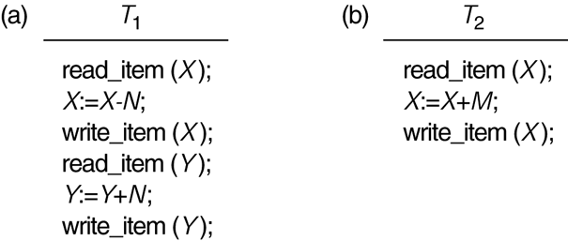
Two Sample Transactions
Two sample transactions (only showing the database operations):

Slide 7
Read and Write Operations (1/2)
Data are resided on disk and the basic unit of data transferring from the disk to the main memory is one disk block
In general, a data item (what is read or written) will be the field/fields of some records in the database (in a disk block)
read_item(X) command includes the following steps:
Find the address of the disk block that contains item X
Copy that disk block into a buffer in main memory (if that disk block is not already in some main memory buffer
Search for the required value in the buffer
Copy item X from the buffer to the program variable named X

Slide 8
Read and Write Operations (2/2)
write_item(X) command includes the following steps:
Find the address of the disk block that contains item X
Copy that disk block into a buffer in main memory (if that disk block is not already in some main memory buffer)
Search for the required value in the buffer
Copy item X from the program variable named X into its correct location in the buffer
Store the updated block from the buffer back to disk (either immediately or at some later point in time)
Note that we DO NOT need to read an item before update it
Program
Transaction
Buffer
Temporary storage
Disk
Permanent storage

Slide 9
Transaction Processing Performance (1/2)
Fast CPU in accessing buffered data (in main memory)
Slow disk data access performance (use of buffer to improve the performance)
Long transactions → many database operations
Undo and redo of transactions to maintain atomicity in cases of failures
Disk Controller
Program
Transaction
CPU
Buffer
Temporary storage
Disk
Permanent storage
fast
slow

Slide 10
Transaction Processing Performance (2/2)
Multiuser systems
Many users (transactions) can access the database concurrently at the same time Concurrent execution
Interleaved processing
Concurrent execution of processes/transactions are interleaved in a single CPU system (E.g., use the CPU while waiting for disk block)
Parallel processing
Processes/transactions are concurrently executed in multiple CPUs system
Higher Concurrency (more than one transaction is executing)
Better performance, i.e., lower response time
Problem: difficult to maintain the ACID properties

Slide 11
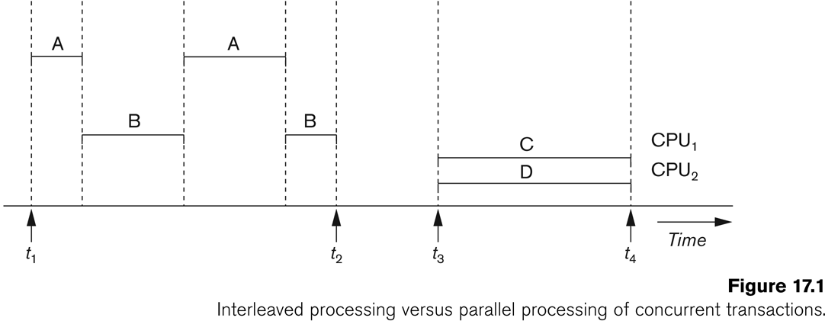
Interleaved vs Parallel
While waiting disk data, the CPU processes another transaction

Slide 12
Transaction Schedule
Transaction schedule
When transactions are executing concurrently in an interleaved fashion or serially, the order of execution of operations from the transactions forms a transaction schedule
A schedule S of n transactions T₁, T₂, …, T_{n} is an ordering of the operations of the transactions subject to the constraint:
For each transaction T_{i} that participates in S, the operations of T_{i} in S must appear in the same order as in T_{i} (operations from other transactions T_{j} can be interleaved with the operations of T_{i} in S)
A concurrent schedule: a new transaction starts BEFORE the completion of the current transaction
A serial schedule: a new transaction only starts AFTER the current transaction is completed

Slide 13
Serial Schedule
In a serial schedule, the transactions are execution one after one
Transaction V:
Transaction W:
a.withdraw(100);
aBranch.branchTotal();
b.deposit(100);
a.withdraw(100);
$100
b.deposit(100);
$300
total = a.getBalance();
$100
total = total+b.getBalance();
$400
total = total+c.getBalance();
...

Slide 14
A Concurrent Schedule
Transaction T:
Transaction U:
Time
balance = b.getBalance();
balance = b.getBalance();
b.setBalance(balance*1.1);
b.setBalance(balance*1.1);
a.withdraw(balance/10);
c.withdraw(balance/10);
balance = b.getBalance();
$200
balance = b.getBalance();
$200
b.setBalance(balance*1.1);
$220
b.setBalance(balance*1.1);
$220
a.withdraw(balance/10);
$80
c.withdraw(balance/10);
$280

Slide 15
Schedule Examples
T₁: w₁(x), r₁(y), w₁(y)
T₂: r₂(x), r₂(y), w₂(y)
A possible schedule for T₁ and T₂:
w₁(x), r₂(x), r₁(y), w₁(y), r₂(y), w₂(y)
Is the following one a serial schedule?
r₁(y), w₁(y), r₂(x), r₂(y), w₂(y), w₁(x) (concurrent schedule)
How about this one?
r₁(y), w₁(y), w₁(x), r₂(x), r₂(y), w₂(y) (serial schedule)

Slide 16
Example Consistency Problems
Lost update problem (write/write conflicts)
When two transactions that access the same database items have their operations interleaved in a way that makes the value of some database item incorrect (inconsistent)
Inconsistent retrieval problem (read/write conflicts)
If a transaction is calculating an aggregate summary function on a number of records while other transactions are updating some of these records, the aggregate function may calculate some values before they are updated and others after they are updated

Slide 17
Lost Update Problem
A schedule shows the execution order of the operations of two concurrently executing transactions (Initial account value: A=100; B=200; C=300)
Transaction T:
Transaction U:
Time
balance = Read(b)
balance = Read(b)
Write(b) = balance + 20
Write(b) = balance + 30
Write(a) = balance - 20
Write(c) = balance - 30
balance = Read(b)
$200
balance = Read(b)
$200
Write(b)= balance + 30
$230
Write(b) = balance + 20
$220
Write(a) = balance - 20
$80
Write(c) = balance - 30
$270

Slide 18
Schedules Classified on Serializability
Serial schedule
A schedule S is serial if, for every transaction T participating in the schedule, all the operations of T are executed consecutively in the schedule
Serial schedules can maintain the database consistency
But, poor performance
Serializable schedule
A concurrent schedule S which is equivalent to a serial schedule
Can guarantee the database consistency and can have better performance

Slide 19
Serial Equivalence
A serially equivalent schedule means that the results from the schedule is equivalent to a serial schedule, i.e., execute one after one
Transaction T:
Transaction U:
balance = Read(b)
balance = Read(b)
Write(b) = balance + 20
Write(b) = balance + 30
Write(a) = balance - 20
Write(c) = balance - 30
balance = Read(b)
$200
Write(b) = balance + 20
$220
balance = Read(b)
$220
Write(b) = balance + 30
$250
Write(a) = balance - 20
$80
Write(c) = balance - 30
$270

Slide 20
Read and Write Operation Conflict Rules
Operations of Different Transactions |  | Conflict | Reason
Read | Read | No | Because the effect of a pair of read operations does not depend on the order in which they are executed
Read | Write | Yes | Because the effect of a read and a write operation depends on the order of their execution
Write | Write | Yes | Because the effect of a pair of write operations depends on the order of their execution

Slide 21
Schedules Classified on Serializability
Conflict equivalent schedule
Two schedules are said to be conflict equivalent if the order of any two conflicting operations (RW,WW) is the same in both schedule. Example:
Conflict serializable schedule
A schedule S is said to be conflict serializable if it is conflict equivalent to some serial schedule S’
S1 S2
T1 | T2
Read(A) Write(A) Read(B) | Read(A)
T1 | T2
Read(A) Write(A) Read(B) | Read(A)

Slide 22
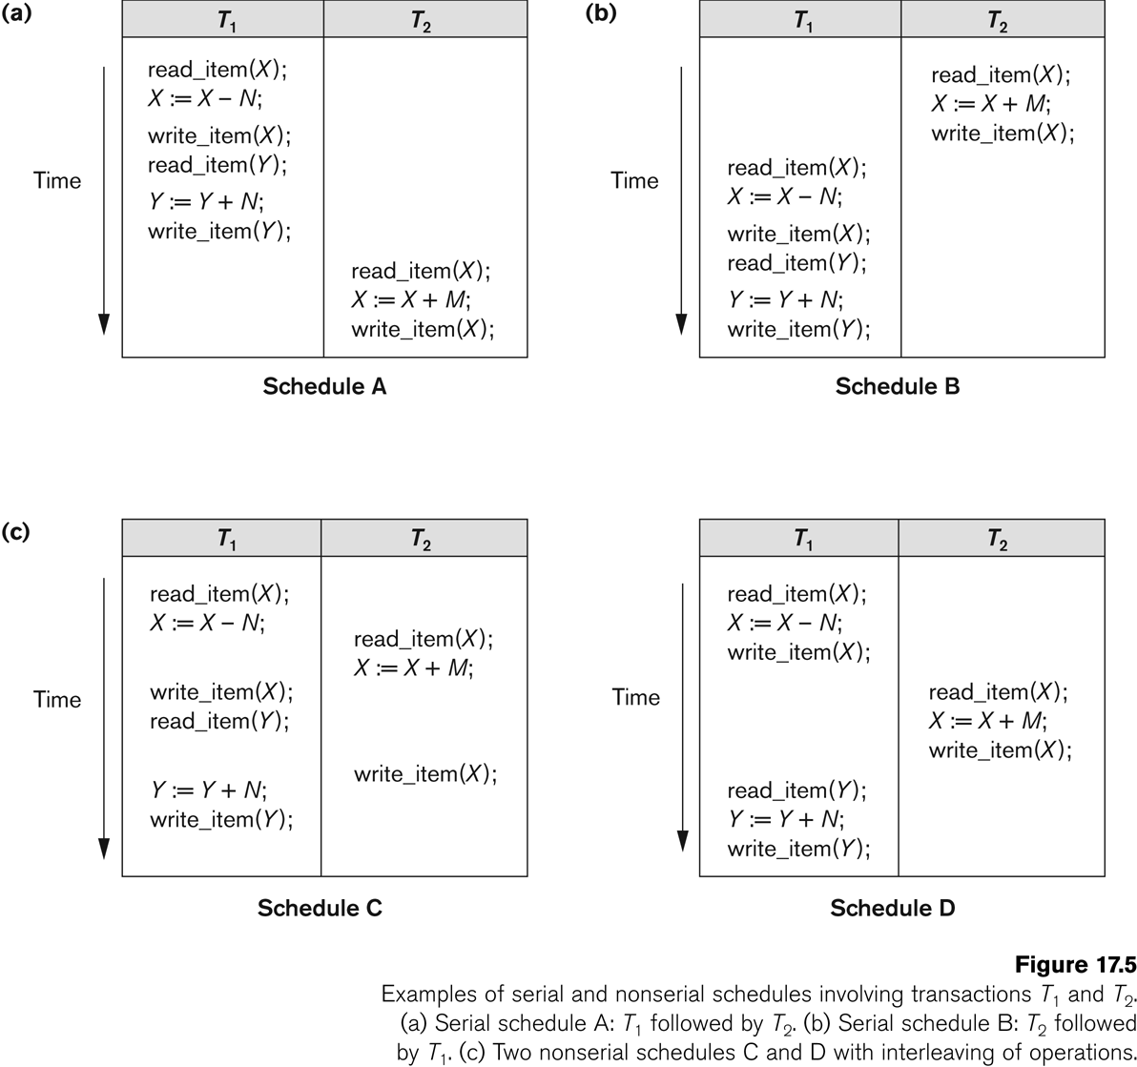
Examples of Serial Schedules
Examples of serial schedules involving transactions T₁ and T₂
(a) Serial schedule A: T₁ followed by T₂
(b) Serial schedule B: T₂ followed by T₁

Slide 23
Examples of Nonserial Schedules
Examples of nonserial schedules involving transactions T₁ and T₂
Two nonserial schedules C and D with interleaving of operations

Slide 24
Serialization Graphs
The determination of a conflict serializable schedule can be done by the use of serialization graph (SG) or called precedence graph
A serialization graph tells the effective execution order of a set of transactions
The set of edges consists of all edges T_{i} → T_{j} for which one of the following three conditions holds:
W/R conflict: T_{i} executes write(x) before T_{j} executes read(x)
R/W conflict: T_{i} executes read(x) before T_{j} executes write(x)
W/W conflict: T_{i} executes write(x) before T_{j} executes write(x)
Each edge T_{i} → T_{j} in a SG means that at least one of T_{i}’s operations precede and conflict with one of T_{j}’s operations
Serializability theorem: A schedule is serializable if and only if the SG is acyclic

Slide 25
Serialization/Precedence Graph
Transaction T: | Transaction U:
x = read(i)
write(i, 10)
 | y = read(j)
 | write(j, 30)
write(j, 20)
 | z = read(i)
T
U

Slide 26
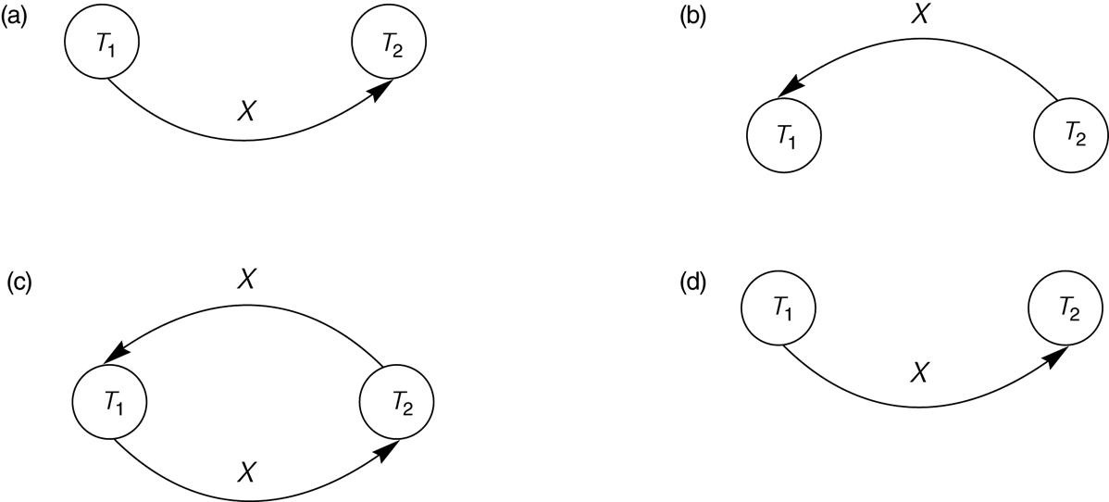
Serialization/Precedence Graph: Examples
Constructing the precedence graphs for schedules A and D on Slides #22 and #23 to test for conflict serializability
(a) Precedence graph for serial schedule A.
(b) Precedence graph for serial schedule B.
(c) Precedence graph for schedule C (not conflict serializable).
(d) Precedence graph for schedule D (conflict serializable, equivalent to schedule A).

Slide 27
Schedules Classified on Recoverability
Recoverable schedule:
If a transaction is aborted, all its effects have to be undone
Rollback of a transaction: undo those processed operations of an aborted transaction
Why needs to be rollback → maintaining consistency and all or nothing property
A schedule S is recoverable if
For all T_{i} and T_{j} where T_{i} read an item written by T_{j}, T_{j} commits before T_{i}
Cascaded rollback
A single rollback leads to a series of rollback
All uncommitted transactions that read data items from a failed (aborted) transaction must be rolled back

Slide 28
How to Ensure Recoverability?
To ensure recoverability (undo to previous database state):
No dirty read: reading uncommitted data items
No premature write: no update on a data item if another transaction has updated it and the transaction has not committed
Strict execution: delay the reading and updating of a data item until the previous transaction that has updated the same data item has committed/aborted

Slide 29
Non-recoverable vs. Recoverable
T₁ | T₂
read(A)
write(A)
 | read(A)
 | commit/abort
read(b)
commit/abort
T1 | T2
read(A)
write(A)
 | read(A)
read(b)
commit/abort
 | commit/abort
Non-recoverable
If T₂ commits and then T₁ aborts
Recoverable

Slide 30
Cascade Rollback
T₁ | T₂ | T₃
read(A)
read(B)
write(A)
 | read(A)
 | write(A)
 |  | read(A)
commit/abort
 | commit/abort
 |  | commit/abort
Recoverable but when T₁ fails, T₂ and T₃ should rollback

Slide 31
Dirty Read
Transaction T: |  | Transaction U:
balance = read (a) | $100
write(a) = balance + 10 | $110
 |  | balance = read(a) | $110
 |  | write(a) = balance + 20 | $130
 |  | commit
abort
Dirty read

Slide 32
A Transaction may Fail (1/2)
Why recovery is needed? (What causes a Transaction to abort)
1. A computer failure (system crash)
A hardware or software error occurs in the computer system during transaction execution
If the hardware crashes, the contents of the computer’s internal memory may be lost.
2. A transaction error
Some operation in the transaction may cause it to fail, such as integer overflow or division by zero
Transaction failure may also occur because of erroneous parameter values or because of a logical programming error. In addition, the user may interrupt the transaction during its execution.

Slide 33
A Transaction may Fail (2/2)
3. Local errors or exception conditions detected by the transaction
Certain conditions necessitate cancellation of the transaction. For example, data for the transaction may not be found
4. Concurrency control enforcement
The concurrency control method may decide to abort the transaction, to be restarted later, because it violates serializability or because several transactions are in a state of deadlock
5. Disk failure
Some disk blocks may lose their data because of a read or write malfunction or because of a disk read/write head crash. This may happen during a read or a write operation of the transaction.
6. Physical problems and catastrophes
This refers to an endless list of problems that includes power or air-conditioning failure, fire, theft, overwriting disks

Slide 34
Transaction State
A transaction is an atomic unit of work that is either completed in its entirety or not done at all (atomicity)
For recovery purposes, the system needs to keep track of when a transaction starts, terminates, and commits or aborts
Transaction states
Active state
Partially committed state
Committed state
Failed state
Terminated State

Slide 35
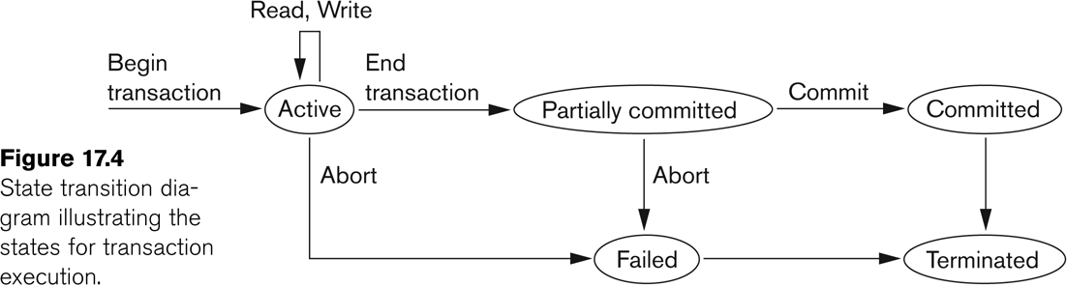
State Transition Diagram

Slide 36
Primitive Operations of Transactions
INPUT(X): copy the disk block containing database element X to a memory buffer
READ(X, t): copy the database element X to the transaction’s local variable t. If the block containing database element X is not in a memory buffer, first INPUT(X). Next, assign the value of X to a local variable t
WRITE(X, t): copy the value of local variable t to database element X in a memory buffer. If the block containing database element is not in a memory buffer, execute INPUT(X). Next copy the value of t to X in the buffer
OUTPUT(X): copy the block containing X from its buffer to disk
Program
Transaction
Buffer
Temporary storage
Disk
Permanent storage

Slide 37
Primitive Operations of Transactions
Transaction
Read(A, t); t:= t * 2; Write(A, t); Read(B, t); t:= t * 2; Write(B, t)
Action | t | MEM A | MEM B | DISK A | DISK B
Read(A, t) | 8 | 8 |  | 8 | 8
t:= t * 2; | 16 | 8 |  | 8 | 8
Write(A, t); | 16 | 16 |  | 8 | 8
Read(B, t); | 8 | 16 | 8 | 8 | 8
t:= t * 2; | 16 | 16 | 8 | 8 | 8
Write(B, t) | 16 | 16 | 16 | 8 | 8
Output(A) | 16 | 16 | 16 | 16 | 8
Output(B) | 16 | 16 | 16 | 16 | 16

Slide 38
Undo Logging for Recovery
A log is a file of log records, each telling something about what some transaction has done
As transactions execute, the log manager records in the log each important event (e.g., write operations)
Logs are initially created in main memory and are allocated by the buffer manager
Why not on disk? Disk I/O takes a lot of time
Logs are copied to disk by “flush-log” operation
If log records appear in nonvolatile storage (disk), we can use them to restore the database to a consistent state after a system crash
After a system failure, all data in volatile storage (memory) will lose but the data in nonvolatile storage remain

Slide 39
Log Records
<START T>: This record indicates that transaction T has begun
<COMMIT T>:
Transaction T has completed successfully and will make no more changes to database.
Because we cannot control when the buffer manager chooses to copy blocks from memory to disk, we cannot be sure that the changes are already on disk when we see <COMMIT T>
<ABORT T>: Transaction T could not complete successfully. If transaction T aborts, no change it made can be copied to disk, and it is the job of the transaction manager to make sure that such changes never appear on disk

Slide 40
Undo-Logging Rules
U1: if transaction T modifies database element X (current value is v), the log record of the form <T, X, v> must be written to the disk BEFORE the new value of X is written to disk
U2: if a transaction commits, its COMMIT log record must be written to disk ONLY after all database elements changed by the transaction have been written to disk
A transaction must be written to disk in the following order
The log records indicating changed database elements
The changed database elements themselves
The COMMIT log record

Slide 41
Undo Rules and Actions
Action | t | MEM A | MEM B | DISK A | DISK B | Log
 |  |  |  |  |  | <START T>
Read(A, t) | 8 | 8 |  | 8 | 8
t:= t * 2; | 16 | 8 |  | 8 | 8
Write(A, t); | 16 | 16 |  | 8 | 8 | <T, A, 8>
Read(B, t); | 8 | 16 | 8 | 8 | 8
t:= t * 2; | 16 | 16 | 8 | 8 | 8
Write(B, t) | 16 | 16 | 16 | 8 | 8 | <T, B, 8>
FLUSH LOG |  |  |  |  |  | (1)
Output(A) | 16 | 16 | 16 | 16 | 8 | (2)
Output(B) | 16 | 16 | 16 | 16 | 16 | (2)
 |  |  |  |  |  | <COMMIT T> (3)
FLUSH LOG

Slide 42
Recovery Using Undo-Logging (1/2)
Suppose a system failure occurs while a transaction is committing. It is possible certain changes made by the transaction were written to disk while others changes never reached the disk
Recovery manager has to REMOVE the partial changes of a transaction
If there is a log record <COMMIT T>, by undo rule U2, all changes made by T were previously written to disk
If we find <START T> on the log but no <COMMIT T> record, T may be incomplete and must be undone
Rule U1 assures that if T changed X on disk before the crash, there will be a <T, X, v> record on the log, and that record will have been copied to disk before the crash. During recovery, we must write the value v for X

Slide 43
Recovery Using Undo-Logging (2/2)
The recovery manager scans the log from the end and remembers all those transactions T for which it has a <COMMIT T> record or an <ABORT T> record
If it sees a record <T, X, v>
If T is a transaction whose COMMIT record has been seen, do nothing. T is committed and must not be undone
Otherwise, T is an incomplete transaction, or an aborted transaction. The recovery manager must change the value of X in the database to v in case X had been altered just before the crash
After making the changes, the recovery manager must write a log record <ABORT T> for each incomplete transaction that was not previously aborted and the flush the log

Slide 44
Redo Logging for Recovery
Undo logging has a potential problem that we cannot commit a transaction without first writing all changed data to disk (flush → commit)
Differences between redo and undo logging
While undo logging cancels the effect of incomplete transactions and ignores committed ones during recovery, redo logging ignores incomplete transactions and repeats the changes made by committed transactions
While undo logging requires us to write changed database elements to disk before the COMMIT log records reaches disk, redo logging requires that the COMMIT record appears on disk before any changed values reach disk

Slide 45
Redo Logging Rules
R1: before modifying any database element X on disk, it is necessary that all log records pertaining to this modification of X, including both the update record <T, X, v> (v is the new value) and <COMMIT T> record, must appear on disk
The order in which material associated with one transaction gets to written to disk is:
The log record indicating changed database elements
The COMMIT log record
The changed database elements themselves
Undo: Log → change → COMMIT
Redo: Log → COMMIT → change

Slide 46
Redo Rules and Actions
Action | t | MEM A | MEM B | DISK A | DISK B | Log
 |  |  |  |  |  | <START T>
Read(A, t) | 8 | 8 |  | 8 | 8
t:= t * 2; | 16 | 8 |  | 8 | 8
Write(A, t); | 16 | 16 |  | 8 | 8 | <T, A, 16>
Read(B, t); | 8 | 16 | 8 | 8 | 8
t:= t * 2; | 16 | 16 | 8 | 8 | 8
Write(B, t) | 16 | 16 | 16 | 8 | 8 | <T, B, 16>
 |  |  |  |  |  | <COMMIT T>
FLUSH LOG
Output(A) | 16 | 16 | 16 | 16 | 8
Output(B) | 16 | 16 | 16 | 16 | 16

Slide 47
Recovery Using Redo-Logging
To recover using a redo log, after a system crash:
Identify the committed transactions
Scan the log forward from the beginning. For each log record <T, X, v> encountered:
If T is not a committed transaction, do nothing
If T is a committed transaction, write value v for database element X
For each incomplete transaction T, write an <ABORT T> record to the log and flush the log

