Slide 1
Tutorial 1: Entity-Relationship (ER) Model
CS3402 Database Systems

Slide 2
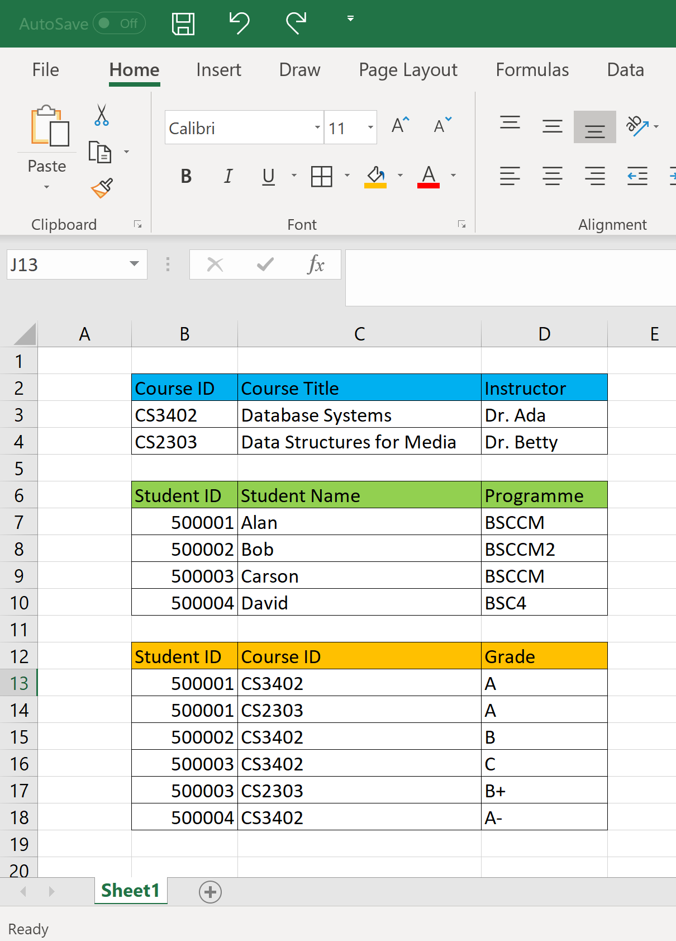
Question 1
An instructor Peter does not know relational database management systems. He uses an Excel file to store university data. Here are some sample data stored in the Excel file.
Identify entity, entity set, attribute, relationship, relationship set in this application.
Is there any integrity constraint in this application? If so, is it easy to make sure the constraint(s) is not violated in Excel?

Slide 3
Question 1a (Answer) (1/2)
Entity: course, student, and instructor
Entity set:
Course – the set of courses
Student – the set of students
Instructor – the set of instructors
Attributes: (Note: You may add more attributes.)
Course – Course ID and Course Title
Student – Student ID, Student Name and Programme
Instructor – Instructor ID, Instructor Name and Office

Slide 4
Question 1a (Answer) (2/2)
Relationships:
Teaches – an instructor teaches a course
Takes – a student takes a course
Relationship sets:
Teaches: the set of relationships of an instructor teaching a course
Takes: the set of relationships of a student taking a course

Slide 5
Question 1b (Answer)
Integrity Constraints: (Note: You may have more integrity constraints.)
No two students having the same Student ID
No two courses having the same Course ID
No two instructors having the same Instructor ID
One student can only take the course once
Some courses are offered to BSCCM students only
…
It is not easy to maintain integrity constraints in Excel. Need a relational database management system!!

Slide 6
Question 2
Construct an ER diagram for a car insurance company. Identify the key entities, relationships and their attributes in the ER diagram.
A customer owns at least one car.
A car may be owned by more than one customer.
An accident involves at least one car.
A car may have a number of recorded accidents associated with it.

Slide 7
Question 2 (Answer)
This answer is only a sample answer.
SSN
Name
License
Year
Report No.
Date
owns
involves
Customer
Car
Accident
m
n
m
n
Address
Model
Color
Location
Amount

Slide 8
Question 3
Construct an ER diagram for a hospital. Identify the key entities, relationships and their attributes in the ER diagram.
The hospital has a set of patients and a set of medical doctors.
A patient may be treated by more than one doctor.
A doctor may have a number of patients.
Various conducted tests and results are associated with their corresponding patients.

Slide 9
Question 3 (Answer)
This answer is only a sample answer.
Test_ID
Date
SSN
Name
Doctor_SSN
Name
takes
treated_by
Test
Patient
Doctor
m
n
m
n
Test_ name
Time
Result
Check_ out_date
Check_in_date
Specialization

