Slide 1
Tutorial 8: Indexing Techniques
CS3402 Database Systems

Slide 2
Question 1
Construct a B⁺-tree for the following set of key values: (2, 3, 5, 7, 11, 17, 19, 23, 29, 31) Assuming that the tree is initially empty, values are added in ascending order, and the number of key values in internal nodes and leaf nodes are both 3 (i.e., the maximum number of tree pointers in an internal node is 4 = max. degree).

Slide 3
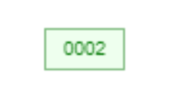
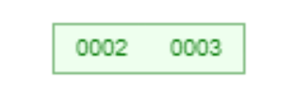

Question 1 (Answer) (1/5)
Insert 2
The node has an empty space
Insert 3
The node has an empty space
Insert 5
The node has an empty space
B⁺-tree visualization tool: https://www.cs.usfca.edu/~galles/visualization/BPlusTree.html

Slide 4
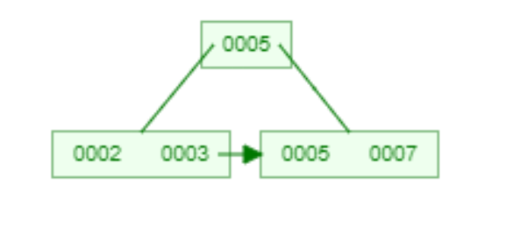

Question 1 (Answer) (2/5)
Insert 7
Since the node is already full, split it into two nodes, distributing the keys evenly between the two nodes. Since the node is a leaf, take a copy of the minimum value in the second of these two nodes (i.e., 5) and repeat the insertion algorithm to insert it into the parent node.
Insert 11
The node has an empty space

Slide 5
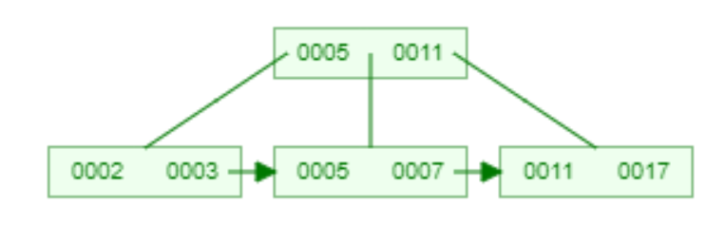
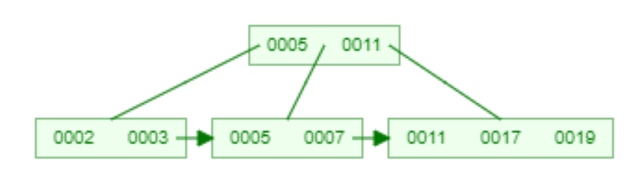
Question 1 (Answer) (3/5)
Insert 17
Since the node is already full, split it into two nodes, distributing the keys evenly between the two nodes. Since the node is a leaf, take a copy of the minimum value in the second of these two nodes (i.e., 11) and repeat the insertion algorithm to insert it into the parent node.
Insert 19
The node has an empty space

Slide 6
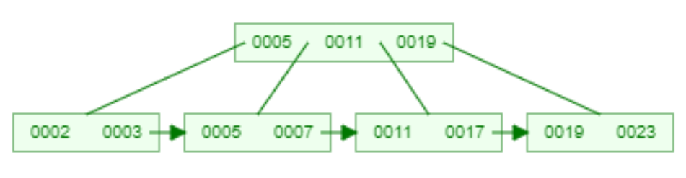
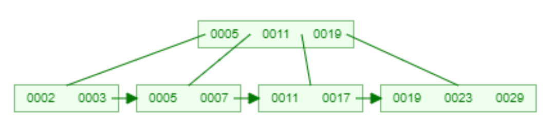
Question 1 (Answer) (4/5)
Insert 23
Since the node is already full, split it into two nodes, distributing the keys evenly between the two nodes. Since the node is a leaf, take a copy of the minimum value in the second of these two nodes (i.e., 19) and repeat the insertion algorithm to insert it into the parent node.
Insert 29
The node has an empty space

Slide 7
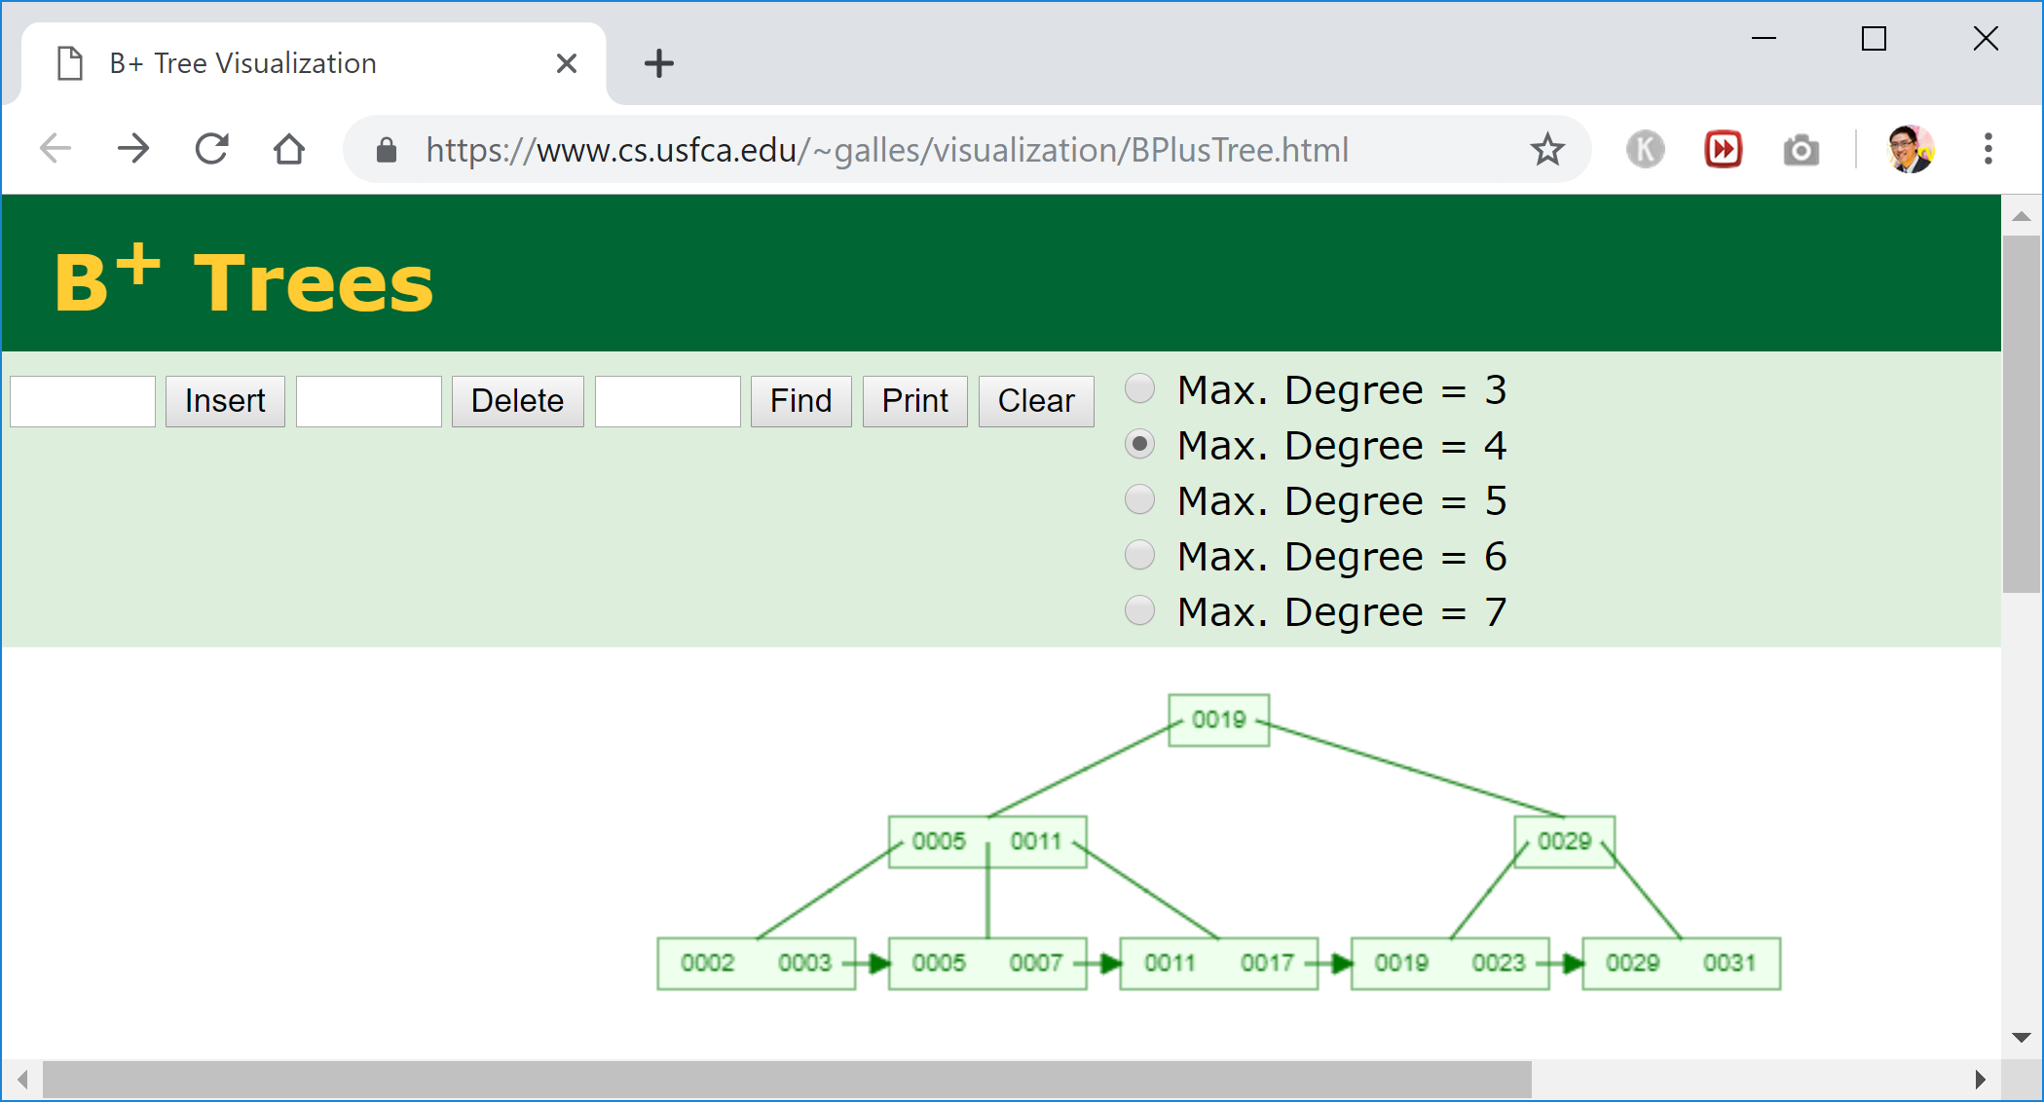
Question 1 (Answer) (5/5)
Insert 31
Since the node is already full, split it into two nodes, distributing the keys evenly between the two nodes. Since the node is a leaf, take a copy of the minimum value in the second of these two nodes (i.e., 29) and repeat the insertion algorithm to insert it into the parent node. Since the parent node is a non-leaf, exclude the middle value (i.e., 19) during the split and repeat this insertion algorithm to insert this excluded value into the parent node (i.e., the root).

Slide 8
Question 2
For the B⁺-tree constructed for Question 1, show the form of the tree after each of the following series of operations:
Insert 9
Insert 10
Insert 8
Delete 7
Delete 8
Delete 5
Delete 3
Delete 11

Slide 9
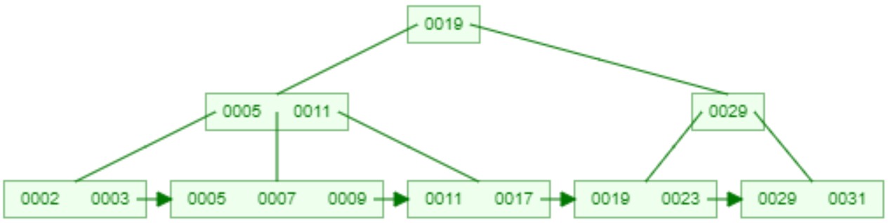
Question 2 (Answer) (1/8)
The B+ tree constructed for Question 1
Insert 9
The node has an empty space

Slide 10
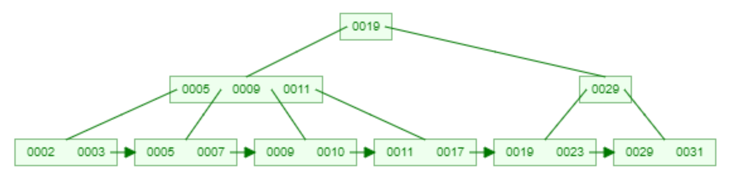
Question 2 (Answer) (2/8)
Insert 10
Since the node is already full, split it into two nodes, distributing the keys evenly between the two nodes. Since the node is a leaf, take a copy of the minimum value in the second of these two nodes (i.e., 9) and repeat the insertion algorithm to insert it into the parent node.

Slide 11
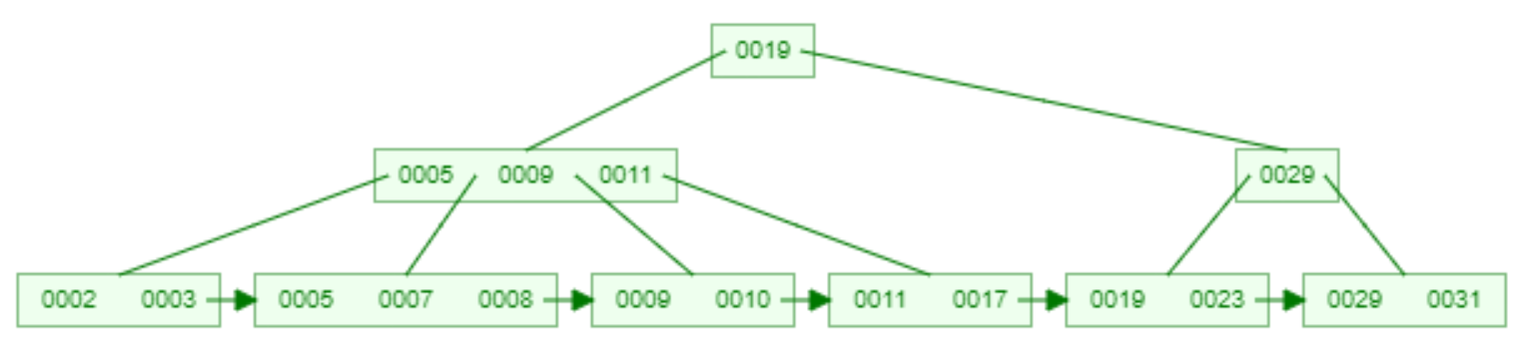
Question 2 (Answer) (3/8)
Insert 8
The node has an empty space

Slide 12

Question 2 (Answer) (4/8)
Delete 7
The node still has half-full keys

Slide 13
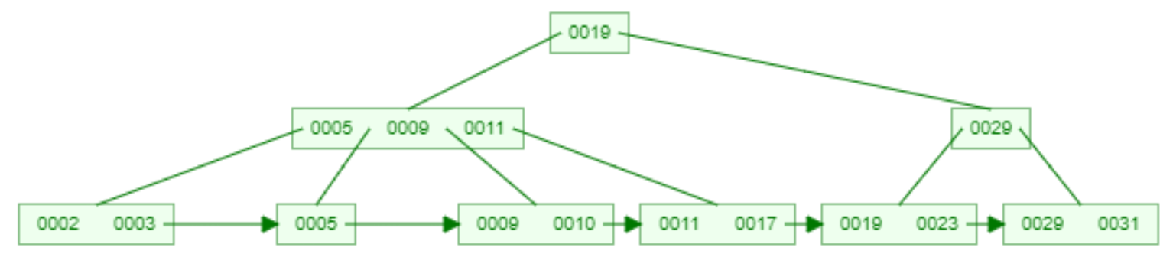
Question 2 (Answer) (5/8)
Delete 8
The node still has half-full keys

Slide 14
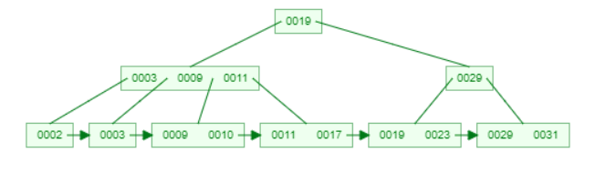
Question 2 (Answer) (6/8)
Delete 5
Distribute the keys between the node and the neighbor. Repair the keys in the levels above.

Slide 15
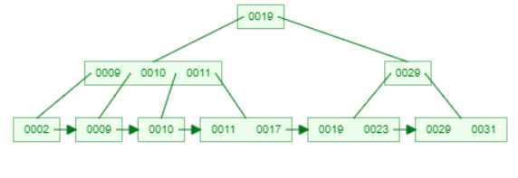
Question 2 (Answer) (7/8)
Delete 3
Distribute the keys between the node and the neighbor. Repair the keys in the levels above.

Slide 16
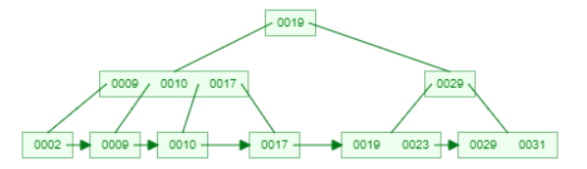
Question 2 (Answer) (8/8)
Delete 11
Distribute the keys between the node and the neighbor. Repair the keys in the levels above.

