Slide 1
EE3211 Modelling Techniques
Lecture 1
Descriptive Statistics

Slide 2
Topics to be covered:
Descriptive statistics
Probability distributions
Estimation
Hypothesis testing
Regression and correlation methods
Logistic regression
Nonparametric methods
Multisample Inference

Slide 3
Assessment criteria
Continuous Assessment (60%)
In-class Exercise / Project (20%)
Skill test (5%)
Project (15%)
Test (20%)
Assignments (20%)
Examination (40%)

Slide 4
Project
Data source: NHANES publicly available datasets
Choose one out of three available projects to work on
Write a report which includes:
Background and objective (3%)
Methods (conduct statistical analyses with at least two methods taught) (5%)
Results (3%)
Conclusion (4%)
*within five A4 pages
(Deadline: End of Week 13, i.e. April 23rd 2021)
Notes:
NHANES: National Health and Nutrition Examination Survey In the United States

Slide 5
Descriptive Statistics

Slide 6
Why do we need descriptive statistics?
Describe the data in some concise manner
Numeric (table) or graphic : capturing and conveying the final results
Good numeric (table) or graphic form of data summarization:
Self-contained
Understandable without reading the text
Clearly labeled of attributes with well-defined terms
Indicate principal trends in data

Slide 7
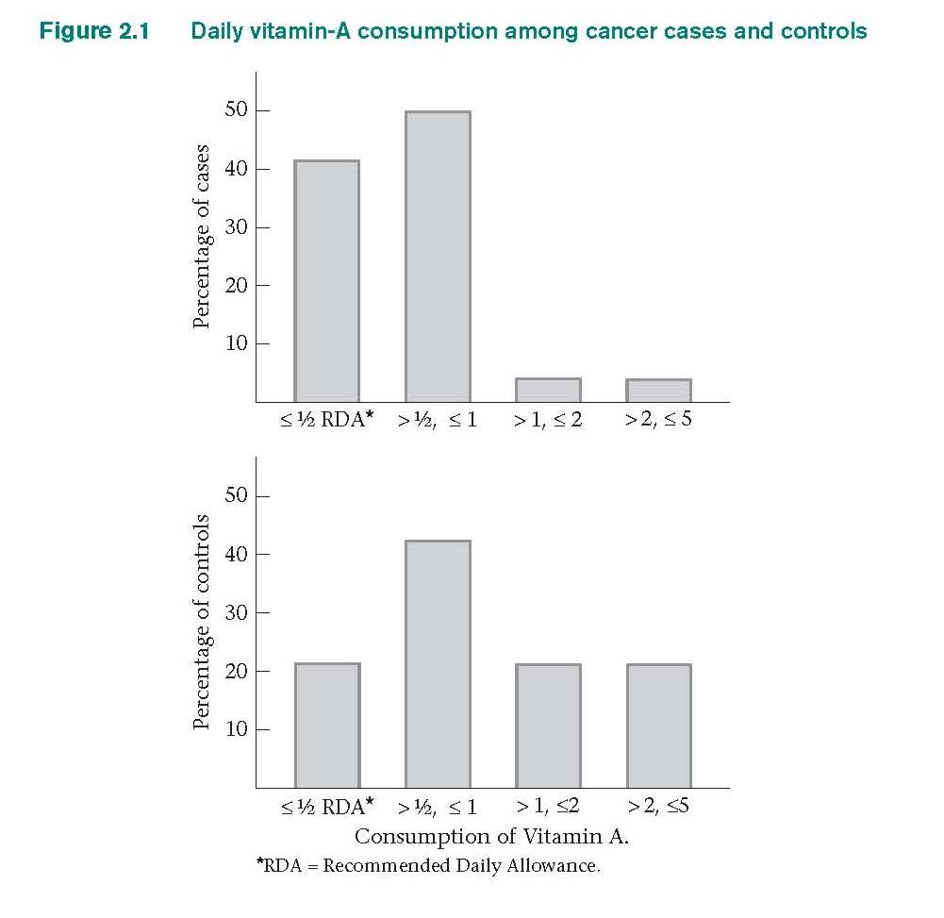
Bar graphs: Vitamin A and Cancer
Vitamin A consumption prevents cancer
Dietary questionnaire: vitamin A
Total cancer cases: 200
Total matched controls (age and gender; unrelated disease): 200
Vitamin A consumed by controls is more than that consumed by the patients with cancer.
(In some cases, the levels exceed the recommended daily allowance (RDA).)

Slide 8
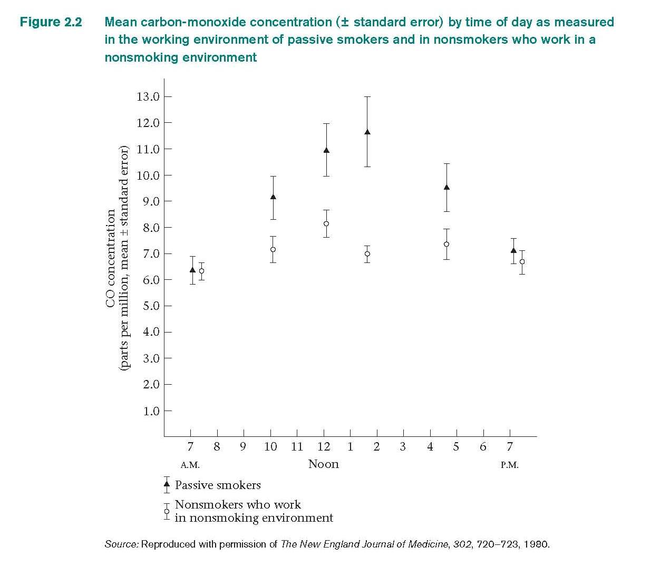
Scatter plot: Passive smoking and pulmonary function
Measure CO in the working environments of passive smokers and non-smoking workplace
Early in the day: CO concentrations are about the same in the working environments of passive smokers and non-smokers
Supports the observation that passive smokers have lower pulmonary function than comparable nonsmokers

Slide 9
Descriptive statistics: graph
Shows the key role of descriptive statistics:
Display data to give researcher a clue about main trends in the data
Suggest hints where to look for more details at the data (inferential statistics)
Important to convey the findings in publications
Influence the readers’ impression of the work

Slide 10
Measure of Location
No. of sample points: large
-difficult to look at each sample points
Measure of location: good for data summarization defining the center or middle of the sample

Slide 11
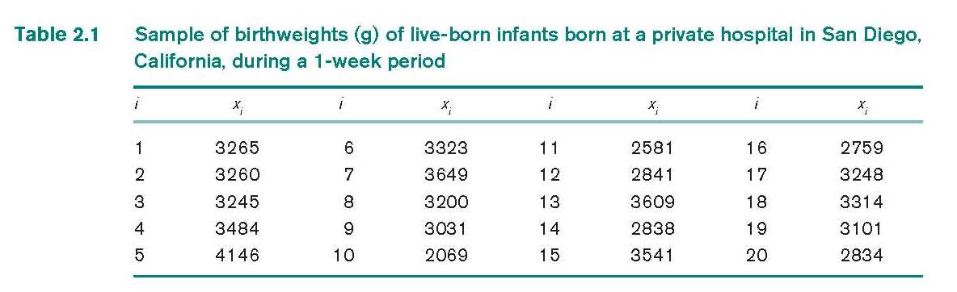

Measure of Location: The Arithmetic Mean
Arithmetic mean: sum of all the observations divided by the number of observations
Statistically expressed as
Limitation: Oversensitive to extreme values; not be representative of the location of the majority

Slide 12




Measure of Location: The Arithmetic Mean
Sigma ∑ is a summation sign
implies (x₁ + x₂ +…+ x_{n})
If a and b are integers where a ≤ b,
then =(x_{a} + x_{a+1}+…+x_{b})
If a = b, then
If c is some constant, then

Slide 13
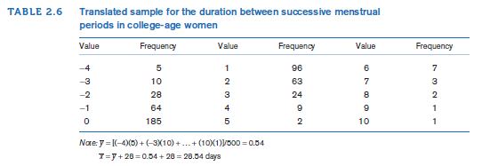
Some Properties of Arithmetic Mean
Original samples : x₁, …, x_{n}
Translated samples : x₁ + c, …, x_{n} + c (where c is some constant)
Let y_{i} = x_{i} + c i = 1, …, n
then y = x + c
* Change the “origin” of the sample data

Slide 14
If the unit or scale changes, then using the rescaled sample
y_{i} = cx_{i} i = 1, …, n
Arithmetic mean : y = cx
Let x₁, …, x_{n} be the original sample of data.
Let y_{i} = c₁x_{i} + c₂ i = 1, …, n represent a transformed
sample obtained by multiplying each original sample point by a factor c₁ and then shifting over by a constant c₂
If y_{i} = c₁x_{i} + c₂ i = 1, …,n
then y = c₁x + c₂
*change both the origin and the scale of the data

Slide 15



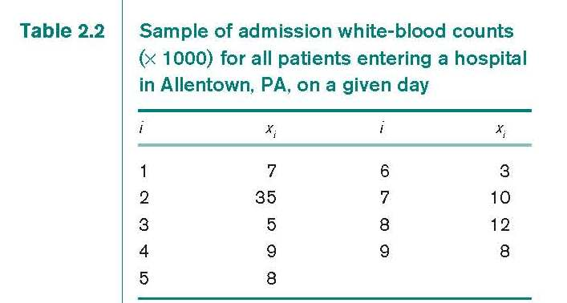
Measure of Location: Median
N observations in a sample (smallest to largest)
Sample median is
th the largest observation if n is odd
Average of the th and the th observation if n is even
White-blood counts of admitted patients
Order the sample:
3, 5, 7, 8, 8, 9, 10, 12, 35
n is odd, sample median of white-blood
cell count:
8 (5th largest point)

Slide 16
Measure of Location: Median
Strength:
insensitive to very large or very small values
E.g. white blood cell counts:
3, 5, 7, 8, 8, 9, 10, 12, 35
Vs. 3, 5, 7, 8, 8, 9, 10, 12, 65
Same median
Arithmetic mean: increase a lot (10778 → 14111)
Weakness:
determined mainly by the middle point(s)
less sensitive to the actual values of the other data points

Slide 17
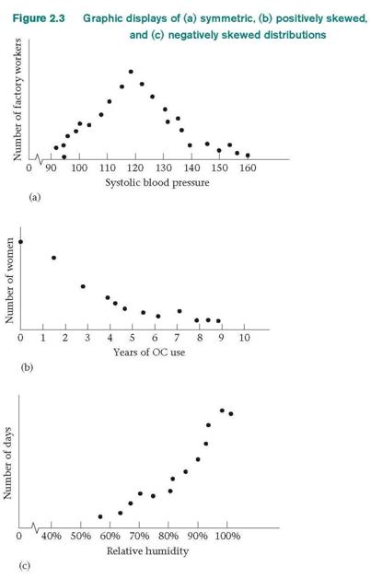
Comparing Mean and Median
Symmetric distributions:
arithmetic mean is approximately the same as the median
E.g. systolic blood-pressure measurements for 30-39 aged factory workers
Positively skewed (skewed to the
right) distributions:
arithmetic mean tends to be larger
than the median
E.g. years of oral contraceptive use
among women aged 20-29
Negatively skewed (skewed to the
left distributions:
the arithmetic mean tends to be
smaller than the median
E.g. relative humidities in a humid
climate at the same time of day over a no.
of days

Slide 18
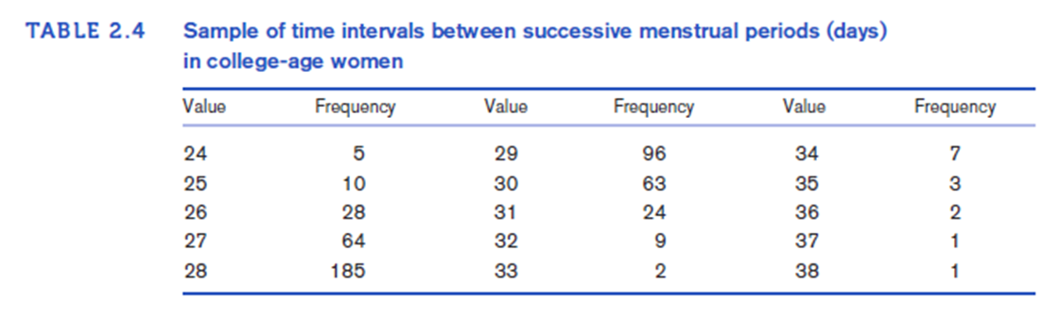
Measure of Location: Mode
Mode: the most frequent value among all the observations in a sample
Data distributions may have one or more modes
-One mode = unimodal
-Two modes = bimodal
-Three modes = trimodal
Time intervals between successive menstrual periods of 500
college women (aged 18-21)
Mode = 28

Slide 19
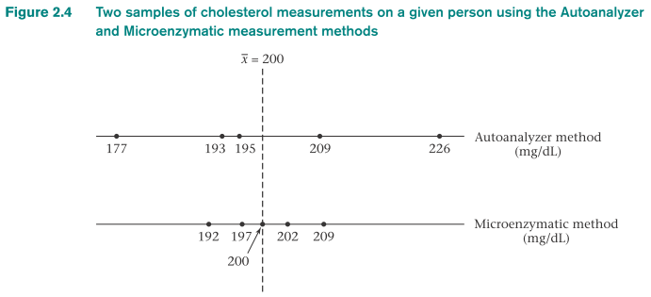
Measures of Spread
The mean obtained by the two methods is the same (same centre)
Variability or spread of the Autoanalyzer method appears to be greater
samples can be described by: measure of location
+
measure of spread

Slide 20
Measure of Spread Range or variability
Simplest measure about variability of a sample: range
Range: difference between the largest and smallest observations in a sample
Pros: easy to compute with ordered samples
Cons:
-very sensitive to extreme observations or outliers
-depends on the sample size (n) (larger n→ larger range)
→ difficult to compare ranges of data with different n
A better measure of spread: percentiles or quantiles
- less sensitive to outliers and are not greatly affected by the sample size

Slide 21
Measure of Spread Quantiles or percentiles
The pth percentile: value V_{p} such that p percent of the sample points are ≤ V_{p}.
Median: 50th percentile *special case of a quantile*
The pth percentile
If np/100 is not an integer (where k = largest integer less than np/100) : The (k+1)th largest sample point
If np/100 is an integer: average of the (np/100)th and (np/100 +1)th largest observations
Percentiles computation: sample points must be ordered
If n is large, a stem-and-leaf plot or a computer program may be used
Frequently used percentiles are
quartiles (25th, 50th, and 75th percentiles)
quintiles (20th, 40th, 60th, and 80th percentiles)
deciles (10th, 20th,…, 90th percentiles)

Slide 22


Measure of Spread Variance and Standard Deviation
If center of the sample = arithmetic mean:
- a measure summarizing the difference between the
individual sample points and the arithmetic mean:
Sample variance or variance: average of the squares of the deviations from the sample mean:
Sample standard deviation:
(Commonly used)

Slide 23
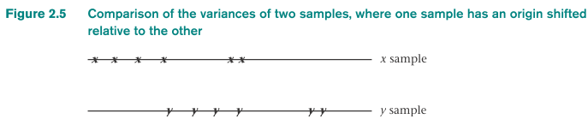
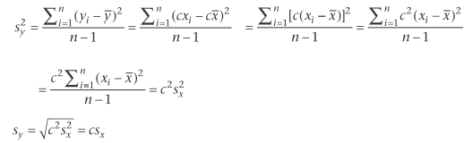
Measure of Spread Properties of Variance and Standard Deviation
Samples x₁, …, x_{n} and y₁, …, y_{n}
where yi = xi + c i = 1, …, n
If respective sample variances: s_{x}² and s_{y}² then s_{y}² = s_{x}²
Samples x₁, …, x_{n} and y₁, …, y_{n}
where yi = cxi i = 1, …, n and c>0
then s_{y}² = c²s_{x}² which is s_{y} = cs_{x}

Slide 24
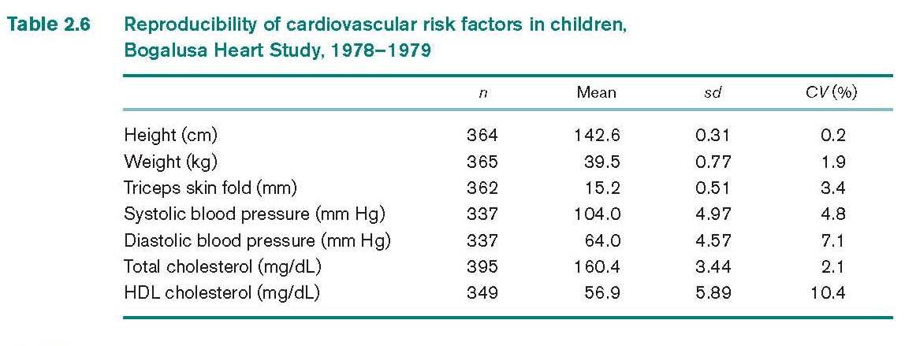
Coefficient of Variation (CV)
Useful to link arithmetic mean and standard deviation
CV = 100% × (s/x)
Remains the same regardless of units used
CV is useful:
comparing variability of different samples with different arithmetic means
comparing the reproducibility of different variables

Slide 25
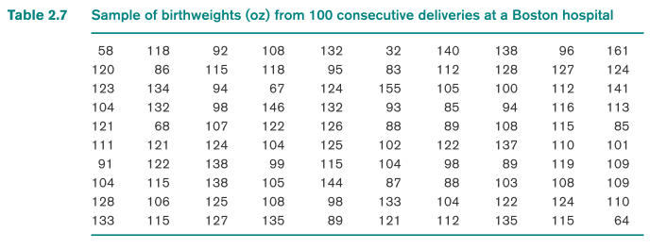
Grouped Data
Sample size is large: data collected in grouped form
-less accurate to measure certain quantities (measurement
error and imprecise patient recall)
The simplest way to display the data: frequency distribution (usually using a statistical package)
Frequency distribution: ordered display of each value in a data set and its frequency (number of times that value occurs)

Slide 26
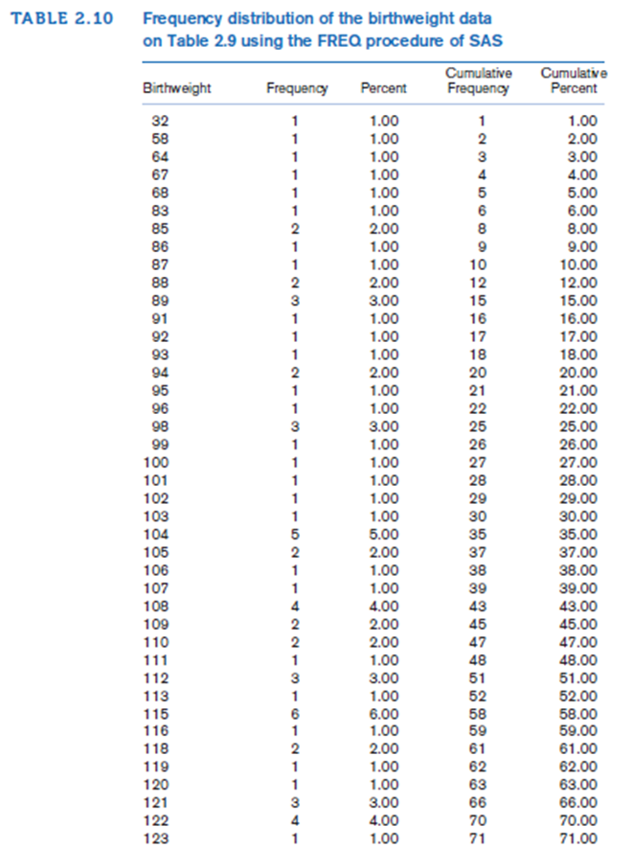
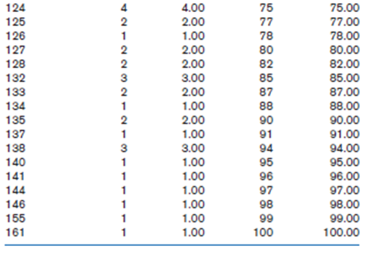
Unique sample
values is large:
a frequency distribution may still be too detailed

Slide 27
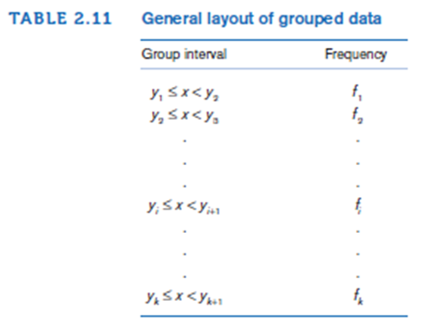
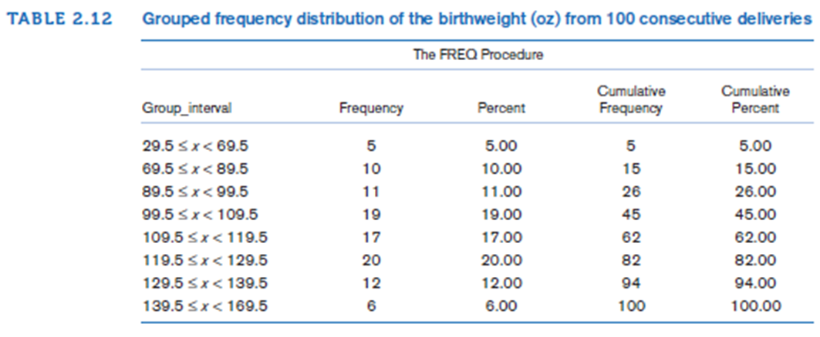
If the data is too large: data can be categorized into broader groups

Slide 28
Graphic Methods
Graphic methods: quick overall impression of data
Bar graphs:
used to display grouped data
Cons:
-groups are defined in arbitrary way
-Identity of the sample points within the respective groups is lost
2) Stem-and-Leaf plots:
Leaves: general shape of the distribution of data points
preserve actual data points + display grouped data (pros)
easy to compute the median and other quantiles
Each data point is converted into stem and leaf, e.g., 438 (stem: 43; leaf: 8)
3) Box plots:
median, upper quantile + lower quantile: skewness or symmetry of a distribution
Skewness: compare arithmetic mean vs. median

Slide 29
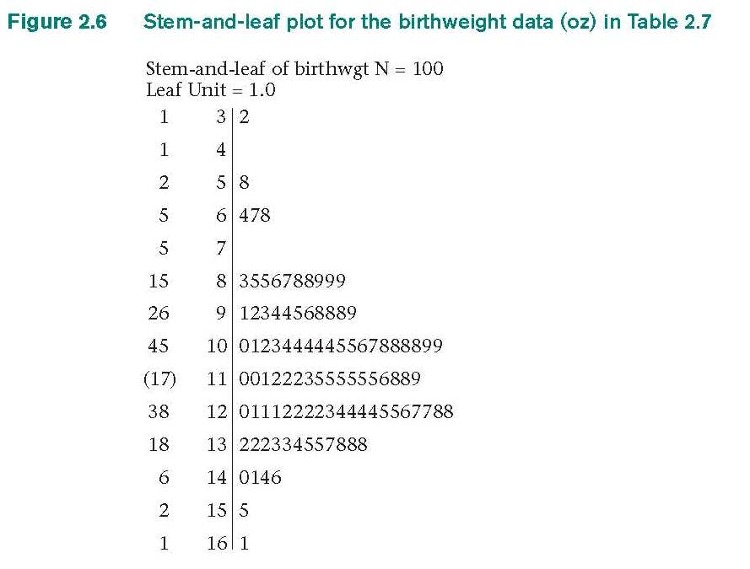
Stem-and-leaf plots
St
5|8: 58
11|8: 118
Overall data distribution (not sacrificing
the individual values)
First column: lowest / highest value in
cumulative frequency
(17): leaves including the median
Stem
|Leaf

Slide 30
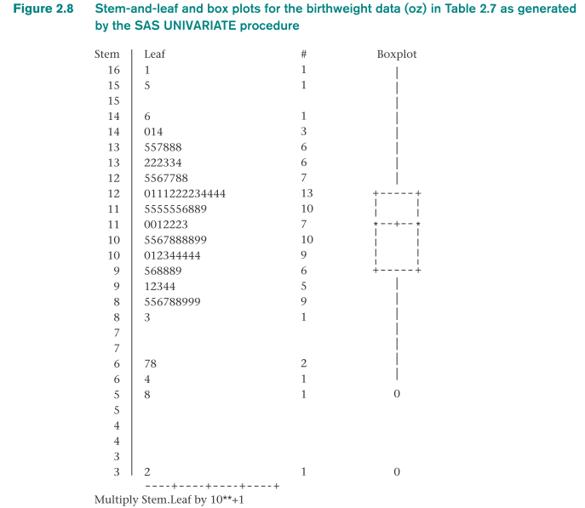
Stem-and-leaf vs. Box Plot
Upper quartile
Upper quartile
median
median
lower quartile
Lower quartile
*negatively skewed*

Slide 31
Box plot
Visually describe the distribution of sample points + point out possible outliers
Symmetric distribution: upper and lower quartiles approximately equally spaced from median
Positively skewed distribution: upper quartile is farther from median than lower quartile
Negatively skewed distribution: lower quartile is farther from median than upper quartile

Slide 32
Box plot
outlying value:
x > upper quartile + 1.5 × (upper quartile – lower quartile)
or x < lower quartile – 1.5 × (upper quartile – lower quartile)
extreme outlying value:
x > upper quartile + 3.0 × (upper quartile – lower quartile)
or x < lower quartile – 3.0 × (upper quartile – lower quartile)
A vertical bar:
- connects upper quartile to largest nonoutlying value among
the data points
- connects lower quartile to smallest nonoutlying value
among the data points

Slide 33
Summary
Numeric or graphic methods for displaying data help in
quickly summarizing a data set
presenting results (publications)
A data set can be described numerically in terms of measure of location and a measure of spread
Measure of location
Arithmetic mean
Median
Mode
Measure of spread
Standard deviation
Quantiles
Range
Graphic methods include bar graphs and more exploratory methods such as bar graphs, stem-and-leaf plots and box plots.

