Slide 1
EE3211 Modelling Techniques
Lecture 2
Probability Distributions

Slide 2
Discrete Probability Distributions

Slide 3
Random Variables
Random variable: assigns numeric values to different events in a sample space
Discrete and continuous random variables
Discrete random variable: random with a discrete set of numeric values
Continuous random variable: random variable without possible values enumeration

Slide 4
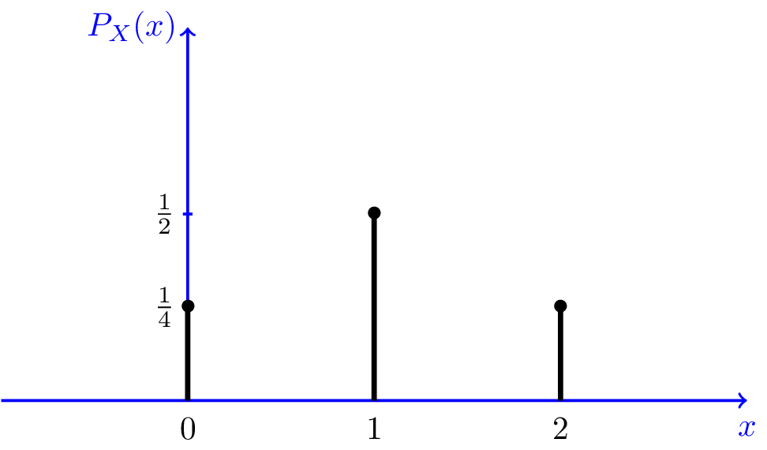
Probability-Mass Function for Discrete Random Variable
Probability-mass function (pmf):
express values of a discrete random variable and its associated probabilities
Probability distribution:
-discrete random variable X
-Pr (X=r), all values of r have +ve probability
Display in a table with the values and their probabilities or mathematical formula with probabilities of all values

Slide 5

Example (Hypertension): Suppose from previous experience with a
certain drug, the drug company expects that for any clinical
practice the probability that 0 patients of 4 will be brought under
control is 0.008, 1 patient of 4 is 0.076, 2 patients of 4 is 0.265,
3 patients of 4 is 0.411, and all 4 patients is 0.24.
0 < Pr(X = r) ≤ 1
∑ Pr(X = r) = 1
-summation is taken over all possible values that have positive
probability

Slide 6
Relationship of Probability Distributions to Frequency Distributions
Frequency distribution: list of each possible value in and a corresponding count (how frequent the value occurs)
Divide each count by sample size:
frequency distribution ~ probability distribution
Probability distribution: model based on very large sample
-each value → fraction of data points in a sample
Frequency distribution gives actual proportion of points corresponds to specific values
-Goodness-of-fit test: check the appropriateness of the
model
*comparing the observed sample frequency distribution
with the probability distribution

Slide 7
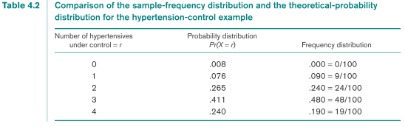
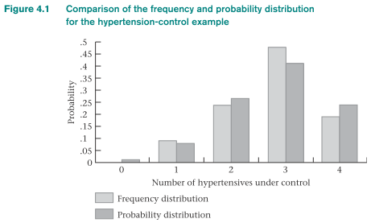
Question: How can the probability-mass function (pmf) in the table be
used to judge whether the drug behaves with the same efficacy in
actual practice as predicted by the drug company?
Drug company
Drug → 100 physicians
Physician treat first four untreated hypertensives
Physician reports the results → drug company
Combine results and compare with expected results (table on P. 5)
Statistical inference: compare the two distributions to judge differences between the two (chance or real differences ?)
Pmf: previous data / well-known distribution
Pmf derived from the binomial distribution is compared with the frequency distribution to determine whether the drug behaves with the same efficacy as predicted.

Slide 8

Discrete Random Variable: Expected value
X (random variable): many values with +ve probability → pmf is not useful
-summarize sample points by listing each data value
Develop measure of location and spread for X
Arithmetic mean x
= expected value of a random variable (E(X) )
= population mean (μ)
= the “average” value of the random variable
Expected value of a
discrete random variable:
x_{i}’s are the values the random variable
assumes with positive probability

Slide 9

Discrete Random Variable: Expected value
Example: Number of episodes of otitis media in the first 2 years of life.
Question: What is the expected number of episodes of otitis media in the
first 2 years of life?
E(X)=0(0.129)+1(.264)+2(.271)+3(.185)+4(.095)+5(.039)+6(.017)=2.038
Interpretation: on average a child would be expected to have about two episodes of
otitis media in the first 2 years of life.

Slide 10

Discrete Random Variable: Variance + SD
Population variance (Var(X) / or σ² ):
= sample variance (s²) for a random variable
where x_{i}² are with positive probability
- spread (relative to E(X)) about values with +ve probability
Standard deviation (sd(X) / σ)
-square root of its variance

Slide 11
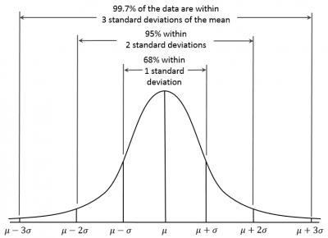
Discrete Random Variable: Variance + SD
Approximately 95% of the probability mass falls within two standard deviations (2σ) of the mean of a random variable

Slide 12
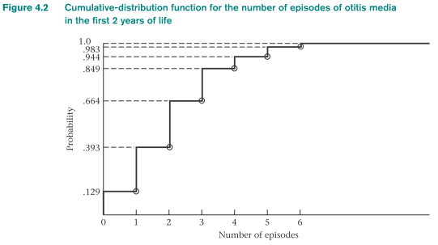
Cumulative-Distribution Function of a Discrete Random Variable
Cumulative-distribution function (cdf):
for a specific value of x of X: Pr(X ≤ x) = F(x)
can be used to distinguish a certain variable is discrete or continuous
Discrete random variable : series of steps (step function)
With the increase in number of values, the cdf approaches that of a smooth curve
Continuous random variable: smooth curve

Slide 13
Continuous Probability Distribution

Slide 14
The normal, Gaussian or “bell-shaped” distribution: foundation of estimation and hypothesis testing
Many random variables tend to follow a normal distribution (approximately)
e.g. birthweights, blood pressure
Variables are not themselves normal: can be approximated by a normal distribution by summing many times
Normal distribution is commonly used :
- easy to use
- normal distribution tables more widely available

Slide 15
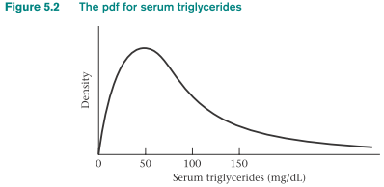
Continuous random variable and probability-mass function: which values are more probable than others and to what degree
Probability-density function (pdf): certain ranges of values occur more frequently than others
large values in regions of high probability
small values in regions of low probability
Example:
Serum triglyceride level:
asymmetric and positively skewed
Pdf of the continuous random variable
Cumulative-distribution function (cdf): probability that X will take
on values ≤ a
- area under the pdf to the left of a
- similar to that for discrete random variable

Slide 16
Continuous random variable: Pr(X < x) = Pr(X ≤ x)
Pr(X = x) = 0
Expected value and variance for continuous random variables have the same meaning as for discrete random variables
Expected value of a continuous random variable X:
- E(X) = μ
− average value of the random variable

Slide 17
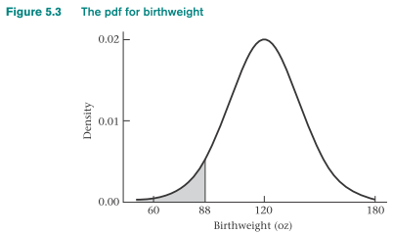
88oz:
-special meaning in obstetrics
-cutoff for identifying low birthweight infants
-with higher risk for different unfavorable outcomes
e.g. mortality in the first year of life
Probability density
function (pdf):
birthweights in
general population
cdf
Pr(X<=88)
Continuous random variable X:
Variance: Var(X) = σ²
- average squared distance of each value of the random variable from
its expected value = E(X²) - μ²
Standard deviation = σ = squared root of the variance = √Var(X)

Slide 18
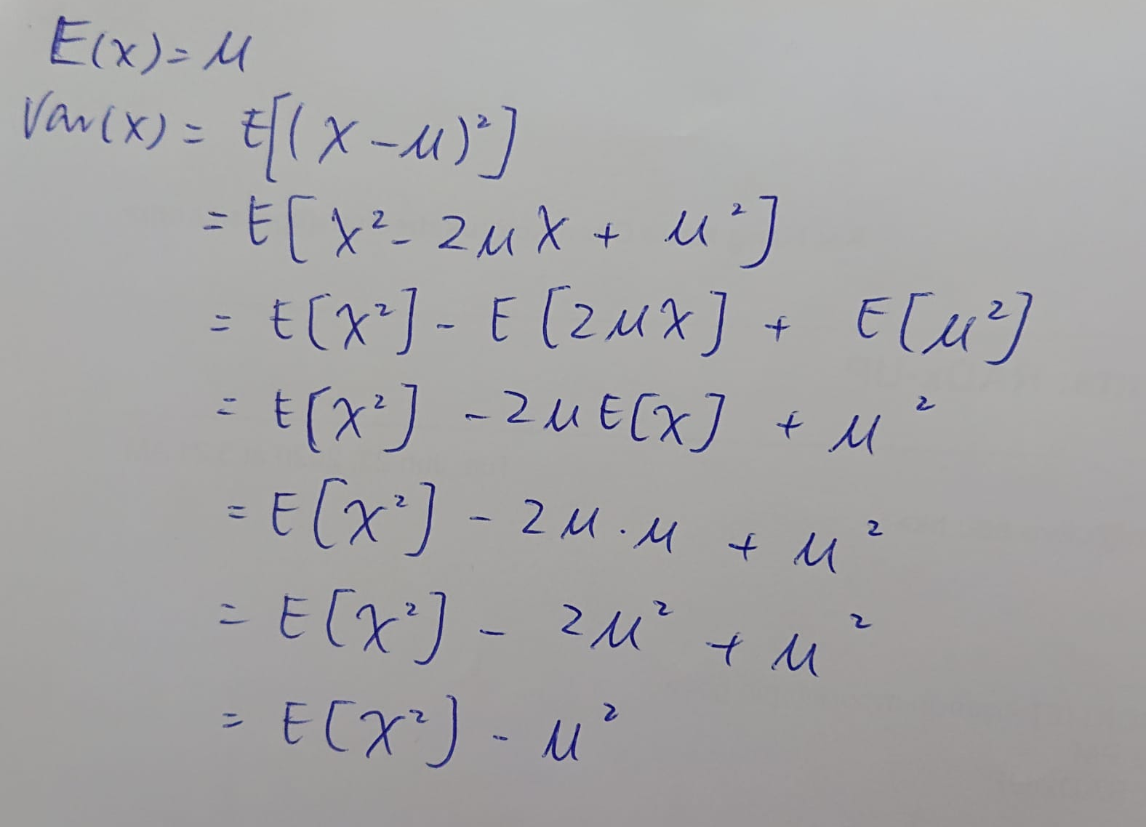

Slide 19
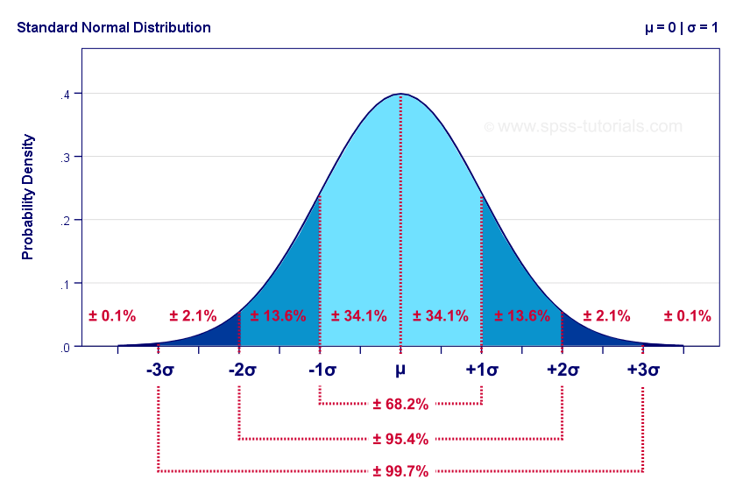
Normal Distribution
most widely used continuous
distribution
Also called Gaussian distribution
(Karl Friedrich Gauss)
Important in statistics
E.g. body weights or blood pressures
follows normal distribution
Other distributions that are not themselves normal can be made normal by transformation
e.g. positively skewed serum triglyceride concentrations
→ log transformation
→ normal distribution
An approximating distribution to other distributions
- convenient to work with (hypothesis testing)

Slide 20

Normal Distribution
Random variables can be approximated by a normal distribution by summing
Many physiologic measures (genetic + environmental risk factors) can be approximated by normal distribution
Most estimation procedures and hypothesis tests assume the random variable being considered has an underlying normal distribution
Probability density function of the normal distribution:
-for some parameters μ, σ, where σ > 0
-exp is the power to which “e” (≈2.17828) is raised

Slide 21
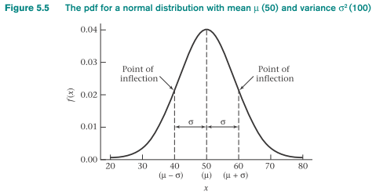
Normal Distribution
Bell-shaped curve:
-mode at μ
-symmetric around μ
-points of inflection on either side
of μ at μ - σ and μ = σ
*A point of inflection: slope of
the curve changes direction
Slope:
- increase to the left of μ – σ
- decrease to the right of μ – σ
- continues to decrease until μ + σ
Magnitude of σ: distance from μ to the points of inflection (visually)
μ: expected value of the distribution
σ² : variance of the distribution

Slide 22
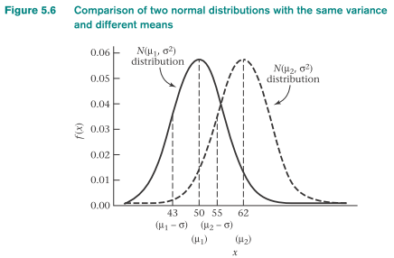
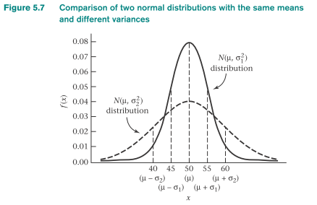
Normal Distribution
N(μ,σ²) distribution:
a normal distribution with mean μ and variance σ²
height of the normal distribution = 1/(√2πσ)
Shape: mean μ and variance σ
Height=1/(√2πσ)
Standard / unit / normal distribution:
mean 0 and variance 1
N(0,1) distribution.

Slide 23
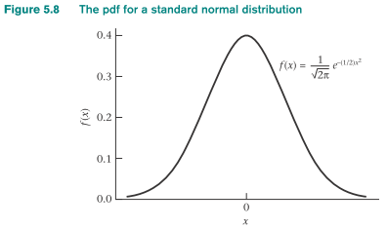

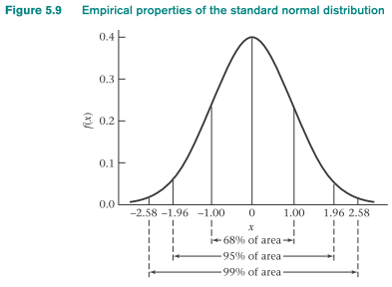
Standard Normal Distribution
Pdf for N(0, 1):
symmetric about 0
- f(x) = f(-x)
68% of the area under the standard normal density lies between +1 and -1
95% of the area lies between +2 and -2
99% lies between +2.5 and -2.5
Pr(-1 < X < 1) = 0.6827
Pr(-1.96 < X < 1.96) = 0.95
Pr(-2.576 < X < 2.576) = 0.99

Slide 24
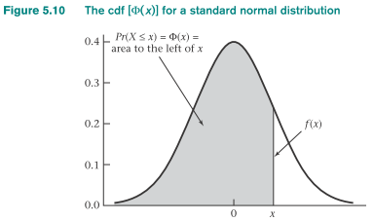
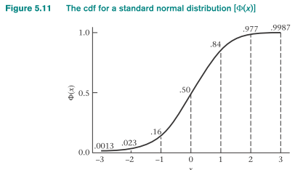
Standard Normal Distribution
Cumulative-distribution function (cdf) for X~N(0,1):
φ(x) = Pr(X ≤ x)
”~”: is distributed as
X ~ N(0,1) : random variable X is distributed as an N(0,1)
distribution
x becomes small: area to the left of x approaches 0
x becomes large: area approaches 1

Slide 25
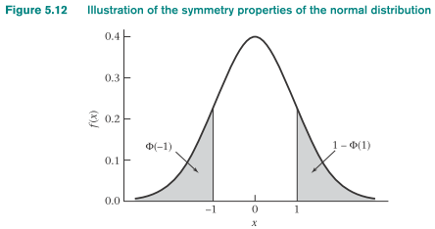
Symmetry Properties of the Standard Normal Distribution
φ(-x) = Pr(X ≤ -x) = Pr(X ≥ x) = 1 – pr(X ≤ x) = 1 - φ (x)
*tail*
*tail*
*tail*:
normal range for a biological quantity: range within x standard deviations of the mean
Probability of a value in this range = Pr(-x ≤ X ≤ x) for N(0,1)

Slide 26
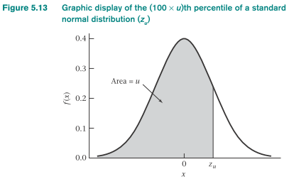
Using (Electronic) Tables for the Normal Distribution
Statistical inference: percentiles of a normal distribution
E.g. Normal range: the upper and lower fifth percentiles
The (100 × u)th percentile of a standard normal distribution:
z_{u :} Pr(X < z_{u}) = u , X ~ N(0,1)

Slide 27
Using (Electronic) Tables for the Normal Distribution
Z_{u} : inverse normal function
- given value of x → normal tables → area to the left of x
e.g. φ(x) for X~N(0,1)
Z_{u} :
- evaluate Z_{u} → area u in normal tables → Z_{u}
- If u < 0.5 : z_{u} = -z_{1-u}
→obtain z_{1-u} from normal table
* symmetry properties of the normal distribution

Slide 28

Conversion:
N(μ,σ²) Distribution to N(0,1) distribution
X ~ N(μ,σ²)
What is Pr(a < X < b) for any a,b?
Consider the random variable Z = (X - μ)/σ
If X ~ N(μ,σ²) and Z = (X - μ)/σ ◊ Z ~ n(0,1)
Evaluation of Probabilities for Any Normal Distribution via Standardization
X ~ N(μ,σ²) and Z = (X - μ)/σ
standardization of a normal variable

Slide 29
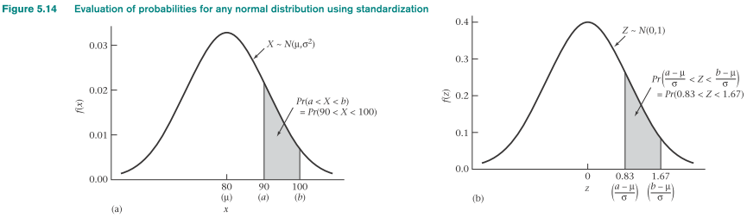
Conversion:
N(μ,σ²) Distribution to N(0,1) distribution
Pr(a < X < b)
population mean μ is subtracted from each boundary point
divided by the standard deviation σ
Pr[(a - μ)/σ < Z < (b - μ)/σ]
standard normal tables can then be used to evaluate this probability

Slide 30
Example of Hypertension
#Suppose the distribution of DBP in 35- to 44-year old men is #normally distributed with mean=80 mm Hg and variance =144 mm #Hg. Find the upper and lower fifth percentiles of this distribution.
#We could do this using normal table or using a computer program.
#We can denote the upper and lower 5th percentiles by X_{.05} and X_{.95}
#respectively:
X_{.05} =80+Z_{.05} (12) =80-1.645(12)=60.3 mm Hg
X_{.95} =80+Z_{.95} (12) =80+1.645(12)=99.7 mm Hg
#Use the qnorm function of R, we have
X_{.05} =qnorm(0.05, mean=80, sd=12)
X_{.95} =qnorm(0.95, mean=80, sd=12)
>x=qnorm(0.05, mean=80, sd=12)
>x
[1] 60.26176
>y=qnorm(0.95, mean=80, sd=12)
>y
[1] 99.73824
Z = (X - μ)/σ
X= μ+ Z* σ

Slide 31
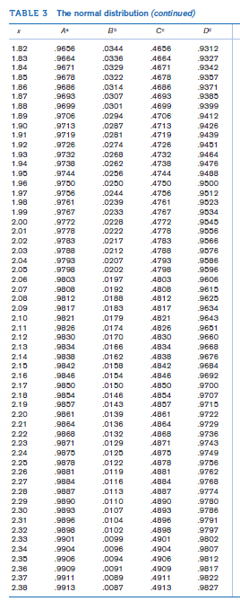
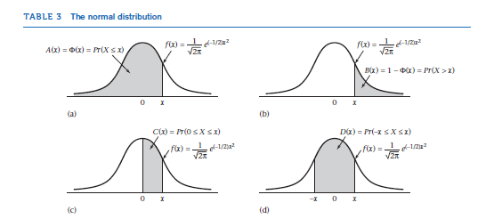
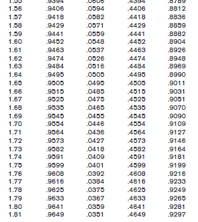

Slide 32
Summary: Discrete Probability Distribution
Random variables
- discrete vs. continuous variables
Specific attributes of random variables
- probability-mass function (probability distribution)
- cumulative density function (cdf)
- expected value and variance
Sample frequency distribution : sample realization of a probability distribution
- sample mean (x) and variance (s²)
- expected value and variance (random variable)

Slide 33
Summary:
Continuous Probability Distribution
Continuous random variables
- Probability-density function: analogs of probability-mass
function for discrete random variables
Expected value, variance, cumulative distribution for continuous random variables
Normal distribution: most important continuous distribution
The two parameters: mean μ and variance σ2
Normal tables (working with standard normal distribution)

Slide 34
Extra Question
Q1.

