Slide 1
EE3211 Modelling Techniques
Lecture 3
Hypothesis Testing: One-sample Inference

Slide 2
Overview
Null hypothesis and alternative hypothesis
Type I error and type II error
Hypothesis testing using one-sample inference, including:
calculation of t statistics, critical value and p-value for one-sided alternative
computation of t statistics, critical value and p-value for two-sided alternative
Calculate the power of a test and determine the appropriate sample size

Slide 3
Hypothesis Testing
Hypothesis-testing framework: null and alternative hypothesis
Hypothesis-testing: make decisions using probabilities methods, (not rely on subjective impressions)
uniform and consistent decision-making criterion
one-sample problem: hypotheses about a single distribution
two-sample problem: compare two different distributions

Slide 4
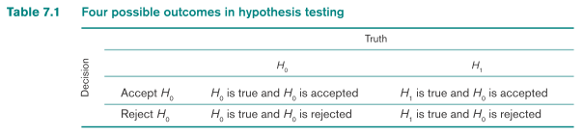
Hypothesis Testing
The null hypothesis (H_{o}): hypothesis to be tested
The alternative hypothesis (H₁): hypothesis contradicts the null hypothesis
H₀: μ = μ₀ vs. H₁: μ < μ₀
Decisions: H₀ is true or H₁ is true
All outcomes in a hypothesis testing situation: null hypothesis
If we decide H₀ is true→ accept H₀
If we decide H₁ is true→ H₀ is not true (reject H₀)

Slide 5
Hypothesis Testing
Probability of a type I error:
α : significance level of a test
Probability of a type II error:
β: function of μ and other factors
Power of a test : 1 - β = 1 – probability of a type II error = Pr(rejecting H₀|H₁ true)
Objective of hypothesis testing: use statistical tests that make α and β as small as possible
α
β

Slide 6
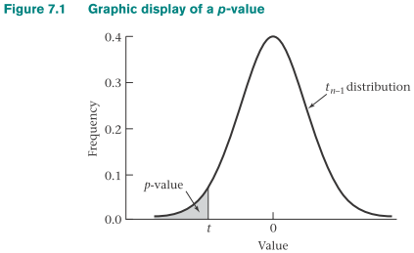
Determination of Statistical Significance for Results from Hypothesis Tests
Critical-value method: compute a test statistic and determine the outcome of a test by comparing the test statistic with a critical value determined by α (type I error)
P-value: α level that we are not concerned between accepting or rejecting H₀
p = Pr(t_{n-1} ≤ t)

Slide 7
Determination of Statistical Significance for Results from Hypothesis Tests
Critical-value method
1) Compute test statistic t
2) Compare with critical value t_{n-1,α} at α level e.g. 0.05
H₀: μ = μ₀ vs. H₁: μ < μ₀
t < t_{n-1,0.05}
Reject H0
Result: statistically significant (p<0.05)
t ≥ t_{n-1,0.05}
Accept H₀
Result: not statistically significant (p≥0.05)
P-value method
-Compute exact p-value
If p < 0.05
Reject H₀
Result: statistically significant (p<0.05)
if p ≥ 0.05
Accept H₀
Result: not statistically significant (p≥0.05)

Slide 8
P-value
P-value: probability of obtaining a test statistic as extreme as or more extreme than the actual test statistic obtained (null hypothesis is true)
- If the null hypothesis is true → determine likelihood of
getting me observed sample data
- ”If the null hypothesis is true, are your sample data
unusual?”
Guidance for Judging the significance of a p-value:
If 0.01 ≤ p < 0.05: significant results
If 0.001 ≤ p < 0.01: highly significant results
If p < 0.001: very highly significant results
If p > 0.05: results are considered not statistically significant (NS)
If 0.05 ≤ p < 0.1: a trend toward statistical significance

Slide 9
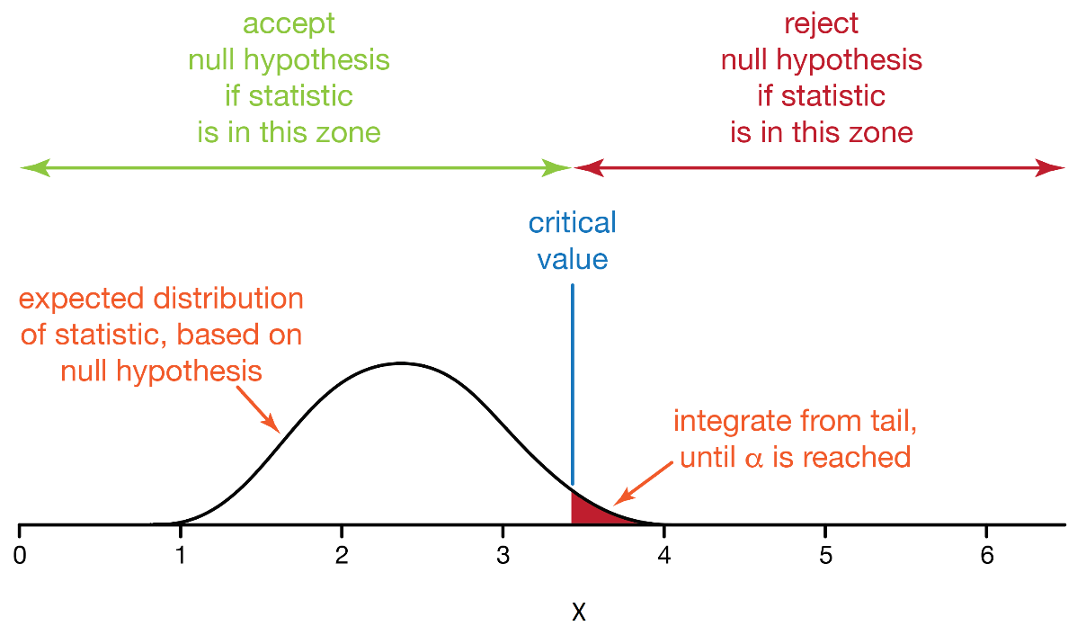
One-Sample Test for the Mean of a Normal Distribution: One-Sided Alternatives
Acceptance region: range of values of x that H₀ is accepted
Rejection region: range of values of x that H₀ is rejected
One-tailed test: values of the parameter being studied (i.e. μ) under the alternative hypothesis are allowed to be either > or < the values of the parameter under the null hypothesis (μ₀)

Slide 10
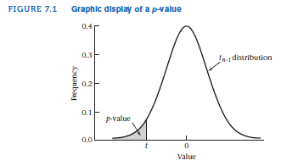
One-sample t Test for the Mean of a Normal Distribution with Unknown Variance (Alternative Mean < Null Mean)
H₀: μ = μ₀ vs. H₁: μ < μ₀ * σ unknown*
*with a significance level of α
t = (x - μ₀)/(s/√n)
t_{n-1,α} : critical value
t < t_{n-1,α} → Reject H₀
t ≥ t_{n-1,α} → accept H₀

Slide 11
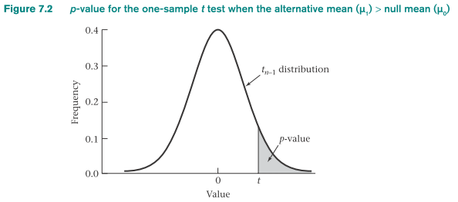
One-Sample t Test for the Mean of a Normal Distribution with Unknown Variance (Alternative Mean > Null Mean)
H₀: μ = μ₀ vs. H₁: μ > μ₀ with a significance level of α
t = (x - μ₀)/(s/√n)
t > t_{n-1,1- α} → reject H₀
t ≤ t_{n-1,1- α} → accept H₀
P-value = Pr(t_{n-1} > t)

Slide 12
Example on One-Sample t Test for the Mean of a Normal Distribution with Unknown Variance:
Cardiovascular Disease: Pediatrics
A current area of research interest is the familial aggregation of cardiovascular risk factors in general and lipid levels in particular.
Suppose the “average” cholesterol level in children is 175 mg/dL. A group of men who have died from heart disease within the past year are identified, and the cholesterol levels of their offspring are measured.
Two hypotheses are considered:
(1) The average cholesterol level of these children is 175 mg/dL.
(2) The average cholesterol level of these children is >175 mg/dL.
Suppose the mean cholesterol level of 10 children whose fathers died from heart disease is 200 mg/dL and the sample standard deviation is 50 mg/dL.
Q: Test the hypothesis that the mean cholesterol level is higher in this group than in the general population.

Slide 13



Example on One-Sample t Test for the Mean of a Normal Distribution with Unknown Variance:
Cardiovascular Disease: Pediatrics
Solution:
Hypothesis:
$$H_{0}: μ=175 vs. H_{1}: μ>175$$
at α level of .05
H₀ is rejected if:
$$t>t_{n−1,1−α}= t_{9, .95}$$
$$t=\frac{200−175}{50/\sqrt{10}}= \frac{25}{15.81}=1.58$$
Table: t_{9,.95} = 1.833
1.833 > 1.58 → accept H0 at the 5% level of significance
use p-value method:
- exact p-value : p = Pr(t9 > 1.58)
- t9,.90 = 1.383 and t9,.95 = 1.833
- because 1.383 < 1.58 < 1.833→ .05 < p < .10
- using the pt function of R:
exact p-value = Pr(t9 > 1.58) = 1 − pt (1.58,9) = .074 (p > .05)
Conclusion: results are not statistically significant, and the null hypothesis is accepted
→ mean cholesterol level of these children does not differ significantly from that
of an average child

Slide 14
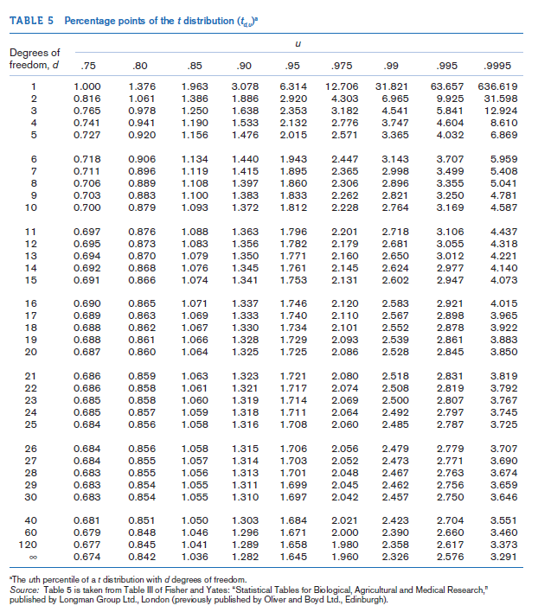

Slide 15
One-Sample Test for the Mean of a Normal Distribution: Two-Sided Alternatives
Two-tailed test: values of the parameter being studied (μ) under H₁ are allowed to be either > or < the values of the parameter under H₀ (μ = μ₀)
Decision rule: reject H₀ if t is either too small or too large
if t is either < c₁ or > c₂ for some constants c₁, c₂ → reject H₀
if c₁ ≤ t ≤ c₂ → accept H₀

Slide 16
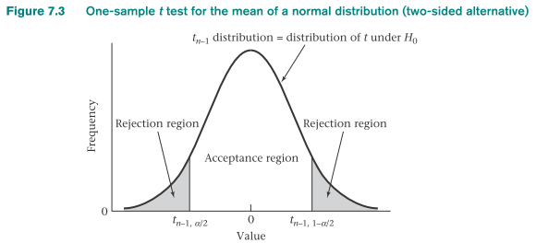
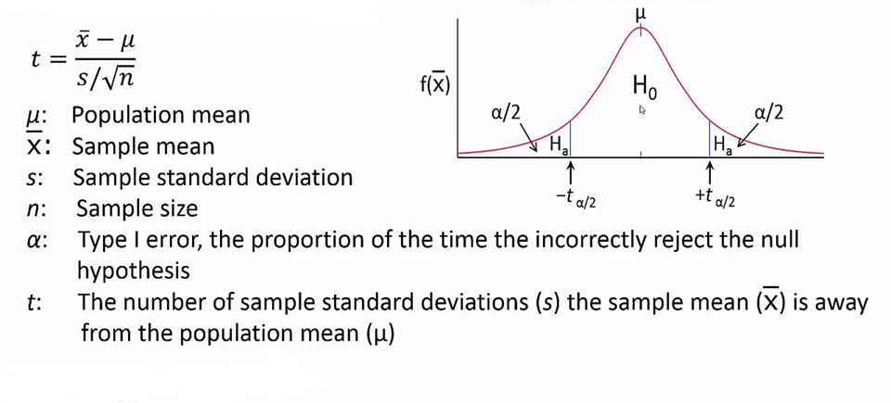
One-sample t Test for the Mean of a Normal Distribution with Unknown Variance (Two-Sided Alternative)
H₀: μ = μ₀ vs. H₁: μ ≠ μ₀ with a significance level of α
t = (x - μ₀)/ (s/√n)
If |t| > t_{n-1,1- α/2} → reject H₀
If |t| > t_{n-1,1- α/2} → accept H₀

Slide 17
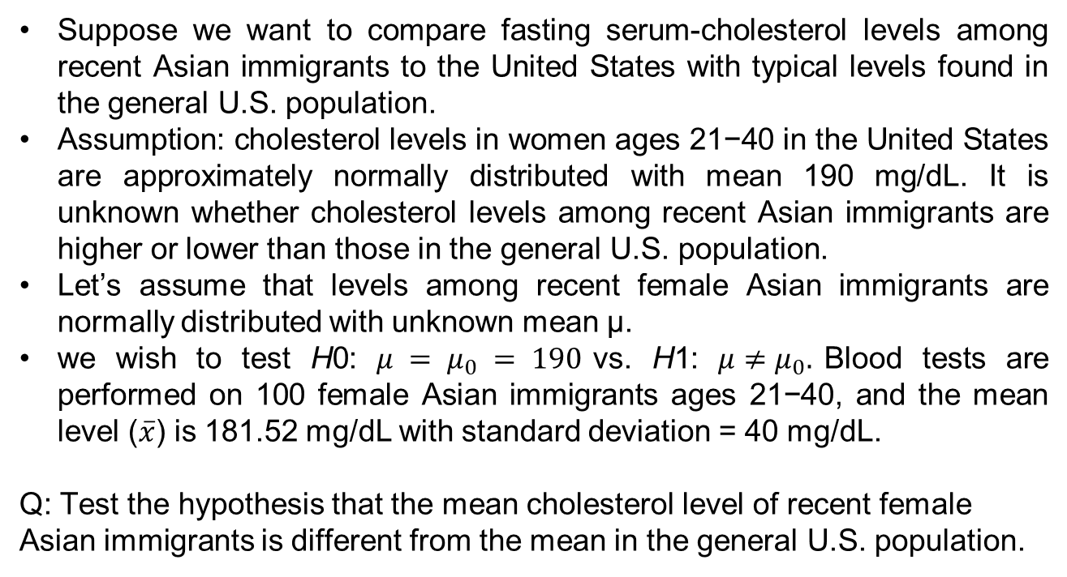
Example on One-sample t Test for the Mean of a Normal Distribution with Unknown Variance:
Cardiovascular Disease
Suppose we want to compare fasting serum-cholesterol levels among recent Asian immigrants to the United States with typical levels found in the general U.S. population.
Assumption: cholesterol levels in women ages 21−40 in the United States are approximately normally distributed with mean 190 mg/dL. It is unknown whether cholesterol levels among recent Asian immigrants are higher or lower than those in the general U.S. population.
Let’s assume that levels among recent female Asian immigrants are normally distributed with unknown mean μ.
we wish to test H0: $μ = μ_{0} = 190$vs. H1: $μ≠μ_{0}.$Blood tests are performed on 100 female Asian immigrants ages 21−40, and the mean level ($\overline{x}$) is 181.52 mg/dL with standard deviation = 40 mg/dL.
Q: Test the hypothesis that the mean cholesterol level of recent female Asian immigrants is different from the mean in the general U.S. population.

Slide 18

Example on One-sample t Test for the Mean of a Normal Distribution with Unknown Variance:
Cardiovascular Disease
Solution:
Given that $t_{40, .975}=2.021 ,t_{60, .975}=2.000, t_{120, .975}=1.980$
We compute the test statistic:
$$t=\frac{\overline{x}−μ_{0}}{s/\sqrt{n}}= \frac{181.52−190}{40/\sqrt{100}}= \frac{−8.48}{4}=−2.12$$
two-sided test with α = .05: critical values are c1 = t99,.025, c2 = t99,.975.
t99,.975 < t60,.975 = 2.000 → c2 < 2.000
c1 = −c2 → c1 > −2.000
t = −2.12 < −2.000 < c1 → reject H0 at the 5% level of significance
Conclusion: the mean cholesterol level of recent Asian immigrants is significantly different from that of the general U.S. population

Slide 20

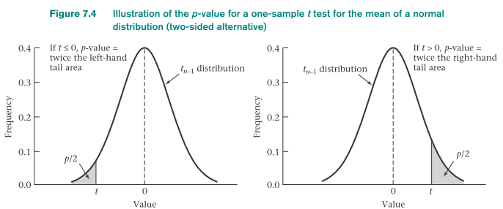
P-Value for the One-Sample t Test for the Mean of a Normal Distribution
(Two-Sided Alternative)
Let t = (x - μ₀)/(s/√n)
P-value: probability under H₀ of obtaining a test statistic as extreme as or more extreme than the observed test statistic
a two-sided H₁ is used
absolute value of t: measures extremeness

Slide 21
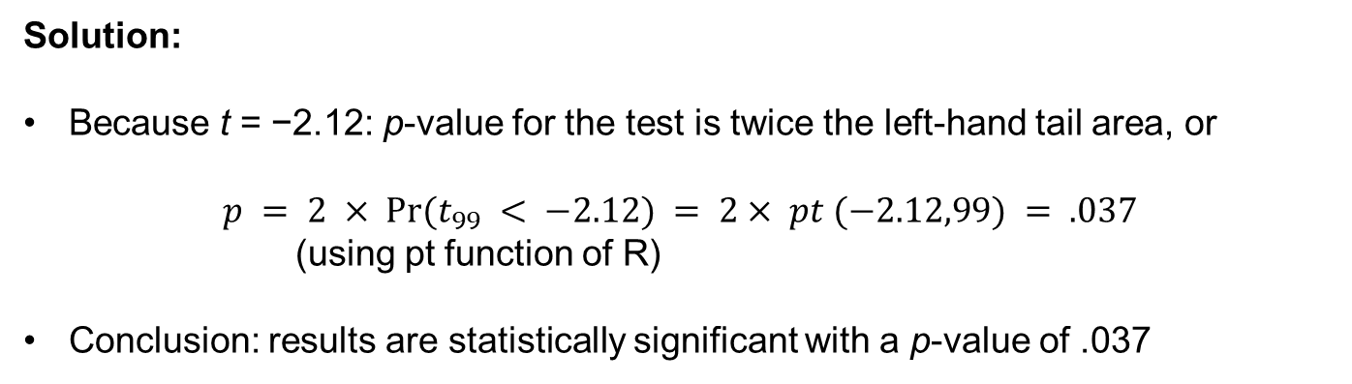
Example on P-Value calculation for the One-Sample t Test
Q: Compute the p-value for the hypothesis test in the previous example (cholesterol levels).
Solution:
Because t = −2.12: p-value for the test is twice the left-hand tail area, or
$$p = 2 × Pr⁡(t_{99} < −2.12) = 2× pt (−2.12,99) = .037$$
(using pt function of R)
Conclusion: results are statistically significant with a p-value of .037

Slide 22
When is a one-sided test more appropriate than a two-sided test?
One-sided test is easier to reject H₀: sample mean falls in the expected direction from μ₀
One-sided test is better: only alternatives on one side of the null mean are of interest or possible
more power (easier to reject H₀ based on a finite sample if H₁ is true)
Decision about using one-side or two-sided test should be made before the data analysis (or before data collection)
not to bias conclusions based on results of hypothesis testing
Do not change from a two-sided to a one-sided test after looking at the data

Slide 23
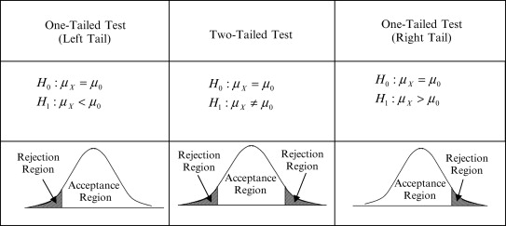
One-Sample z Test for the Mean of a Normal Distribution with Known Variance
(Two-Sided Alternative)
H₀: μ = μ₀ vs. H₁: μ ≠ μ₀ with a significance level of α
standard deviation σ is known
z = (x - μ₀)/(σ/√n)
If z < z_{α/2} or z > z_{1- α/2} → reject H₀
If z_{α/2} ≤ z ≤ z_{1- α/2} → accept H₀
Two-sided p-value calculation:
p = 2Φ(z) if z ≤ 0
p = 2[1 - Φ(z)] if z > 0

Slide 24
One-Sample z Test for the Mean of a Normal Distribution with Known Variance
(One-Sided Alternative)
H₀: μ = μ₀ vs. H₁: μ < μ₀ with a significance level of α
standard deviation σ is known
z = (x - μ₀)/(σ/√n)
If z < z_{α} → reject H₀
if z ≥ z_{α}, → accept H₀ is accepted
p-value: p = Φ(z)
H₀: μ = μ₀ vs. H₁: μ > μ₀ with a significance level of α
standard deviation σ is known
z = (x - μ₀)/(σ/√n)
If z > z_{1-α} → reject H₀
if z ≤ z_{1-α} → accept H₀
p-value: p = 1 - Φ(z).

Slide 25
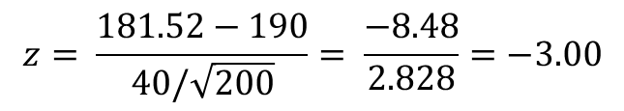
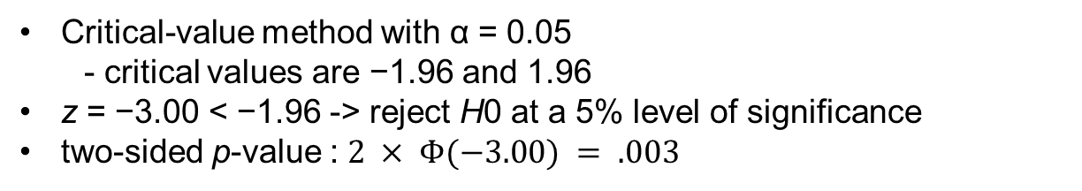
Example on One-Sample z Test for the Mean of a Normal Distribution with Known Variance
Q: Consider the cholesterol data in the cholesterol example. Assume that the standard deviation is known to be 40 and the sample size is 200 instead of 100. Assess the significance of the results.
Solution:
The test statistic :
$$z= \frac{181.52−190}{40/\sqrt{200}}= \frac{−8.48}{2.828}=−3.00$$
Critical-value method with α = 0.05
- critical values are −1.96 and 1.96
z = −3.00 < −1.96 -> reject H0 at a 5% level of significance
two-sided p-value :$2 × Φ(−3.00) = .003$

Slide 26
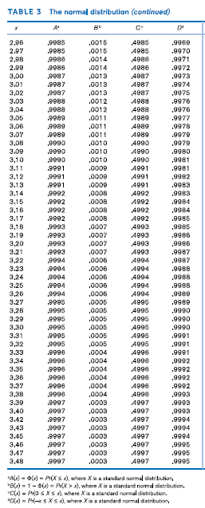
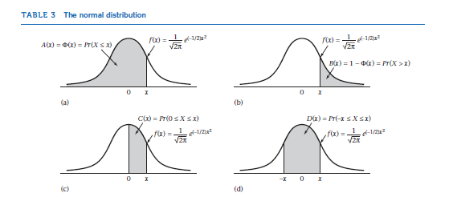

Slide 27
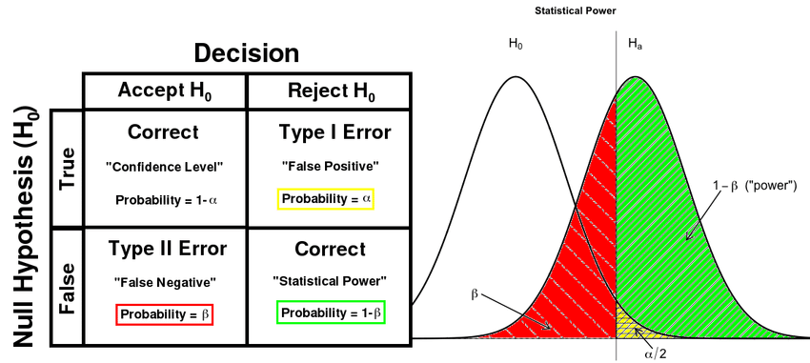

The Power of a Test
how likely a statistically significant difference will be distinguished based on a finite sample size n
probability that statistical test correctly rejects the null hypothesis
Likelihood of a true positive result
Probability of avoiding a Type II error
The power of the one-sided test
(one-sample z test):
Φ(z_{α} +|μ₀ - μ₁|√n/σ) = Φ(-z_{1- α} + |μ₀ - μ₁|√n/σ)
The power of the two-sided test
(one-sample z test):
Approx. by: Φ(-z_{1- α/2} + |μ₀ - μ₁|√n/σ)

Slide 28
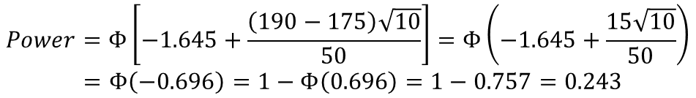
Example on Power Calculation:
Cardiovascular Disease, Pediatrics
Q: Using a 5% level of significance and a sample of size 10, compute the power of the test for the cholesterol data example, with an alternative mean of 190 mg/dL, a null mean of 175 mg/dL, and a standard deviation (σ) of 50 mg/dL.
Solution:
We have μ0 = 175, μ1 = 190, α = .05, σ = 50, n = 10
$$Power=Φ\left[−1.645+\frac{\left(190−175\right)\sqrt{10}}{50}\right]=Φ\left(−1.645+\frac{15\sqrt{10}}{50}\right)$$
$$=Φ\left(−0.696\right)=1−Φ\left(0.696\right)=1−0.757=0.243$$
Chance of finding a significant difference in this case is only 24%
it is not surprising that a significant difference was not found the previous example because the sample size was too small

Slide 29
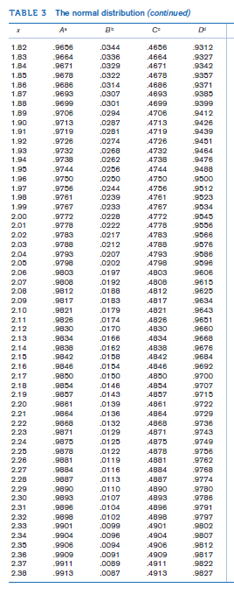
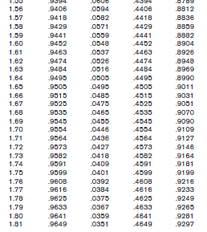

Slide 30
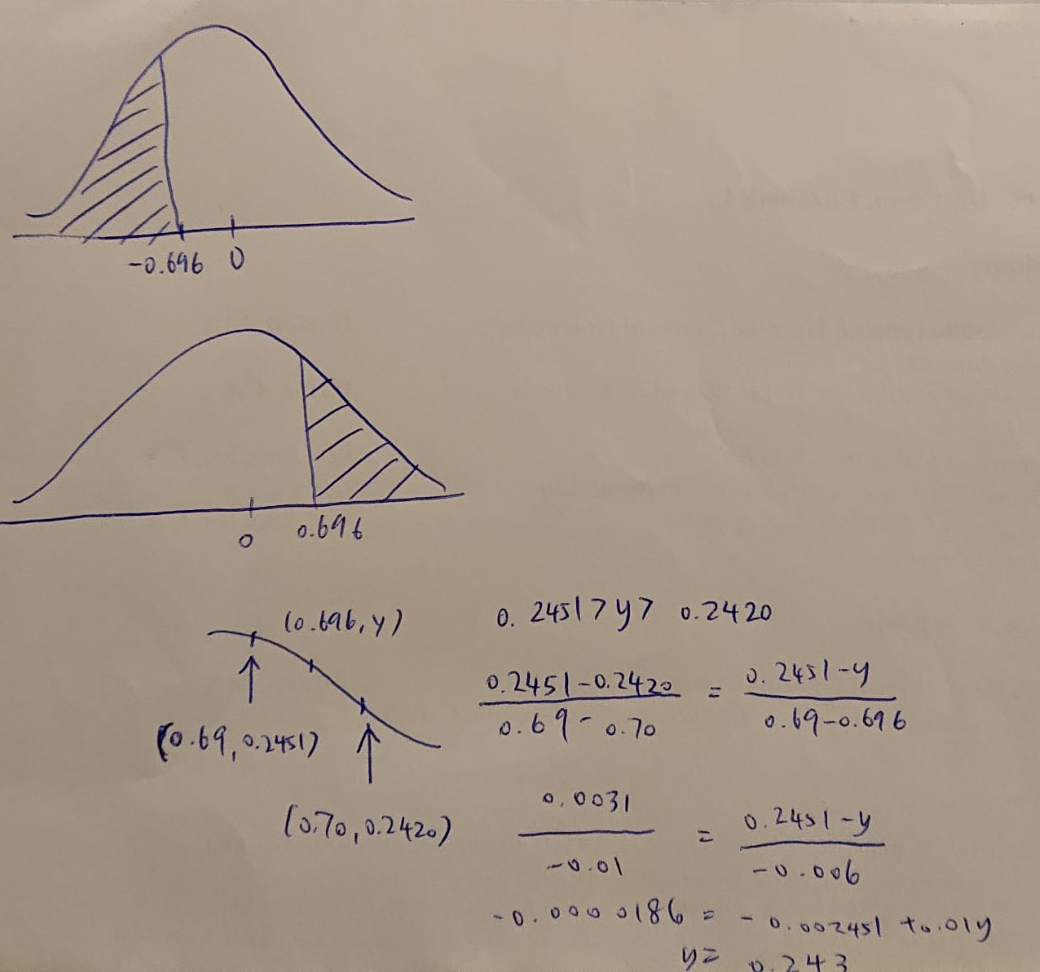
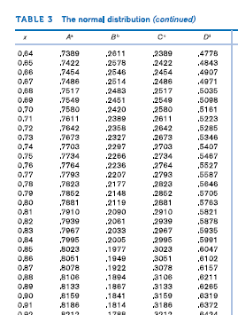

Slide 31
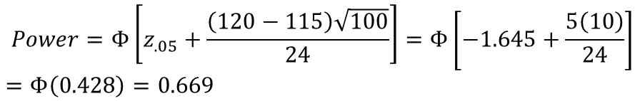
Example on Power Calculation:
Obstetrics
Suppose we want to test the hypothesis that mothers with low socioeconomic status (SES) deliver babies whose birthweights are lower than “normal.” To test this hypothesis, a list is obtained of birthweights from 100 consecutive, full-term, live-born deliveries from the maternity ward of a hospital in a low-SES area. The mean birthweight (x) is found to be 115 oz with a sample standard deviation (s) of 24 oz. Suppose we know from nationwide surveys based on millions of deliveries that the mean birthweight in the United States is 120 oz. Compute the power of the test for the birthweight data with an alternative mean of 115 oz and α = .05, assuming the true standard deviation = 24 oz.
Q: Assuming a sample size of 10 rather than 100, compute the power for the birthweight data with an alternative mean of 115 oz and α = .05.
Solution:
We have $μ0 = 120 oz, μ1 = 115 oz, α = .05, σ = 24, n = 100.$
$$Power=Φ\left[z_{.05}+\frac{\left(120−115\right)\sqrt{100}}{24}\right]=Φ\left[−1.645+\frac{5\left(10\right)}{24}\right]$$
$=$ $Φ\left(0.428\right)=0.669$
There is about a 67% chance of detecting a significant difference using a 5% significance level with this sample size

Slide 32
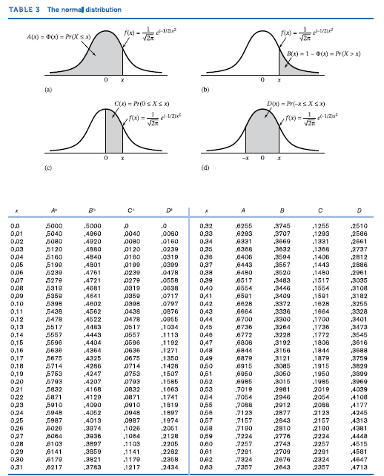
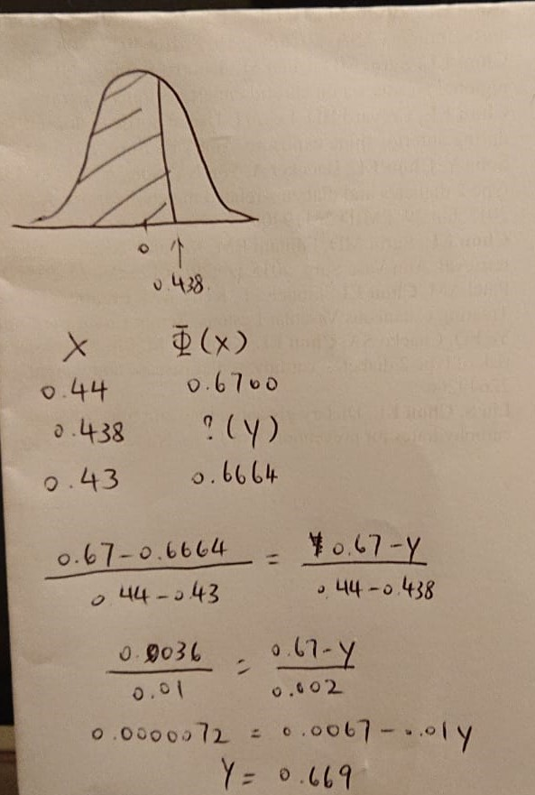

Slide 33

Example on Power Calculation:
Obstetrics
$μ0 = 170 oz, μ1 = 190 , α = .05, σ =50, n = 10$ :
$Power=Φ\left[z_{.05}+\frac{\left(120−115\right)\sqrt{10}}{24}\right]=Φ\left[−1.645+\frac{5\sqrt{10}}{24}\right]=$ $Φ\left(−0.986\right)$
$=1−0.838=0.162$
there is only a 16% chance of finding a significant difference with a sample size of 10
whereas there was a 67% chance with a sample size of 100
→ if 10 infants were sampled, we would have virtually no chance of finding a significant difference and would almost surely report a false-negative result

Slide 34
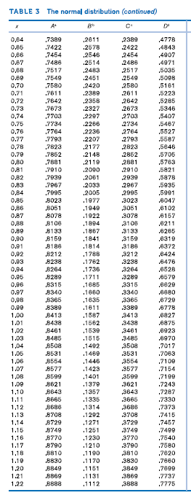
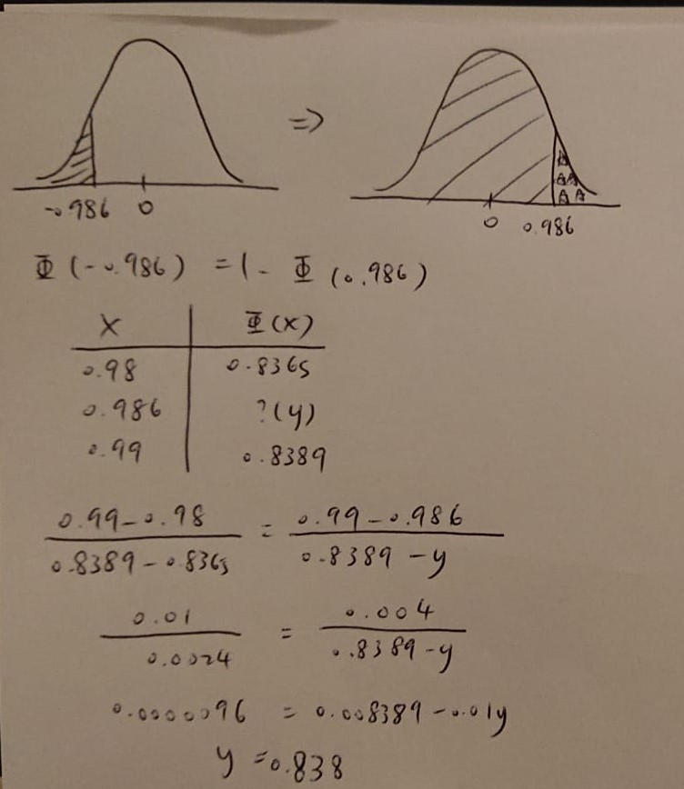

Slide 35
Factors affecting the power
E.g. 2-sided one-sample test: Φ(-z_{1- α/2} + |μ₀ - μ₁|√n/σ)
If the significance level is made smaller (α decreases)→ z_{α} increases → power decreases
If the alternative mean is shifted farther away from the null mean (|μ₀ - μ₁| increases) → power increases
If σ of the distribution of individual observations increases (σ increases) → power decreases
If the sample size increases (n increases) →power increases
Notes:
There is close relation between
Factors affecting the power:
If the significance level is made smaller (α decreases), z_{α} increases and hence the power decreases.
If the alternative mean is shifted farther away from the null mean (|μ₀ - μ₁| increases), then the power increases.
If the standard deviation of the distribution of individual observations increases (σ increases), then the power decreases.
If the sample size increases (n increases), then the power increases.

Slide 36
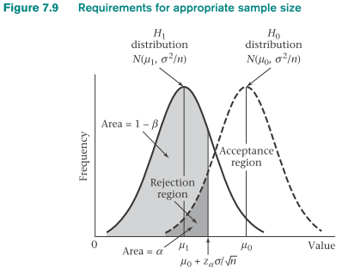

Sample-Size Determination: One-Sided Alternatives
H₀: μ = μ₀ vs. H₁: μ = μ₁ , data ~ N(μ, σ²)
What is the same size for a one-sided test with significance level α and probability of detecting a significant difference = 1- β?

Slide 37
Factors Affecting the Sample Size (n)
σ² increases → n increases
The significance level is made smaller (α decreases) → n increases
The required power increases ( 1- β increases) → n increases
The absolute value of the distance between the null and alternative means (|μ₀ - μ₁|) increases → n decreases

Slide 38


Sample-Size Estimation When Testing for the Mean of a Normal Distribution
(Two-Sided Alternative)
H₀: μ = μ₀ vs. H₁: μ = μ₁ , data ~ N(μ, σ²)
What is the sample size for a one-sided test with significance level α and power 1- β ?
Sample-Size Estimation Based on CI Width
What is the mean of a normal distribution with sample variance s²?
The two-sided 100% × (1 - α) CI for μ be no wider than L

Slide 39
Example on Sample Size Estimation:
Obstetrics
Consider the birthweight data. Suppose that μ0 = 120 oz, μ1 = 115 oz, σ = 24, α = .05, 1 − β = .80.
Q: Using a one-sided test, compute the appropriate sample size needed to conduct the test.
Solution:
$$n=\frac{{24}^{2}{(z_{.8}+z_{.95})}^{2}}{25}=23.04{(0.84+1.645)}^{2}=23.04\left(6.175\right)=142.3$$
sample size is always rounded up → sure to achieve at least the required level of power (in this case, 80%)
a sample size of 143 is needed to have an 80% chance of detecting a significant difference at the 5% level (if the alternative mean is 115 oz and a one-sided test is used)

Slide 40
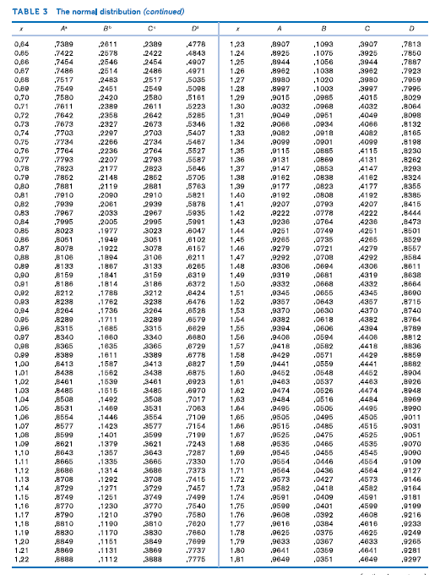

Slide 41

Example on Sample Size Estimation:
Cardiology
Suppose it is well known that propranolol lowers heart rate over 48 hours when given to patients with angina at standard dosage levels. A new study is proposed using a higher dose of propranolol than the standard one. Investigators are interested in estimating the drop in heart rate with high precision.
Q: Find the minimum sample size needed to estimate the change in heart rate (μ), if we require that the two-sided 95% CI for μ be no wider than 5 beats per minute and the sample standard deviation for change in heart rate equals 10 beats per minute.
Solution:
$$n=\frac{4{\left(z_{.975}\right)}^{2}{\left(10\right)}^{2}}{{\left(5\right)}^{2}}=\frac{4{\left(1.96\right)}^{2}\left(100\right)}{25}=61.5$$
We have α =.05, s=10,L=5
62 patients need to be studied

Slide 42
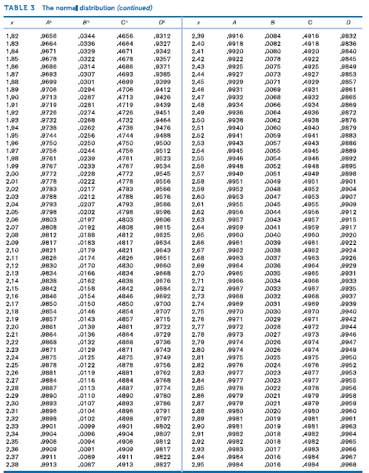

Slide 43
The Relationship Between Hypothesis Testing and
Confidence Intervals (Two-Sided Case)
H₀: μ = μ₀ vs. H₁: μ ≠ μ₀
The two-sided 100% × (1 - α) CI for μ does not contain μ₀→ Reject H₀
The two-sided 100% × (1 - α) CI for μ does contain μ₀→ Accept H₀

Slide 44
Summary
Null (H₀) and alternative (H₁) hypotheses
Type I error (α), type II error (β), and the power (1-β) of a hypothesis test
P-value of a hypothesis test and the distinction between on-sided and two-sided tests
Hypothesis testing:
-critical value method
-p-value method
Estimating appropriate sample size as determined by the pre-specified null and alternative hypotheses and type I and type II errors

Slide 45
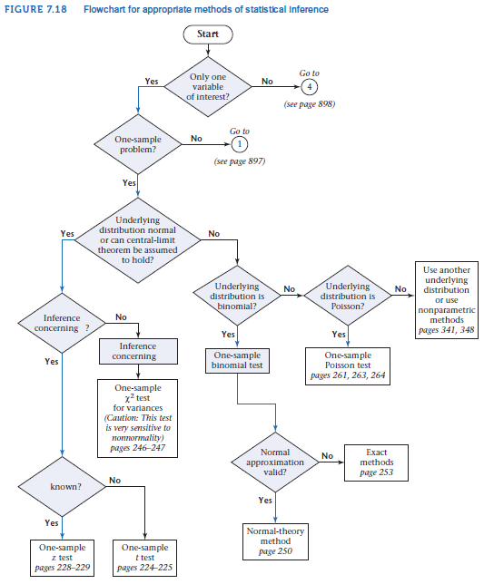

Slide 46
