Slide 1
EE3211 Modelling Techniques
Lecture 8
Multisample Inference

Slide 2
Example on Pulmonary Disease
Topic: passive smoking and pulmonary health
Information on pulmonary function was collected in 6 groups:
Nonsmokers (NS): did not smoke
Passive smokers (PS): in enclosed working area routinely contained tobacco smoke
Non-inhaling smokers (NI): smoked pipes, cigars, or cigarettes (did not inhale)
Light smokers (LS): smoked and inhaled 1-10 cigarettes per day for 20+ years
Moderate smokers (MS): …11-39 cigarettes…..
Heavy smokers (HS)….40+ cigarettes…….
Measured forced mid-expiratory flow (FEF) and compare mean FEF among the 6 groups
Q: how can the means of these six groups be compared?

Slide 3
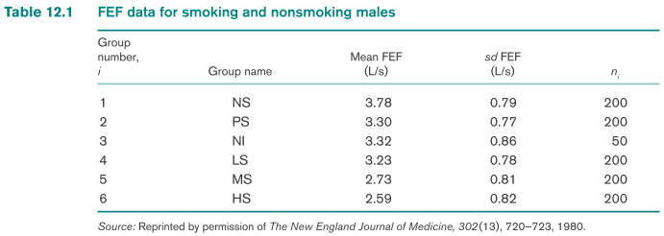
One-Way ANOVA—Fixed-Effects Model
Suppose: k groups of n_{i} observations in the ith group.
y_{ij} : jth observation in the ith group
Model: y_{ij} = µ + α_{i} + e_{ij}
µ: constant
α_{i}: constant specific to the ith group
e_{ij} : error term (normally distributed with mean 0 and variance σ²)
A typical observation from the ith group is normally distributed with mean µ+α_{i} and variance σ²
Q: How do you compare the means of the six groups?

Slide 4
One-way analysis of variance (one-way ANOVA) model:
means of an arbitrary number of groups
each group follows a normal distribution with the same variance
can determine if the variability in the data comes mostly from variability within groups or can truly be attributed to variability between groups
Interpretation of the parameters of a one-way ANOVA fixed-effects model
µ : underlying mean of all groups
α_{i} : difference between mean of the ith group and the overall mean
e_{ij} : random error about the mean µ+α_{i} for an individual observation from ith group

Slide 5
Hypothesis Testing in One-Way ANOVA—Fixed-Effects Model
F test for overall comparison of group means
y_{ij} – y = (y_{ij} – y_{i}) + (y_{i} – y)
(y_{ij} – y_{i}), within-group variability: deviation of an individual observation from the group mean for that observation
(y_{i} – y), between-group variability: deviation of a group mean from the overall mean
if between-group variability is large + within-group variability is small:
→ reject H_{0:} underlying group means are significantly different
if between-group variability is small + within-group variability is large:
→ accept H₀ : underlying group means are the same
H₀: all α _{i} =0
vs.
H₁ at least one α _{i} ≠0

Slide 6




Squared and summation of the squared deviations:
Total Sum of Squares (Total SS):
Within Sum of Squares (Within SS):
Between Sum of Squares (Between SS):
Total SS = Between SS + Within SS

Slide 7
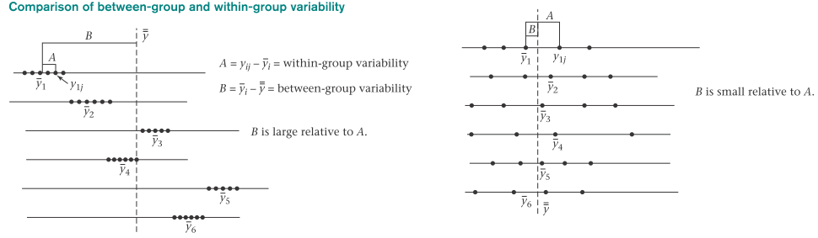
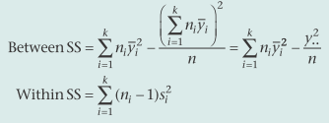
Reject H₀
Accept H₀
Short computational form for the Between SS and Within SS
y..= sum of the observations across all groups (grand total of all observations over all groups)
n = total number of observations over all groups

Slide 8
Between Mean Square = Between MS = Between SS/(k-1)
Within Mean Square = Within MS = Within SS/(n-k)
Significance test : ratio of Between MS to Within MS
If this ratio is large → reject H₀
If it is small → accept H₀
Under H₀ : the ratio follows an F distribution with k – 1(numerator) and n - k (dominator) df
Overall F test for One-way ANOVA Procedure
H₀: α_{i} = 0 for all i
H₁: at least one α_{i} ≠ 0
1. Compute Between SS, Between MS, Within SS, and Within MS
2. Compute test statistic F = Between MS/Within MS, which follows an F
distribution with k - 1 and n - k df under H₀
If F > F_{k-1,n-k,1-α} → reject H₀
If F ≤ F_{k-1,n-k,1-α} → accept H\
3. Exact p-value = area to the right of F under an F_{k-1,n-k} distribution = Pr(F_{k-1,n-k} > F)

Slide 9
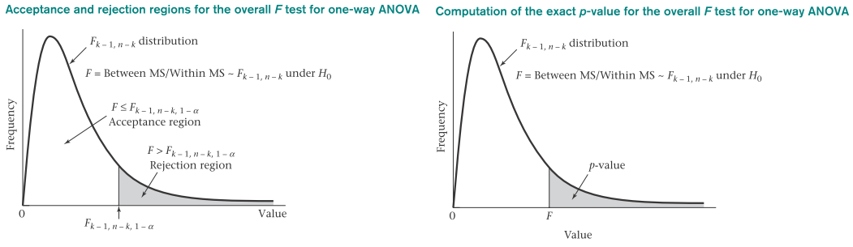
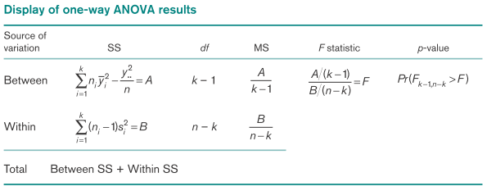

Slide 10
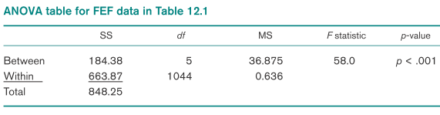
To test whether the mean FEF scores differ significantly among the six groups:
Calculate the Between MS and Within MS.
Determine F = Between MS/Within MS
Find the F value (with the F-table / statistical software)
If p < 0.05→ reject H₀ (all means are equal) → not all means are equal
Conclusion: at least two of the means are significantly different
R commands to perform one-way ANOVA
#use aov command
>model=aov(depvar ~ groupvar)
>summary(model)

Slide 11
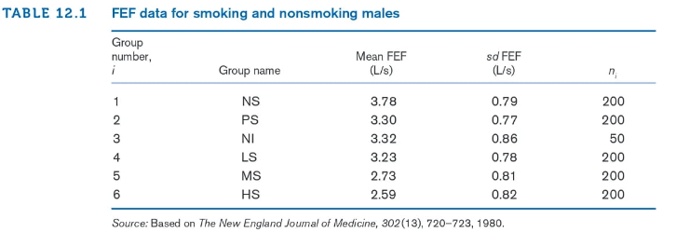
Examples on One-way ANOVA – Pulmonary Disease
Question: Compute the Within SS and Between SS for the FEF data in Table 12.1

Slide 12
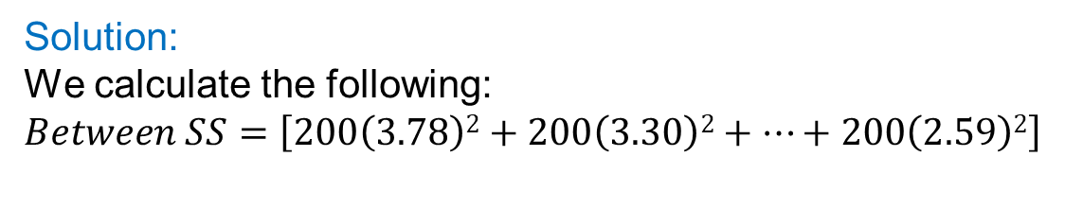



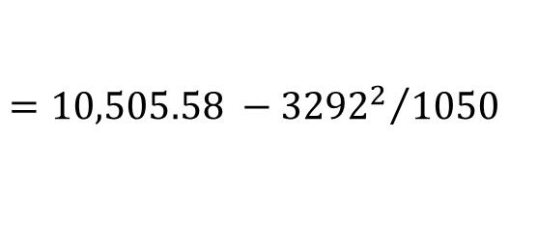
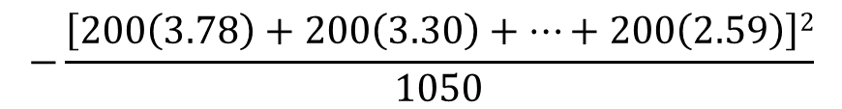

Examples on One-way ANOVA – Pulmonary Disease
Solution:
We calculate the following:
$$Between SS=\left[200\left(3.78\right)2+200\left(3.30\right)2+⋯+200\left(2.59\right)2\right]$$
$$−\frac{\left[200\left(3.78\right)+200\left(3.30\right)+⋯+200\left(2.59\right)\right]2}{1050}$$
$$=10,505.58 −{{3292}^{2}}/{1050}$$
$$=10,505.58 −13,321.20$$
$$=184.38$$
$$Within SS=199{\left(0.79\right)}^{2}+199{\left(0.77\right)}^{2}+49{\left(0.86\right)}^{2}+199{\left(0.78\right)}^{2}$$
$$+199{\left(0.81\right)}^{2}+199{\left(0.82\right)}^{2}$$
$$=124.20+117.99+36.24+121.07+130.56+133.81$$
$$=663.87$$

Slide 13
Examples on One-way ANOVA – Pulmonary Disease
Question: Test whether the mean FEF scores differ significantly among the six groups in Table 12.1
Solution:
Between SS = 184.38 and Within SS = 663.87.
Therefore, because there are 1050 observations combined over all 6 groups, it follows that
Between MS = 184.38 / 5 = 36.875
Within MS = 663.87 / (1050 - 6) = 663.87 / 1044 = 0.636
F = Between MS / Within MS = 36.875 / 0.636 = 58.0 ~ F_{5,1044} under H₀
Between Mean Square = Between MS = Between SS/(k-1)
Within Mean Square = Within MS = Within SS/(n-k)
F =58 > F_{5,1044} = 4.10 → reject H₀
Conclusion: at least two of the means are significantly different

Slide 14
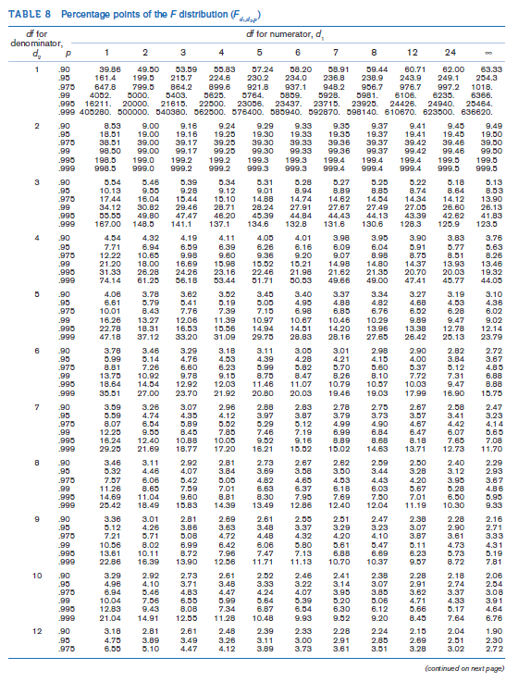

Slide 15
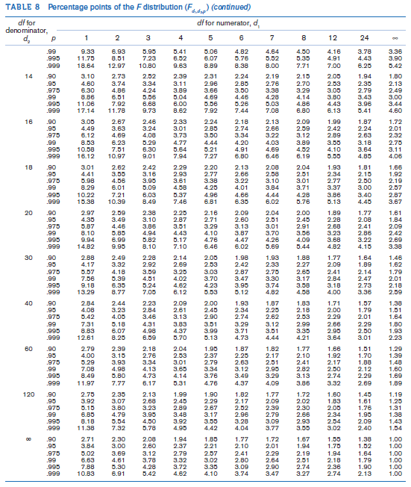

Slide 16



Comparisons of Specific Groups in
One-Way ANOVA
H₀: all group means are equal
H₁: at least two group means are different
Do not know which of the groups have means that differ from each other
Overall F test: if reject H₀ → compare the specific groups
t Test for Comparison of Pairs of Groups
test whether groups 1 and 2 have means that are significantly different from each other
Under either hypothesis:
Y₁ is normally distributed with mean µ+α₁ and variance σ²/n₁
Y₂ is normally distributed with mean µ+α₂ and variance σ²/n₂
The difference of the sample means (y₁ – y₂) will be used as a test criterion:
Reduce to:
If σ² known, dividing by the standard error:

Slide 17

Z ~ N(0,1) distribution under H₀
Because σ² is unknown and can be estimated by s²
The test statistic becomes:
S² = [(n₁-1)s₁² + (n₂-1)s₂²]/(n₁+n₂- 2)
One-way ANOVA:
k sample variances
Estimate σ² by computing a weighted average of k individual sample variances
Weights are the df in each of k samples
(degree of freedom: max. no. of logically independent values;
values that have freedom to vary)
Pooled estimate of the variance for one-way ANOVA

Slide 18

t Test for the Comparison of Pairs of Groups in One-Way ANOVA
(LSD Procedure)
Goal: suppose we wish to compare two specific groups (group 1 and group 2) among k groups
H₀: α₁ = α₂ vs. H₁: α₁ ≠ α₂
Compute the pooled estimate of variance s² = within MS from one way ANOVA
2. Compute the test statistic:
which follows a t_{n-k} distribution under H₀
3. Two-sided level α test:
reject H₀: if t > t_{n-k,1-α/2} or t < t_{n-k,α/2}
accept H_{0 :}if t_{n-k,α/2} ≤ t ≤ t_{n-k,1-α/2}
4. Exact p-value:
p = 2 × the area to the left of t under a t_{n-k} distribution if t < 0
= 2 × Pr(t_{n-k} < t)
p = 2 × the areas to the right of t under a t_{n-k} distribution if t ≥ 0
= 2 × Pr(t_{n-k} > t)

Slide 19
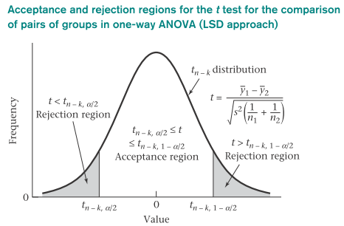
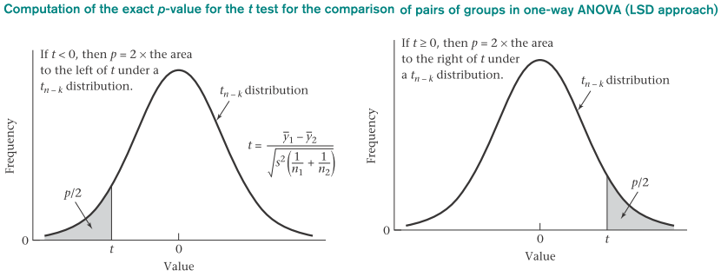

Slide 20

Example on Comparison of Specific Group(s) in One-way ANOVA: Pulmonary Disease
Question: Compare each pair of groups for the FEF data in Table 12.1, and report any significant differences.
Solution:
First plot the mean ± se of the FEF values for each of the six groups in Figure 12.6 to obtain some idea of the magnitude of the differences between groups.
The standard error for an individual group mean is estimated by $s/{\sqrt{n_{i}}}$ , where s² = within MS.
Notice that the nonsmokers, and light smokers have about the same pulmonary function and are worse off than the nonsmokers; and the moderate and heavy smokers have the poorest pulmonary function.

Slide 21
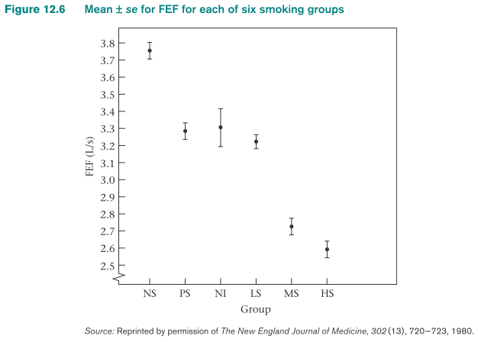
Example on Comparison of Specific Group(s) in One-way ANOVA: Pulmonary Disease
correct
Frequent error in performing the t test (compare groups 1 and 2):
use sample variances to estimate σ² from these two groups (vs. from all k groups)
If former situation: different estimates of σ² obtained for each pair of groups considered
not reasonable (all the groups are assumed to have the same underlying variance σ²)

Slide 22
Example on Comparison of Specific Group(s) in One-way ANOVA: Pulmonary Disease
Note also that the standard error bars are wider for the non-inhaling smokers than for the other groups because this group has only 50 people compared with 200 for all other groups.
Are the observer differences in the figure statistically significant as assessed by the LSD procedure in Equation 12.12? The results are presented in Table 12.4.

Slide 23
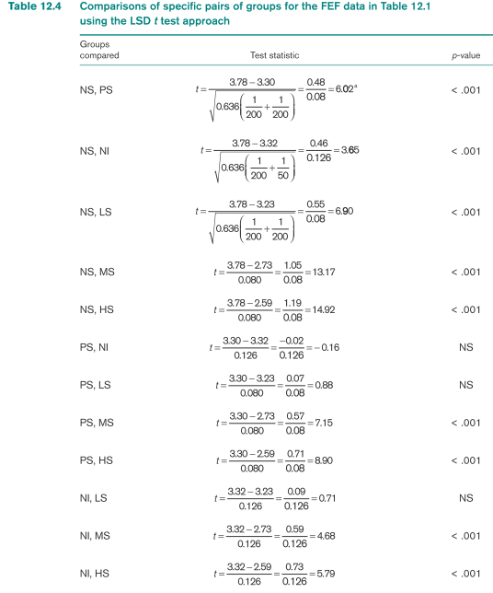
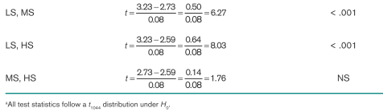

Slide 24
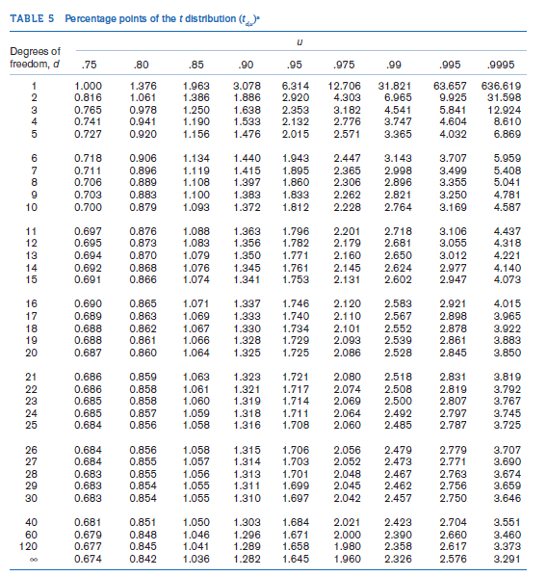

Slide 25
Multiple Comparisons
Comparisons are made before looking at the data → t test procedure is appropriate
Comparisons are made after looking at the data
→ large no. of comparisons
→ some significant differences may be found by chance (false significant difference)

Slide 26
Example on Comparison of Specific Group(s) in One-way ANOVA: Pulmonary Disease
Solution:
There are very highly significant differences:
(1) between the nonsmokers and all other groups
(2) between the passive smokers and the moderate and heavy
smokers
(3) between the non-inhaling and the moderate and heavy smokers
(4) between the light smokers and the moderate and heavy smokers.
There are no significant differences between the passive smokers, non-inhalers, and light smokers and no significant differences between the moderate and heavy smokers
- there is a trend toward significance with the latter comparison.

Slide 27

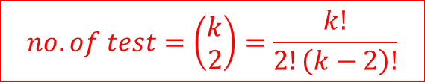
Multiple Comparisons—Bonferroni Approach
Avoid too many falsely significant difference
Overall probability of declaring any significant differences between all possible pairs of groups is maintained at some fixed significance level
Simplest : Bonferroni adjustment
Suppose we want to compare two specific groups (group 1 and group 2) among k groups.
H₀: α₁ = α₂ vs. H₁: α₁ ≠ α₂
Bonferroni multiple-comparisons procedure:
1. Compute pooled estimate of the variance s² = Within MS from the one-way ANOVA.
2. Compute test statistic:
3. Two-sided level α test, let α* = α/(^{k}₂)
reject H₀: if t > t_{n-k,1-α*/2} or t < t_{n-k,α*/2}
accept H₀: if t > t_{n-k,α*/2} ≤ t ≤ t_{n-k,1-α*/2}
$$no. of test=\left(\begin{matrix}k \\ 2\end{matrix}\right)=\frac{k!}{2!\left(k−2\right)!}$$

Slide 28
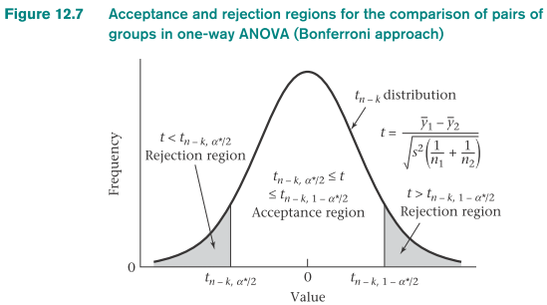
k groups:
( ^{k}₂) possible two-group comparisons
each two-group comparison at the α* level of significance.
Let E be the event that at least one of the two-group comparisons is statistically significant
Pr(E) = Pr(none of the two-group comparisons is statistically significant)
= 1- α
each of the two-group comparisons were independent
from the multiplication law of probability: Pr(E) = (1- α*)^{c} where c = (^{k}₂)
1- α = (1-α*)^{c}

Slide 29
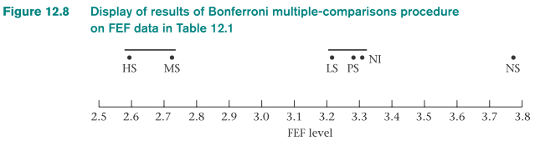
Line drawn between the names or numbers of each pair of means that is not significantly different
Visually summarize the results of many comparisons of pairs of means
Multiple-comparisons procedures are more strict than ordinary t tests (compare more than two means )
As k increases, c = (^{k}₂) increases and therefore α* = α/c decreases
The critical value, t_{n-k,1-α*/2}, therefore increases
As k increases, the df (n-k) decreases and the percentile 1- α*/2 increases
Both lead to larger critical value

Slide 30
When is multiple-comparisons procedure used over LSD procedure?
Multiple-comparisons procedures should be used if there are many groups and not all comparisons between individual groups are planned
Relatively few groups and only specific comparisons of interest are intended, then use ordinary t tests (i.e., the LSD procedure)
Multiple-comparisons procedure is applicable for comparing pairs of means

Slide 31
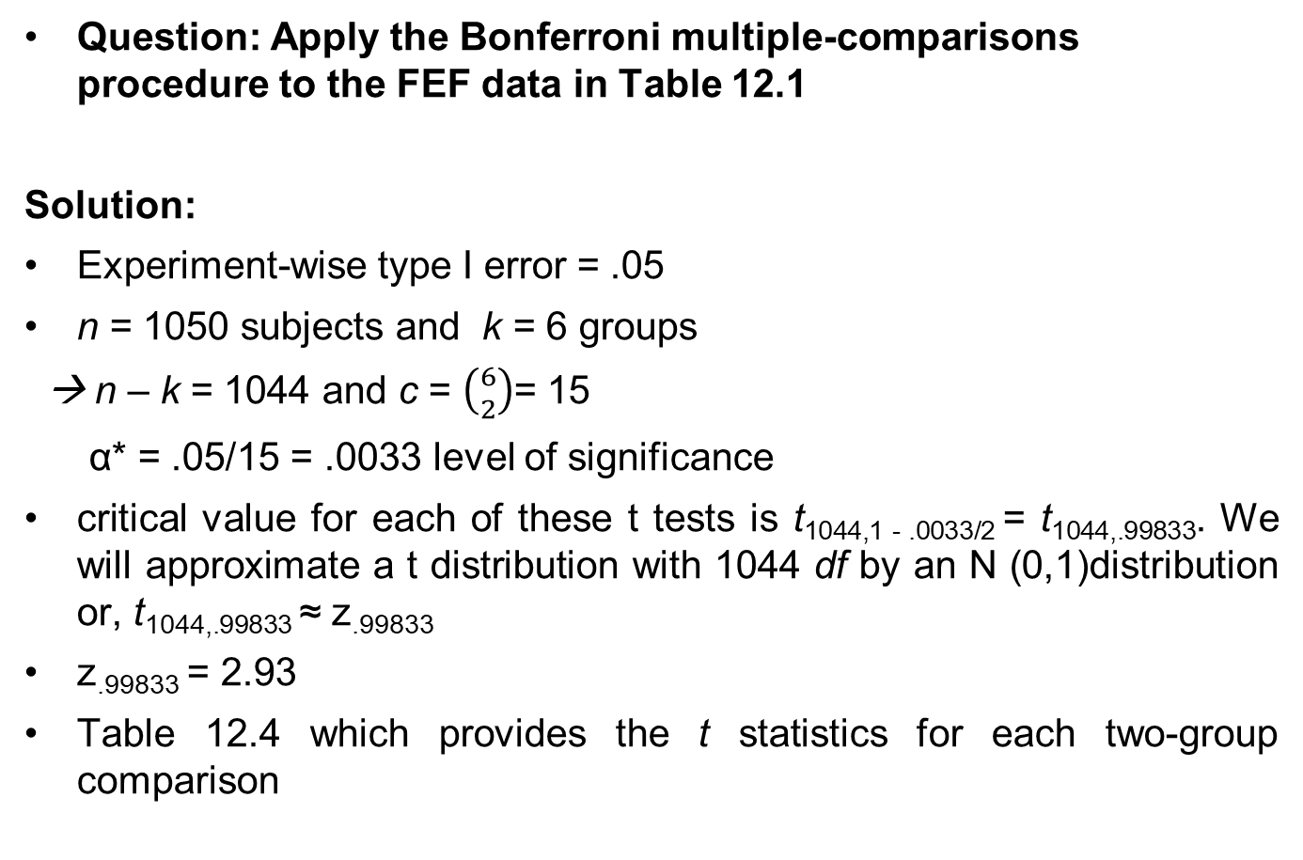

Example on Bonferroni Correction – Pulmonary Disease
Question: Apply the Bonferroni multiple-comparisons procedure to the FEF data in Table 12.1
Solution:
Experiment-wise type I error = .05
n = 1050 subjects and k = 6 groups
→ n – k = 1044 and c = $\left({6 \atop 2}\right)$= 15
α* = .05/15 = .0033 level of significance
critical value for each of these t tests is t_{1044,1 - .0033/2} = t_{1044,.99833}. We will approximate a t distribution with 1044 df by an N (0,1)distribution or, t_{1044,.99833} ≈ z_{.99833}
z_{.99833} = 2.93
Table 12.4 which provides the t statistics for each two-group comparison
$\left({6 \atop 2}\right)$=$\frac{6!}{2!\left(6−2\right)!}=\frac{6∗5∗4∗3∗2∗1}{2∗(4∗3∗2∗1)}$

Slide 32
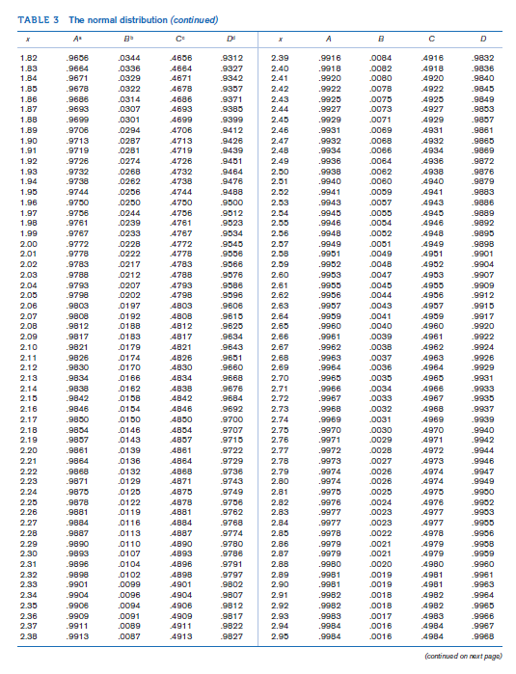

Slide 34
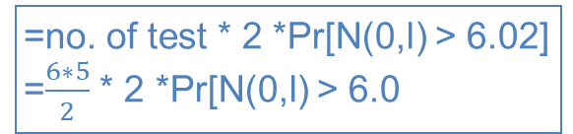
Example on Bonferroni Correction – Pulmonary Disease
Solution:
Absolute value of all t statistics for two-group comparisons that were statistically significant using the LSD approach are ≥ 3.65
(3.65 ≥ 2.935 → remain statistically significant under the Bonferroni
procedure)
Comparisons that were not statistically significant with the LSD procedure are also not significant under the Bonferroni procedure
*must be the case because the Bonferroni procedure is more
conservative than the LSD procedure.
*critical region using the LSD procedure with a two-sided test (α =
.05) is t < -1.96 or t > 1.96, whereas the comparable critical region
using the Bonferroni procedure is t < -2.935 or t > 2.935
The Bonferroni-corrected p-value for comparison of the NS vs. the PS group = 6(5) Pr[N(0,l) > 6.02]
=no. of test * 2 *Pr[N(0,l) > 6.02]
=$\frac{6∗5}{2}$ * 2 *Pr[N(0,l) > 6.0

Slide 35
The False Discovery Rate
Genetic studies with many hypotheses: control of the experiment-wise type I error does not seem a reasonable approach to control for multiple comparisons (very conservative inferential procedures)
FDR: developed by Benjamini and Hochberg
Goal: control the proportion of false-positive results among reported statistically significant results

Slide 36
False-Discovery-Rate (FDR) Testing Procedure
k separate tests with p-values = p₁,…, p_{k}
Renumber the tests : p₁ ≤ p₂ ≤ … ≤ p_{k}
Define q_{i} = kp_{i}/i, i = 1,…,k
i = rank of the p-values among the k tests
Let FDRi = false-discovery rate for the ith test be defined by min (q_{i}, …, q_{k})
Find the largest i such that FDR_{i} < FDR₀ = critical level for the FDR (usually 0.05).
Reject H₀ for the hypotheses 1, …, i, and accept H₀ for the remaining hypotheses.
*no more than 5% of the reported positive results will be false positives*
*less conservative*

Slide 37
Example on FDR –
Cardiovascular Disease, Genetics
A subsample of 520 cases of cardiovascular disease (CVD) and 1100 controls was obtained among men in a prospective cohort study *nested case-control study*
Baseline blood samples were obtained from men in the subsample and analyzed for 50 candidate single-nucleotide polymorphisms (SNPs).
Each SNP was coded as 0 if homozygous wild type (the most common), 1 if heterozygote, and 2 if homozygous mutant. The association of each SNP with CVD was assessed using contingency-table methods.
A chi-square test for trend was run for each SNP. This yielded 50 separate p-values. If the Bonferroni approach in Equation 12.14 were used, then α* = .05/50 = .001. With such a low value for α* it is likely that very few of the hypotheses would be rejected, resulting in a great loss in power.
Instead, an alternative approach based on the false-discovery rate (FDR) was used to control for the problem of multiple testing.

Slide 38
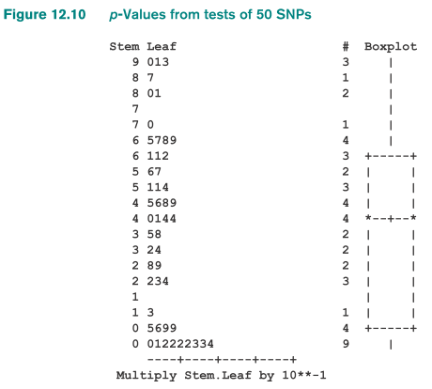
Stem-and-leaf plot and box plot of the p-values from the tests of 50 SNPs.

Slide 39
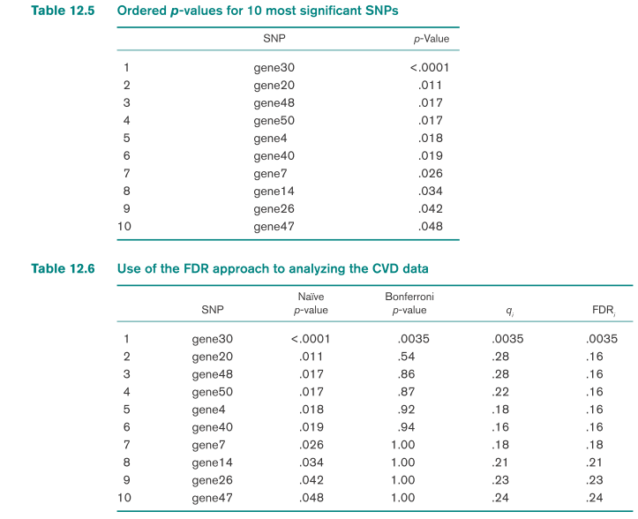
Example on FDR –
Cardiovascular Disease, Genetics
Question: Apply the FDR approach to the genetics data
Solution:
Stem-and-leaf plot and box plot of the p-values from the tests of each of the 50 SNPs
The p-values for the nominally significant genes:
Note that 10 of the genes are statistically significant, with nominal p-values ranging from <.0001 to .048

Slide 40
Example on FDR –
Cardiovascular Disease, Genetics
Solution:
The “Bonferroni p-value” = min {50 x nominal p-value, 1.0} (third column)
→ the level of significance at which the results for a specific SNP
would be just statistically significant if a Bonferroni correction were
made
q_{i} are not necessarily in the same order as the original nominal p-values

Slide 41
Summary
One-way ANOVA methods: relate a normally distributed outcome variable to the levels of a single categorical independent variable
-Fixed-effects model: the levels of categorical variable are determined in
advance
→ test the hypothesis that the mean level of the dependent variable is
different for different groups defined by the categorical variable
Methods to adjust for multiple comparisons: Bonferroni correction and false-discovery rate

