Slide 1
Review

Slide 2
Descriptive statistics
Measures of location e.g. mean, median, mode
Measures of spread e.g. standard deviation
Graphic methods e.g. boxplot, stem-and-leaf plot
Symmetric distribution
Unsymmetric distribution (skewed to the right / left)

Slide 3
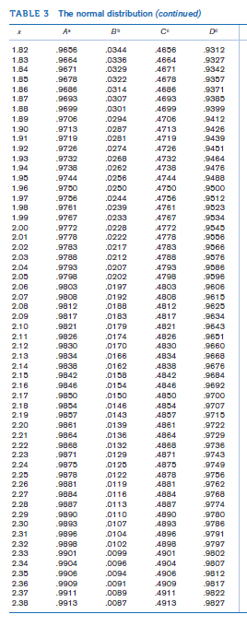
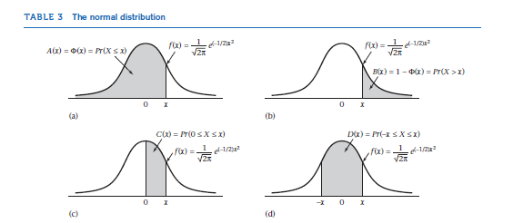
Probability distribution
Discrete vs. continuous
Measure of location
Measure of spread
Standardization of a normal variable
Z-table

Slide 4
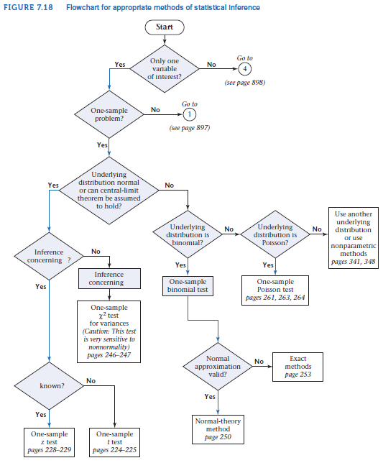
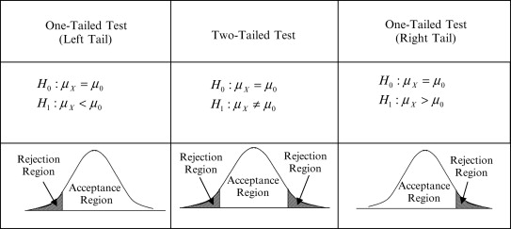
Hypothesis testing: one-sample inference
Type 1 error
Type 2 error
Two-sided test
One-sided test
P-value
Z-test (Normal distribution table)
T-test (t distribution table)

Slide 5
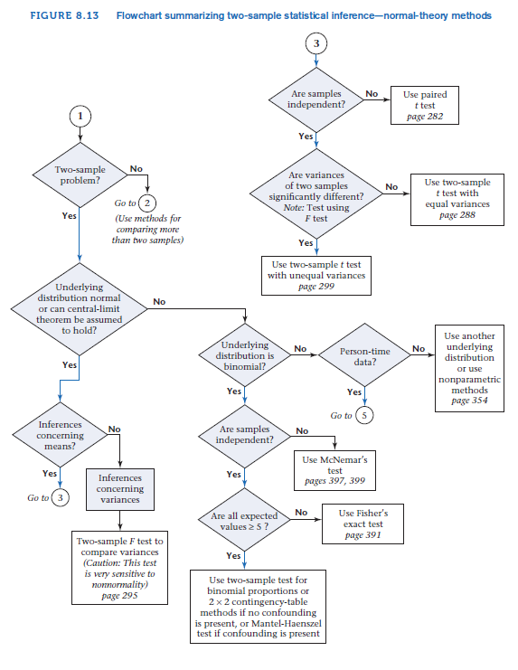
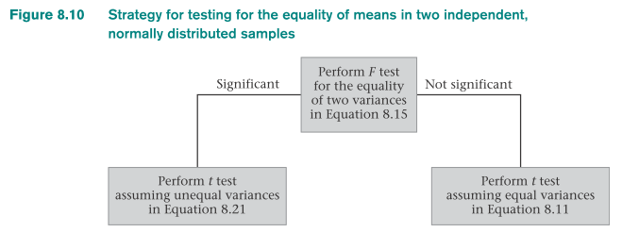
Hypothesis testing: two-sample inference
F = s₁²/s₂²

