Slide 1
Review 2

Slide 2
Test 1 topics
Descriptive statistics
e.g. stem-and-leaf plot, mean, median, mode…
Probability distribution
e.g. discrete vs. continuous probability distribution…
Hypothesis testing: one-sample inference
e.g. p-value, null hypothesis, alternate hypothesis…
Hypothesis testing: two-sample inference
e.g. paired samples hypothesis testing, independent samples hypothesis testing (F-test: check equal variances, t-test)…

Slide 3
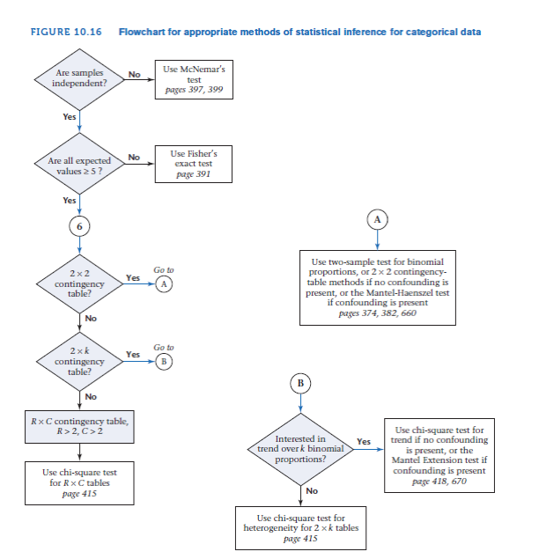
Hypothesis testing: categorical data
Contingency Table Approach
Expected number of units in the (i,j) cell (E_{ij}):
ith row margin X jth column margin
grand total
none of the four expected values < 5
Fisher’s exact test
1 of the cells with expected values <=5
McNemar’s Test
Normal Theory test (n_{D} ≥20)
Exact Method (n_{D} < 20)
RxC Contingency Table
Test statistic:
H₀ ~ ꭓ² distribution with (R - 1) × (C - 1) df

Slide 4
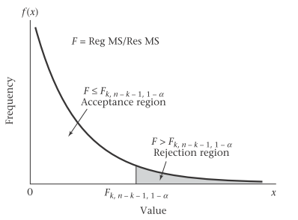

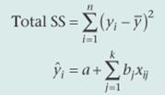
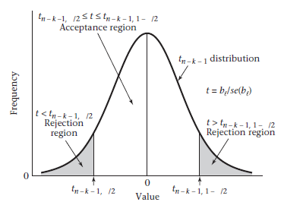
Regression and Correlation
Interpretation of regression line
Correlation (Pearson’s vs. Spearman ranks)
Hypothesis testing for multiple regression
F test:
H₀: β₁ = β₂ = …= β_{k} = 0
vs. H₁: at least one of the β_{j} ≠ 0 in multiple linear regression
Test statistic:
F = Reg MS/Res MS, df = n-k-1 where n=sample size, k =no of independent
T test:
H₀: β_{l} = 0, All other β_{j} ≠ 0 vs. H₁: β_{l} ≠ 0 , all other β_{j} ≠ 0 in multiple linear regression
Statistical output for multiple regression model

Slide 5
Nonparametric Methods
Parametric Methods: data of known distribution
Non-parametric methods: data of unknown distribution, skewed / not normally distributed, ordinal
Analysis Type | Example | Parametric Procedure | Nonparametric Procedure
Compare means between two distinct/independent groups | Is the mean systolic blood pressure (at baseline) for patients assigned to placebo different from the mean for patients assigned to the treatment group? | Two-sample t-test | Wilcoxon rank-sum test
Compare two quantitative measurements taken from the same individual | Was there a significant change in systolic blood pressure between baseline and the six-month follow-up measurement in the treatment group? | Paired t-test | Wilcoxon signed-rank test
Estimate the degree of association between two quantitative variables | Is systolic blood pressure associated with the patient’s age? | Pearson coefficient of correlation | Spearman’s rank correlation

