Slide 1
EE3211 Modelling Techniques
Week 1 Tutorial
Descriptive Statistics

Slide 2
R
Install R: Instruction on R installation
R 101: Undergrad Guide to R

Slide 3
Work directory
Check working directory:
>getwd()
[1] "C:/Users/myusername/Documents/My R Stuff"
Change working directory:
>setwd("C:/Users/XYZ/EE3211_tutorial/")
Check working directory again:
>getwd()
[1] "C :/Users/XYZ/EE3211_tutorial/")

Slide 4
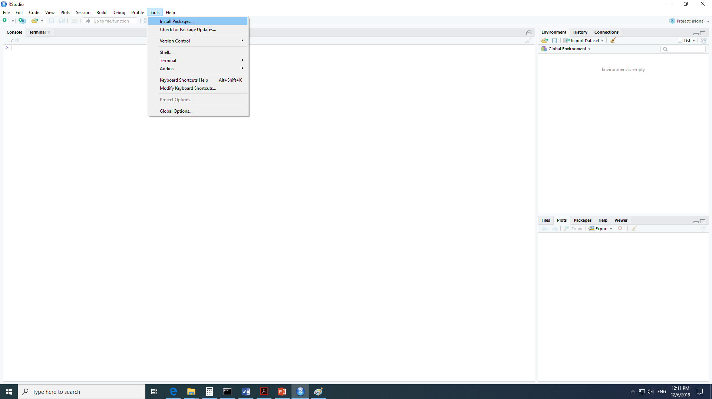
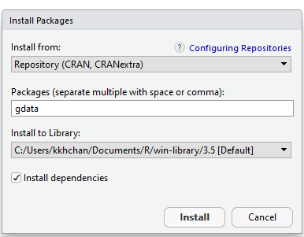
Install R

Slide 5
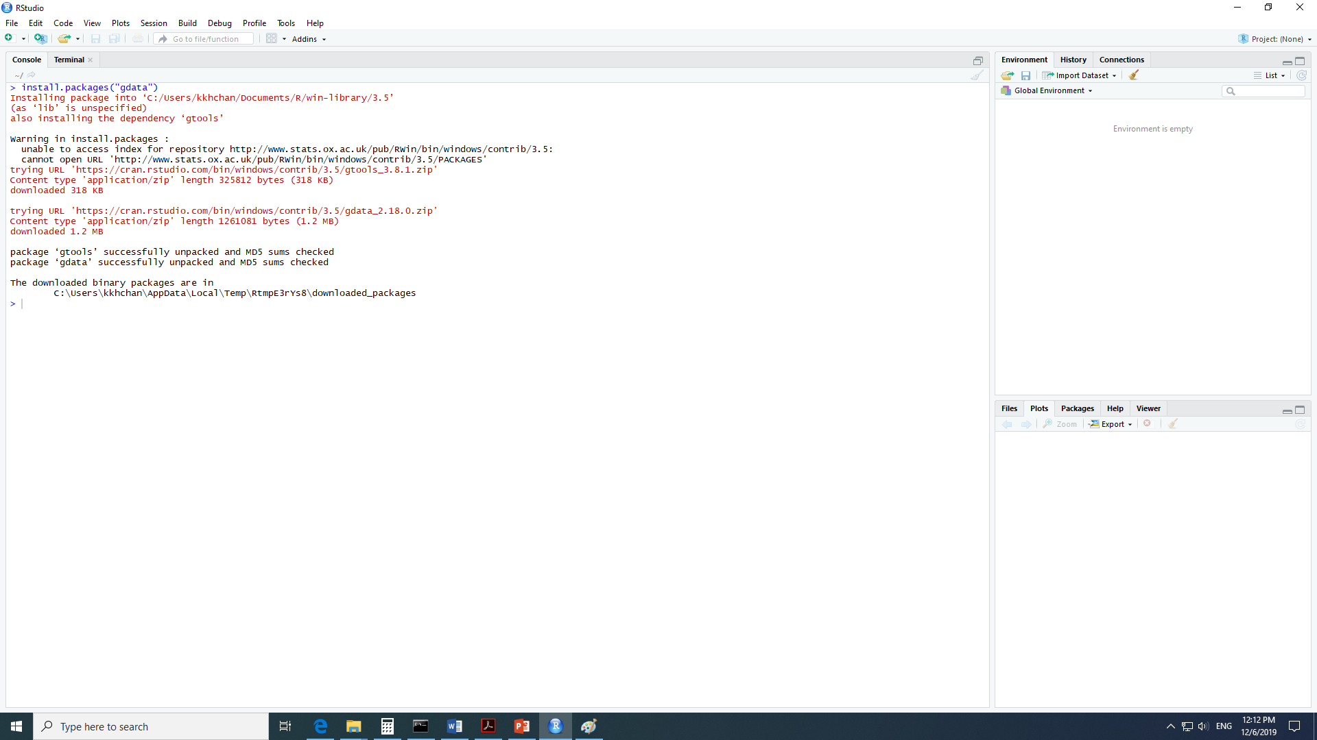

Slide 6
Read data file
>library(gdata)
>cls=read.csv("Cholesterol.csv")
OR
>chol.df=read.table("Cholesterol.csv", header=TRUE, sep=",")

Slide 7
Your first R adventure
>WeightG12Stu.df=read.table("WeightGrade12Students.csv", header=TRUE, sep=", ")
>WeightG12Stu.df
>head(WeightG12Stu.df)
Subject Weight
1 N0017 120.9
2 N0128 119.9
3 N0212 104.5
4 N0983 145.1
5 N8731 111.7
6 N0955 134.5

Slide 8
Plot
>hist(WeightG12Stu.df$Weight)
>plot(density(WeightG12Stu.df$Weight))
> boxplot(WeightG12Stu.df$Weight)
> stem(WeightG12Stu.df$Weight)
> stripchart(WeightG12Stu.df$Weight)
> dotchart(WeightG12Stu.df$Weight)
> qqnorm(WeightG12Stu.df$Weight)

Slide 9
Data: at a glance
> length(WeightG12Stu.df$Weight)
# Length or N of a vector
[1] 30
> summary(WeightG12Stu.df$Weight)
# Descriptive statistics, including NAs if any
Min. 1st Qu. Median Mean 3rd Qu. Max.
94.4 117.5 124.6 123.4 130.2 151.5

Slide 10
Data: at a glance
>is.na(WeightG12Stu.df$Weight)
# Returns TRUE if indexed value is missing (e.g., NA) and FALSE if indexed value is not missing
[1] FALSE FALSE FALSE FALSE FALSE FALSE FALSE FALSE FALSE FALSE FALSE FALSE
[13] FALSE FALSE FALSE FALSE FALSE FALSE FALSE FALSE FALSE FALSE FALSE FALSE
[25] FALSE FALSE FALSE FALSE FALSE FALSE
>complete.cases(WeightG12Stu.df$Weight)
# Returns TRUE if indexed value is not missing (e.g., NA) and FALSE if indexed value is missing
[1] TRUE TRUE TRUE TRUE TRUE TRUE TRUE TRUE TRUE TRUE TRUE TRUE TRUE TRUE
[15] TRUE TRUE TRUE TRUE TRUE TRUE TRUE TRUE TRUE TRUE TRUE TRUE TRUE TRUE
[29] TRUE TRUE

Slide 11
Descriptive Statistics
> mean(WeightG12Stu.df$Weight)
# Mean or arithmetic average
[1] 123.3533
> sd(WeightG12Stu.df$Weight)
# Standard Deviation
[1] 12.90337
> var(WeightG12Stu.df$Weight)
# Variance
[1] 166.4971
> median(WeightG12Stu.df$Weight)
# Median or midpoint
[1] 124.6

Slide 12
Descriptive Statistics
> range(WeightG12Stu.df$Weight)
# Range, minimum and maximum
[1] 94.4 151.5
> quantile(WeightG12Stu.df$Weight)
# Quantiles, or values at: 0%, 25%, 50% 75%, and 100%
0% 25% 50% 75% 100%
94.40 117.50 124.60 130.25 151.50
> sort(WeightG12Stu.df$Weight)
# Sort or order values in a vector
[1] 94.4 100.9 104.5 105.8 111.4 111.7 112.2 117.4 117.8 119.9 120.9 120.9
[13] 121.4 121.7 124.5 124.7 125.2 125.8 126.8 127.1 127.7 129.2 130.6 132.6
[25] 134.5 135.1 135.5 143.8 145.1 151.5
> sum(WeightG12Stu.df$Weight)
# Arithmetic sum of all values in a vector
[1] 3700.6

Slide 13
Descriptive Statistics
> min(WeightG12Stu.df$Weight)
# Minimum
[1] 94.4
> which.min(WeightG12Stu.df$Weight)
# Location (e.g., index) of the first
occurrence of the minimum value
[1] 21
> max(WeightG12Stu.df$Weight)
# Maximum
[1] 151.5
> which.max(WeightG12Stu.df$Weight)
# Location (e.g., index) of the first
occurrence of the maximum value
[1] 12

Slide 14
Descriptive Statistics
> boxplot.stats(WeightG12Stu.df$Weight)
# Produce values for a vector related to a boxplot:
# lower whisker, lower hinge, median, upper hinge, upper whisker, N, and outliers
$`stats`
[1] 100.9 117.4 124.6 130.6 145.1
$n
[1] 30
$conf
[1] 120.7922 128.4078
$out
[1] 151.5 94.4

Slide 15
Descriptive Statistics
> fivenum(WeightG12Stu.df$Weight)
# Tukey’s five number summary for a vector: minimum, lower-hinge, median, upper-hinge, and maximum
[1] 94.4 117.4 124.6 130.6 151.5
> IQR(WeightG12Stu.df$Weight)
# Interquartile range of a vector (e.g., a measure of dispersion that is equal to the difference between the upper quartile and the lower quartile
[1] 12.75

Slide 16
Descriptive Statistics
> table(WeightG12Stu.df$Weight)
# Contingency table (e.g., crosstab) of counts for each combination of vector
values v factor levels
94.4 100.9 104.5 105.8 111.4 111.7 112.2 117.4 117.8 119.9 120.9 121.4
1 1 1 1 1 1 1 1 1 1 2 1
121.7 124.5 124.7 125.2 125.8 126.8 127.1 127.7 129.2 130.6 132.6 134.5
1 1 1 1 1 1 1 1 1 1 1 1
135.1 135.5 143.8 145.1 151.5
1 1 1 1 1

Slide 17
Before quitting the R session
> save.image("R_Lesson_DescriptiveStatistics.rdata")
> q()
# Quit this session
# Prepare for Save workspace image? query
#Use the R Graphical User Interface (GUI) to load the saved rdata file:
File and then Load Workspace
#Otherwise, use the load() function, typing the full pathname, to load the .rdata file and retrieve the session

