Slide 1
Implement Segmentation Network with Pytorch
Tutorial of EE4211
Department of Electrical Engineering
City University of Hong Kong
06/11/2020
1

Slide 2
Outline
Segmentation Network Structure (Inf-Net)
Inf-Net: Automatic COVID-19 Lung Infection Segmentation From CT Images (IEEE TMI 2020)
Install CUDA, cuDNN, Anaconda, Pytorch and Related Library
torch, numpy, opencv-python, scikit-image, scipy, SimpleITK
Implement Inf-Net with Pytorch
Data preprocessing
Read, edit, debug and run the code
2
Notes:
This tutorial includes two main parts: WCE image classification and COVID-19 CT image segmentation. For each part, I will introduce a baseline network that is widely utilized as backbone in many related works, then I will present a novel framework based on this baseline network, which propose many advanced technologies, like attention mechanism and objective function, to enhance the performance of original baseline network, and then apply this novel framework to some medical image analysis applications, such as WCE image classification and segment lung infection from CT images.

Slide 3

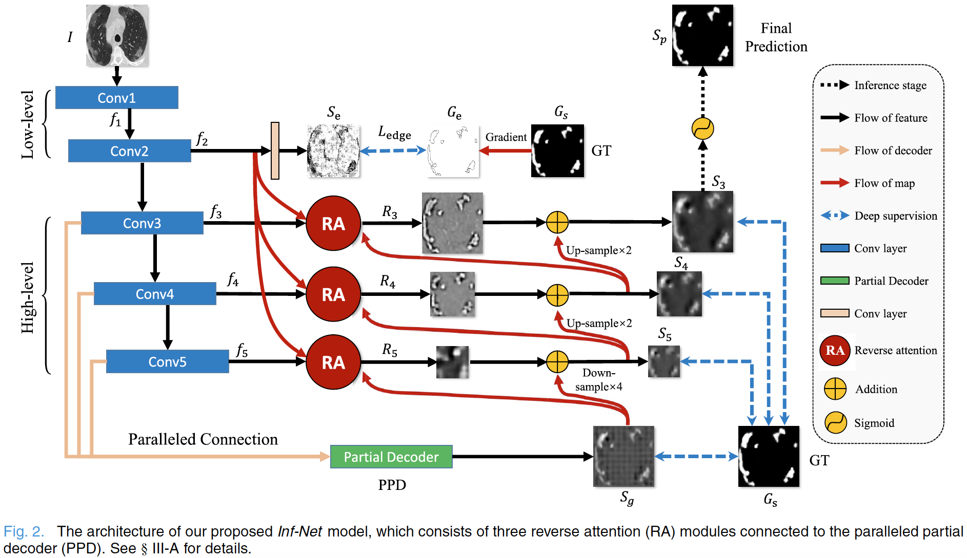
Segmentation Network Structure (Inf-Net)
Fan, Deng-Ping, et al. "Inf-Net: Automatic COVID-19 Lung Infection Segmentation from CT Images." IEEE Transactions on Medical Imaging (2020).
Notes:
This is the whole framework of Inf-Net. As in this figure, CT images are first fed to two convolutional layers to extract low-level features. Herein, an edge attention module is added to explicitly improve the representation of objective region boundaries. Then, the low-level features f2 are fed to three convolutional layers for extracting the high-level features, which are used for two purposes. First,
A parallel partial decoder (PPD) is devised to aggregate these high-level features and generate a global semantic map Sg for the coarse localization of lung infections. Second, these features combined with f2 are fed to multiple reverse attention (RA) modules under the guidance of the Sg.
Therefore, the key components of Inf-Net is PPD, edge attention module and this reverse attention module.

Slide 4
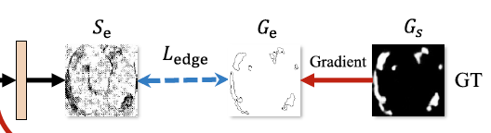
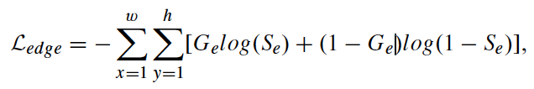
Segmentation Network Structure (Inf-Net)
Edge Attention Module （EAM）
Fan, Deng-Ping, et al. "Inf-Net: Automatic COVID-19 Lung Infection Segmentation from CT Images." IEEE Transactions on Medical Imaging (2020).
Fan, Deng-Ping, et al. "Inf-Net: Automatic COVID-19 Lung Infection Segmentation from CT Images." IEEE Transactions on Medical Imaging (2020).
Notes:
As for this edge attention module, it aims to extract edge information. Existing segmentation network tends to result in wrong prediction around boundary of lesion, so in this way, by enhancing the feature representation around the boundary can lead to a more accurate prediction.
Firstly, it embeds an edge encoder to extract edge features and utilized an edge objective function to constrain the extracted edge information. Specifically, the edge ground truth is calculated from the segmentation ground truth through some conventional method, such as sobel filter. Then the objective function measures the difference between the extracted edge and the generated edge ground truth.

Slide 5
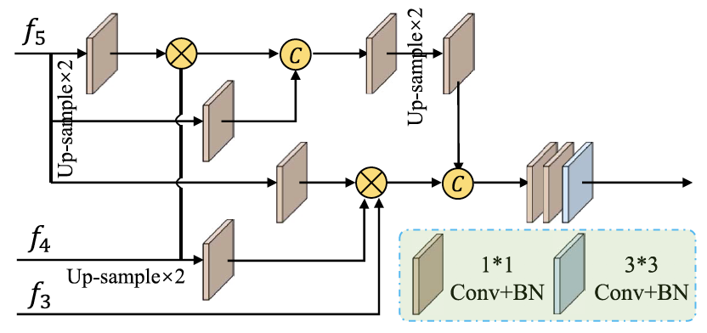
Segmentation Network Structure (Inf-Net)
Paralleled partial decoder （PPD）
coarse global map
S_{g}
Fan, Deng-Ping, et al. "Inf-Net: Automatic COVID-19 Lung Infection Segmentation from CT Images." IEEE Transactions on Medical Imaging (2020).
Fan, Deng-Ping, et al. "Inf-Net: Automatic COVID-19 Lung Infection Segmentation from CT Images." IEEE Transactions on Medical Imaging (2020).
Notes:
As for the paralleled partial decoder, it aims to aggregate the high-level features with a paralleled connection. Then the partial decoder yields a coarse global map, which will serve as global guidance for RA modules.

Slide 6
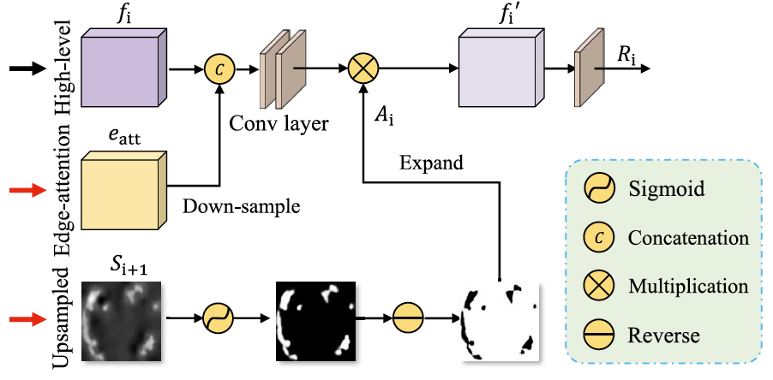
Segmentation Network Structure (Inf-Net)
Reverse attention module (RAM)
Fan, Deng-Ping, et al. "Inf-Net: Automatic COVID-19 Lung Infection Segmentation from CT Images." IEEE Transactions on Medical Imaging (2020).
Fan, Deng-Ping, et al. "Inf-Net: Automatic COVID-19 Lung Infection Segmentation from CT Images." IEEE Transactions on Medical Imaging (2020).
Notes:
Details of reverse attention module is detailed in this figure, it also aims to implicitly learn edge features. Actually, this reverse attention module is a common module for edge feature extraction.

Slide 7

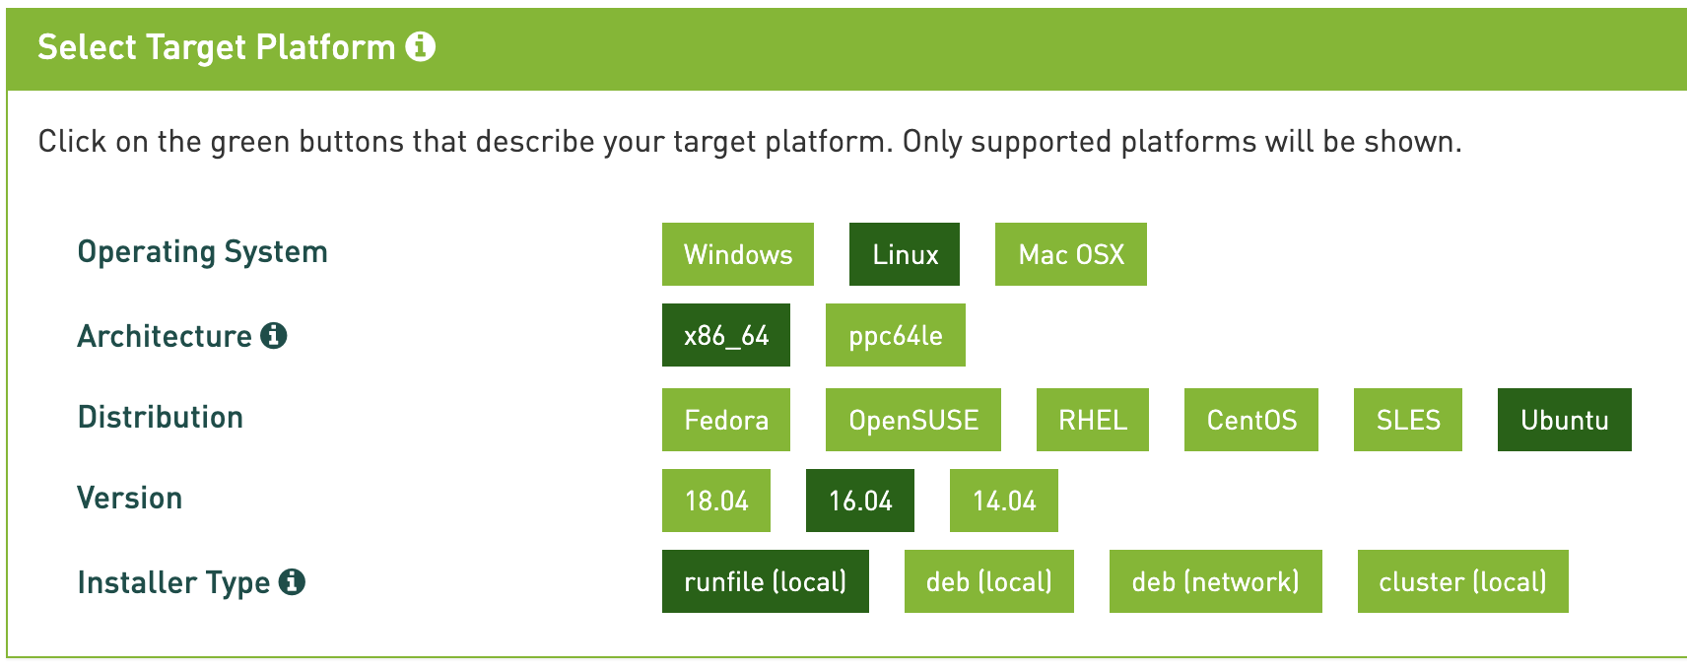
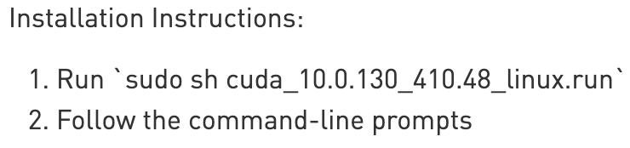
Install CUDA
Download: https://developer.nvidia.com/cuda-10.0-download-archive

Slide 8
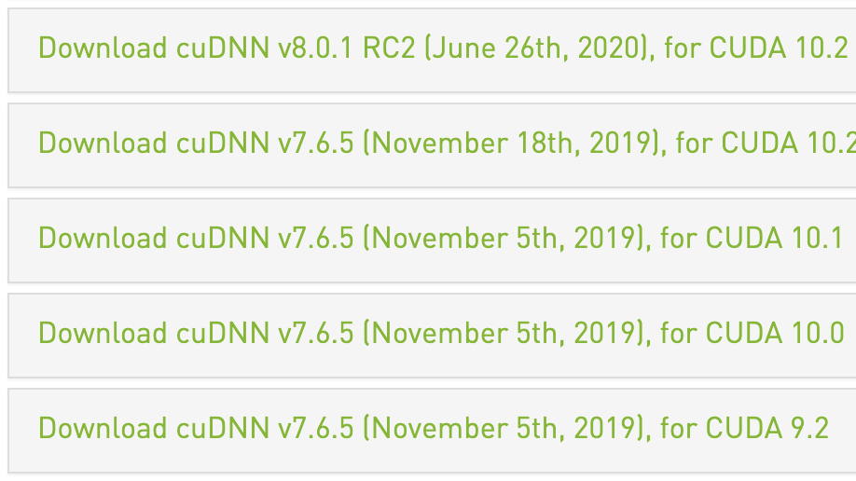
Install cuDNN
Download: https://developer.nvidia.com/rdp/cudnn-archive
You should choose the matched version of cuDNN with the installed CUDA
Installation instruction: https://docs.nvidia.com/deeplearning/cudnn/install-guide/index.html#installlinux

Slide 9

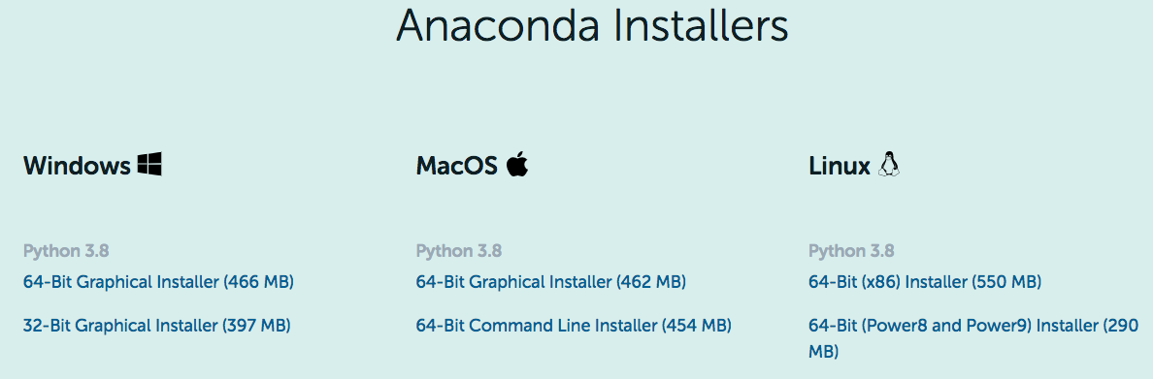
Install Anaconda
Download: https://www.anaconda.com/products/individual#linux

Slide 10
Install Anaconda
Install Steps:
cd /home # The path you download Anaconda
bash Anaconda3-2020.07-Linux-x86_64.sh # Enter,
# Follow the command-line prompts and answer each question
# Once install successfully, test with
python # If there is an error indicating ‘cannot find python’
sudo vim /etc/profile # Configure and edit the environment variables
PATH=/home/user/anaconda3/bin:$PATH # Add this line into the file
# Save this configure file with ‘:wq!’
source /etc/profile # Update the environment variables
# Test again
python

Slide 11






Install Pytorch and Related Library
Install torch, numpy, opencv-python, scikit-image, scipy, SimpleITK
conda create -n SINet python=3.6 # construct virtual environment named SINet
conda activate SINet # activate virtual environment
pip list # show the installed library
pip install torch==1.3.1
pip install numpy
pip install opencv-python
pip install scikit-image
pip install scipy
# The resting required libraries can be installed following the reported error when debugging

Slide 12
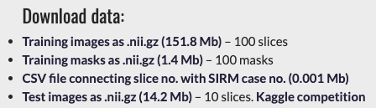
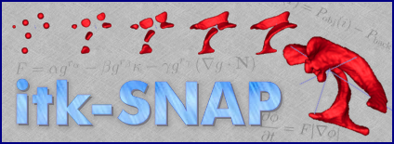
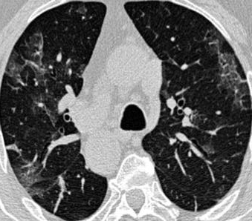
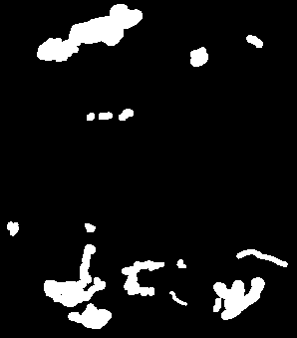
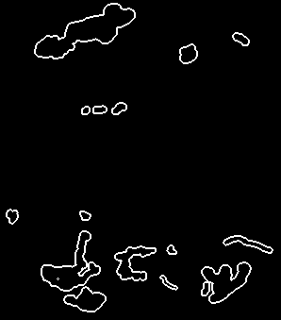
Implement Inf-Net with Pytorch – Data preprocessing
Code: https://github.com/DengPingFan/Inf-Net
Dataset: https://medicalsegmentation.com/covid19/
Preprocessed dataset: https://drive.google.com/file/d/1bbKAqUuk7Y1q3xsDSwP07oOXN_GL3SQM/view
Software for 3D medical image visualization
Input image
Segmentation label
Edge label

Slide 13
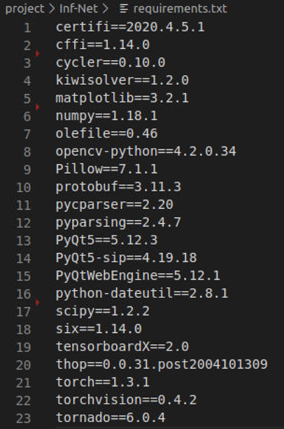
Implement Inf-Net with Pytorch – Read, edit, debug and run the code
Requirement: https://github.com/DengPingFan/Inf-Net/blob/master/requirements.txt
conda activate SINet # activate virtual environment
pip install -r requirements.txt # this Inf-Net requires left dependent libraries
pip list # show the installed library
# read and edit code……
# run training code:
python MyTrain_LungInf.py
# run testing code:
python MyTest_LungInf.py
# perform evaluation
## Run Matlab code in folder ‘EvaluationTool’

Slide 14
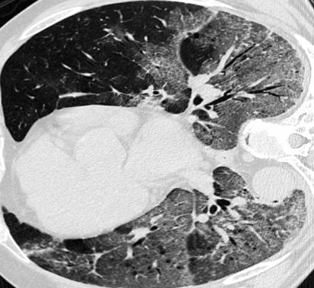

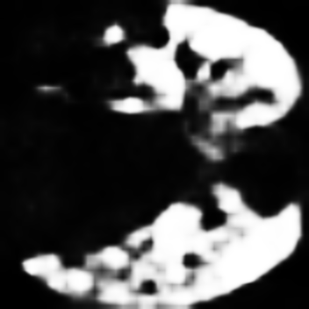
Implement Inf-Net with Pytorch – Read, edit, debug and run the code
Results:
Input image
Segmentation label
Segmentation result
Probability of being classified into lung infection category

