Slide 1
CS3103
Operating System
Workshop 1
C++ Programming and System Calls
in Unix/Linux

Slide 2
Interact with Linux via command-line terminal
Develop program in Linux
Make system calls which involve process management
Send and receive Linux signals
Learning Outcomes

Slide 3
Connect to Linux server.
Invoke Xterm (from CSLab software menu).
Click “Session” button.
Click “SSH” button.
host: gateway.cs.cityu.edu.hk
username: <eid>
password: <cityu AD password>
You should be in your home directory now, otherwise change to your home directory.
> cd
Create and move to the working directory CS3103/ws1.
> mkdir CS3103
> mkdir CS3103/ws1
> cd CS3103/ws1
Startup: CS3103 Linux Server
Notes:
You also can download SSH Secure Shell Client to your PC or laptop, and use it to remote access Linux server.
SSH clients are available for a wide variety of operating systems including Linux, Mac OS and Windows.

Slide 4
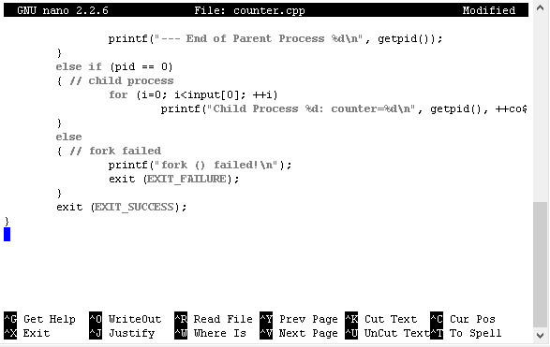
Create the source program counter.cpp using the text editor nano.
> nano counter.cpp
GNU nano is a simple terminal-based text editor. Press Ctrl+G after invoking nano to get online help or learn more at https://help.ubuntu.com/community/Nano
Press Ctrl+G to get help
Startup: Create and edit a C++ program

Slide 5
counter.cpp
#include <stdio.h>
#include <sys/types.h>
#include <sys/wait.h>
#include <unistd.h>
#include <stdlib.h>
int main(int argc, char **argv)
{
int input;
int counter=0;
int status=0;
int i;
pid_t pid;
printf ("--- Process %d is running\n", getpid());
printf ("Enter a number: ");
scanf ("%d", &input);
pid=fork();
Startup: Create and edit a C++ program

Slide 6
counter.cpp
if (pid > 0)
{ // parent process
pid = wait(&status);
printf("--- End of Parent Process %d\n", getpid());
}
else if (pid == 0)
{ // child process
for (i=0; i<input; ++i)
{ printf("Child Process %d: counter=%d\n",
getpid(), ++counter);
sleep(1); // count slowly
}
}
else
{ // fork failed
printf("fork () failed!\n");
exit (EXIT_FAILURE);
}
exit (EXIT_SUCCESS);
}
Startup: Create and edit a C++ program

Slide 7


Save the code and exit.
Press Ctrl+X to exit
Press y and Enter to save the modification
Alternatively, you can download the source file from Canvas and upload the source file to your working directory via Xterm.
Startup: Create and edit a C++ program

Slide 8








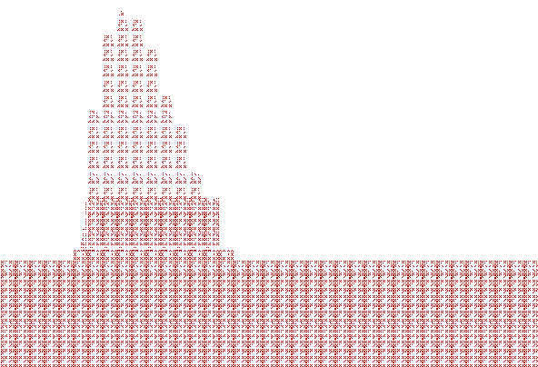
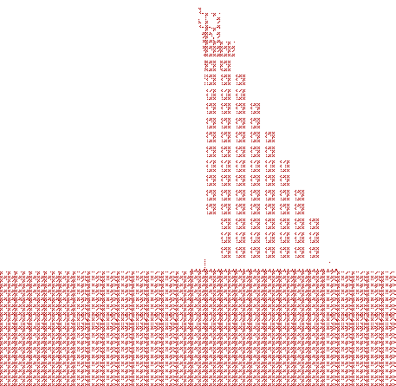
Compile and link the source program counter.cpp to produce an executable file counter.
> g++ counter.cpp -o counter
C++ Libraries
Edit
hello.cpp
Compile
hello.o
Link
hello
Run
Hello World!
Source code
Object file (machine code)
Executable
Output
Startup: Compile and Link
Notes:
What if you have more source files? Makefile for multiple source files.
There is not enough time to introduce Makefile in details in this workshop. You can study online tutorials (on the final page) if you need to use it for your assignments.

Slide 9
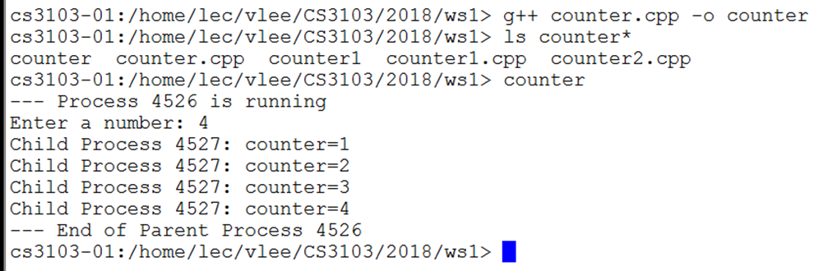
List the files in the current working directory (to check whether you create the executable file counter successfully).
> ls
Run the executable file.
> ./counter
If you enter 4, the output should be as follows:
Startup: Run

Slide 10
Create an executable file that allows debugging.
> g++ counter.cpp -o counter –g
Debug the file.
> gdb counter
Gdb64 counter
(gdb) break 17
Breakpoint 1 at 0x4007d4: file counter.cpp, line 17.
(gdb) run
Starting program: /home/grads/yliang22/cs3103/ws1/counter
warning: the debug information found in "/lib64/ld-2.19.so" does not match "/lib64/ld-linux-x86-64.so.2" (CRC mismatch).
--- Process 8151 is running
Enter a number: 3
Breakpoint 1, main (argc=1, argv=0x7fffffffe9f8) at counter.cpp:17
set a breakpoint at line 17
start the program
GDB – GNU Debugger

Slide 11
17 pid=fork();
(gdb) print pid
$1 = 0
(gdb) next
Child Process 8174: counter=1
Child Process 8174: counter=2
Child Process 8174: counter=3
18 if (pid > 0)
(gdb) next
20 pid = wait(&status);
(gdb) c
Continuing.
--- End of Parent Process 8151
[Inferior 1 (process 8151) exited normally]
(gdb) quit
cs3103-01:/home/grads/yliang22/cs3103/ws1>
display the value of a variable
execute next line
continue running the program
exit from GDB
GDB – GNU Debugger

Slide 12
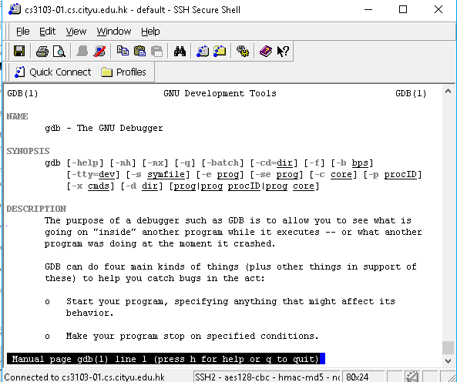
Show more GDB commands.
> man gdb
Edit, compile and run the program again until you are happy with it ☺
GDB – GNU Debugger

Slide 13
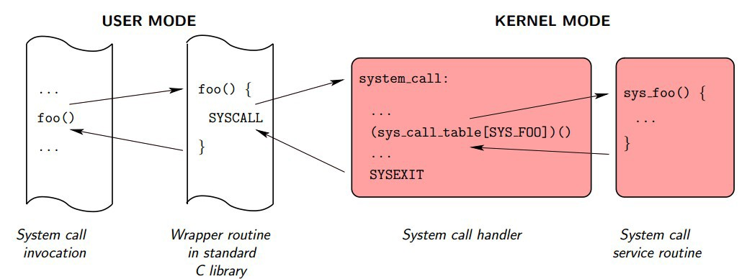
Kernel interfaces: deliver services provided by the OS kernel.
System call wrapper functions: functions in the standard C library that are used to invoke system calls.
To use system calls like library functions, include necessary header ﬁles (e.g., #include <unistd.h>).
System Calls

Slide 14
fork(): create a new (child) process
getpid(): return the id of current process
getppid(): return the id of current process’s parent
exec*(): a family of functions: execute other programs from a process
wait()/ waitpid(): wait for a (child) process to change state
Use man to check the details
System Calls – Process Management

Slide 15
By calling fork(), a process can spawn a child process.
The child duplicates the parent process, so it is almost identical to the parent (except PID).
After fork(), both the parent and child execute the same program.
Prototype:
pid_t pid = fork(); (pid_t is an alias to an integer type)
Header files:
#include <unistd.h>
#include <sys/types.h>
Return values:
pid > 0: succeed, in parent process
pid == 0: succeed, in child process
pid < 0: fail.
System Call: fork ()

Slide 16
Forces the parent to suspend execution and wait for its children or a specific child to change states/state.
Two forms:
wait(): parent waits for any child process
waitpid(): parent waits for the child with a specific PID
Prototype:
pid_t wait(int *status);
pid_t waitpid(pid_t pid, int *status, int options);
Header file:
#include <sys/types.h>
#include <sys/wait.h>
Return values:
On success: PID of the exited process
On error: -1
System Call: Wait ()

Slide 17
You have seen the use of some of the system calls such as fork() and wait() in the given program counter.cpp.
Try to take the following challenge to practice another common system call execvp().
Modify counter.cpp such that the counting step is done by another program executed from the child process.
Hints:
You need to create another program such as counting.cpp, compile it to generate an executable file such as counting.
Modify the child process to execute counting using the system call execvp.
Use man execvp to check the details of the system call.
Challenge 1

Slide 18
A signal is a small message that notiﬁes a process that an event of some type has occurred in the system.
Signal

Slide 19
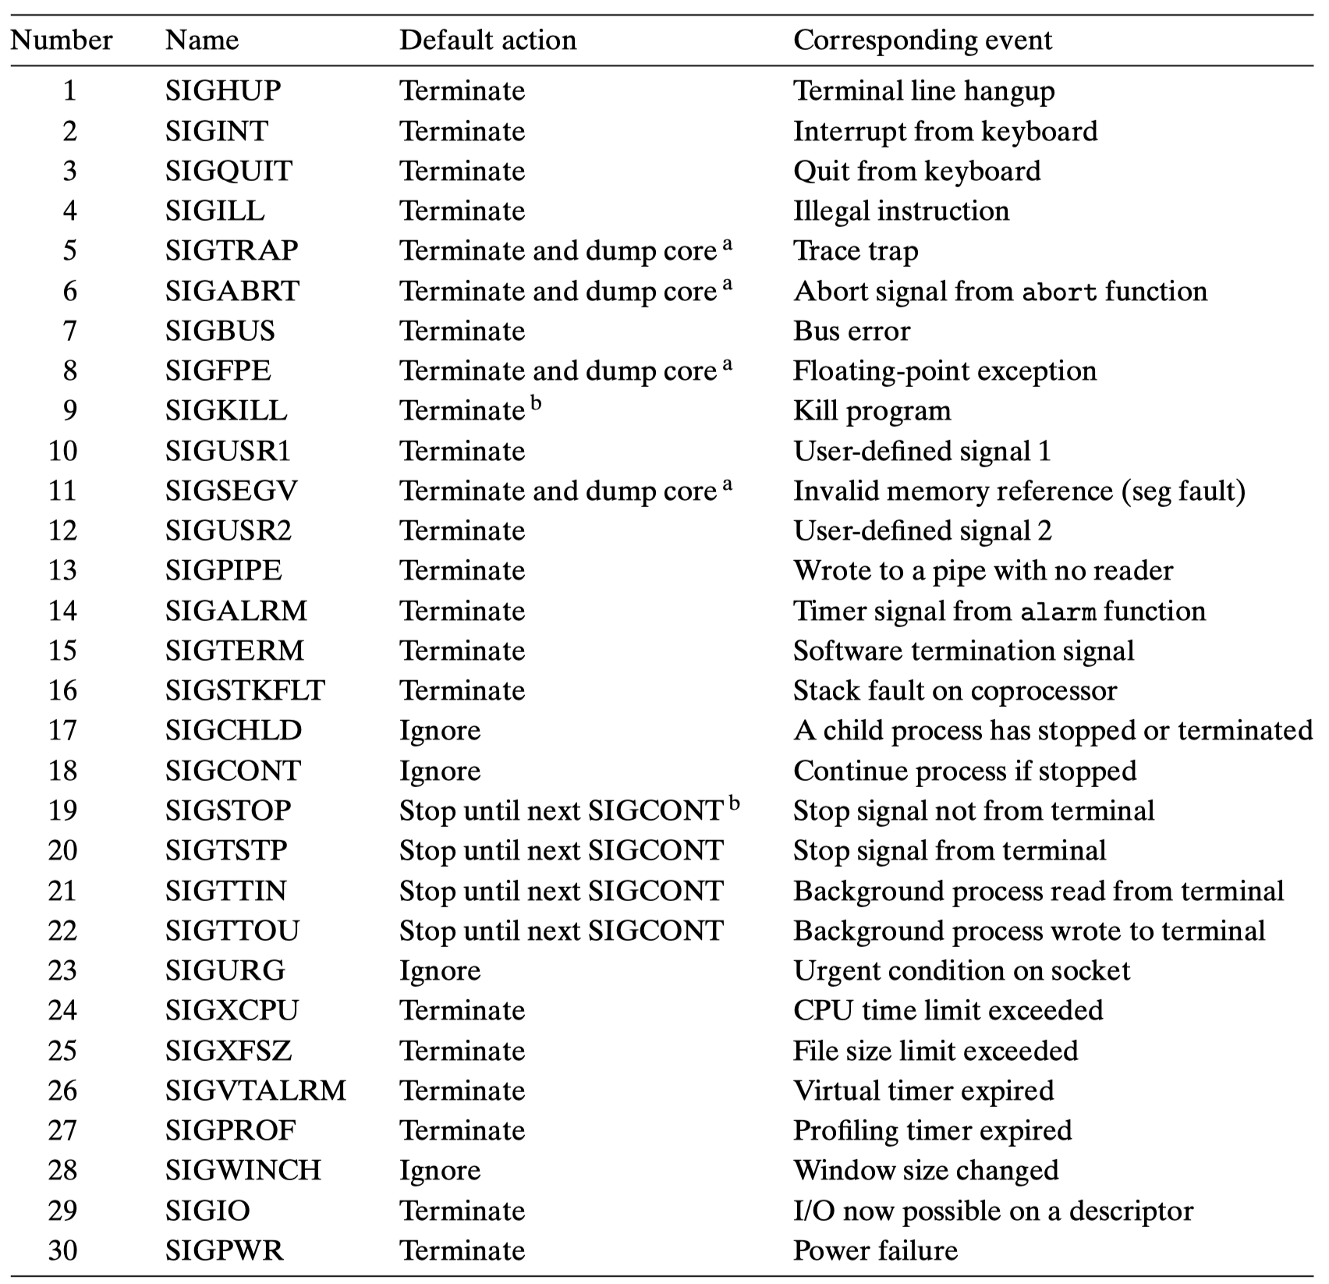
Signal List

Slide 20
The signal is sent for one of two reasons:
Reason 1: the kernel has detected a system event
Example:
Typing Ctrl+C at the keyboard causes the kernel to send a SIGINT signal to every process in the foreground process group;
Typing Ctrl+Z causes the kernel to send a SIGTSTP signal to every process in the foreground process group;
When a child process terminates or stops, the kernel sends a SIGCHLD signal to the parent;
Sending Signals

Slide 21
Reason 2: a process has invoked the kill function
int kill(pid_t pid, int sig)
pid > 0: send signal number sig to process pid
pid == 0: send signal sig to every process in the process group of the calling process, including the calling process itself
pid < 0: send signal sig to every process in process group |pid| (the absolute value of pid).
Example:
/* send SIGTERM to process 4096 as well as all child processes that process 4096 forked */
kill(-4096, SIGTERM);
Sending Signals

Slide 22
A process receives a signal and reacts to the signal, which will trigger the default action or user-defined action:
Default Action (See the Signal List page for more details)
Each signal type has a predeﬁned default action, which is one of the following:
(1) The process terminates;
(2) The process terminates and dumps core;
(3) The process stops (suspends) until restarted by a SIGCONT signal;
(4) The process ignores the signal.
Receiving Signals

Slide 23
User-defined Action
A process can modify its action by using the Signal function (Note: this won’t change the default action of any other processes).
Example:
/* catch SIGINT, print a message, and then terminate the process */
void sigint_handler(int sig) {
printf ("Caught SIGINT!\n");
exit (0);
}
int main() {
/* Install the self-defined SIGINT handler */
Signal (SIGINT, sigint_handler);
}
Receiving Signals

Slide 24
After learning the basic concepts of signal, try to take another challenge to practice the use of signal() and kill().
Modify counter.cpp such that when user types Ctrl+C while the child process is counting, the child process will be terminated before the parent process exits normally.
Hint:
You need to create a signal handler function for the SIGINT signal to kill the child process.
Challenge 2

Slide 25
Available Online C Programming Tutorials：
http://www.cprogramming.com
http://www.cprogrammingexpert.com/C/
Unix Startup Guide
http://cslab.cs.cityu.edu.hk/supports/unix-startup-guide
Common File and Directory Commands at Linux Server
https://help.ubuntu.com/community/UsingTheTerminal#File_.26_Directory_Commands
GDB User Manual
http://sourceware.org/gdb/current/onlinedocs/gdb/
Tutorials for Makefile :
http://mrbook.org/blog/tutorials/make/
http://www.cprogramming.com/tutorial/makefiles.html
More on Signals
Computer Systems: A programmer’s Perspective, 3/E, Chapter 8
Of course, YouTube!
Materials

