Slide 1

Chapter 5 Concurrency: Mutual Exclusion and Synchronization
Operating Systems: Internals and Design Principles William Stallings

Slide 2
Roadmap
Principles of Concurrency
Mutual Exclusion
Semaphores
IPC - Message Passing
Readers/Writers Problem

Slide 3
Multiple Processes
OS design is concerned with the management of processes and threads in different systems.
Multiprogramming
Multiple processes, one core
Multiprocessing
Multiple processes, multiple cores (shared memory)
Distributed Processing
Multiple processes, multiple nodes (distributed memory)

Slide 4
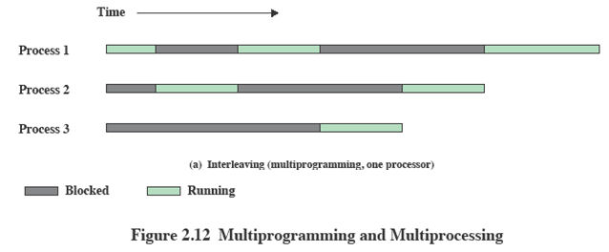
Interleaving and Overlapping Processes
Earlier (Ch2) we saw that processes may be interleaved on uniprocessors

Slide 5
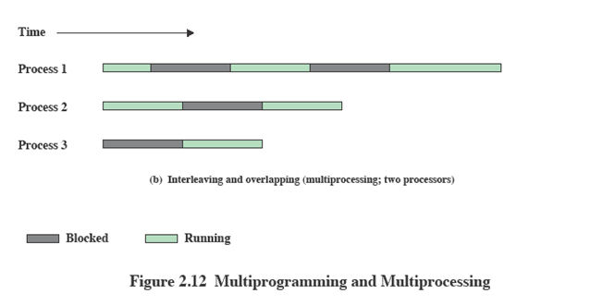
Interleaving and Overlapping Processes
Not only interleaved but overlapped on multi-processors

Slide 6
Principles of Concurrency
Interleaving and overlapping can be viewed as examples of concurrent processing and present the same problems.
The relative speed of execution of processes cannot be predicted.
depends on activities of other processes
the way the OS handles interrupts
scheduling policies of the OS

Slide 7
Difficulties of Concurrency
Sharing of global resources
Example: global variables
Difficult for the OS to manage the allocation of resources optimally
Multiple processes may request use of the same resource.
Difficult to locate programming errors
Results are not deterministic and reproducible.

Slide 8
Race Condition
A race condition occurs when multiple processes or threads read and write shared data items.
The final result depends on how the execution of instructions in the multiple processes interleaves.
The “loser” of the race is the process that updates last and will determine the final value of the variable.

Slide 9
Execution Sequence Example
Assume X is a global variable which can be accessed by P1 and P2
X = 5000
P1 | P2
(X = X + 2000) Reg ← Read Mem Reg ← Reg + 2000 Reg → Write Mem | (X = X – 1000) Reg ← Read Mem Reg ← Reg - 1000 Reg → Write Mem

Slide 10
Execution Sequence Example
Can you give a sequence which results in X being 7000 at the end?
 |  | Reg | X
P1 | 1 | 5000 | 5000
P1 | 2 | 7000 | 5000
P1 | 3 | 7000 | 7000
P2 | 1 | 7000 | 7000
P2 | 2 | 6000 | 7000
P2 | 3 | 6000 | 6000
 |  | Reg | X
P1 | 1 | 5000 | 5000
P2 | 1 | 5000 | 5000
P1 | 2 | 7000 | 5000
P2 | 2 | 4000 | 5000
P1 | 3 | 7000 | 7000
P2 | 3 | 4000 | 4000
 |  | Reg | X
P1 | 1 | 5000 | 5000
P1 | 2 | 7000 | 5000
 |  |  | 7000
Nondeterministic result !!!

Slide 11
Operating System Concerns
What design and management issues are raised by the existence of concurrency?
The OS must
keep track of various processes
allocate and de-allocate resources for each active process; multiple processes want access to the same resource
protect the data and physical resources of each process against interference by other processes
ensure that a process and its output must be independent of the speed at which its execution is carried out relative to the speed of other concurrent processes

Slide 12
Resource Competition
Concurrent processes come into conflict when they are competing for use of the same resource such as I/O devices, memory, and processor time.
In the case of competing processes, three control problems must be faced:
Need for Mutual Exclusion
Example: In the case of the printer, we want any individual process to have control of the printer while it prints an entire file. Otherwise, lines from competing processes will be interleaved.
Deadlock
Starvation

Slide 13
Roadmap
Principles of Concurrency
Mutual Exclusion
Semaphores
IPC - Message Passing
Readers/Writers Problem

Slide 14
Mutual Exclusion
The problem concerns a group of processes which need access to some resource that cannot be used simultaneously by more than one single process.
Control of competition involves the OS because it is the OS that allocates resources.
The processes themselves also need to be able to express the requirement for mutual exclusion.
Critical Section: The piece of code within a process that accesses a shared resource (data structure or device) that must not be concurrently accessed by other processes.
It is important that only one program at a time be allowed in its critical section.

Slide 15
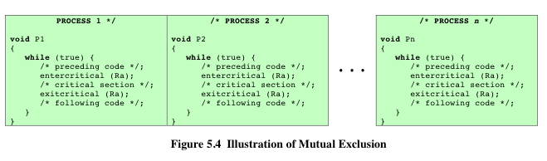
Mutual Exclusion
In the following figure, each process includes a critical section that operates on some resource Ra.
The two functions: entercritical and exitcritical are used to enforce mutual exclusion: any process that attempts to enter its critical section while another process is in its critical section is made to wait.
BUT, how to provide the functions entercritical and exitcritical?

Slide 16
Requirements for Mutual Exclusion
Any facility that is to provide support for mutual exclusion should meet the following requirements:
Mutual exclusion must be enforced: only one process at a time is allowed into its critical section, among all processes that have critical sections for the same resource
A process that halts in its noncritical section must do so without interfering with other processes
No deadlock or starvation
When no process is in a critical section, any process that request entry to its critical section must be permitted to enter without delay
No assumptions are made about relative process speeds or number of processes
A process remains inside its critical section for a finite time only

Slide 17
Hardware Support: Disabling Interrupts
Uniprocessors only allow interleaving, no overlapping.
To guarantee mutual exclusion, it is sufficient to prevent a process from being interrupted while it is in the critical section.
Will it work for multi-processor architecture?
while (true) {
/* disable interrupts */;
/* critical section */;
/* enable interrupts */;
/* remainder */;
}

Slide 18
Hardware Support: Special Machine Instructions
Another hardware solution:
Compare-and-Swap (CAS) Instruction
A compare is made between a memory value and a test value.
If the values are the same, a swap occurs.
atomic CPU instruction that cannot be interrupted

Slide 19
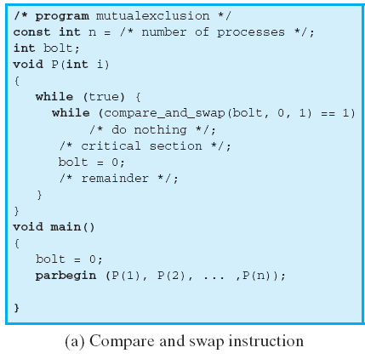
Compare & Swap Instruction
Pesudo Code
Usage Example
int compare_and_swap (int *word,
int testval, int newval)
{
int oldval;
oldval = *word;
if (oldval == testval)
*word = newval;
return oldval;
}
Only one process finding bolt equal to 0 will enter its critical section; all other processes go into a busy waiting mode

Slide 20
Special Machine Instruction
Advantages
Applicable to any number of processes on either a single processor or multiple processors sharing main memory
Simple and easy to verify
It can be used to support multiple critical sections; each critical section can be defined by its own variable

Slide 21
Special Machine Instruction
Disadvantages
Busy-waiting consumes processor time
Starvation is possible
When a process leaves a critical section and more than one process is waiting, the selection of a waiting process is arbitrary; some process could indefinitely be denied access.
Deadlock is possible
P1 enters its critical section and is then preempted by a higher-priority P2.
P2 attempts to use the same resource as P1 but is denied access because of the mutual exclusion mechanism.
P2 goes into a busy waiting loop.
The lower-priority P1 will never be dispatched.

Slide 22
Roadmap
Principles of Concurrency
Mutual Exclusion
Semaphores
IPC - Message Passing
Readers/Writers Problem

Slide 23
Semaphore
Fundamental principle: multiple processes can cooperate by means of simple signals such that a process can be forced to stop at a specified place until it has received a specific signal.
Semaphore: an integer value used for signalling among processes.
Three operations on a semaphore are all atomic:
Initialize to a non-negative integer value
semWait decrements the semaphore value: to receive a signal
semSignal increments the semaphore value: to transmit a signal

Slide 24
Semaphore
The semaphore is initialized to zero or a positive value.
When the value is positive, that value equals the number of processes that can issue a wait and immediately continue to execute.
When the value is zero, the next process to issue a wait is blocked, and the semaphore value goes negative.
Each subsequent wait further decrements the value.
The negative value equals the number of processes waiting to be unblocked.
Each signal unblocks one of the waiting processes, if any.

Slide 25
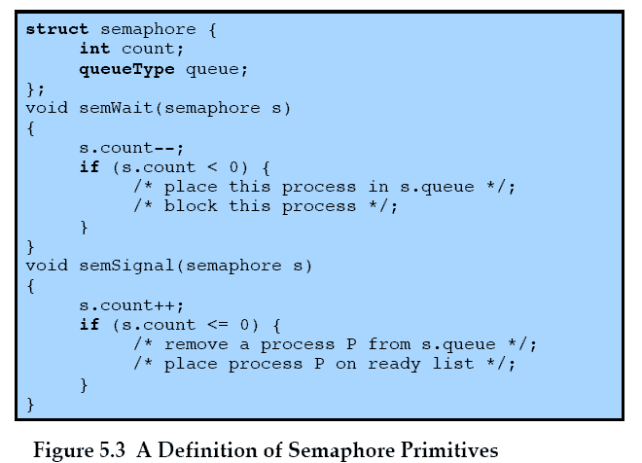
General Semaphore Primitives
-ve value equals the number of blocked processes

Slide 26
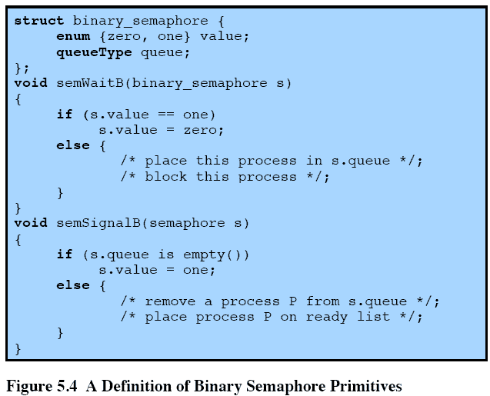
Binary Semaphore Primitives

Slide 27
Mutex
A concept related to the binary semaphore is the mutex.
Two operations: lock() and unlock()
When a process tries to lock a mutex
It may acquire the lock if the mutex is not being locked
Or it may fail and enter in a waiting mode if the mutex is being locked
When a process tries to unlock a mutex
It releases the lock and makes the mutex available for another process to lock
A key difference between binary semaphore and mutex is that the process that locks the mutex must be the one to unlock it, i.e., a process cannot unlock a mutex that is not locked by itself.

Slide 28
Strong/Weak Semaphore
A queue is used to hold processes waiting on the semaphore.
In what order are processes removed from the queue?
Strong Semaphores use FIFO: the process that has been blocked the longest is released from the queue first.
Weak Semaphores do not specify the order of removal from the queue.

Slide 29
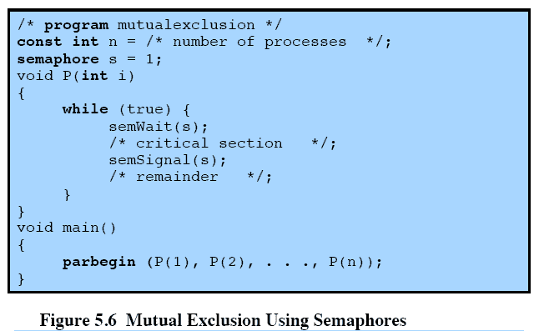
Mutual Exclusion Using Semaphores
The first process will be able to enter the critical section immediately, setting the value of s to 0.
Any other processes attempting to enter the critical section will be blocked, s is decremented.
When the first process departs, s is incremented and one of the blocked processes (if any) becomes Ready.

Slide 30
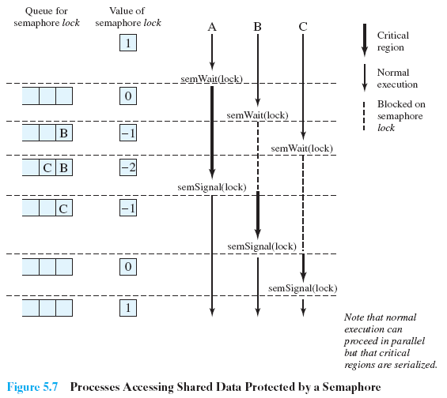
Processes Using Semaphore

Slide 31
Producer/Consumer Problem
General Statement:
One or more producers are generating data and placing these in a buffer.
A single consumer is taking items out of the buffer one at time.
Only one producer or consumer may access the buffer at any one time.
The Problem:
Ensure that the Producer can’t add data into full buffer and Consumer can’t remove data from empty buffer.

Slide 32
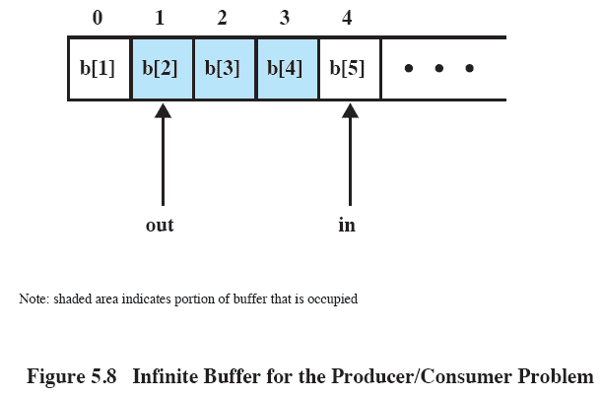
Infinite Buffer
Assume an infinite buffer b with a linear array of elements.
The consumer must make sure that it does not attempt to read from an empty buffer.
The producer can generate items and store them in the buffer at its own pace.

Slide 33
Idea
A consumer is
blocked when removing from empty buffer (i.e., ZERO item in the buffer)
unblocked when an item is inserted by the producer (i.e., >0 number of items in the buffer)
A semaphore, n = number of items in the buffer, can be used to implement the idea.

Slide 34
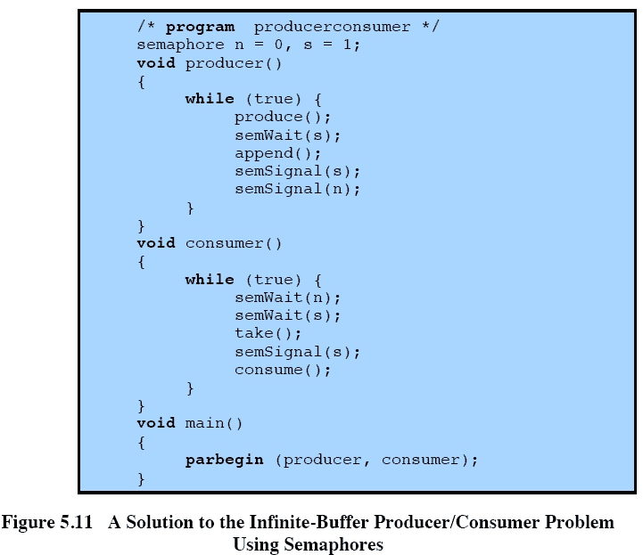
Semaphores
n is equal to the number of items in the buffer.
Prevent the consumer and any other producer from accessing the buffer during the append operation.
The consumer must wait on both semaphores before proceeding.

Slide 35
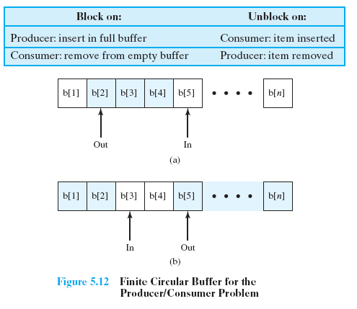
Bounded Buffer

Slide 36
Idea
A producer is
blocked when inserting in full buffer (i.e., ZERO empty space in the buffer)
unblocked when an item is removed by the consumer (i.e., >0 number of empty space in the buffer)
A semaphore, e = number of empty spaces in the buffer, can be used to implement the idea.

Slide 37
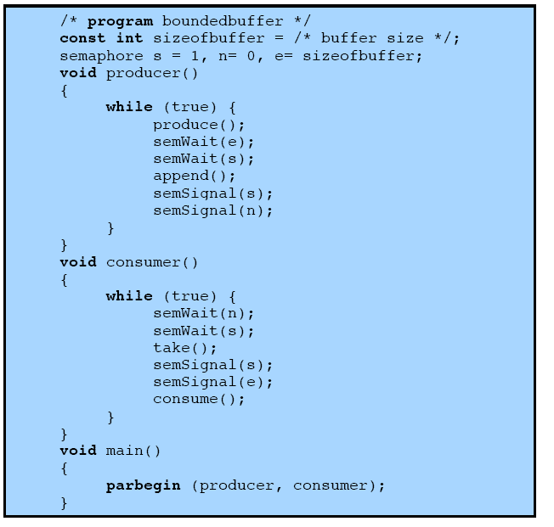
Semaphores
e keeps track of the number of empty spaces

Slide 38
Roadmap
Principles of Concurrency
Mutual Exclusion
Semaphores
IPC - Message Passing
Readers/Writers Problem

Slide 39
Message Passing
When processes interact with one another, they may need to satisfy two fundamental requirements:
synchronization: to enforce mutual exclusion
communication: to exchange information
Message Passing is one approach to providing both of these functions.

Slide 40
Message Passing
The actual function is normally provided in the form of a pair of primitives:
send (destination, message)
receive (source, message)
If P1 and P2 wish to communicate, they must send messages to and receive messages from each other.
a communication link must exist between them

Slide 41
Direct Communication
Processes must name each other explicitly:
send(P1, message) – send a message to process P1
receive(P2, message) – receive a message from process P2
Properties of communication link
The processes need to know each other’s identity to communicate.
A link is associated with exactly two processes.
Between each pair of processes, there exists exactly one link.

Slide 42
Indirect Communication
Messages are directed to and received from mailboxes (also referred to as ports)
boxid = mailbox-create(IDENTIFIER)
send(boxid, message)
receive(boxid, message)
One process sends a message to the mailbox and the other process picks up the message from the mailbox
Properties of communication link
A link is established between a pair of processes only if they have a shared mailbox.
A link may be associated with many processes.
Each pair of processes may have several links, each link corresponds to one mailbox.

Slide 43
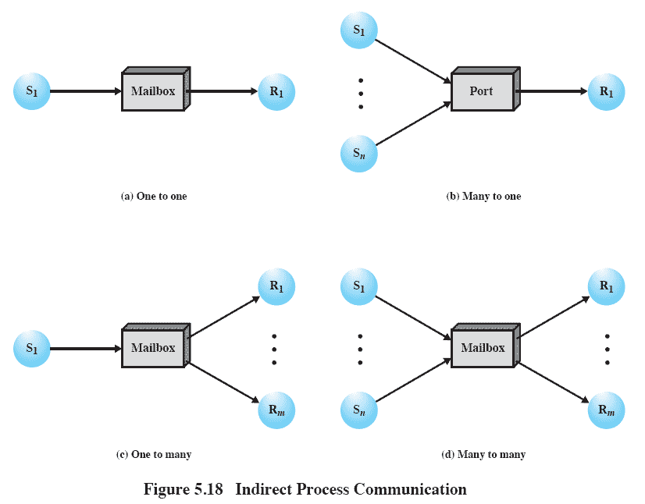
Indirect Communication
One-to-one relationship
allows a private communications link to be set up between two processes.
Many-to-one relationship
useful for client/server interaction, one process provides service to a number of other processes.
the mailbox is often referred to as a port.

Slide 44
Indirect Communication
One-to-many relationship
allows for one sender and multiple receivers;
useful for applications where a message is to be broadcast to a set of processes.
Many-to-many relationship
allows multiple server processes to provide concurrent service to multiple clients.

Slide 45
Synchronization
Message passing may be either blocking or non-blocking
Blocking is considered synchronous
Blocking send: the sender is blocked until the message is received
Blocking receive: the receiver is blocked until a message arrives
Non-blocking is considered asynchronous
Non-blocking send: the sender sends the message and continues
Non-blocking receive: the receiver receives the message or abandons the attempt to receive and continues

Slide 46
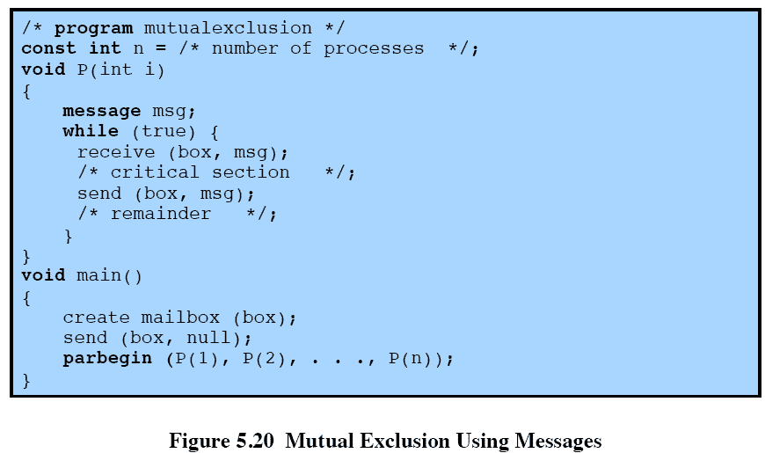
Mutual Exclusion Using Messages
blocking receive
non-blocking send
A process wishing to enter its critical section attempts to receive a message.
The process places the message back into the mailbox.
The message functions as a token that is passed from process to process.

Slide 47
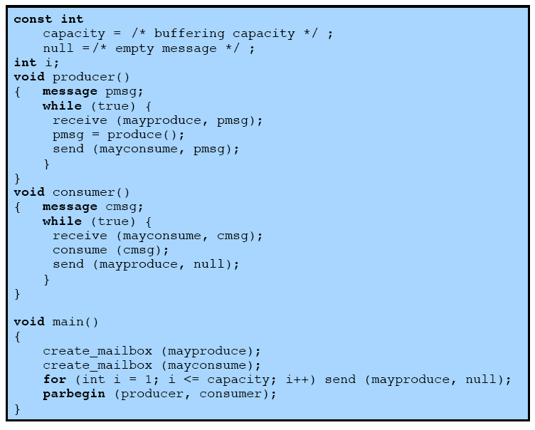
Producer/Consumer Messages
blocking receive
non-blocking send
Data are sent as messages to mayconsume which serves as the buffer.
The number of messages in mayproduce shrinks with each production and grows with each consumption.
mayproduce is filled with a number of null messages equal to the capacity of the buffer.

Slide 48
Roadmap
Principles of Concurrency
Mutual Exclusion
Semaphores
IPC - Message Passing
Readers/Writers Problem

Slide 49
Readers / Writers Problem
A data area is shared among many processes
Some processes only read the data area (readers), some only write to the data area (writers)
Conditions to satisfy:
Any number of readers may simultaneously read the file.
Only one writer at a time may write to the file.
If a writer is writing to the file, no reader may read it.

Slide 50
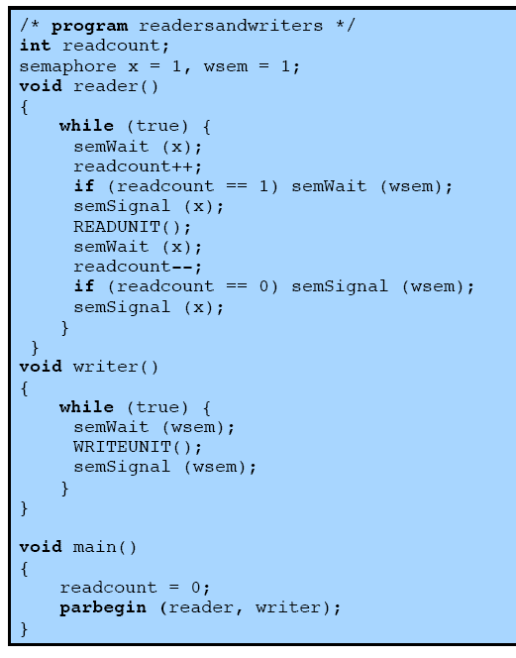
Readers have Priority
readcount keeps track of the number of readers
x assures that readcount is updated properly
the first reader that attempts to read should wait on wsem
wsem is used to enforce mutual exclusion: as long as one writer is accessing the shared data area, no other writers and no readers may access it

Slide 51
Readers/Writers Problem
Once a single reader has begun to access the data area, it is possible for readers to retain control of the data area as long as there is at least one reader reading.
Therefore, writers are subject to starvation
An alternative solution: no new readers are allowed access to the data area once at least one writer wants to write

Slide 52
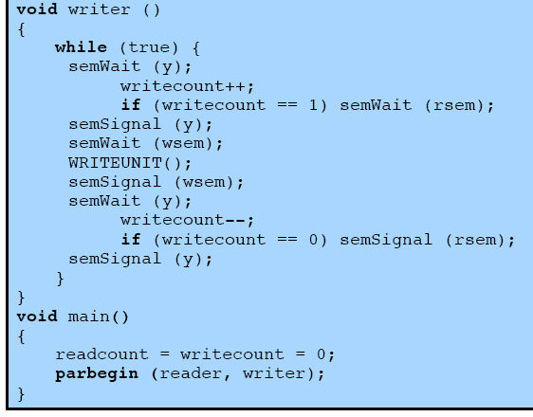
Writers have Priority
y controls the updating of writecount
writecount controls the setting of rsem
rsem inhibits all readers while there is at least one writer desiring access to the data area

Slide 53
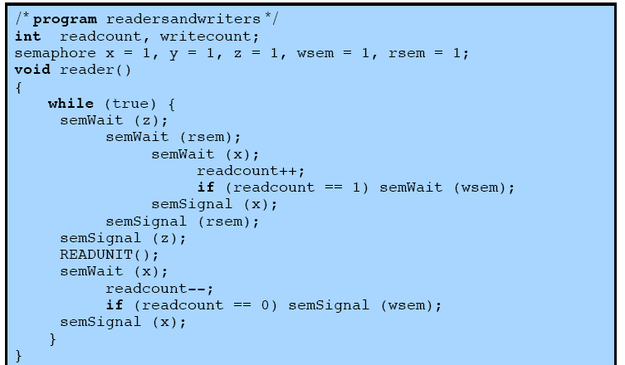
Writers have Priority
only one reader is allowed to queue on rsem, with any additional readers queuing on z

Slide 54
Reader
semWait (rsem);
semWait(x);
readcount++;
if(readcount==1)
semWait(wsem);
semSignal(x);
semSignal (rsem);
READUNIT( );
semWait(x);
readcount--;
if (readcount==0)
semSignal(wsem);
semSignal(x);
Reader
blocked
semWait (rsem);
semWait(x);
readcount++;
if(readcount==1)
semWait(wsem);
semSignal(x);
semSignal (rsem);
READUNIT( );
semWait(x);
readcount--;
if (readcount==0)
semSignal(wsem);
semSignal(x);
Reader
blocked
Writer
semWait (rsem);
semWait(x);
readcount++;
if(readcount==1)
semWait(wsem);
semSignal(x);
semSignal (rsem);
READUNIT( );
semWait(x);
readcount--;
if (readcount==0)
semSignal(wsem);
semSignal(x);
semWait(y)
writecount++;
if (writecount==1)
semWait(rsem);
semSignal(y);
semWait(wsem);
WRITEUNIT( );
semSignal(wsem);
semWait(y);
writecount--;
If (writecount==0)
semSignal(rsem);
semSignal(y);
blocked
Unblock the following readers.
Unblock the writer. The writer is then blocked on wsem
The writer has to wait until the all readers finish reading and semSignal(wsem).

Slide 55
Reader
Reader
semWait(z);
semWait (rsem);
semWait(x);
readcount++;
if(readcount==1)
semWait(wsem);
semSignal(x);
semSignal (rsem);
semSignal(z);
READUNIT( );
semWait(x);
readcount--;
if (readcount==0)
semSignal(wsem);
semSignal(x);
Reader
blocked
semWait(z);
semWait (rsem);
semWait(x);
readcount++;
if(readcount==1)
semWait(wsem);
semSignal(x);
semSignal (rsem);
semSignal(z);
READUNIT( );
semWait(x);
readcount--;
if (readcount==0)
semSignal(wsem);
semSignal(x);
Writer
blocked
semWait(z);
semWait (rsem);
semWait(x);
readcount++;
if(readcount==1)
semWait(wsem);
semSignal(x);
semSignal (rsem);
semSignal(z);
READUNIT( );
semWait(x);
readcount--;
if (readcount==0)
semSignal(wsem);
semSignal(x);
semWait(y)
writecount++;
if (writecount==1)
semWait(rsem);
semSignal(y);
semWait(wsem);
WRITEUNIT( );
semSignal(wsem);
semWait(y);
writecount--;
If (writecount==0)
semSignal(rsem);
semSignal(y);
blocked
Unblock the writer. The writer is then blocked on wsem
Unblock the 2nd reader waiting on z, but it will be blocked on rsem.
Unblock the writer

Slide 56
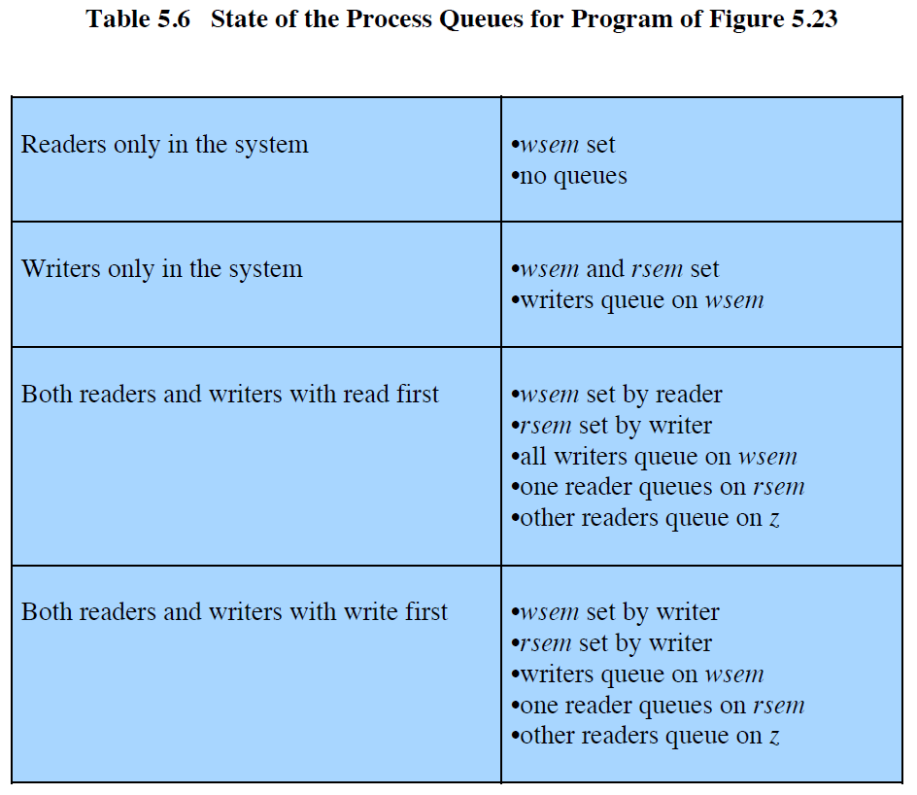
Writers have Priority

Slide 57
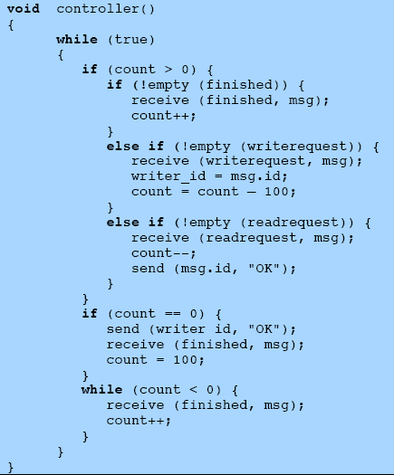
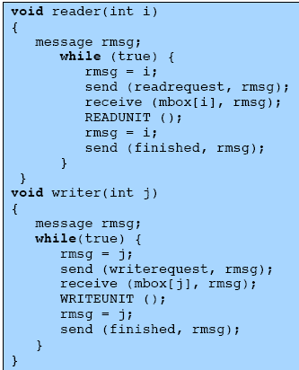
Writers Have Priority Message Passing
count = 100, initially

Slide 58
Writers Have Priority Message Passing
Processes wishing to access the data area send a request message to the controller
Granted access with an “OK” reply message
Completion of access with a “finished” message
count is initialized to 100 (> the maximum possible number of readers)
count > 0: no writer is waiting, clear active readers first, then service write requests and then read requests
count = 0: the only request outstanding is a write request
count < 0: a writer has made a request and is being made to wait to clear all active readers

Slide 59
Writers Have Priority Message Passing
Writers have priority
The controller services write requests before read requests.
Readers only and readers can read simultaneously
After receiving a read request, the controller sends “OK” and does not block to receive “finished” (count > 0) → can continue to receive other read requests.
Writers only and only one writer can write at a time
After receiving a write request, the controller sends “OK” and blocks to receive “finished” (count == 0) → cannot continue until the writer finishes.

Slide 60
Writers Have Priority Message Passing
Both readers and writers and read first (i.e., a writer arrives while the first reader is reading)
The controller receives the write request and makes the writer to wait until receiving “finished” from the first reader (count < 0).
When the first reader finishes, the controller sends “OK” to the writer and blocks to receive “finished” (count == 0).
Both readers and writers and write first (i.e., a reader arrives while the first writer is writing)
The controller blocks to receive “finished” while the first writer is writing (count == 0).
When the first writer finishes, the controller receives the read request and send “OK” to the reader” (count > 0).

