Slide 1
Lecture 2: Relational Model
CS3402 Database Systems

Slide 2
Introduction (1/2)
Although the ER approach is a simple and an appropriate way to describe the structure of data, many database implementations are always based on another approach called the relational model
ER diagram ⇒ relational model
The relational model was first proposed by Dr. E.F. Codd of IBM Research in 1970 in the following paper: “A Relational Model for Large Shared Data Banks,” Communications of the ACM, June 1970.
The above paper caused a major revolution in the field of database management and earned Dr. Codd the coveted ACM Turing Award.

Slide 3
Introduction (2/2)
A relation looks like a table (rows x columns) of values
A relation contains a set of rows (tuples) and each column (attribute) has a column header that gives an indication of the meaning of the data items in that column
Associated with each attribute of a relation is a set of values (domain)
Students(SSN:string, Name:string, GPA:double)
The data elements in each row (tuple) represent certain facts that correspond to a real-world entity or relationship

Slide 4
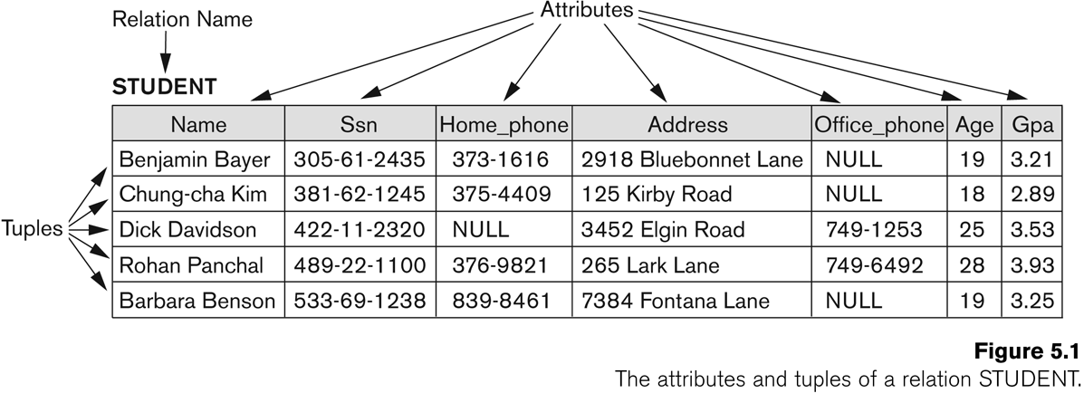
Example

Slide 5
Primary Key vs Foreign Key
Primary Key | Foreign Key
Primary key uniquely identify a record in the table. | Foreign key is a field in the table that is primary key in another table.
We can have only one Primary key in a table. | We can have more than one foreign key in a table.

Slide 6
Relational Data Model: Basic Structure (1/2)
Records
Each row/tuple in a relation is a record/tuple (an entity)
Each attribute in a relation corresponds to a particular field of a record
Sample relational DB schema:
Customer
Part
customer_no | customer_name | address
part_no | part_name | cost
Order
order_no | customer_no | part_no | quantity

Slide 7
Relational Data Model: Basic Structure (2/2)
A corresponding DB instance
Customer
Part
customer_no | customer_name | address
101 | Alan | 8 Blue St., LA
102 | Bob | 6 Red Ave., SF
103 | Carrie | 12 Pink Rd., NY
part_no | part_name | cost
301 | widget | 25,000
302 | Gadget | 17,500
303 | screw | 5,900
Order
order_no | customer_no | part_no | quantity
1 | 101 | 301 | 2
2 | 101 | 302 | 5
3 | 103 | 303 | 5
4 | 102 | 301 | 6

Slide 8
Definition Summary
Informal Terms | Formal Terms
Table | Relation
Column header | Attribute
All possible values for a column | Domain
Row | Tuple
Table definition | Schema of a relation
Populated table | State of the relation

Slide 9
Relation State
Each populated relation has many records or tuples in its current relation state
Whenever the database is changed, a new state arises.
Basic operations for changing the database:
Insert – add a new tuple in a relation
Delete – remove an existing tuple from a relation
Update – modify an attribute of an existing tuple

Slide 10
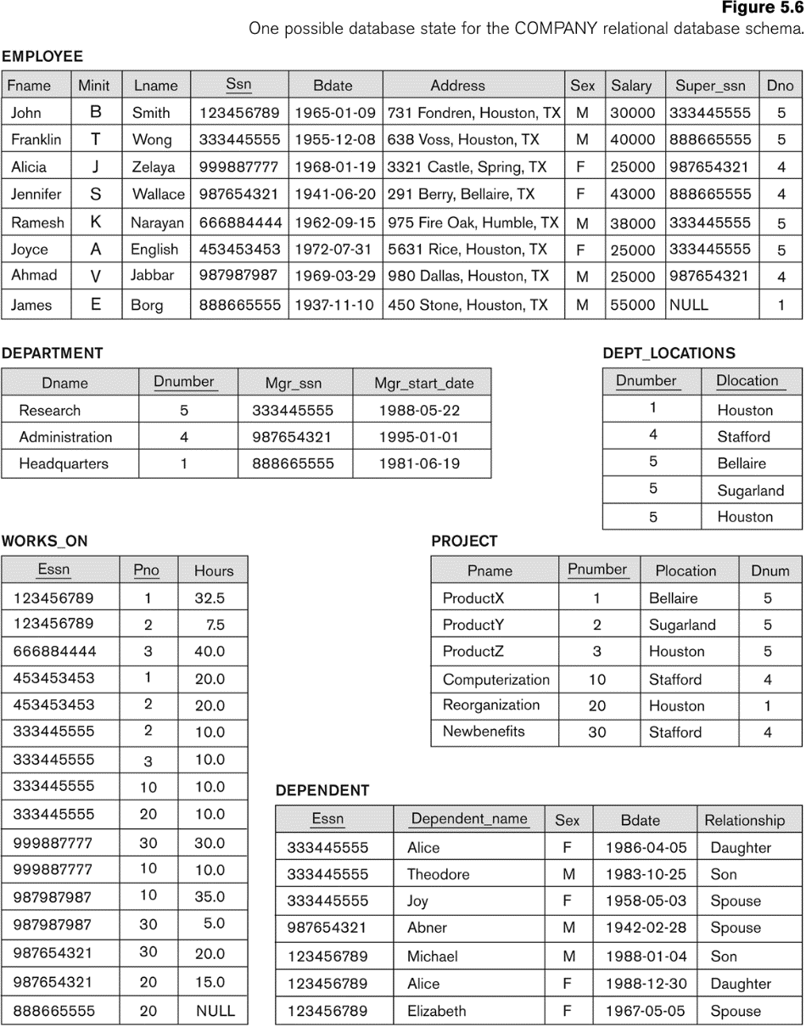
Database State
One possible database state for the Company relational database schema

Slide 11
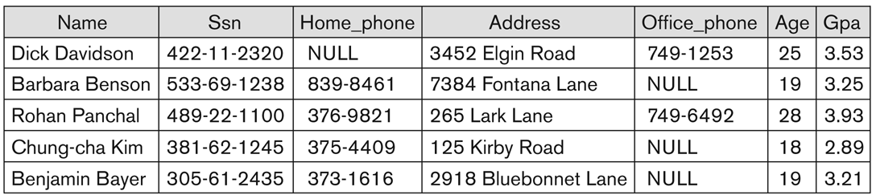
Characteristics of Relations (1/2)
The tuples are not considered to be ordered, even though they appear to be in a tabular form (may have different presentation orders)
Same relation state with different order of tuples

Slide 12
Characteristics of Relations (2/2)
Values in a tuple
All values are considered atomic (indivisible)
Basic unit for manipulation (add or change)
Each value in a tuple must be from the domain (set of values) of the attribute for that column
A special null value is used to represent values that are unknown or not available or inapplicable in certain tuples

Slide 13
From ER Diagrams to Relations: Step 1 (1/2)
Mapping of strong Entity Types
For each regular entity type,
Create a relation R that includes all the simple attributes of E
Choose one of the key attributes E as the primary key for R
R is called an entity relation
Each tuple in R represents an entity instance
For example, entity E with k simple attributes, a₁, a₂, …, a_{k}, where a₁ is a key attribute, and entity set {e₁, e₂, …, e_{n}}
Primary key
a₁
a₂
…
a_{k}
a₁ | a₂ | … | a_{k}
Tuples e₁, e₂, …, e_{n}
E

Slide 14
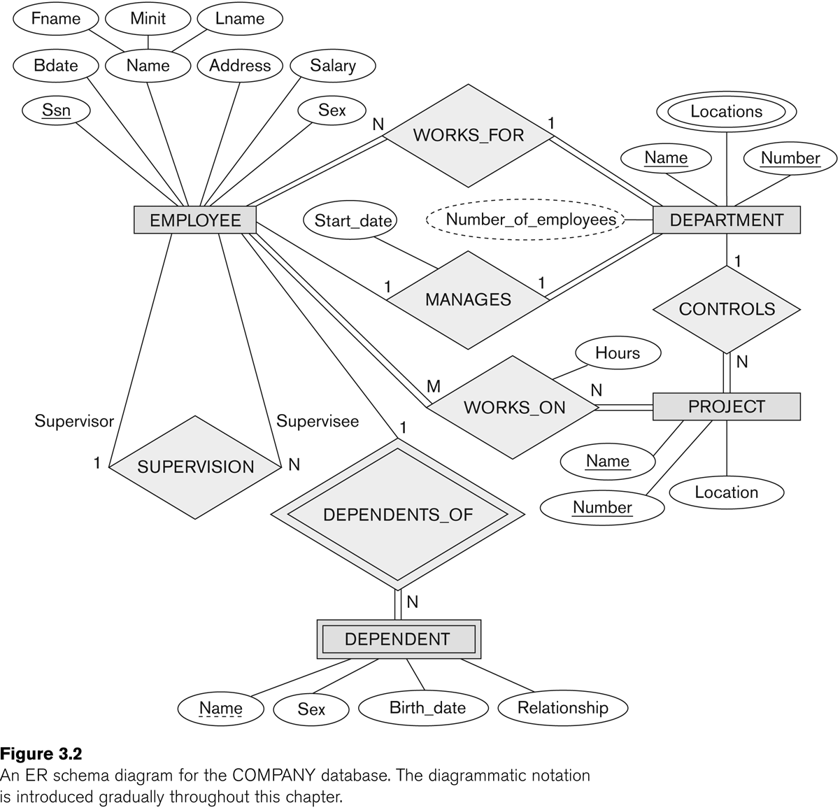
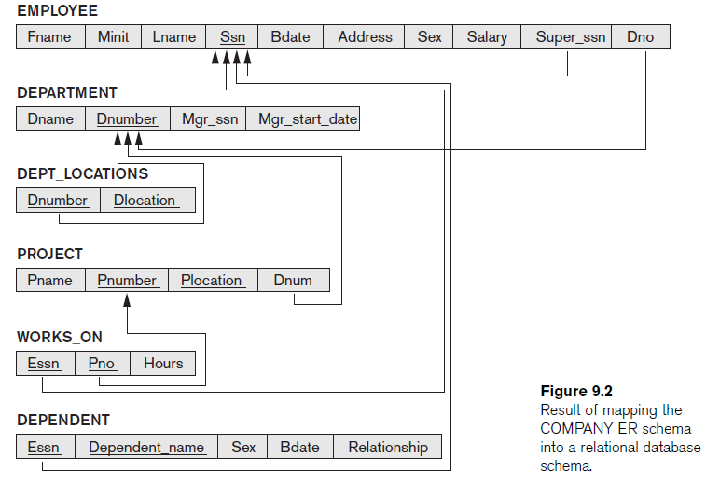
From ER Diagrams to Relations: Step 1 (2/2)

Slide 15
From ER Diagrams to Relations: Step 2 (1/2)
Mapping of Weak Entity Types
For each weak entity type
Create a relation R and includes all the simple attributes of the entity type as the attributes of R
Include the primary key attribute of the owner as the foreign key attributes of R
The primary key of R is the combination of (1) the primary key of the owner and (2) the partial key of the weak entity type

Slide 16
From ER Diagrams to Relations: Step 2 (2/2)
the primary key of the owner
the partial key of the weak entity type

Slide 17
From ER Diagrams to Relations: Step 3 (1/4)
Mapping of Binary 1:1 Relationship Types
For each binary 1:1 relationship type
Identify relations that correspond to the entity types participating in R
Possible approaches
Foreign key approach
Merged relationship approach
Cross reference or relationship relation approach

Slide 18
From ER Diagrams to Relations: Step 3 (2/4)
Foreign key approach (with relations S and T)
Choose one of the relations (i.e., S) and include the primary key of T as the foreign key in S
Include all the simple attributes of the relationship as the attributes of S

Slide 19
From ER Diagrams to Relations: Step 3 (3/4)
(T)
(S)

Slide 20
From ER Diagrams to Relations: Step 3 (4/4)
Merged relationship approach (with relations S and T)
Merge the two entity types and the relationship into a single relation
Cross reference or relationship relation approach (with relations S and T)
Set up a third relation R for the purpose of cross-referencing the primary keys of the two relations S and T representing the entity types
Relation R will include the primary key attributes of S and T as foreign keys to S and T, respectively
The primary key of R will be one of the two foreign keys
Include all the simple attributes of the relationship as the attributes of R
Relation Department_manager
Dnumber | Ssn | Start_date

Slide 21
From ER Diagrams to Relations: Step 4 (1/2)
Mapping of Binary 1:N Relationship Types
Identify relation S that represents participating entity type at N-side of relationship type
Include the primary key of relation T as the foreign key in S
Include the simple attributes of the 1:N relationship type as the attributes of S
Alternative approach
Use the relationship relation (cross-reference) option as in the third approach for binary 1:1 relationships, but the primary key of R will be two foreign keys of both involving entities
Relation work_for
Dnumber | Ssn

Slide 22
From ER Diagrams to Relations: Step 4 (2/2)
(S)
(T)

Slide 23
From ER Diagrams to Relations: Step 5 (1/2)
Mapping of Binary M:N Relationship Types
Create a new relation R
Include as the primary key of the participating entity types as the foreign key attributes in R
The combination of all the foreign key attributes forms the primary keys of R
Include all the simple attributes of M:N relationship type as the attributes of R

Slide 24
From ER Diagrams to Relations: Step 5 (2/2)

Slide 25
From ER Diagrams to Relations: Step 6 (1/3)
Mapping of Multivalued Attributes
For each multivalued attribute A
Create a new relation R
Primary key of R is the combination of A and the primary key attribute of the relation that represents the entity type or relationship that has A as a multivalued attribute
If the multivalued attribute is composite, include its simple components.

Slide 26
From ER Diagrams to Relations: Step 6 (2/3)

Slide 27
From ER Diagrams to Relations: Step 6 (3/3)

Slide 28
From ER Diagrams to Relations: Step 7 (1/2)
Mapping of N-ary Relationship Types
For each n-ary relationship type R,
Create a new relation S to represent R
Include primary keys of participating entity types as foreign keys
Include all the simple attributes of R as the attributes of S
The primary key of S is a combination of all the foreign keys that reference the relations representing the participating entity types

Slide 29
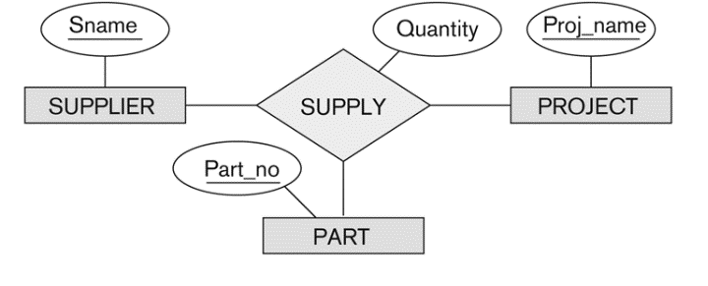
From ER Diagrams to Relations: Step 7 (2/2)
Relation Supply
Sname | Proj_name | Part_no | Quantity

Slide 30
Summary of Mapping for ER Model to Relational Model
ER Model | Relational Model
Entity type | Entity relation
1:1 or 1:N relationship type | Foreign key (or relationship relation)
M:N relationship type | Relationship relation and two foreign keys
n-ary relationship type | Relationship relation and n foreign keys
Simple attribute | Attribute
Composite attribute | Set of simple component attributes
Multivalued attribute | Relation and foreign key
Value set | Doman
Key attribute | Primary key

