Slide 1
Lecture 8: Indexing Techniques
CS3402 Database Systems

Slide 2
Indexes as Access Paths (1/2)
An index is an auxiliary file to provides fast access to a record in a data file (index file + data file)
Without an index, we may use the sequential search (for unordered file), i.e., to examine the record one by one to find the required record stored in disk (from beginning to end of the file until the required record is found)
An index is an ordered sequence of entries <field value, pointer to record>, ordered by the field value
The pointer provides the address (location or physical block) of the required record (in the data file) in disk storage
An index is usually specified on one field (called key field which may not be a key) of the data file (although it could be specified on several fields)

Slide 3
Indexes as Access Paths (2/2)
The index file usually occupies considerably less disk blocks than the data file because its entries are much smaller
The biggest delay in data retrieval is the disk retrieval time
The size of each index entry is much smaller than the size of a record
Reading the index from disk is faster than reading data/records file from disk (smaller number of disk blocks)
Searching data/records in the main memory is much faster than the disk access
Instead of searching the data file sequentially, we search the index to get the address of the required records
A binary search on the index yields (ordered) a pointer to the file record

Slide 4
Types of Single Level Indexes
Single level index: one index points to one data record
Primary index (key field)
Specified on the ordering key field of an ordered file of records
Cluster index (non-key field)
The ordering field of the index is not a key field and numerous records in the data file can have the same value for the ordering field (repeating value attributes)
Secondary index (non-ordering field)
The index field is specified on any non-ordering field of a data file
Dense or sparse indexes
A dense index has an index entry for every search key value (and hence every record) in the data file. Thus larger index size
A sparse index, on the other hand, has index entries for only some of the search values. Thus smaller index size

Slide 5
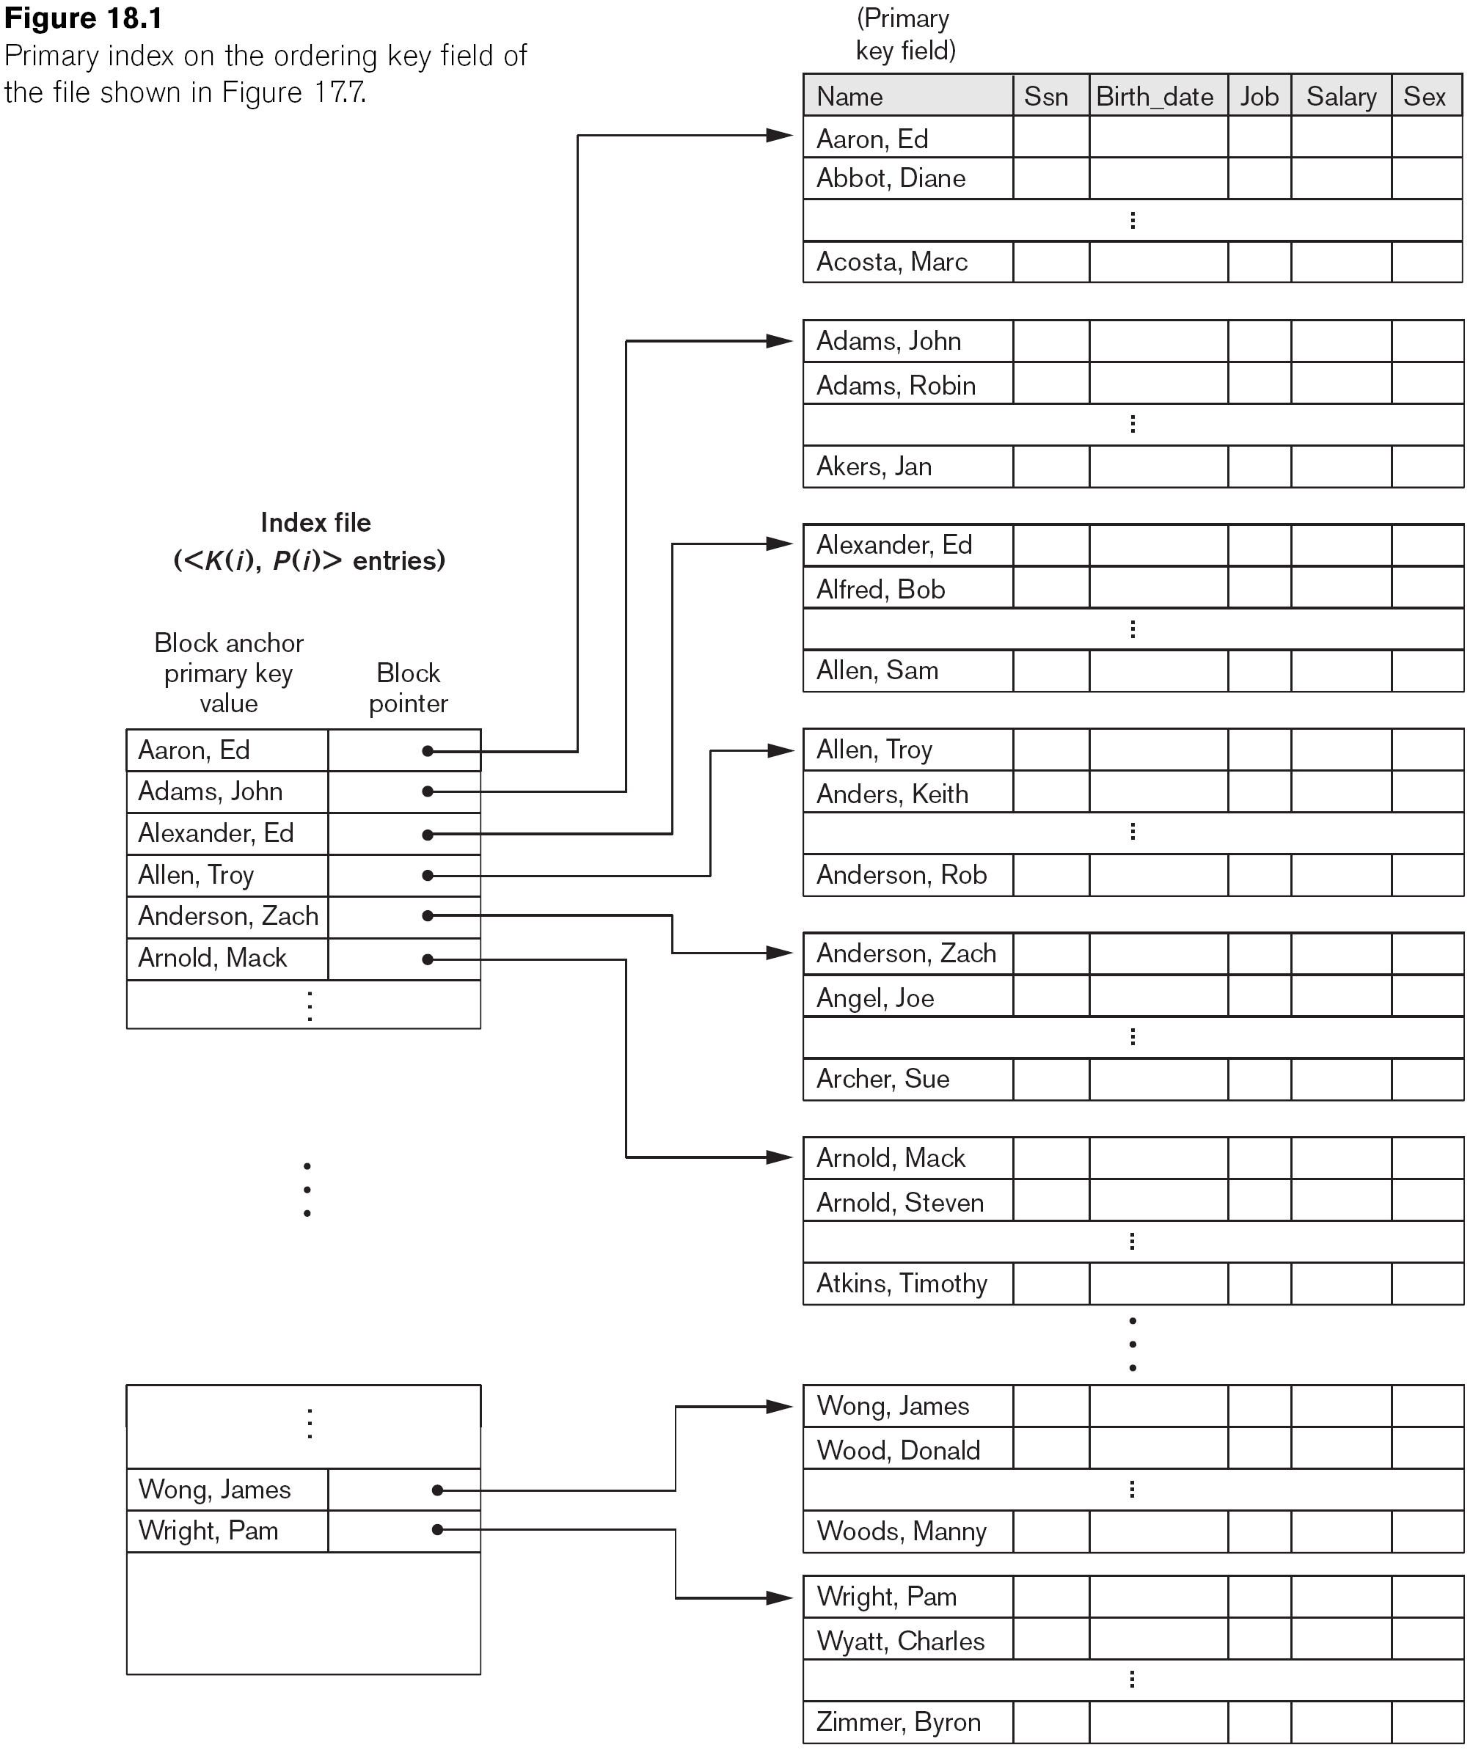
Primary Index
Defined on an ordered data file (of a specific key)
The data file is physically ordered on a key field (non-repeating value attribute)
One index entry for each block in the data file
A primary index is a sparse index (small index)
The number of entries is much smaller than the number of records
The index entry has the key field value for the first record in the block, which is called the block anchor
Searching subsequent records in the block is easy once the block is in the main memory

Slide 6
Primary Index: Example 1
Given the following data file EMPLOYEE(NAME, SSN, ADDRESS, JOB, SAL, ... )
SSN is the ordering key field that is used to physically order the records on storage
Suppose that record size fixed and unspanned R = 100 bytes, Block size B = 1,024 bytes, and the number of records r = 30,000 records
Then, we get:
Blocking factor Bfr = B/R = 1,024/100 = 10 records/block
Number of file blocks b = r/Bfr = 30,000/10 = 3,000 blocks
A binary search on the data file needs approximate log₂3000 = 12 block accesses

Slide 7
Primary Index: Example 2
For an index on the SSN field, assume field size V_{SSN} = 9 bytes and record pointer size P_{R} = 6 bytes. Then, we get:
An index entry size R_{I} = V_{SSN}+P_{R} = 9+6 = 15 bytes
Index blocking factor Bfr_{I} = B/R_{I} = 1,024/15 = 68 entries/block
The total number of index entries = number of blocks = r = 3,000
Number of index blocks b_{I} = r/Bfr_{I} = 3,000/68 = 45 blocks
Binary search needs log₂b_{I} = log₂45 = 6 block accesses
In total, to get the required record = 6+1 block accesses
Note: Once a block is stored in the main memory, the searching cost of the data/records within the block can be ignored (very fast)

Slide 8
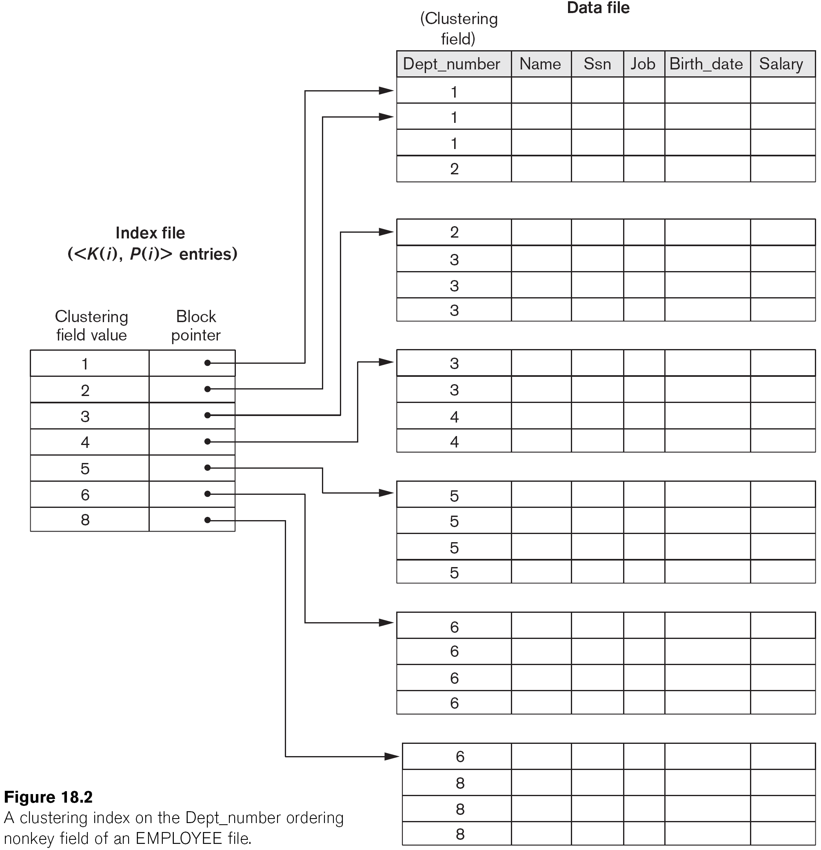
Clustering Index (1/2)
Defined on an ordered data file that is ordered on a non-key field (repeating values)
One index entry for each distinct value of the field
A clustering index is also an ordered file with two fields:
<clustering field, disk block pointer>
The pointer points to the first block in the data file that has a record with that value for its clustering field

Slide 9
Clustering Index (2/2)
It is another example of sparse index
One index entry points to multiple records (ordered)
Ordered data file → overflow problem
Use overflow pointers or reservation
Example: reserving the whole block for handling overflow due to record insertion (anchoring block)

Slide 10
Secondary Index (1/2)
A secondary index provides a secondary means of accessing a file for which some primary access already exists
The secondary index may be on a key field or a non-key field
The index is an ordered file with two fields
An indexing field + a block pointer or a record pointer
There can be several secondary indexes (and hence, indexing fields) for the same file

Slide 11
Secondary Index (2/2)
Block pointers → sparse index
Each index entry has multiple index pointers pointing to the records with the same value
One entry for each record in the data file → dense index
Each record has one pointer
Using blocks of record pointers for handling same value non-key records

Slide 12
Secondary Index: Example 1
Suppose:
Record size fixed and unspanned R = 100 bytes
Block size B = 1024 bytes
Number of record r = 30,000 records
Then, we get:
Blocking factor Bfr = B/R = 1,024/100 = 10 records/block
Number of file blocks b = r/Bfr = 30,000/10 = 3,000 blocks
We want to search for a record with a specific value for the secondary key (length 9 bytes)
Without the secondary index, a linear search on the data file requires on average is b/2 = 3,000/2 = 1,500 block accesses on average

Slide 13
Secondary Index: Example 2
Suppose we construct a secondary index on a non-ordering key field of the data file
An index entry size R_{I} = V+ P_{R} = 9+6 =15 bytes
Index blocking factor Bfr_{I}= B/R_{I}= 1,024/15= 68 entries/block
In a dense index, the total number of index entries = number of records = r = 30,000
Number of index blocks b_{I} = r/ Bfr_{I} = 30,000/68 = 442 blocks
Binary search needs log₂b_{I} = log₂442 = 9 block accesses
To get the required record = 9 + 1 block accesses
This is compared to an average linear search cost of:
b/2 = 3,000/2= 1,500 block accesses
If the file records are ordered, the binary search cost would be:
Log₂b = log₂30,000= 12 block accesses

Slide 14
Properties of Index Types

Slide 15
Multi-Level Indexes
Because a single-level index is an ordered file, we can create a primary index to the index itself
In this case, the original index file is called the first-level index and the index to the index is called the second-level index
We can repeat the process, creating a third, fourth, ..., top level until all entries of the top level fit in one disk block
A multi-level index can be created for any type of first-level index (primary, secondary, clustering) as long as the first-level index consists of more than one disk block

Slide 16
Multi-Level Indexes: Example
Suppose the dense secondary index of Example 2 is converted into a multi-level index
The index blocking factor (also called fan out, fo) bfr_{i} = 68 index entries per block
The number of first level blocks b₁ =442
The number of second-level blocks b₂ = b₁/fo = 442/68 = 7 blocks
The number of third-level blocks b₃ = b₂/fo = 7/68 = 1
Hence the third-level is the top level of the index t = 3
To access a record, access one block at each level plus one block from the data file = t + 1 = 3 + 1 = 4 block accesses

Slide 17
Tree Index Structure (1/2)
A multi-level index is a form of search tree
However, insertion and deletion of new index entries is a severe performance problem because every level of the index is an ordered file
We may use a B-/B⁺-tree index to resolve the problem (reservation of nodes)
A tree is formed of multi-level nodes
Except the root node, each node in the tree has one parent node and zero or more child node
A node that does not have any child nodes is called a leaf node
A non-leaf node is called internal node
A sub-tree of a node consists of the node and all its descendant
If the leaf nodes are at different levels, the tree is called unbalanced

Slide 18
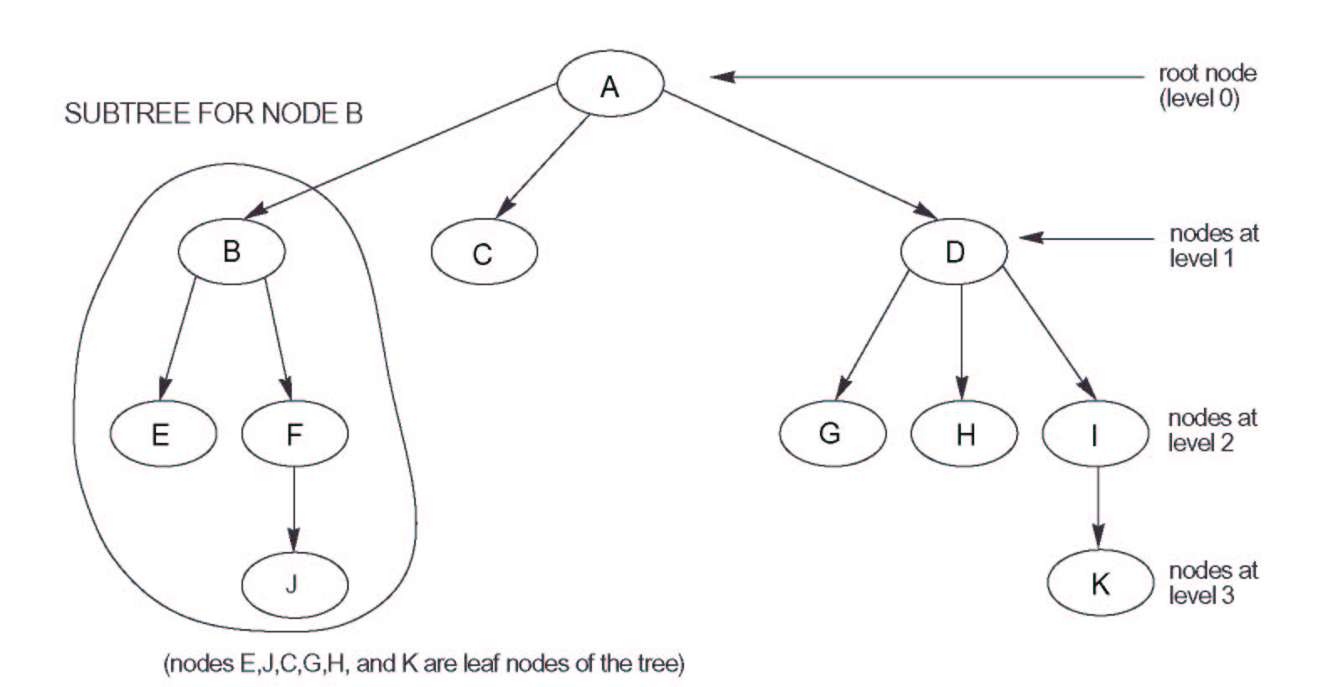
Tree Index Structure (2/2)
A tree data structure that shows an unbalanced tree

Slide 19
Dynamic Multilevel Indexes Using B-Trees and B+-Trees (1/2)
Most multi-level indexes use B-tree or B⁺-tree data structures for solving the insertion and deletion problem
They reserves spaces in each tree node (disk block) to allow for new index entries
In B-Tree and B⁺-Tree, each node corresponds to a disk block
Each node is kept between half-full and completely full
Need to restructure the tree in case of node overflow (insertion when full) or underflow (deletion when half full)
Less than half-full, wastes of space and the tree will have many levels (higher retrieval cost)

Slide 20
Dynamic Multilevel Indexes Using B-Trees and B+-Trees (2/2)
An insertion into a node that is not full is quite efficient
If a node is full the insertion causes a split into two nodes
Splitting may propagate to higher tree levels
A deletion is quite efficient if a node does not become less than half full
If a deletion causes a node to become less than half full, it may merge with neighboring nodes (may propagate to higher levels)

Slide 21
Difference between B-tree and B+-tree
In a B-tree, pointers to data records exist at all levels of the tree
In a B⁺-tree, all pointers to data records exists at the leaf-level nodes
A B⁺-tree can have less levels (or higher capacity of search values) than the corresponding B-tree since its entry is smaller in size
The internal nodes of B+-tree contain pointers only

Slide 22
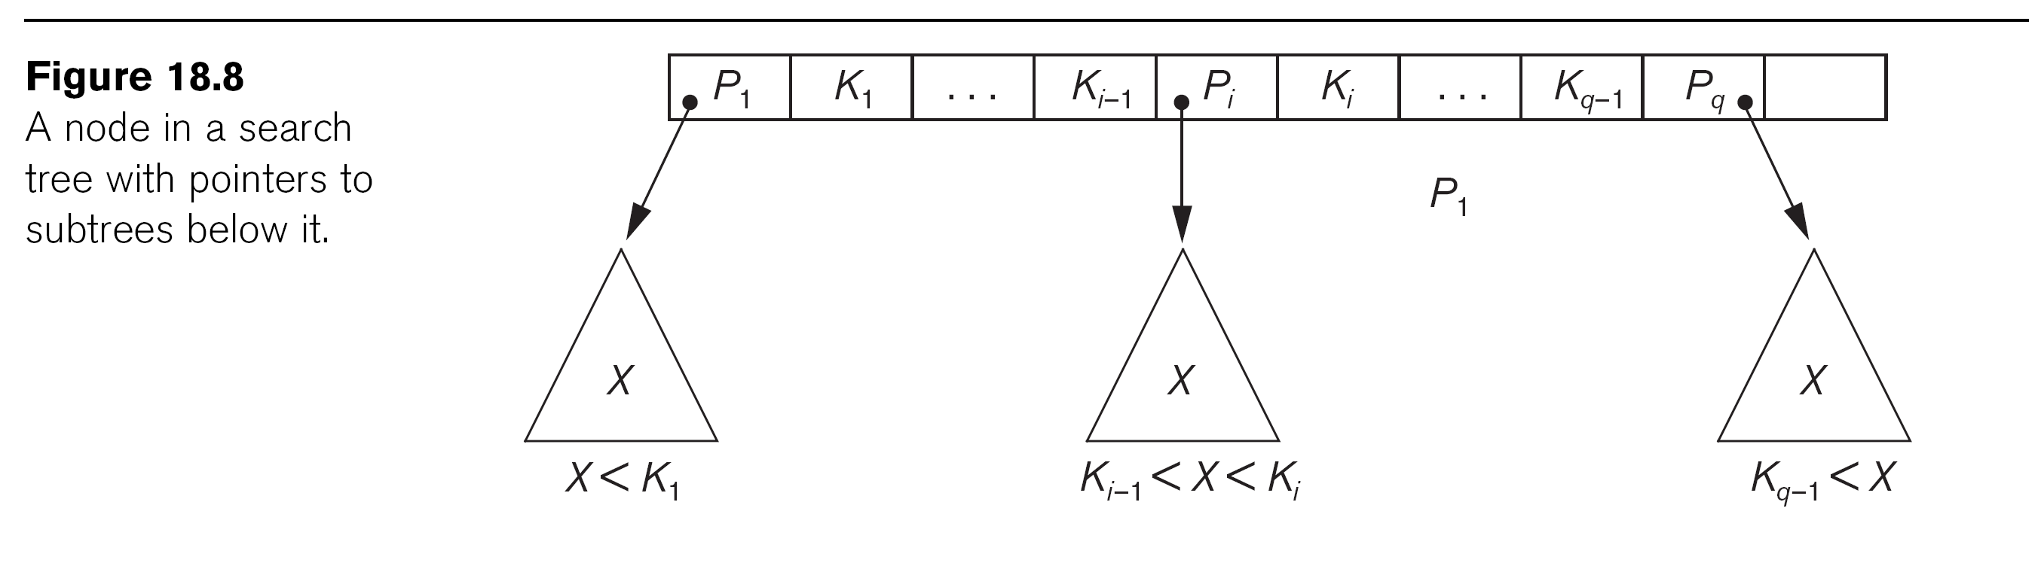
B-tree Index (1/2)
B-tree organizes its nodes into a tree
It is balanced (B) as all paths from the root to a leaf node have the same length
p = 4
Four pointers
Three keys
57
81
95
To key
K < 57
To key
57 < K < 81
To key
81 < K < 95
To key
K > 95

Slide 23
B-tree Index (2/2)
Each internal node in a B-tree is of the form <P₁, <K₁,Pr₁>, P₂, <K₂,Pr₂>, …, <K_{q-1},Pr_{q-1}>,P_{q}> where q ≤ p (each node has at most p tree pointers)
Each P_{i} is a tree pointer to another node in the B-tree
Each Pr_{i} is a data pointer points to the record whose search key field value is equal to K_{i}
Within each node, K₁ < K₂ < … < K_{q-1}
For all search key field values X in the subtree pointed by P_{i}, we have (i) K_{i-1} < X < K_{i} for 1 < i < q; (ii) X < K_{i} for i = 1; and (iii) K_{i-1} < X for i = q
Each node has at most p tree pointers (order of the tree)
Each node except the root and leaf nodes, has at least p/2 tree pointers
All leaf nodes are at the same level (balanced tree) and have the same structure as internal nodes except that all of their tree pointers of P_{i} are NULL

Slide 24
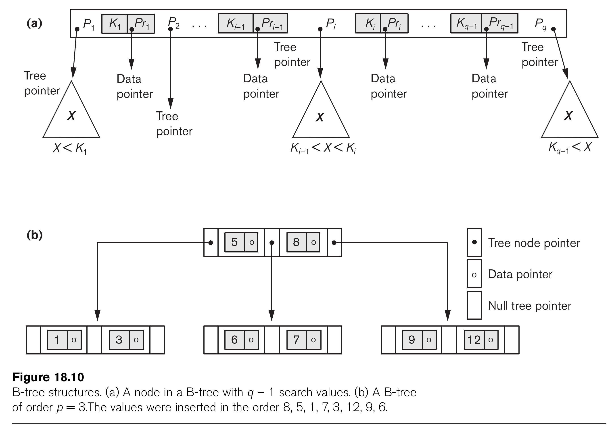
B-tree Structures

Slide 25
B-tree Index Insertion
Each B-tree node can have at most q tree pointers, p – 1 data pointers, and search key values
Insertion
B-tree starts with a single root node at level 0
Once the root is full with p – 1 search key values and we attempt to insert another entry into the tree, the root node splits into two nodes at level 1
Only the middle value is kept in the root node and the rest of the values are split evenly between the other two nodes
When a non-root node is full and a new entry is inserted into it, that node is split into two nodes at the same level, and the middle entry is moved to the parent node along with two pointers to the new split nodes
If the parent node is full, it is also split

Slide 26
B-tree Index Capacity
Suppose the search field is a non-ordering key field and we construct a B-tree on this field with p = 23 (i.e., each node has at most 23 pointers)
Assume that each node is 69% full, i.e., 0.69 * 23 = 16 pointers (fan-out)
Key field: all search values K are unique
Non-key field: the entry pointer may point to a block or a cluster of blocks that contain the pointers to the file records (repeating value)
Root: | 1 node | 15 key entries | 16 pointers
Level 1: | 16 nodes | 240 key entries | 256 pointers
Level 2: | 256 nodes | 3840 key entries | 4096 pointers
Level 3: | 4096 nodes | 61,440 key entries

Slide 27
B⁺-tree Index (1/2)
In a B⁺-tree, data pointers are stored only at the leaf nodes of the tree
The pointers in internal nodes are tree pointers to blocks that are tree nodes
The pointers in leaf nodes are data pointers to the data file records
The leaf nodes of a B⁺-tree are usually linked to provide ordered access on the search field to the records
Because entries in the internal nodes of a B⁺-tree does not include data pointers, more entries (tree pointers) can be packed into an internal node and thus fewer levels (higher capacity)

Slide 28
The Structure of Internal Nodes of a B⁺-tree
Each internal node in a B⁺-tree is of the form <P₁, K₁, P₂, K₂, …,P_{q-1}, K_{q-1},P_{q}> where q ≤ p and P_{i} is a tree pointer and is also called the tree order
Each node has at most p tree pointers
Within each node, K₁ < K₂ < … < K_{q-1}, for all search key field values X in the subtree pointed by P_{i}, we have
K_{i-1} ≤ X < K_{i} for 1 < i < q;
X < K_{i} for i = 1; and
K_{i-1} ≤ X for i = q
Each node except the root and leaf nodes has at least ⎣p/2⎦ tree pointers

Slide 29
The Structure of the Leaf Nodes of a B⁺-tree
Each leaf node is of the form <<K₁, Pr₁> ,<K₂, Pr₂>, …,<K_{q-1}, Pr_{q-1}>, P_{next}> and Pr_{i} is a data pointer and P_{next} points to the next leaf node of the tree
Within each node, K₁ < K₂ < … < K_{q-1}
The maximum number of data pointers in a leaf node is the tree order (or degree) minus 1
Each Pr_{i} is a data pointer points to the record whose search field is K_{i}
Each leaf node has at least ⎣p_{leaf}/2⎦ data records
All leaf nodes are at the same level

Slide 30
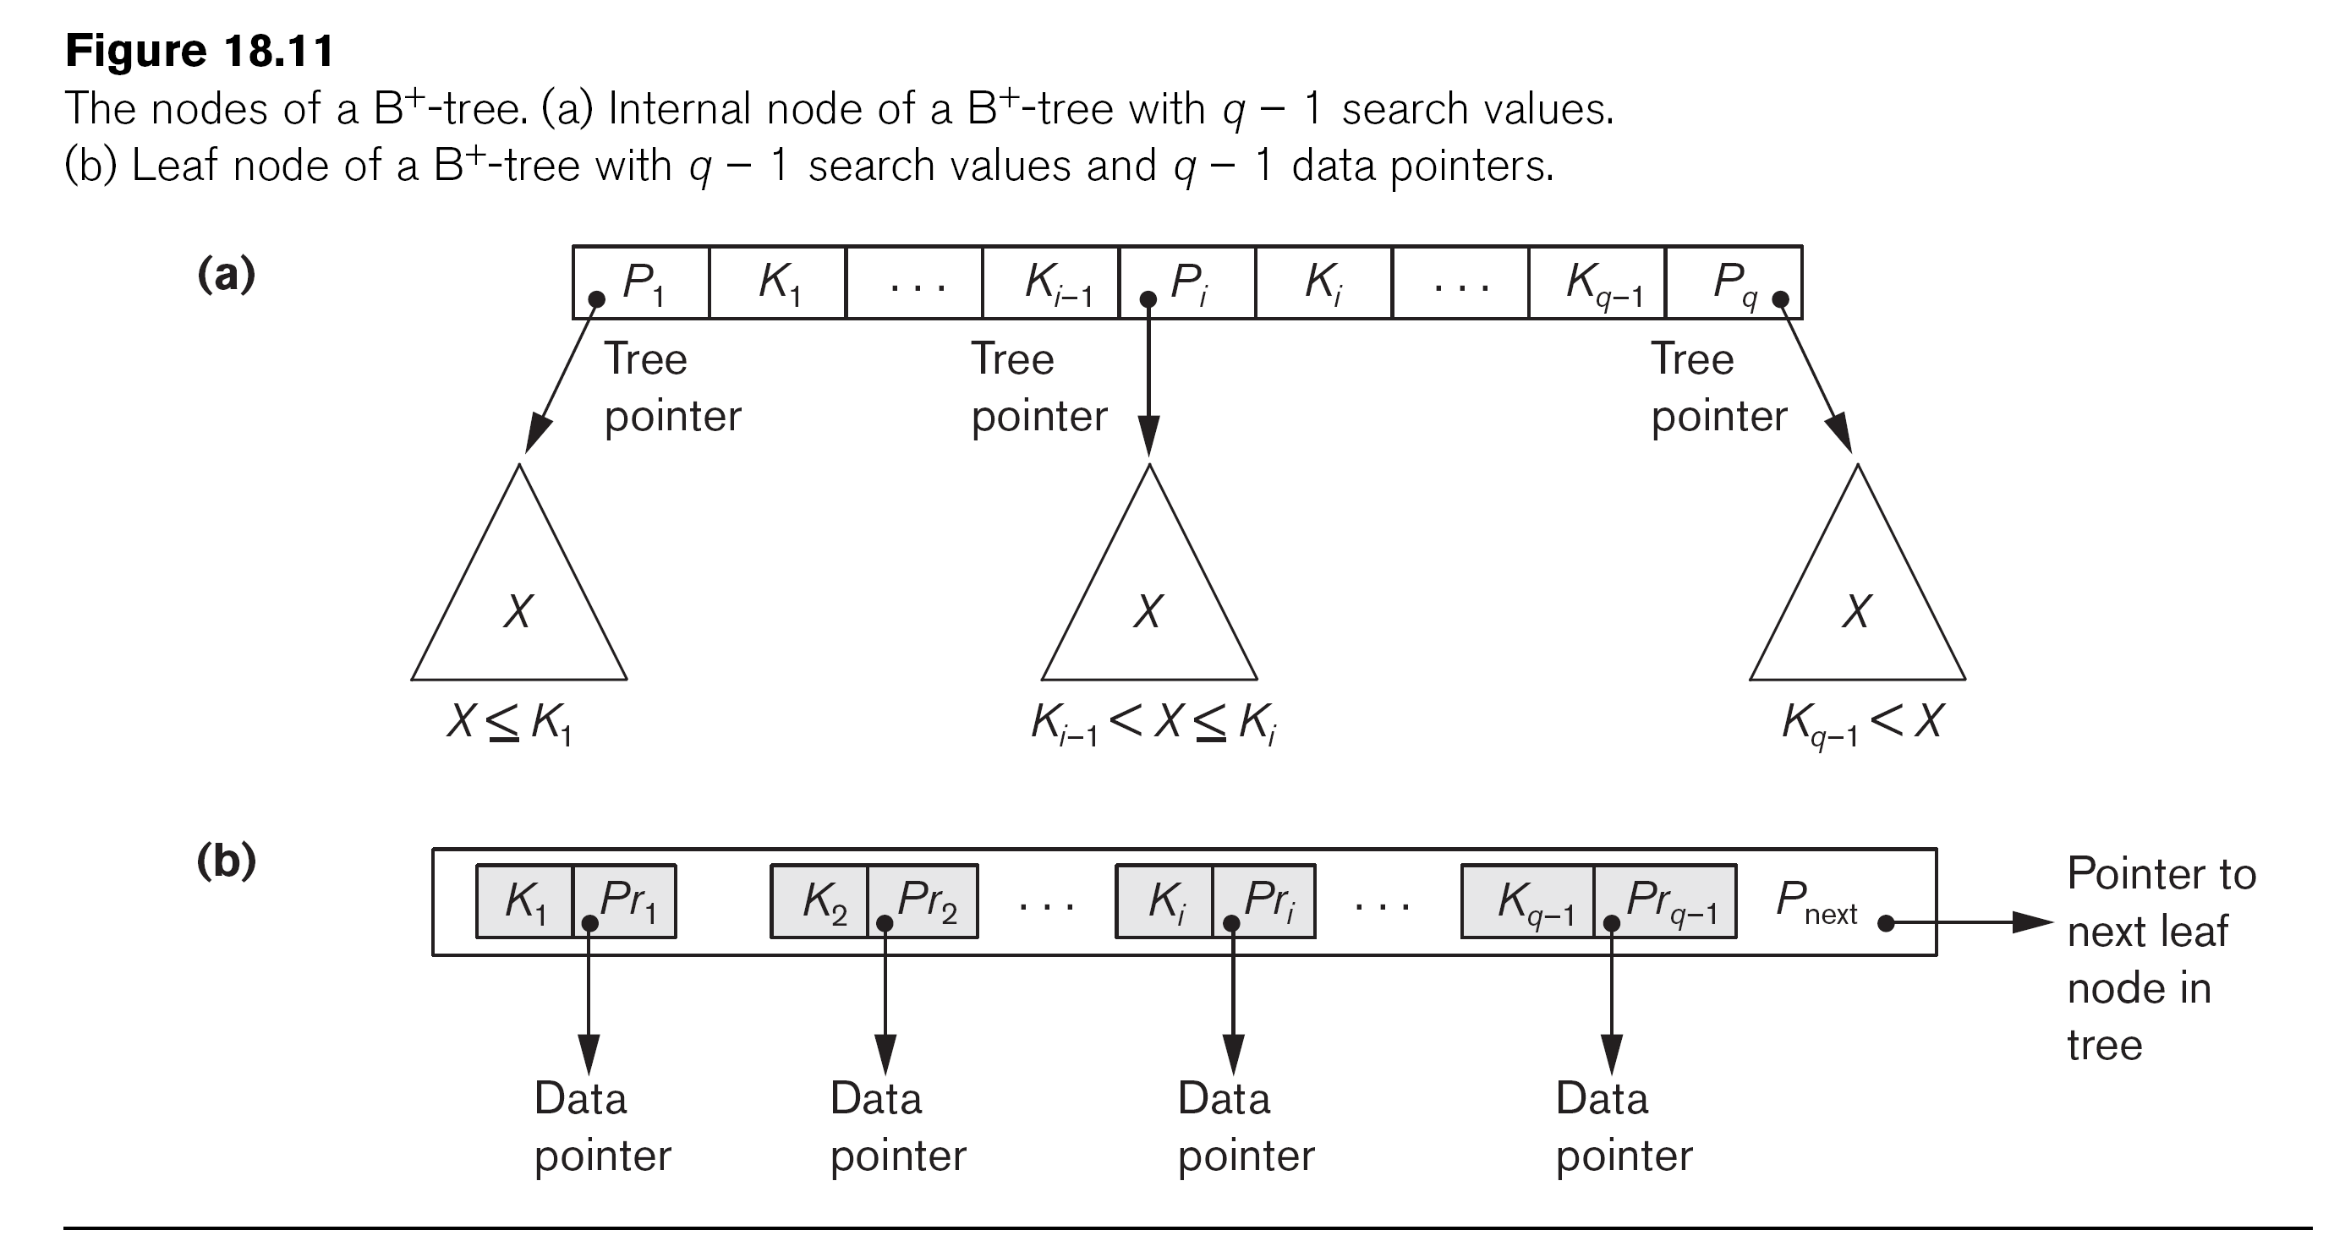
The Nodes of a B⁺-tree
X < K₁
K_{i-1} ≤ X < K_{i}
K_{q-1} ≤ X

Slide 31
B⁺-tree Index: Example 1
Suppose the search key field is V = 9 bytes, the block size is B = 512 bytes, a record pointer is Pr = 7 bytes, and a block pointer is P = 6 bytes
An internal node of B⁺-tree can have up to p tree pointers and p-1 search field values. These must fit into a single block.
(p * P) + [(p – 1) * V] ≤ B
(p * 6) + [(p – 1) * 9] ≤ 512
15p ≤ 512
p = 34
The order p_{leaf} for the leaf node
p_{leaf} * (Pr + V) + P ≤ B
p_{leaf} * (7 + 9) + 6 ≤ 512
16 * p_{leaf} ≤ 506
p_{leaf} = 31

Slide 32
B⁺-tree Index Capacity
To calculate the approximate number of entries in B⁺-tree, we assume each node is 69% full
On average each internal node will have 34 * 0.69 = 23 pointers and 22 key values
Each leaf node on average will hold 0.69 * P_{leaf} = 0.69 * 31 = 21 data record pointers
Root: | 1 node | 22 key entries | 23 pointers
Level 1: | 23 nodes | 506 key entries | 529 pointers
Level 2: | 529 nodes | 11,638 key entries | 12,167 pointers
Level 3: | 12,167 nodes | 255,507 data record pointers

Slide 33
B⁺-tree Index Insertion
Step 1: Descend to the leaf node where the key fits.
Step 2:
(Case 1) If the node has an empty space, insert the key into the node.
(Case 2) If the node is already full, split it into two nodes, distributing the keys evenly between the two nodes. (Note: ⎡(n+1)/2⎤-th key is the middle key, hence, the first ⎣(n+1)/2⎦ keys are arranged in the first node and the remaining keys are arranged in the second node.)
If the node is a leaf, take a copy of the minimum value in the second of these two nodes and repeat this insertion algorithm to insert it into the parent node.
If the node is a non-leaf, exclude the middle value during the split and repeat this insertion algorithm to insert this excluded value into the parent node.

Slide 34
Example of an Insertion in a B⁺-tree (1/5)
Insert 8, 5, 1, 7, 3, 12 into an empty B⁺-tree, in which (i) an internal node can fit three tree node pointers and two key values and (ii) a leaf node can fit two key values with data pointers.
Insert 8
The node has an empty space
Insert 5
The node has an empty space
Tree node pointer
Data pointer
Null tree pointer
8
5
8

Slide 35
Example of an Insertion in a B⁺-tree (2/5)
Insert 1
Since the node is already full, split it into two nodes, distributing the keys evenly between the two nodes. Since the node is a leaf, take a copy of the minimum value in the second of these two nodes (i.e., 5) and repeat the insertion algorithm to insert it into the parent node.
5
1
5
8

Slide 36
Example of an Insertion in a B⁺-tree (3/5)
Insert 7
Since the node is already full, split it into two nodes, distributing the keys evenly between the two nodes. Since the node is a leaf, take a copy of the minimum value in the second of these two nodes (i.e., 7) and repeat the insertion algorithm to insert it into the parent node.
5
7
1
5
7
8

Slide 37
Example of an Insertion in a B⁺-tree (4/5)
Insert 3
The node has an empty space
5
7
1
3
5
7
8

Slide 38
Example of an Insertion in a B⁺-tree (5/5)
Insert 12
Since the node is already full, split it into two nodes, distributing the keys evenly between the two nodes. Since the node is a leaf, take a copy of the minimum value in the second of these two nodes (i.e., 8) and repeat this insertion algorithm to insert it into the parent node. Since the parent node is a non-leaf, exclude the middle value (i.e., 7) during the split and repeat the insertion algorithm to insert 7 into the parent node.
7
5
8
1
3
5
7
8
12

Slide 39
B⁺-tree Index Deletion
Step 1: Descend to the leaf where the key exists.
Step 2: Remove the required key and associated reference from the node.
(Case 1) If the node still has half-full keys, stop.
(Case 2) If next oldest or next youngest sibling at the same level has more than necessary, distribute the keys between this node and the neighbor. Repair the keys in the level above to represent that these nodes now have a different “split point” between them; this involves simply changing a key in the levels above, without deletion or insertion.
(Case 3) Merge the node with its sibling; if the node is a non-leaf, we will need to incorporate the “split key” from the parent into our merging. In either case, we will need to repeat the removal algorithm on the parent node to remove the “split key” that previously separated these merged nodes — unless the parent is the root and we are removing the final key from the root, in which case the merged node becomes the new root (and the tree has become one level shorter than before).

Slide 40
Example of a Deletion in a B⁺-tree (1/3)
Delete 3: the node still has half-full keys
7
5
8
1
3
5
7
8
12
7
5
8
1
5
7
8
12

Slide 41
Example of a Deletion in a B⁺-tree (2/3)
Delete 7: Distribute the keys between the node and the neighbor. Repair the keys in the levels above.
7
5
8
1
5
7
8
12
8
5
12
1
5
8
12

Slide 42
Example of a Deletion in a B⁺-tree (3/3)
Delete 12: (1) Merge the node with its sibling, (2) remove the “split key” (i.e., 12) from the parent, (3) merge the parent node with its sibling, and (2) remove the “split key” (i.e., 8) from its parent node (i.e., the root)
8
5
12
1
5
8
12
5
8
1
5
8

