Slide 1
EE3211 Modelling Techniques
Lecture 5
Hypothesis Testing: Categorical Data

Slide 2
Overview
Methods of hypothesis testing for comparing categorical data

Slide 3
Types of Data
Categorical variables: two or more categories that do not have any ordering
e.g. race and ethnicity
Dichotomous variables: two possible values
e.g. gender, death, disease status
Ordinal variables: more than two ranked or ordered values
e.g., amount of current smoking: none, <10/day, 10-
20/day, 21-30/day, >30/day

Slide 4
A Scenario
Breast cancer in women: caused partially by happenings that occur between age at menarche and age at first childbirth
- Risk of breast cancer as time between age at menarche and
age at first childbirth
Breast cancer cases: selected hospitals in the US, Greece, Yugoslavia, Brazil, Taiwan and Japan
Controls: women of comparable age in the hospital at the same time as the cases but who did not have breast cancer
*asked all women about their age at first birth*
Divide women with at least one birth into two categories:
Women whose age at first birth was ≤ 29 years
Women whose age at first birth was ≥ 30 years
Results: 683 of 3220 (21.2%) women with breast cancer (case women) and 1498 of 10,245 (14.6%) women without breast cancer (control women) had an age at first birth>=30
*How can we evaluate whether this difference is significant or simply due to chance?

Slide 5
Contingency-Table Method
2 × 2 contingency table: a table with two rows and two columns
Display data that can be classified by two different variables
-each has only two possible outcomes
-one variable is arbitrarily assigned to rows and another variable
to columns
Each cell: represents number of units for each variable
(1,1) cell: cell in the first row and first column
(1,2) cell: cell in the first row and second column …..
(2,2) cell: cell in the second row and second column
The observed number of units: O₁₁, O₁₂, O₂₁, and O₂₂

Slide 6
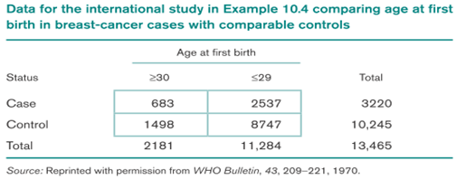
Row marginal totals or row margins: the number of units in each row and show them in the right margins.
Column marginal totals or column margins : the number of units in each column and show them in the bottom margins.
Grand total: the total number of units in the four cells, which is displayed in the lower right-hand corner of the table
Example: Suppose all women with at least one birth in the breast cancer
study described previously are classified as either cases or controls and with
age at first birth as either <=29 or >=30. The our possible combinations are
shown in the first table here:

Slide 7
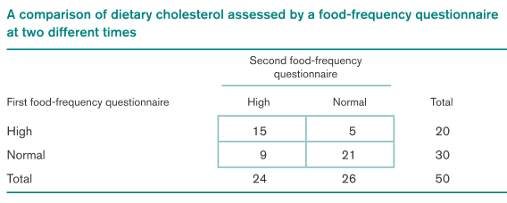
Test for homogeneity of binomial proportions: tests whether the proportions are the same in two independent samples
- one set of margins is fixed ( e.g. rows)
- no. of successes in each row: random variable
Test of independence or a test of association: tests whether there is some association between two reported measures of a characteristic
Example:
- Association between two reported measures of dietary cholesterol for same person?
(reproducibility) - Food-frequency questionnaire (FFQ): measure dietary intake
person specifies number of servings consumed per day of different food items
- total nutrient composition is calculated from specific dietary components of food item

Slide 8
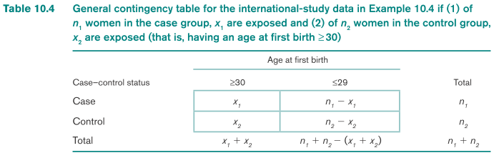
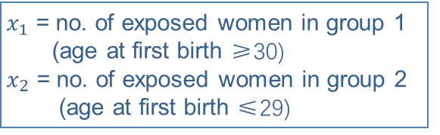

Significance Testing:
Using Contingency-Table Approach
Computation of expected values for 2 × 2 contingency tables
Expected number of units in the (i,j) cell (E_{ij}):
ith row margin X jth column margin
grand total
H₀: p1=p2
H₁: p1≠p2
$$\hat{p}=\frac{n_{1}\hat{p_{1}}+n_{2}\hat{p_{2}}}{n_{1}+n_{2}}=\frac{x_{1}+x_{2}}{n_{1}+n_{2}}$$
$n_{1}\hat{p}$= $\frac{{n_{1}(x}_{1}+x_{2})}{n_{1}+n_{2}}$
$x_{1}$ = no. of exposed women in group 1
(age at first birth ≥30)
$x_{2}$ = no. of exposed women in group 2
(age at first birth ≤29)

Slide 9
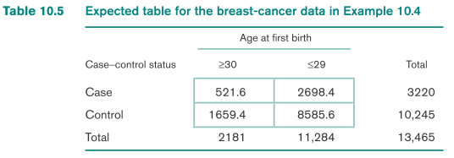
Expected table: contingency table that would be expected if there were no relationship between parameters, i.e.
H₀: p₁ = p₂ = p were true
Observed
Data
E(1,1)=3220(2181)/13465
=521.6
E(1,2)=3220(11284)/13465
=2698.4
E(2,1)=10245(2181)/13465
=1659.4
E(2,2)=10245(11284)/13465
=8585.6
Expected
Data

Slide 10
Observed table vs. Expected table
Corresponding cell values in two tables are close → accept H₀
Comparing cells in two tables: (O-E)²
E
Under H₀: Sum of (O-E)² over 4 cells ~ ꭓ² distribution (df=1)
E
*Pearson ꭓ² statistics*
-Sum is large → reject H₀ (poor agreement between O and E tables)
-Sum is small → accept H₀ (good agreement between O and E tables)
Condition: normal approximation to binomial distribution valid
- No expected value < 5 → normal approximation true
*rule of five*
O: observed number
E: expected number

Slide 11

2×2 Contingency Table:
Yates-Corrected Chi-Square Test (more accurate p-values)
H₀: p₁ = p₂ vs. H₁: p₁ ≠ p₂
O_{ij} : observed number of units in the (i,j) cell
E_{ij} : expected number of units in the (i,j) cell
Compute test statistic which under H₀ ~ χ₁² distribution
Level α test:
X² > χ²_{1,1-α} → reject H₀
X² ≤ χ²_{1,1-α} → accept H₀
3. P-value = area to the right of X² under a χ₁² distribution
* Use this test only if none of the four expected values < 5

Slide 12
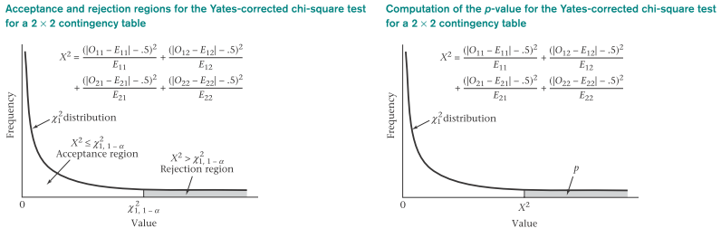
The Yates-corrected chi-square test: two-sided test
Critical region (chi-square distribution): one-sided
Large values of |O_{ij} – E_{ij}|, test statistic X² : obtained under H₁
p₁ < p₂ or p₁ > p₂
Small values of X²: in favor of H₀

Slide 13
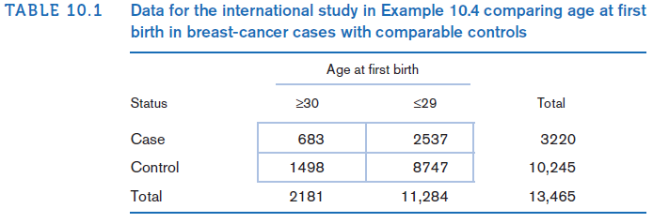
Example on 2x2 Contingency Table:
breast cancer
Q: Assess the breast-cancer data for statistical significance, using a contingency-table approach.
Solution:
First compute observed and expected tables
Check all expected values in expected table are at least 5

Slide 14
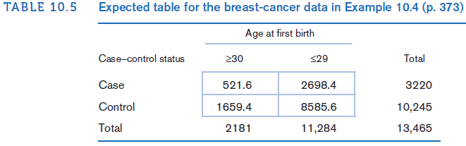
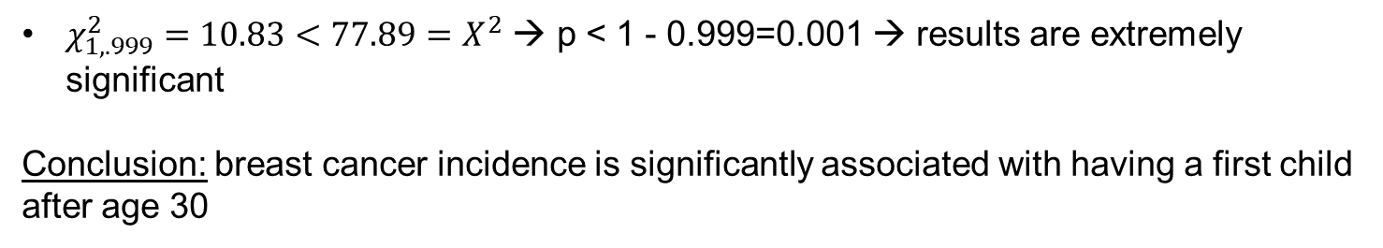
Example on 2x2 Contingency Table:
breast cancer
$$X^{2}=\frac{{(\left|683−521.6\right|−0.5)}^{2}}{521.6}+\frac{{(\left|2537−2698.4\right|−0.5)}^{2}}{2698.4}+\frac{{(\left|1498−1659.4\right|−0.5)}^{2}}{1659.4}+\frac{{(\left|8747−8585.6\right|−0.5)}^{2}}{8585.6}$$
$$=\frac{{(160.9)}^{2}}{521.6}+\frac{{(160.9)}^{2}}{2698.4}+\frac{{(160.9)}^{2}}{1659.4}+\frac{{(160.9)}^{2}}{8585.6}=49.661+9.599+15.608+3.017=77.89\sim χ_{1}^{2} under H_{0}$$
$χ_{1,.999}^{2}=10.83<77.89=X^{2}$ → p < 1 - 0.999=0.001 → results are extremely significant
Conclusion: breast cancer incidence is significantly associated with having a first child after age 30

Slide 15
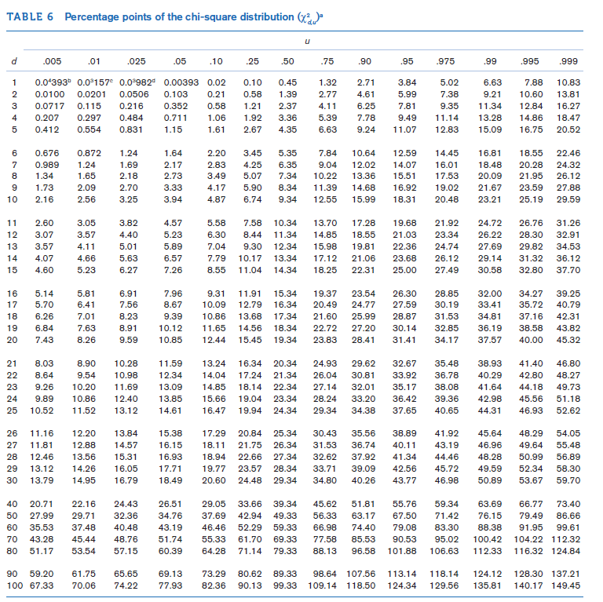

Slide 16
Use of a continuity correction for the contingency table is a debated subject
Generally, p-values obtained using the continuity correction are slightly larger and are slightly less significant than comparable results (other methods)
R commands to perform the chi-square test for 2x2 tables
#*x and y are vectors pertaining to 2 variables
>chisq.test(x, y)
#use the matrix command to for the contingency table
>table=matrix(c(a, b, c, d), nrow=2)
#to obtain Yates-corrected chi-square statistic:
>chisq.test(table)

Slide 17
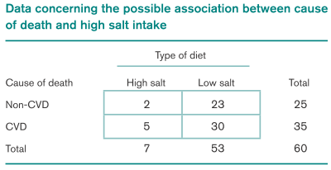
Fisher’s Exact Test
Offers exact levels of significance for any 2×2 table but it is only necessary for tables with small expected values
H₀: p₁ = p₂ = p vs. H₁: p₁ ≠ p₂
Example: relation between high salt intake and death from CVD (retrospective or
longitudinal study)
approximately same number of 50-54 men who died from CVD (the cases) and
men who died from other causes (the controls) over a 1-month period
identify high- and low-salt users over a period of time
compare relative frequency of death from CVD in two groups
data are presented in the left table (2x2 contingency table):
Fisher’s Exact Test:
same level of significance for any 2x2
table with small expected values
similar results as ꭓ² test (if applicable)
E(1,1)=7(25)/60=2.92
E(2,1)=7(35)/60=4.08

Slide 18
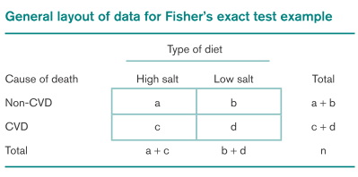

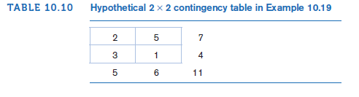

p₁= probability that a man was on high-salt
diet with a non-CVD death
p₂= probability that a man was on high-salt
diet with a CVD death
H₀: p₁ = p₂ vs. H₁: p₁ ≠ p₂
assume that margins of this table are fixed
exact probability of observing the table with cells a, b, c, d is:
Exact Probability of Observing
A Table with Cells a, b, c, d
Pr(2, 5, 3, 1)=$\frac{7!4!5!6!}{11!2!5!3!1!}$ =$\frac{5040(24)(120)(720)}{(39916800)(2)(120)(6)}=0.182$

Slide 19
Enumeration of All Possible Tables with
Same Margins as the Observed Table
Rearrangement of the rows and columns of the observed table
Smaller row total in first row
Smaller column total in first column
2. Begin the table with 0 in the (1, 1) cell. Other cells determined from the row and column margins.
3. Increase the (1, 1) cell by 1 in the next table, decrease the (1, 2) and (2, 1) cells by 1, increase the (2, 2) cell by 1.
4. Continue step 3 until one of the cells is 0

Slide 20
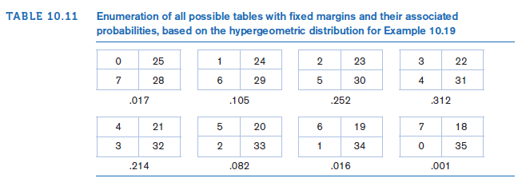

Slide 21
Fisher’s Exact test: General Procedure and Computation of p-Value
H₀: p₁ = p₂ vs. H₁: p₁ ≠ p₂
*the expected value of at least one cell is <5
1. Enumerate all possible tables with the same row and column margins as the observed table
2. Compute exact probability of each table from step 13. 3. Suppose observed table is "a table" and the last table enumerated is "k table"
Hypothesis H₀: p₁ = p₂ vs. H₁: p₁ ≠ p₂
p-value = 2 × min[Pr(0)+Pr(1)+…+Pr(a),
Pr(a)+Pr(a+1)+…+Pr(k),.5]
Hypothesis H₀: p₁ = p₂ vs. H₁: p₁ < p₂
p-value = Pr(0) +Pr(1)+…+Pr(a)
Iii Hypothesis H₀: p₁ = p₂ vs. H₁: p₁ > p₂
p-value = Pr(a) +Pr(a+1)+…+Pr(k)

Slide 22
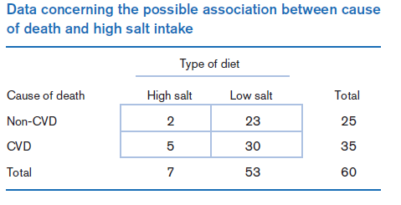
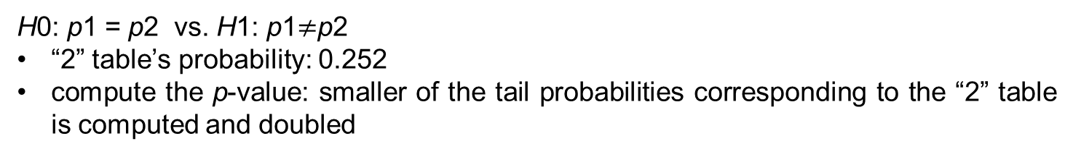
Example on Fisher’s Exact Test:
Cardiovascular Disease, Nutrition
Q: Evaluate the statistical significance of the data using a two-sided alternative.
H0: p1 = p2 vs. H1: p1$≠$p2
“2” table’s probability: 0.252
compute the p-value: smaller of the tail probabilities corresponding to the “2” table is computed and doubled

Slide 23
Example on Fisher’s Exact Test:
Cardiovascular Disease, Nutrition
First compute left-hand tail area:
Pr(0) + Pr(1) + Pr(2) = .017 + .105 + .252 = .375
Right-hand tail area:
Pr(2) + Pr(3) + . . . + Pr(7) = .252 + .312 + .214 + .082 + .016 + .001 = .878
p = 2 ×min(.375,.878,.5) = 2(.375) = .749
If a one-sided alternative of the form H0: p1 = p2 vs. H1: p1 < p2 is used
- p-value equals:
Pr(0) + Pr(1) + Pr(2) = .017 + .105 + .252 = .375
Conclusion: Two proportions in this example are not significantly different with either a one-sided or two-sided test
We cannot say (based on limited amount of data) that there is a significant association between salt intake and cause of death

Slide 24
R command to perform Fisher’s Exact test for 2x2 tables
#use matrix command to form the 2x2 table and assign it the name table
>table=matrix(c(a, b, c, d), rnow=2)
#compute the p-value when H1: p1<p2
>p.value.lower=fisher.test(table, alternative=“l”)
#compute the p-value when H1: p1>p2
>p.value.upper=fisher.test(table, alternative=“g”)
#compute the two-sided pvalue
>p.value.two.sided=2*min(p.value.lower, p.value.upper, 0.5)

Slide 25
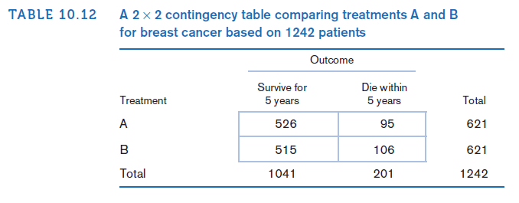
Two-Sample Test for Binomial Proportions for Matched-Pair Data
(McNemar’s Test)
Example: compare two different chemotherapy regimens for breast cancer after mastectomy. The two treatment groups should be as comparable as possible on other prognostic factors.
Matched study:
random member
of each matched pair receives
treatment A (chemotherapy)
perioperatively (within 1 week
after mastectomy) and
6 months additionally
other member gets
treatment B (chemotherapy
only perioperatively)
in pairs matched on age
(+/- 5)
Follow for 5 years
Outcome: survival
A: 526/621=0.847
B: 515/621=0.829

Slide 26
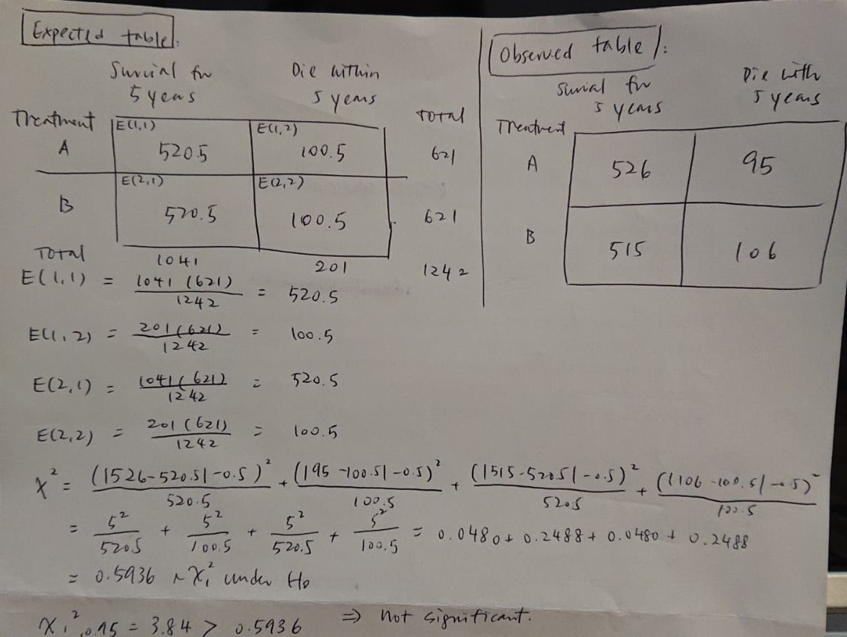
Independent samples

Slide 27
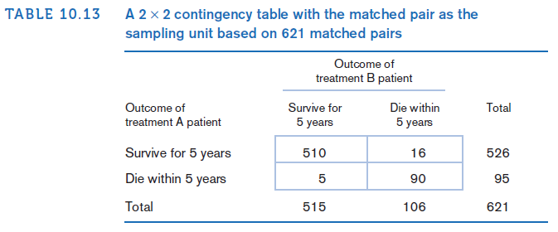
Two-Sample Test for Binomial Proportions for Matched-Pair Data
(McNemar’s Test)
A: 526/621=0.847
B: 515/621=0.829
Prob that treatment
B member survived
given treatment A
member survived
=510/526=0.97
Prob that treatment
B member survived
given treatment A
member died
=5/95=0.053
*Dependent
data*

Slide 28
Concordant pair: matched pair, same outcome for each member of the pair
Discordant pair: matched pair, different outcomes for members of the pair
Type A discordant pair: discordant pair, treatment A member of the pair has the event and treatment B member does not
Type B discordant pair: discordant pair, treatment B member of the pair has the event and the treatment A member does not
p = probability that a discordant pair is of type A
If treatment is equally effective: type A and type B discordant pairs would be approx. equal, and p = ½
If treatment A is more effective: type A would be fewer than type B discordant pairs, and p < ½
If treatment B is more effective: type B would be fewer than type A discordant pairs, and p > ½

Slide 29

McNemar’s Test for Correlated Proportions
Normal-Theory Test
Form a 2×2 table of matched pairs:
Rows: outcomes for the treatment A members of the matched pairs
Columns: outcomes for the treatment B members
Count total number of discordant pairs (n_{D}) and number of type A discordant pairs (n_{A})
Compute the test statistic
An equivalent version: X² = (|n_{A} – n_{B}| -1)²/(n_{A} +n_{B})
where n_{B}= number of type B discordant pairs
3. For a two-sided level α test:
if X² > χ_{1,1-α}² → reject H₀
If X² ≤ χ_{1,1-α}² → accept H₀
4. The exact p-value =Pr(χ₁² ≥ X²)
*Use this test only if n_{D} ≥20

Slide 30
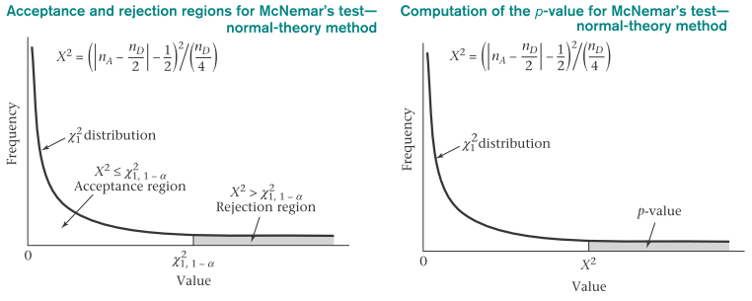
A two-sided test despite the one-sided nature of the critical region
p<1/2 or p>1/2 → | n_{A} - n_{D} /2| is large → X² is large

Slide 31
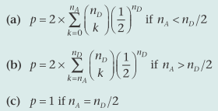
McNemar’s Test for Correlated Proportions
Exact Test
n_{D}/4 < 5 (n_{D} < 20): normal approximation to the binomial distribution cannot be used
→ test based on exact binomial probabilities is required
The exact p-value:
valid for any number of discordant pairs (n_{D}) but is particularly useful for n_{D} < 20 (normal-theory test cannot be used)

Slide 32
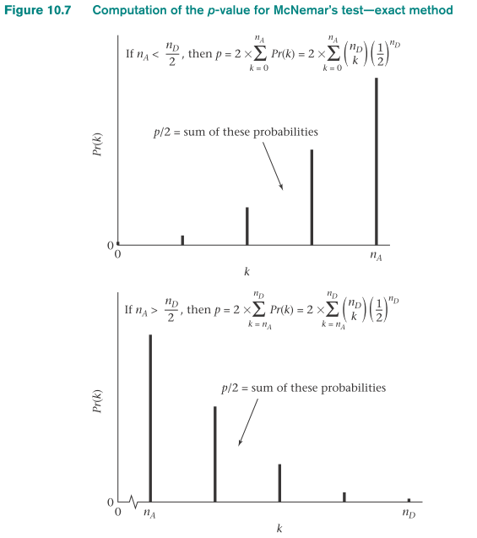

Slide 33
Example on McNemar’s Test: Hypertension
Blood pressure recording via automated blood-pressure machine in a computer device (with small fee)
Study: compare the computer device with standard methods of blood pressure measurement
20 patients are recruited with hypertensive status assessed by both computer device and a trained observer
Hypertensive status: either hypertensive (+)
- systolic blood pressure is >=160 mm Hg or higher or
- diastolic blood pressure is >=95 mm Hg or higher
Otherwise: patient is normotensive (-)

Slide 34
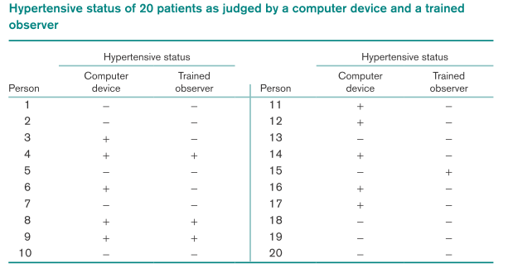
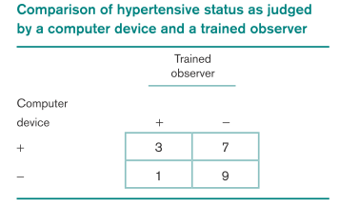
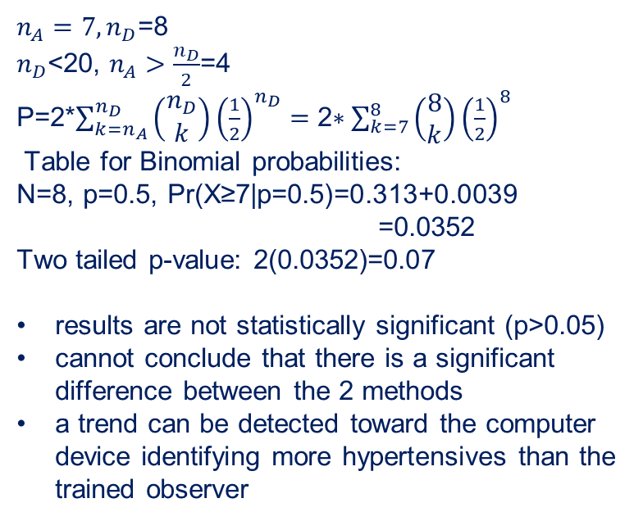
Q: assess the statistical significance of these findings
Each person used himself/herself as control → dependent samples
→ can’t use Yates-corrected ꭓ² test
Concordant pairs: 9+3=12
Discordant pairs: 7+1=8
$n_{A}=7, n_{D}$=8
$n_{D}$<20, $n_{A}>\frac{n_{D}}{2}$=4
P=2*$\sum_{k=n_{A}}^{n_{D}}{\left(\begin{matrix}n_{D} \\ k\end{matrix}\right){\left(\frac{1}{2}\right)}^{n_{D}}=\text{2∗}\sum_{k=7}^{8}{\left(\begin{matrix}8 \\ k\end{matrix}\right){\left(\frac{1}{2}\right)}^{8}}}$
Table for Binomial probabilities:
N=8, p=0.5, Pr(X≥7|p=0.5)=0.313+0.0039
=0.0352
Two tailed p-value: 2(0.0352)=0.07
results are not statistically significant (p>0.05)
cannot conclude that there is a significant
difference between the 2 methods
a trend can be detected toward the computer
device identifying more hypertensives than the
trained observer

Slide 35
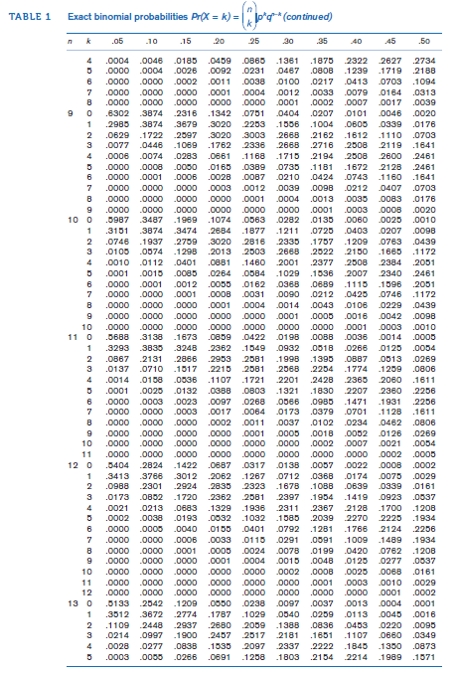

Slide 36
R command to perform McNemar’s Test for correlated proportions
#use matrix command to form the 2x2 table :
>table=matrix(c(a, c, b, d), nrow=2)
#x and y variables (vectors) consisting of outcomes for matched pairs
>mcnemar.test(x, y)

Slide 37
Scenario: Age at first birth and Development of breast Cancer
Study link between age at first birth and development of breast cancer
Investigate whether effect of age at first birth follows a consistent trend:
More protection for women whose age at first birth is <20 than for women whose age at first birth is 25-29
Higher risk for women whose age at first birth is >=35 than for women whose age at first birth is 30-34

Slide 38
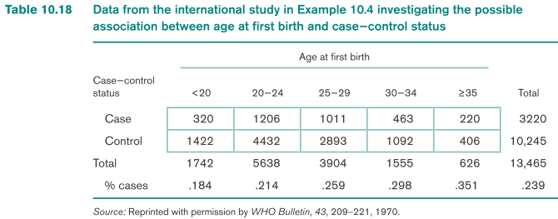
R × C Contingency Tables
R × C contingency table: R rows and C columns; variable in the rows has R categories, variable in the columns has C categories
Expected number of units in the (i,j) cell
= E_{ij} =no. of units in the ith row X no. of units in the jth column
total no. of units

Slide 39
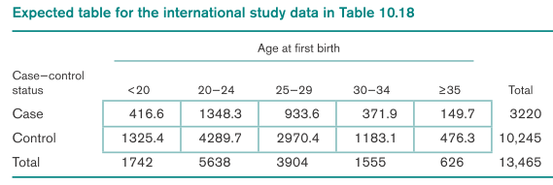
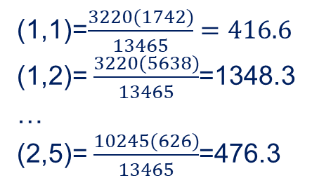
(1,1)=$\frac{3220(1742)}{13465}=416.6$
(1,2)= $\frac{3220(5638)}{13465}$=1348.3
…
(2,5)= $\frac{10245(626)}{13465}$=476.3
*Checking: sum of the expected values across any row or column must equal
corresponding row of column total*
To test relationship between two discrete variables (one variable has R categories and the other has C categories), use the following procedure:
R × C contingency table: O_{ij} represents the observed number of units in the (i,j) cell
2. Expected table: E_{ij} represents the expected number of units in the (i,j) cell
3. Test statistic:
H₀ ~ ꭓ² distribution with (R - 1) × (C - 1) df
*do not need correction for contingency tables > 2x2*

Slide 40
For a level α test:
if X² > χ²_{(R-1)×(C-1),1-α} →reject H₀
if X² ≤ χ²_{(R-1)×(C-1),1-α} → accept H₀
5. P-value=area to the right of X^{2 under a} χ²(R-1)×(C-1) distribution
*Use this test only if both of the following conditions are satisfied:
No more than 1/5 of the cells have expected values <5
No cell has an expected value <1

Slide 41
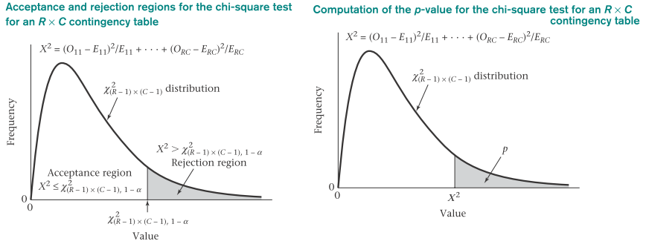
R command to perform the Chi-square test for R x C Tables
#we first create the matrix form of R x C table
>table=matrix(c(….))
#then, using the chisq.test to analyze the ata
>chisq.test(table)

Slide 42
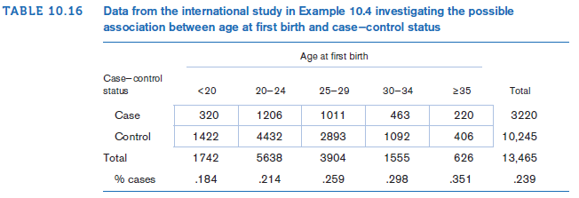
Example on R x C Table:
Cancer
Suppose we want to study further the relationship between age at first birth and development of breast cancer. In particular, we would like to know whether the effect of age at first birth follows a consistent trend, that is, (1) more protection for women whose age at first birth is <20 than for women whose age at first birth is 25−29 and (2) higher risk for women whose age at first birth is ≥35 than for women whose age at first birth is 30−34. The data are presented in Table 10.16, where case−control status is indicated along the rows and age at first birth categories are indicated along the columns. The data are arranged in the form of a 2 × 5 contingency table because case−control status has two categories and age at first birth has five categories. We want to test for a relationship between age at first birth and case−control status.
Q: Assess the statistical significance of the data

Slide 43
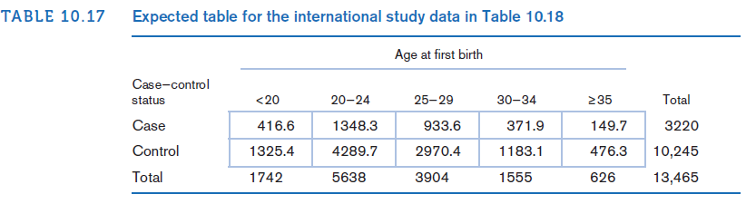
Example on R x C Table:
Cancer
Solution:
$$Expected Value of the \left(1,1\right) cell= \frac{first row total×first column total}{grand total}=\frac{3220(1742)}{13465}=416.6$$
$$Expected Value of the \left(1,2\right) cell= \frac{first row total×second column total}{grand total}=\frac{3220(5638)}{13465}=1348.3$$
$$Expected Value of the \left(2,5\right) cell= \frac{second row total×fifth column total}{grand total}=\frac{10245(626)}{13465}=476.3$$
Here shows all 10 expected values:

Slide 44

Example on R x C Table:
Cancer
all expected values are ≥5
$$X^{2}=\frac{{(320−416.6)}^{2}}{416}+\frac{{(1206−1348.3)}^{2}}{1348.3}+…+\frac{{\left(406−476.3\right)}^{2}}{476.3}=130.3$$
Under H0, X2 follows a chi-square distribution with (2 − 1) × (5 − 1), or 4, df
Because
$$χ_{4, .999}^{2}=18.47<130.3=X^{2}$$
It follows that p < 1 − .999 = .001
Results are very highly significant
Conclusion: there is a significant relationship between age at first birth and prevalence of breast cancer

Slide 46
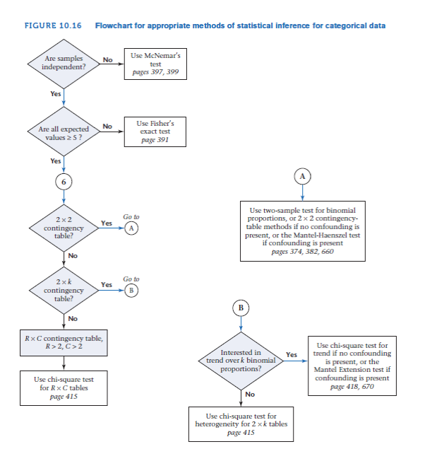

Slide 47
Summary
Techniques for analyzing qualitative or categorical data
Comparison of proportions from two independent samples using
chi-square test
Fisher’s exact test
McNemar’s test for correlated proportions
Notes:
In this lecture, we discussed…..

