Slide 1
EE3211 Modelling Techniques
Lecture 7
Nonparametric Methods

Slide 2
Overview
Parametric statistical methods:
For estimation and hypothesis testing
We assume that the parametric form of the distribution is known
Nonparametric statistical methods
If no assumptions about the shape of the distribution
Cannot apply central-limit theorem due to small sample size (n)
Make fewer assumptions about the distributional shape

Slide 3
Types of Data
Categorical variables: two or more categories that do not have any ordering
e.g. race and ethnicity
Dichotomous variables: two possible values
e.g. gender, death, disease status
Ordinal variables: more than two ranked or ordered values
e.g., amount of current smoking: none, <10/day, 10-
20/day, 21-30/day, >30/day

Slide 4
Ordinal data
Measure relative ordering of different categories
E.g. two people: A and B
→ Whether score for A is >, <, or = to the score for B relative magnitude of the differences

Slide 5
Example on Dermatology
Objective: compare the effectiveness of two ointments (A, B) in reducing excessive redness in people who cannot otherwise be exposed to sunlight
Oinment A: randomly applied to either the left or right arm
Oinment B: applied to the corresponding area on the other arm.
Person is then exposed to 1 hour of sunlight
Compare the degrees of redness of the two arms
Make qualitative assessments:
Arm A is not as red as arm B
Arm B is not as red as arm A
Both arms are equally red
Of 45 people tested with the condition, 22 are better off on arm A, 18 are better off on arm B, 5 are equally well off on both arms.
Q: How can we decide whether this evidence is enough to conclude that ointment A is better than ointment B?

Slide 6
Large-sample Method
Degree of redness can be measured on a quantitative scale (higher number indicates more redness)
Let x_{i} = degree of redness on arm A for the ith person
y_{i} = degree of redness on arm B for the ith person
d_{i} = x_{i} – y_{i} = difference in redness between the A and B
arms for the ith participant
H₀: Δ = 0 vs. H₁: Δ ≠ 0 (Δ : the population median of the d_{i} / the 50th percentile of the underlying distribution of the d_{i})
(i) if Δ = 0 : ointments are equally effective
(ii) if Δ < 0 : ointment A is better (arm A is less red than arm B)
(iii) if Δ > 0 : ointment B is better (arm A is redder than arm B)
d_{i} cannot be observed, can on observe whether:
(i) d_{i} > 0
(ii) di < 0
(iii) di = 0

Slide 7

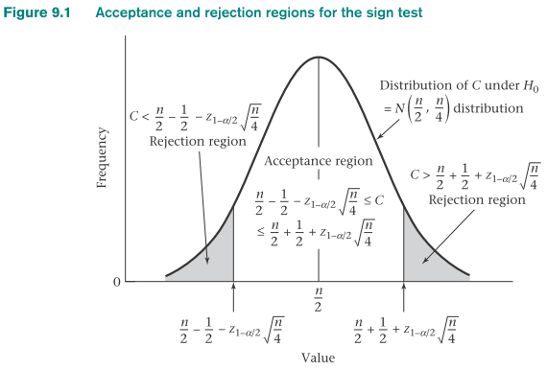
The Sign Test
Depends only on the sign of the difference, not their actual magnitude
To test the hypothesis H₀: Δ = 0 vs. H₁: Δ ≠ 0
*number of nonzero d_{i}’s = n ≥ 20 and C = the number of d_{i}’s where d_{i} > 0,
if
→ Reject H₀; otherwise accept H₀

Slide 8



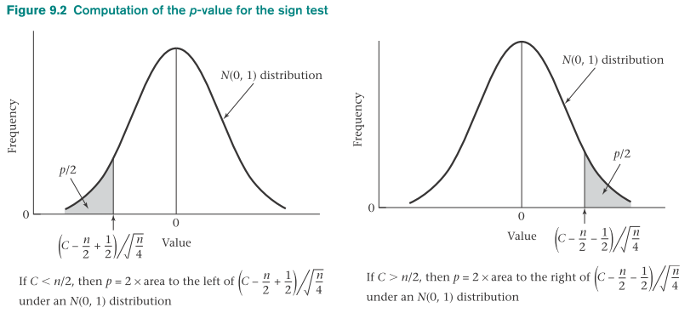
Computation of the p-Value for the Sign Test (Normal-Theory Method)

Slide 9
R commands to perform the sign test
#x=number of subjects with di>0
#n=total number of subjects with di not equal to 0
#codes for one-sample binomial test with p0=0.5 with continuity correction
>prop.test(x,n,p=0.5, alternative=“two.sided”, correct=TRUE)

Slide 10
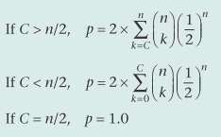
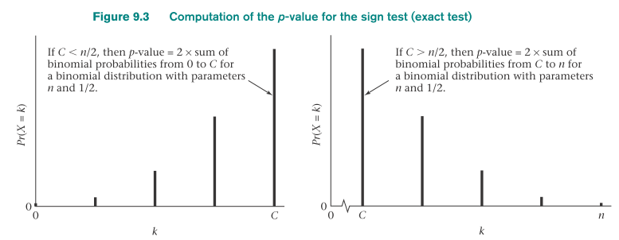
Computation of the p-Value for the Sign Test
(Exact Method)
n < 20: exact binomial probabilities to compute the p-value
If C is very large or very small: reject H₀

Slide 11
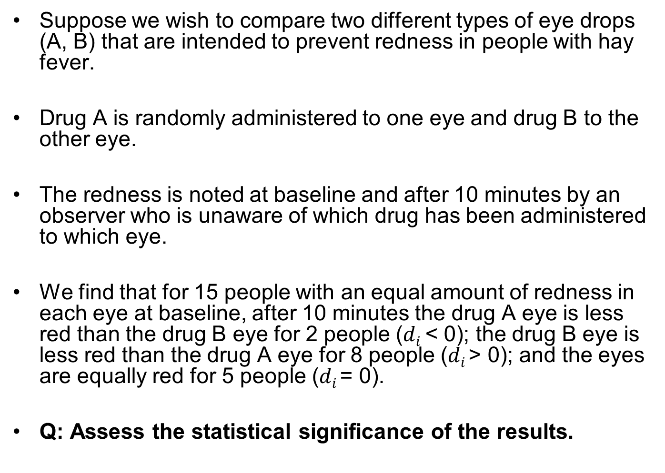
Example on Sign Test - Ophthalmology
Suppose we wish to compare two different types of eye drops (A, B) that are intended to prevent redness in people with hay fever.
Drug A is randomly administered to one eye and drug B to the other eye.
The redness is noted at baseline and after 10 minutes by an observer who is unaware of which drug has been administered to which eye.
We find that for 15 people with an equal amount of redness in each eye at baseline, after 10 minutes the drug A eye is less red than the drug B eye for 2 people ($di$ < 0); the drug B eye is less red than the drug A eye for 8 people ($di$> 0); and the eyes are equally red for 5 people ($di$= 0).
Q: Assess the statistical significance of the results.

Slide 12
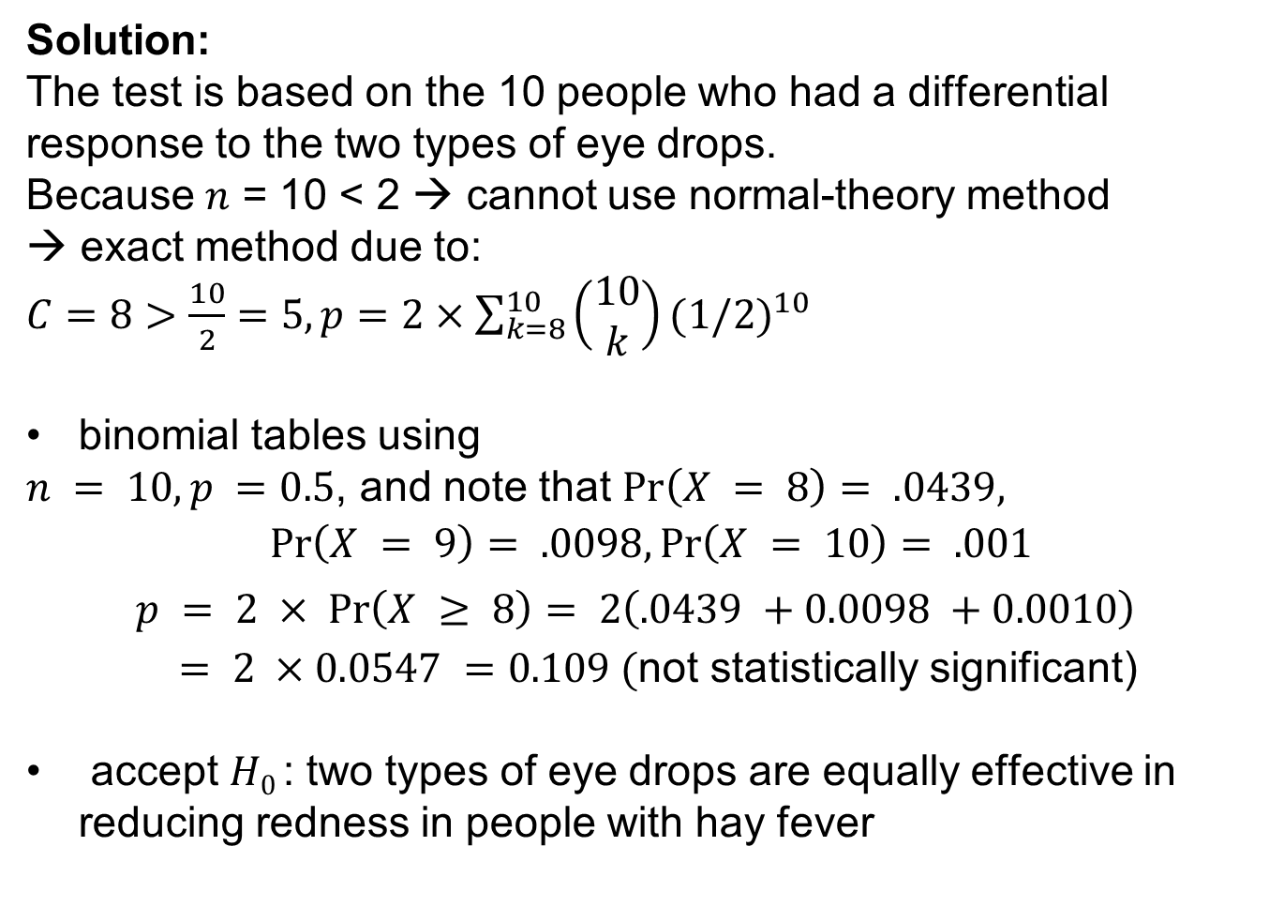
Example on Sign Test - Ophthalmology
Solution:
The test is based on the 10 people who had a differential response to the two types of eye drops.
Because $n$ = 10 < 2 → cannot use normal-theory method
→ exact method due to:
$C=8>\frac{10}{2}=5, p=2×\sum_{k=8}^{10}{\left(\begin{matrix}10 \\ k\end{matrix}\right)}{(1/2)}^{10}$
binomial tables using
$n = 10, p =0.5$, and note that $Pr\left(X = 8\right)= .0439,$
$$Pr\left(X = 9\right)= .0098,\operatorname{Pr}\left(X = 10\right)= .001$$
$$p = 2 × Pr\left(X ≥ 8\right)= 2{\left(.0439 +0.0098 +0.0010\right)}^{}$$
$= 2 ×0.0547 =0.109 ($not statistically significant)
accept $H0$: two types of eye drops are equally effective in reducing redness in people with hay fever

Slide 13
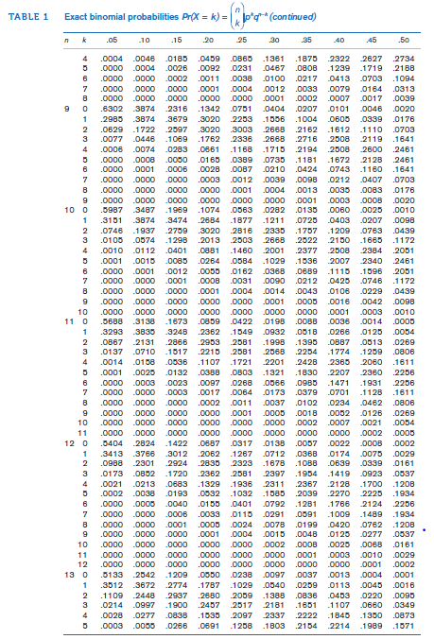

Slide 14
Modified Scenario on Dermatology
New assumption: degree of burn can be quantified on a 10-point scale (10: worst burn; 1 no burn)
Compute d_{i} = x_{i} – y_{i} and x_{i} = degree of burn for ointment A and y_{i} = degree of burn for ointment B
If d_{i} > 0 : ointment B is doing better than ointment A
If d_{i} < 0 : ointment A is doing better than ointment B
E.g. d_{i} = +5 : degree of redness is 5 units > on the ointment A
arm than on the ointment B arm
d_{i} = -3 : degree of redness is 3 units < on the ointment A
arm than on the ointment B arm
Q: how can this additional information be used to test if the ointments are equally effectively?
Wilcoxon Signed-Rank

Slide 15
Wilcoxon Signed-Rank test’s ranking procedure:
Arrange d_{i} (the differences) in order of absolute value
Count the number of differences with the same absolute value
Rank d_{i} from 1 (observation with the lowest absolute value) to n (highest absolute value)
Group of several observations with the same absolute value
find the lowest rank in the range = 1+R and the highest rank in the range = G +R
R = highest rank used prior to considering this group and G = the number of differences in the range of ranks for the group
Assign the average rank = (lowest rank in the range + highest rank in the range)/2 as the rank for each difference in the group

Slide 16
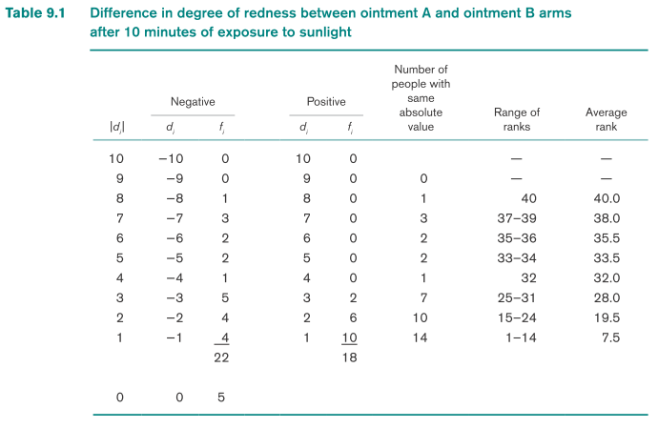
The Wilcoxon Signed-Rank Test
H0: Δ = 0 vs. H1: Δ ≠ 0
Δ = median score difference between ointment A and B
If Δ < 0, then ointment A is better
If Δ > 0, then ointment B is better

Slide 17
Question: Compute the ranks for the skin-ointment data in Table 9.1.
Solution:
First collect the differences with the same absolute value
Fourteen people have absolute value 1; this group has a rank range from 1 to 14 and an average rank of (1 + 14)/2 = 7.5.
The group of 10 people with absolute value 2 has a rank range from (1 + 14) to (10 + 14) = 15 to 24 and an average rank = (15 + 24)/2 = 19.5, . . . , and so on. T
The column ‘Average rank’ in table 9.1 includes the ranks for each row of absolute value.

Slide 18
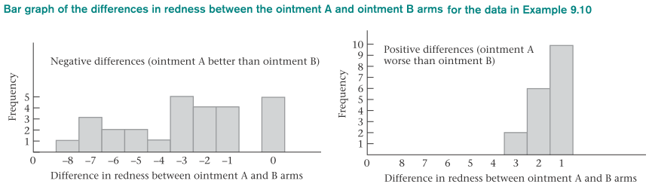
Wilcoxon Signed-Rank test:
nonparametric test that is analogous to the paired t test
based on the ranks of the observations rather than on their actual values

Slide 19


Wilcoxon Signed-Rank Test
(Normal Approximation Method for Two-Sided Level α Test)
*number of nonzero di’s ≥16* (normal approximation → sampling distribution of R1)
Rank the differences
Compute the rank sum R1 of the positive differences
If R1 ≠ [n(n+1)]/4 and there are no ties (no groups of differences with the same absolute value), then
If R1 ≠ [n(n+1)]/4 and there are ties, where t_{i} refers to the number of differences with the same absolute value in the ith tied group and g is the number of tied groups, then

Slide 20
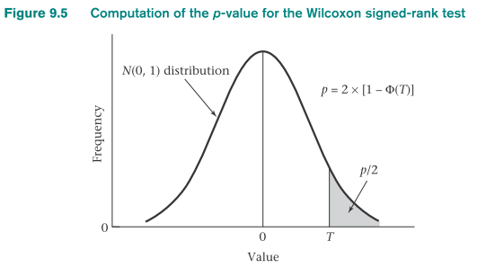
If T > z_{1-α/2} then reject H₀. Otherwise, accept H₀.
The p-value for the test is given by p = 2 × [1-Φ(T)]
This test should be used only if the number of nonzero differences is ≥ 16 and if the difference scores have an underlying continuous symmetric distribution.

Slide 21
R Commands to perform the Wilcoxon Signed Rank Test
#For large sample method with one set of difference scores in variable x
>wilcox.test(x, y=NULL, alternative=“two.sided”, mu=0, paired=FALSE, exact=NULL, correct=TRUE, conf.int=FALSE)
#Two sets of paired scores in variables x and y
>wilcox.test(x, y, alternative=“two.sided”, mu=0, paired=TRUE, exact=NULL, correct=TRUE, conf.int=FALSE)

Slide 22
Example on Wilcoxon Signed-rank test - Dermatology
Question: Perform the Wilcoxon signed-rank test for the data below.

Slide 23
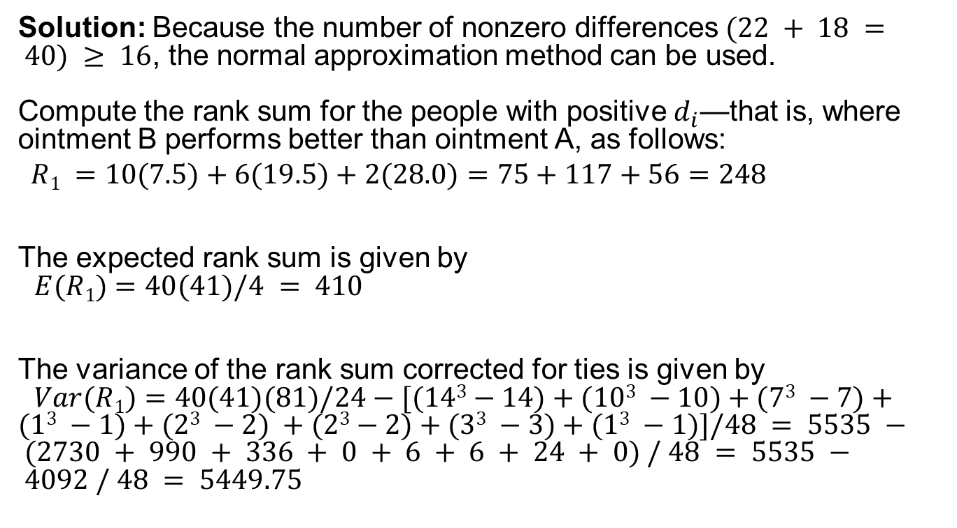
Example on Wilcoxon Signed-rank test - Dermatology
Solution: Because the number of nonzero differences $(22 + 18 = 40) ≥ 16$, the normal approximation method can be used.
Compute the rank sum for the people with positive $d_{i}$—that is, where ointment B performs better than ointment A, as follows:
$$R1 =10(7.5)+6(19.5)+2(28.0)=75+117+56=248$$
The expected rank sum is given by
$E(R1)=40(41)/4 = 410$
The variance of the rank sum corrected for ties is given by
$Var(R1)=40(41)(81)/24−[(143−14)+(103 −10)+(73 −7)+(13 −1)+(23 −2) +(23−2)+(33 −3)+(13 −1)]/48 = 5535 − (2730 + 990 + 336 + 0 + 6 + 6 + 24 + 0) / 48 = 5535 − 4092 / 48 = 5449.75$
[n(n+1)]/4

Slide 24
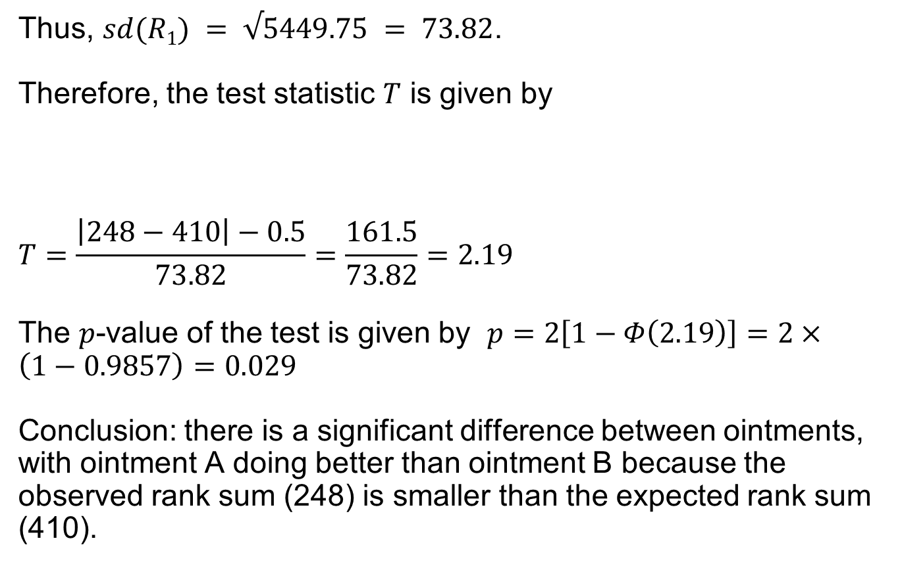
Example on Wilcoxon Signed-rank test - Dermatology
Thus, $sd(R1) = √5449.75 = 73.82$.
Therefore, the test statistic $T$ is given by
$$T=\frac{\left|248−410\right|−0.5}{73.82}=\frac{161.5}{73.82}=2.19$$
The $p$-value of the test is given by $p=2\left[1−Φ\left(2.19\right)\right]=2×\left(1−0.9857\right)=0.029$
Conclusion: there is a significant difference between ointments, with ointment A doing better than ointment B because the observed rank sum (248) is smaller than the expected rank sum (410).
p = 2 × [1-Φ(T)]

Slide 25
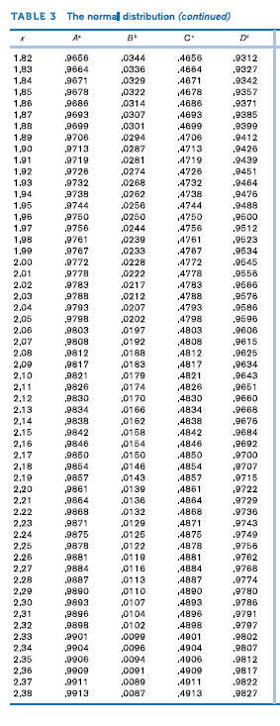
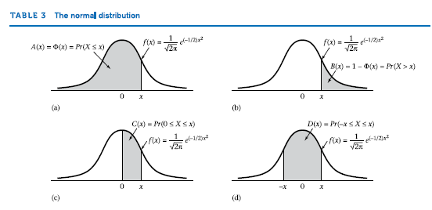

Slide 26
Scenario on Opthalmology
Different genetic types of the disease retinitis pigmentosa (RP) are thought to have different rates of progression
Dominant form of the disease: slowest progression
Recessive form: next slowest
Gender-linked form: fastest progression
Test the hypothesis by comparing the visual acuity of people who have different genetic types of RP
Scenario: 25 people aged 10-19 with dominant disease and 30 people with gender-linked disease
The best-corrected visual acuities (i.e. with appropriate glasses) in the better eye of these people are shown in the next slide.
Q: how can these data be used to test if the distribution of visual acuity is different in the two groups?

Slide 27
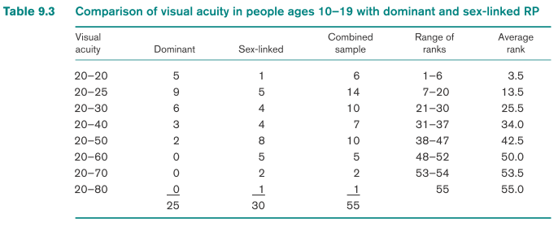
Wilcoxon Rank Sum Test
Nonparametric analog to the t test for two independent samples
Hypothesis H₀: F_{D} = F_{SL} vs. H₁: F_{D}(x) = F_{SL}(x -Δ) where Δ ≠ 0
F_{D} = cdf of visual acuity for dominant grp
F_{SL} = cdf of visual acuity for sex-linked grp
Δ = location shift of cdf for the sex linked grp relative to dominant group

Slide 28
Ranking Procedure for the Wilcoxon Rank-Sum Test
Combine data from the two groups, order the values smallest to largest (or e.g. visual acuity from best [20-20] to worst [20-80])
Assign ranks to the individual values
e.g. lowest rank: with the best visual acuity (20-20)
highest rank: with worst visual acuity (20-80)
or vice versa
3. Group of observations has the same value
compute the range of ranks for the group (similar to signed-rank test)
assign the average rank for each observation in the group

Slide 29

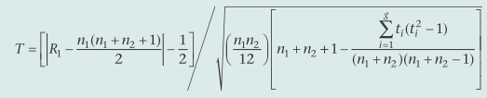
Wilcoxon Rank-Sum Test
(Normal Approximation Method for Two-Sided Level α Test)
Rank the observations
Compute the rank sum R1 in the first sample (the choice of sample is arbitrary)
If (i) R₁ ≠ n₁(n₁+n₂+1)/2 and there are no ties, then compute
(ii)R₁ ≠ n₁(n₁+n₂+1)/2 and there are ties, then compute
where t_{i} refers to the number of observations with the same value in the ith tied group and g is the number of tied groups

Slide 30
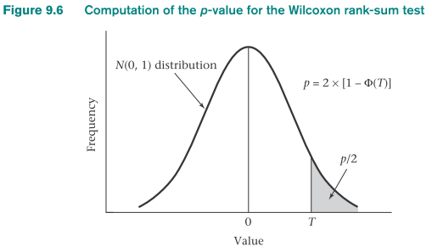
(iii) If R1 = n1(n1+n2+1)/2, then T = 0
If T > z_{1-α/2} then reject H0. Otherwise, accept H0.
Compute the exact p-value by p = 2 ×[1-Φ(T)]
Conditions:
both n1 and n2 are ≥10
there is an underlying continuous distribution

Slide 31
Example on Wilcoxon Rank-sum Test - Ophthalmology
Question: Compute the ranks for the visual-acuity data in Table 9.3.

Slide 32
Example on Wilcoxon Rank-sum Test
- Ophthalmology
Solution:
First collect all people with the same visual acuity over the two groups, as shown in Table 9.3.
There are 6 people with visual acuity 20–20 who have a rank range of 1–6 and are assigned an average rank of (1 + 6)/2 = 3.5.
There are 14 people for the two groups combined with visual acuity 20–25. The rank range for this group is from (1 + 6) to (14 + 6) = 7 to 20.
All people in this group are assigned the average rank = (7 + 20)/2 = 13.5, and similarly for the other groups. The column ‘Average rank’ in table 9.3 depicts the ranks as required.

Slide 33
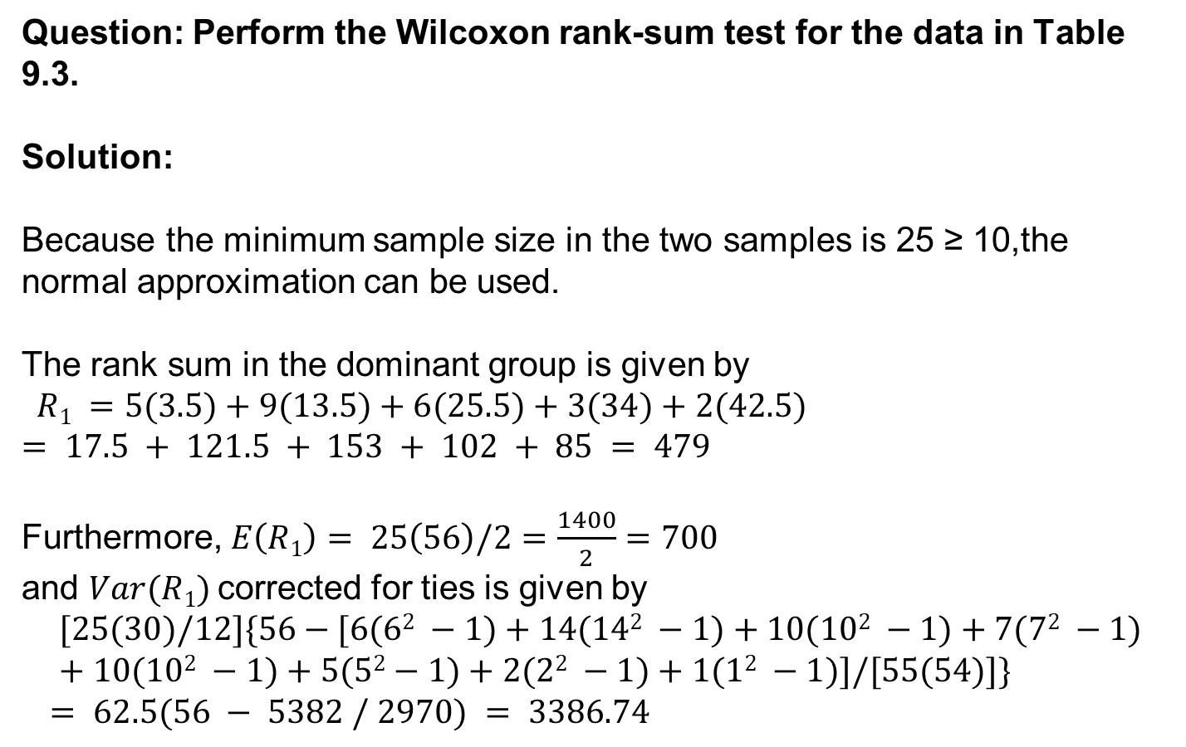
Example on Wilcoxon Rank-sum Test
- Ophthalmology
Question: Perform the Wilcoxon rank-sum test for the data in Table 9.3.
Solution:
Because the minimum sample size in the two samples is 25 ≥ 10,the normal approximation can be used.
The rank sum in the dominant group is given by
$$R1 =5(3.5)+9(13.5)+6(25.5)+3(34)+2(42.5) = 17.5 + 121.5 + 153 + 102 + 85 = 479$$
Furthermore, $E\left(R1\right)= 25\left(56\right)/2=\frac{1400}{2}=700$
and $Var(R1)$corrected for ties is given by
$$[25(30)/12]\{56−[6(62 −1)+14(142 −1)+10(102 −1)+7(72 −1)+10(102 −1)+5(52−1)+2(22 −1)+1(12 −1)]/[55(54)]\}$$
$= 62.5(56 − 5382 / 2970) = 3386.74$
n₁(n₁+n₂+1)/2

Slide 34
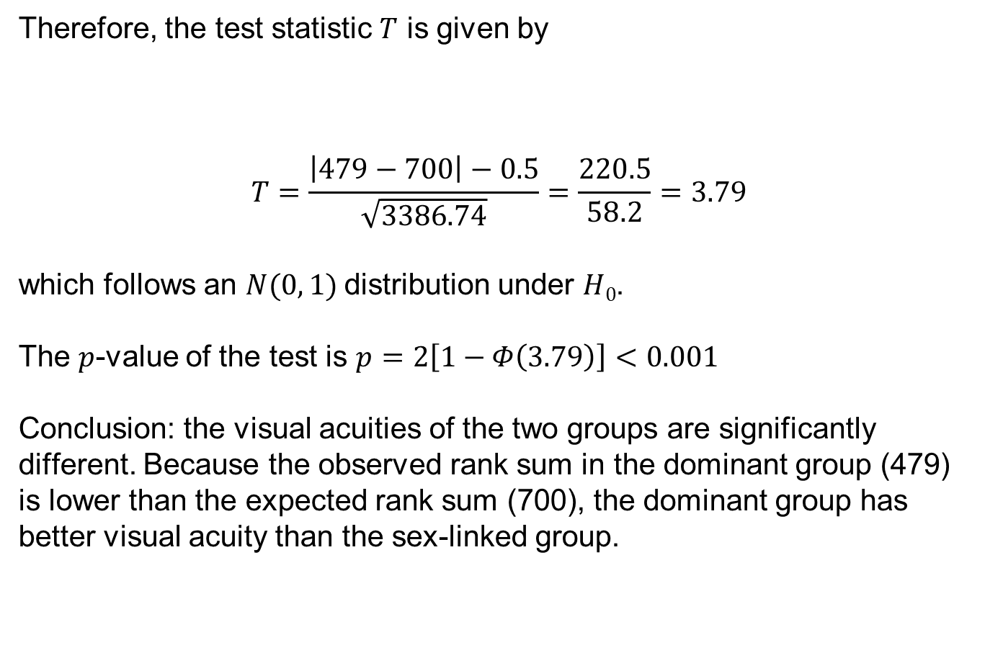
Wilcoxon Rank-sum Test - Ophthalmology
Therefore, the test statistic $T$ is given by
$$T=\frac{\left|479−700\right|−0.5}{\sqrt{3386.74}}=\frac{220.5}{58.2}=3.79$$
which follows an $N(0, 1)$distribution under $H0$.
The $p$-value of the test is $p=2\left[1−Φ\left(3.79\right)\right]<0.001$
Conclusion: the visual acuities of the two groups are significantly different. Because the observed rank sum in the dominant group (479) is lower than the expected rank sum (700), the dominant group has better visual acuity than the sex-linked group.

Slide 35
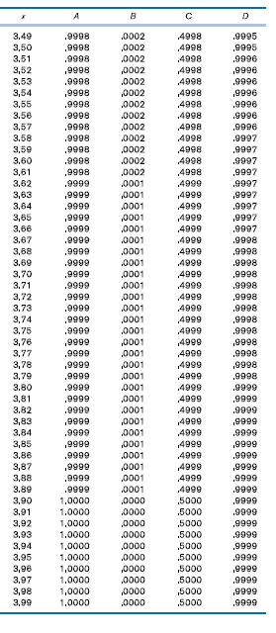

Slide 36
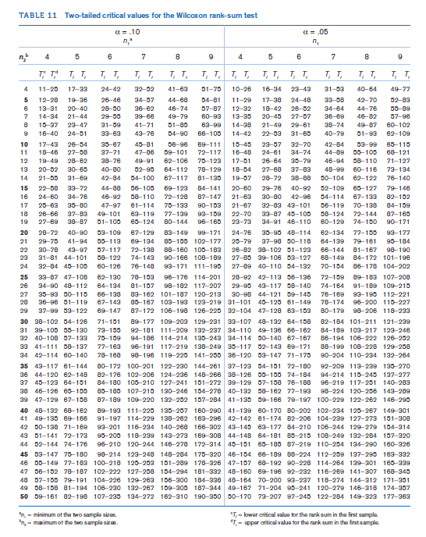

Slide 37
R commands to perform the Wilcoxon Rank Sum Test
#scores for the two groups
#x=values for one group and y=values for the other group
>wilcox.test(x,y,alternative=“two.sided”, mu=0, paired=FALSE, exact=NULL,
Correct=TRUE, conf.int=FALSE)

Slide 38
Summary
Advantage of nonparametric methods: assumption of normality can be relaxed when such assumptions are unreasonable
2. Disadvantage of nonparameteric procedures: some power is lost relative to using a parametric procedure (such as a t test) if the data truly follow a normal distribution (or central-limit theorem is applicable)
3. The sign test and the signed-rank test are nonparametric analogs to the paired t test.
Sign test: to determine whether one member of a matched pair has a higher or lower score than the other member of the pair
For the signed-rank test: the magnitude of the absolute value of the difference score and its sign is used in performing the significance test.
4. The Wilcoxon rank-sum test is an analog to the two-sample t test for independent samples in which the actual values are replaced by rank scores.

Slide 39
Parametric tests and analogous nonparametric procedures
Analysis Type | Example | Parametric Procedure | Nonparametric Procedure
Compare means between two distinct/independent groups | Is the mean systolic blood pressure (at baseline) for patients assigned to placebo different from the mean for patients assigned to the treatment group? | Two-sample t-test | Wilcoxon rank-sum test
Compare two quantitative measurements taken from the same individual | Was there a significant change in systolic blood pressure between baseline and the six-month follow-up measurement in the treatment group? | Paired t-test | Wilcoxon signed-rank test
Estimate the degree of association between two quantitative variables | Is systolic blood pressure associated with the patient’s age? | Pearson coefficient of correlation | Spearman’s rank correlation

