Slide 1
EE3211 Modelling Techniques
Lecture 9
Analytical Techniques for Epidemiological Studies

Slide 2
Overview
Common study designs (epidemiology)
Prospective, retrospective , and cross-sectional study
Commonly used measures of effect for categorial data
Risk Difference, Risk Ratio, and Odds Ratio
Parameters estimation with confidence intervals
Multiple Logistic regression

Slide 3
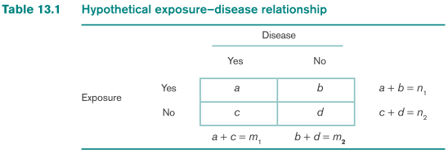
Study Design
n₁ = a + b exposed subjects (a have disease)
n₂ = c + d unexposed subjects (c have disease)
Three main study designs: prospective, retrospective, and cross-sectional study design
Prospective (Cohort) study design: a group of disease-free individuals is identified at one point in time and are followed over a period of time until some of them develop the disease
development of disease over time is then related to other variables (exposure variables) measured at baseline
Cohort: study population in a prospective study

Slide 4
Retrospective (case-control) study: two groups of individuals are initially identified:
(1) Cases: a group that has the disease under study
(2) Controls: a group that does not have the disease under study
- relate their prior health habits to their current disease status
Cross-sectional (Prevalence) study: study population is ascertained at a single point in time
Collect current disease status and current or past exposure status from study participants
Prevalence of disease at one point in time is compared between exposed and unexposed individuals (v.s. prospective study: incidence rather than the prevalence of the disease)

Slide 5
A prospective study is usually more definitive
- patient’s knowledge of their current health habits is more
precise than recall of their past health habits
A retrospective study has a greater chance of bias for two reasons
Selection bias: more difficult to obtain a representative sample of people who already have the disease in question
Recall bias: individuals with the disease or their surrogates may tend to give biased answers about prior health habits if they believe there is a relationship between these prior health habits and the disease
much less expensive to perform and can be completed in much less time than a prospective study

Slide 6
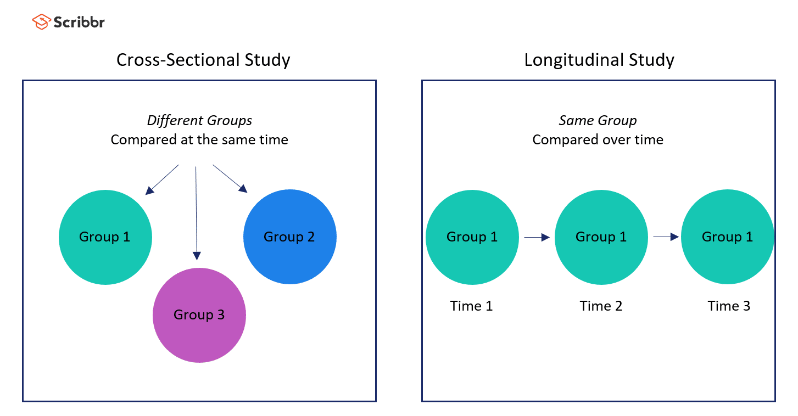
Two main study designs
Cohort Study
Cross-sectional Study

Slide 7
An Example of Cohort Study
A disease-free group in which outbreak (expected) to occur later
Compare attack rates among people who ate and did not eat certain food(s)
Higher attack rates among people eating a food (compared to those not eating it) suggest the food might be associated with illness
Illness
Ate food
No illness
a disease-
free group
Illness
Did not eat food
No illness

Slide 8
Relative Risk / Risk Ratio (RR)
Measure of association for a cohort study
Compares proportion of people who ate the food who became ill with the proportion of people did not eat the food who became ill
Q: How much more likely is it for people who ate the food to become ill than people not eating the food?
Relative risk
=
attack rate among exposed
attack rate among unexposed

Slide 9
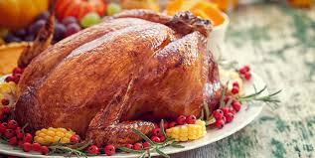
Example: Outbreak of Salmonella at a Hospital
Returning to the outbreak of salmonella:
212 (37%) of 571 attending lunch became ill *exposed*
12 (7%) of 165 not attending lunch became ill *unexposed*
Relative risk
attack rate (attended)
attack rate (did not attend)
37% 7%
=
=
=
5.3
A relative risk of 5.3 : people who attended the luncheon were about 5 times more likely to become ill than those who did not attend
→ Attending the luncheon might be a risk factor for
salmonellosis in this outbreak

Slide 10
Magnitudes of Relative Risk
Close to 1.0 = risk of disease is similar among people eating and not eating the food → food not associated with illness
Greater than 1.0 = risk of disease is higher among people eating the food than people not eating the food → food could be risk factor
Less than 1.0 = risk of disease is lower among people eating the food than people not eating the food → food could be “protective factor”
Magnitude reflects strength of association between eating food and illness
> Cohort studies

Slide 11
Case-Control Study
Also called retrospective study: 2 groups are identified
Cases (people with illness) and controls (people with no illness)
Compare foods eaten by cases and controls
Foods more commonly eaten by cases than controls might be associated with illness
Ate food
Cases
Did not eat food
Population
at risk
Ate food
Controls
Did not eat food

Slide 12
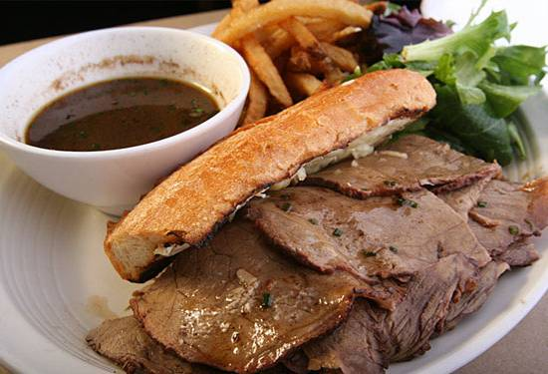
Example: Outbreak of Botulism in Vancouver, B.C.
Two sisters and their mother from Vancouver developed signs and symptoms suggestive of botulism
36 cases of botulism among customers of Restaurant X
Case-control study undertaken
20 (91%) of 22 cases ate beef dip sandwich
3 (14%) of 22 controls ate beef dip sandwich

Slide 13
Odds Ratio
Measure of association for a case-control study
Compares odds of cases having eaten a certain food to odds of controls having eaten the food
Answers for “How much higher is the odds of eating the food among cases than controls?”
odds of eating food among cases
odds of eating food among controls
odds ratio =

Slide 14
Odds Ratio
Close to 1.0 = odds of eating food is similar among cases and controls → no association between food and illness
Greater than 1.0 = odds of eating food among cases is higher than among controls → food could be risk factor
Less than 1.0 = odds of eating food among cases is lower than among controls → food could be “protective factor”
Magnitude reflects strength of association between illness and eating the food
> Case-control studies

Slide 15
Odds Ratio Calculation
Let p = probability of a success →
the odds in favor of success = p/(1-p)
p₁, p₂ : the odds in favor of success are computed for each of two proportions → ratio of odds (OR): useful measure for relating the two proportions

Slide 16
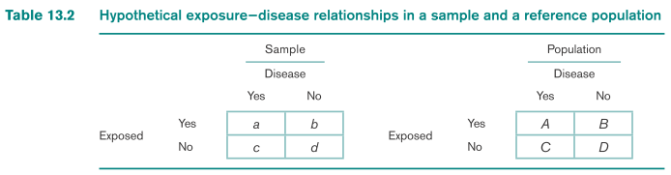


Let p₁, p₂ : underlying probability of success for two groups
OR :
Let a, b, c, d: label of the four cells of the 2 × 2 contingency table
Interpretation of OR:
disease-odds ratio: odds in favor of disease for the exposed group divided by the odds in favor of disease for the unexposed group

Slide 17
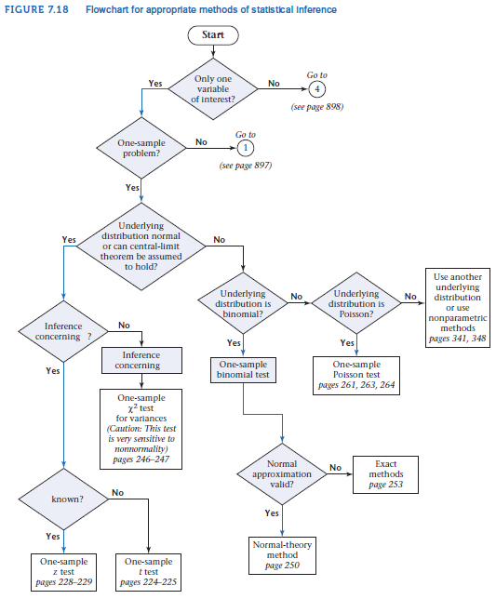

Slide 18
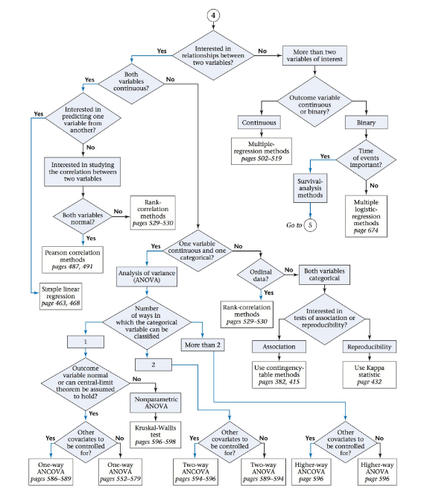

Slide 19
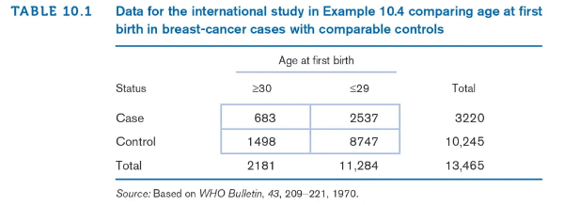
Example on Relative Risk / Risk Ratio –
Cancer
Question: Estimate the RR for breast cancer for women with a late age at first birth (≥ 30) compared with women with a nearly age at first birth(≤ 29) based on the data below.

Slide 20

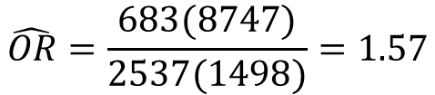
Example on Relative Risk / Risk Ratio –
Cancer
Solution：
The estimated OR is given by
$$\hat{OR}=\frac{ad}{bc}$$
$$\hat{OR}=\frac{683(8747)}{2537(1498)}=1.57$$
An estimate of the RR

Slide 21


Multiple Logistic Regression
p = α + β₁x₁ + …+ β_{k}x_{k}
p is the probability of disease
Right hand side: < 0 or > 1 for certain values of x₁,…., x_{k}
- predicted probabilities < 0 or > 1 → impossible
logit (logistic) transformation of p is often used as the dependent variable
The logit transformation logit(p): logit(p) = ln[p/(1-p)]
logit transformation: -∞ to +∞)
Multiple Logistic-Regression Model
x₁,…, x_{k} : independent variables
y: binomial-outcome variable with probability of success = p
multiple logistic-regression model:
Or

Slide 22

Interpretation of Logistic-Regression Parameters
Multiple logistic regression: analog to multiple linear regression
Dichotomous exposure variable (xj):1 (if present) and 0 (if absent)
OR associates this exposure variable to dependent variable:

Slide 23
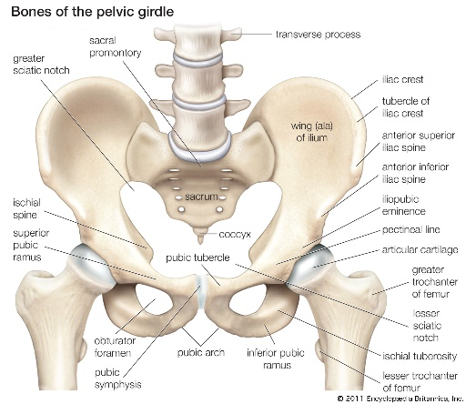
Example on Infectious Disease
Chlamydia trachomatis : microorganism that has been established as an important cause of nongonococcal urethritis, pelvic inflammatory disease
A study of risk factors for C. trachomatis in 431 female college students
Because multiple risk factors may be involved, several risk factors must be controlled for simultaneously in analyzing variables associated with C. trachomatis

Slide 24

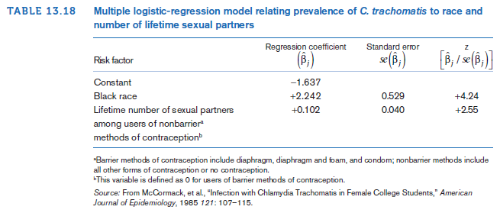
logit(p_{A}), logit(p_{B}): logit of the probability of success for individuals A and B:

Slide 25


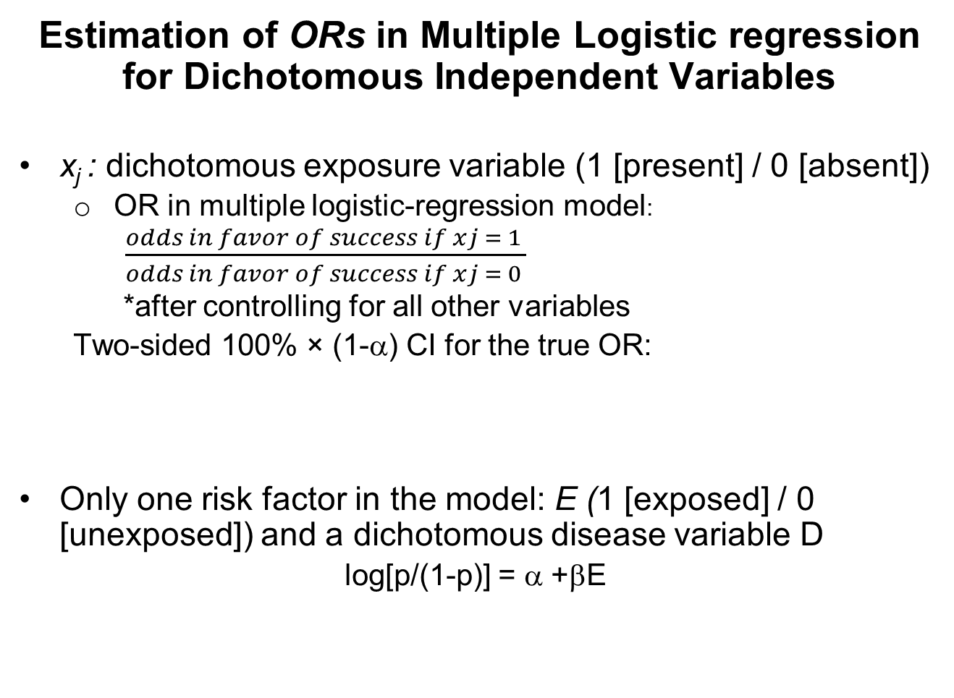
Estimation of ORs in Multiple Logistic regression for Dichotomous Independent Variables
x_{j} : dichotomous exposure variable (1 [present] / 0 [absent])
OR in multiple logistic-regression model:
$\frac{odds in favor of success if xj = 1 }{odds in favor of success if xj = 0 }$
*after controlling for all other variables
Two-sided 100% × (1-α) CI for the true OR:
Only one risk factor in the model: E (1 [exposed] / 0 [unexposed]) and a dichotomous disease variable D
log[p/(1-p)] = α +βE

Slide 26
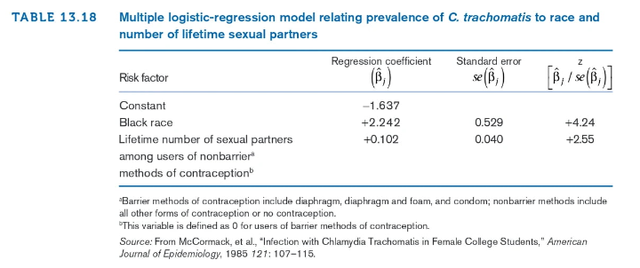
Example on Multiple Logistic Regression –
Infectious Disease
Question: Estimate the odds in favor of infection with C. trachomatis for African American women compared with Caucasian women after controlling for previous sexual experience and provide a 95% CI about this estimate.

Slide 27

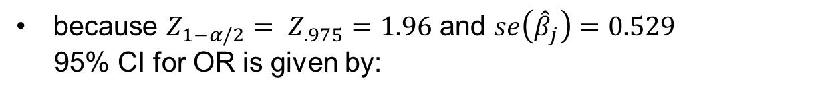
Example on Multiple Logistic Regression –
Infectious Disease
Solution：
$$\hat{OR}= e^{2.242}=9.4$$
Conclusion: odds in favor of infection for African American women are nine times as great as those for Caucasian women after controlling for previous sexual experience.
because $Z_{1−α/2}= Z_{.975}=1.96$ and $se\left({\hat{β}}_{j}\right)=0.529$
95% CI for OR is given by:
$$\left[e^{2.242−1.96\left(0.529\right)}, e^{2.242+1.96\left(0.529\right)}\right]=\left(e^{1.205}, e^{3.279}\right)= (3.3, 26.5)$$

Slide 28
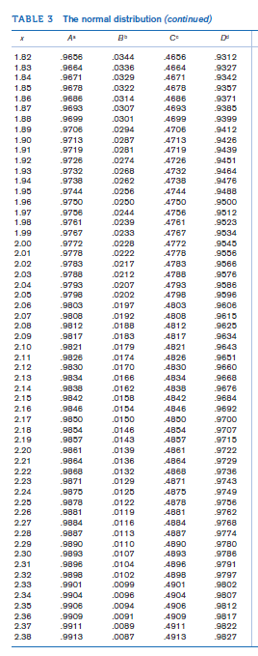
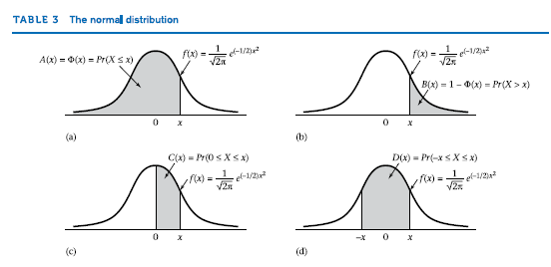

Slide 29
Summary
Main epidemiological study designs and relevant effect estimates:
Multiple logistic regression: p = α + β₁x₁ + …+ β_{k}x_{k}
₋
OR: links exposure variable to the dependent variable:
95% CI for OR:
Study Design | Prospective cohort study | Case and Control
Effect Estimate | Relative Risk/ Risk Ratio | Odds ratio

