Slide 1
EE3211 Modelling Techniques
Week 6 Tutorial
Regression and Correlation

Slide 2
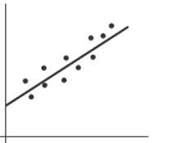
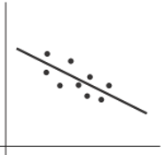
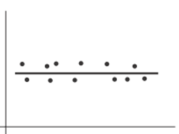
Review
Linear-regression equation: y = a + bx + e
y : dependent variable
x : independent variable (predict y as a function of x)
b = 0: no linear relationship between x and y
b > 0
b < 0
b = 0

Slide 3
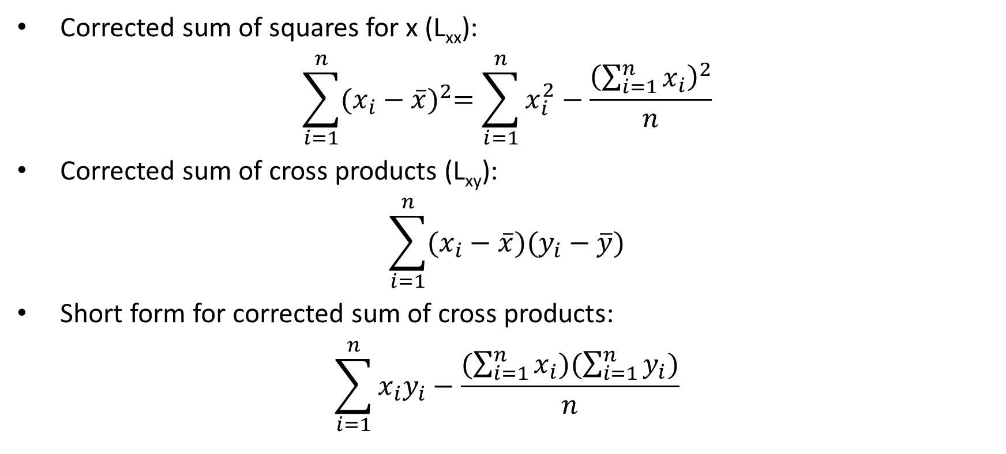
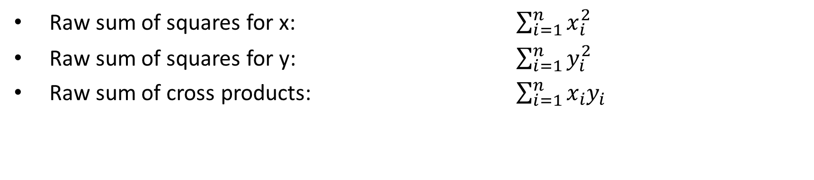
Review
Raw sum of squares for x: $\sum_{i=1}^{n}{x_{i}^{2}}$
Raw sum of squares for y: $\sum_{i=1}^{n}{y_{i}^{2}}$
Raw sum of cross products: $\sum_{i=1}^{n}{x_{i}y_{i}}$
Corrected sum of squares for x (L_{xx}):
$$\sum_{i=1}^{n}{{(x_{i}−\overline{x})}^{2}=\sum_{i=1}^{n}{x_{i}^{2}}−\frac{{\left(\sum_{i=1}^{n}{x_{i}}\right)}^{2}}{n}}$$
Corrected sum of cross products (L_{xy}):
$$\sum_{i=1}^{n}{(x_{i}−\overline{x})(y_{i}−\overline{y})}$$
Short form for corrected sum of cross products:
$$\sum_{i=1}^{n}{x_{i}y_{i}−\frac{(\sum_{i=1}^{n}{x_{i}})(\sum_{i=1}^{n}{y_{i}})}{n}}$$

Slide 4
Scenario: cholesterol level
Data file: cholesterol.csv
Features | Unit / class
age | year
sex | 1 = male; 0 = female
chest_pain_type | 1 = typical angina; 2 = atypical angina; 3 = non-anginal pain; 4 = asymptomatic
resting_blood_pressure | mm Hg
fasting_blood_sugar | > 120 mg/dl, 1 = true; 0 = false
maximum_heart_rate | maximum heart rate achieved
chol | Cholesterol level (mg)
Q: Find the best-fitting regression line between x=1)BP,2)HR,3)AG and y=Cholesterol level, and test them for statistical significance.

Slide 5
Scenario: cholesterol level
Q1: Find the best-fitting regression line between x=BP and y=Cholesterol level, and test them for statistical significance.
What are the:
-raw sum of squares for x?
-raw sum of squares for y?
-raw sum of cross products?
-corrected sum of cross products?
-corrected sum of squares for x?
-b?
-a?
-fitted regression line?
Sx =39902
Sy = 74748
Sxx = 5348230
Syy = 19249430
Sxy = 9879356
n = 303
Lxy = 35809.15
Lxx = 93544.84
b = 0.382802
a = 196.282
y = 196.282 + 0.382802x

Slide 6
Scenario: cholesterol level
Q1: Find the best-fitting regression line between x=BP and y=Cholesterol level, and test them for statistical significance.
R Syntax
Fit_model <- lm(y~x) # Linear-regression
summary (Fit_model) #summarize model
coefficients(Fit_model) #print a,b
plot(x,y) #plot (dots)
lines(x,fitted(Fit_model)) #plot (regression line)

Slide 7
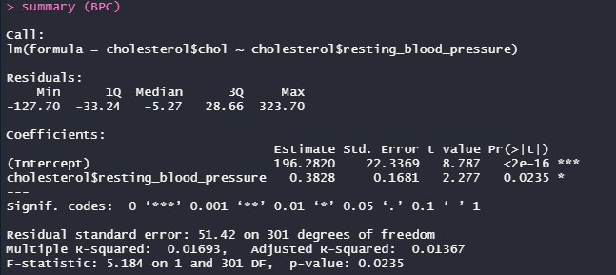
Scenario: cholesterol level
Q1: Find the best-fitting regression line between x=BP and y=Cholesterol level, and test them for statistical significance.

Slide 8
Scenario: cholesterol level
Q: Find the best-fitting regression line between x=1)BP,2)HR,3)AG and y=Cholesterol level, and test them for statistical significance.
Q1. y=Cholesterol level ~ x = BP:
b = 0.3828, a = 196.2820, p-value = 0.0235 < 0.05
Q2. y=Cholesterol level ~ x = HR:
b = -0.007768, a = 247.855196, p-value = 0.953 > 0.05
Q3. y=Cholesterol level ~ x = AG:
b = 1.196947, a = 181.532533, p-value = 0.0002496 < 0.05

